Slide 1
Performance Assessments in Social Studies
Module One:
What are the different types of classroom assessments in social studies?
Notes:
Module Series Overview:

Slide 2
Introduction
Compelling Question: How do I implement performance assessments to assess student mastery of the KAS for Social Studies?
Supporting Question: What are the different types of classroom assessments in social studies?
Learning Target: I can implement performance assessments that evaluate student mastery of the KAS for Social Studies.
Success Criteria: I will be successful when I can identify the different types of assessments, using examples from social studies.
Notes:
Guiding Notes:
Performance Assessments in Social Studies module series has five modules that build on one another to support a participant in answering the compelling question: How do I implement performance assessments to assess student mastery of the KAS for Social Studies? Participants will answer this question after completing the module series. Answering this question will support participants in meeting the Learning Target: I can implement performance assessments that evaluate student mastery of the KAS for Social Studies.
Each module within the module series supports a participant in answering a supporting question. At the conclusion of engaging with Module One of this series, participants will answer the supporting question: “What are the different types of classroom assessments in social studies?”
Participants will meet the success criteria for Module One when they can demonstrate the Success Criteria: I will be successful when I can identify the different types of assessments, using examples from social studies.
For more information on compelling questions, visit Section 3B: “What are Compelling Questions and how do students ask them?” from the Inquiry Practices module: https://education.ky.gov/curriculum/standards/kyacadstand/Documents/Inquiry_Practices_of_KAS_for_Social_Studies.pptx
For more information on supporting questions, visit “Section C: What are Supporting Questions, and how do students ask them?” from the Inquiry Practices module: https://education.ky.gov/curriculum/standards/kyacadstand/Documents/Inquiry_Practices_of_KAS_for_Social_Studies.pptx
For more information on Learning Goals and Success Criteria and their alignment to the KAS for Social Studies, visit Learning Goals, Success Criteria and the KAS for Social Studies: https://kystandards.org/standards-resources/ss-resources/learning-goals-success-criteria-and-the-kas-for-social-studies/

Slide 3
Overview of this module
The role of assessments in social studies is a linear process; therefore, it is important to go through the first sections in order to better understand the purpose of performance assessments in the bigger picture of assessing learning.
Module One is focused on classroom assessments in social studies.
Notes:
Guiding Notes:
Read the slide. This image shows the different sections of this module. Module One is focused on classroom assessments in social studies. This visual also outlines the processes and steps to better understand the purpose and role of assessment in social studies. It is a linear process – it is important to go through the first sections in order to better understand the purpose of performance assessments in the bigger picture of assessing learning.

Slide 4
Warm-Up
Finish this sentence:
Assessment is like _______________
because _______________________.
Notes:
Guiding Notes:
Read the slide and complete the activity on it in your Note Catcher where it says slide 4. If possible, share your response with a colleague and engage in the What Makes You Say That? Thinking Routine. After your colleague shares their response, ask “What makes you say that?” to support your partner in providing more information on their sentence using evident-based reasoning. Repeat this process where your partner asks you “What makes you say that?” after you read your sentence.
Some examples may be:
Assessment is like a GPS because it helps teachers and students know where they are and what direction they need to go.
Assessment is like a photograph because it captures a snapshot of student thinking at a specific moment in time.
Resource:
Project Zero. (2019). What Makes You Say That? Harvard Graduate School of Education. https://pz.harvard.edu/sites/default/files/What%20Makes%20You%20Say%20That_2.pdf

Slide 5
What is Assessment?
The word ‘assess’ comes from the Latin verb ‘assidere’ meaning ‘to sit with’.
In assessment one is supposed to sit with the learner. This implies it is something we do ‘with’ and ‘for’ students and not ‘to’ students (Green, 1999).
Assessment in education is the process of gathering, interpreting, recording, and using information about pupils’ responses to an educational task. (Harlen, Gipps, Broadfoot, Nuttal,1992)
Notes:
Guiding Notes:
Read the slide.

Slide 6
Classroom Assessments Should Be . . .
Aligned to the standards
Learner centered
Teacher directed
Formative and summative
Ongoing
Rooted in good teaching practice
Notes:
Guiding Notes:
Read the slide.

Slide 7
Purposes of Assessments
We use assessments for three primary purposes:
Formative
Summative
Interim
Notes:
Guiding Notes:
Read the slide. Using this slide and the slides that follow (through slide 10), describe the different purposes for each of these assessment types in your Note Catcher where it says Slides 7-9.

Slide 8
Purposes of Assessments (2)
Formative assessment is a process used by teachers and students during instruction that provides feedback to adjust ongoing teaching and learning to improve students’ achievement of intended instructional outcomes.
End-of-unit or term tests usually serve a summative purpose.
Interim assessments fall somewhere between formative and summative. They measure students’ knowledge and skills on a specific set of academic goals, typically within a particular time frame.
Notes:
Guiding Notes:
Read the slide. It is important to note that the key takeaway from this slide is to determine the purpose of your assessment at the start of the assessment design process. Using this slide and the slides that follow (through slide 10), describe the different purposes for each of these assessment types in your Note Catcher where it says Slides 7-9.
QUESTION:
True or false: A MAP test (measures of academic progress) that is taken three times per year could be considered an interim test.

Slide 9
Purposes of Assessments (3)
Assessment can serve different purposes, to the extent it is aligned to the learning goals and how you use the evidence of the student learning it elicits.
Example One
Example Two
In the middle of a unit, you could ask your students to write an essay about the root causes of the Civil War to monitor their progress and inform your instruction.
Or, instead, you could use the essay prompt at the end of a unit to assess your student’s mastery of standards.
Example One is a formative assessment.
Example Two is a summative assessment.
Notes:
Guiding Notes:
Read the slide. Use these examples to reflect on why it is important to determine the purpose of your assessment at the start of the assessment design process. Capture your reflection in your Note Catcher. Using this slide and the slides that follow (through slide 10), describe the different purposes for each of these assessment types in your Note Catcher where it says Slides 7-9.

Slide 10
Assessment Flow
Formative
Formative
Formative
Formative assessments are used to gauge student learning throughout a unit, and the summative assessment is used to determine student mastery of the standards at the end of the unit.
Formative assessments are like CAT scans – you can do something about it.
Summative assessments are like autopsies – they are final determinations.
Formative
Formative
Formative
Formative
Formative
SUMMATIVE
Notes:
Guiding Notes:
Read the slide. Using this slide and the slides that follow (through slide 10), describe the different purposes for each of these assessment types in your Note Catcher where it says Slides 7-9.
QUESTION: Formative assessments are a checkpoint that provide information that can be used to guide future instruction.

Slide 11
Why Are Assessments Important?
Asking students to demonstrate their understanding of the subject matter is critical to the learning process; it is essential to evaluate whether the learning goals, success criteria and standards of the lessons are being met.
Assessments inspire us to ask these hard questions:
Are we teaching what we think we are teaching?
Are students learning what they are supposed to be learning?
Is there a way to teach the subject better, thereby promoting better learning?
Notes:
Guiding Notes:
Read through the next two slides to understand the importance of assessments overall.

Slide 12
Types of Assessment Items
You likely already have experience writing or selecting these types of assessment items. We are taking the time now to define these terms to establish a common understanding:
Selected response items
Constructed response items
Performance tasks
Notes:
Guiding Notes:
Read the slide.

Slide 13
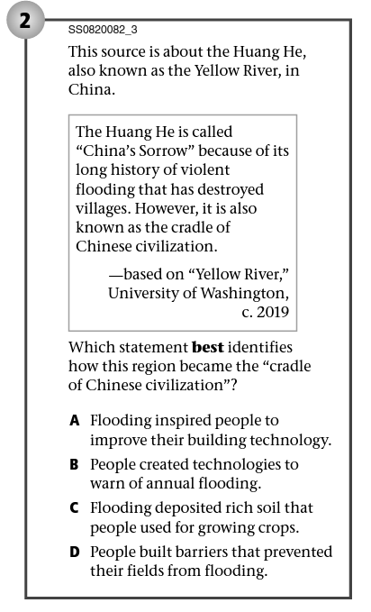
Types of Assessment Items (2)
Selected response items:
These items ask students to select the correct answer from a list of options included in the item.
Examples of selected-response items include matching, true/false, and multiple choice.
Notes:
Guiding Notes:
Read the slide. Record your answer to the question, “What are selected response items?” on your Note Catcher where it says Slide 13.

Slide 14
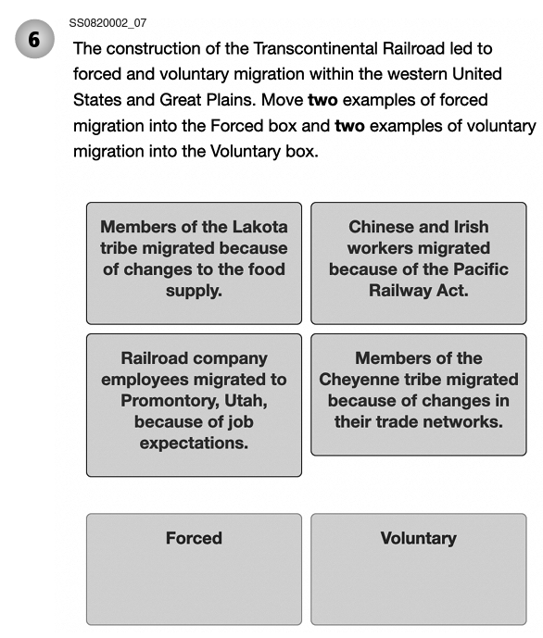
Types of Assessment Items (3)
Selected response item
Notes:
Guiding Notes:
Read the slide.

Slide 15
Types of Assessment Items (4)
Constructed response items:
These items ask students to write, or “construct,” the correct answer.
We use answer keys to score simpler constructed-response items, such as fill-in-the-blank items. We use scoring guides to score more complex constructed-response items, such as short- and longer-answer items.
Notes:
Guiding Notes:
Read the slide. We can think of constructed-response items as short, written performance tasks, which ask students to create products or perform tasks to show their mastery of particular skills. Record your answer to the question, “What are constructed response items?” on your Note Catcher where it says Slide 15.
QUESTION: A multiple choice question is considered a constructed response item.

Slide 16
Types of Assessment Items (5)
Constructed response item:
Do a Quick Write to answer the following question: “Why do countries specialize in certain products?” Include at least two examples to support your explanation and cite information from sources.
Notes:
Guiding Notes:
Read the slide. As you read this prompt, reflect on the characteristic of constructed responses: They are short tasks that ask students to show their mastery of particular skills.

Slide 17
Types of Assessment Items (6)
Performance tasks
Performance Tasks ask students to create products or perform tasks to show their mastery of particular skills. They take a wide variety of forms.
In small groups, use the discussion from Part One to create a poster that shows your new classroom rule. Create a poster to hang in our classroom. The poster must show a new rule that you and your classmates think will improve our classroom community. Your poster must show the following: 1. The new rule to use in your classroom, 2. Why the rule is needed. What problem does it solve? Use information from two or more sources in the classroom to explain how creating a new rule will improve your classroom community. 3. How following the new rule will improve the classroom community. Use what you have learned about school and community rules and why they exist to design the new classroom rule. Use drawing and writing that will make your friends want to follow the classroom rule.
Notes:
Guiding Notes:
Read the slide.

Slide 18
Types of Assessment Items (7)
Performance tasks:
Performance tasks can be extended-response items or essays.
They can also involve multiple steps that culminate in a product, such as carrying out an experiment, giving a speech or writing a research paper.
We use scoring guides and rubrics to score all types of performance tasks.
Notes:
Guiding Notes:
Read the slide. Record your answer to the question, “What are performance tasks?” on your Note Catcher where it says Slide 18.

Slide 19
Types of Assessment Items (9)
Performance Task
How does the desire for inexpensive goods lead to unintended consequences? Part One: Construct an argument to answer the following compelling question: “How does the desire for inexpensive goods lead to unintended consequences?” Gather information and evidence from credible sources and use appropriate evidence to construct claim(s) and counterclaim(s) to answer the compelling question. Part Two: Based on your argument to the compelling question, investigate your slavery footprint using http://slaveryfootprint.org/. Using this knowledge, identify a local, regional or global problem that results from the unintended consequences of desiring goods at low prices. Be prepared to share your response through meaningful discussions and democratic discourse. In your discussions, respect diverse opinions related to the problems that result from the unintended consequences of desiring goods at low prices. Part Three: Engage in disciplinary thinking and apply appropriate evidence to design an action plan that identifies how you can address a local, regional or global problem that results from the unintended consequences of desiring goods.
Notes:
Guiding Notes:
Read the slide.

Slide 20
This slide shows a continuum of assessment, with different assessment item types along the horizontal axis, and depth of knowledge represented on the vertical axis.
Notes:
Guiding Notes:
Read the slide.
QUESTION: According to the continuum, selected response items are higher on depth of learning than constructed responses.

Slide 21
Reflection
Complete the Explanation Game Thinking Strategy about the graph by answering the following two prompts:
I notice that…
Why is it that way?
Notes:
Guiding Notes:
Read the slide and complete the task in your Note Catcher where it says Slide 21. If possible, share your response with a colleague and repeat this process until so that you are able to share your responses too.
Some possible responses may include, but are not limited to the following:
“I notice that the depth of learning increases throughout the assessment continuum. Students build on their understanding. I also notice that the assessment continuum is set up to help our students become knowledgeable, active citizens in their communities. Another observation I had is that many assessments that are currently being used do not reach the depth of learning that the KAS for social studies requires. Many assessments focus on selected response items and short and long constructed response items, but they do not focus on performance tasks or complex extended projects. Why is it that way? Why are we so focused on the response items that are not at the higher end of the depth of learning? I feel like too many times the focus is on selected response items and short and long constructed response items because people are trying to create KSA-like assessments. I notice that if we want our students to become active citizens, we must push beyond selected responses and short and long constructed responses. While those items definitely have their place, we must push our assessments beyond that in order to help our students maximize their depth of learning.”
“I notice that the more complex the task, the higher the depth of learning. It is this way because as students are asked to engage at deeper levels the learning is greatly impacted. Performance tasks can help deepen learning.”
“I notice that as one moves from standardized items and tasks to curriculum-embedded performance tasks, critical thinking, collaboration, and communication skills are more heavily utilized. This is because the more opportunities students have to engage in these high-level tasks, the more proficient they will become in the skills of critical thinking, collaboration, and communication. When students become vested in solving a problem, they are able to immerse themselves into the learning experience and will ultimately develop a deeper understanding of the standard. Skills such as critical thinking, collaboration and communication as desirable traits for the workplace and for life. If students are being asked to complete high level tasks, we should help them develop skills that will be beneficial to them once they leave our classrooms.”
Resource:
Project Zero. (2019). The Explanation Game. Harvard Graduate School of Education. https://pz.harvard.edu/sites/default/files/The%20Explanation%20Game_1.pdf

Slide 22
Performance Assessments in Social Studies end
Module One:
What are the different types of classroom assessments in social studies?
Notes:
Thank you for completing Module One.
The KDE needs your feedback on the effectiveness of this module, the learning platform and how the consultants may best support you as you take the next steps in the implementation process. We are going to complete a short survey to share our thinking and provide them with feedback on how the KDE can best meet our needs. Feedback from our surveys will be used by the KDE to plan and prepare future professional learning.
Post-survey: https://docs.google.com/forms/d/e/1FAIpQLSd5pVVdKiDLKxM4wKq46V2JcO7UTMtFk8ELVR31du6HTO2Szg/viewform

