Slide 1
2024-2025 Back to School Trainings-Module 3-WIDA Secure Portal
ACCESS for ELLs/WIDA Alternate ACCESS
Chris Williams, Program Consultant
Office of Assessment and Accountability

Slide 2
Module Trainings
Module 1-WIDA Screener for Kindergarten and WIDA Screener Online
Module 2-Identified EL Students
Module 3-WIDA Secure Portal
Module 4-WIDA AMS
Module 5-ACCESS/Alternate ACCESS

Slide 3
Module 3-WIDA Secure Portal
Assessment training courses and quizzes, webinars, professional learning and resources

Slide 4
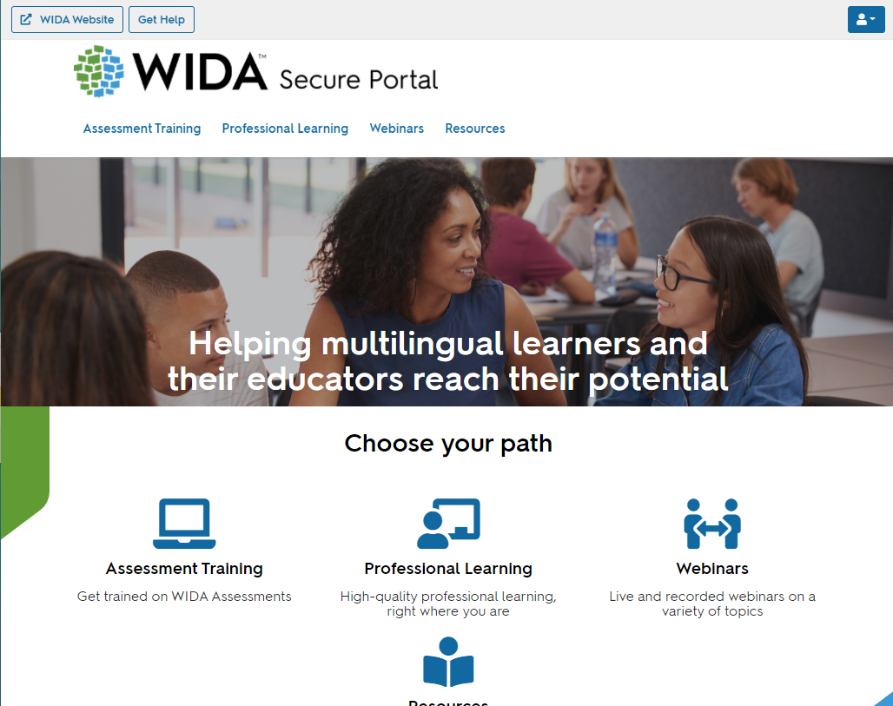
WIDA Secure Portal
WIDA Secure Portal
Assessment Training
Professional Learning
Webinars
Resources
Test Administrators are provided a login to the WIDA Secure Portal (must be added to the google form that the District Assessment Coordinator (DAC) has) to:
Access the training course and quiz specific to the assessment(s)
Manage User Account
Users will continue to see courses, webinars, and resources based on permissions.
If a user has been given access to professional learning courses only, they will not see the assessment training category— nor any resources tagged solely to assessment training.
Users will be able to update their own personal information.

Slide 5
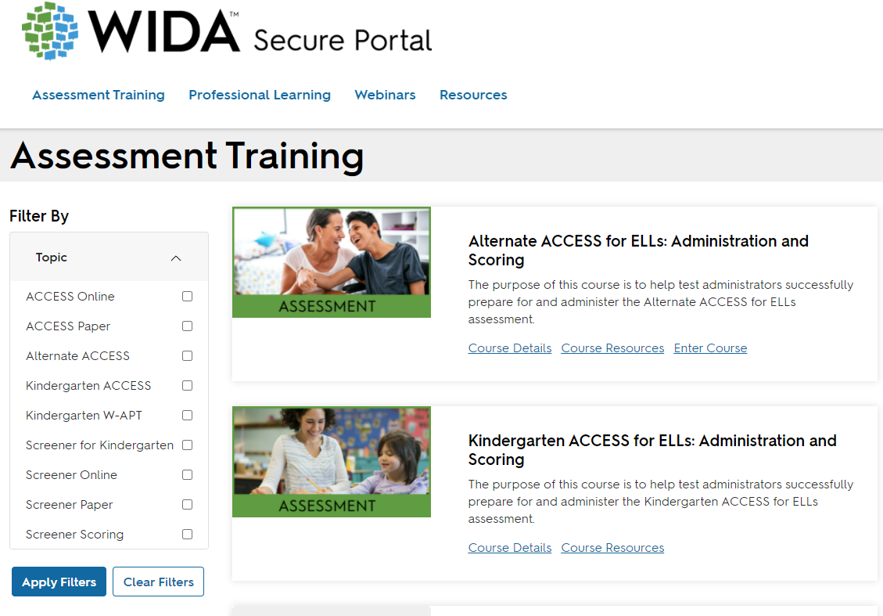
Assessment Training

Slide 6
ACCESS for ELLs® Training Course
The following courses will be available under Assessment Training (depending on user permission):
Kindergarten ACCESS for ELLs: Administration and Scoring
Alternate ACCESS for ELLs: Administration and Scoring and Field Test
Paper ACCESS for ELLs: Administration
Online ACCESS for ELLs: Administration
Speaking for Grades 1-5: Scoring Paper ACCESS and WIDA Screener
Speaking for Grades 6-12: Scoring Paper ACCESS and WIDA Screener
Writing for Grades 1-5: Scoring WIDA Screener
Writing for Grades 6-12: Scoring WIDA Screener
WIDA Screener Online: Administration
WIDA Screener Paper: Administration
WIDA Screener for Kindergarten: Administration and Scoring
Annual training certifications are required every year for test administrators prior to Screener or ACCESS for ELLs testing.
Those will be reset this year on Sept. 1 instead of July 1 for ACCESS for ELLs, but WIDA Screeners quizzes were available July 1. The quizzes will be available for the test administrator to retake for the current year ACCESS for ELLs Testing Cycle.
Notes:
After you log-on, you’ll be granted access to the My Account and Secure Portal.
Click 1: Records of individuals’ certification quiz progress are available within the WIDA Secure Portal, and individuals can print a certificate of their completed training. All individual certifications will remain available in the WIDA Secure Portal as the tests have not changed, although the format of the training has been updated.
Click 2: Within the ACCESS for ELLs Training Course, information and new web-based training modules for each assessment can be accessed. For Test Administrators who were certified to administer the ACCESS for ELLs suite of assessments, information on recertification can be found within your state checklist. Test Administrators must take all quizzes annually for ACCESS, Alternate ACCESS, and Kindergarten
Click 3: Test Coordinators are responsible for ensuring that all Test Administrators have completed applicable training components before giving ACCESS for ELLs , Alternate ACCESS and Kindergarten. Please make sure your information within the My Account Info is correct.
Click 4: Most importantly, please make sure your e-mail address, district, and school is correct. If not, please update and save.

Slide 7
WIDA Professional Learning
PD opportunity from WIDA
For EL and Content Teachers, some for Administrators
Self-paced e-Learning workshops in the WIDA Secure Portal
Available Sept. 1, 2024 -- new ones added, and some removed from last year and ends on Aug. 31, 2025
Sent information about WIDA PD through the WIDA Monday Mail and the WIDA PD flyer is on Kentucky’s member/state page on the WIDA website
Notes:
Must complete all e-Learning workshops by Aug. 31 of each year.

Slide 8
Contact Us
Jennifer Stafford, Division Director
Helen Jones, Academic Program Manager
Shara Savage, Education Administration Program Manager
Ben Riley, Systems Consultant
Devon Avery, Program Consultant
Chris Williams, Program Consultant
Christen Roseberry, Program Consultant
Krista Mullins, Program Consultant
Melissa Chandler, Program Consultant

Slide 9
Other Back to School Trainings
Accountability Overview
ACCESS/Alternate ACCESS
AKSA (Attainment Tasks)
K Screen
Test Security

Slide 10
Division of Assessment and Accountability Support
OAA/DAAS (502) 564-4394 dacinfo@education.ky.gov
Chris Williams, Program Consultant,
chris.williams@education.ky.gov

Slide 11
Thanks for Attending

