Slide 1
How Many of Me? - Introduction
Kentucky Family Math Night Game
How Many of Me?
Recommended for Grades K-5
This game will help your student measure various objects to answer the question, “ How many of me does it take to measure ___?”
Kentucky Academic Standards for Mathematics Connections:
Kindergarten Measurement and Data
KY.K.MD.1 Describe measurable attributes (length, height, weight, width, depth) of an object or a set of objects using appropriate vocabulary.
KY.K.MD.2 Directly compare two objects with a measurable attribute in common, to see which object has “more of”/ “less of” the attribute and describe the difference.
First grade Measurement and Data
KY.1.MD.1 Order three objects by length; compare the lengths of two objects indirectly by using a third object.
KY.1.MD.2 Express the length of an object as a whole number of same size length units, by laying multiple copies of a shorter object (the length unit) end to end with no gaps or overlaps.
Second grade Measurement and Data
KY.2.MD.1 Measure the length of an object by selecting and using appropriate tools such as rulers, yardsticks, meter sticks and measuring tapes
KY.2.MD.2 Measure the length of an object twice, using length units of different lengths for the two measurements; describe how the two measurements relate to the size of the unit chosen.
Third grade Measurement and Data
KY.3.MD.8 Solve real world and mathematical problems involving perimeters of polygons.
a. Find the perimeter given the side lengths of a polygon.
b. Find an unknown side length, given the perimeter and some lengths.
c. Draw rectangles with the same perimeter and different areas or with the same area and different perimeters.
Fourth grade Measurement and Data
KY.4.MD.1 Know relative size of measurement units (mass, weight, liquid volume, length, time) within one system of units (metric system, U.S. standard system and time).
a. Understand the relationship of measurement units within any given measurement system.
b. Within any given measurement system, express measurements in a larger unit in terms of a smaller unit.
c. Record measurement equivalents in a two-column table.
KY.4.MD.2 Use the four operations to solve word problems involving distances, intervals of time, liquid volumes, masses of objects and money.
a. Solve measurement problems involving whole number, simple fractions or decimals.
b. Solve problems that require converting a given measurement from a larger unit to a smaller unit within a common measurement system, such as 2 km = 2,000 m.
c. Visually display measurement quantities using representations such as number lines that feature a measurement scale.
Standards for Mathematical Practice:
MP.1 Make sense of problems and persevere in solving them. MP.2 Reason abstractly and quantitatively. MP.5 Use appropriate tools strategically. MP.6 Attend to precision.

Slide 2
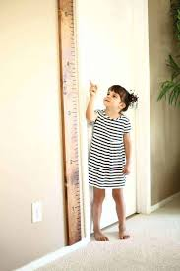
How Many of Me? - Instructions
How Many of Me? – Instructions
Players: Two or more players
Goal: Measure various objects to answer the question “How many of me does it take to measure _____?”
Notes:
Parents have a hard time getting their child to understand improvised units of measure (ribbon). Provide video to accompany online version.

Slide 3
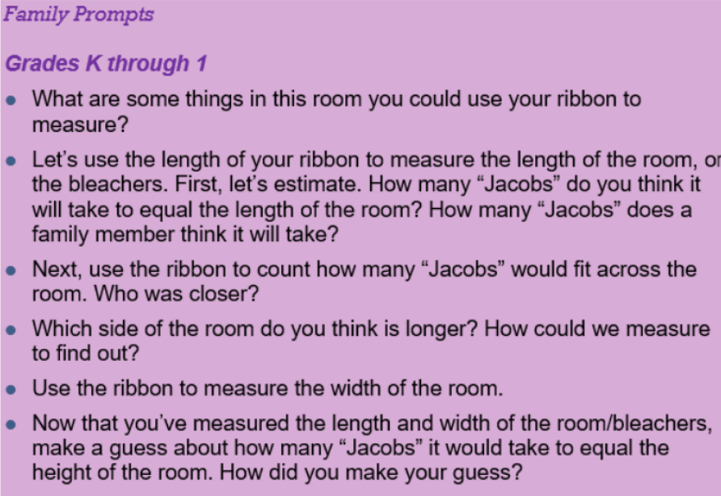
How Many of Me – Grades K-1 Family Prompts
How Many of Me? – Grades K-1 Family Prompts

Slide 4
How Many of Me? – Grades 2-3 Family Prompts
How Many of Me? – Grades 2-3 Family Prompts
Notes:
3rd grade­ fractions! When a length is one-third Jacob, etc

Slide 5
How Many of Me? – Grades 4-5 Family Prompts
How Many of Me? – Grades 4-5 Family Prompts
Notes:
4-5 students were much more able to estimate measurements with "Jacobs" compared to k-3, and even some parents.

Slide 6
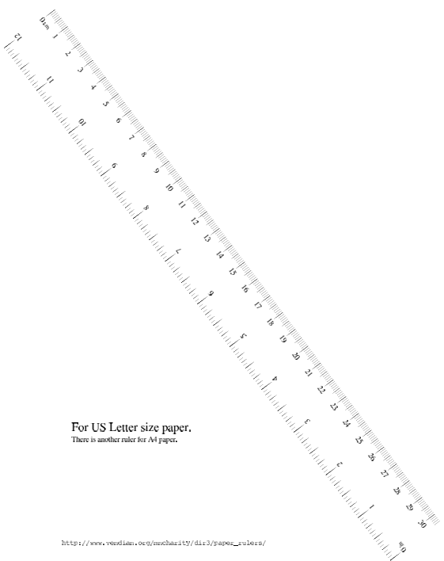
How Many of Me? – Printable Ruler
How Many of Me? – Ruler
Printable Ruler: http://www.vendian.org/mncharity/dir3/paper_rulers/UnstableURL/ruler_foot.pdf
Notes:
The link will allow you to print a ruler so you and your student can explore. Enjoy!
Printable Ruler: http://www.vendian.org/mncharity/dir3/paper_rulers/UnstableURL/ruler_foot.pdf

Slide 7
How Many of Me? – Closing Slide
Kentucky Family Math Night Games
How Many of Me?
Thank you for playing!
Access more digital family math games at: https://www.education.ky.gov/curriculum/conpro/Pages/summer_support_math_resources.aspx

