Slide 1
Broken Calculator - Introduction
Kentucky Family Math Night Game
Broken Calculator
Recommended for Grades 2-3
This game will help your student use place value, addition and subtraction to create solutions to math challenges with various restrictions.
Kentucky Academic Standards for Mathematics Connections:
Second grade Number and Operations in Base Ten
KY.2.NBT.5 Fluently add and subtract within 100 using strategies based on place value, properties of operations and/or the relationship between addition and subtraction.
Third grade Number and Operations in Base Ten
KY.3.NBT.2 Fluently add and subtract within 1000 using strategies and algorithms based on place value, properties of operations and/or the relationship between addition and subtraction.
Standards for Mathematical Practice:
MP.1 Make sense of problems and persevere in solving them.
MP.2 Reason abstractly and quantitatively.
MP.8 Look for and express regularity in repeated reasoning.

Slide 2
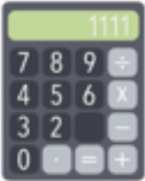
Broken Calculator - Instructions
Broken Calculator – Instructions
Players: One or more
Goal: Use place value, addition, and subtraction to create solutions to math challenges with various restrictions on a calculator.

Slide 3
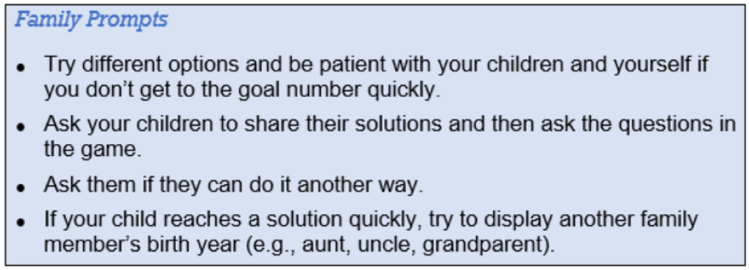
Broken Calculator – Family Prompts
Broken Calculator – Family Prompts
Ask any of the following questions as you play the game.

Slide 4
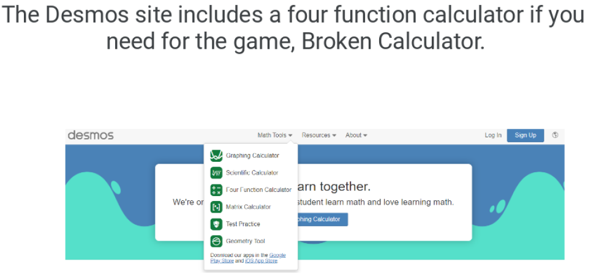
Broken Calculator Desmos Online Calculator
Broken Calculator – Desmos online calculator
www.desmos.com/fourfunction

Slide 5
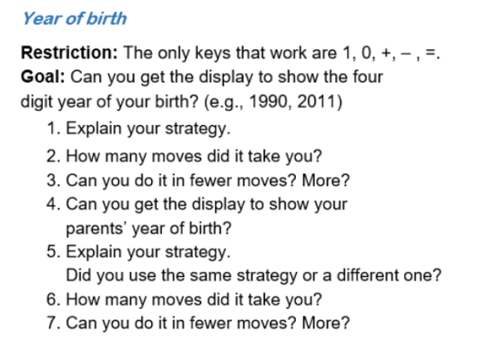
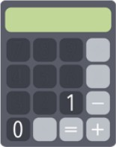
Broken Calculator – Year of Birth
Broken Calculator – Year of birth
www.desmos.com/fourfunction
Family Prompts
Can you do another family members birth year?

Slide 6
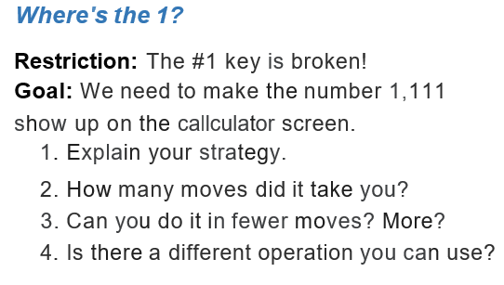
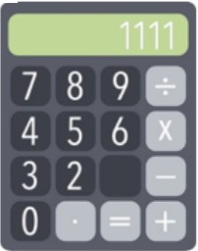
Broken Calculator – Where’s the 1
Broken Calculator – Where’s the 1?
www.desmos.com/fourfunction
Family Prompts
Can you get your answer in a different way? In fewer moves?

Slide 7
Broken Calculator – Closing Slide
Kentucky Family Math Night Games
Broken Calculator
Thank you for playing!
Access more digital family math games at:
https://www.education.ky.gov/curriculum/conpro/Pages/family_math_games.aspx

