Slide 1
Implicit & Explicit Vocabulary Instruction
STUDENT PROGRESS
SESSION 6
1
Notes:
Session Summary: During this session, teachers will engage in student work analysis to identify evidence of student progress toward goals and to suggest instructional next steps. Following the analysis, teachers will share feedback in order to prepare for individual or co-teaching team planning. Finally, teachers will have the opportunity to plan strategically in response to the analyzed data to ensure that all students demonstrate progress toward the overall intended learning.
Session Length: 90 minutes

Slide 2
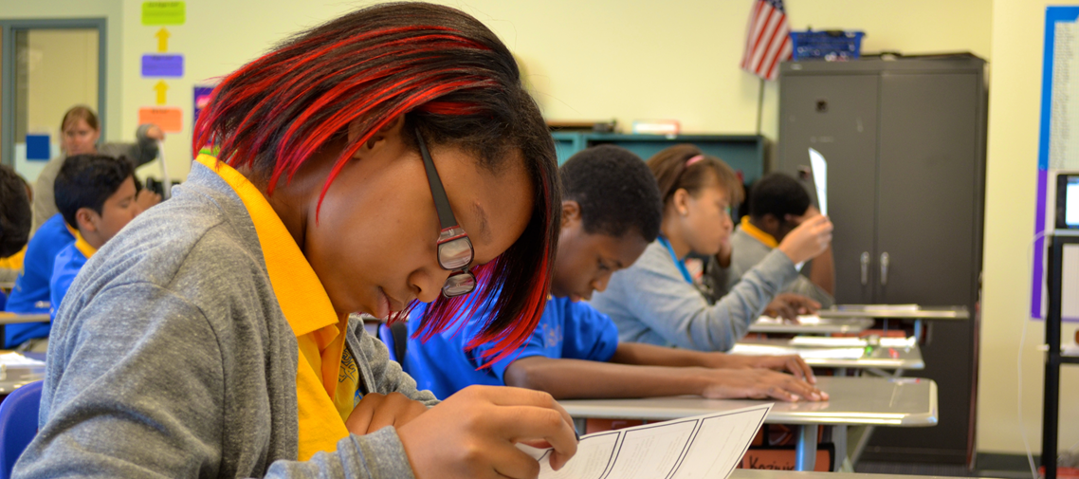
Do Now
ACADEMIC VOCABULARY SESSION 6
Think of one student in your sub-group who had a “bright spot” learning moment this week.
As you reflect on this student’s experience, share a positive take-away about their learning with a partner.
2
Notes:
Do Now (3 min): “Think of one student in your sub-group who had a “bright spot” learning moment this week. As you reflect on this student’s experience, share a positive take-away about their learning with a partner.”

Slide 3
Content Cycle Overview
Session | Type of Learning | Focus Area
1 | Shared Learning | Introduction to Vocabulary and Why It Matters
2 | Shared Learning | Implicit Vocabulary Instruction
3 | Planning & Practice | Implicit Vocabulary Instruction
4 | Shared Learning | Explicit Vocabulary Instruction
5 | Planning & Practice | Explicit Vocabulary Instruction
6 | Student Progress | Implicit and Explicit Vocabulary Instruction
7 | Shared Learning | Text Sets
8 | Planning & Practice | Text Sets
9 | Shared Learning | Maintaining & Extending Vocabulary
10 | Planning & Practice | Maintaining & Extending Vocabulary
11 | Student Progress | Text Sets, Implicit and Explicit Vocabulary
Notes:
Cycle Overview (1 min)
Share path of the cycle, explaining how the professional learning includes opportunities for shared learning, planning and practice, and studying student progress.

Slide 4
Objectives
ACADEMIC VOCABULARY SESSION 6
Agenda
01. Identify strengths and gaps in student outcomes for all students
02. Prioritize instructional next steps to accelerate learning for all students
01. Welcome
02. Examining Student Work
03. Responding to Student Work
04. Closing
4
Notes:
Session Objectives and Agenda (1 min)
Framing (1 min) “This week, we’ll explore connections between our learning about how to effectively approach vocabulary instruction and our students’ growth. To do this, we’ll conduct student work analysis to analyze our instructional effectiveness through the lens of student outcomes on a learning task. As we uncover trends of growth and need, we’ll plan for instructional next steps that will support students in achieving learning targets.”

Slide 5
Preparing for Student Work Analysis
Gather the following:
ACADEMIC VOCABULARY SESSION 6
Exemplar student response for the task
The learning task and intended student outcome for the work
Sub-group student samples
The rubric/checklist you will use to assess proficiency
5
Notes:
Preparing for the Protocol (5 min)
Framing: “As we prepare for our student work analysis protocol today, take a moment to assemble the following materials:
The exemplar student response you completed for pre-work
The learning task and intended student outcome for the student work
Sub-group student work samples
The rubric/checklist you will use to examine the student work for proficiency.”
Teachers should locate a partner, ideally one who teaches the same grade. Other possible configurations: vertical grade partners, co-teachers, etc.

Slide 6
Analyze the Prompt and Exemplar Response
Does the prompt align to the text’s key understandings?
Does the exemplar represent an appropriate bar for excellence, according to the Kentucky Academic Standards for the grade?
Materials
The text students read prior to answering the prompt
Prompt that students responded to
Completed exemplar response
Kentucky Academic Standards
6
Notes:
Analyze the Prompt and Exemplar Response (10 min)
Directions/Framing/Key Points:
Before we look at student samples, it’s important to check our tasks for alignment to the text and the standards. This helps us understand what, exactly, we are looking for in our students’ work.
10 min: With a partner, teachers discuss the prompt that students wrote in response to, and the exemplar response prepared by the teacher:
Does the prompt align to the text’s key understandings?
Does the exemplar represent an appropriate bar for excellence, according to the KAS for the grade?
If both teachers are working with the same prompt and exemplar response, they may have a conversation over the 10 minutes (this is preferred). If they are working with different prompts and exemplars, Partner A can share for 5 minutes, then switch roles for Partner B to share.
Look or Listen For:
Assessment items or culminating writing tasks align to the key understanding(s) of the text/unit
Assessment items or culminating writing tasks require students to read and write in response to grade-level complex texts
Assessment items or culminating writing tasks align to the grade-level Learning Expectations for reading, writing, speaking & listening, and language
Teacher plans exemplar student responses to the text or unit culminating task
The exemplar response explains the key understanding(s) through writing and/or speaking and listening
The exemplar response uses evidence from the text
The exemplar exemplifies the grade-level standards for reading, writing, and language

Slide 7
Examining Student Work
Protocol:
ACADEMIC VOCABULARY SESSION 6
Look Fors:
In analysis, teacher identifies 1-2 specific strengths for class and/or priority students, aligned to standards taught
In analysis, teacher identifies 1-2 specific areas of growth for class and/or priority students, aligned to standards taught
Teacher identifies next steps (including materials, type of support, which students, and dates) for addressing student needs determined by data
15 min: Analyze Partner 1 samples
Partner 1 shares intended outcome and exemplar student response.
Together, partners examine and annotate the student work.
Together, partners identify evidence of strength, growth, trends, and next steps on the student work analysis form.
15 min: Repeat for Partner 2
7
Notes:
Examining Student Work (30 minutes total; 15 minutes/partner)
For the following steps, assign one partner as the first presenter and then repeat the steps with the second partner presenting.
Intended Outcome & Exemplar Student Response: The presenting partner will share the intended outcome and exemplar student response for the learning task that was completed for pre-work.
Examine Student work (Sub-Group): Together, teachers will examine, and annotate the student work.
Identify Evidence and Instructional Next Steps: Teachers will identify evidence of students’ ability to meet the identified learning outcome aligned to the rubric/checklist and individual student goals, jotting evidence of strengths, areas of growth, and instructional next steps.
*After 15 minutes, repeat process with other partner’s student work.

Slide 8
Considering Implications
Reflect individually:
ACADEMIC VOCABULARY SESSION 6
Overall, what strengths and gaps did you observe in your students’ work?
In what ways do you see footprints of your implicit and explicit vocabulary instruction on your students’ learning?
How can you transfer what you learned from your sub-group of students to the larger class?
8
Notes:
Considering Implications (8 minutes)
Reflect Individually: Consider the following questions:
Overall, what strengths and gaps did you observe in your students’ work?
In what ways do you see footprints of your implicit and explicit vocabulary instruction on your students’ learning?
How can you transfer what you learned from your sub-group of students to the larger class?
Whole group share (2 min)

Slide 9
Choose your own adventure!
ACADEMIC VOCABULARY
SESSION 6
Continue analyzing work samples for remaining students
Use ideas and insights gained in the protocol to plan instructional next steps
9
Notes:
Responding to Student Work (20 minutes)
Framing: Now that we’ve spent time examining student work for our sub-group of students and have determined some instructional implications, you have time to apply that learning in one of two ways. For some, it might make sense to continue analyzing student work for the remaining students in the class to determine the best path forward for all students. Others might wish to apply learning from the sub-group and begin planning in response to that data.”
Continue Examining Student Work: Teachers can use the remaining time to continue to analyze student work for remaining students.
Planning in Response to Student Work Analysis: Teachers can use remaining time to use ideas and insights gained in the protocol to plan instructional next steps.

Slide 10
Closing
Reflection:
What next steps will you take in response to the data?
Notes:
Closing (5 min)
Directions/Framing/Key Points:
3 min: Teachers reflect independently on the next steps they will take in response to the data.
2 min: Each teacher shares a next step they’re committing to take in response to the data.
Look or Listen For:
Teachers commit to next steps that are aligned with the trends they saw in their students’ responses.

