Slide 1
2024-2025 Back to School Trainings-Module 5-ACCESS/Alternate ACCESS
ACCESS for ELLs/WIDA Alternate ACCESS
Chris Williams, Program Consultant
Office of Assessment and Accountability

Slide 2
Module Trainings
Module 1-WIDA Screener for Kindergarten and WIDA Screener Online
Module 2-Identified EL Students
Module 3-WIDA Secure Portal
Module 4-WIDA AMS
Module 5-ACCESS/Alternate ACCESS

Slide 3
Module 5-ACCESS for ELLs

Slide 4
Test Vendor
Data Recognition Corporation® (DRC) serves as the operational test vendor for ACCESS for ELLs®, both online and paper.
Notes:
Data Recognition Corporation serves as the operational test vendor for ACCESS for ELLs, both online and paper (including Kindergarten and Alternate ACCESS for ELLs).

Slide 5
2024-2025 ACCESS for ELLs (ACCESS and Alternate ACCESS) Testing Schedule in WIDA AMS (Tentative)
 | Start Date | End Date
Test Materials Ordering | 9/27/24 | 10/23/24
Online Test Setup for Registrations | 11/27/24 | 2/14/25
Districts Receive Test Material | 12/3/24 | 12/4/24
Additional Test Material Window | 12/3/24 | 2/7/25
Test Window | 1/6/25 | 2/14/25
All Test Material Received at DRC | 2/28/25 | 2/28/25
Pre-Reporting Data Validation Window | 3/19/25 | 4/2/25
Districts Receive Reports | 4/28/25 (online) | 5/7-5/8/25 (printed)
Score Correction Window | 5/8/25 | 5/22/25
Notes:
Data Recognition Corporation (DRC) prints, scores, houses the online system and ships the test materials and reports to the districts.
DRC opens a data validation window for districts to have one last look at the demographic data before the reports are printed and sent to the districts.
Kindergarten, Alternate ACCESS and Accommodated (Braille and Large print) are paper/pencil assessments.
Alternate ACCESS Reports will be available in the fall to districts after the WIDA Standard Setting of Alternate ACCESS conducted in summer of 2024.

Slide 6
ACCESS for ELLs Suite of Assessments
The following assessments are used to satisfy state and federal requirements for the annual assessment of the English language proficiency of English Language Learners (ELLs):
ACCESS for ELLs, an online and paper-based assessment for Grades 1–12,
Kindergarten ACCESS for ELLs, a paper-based assessment for Kindergarten,
Alternate ACCESS for ELLs, a paper-based assessment for ELLs in Grades K–12 who have significant cognitive disabilities.
Notes:
The ACCESS for ELLs assessments are a tool to measure English Language Learners proficiency in English. The ACCESS for ELLs suite of assessments includes:
ACCESS for ELLs, an online and paper-based assessment for students in Grades 1–12
Kindergarten ACCESS for ELLs, a paper-based assessment for Kindergarten students
Alternate ACCESS for ELLs, a paper-based assessment for students in Grades 1–12 who have significant cognitive disabilities
More information about Alternate ACCESS for ELLs and Kindergarten ACCESS for ELLs can be found in other presentations available on the WIDA website.

Slide 7
ACCESS for ELLs Trainings/Webinar Updates
District and school staff will begin ACCESS for ELLs trainings for ACCESS Online, Kindergarten and WIDA Alternate ACCESS beginning Sept. 1 in the WIDA Secure Portal
Additional trainings on ACCESS for ELLs be released in the fall on the Kentucky Department of Education (KDE) ACCESS for ELLs website.
ACCESS/Alternate ACCESS? webinar will occur on August 28 from 10-11:15 a.m. CT. Details about the webinar can be found on the WIDA website.

Slide 8
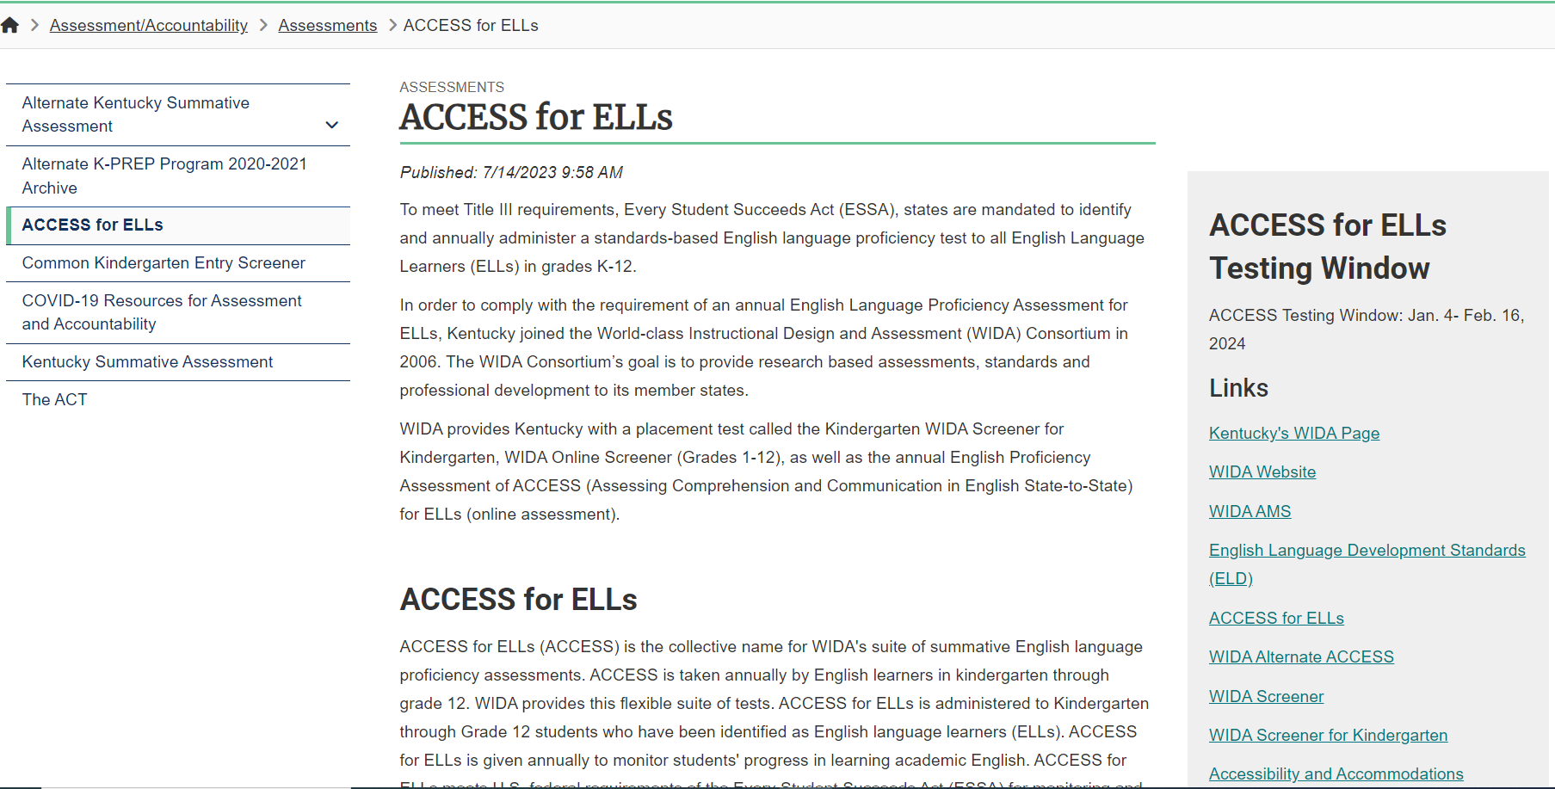
ACCESS for ELLs Webpage (KDE Website)
ACCESS for ELLs Webpage on the Kentucky Department of Education (KDE) Website

Slide 9
Exit Criteria for ACCESS for ELLs and Kindergarten ACCESS for ELLs
Overall Composite of a 4.5 on a Tier B/C is the exit criteria for ACCESS for ELLs.
Overall Composite of a 4.5 is the exit criteria for Kindergarten ACCESS for ELLs.

Slide 10
Module 5- WIDA Alternate ACCESS

Slide 11
WIDA Alternate ACCESS
A paper-pencil test for grades K-12
Individualized Education Program (IEP) team determines whether the student takes WIDA Alternate ACCESS or regular ACCESS with accommodations. IEP Team will use the Participation Decision Tree and the information below to assist.
To participate in WIDA Alternate ACCESS
Must be classified as an English Learner (EL)
Must have a significant cognitive disability
Must participate or is expected to participate in the Alternate Assessment
Must have a disability that precludes taking the ACCESS for ELLs® with accommodations
Notes:
Districts must give either the ACCESS for ELLs® or the WIDA Alternate ACCESS® to EL students each year.
State and federal laws require that all ELLs participate in annual English language proficiency assessments. The WIDA Accessibility/Accommodations Framework provides support for all ELLs, as well as targeted accommodations for students with Individual Education Plans (known as IEPs) or 504 plans. These supports will help all ELLs to better access the test. Some ELLs with significant cognitive disabilities will still be unable to take ACCESS for ELLs, even with supports and accommodations. These students may be eligible to participate in WIDA Alternate ACCESS, but only if they meet specific participation criteria. WIDA’s guidance for participation on Alt is found in Appendix A of the Manual and on the WIDA Website under WIDA Alternate ACCESS. Check with your state education agency for your state’s specific participation criteria for alternate assessment.
As the WIDA Alternate ACCESS Participation Criteria Decision Tree illustrates, there are several criteria that a student must meet to be eligible to participate in the WIDA Alternate ACCESS assessment. Again, it is recommended that the IEP Team makes this determination. Even if all of the criteria are met, it still may be more appropriate for an English language learner with significant cognitive disabilities to take the standard ACCESS for ELLs assessment based on their language proficiency.

Slide 12
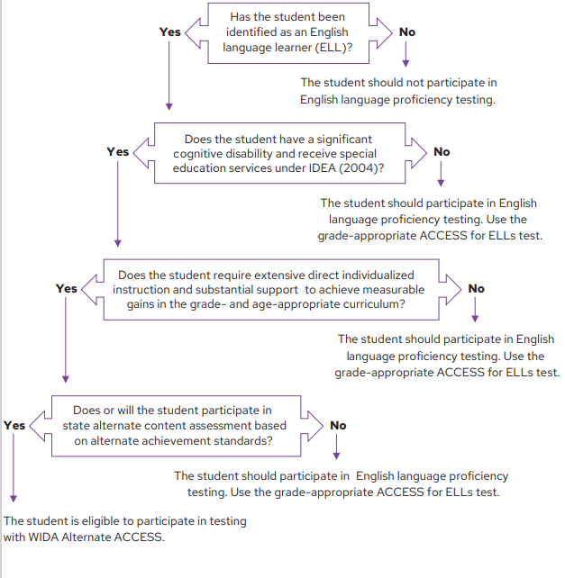
Participation Decision Tree
The IEP Team will use the Participation Decision Tree to see if the EL student is eligible to participate in testing with the WIDA Alternate ACCESS.

Slide 13
WIDA Alternate ACCESS-Operational
When schools and districts tested English learners with the most significant cognitive disabilities during the 2023–2024 school year, the operational test:
Incorporated the WIDA ELD Standards Framework, 2020 Edition
Covered kindergarten, which was part of the new K–2 grade-level cluster
Included a brand-new test content and a new test item type
Contained an Individual Characteristics Questionnaire (ICQ), which prompted test administrators to answer questions about students (ICQ information will be reported on the individual student score report to help educators make reclassification decisions about students taking Alternate ACCESS)
Had a new look: Candoo, the Alternate ACCESS dog, adorned the test materials and we carried over the field test color scheme
Had a redesigned training course, which has new content and a new look and feel
Had scores delayed after WIDA standard setting in late fall of 2024 and not in late April
Notes:
9/11/24
Districts receive WIDA Alternate ACCESS reports – Online
9/26/24
Districts receive WIDA Alternate ACCESS reports - Printed

Slide 14
WIDA Alternate ACCESS Trainings/Webinar/Report Updates
District and school staff will begin ACCESS for ELLs trainings for ACCESS Online, Kindergarten and WIDA Alternate ACCESS beginning Sept. 1 in the WIDA Secure Portal.
Understanding 2023-2024 WIDA Alternate Score Reports webinar will occur on Aug. 27 at 1-2 p.m. CT. Details about the webinar can be found on the WIDA Secure Portal and in the July 8 Monday DAC email. Webinar will be recorded and available on the WIDA Secure Portal approximately one week after the presentation.
ACCESS/Alternate ACCESS? Webinar will occur on August 28 at 10-11:15 a.m. CT. Details about the webinar can be found on the WIDA website.
Districts will receive WIDA Alternate ACCESS reports online in WIDA AMS on Sept. 11.
Districts will receive the WIDA Alternate ACCESS print reports on Sept. 26.

Slide 15
Exit Criteria WIDA Alternate ACCESS
Overall Composite Proficiency Level (PL) 2 is the exit criteria for WIDA Alternate ACCESS now but could change after Alternate Standard Setting.

Slide 16
WIDA Website

Slide 17
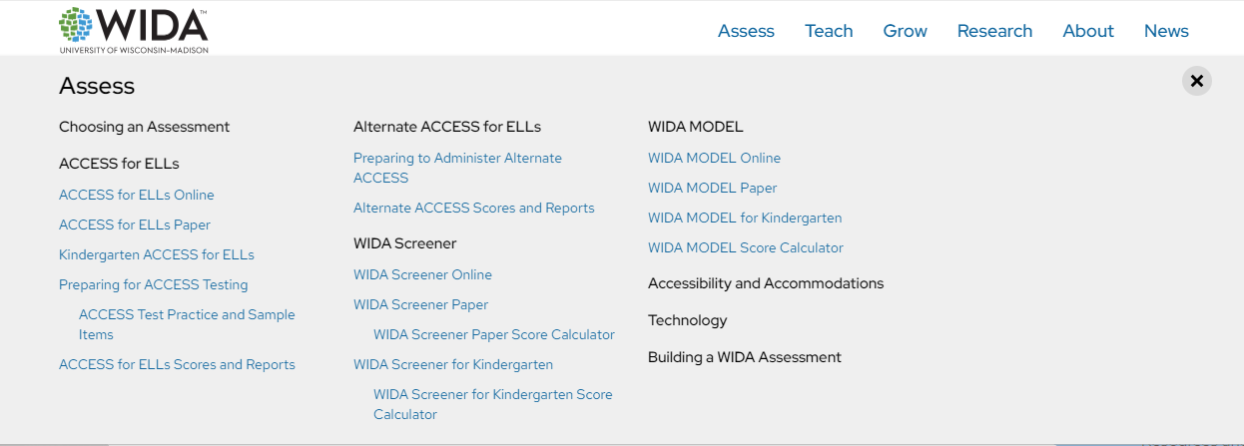
Assess Page (WIDA Website)
Assess on the WIDA website.

Slide 18
Teach Page (WIDA Website)
Teach on the WIDA website.

Slide 19
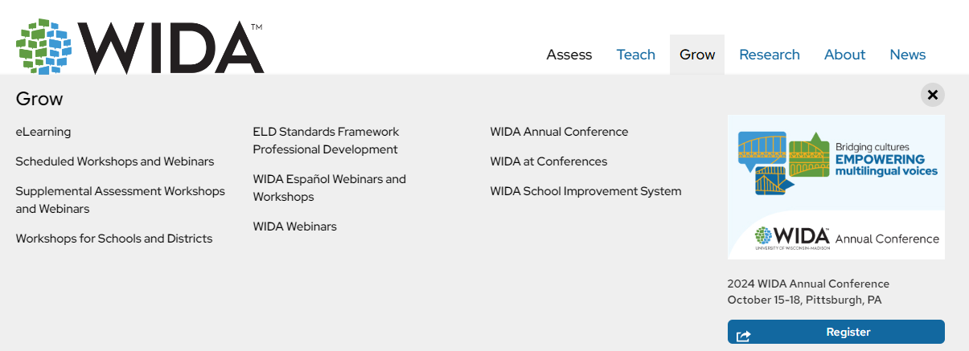
Grow (WIDA Website)
Grow on the WIDA website

Slide 20
WIDA Professional Learning
PD opportunity from WIDA
For EL and Content Teachers, some for Administrators
Self-paced e-Learning workshops in the WIDA Secure Portal
Available Sept. 1, 2024 -- new ones added, and some removed from last year and ends on Aug. 31, 2025
Sent information about WIDA PD through the WIDA Monday Mail and the WIDA PD flyer is on Kentucky’s member/state page on the WIDA website
Notes:
Must complete all e-Learning workshops by Aug. 31 of each year.

Slide 21
State-Specific Guidelines on WIDA Website
Visit Kentucky’s member state page for information related to:
Contacting State Educational Agency’s Representatives
Assessment Materials and Training
ACCESS for ELLs Testing Schedules
State-Specific guidance for ACCESS for ELLs
ACCESS for ELLs Online and Paper Checklist
Identification and Placement Guidance
Professional Development Opportunities
Notes:
Kentucky has its own specific guidance related to this information. Be sure to click on members/states and select Kentucky at wida.wisc.edu to see any specific guidelines and policies.
In 2023-2024, WIDA continues to offer the resource of state specific checklists. State checklists are available as a tool for you to assign and document the tasks that are required to administer ACCESS for ELLs. The state checklist indicates who typically handles each task in our state, along with any state-specific guidance. These are each customized for our state.

Slide 22
Contact Us
Jennifer Stafford, Division Director
Helen Jones, Academic Program Manager
Shara Savage, Education Administration Program Manager
Ben Riley, Systems Consultant
Devon Avery, Program Consultant
Chris Williams, Program Consultant
Christen Roseberry, Program Consultant
Krista Mullins, Program Consultant
Melissa Chandler, Program Consultant

Slide 23
Other Back to School Trainings
Accountability Overview
ACCESS/Alternate ACCESS
AKSA (Attainment Tasks)
K Screen
ACT – Fall ACT Administration
Test Security

Slide 24
Division of Assessment and Accountability Support
OAA/DAAS (502) 564-4394 dacinfo@education.ky.gov
Chris Williams, Program Consultant,
chris.williams@education.ky.gov

Slide 25
Thanks for Attending

