Slide 1
Title II, Part A Supporting Effective Instruction District Coordinators Program Overview
July 2024

Slide 2
Agenda
Intent of Title II, Part A
Allowable expenditures with Title II, Part A funds
Considerations related to Title II, Part A planning
Information needed to include in the district GMAP application

Slide 3
Title II, Part A Intent
Title II, Part A funds can be used to provide supplemental activities that strengthen the quality and effectiveness of teachers, principals, and other school leaders in order to:
Increase student achievement
Improve teacher and principal effectiveness
Increase the number of teachers, principals, and other school leaders who are effective in improving student academic achievement in schools, and
Provide low-income and minority students greater access to effective teachers, principals, and other school leaders

Slide 4
Supplement, Not Supplant
ESSA Section 2123 (b) states the following concerning supplanting funds:
SUPPLEMENT, NOT SUPPLANT- Funds received under this subpart shall be used to supplement, and not supplant, non-Federal funds that would otherwise be used for activities authorized under this subpart.

Slide 5
RAND requirements
Reasonable – Not excessive in cost and based on prudent and sound purchasing practices. (2 CFR 200.404)
Allocable – Cost is incurred specifically for the benefit of the program, distributed proportionately, an allowable activity and meets the program’s intent. (2 CFR 200.405)
Necessary – Essential for carrying out the needs-based program. (2 CFR 200.403(a))
Documented – Purchases must be adequately documented. (2 CFR 200.403(g) and 2 CFR 200.302(b)(3))
“If my school didn’t have Title II, Part A funds, would I still find a way to pay for this?”

Slide 6
Title II, Part A Expenditures
Professional Learning
Retention
Equitable Distribution
Career Pathways
Recruitment
Professional Learning
Recruitment
Retention
Career Pathways
Equitable Distribution of Effective Educators
Support for Effective Instruction

Slide 7
Professional Learning
Districts may use funds to support the ongoing professional learning of teachers, principals and school leaders.
Professional Learning Opportunities
Needs-based
Job-embedded
Sustainable
Evidence-based
Data-driven
Classroom-focused

Slide 8
Professional Development Definition

Slide 9
Evidence-Based Professional Development

Slide 10
Evidence-Based Professional Development Section 8101(2)

Slide 11
Best Practices Clearinghouse

Slide 12
Teacher Recruitment and Retention
Recruitment
Retention
Districts may use funds to recruit teachers in critical shortage areas, particularly in high-poverty schools.
Pay differentials
Signing bonuses
Relocation expenses
Support for paraeducators to gain certification
Districts may use funds to implement activities that are proven to be effective in retaining teachers in a school or district.
Leadership opportunities
Pay differentials
Tuition reimbursement

Slide 13
KRS 161.031(2)
Induction and mentoring programs
Above and beyond requirements (first year)
Programs containing additional years beyond first year may use Title II, Part A funds (if approved)
KEMP document

Slide 14
Class Size Reduction – ESSA 2103(b)(3)(D)
reducing class size to a level that is evidence based, to the extent the State (in consultation with local educational agencies in the State) determines that such evidence is reasonably available, to improve student achievement through the recruiting and hiring of additional effective teachers;

Slide 15
Class Size Reduction
Districts may use funds to reduce class sizes by creating additional classes in a particular grade or subject. Classes must be reduced to an evidence-based effective student/teacher ratio prior to allocating funds for CSR.
Supplemental – NOT a way to address an allocation shortage
Meet class size capacity requirements
Documentable effectiveness regarding student achievement
CSR staff must have a valid teaching certificate in the content and grade level to which they are assigned
CSR staff must have been previously determined to be effective by the district; i.e., should not be a first-year teacher
Supported by evidence and research

Slide 16
Career Pathways
Districts may use funds to create roles for staff that promote leadership and advancement but allow staff to remain in the classroom.
Instructional coaching
Teacher leaders/mentors
Professional development leader (peer-led)
PLC leader

Slide 17
Equitable Distribution of Effective Educators
Districts may use funds to support a balanced distribution of effective teachers and principals throughout the district.
Strategic teacher/principal placement

Slide 18
Title II, Part A Intent
Examples of Allowable Expenditures
Examples of Non-Allowable Expenditures
Salaries, stipends, fees for instructional coaches
Recruitment and retention initiatives
New teacher support systems (see new requirements in KEMP)
Supplemental evidence-based professional learning
Substitutes for teachers attending professional learning
Materials and supplies for approved, reasonable and necessary professional learning sessions
Expenses related to equitable distribution of effective teachers
Required or stand-alone professional development
Curriculum Development
Assessment Development
Data Analysis
Food and refreshment purchases
Direct reimbursement to a nonpublic school
Materials or supplies not directly connected to professional learning
Materials for students
Salaries for required positions

Slide 19
Title II, Part A Considerations
Data-Based Planning
Shareholder Input
District Needs Assessment
Non-Public School Consultation
Documentation of Evidence
Policies, Processes, and Procedures
Title II, Part A Program Monitoring

Slide 20
Planning…
How do you plan your Title II, Part A program?

Slide 21
Planning
What are the district needs?
CDIP
CSIP
Student enrollment data
Teacher certification data
Graduation rates
Attendance data
Survey data
How will the district address the needs?
Professional Learning
Recruitment and/or Retention
Equitable Distribution of Effective Teachers
Career Pathway Opportunities
Other Federal programs
Who is involved in determining district needs?
District: Superintendent, Finance Officer, Title II Coordinator, Curriculum and Instruction Specialists, ESL Coordinator, Human Resources Staff
School: Principals, Teachers, Parents
Community: Businesses, Community Leaders
Needs Assessment
Plan
Shareholders

Slide 22
Developing a Plan
Where are we now?
What does data show?
What do our staff members say?
What do our families say?
What do our community members say?
Where do we want to go?
Based on data and shareholder input, what do we need to work on?
What should be prioritized?
What are our needs?
How will we get there?
What strategies can we try?
What has worked before? What has previously been unsuccessful? Why?
How can we improve?
What resources are available to fund these strategies?
How will we evaluate the implemented strategies?

Slide 23
Considerations for Planning…
Is the strategy REASONABLE and connected to the identified need?
Is the cost ALLOCABLE to Title II, Part A (or another federal funding source)?
Is the strategy and related cost NECESSARY to meet the identified need?
Are procedures in place to ensure that the strategies and funding are DOCUMENTED?
Does the plan intentionally address identified needs?
Identified Need (Where are we now?) | Strategies to Address Identified Need (Where do we want to go?) | Funding Source (How will we get there?) | Evaluation (How will we determine if the strategy is effective?)

Slide 24
Shareholder Consultation
Schedule regular “meetings”
Allow everyone to be heard
Develop credibility for the district ☺
What does consultation look like?
How can shareholder consultation be documented?
Surveys
Emails
Texts
Local newspaper notifications
Website information
Virtual meetings
PTA/PTO
Meeting minutes
Meeting agendas
Sign-in Sheets
Video recordings
Virtual meeting attendance records
Copies of texts and emails
Newspaper clippings

Slide 25
Non-Public School Participation
Districts must reserve funds to provide Title II, Part A equitable services to eligible non-public schools.
Maintain on-going consultation
Provide needs-based professional learning services to participating schools
Services must be supplemental, secular, neutral, and non-ideological in nature
Completed, signed and dated NPS participation packets should be uploaded into GMAP
Participating NPS should be provided with written documentation regarding complaint procedures
Materials provided to NPS should be appropriately labeled and written procedures should be in place regarding the disposal of federally funded inventory
Any professional learning, conference registration fees, etc., must be paid by the district; non-public schools cannot be reimbursed

Slide 26
Documentation
If it’s not documented, then it doesn’t exist
A regulatory requirement
A factual record of work
A way to show and check that processes and procedures are controlled
An advertisement of work and effort

Slide 27
Importance of Policies, Processes, and Procedures
Written processes and procedures meet the Every Student Succeeds Act (ESSA) and Uniform Grant Guidance requirements
Supports internal controls
Establishes transparency
Supports staff changes and/or transitions
Ensures continuity of work
Policy - A course or principle of action.
Process – A high-level operation spanning the organization which consists of the various functions necessary to accomplish a specific task; i.e., “what.”
Procedure – An established way of doing something which outlines the order of specific steps required to achieve an end result; i.e., “how.”

Slide 28
Processes and Procedures Considerations…
A great place to begin is by creating written documentation of an existing process/procedure.
Are all Title II, Part A related policies, processes, and procedures currently used in your district documented?
Are the documents up to date?
Are staff familiar with the documents?
Is there consistent and effective implementation?
Is there consistent and effective evaluation?

Slide 29
Fiscal Management
Allowability procedures
Are other district staff members aware of the process for Title II, Part A spending?
Internal processes or procedures
How does the district ensure that Title II, Part A expenditures are accurate, allowable, and allocable to the program?
How often is MUNIS reviewed?
How does the district ensure funds are being spent in a timely fashion?
Written time and effort procedures
How are Title II, Part A salaries and stipends documented?
How does the district ensure that the work being performed aligns with compensation?

Slide 30
Collaboration and Communication!
District
Schools
Families
Community
Title II Coordinator
District Finance Officer
Policies and Procedures

Slide 31
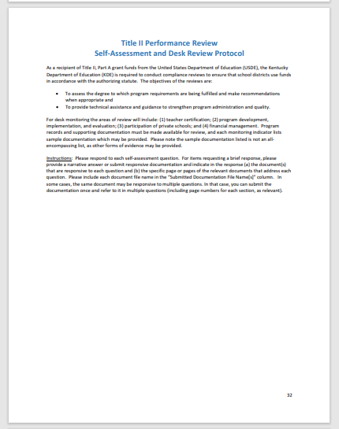
Title II, Part A Monitoring
Program monitoring is an opportunity for celebration and growth!
Desk Monitoring for Title II, Part A: October – December
Consolidated Monitoring: January – April
Teacher Certification
Program Development, Implementation, and Evaluation
Financial Management
Equitable Services

Slide 32
Monitoring Continued…
Teacher Certification
Are all teachers appropriately certified?
Are parents aware of how to request teacher qualification information?
Are parents notified when their child is taught 4+ weeks by a non-certified teacher? (is a PROCESS in place to ensure this is being monitored and implemented consistently?)*
Program Planning, Implementation, and Evaluation
Are Title II, Part A funded activities based on identified needs?
Is the implementation of activities consistent with the approved application?
How is the Title II, Part A program regularly being evaluated for effectiveness?
Financial Management
Do Title II, Part A expenditures align with MUNIS?
Equitable Services
Is there on-going two-way communication between the district and nonpublic schools?

Slide 33
Title II, Part A Suggested Timeline
Winter/Early Spring: Develop district needs assessment with input from all shareholders. Send participation letters to non-public schools.
Spring: Consult with participating non-public schools. Schedule regular times to meet with NPS administration for upcoming year.
Late Spring/Summer: Complete and submit budgets in GMAP application.
Summer: Districts with approved consolidated applications may begin spending new fiscal year funds in July. Schedule regular times to evaluate Title II, Part A spending and implementation for upcoming year.
Fall: Final allocations are uploaded into GMAP. KDE calculates and issues this to districts. Submit revised Title II, Part A budgets in GMAP. Check in with shareholders and NPS administrators; schedule regular times to review Title II, Part A expenditures with district finance officer.

Slide 34
GMAP
Support For Effective Instruction
Title II, Part A Personnel Details
Equitable Services for Private Schools
Budget
Help Pages

Slide 35
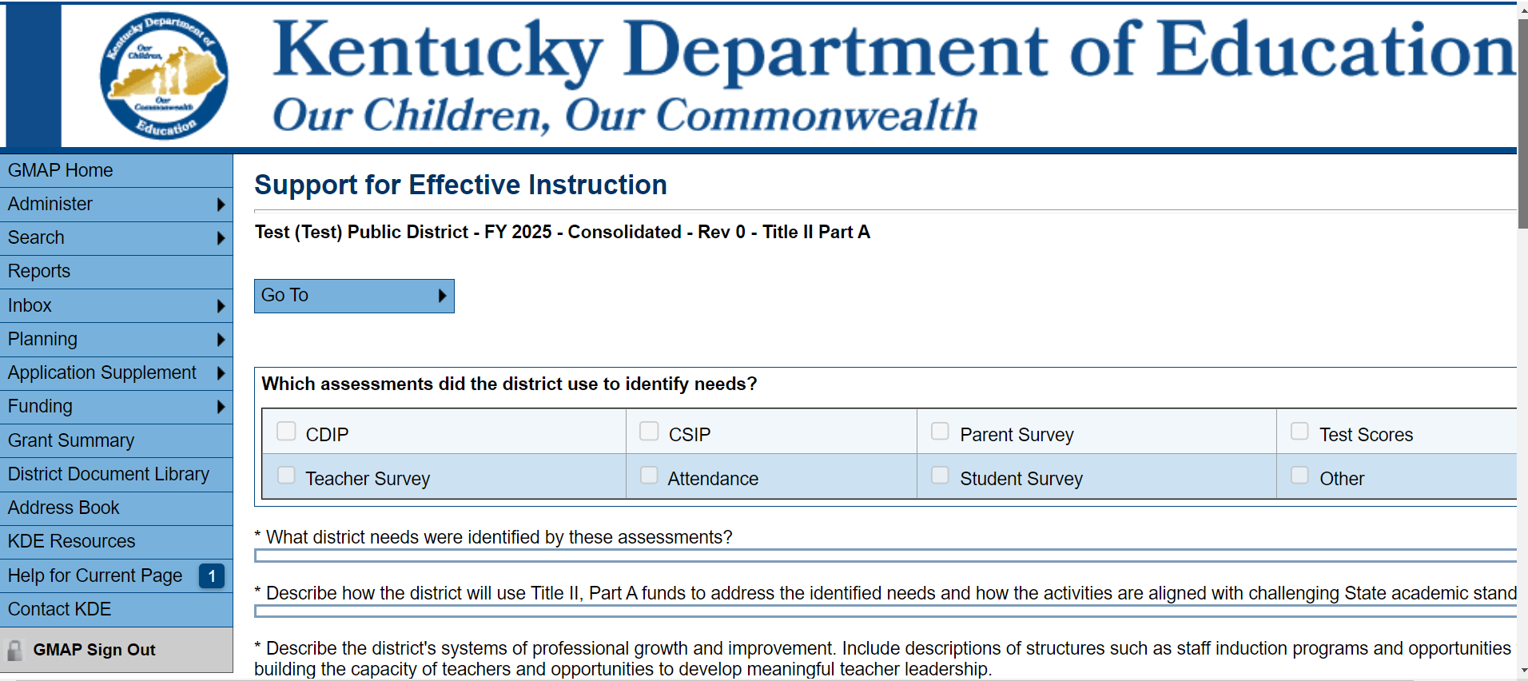
Support for Effective Instruction
What are the CURRENT identified needs of the district?
How will T2A funds be used to meet CURRENT district needs?
How will T2A funded activities be evaluated?

Slide 36
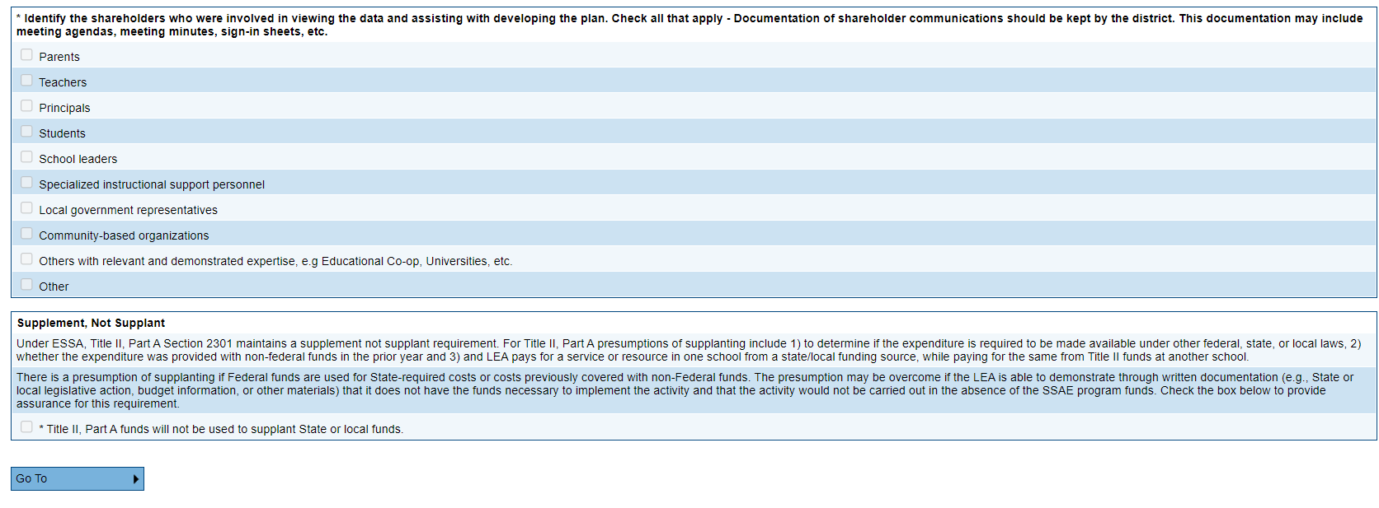
Support for Effective Instruction continued…
How are schools with the highest needs being prioritized?
Are ALL shareholders included in planning the T2A program?

Slide 37
Title II Personnel Details
If any district staff are not appropriately certified, how are they being supported?

Slide 38
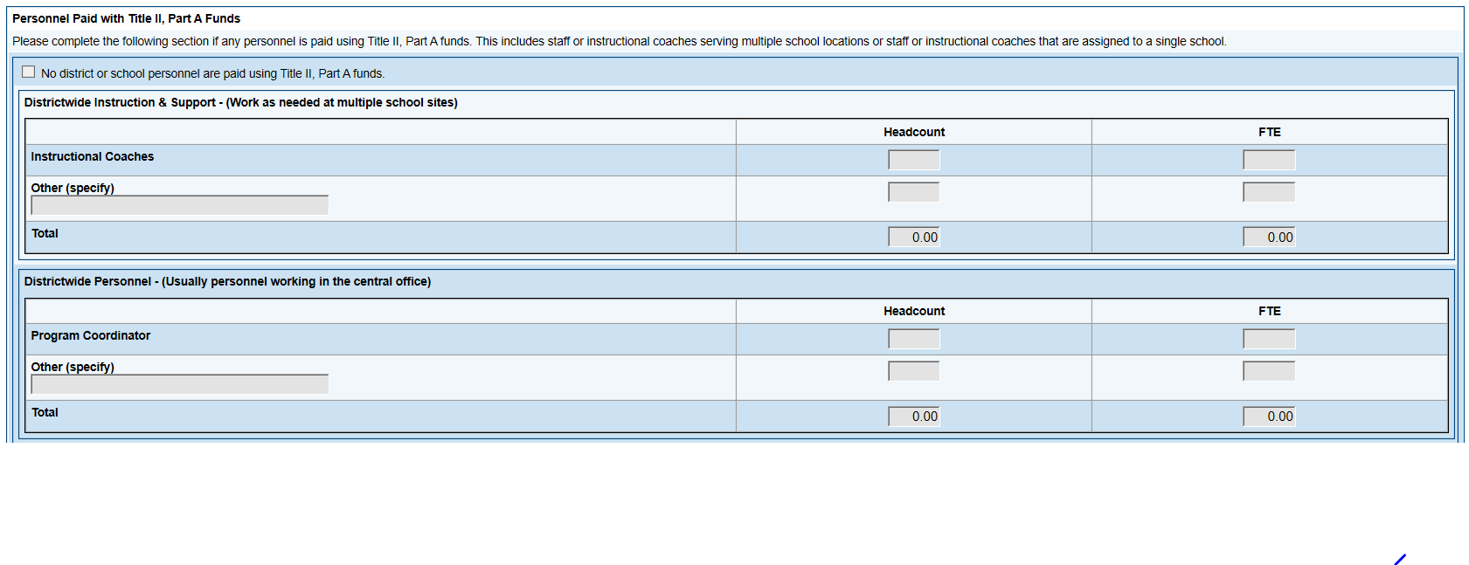
Title II-A Personnel Details continued…
Are salaries and FTEs reasonable?
Does the salary align with the work that is performed?

Slide 39
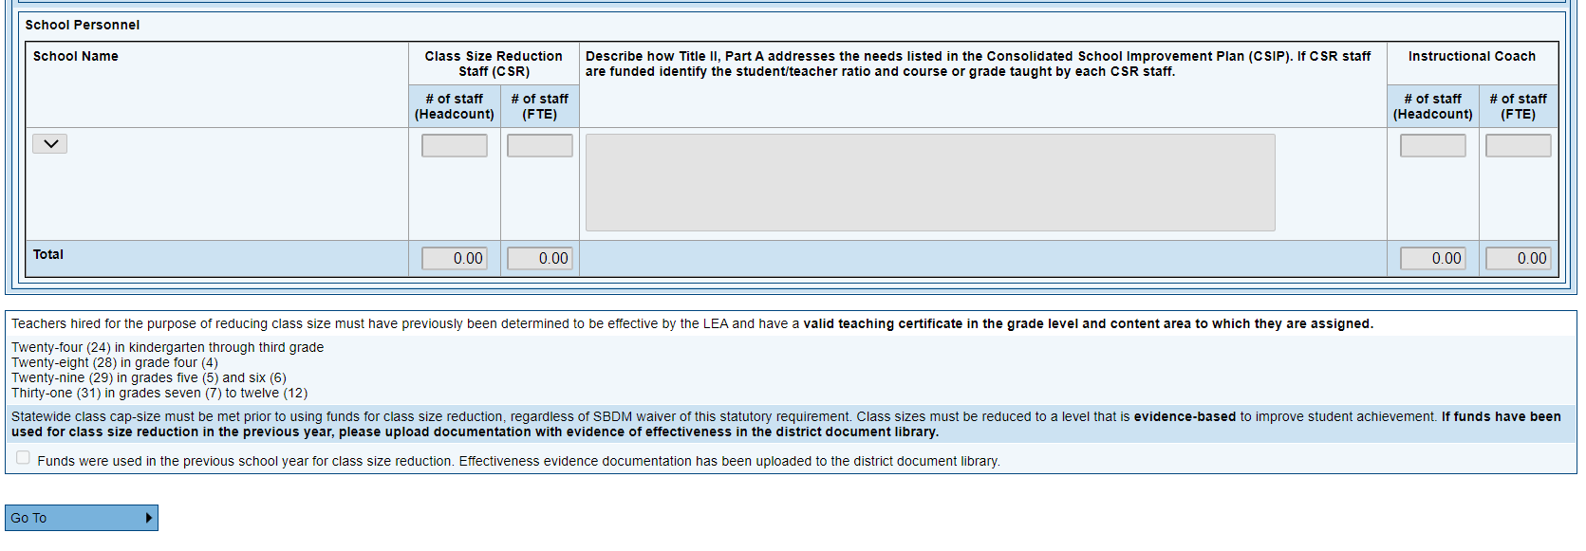
Title II-A Personnel Details continued
CSR staff considerations and assurances:
How does the use of CSR staff meet an identified need?
Is the student/teacher ratio reduced to an evidence-based level?
Does all CSR staff have appropriate certification?
Has effectiveness and staff assurance documentation been uploaded?

Slide 40
Equitable Services for Private Schools
If private schools/home schools are participating, has a consultation packet been uploaded?
Does the description of services align with the signed and dated consultation packet?

Slide 41
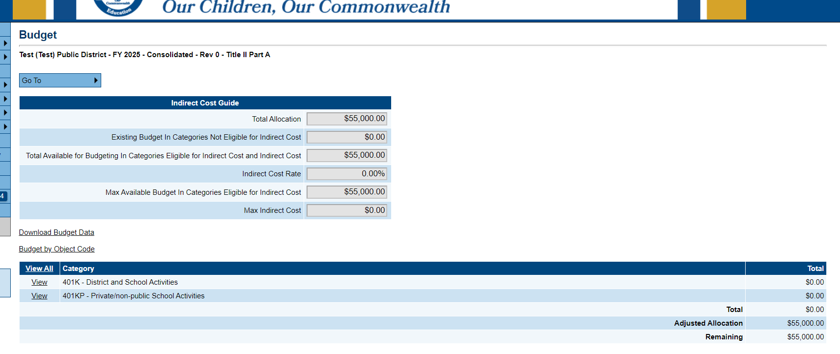
GMAP Budget Page

Slide 42
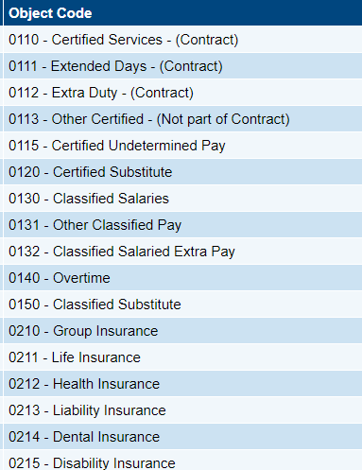
GMAP Budget Page/MUNIS Codes
Does the object code align with the expenditure?

Slide 43
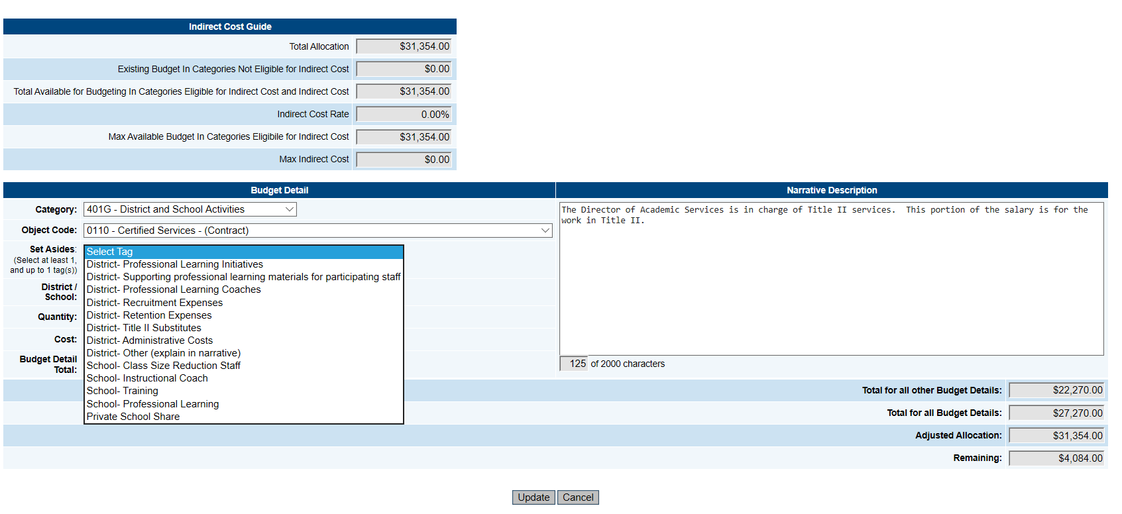
GMAP Budget Page Set Asides
Does the set-aside tag align with the expenditure?
Does the narrative clearly explain how the expenditure addresses an identified district need?

Slide 44
Budget Narratives…

Slide 45
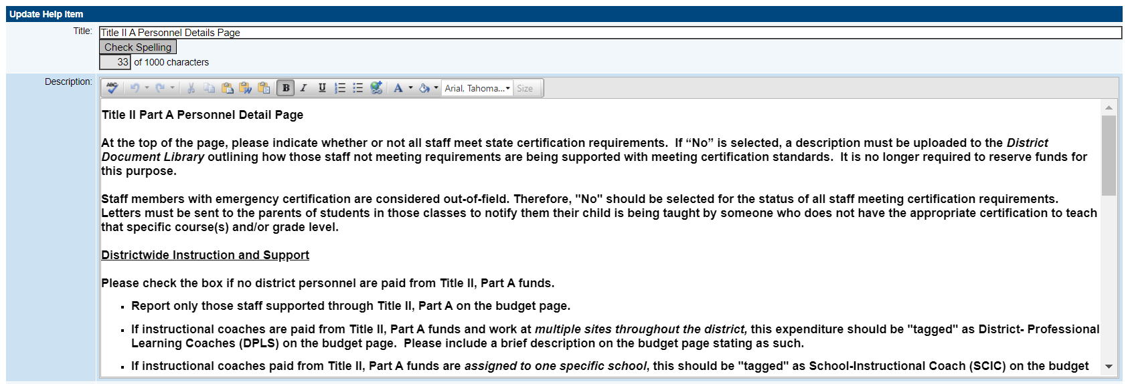
GMAP Help…

Slide 46
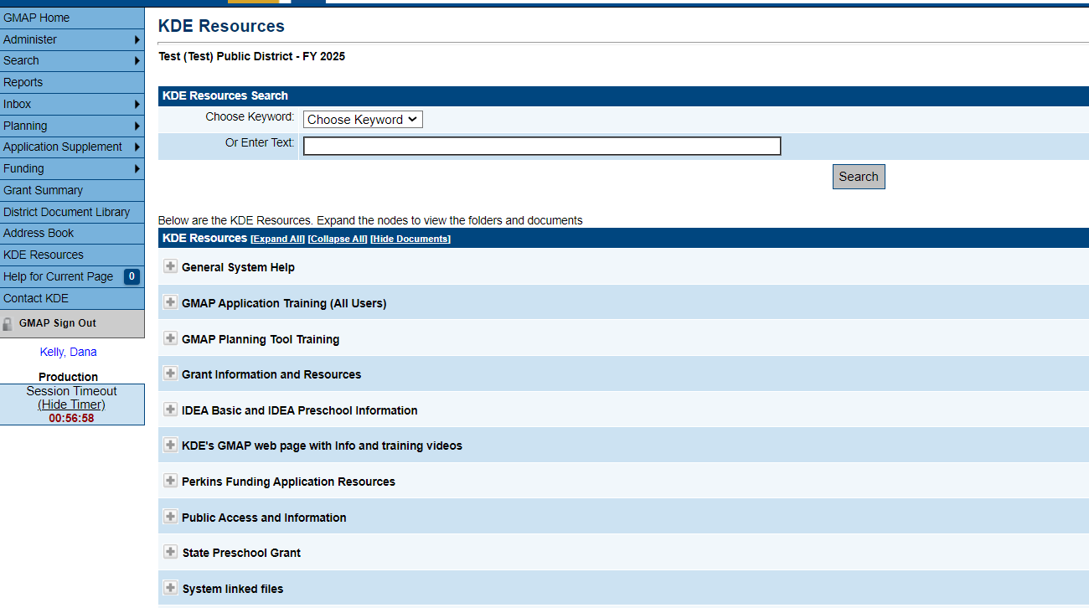
Grants Management Application Help Features

Slide 47
Title II, Part A GMAP Considerations
Has the application been completed based on the current needs of the district?
Do budget expenditures align with the identified needs of the district?
Do budget expenditures align with the CDIP/CSIP?
Do the budget narratives clearly explain the expenditure?
Are the expenditures budgeted in GMAP allowable under Title II, Part A?
Do the budget narratives align with the allowable codes?
Has collaboration occurred with the district finance officer?

Slide 48
Allowable Doesn’t Always Mean Approvable
Allowable
The most recent non-competitive federal funding matrix lists the object code as an allowable expense under the program.
Approvable
Reasonable – Not excessive in amount
Allocable – Meets the intent of the program
Necessary – Essential for carrying out the program
Documented – Supports an identified need and is included in the approved application

Slide 49
Common Application Revision Requests
Misalignment
Support for Effective Instruction details and Budget Page
Lack/Absence of Information
Class size reduction
Shareholder input
Equitable Services Packet
Requests for Unallowable Expenditures

Slide 50
Recommendations for Alignment
KDE recommends reviewing GMAP and MUNIS at least quarterly to ensure alignment and timely expenditure of funds.
Incorporate aligning expenditures into existing internal control processes and procedures.
Are funds being spent in a timely fashion?
Are funds being spent on approved expenditures?
If funds are not being spent on a particular item, is the district/school reevaluating the need for that item?

Slide 51
Title II, Part A Funds…
used to…
…help teachers and school leaders be more instructionally and professionally effective
…recruit, support, and retain effective staff to best meet student needs
…connect effective teachers with students who have the highest needs

Slide 52
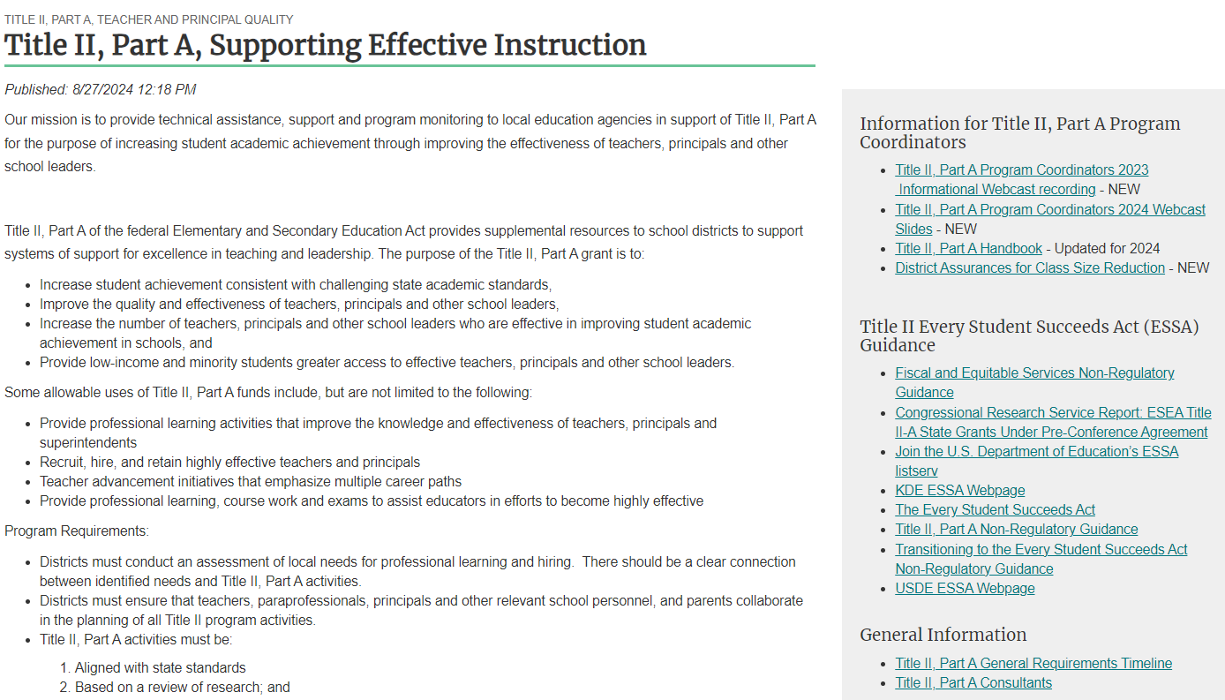
Title II, Part A Resources
Office of Elementary and Secondary Education (USDE)
Title II, Part A Webpage (KDE)

Slide 53
Title II, Part A Consultants
Jason.Howard@education.ky.gov
Dana.Kelly@education.ky.gov
Laura.McCullough@education.ky.gov
Sean.Murphy@education.ky.gov

