Slide 1
What do the KAS for Social Studies look like in practice?
A webinar designed to deepen social studies content knowledge and pedagogy.
Topic Focus: Kindergarten Economics

Slide 2
Webinar Goals
Learning Goal: To support your implementation of the KAS for Social Studies through experiencing a grade level example.
Success Criteria
I can analyze K.E.ST.1 to understand what this standard requires students to know and be able to do.
I can improve my content knowledge and pedagogical skills after exploring a grade level sample.

Slide 3
What Are Standards?
Standards define what students should know, understand and be able to do at the end of a grade level.
 | Definition
Know | Refers to facts, dates, places, people, definitions, rules, or information
Understand | Refers to theories, generalizations, or “big ideas”
Do | Refers to skills such as communication, reading, computation, application, and transfer to new situations

Slide 4
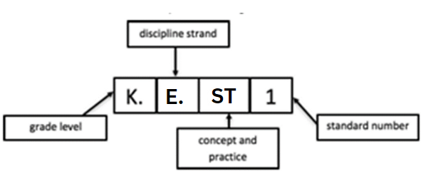
What Does it Mean to Unpack a Standard?
Breaking a standard into smaller, more explicit chunks for the purposes of curriculum development and/or unit and lesson planning.
K.E.ST.1 Demonstrate ways trade can be used to obtain goods and services.
Economics (E)
Microeconomics (MI)
Macroeconomics (MA)
Specialization, Trade and Interdependence (ST)
Incentives, Choices and Decision Making (IC)
Kentucky Economics (KE)
Civics (C) | Economics (E) | Geography (G) | History (H)

Slide 5
What Does It Mean to Unpack a Standard? (2)
Breaking a standard into smaller, more explicit chunks for the purposes of curriculum development and/or unit and lesson planning.
K.E.ST.1 Demonstrate ways trade can be used to obtain goods and services.
What does demonstrate mean in this standard?
Does it mean “make meaning of” or “transfer”?
Does it mean to “accurately state”, or does it mean to “support ideas with details and examples”?
What does the verb demand in terms of student learning?

Slide 6
When Unpacking a Standard, Ask a Series of Questions:
What knowledge will students need to demonstrate the intended learning?
What understandings will they need to master?
What skills will they need to apply to demonstrate mastery?
How might students demonstrate the requisite skills through learning experiences?

Slide 7
Tool to Unpack Standards
Step 1
Step 2
Step 4
Unpacking the Standard
Standard | What Knowledge/Concepts/ Vocabulary do students need to know to reach this standard? | What skills do students need to be able to do to reach this standard? | What level of proficiency do students need to be at in order to reach this standard?
Step 3

Slide 8
Step 1: List the Standards for Your Grade/Course
Copy the standard into the furthest left column of the spreadsheet.
Unpacking the Standard
Standard | What Knowledge/Concepts/ Vocabulary do students need to know to reach this standard? | What skills do students need to be able to do to reach this standard? | What level of proficiency do students need to be at in order to reach this standard?
K.E.ST.1 Demonstrate ways trade can be used to obtain goods and services.

Slide 9
Step 2: What Knowledge, Concepts, Vocabulary Will They Need to Master?
Closely look at each standard and identify the Knowledge/Concepts/Vocabulary
The “what” that students should learn
Unpacking the Standard
Standard | What Knowledge/Concepts/ Vocabulary do students need to know to reach this standard? | What skills do students need to be able to do to reach this standard? | What level of proficiency do students need to be at in order to reach this standard?
K.E.ST.1 Demonstrate ways trade can be used to obtain goods and services. | trade goods and services the relationship between goods and services

Slide 10
Step 2: What Knowledge, Concepts, Vocabulary Will They Need to Master? (2)
Teachers can use the disciplinary clarifications to determine the Knowledge/Concepts/Vocabulary.
The disciplinary clarifications for Kindergarten begin on page 27 of the KAS for Social Studies.
Concepts and Practices | Standard | Disciplinary Clarifications
E: Specialization, Trade and Interdependence | K.EST.1 Demonstrate ways trade can be used to obtain goods and services. | Sometimes a community does not have the resources or skills to produce all the goods and services needed. Therefore, they may trade a good or service they do have to another place in order to receive from that place a good or service they don’t have.

Slide 11
Step 2: What Knowledge, Concepts, Vocabulary Will They Need to Master? (3)
Unpacking the Standard
Standard | What Knowledge/Concepts/ Vocabulary do students need to know to reach this standard? | What skills do students need to be able to do to reach this standard? | What level of proficiency do students need to be at in order to reach this standard?
K.E.ST.1 Demonstrate ways trade can be used to obtain goods and services. | trade goods and services the relationship between goods and services resources and skills needs trading for things you need that you don’t have

Slide 12
Step 3: What Skills Will They Need to Master? (4)
Closely look at the standard and identify the skills
Skills include the thinking skills and mental processes that require skillful application of the knowledge to solve problems, make a decision, etc.
Unpacking the Standard
Standard | What Knowledge/Concepts/ Vocabulary do students need to know to reach this standard? | What skills do students need to be able to do to reach this standard? | What level of proficiency do students need to be at in order to reach this standard?
K.E.ST.1 Demonstrate ways trade can be used to obtain goods and services. | trade goods and services the relationship between goods and services resources and skills needs trading for things you need that you don’t have | Demonstrate

Slide 13
Step 4: What Level of Proficiency Do Students Need to Be at in Order to Reach This Standard?
Look at the standard and identify what level of proficiency students will need to be at in order to reach this standard.
One way to determine answers to this question is to look at the Depth of Knowledge.
Unpacking the Standard
Standard | What Knowledge/Concepts/ Vocabulary do students need to know to reach this standard? | What skills do students need to be able to do to reach this standard? | What level of proficiency do students need to be at in order to reach this standard?
K.E.ST.1 Demonstrate ways trade can be used to obtain goods and services. | trade goods and services the relationship between goods and services resources and skills needs trading for things you need that you don’t have | Demonstrate | 2

Slide 14
What do the KAS for Social Studies look like in practice?
Topic Focus: Grade 3 Kentucky Economics

Slide 15
The views expressed in the presentation are ours and are not the views of the Federal Reserve Bank of St. Louis or the Federal Reserve System.
Amanda Geiger
Federal Reserve Bank of St. Louis
Mary Clare Peate
Federal Reserve Bank of St. Louis

Slide 16
Disclaimer
The views expressed in this presentation are our own and do not reflect official positions of the Federal Reserve Bank of St. Louis or the Federal Reserve System.

Slide 17
K.E.ST.1 Demonstrate ways trade can be used to obtain goods and services.

Slide 18
Picture books

Slide 19
Why is trade helpful?

Slide 20
One Fine Day
Objectives
Students will be able to:
• define barter,
• identify what makes barter a unique form of trade, and
• explain the two main problems with barter as a form of trade.

Slide 21
One Fine Day

Slide 22
Questions
What problems did the fox have?
What did the fox do to get his tail back?
Was he able to get his tail back quickly/
Was it easy for him to get his tail back?

Slide 23
Conclusions about barter
Barter is time consuming. It would have been much easier if the fox could have used money. He could have bought the milk himself or have given the old woman money to buy the milk.
It can be difficult to find a person who is willing to barter. When the fox was on his journey, each person, animal, or thing wanted something the fox didn’t have. So he had to keep going, trading again and again. It would have been a lot easier if he could have used money to buy the milk.

Slide 24
One Fine Day

Slide 25
One Fine Day

Slide 26
Discussion
What problem did each group have?
What did members of each group have to do to get the materials?
Were you able to get all of the materials quickly?
Was it easy for you to get all the materials?
What could have made it easier/faster for you to get what you needed to complete the puzzle?

Slide 27
One Fine Day
+ Transfer

Slide 28
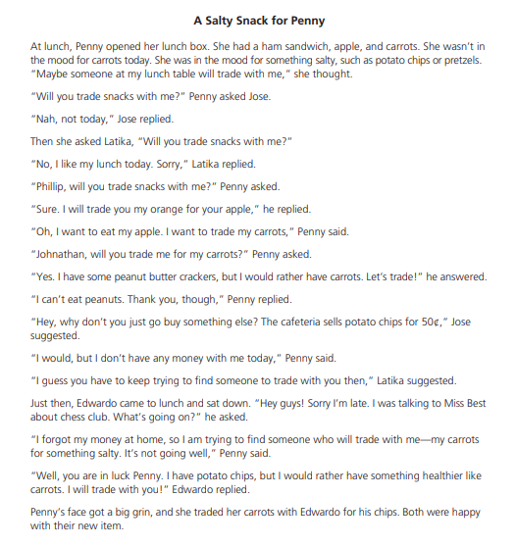
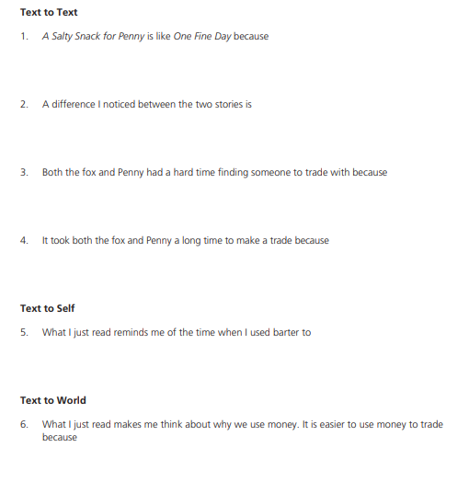
A Salty Snack for Penny

Slide 29
Why is trade helpful?

Slide 30
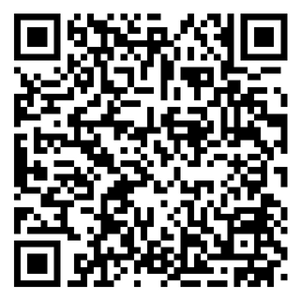
Explore Economics Video Series: The Perfect Breakfast

Slide 31
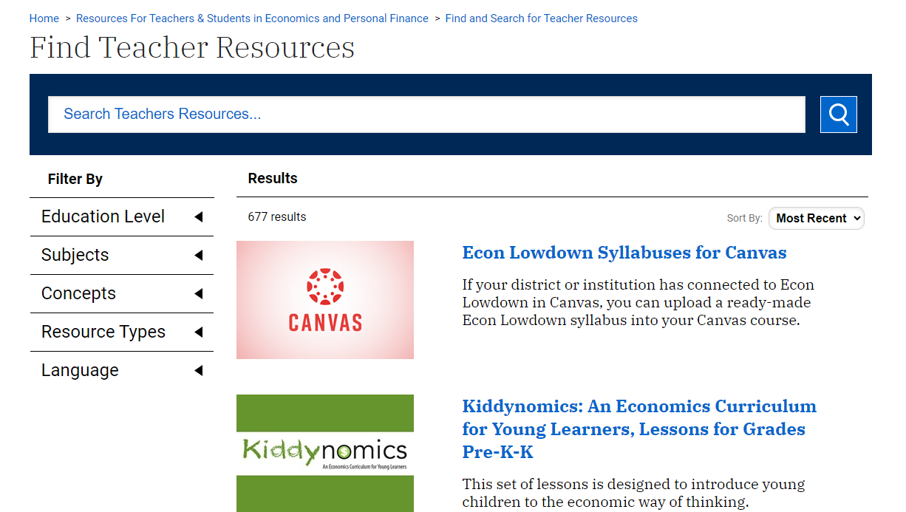
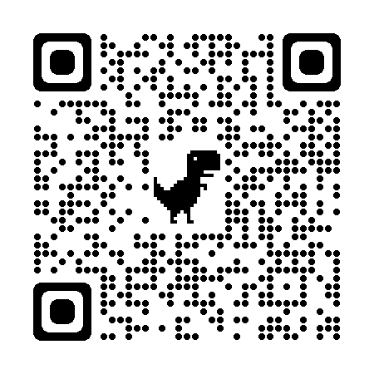
Where can you find more?
Stlouisfed.org/education

Slide 32
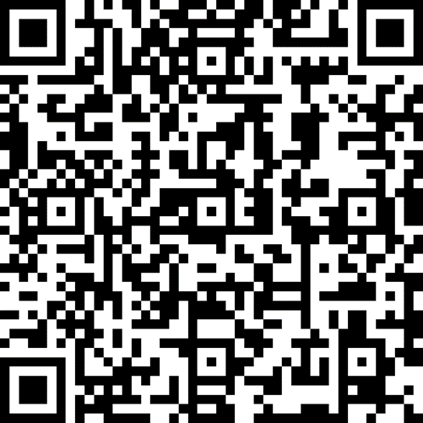
Learn about our other resources by signing up for our newsletter!

Slide 33
Reflection
Concepts and Practices | Standard | Disciplinary Clarifications
E: Specialization, Trade and Interdependence | K.EST.1 Demonstrate ways trade can be used to obtain goods and services. | Sometimes a community does not have the resources or skills to produce all the goods and services needed. Therefore, they may trade a good or service they do have to another place in order to receive from that place a good or service they don’t have.
Today’s webinar was designed to support you in experiencing what the KAS for Social Studies looks like in practice. Complete the Connect, Extend, Challenge strategy to reflect on how what you experienced will help students do social studies and demonstrate mastery of the standards.

Slide 34
Reflection (2)
Concepts and Practices | Standard | Disciplinary Clarifications
E: Specialization, Trade and Interdependence | K.EST.1 Demonstrate ways trade can be used to obtain goods and services. | Sometimes a community does not have the resources or skills to produce all the goods and services needed. Therefore, they may trade a good or service they do have to another place in order to receive from that place a good or service they don’t have.
Consider what you have just read, seen, or heard, and then ask yourself:
How are the ideas and information connected to what you already know?
What new ideas did you get that broadened your thinking or extended it in different directions?
What challenges or puzzles emerge for you?

