Slide 1
Performance Assessments in Social Studies
Module Five:
How do I build rubrics for performance assessments?
Notes:
Module Series Overview:
Performance Assessments in Social Studies module series is a set of five of modules designed to support teachers in implementing performance assessments in social studies classrooms to assess student mastery of the Kentucky Academic Standards (KAS) for Social Studies.
Performance Assessments in Social Studies module series is intended to support the successful implementation of the KAS for Social Studies in classrooms across the state. The duration of the module sections may be customized to accommodate local needs and conditions; however, it is important to engage with this module linearly as the first sections support educators in understanding the purpose of performance assessments in the bigger picture of assessing learning. The sections are designed to provide flexibility for districts and schools and, as such, can be viewed as stand-alone lessons or within the progression of the module as written. You are supported in engaging with this module individually, if desired.
Materials:
The following materials are needed for this section::
Notetaking Guide:
Additional materials, such as but not limited to, discussion strategies, etc. are provided within the notes section of applicable slides throughout the module.
Guiding Notes
Guiding notes are provided in the Notes section of the PowerPoint to support your learning. The information provided in the Notes section includes additional information, directions for the activities on the slide, and citations of used resources, where appropriate. It is critical that you read the material presented in the Notes section to ensure that you are acquiring the important knowledge, skills and understanding required when engaging with this module.
Virtual Training Note:
If you plan to engage with this module virtually as a group, consider directing participants to the Social Studies Professional Learning Modules page so that you may access the resources used directly from the links provided in the PowerPoint: https://kystandards.org/standards-resources/ss-resources/ss-pl-modules/
Additionally, you may consider downloading the resources contained within each section of the module and placing them into a Google folder for you or your colleagues to access.
Module Five: Compelling and Supporting Questions with Learning Goals and Success Criteria
Compelling Question: How do I implement performance assessments to assess student mastery of the KAS for Social Studies?
Supporting Question: How do I build rubrics for performance assessments?
Learning Target: I can implement performance assessments that evaluate student mastery of the KAS for Social Studies.
Success Criteria: I can create rubrics that evaluate performance assessments aligned to the KAS for Social Studies.
Intended Audiences:
Participants
Module participants may include, but are not limited to, district leadership, school administrators, instructional specialists/coaches, intervention specialists, department chairs, special educators and classroom teachers.
Facilitators:
This module series may be implemented with by a teacher individually or a group of educators led by a facilitator. If this module is being completed as a group, facilitators may include, but are not limited to, district leaders, school administrators, instructional specialists/coaches, intervention specialists, department chairs, special educators, and classroom teachers. Facilitators may need to revise specific tasks in order to meet the needs of the participants or to be respectful of the time planned within the work session.
Helpful Hint for Facilitators:
The learning that will take place in this module may cause Kentucky educators to face changes in instructional practices amidst this transition. It is important to realize that while you are the facilitator of these work sessions, you may not have all the answers to the questions asked by participants, and that is okay. Throughout the module, participants may have questions that will be addressed in future work sessions. When that happens, reflect on this quote from Graham Fletcher, “Every teachable moment doesn’t need to be a teachable moment in that moment.” Use these moments to encourage participants to attend future work sessions where those questions will be addressed. If participants ask questions you are not prepared to answer, offer to follow up on that during the next work session.
Planning Ahead for Facilitators:
Determine which stakeholders to invite as participants. In the invitation, describe how the work sessions will benefit them.
A few days before the meeting, you may want to remind participants to be prepared to have their documents available during the meeting. (See below for Participant Documents Needed.)
Reserve adequate space and equipment. Tables or desks should be set up to support small-group discussion. If conducting this module virtually, ensure that your technology platform can support break out rooms to support small group collaboration.
Ensure that participants have access to the Internet.
Consider how you might handle participants who may not be in attendance at all work sessions. It might be worthwhile to consider how those participants might access missed sections of the module between work sessions in order to feel as prepared as the other participants.
Preparation
Participant Documents Needed:
Plan ahead regarding how you will feel most comfortable engaging with the KAS for Social Studies, either:
A device with access to the KAS for Social Studies, or
A hard copy of the KAS for Social Studies
Additional documents needed include:
Notetaking Guide:
Supplies Needed:
• Computer with Module Five: How do I build rubrics for performance assessments?
• Technology with projection capability if in person. Technology platform where presenters have sharing ability and breakout room options if virtual.
• Copies of the handouts needed for the session either in hard copy format or available in a folder online. Links to the participant handouts needed for the session also may be built right into the agenda.
• Parking Lot for questions - If completing as a group, you may consider providing a poster on which participants can write or post questions, or you may prefer to have a digital parking lot where participants can access a Google document, for example, to post questions and that you can modify as the participants work through the sections of the module.
• Self-Sticking Notes (optional)
• Poster paper (optional)
• Highlighters and/or colored pens/markers (optional)
Building a Community:
Building a community is important for any group that will work together, especially if participants have not worked together before. The concept is the same as building a safe, respectful, productive classroom climate. Incorporating community-building into each session builds trust, shows participants that they are valuable as individuals and engages them in the learning process. It is also useful for creating a professional learning network where participants can be supported in their work. Community-building can be as simple as allowing participants to introduce themselves and their role in the school/district, developing or refining group norms, allowing for questions, and/or the sharing of answers to reflection questions or individual discovery task items that are included in this module. Again, time allotted for community-building will allow participants to have a voice and be engaged as active contributors and learners in the sessions.
Virtual Training Options: Be sure to conduct continual check-ins throughout the presentation. Build Google documents to continue to collect feedback, such as questions, hopes, and/or concerns to which participants may continually add.

Slide 2
Introduction
Compelling Question: How do I implement performance assessments to assess student mastery of the KAS for Social Studies?
Supporting Question: How do I build rubrics for performance assessments?
Learning Target: I can implement performance assessments that evaluate student mastery of the KAS for Social Studies.
Success Criteria: I can create rubrics that evaluate performance assessments aligned to the KAS for Social Studies.
Notes:
Guiding Notes:
Performance Assessments in Social Studies module series has five modules that build on one another to support a participant in answering the compelling question: How do I implement performance assessments to assess student mastery of the KAS for Social Studies? Participants will answer this question after completing the module series. Answering this question will support participants in meeting the Learning Target: I can implement performance assessments that evaluate student mastery of the KAS for Social Studies.
Each module within the module series supports a participant in answering a supporting question. At the conclusion of engaging with Module Five of this series, participants will answer the supporting question: “How do I build rubrics for performance assessments?”
Participants will meet the success criteria for Module Five when they can demonstrate the Success Criteria: I can create rubrics that evaluate performance assessments aligned to the KAS for Social Studies.
For more information on compelling questions, visit Section 3B: “What are Compelling Questions and how do students ask them?” from the Inquiry Practices module: https://education.ky.gov/curriculum/standards/kyacadstand/Documents/Inquiry_Practices_of_KAS_for_Social_Studies.pptx
For more information on supporting questions, visit “Section C: What are Supporting Questions, and how do students ask them?” from the Inquiry Practices module: https://education.ky.gov/curriculum/standards/kyacadstand/Documents/Inquiry_Practices_of_KAS_for_Social_Studies.pptx
For more information on Learning Goals and Success Criteria and their alignment to the KAS for Social Studies, visit Learning Goals, Success Criteria and the KAS for Social Studies: https://kystandards.org/standards-resources/ss-resources/learning-goals-success-criteria-and-the-kas-for-social-studies/

Slide 3
Overview of this module
The role of assessments in social studies is a linear process; therefore, it is important to go through the first sections in order to better understand the purpose of performance assessments in the bigger picture of assessing learning.
Module Five is focused on building rubrics for performance assessments..
Notes:
Guiding Notes:
Read the slide. This image shows the different sections of this module. Module Five is focused on building rubrics for performance assessments. This visual also outlines the processes and steps to better understand the purpose and role of assessment in social studies. It is a linear process – it is important to go through the first sections in order to better understand the purpose of performance assessments in the bigger picture of assessing learning.

Slide 4
Warm-Up
Previously, we learned about performance assessments:
What performance assessments are you currently using?
What is one concern you have about implementing performance assessments?
What is one topic, based on the KAS for Social Studies, for which you would like to create a performance assessment?
Notes:
Guiding Notes:
Think back to previous learning about the performance assessments in social studies and consider the questions on the slide. Capture your responses on your note catcher where it says Slide 4.

Slide 5
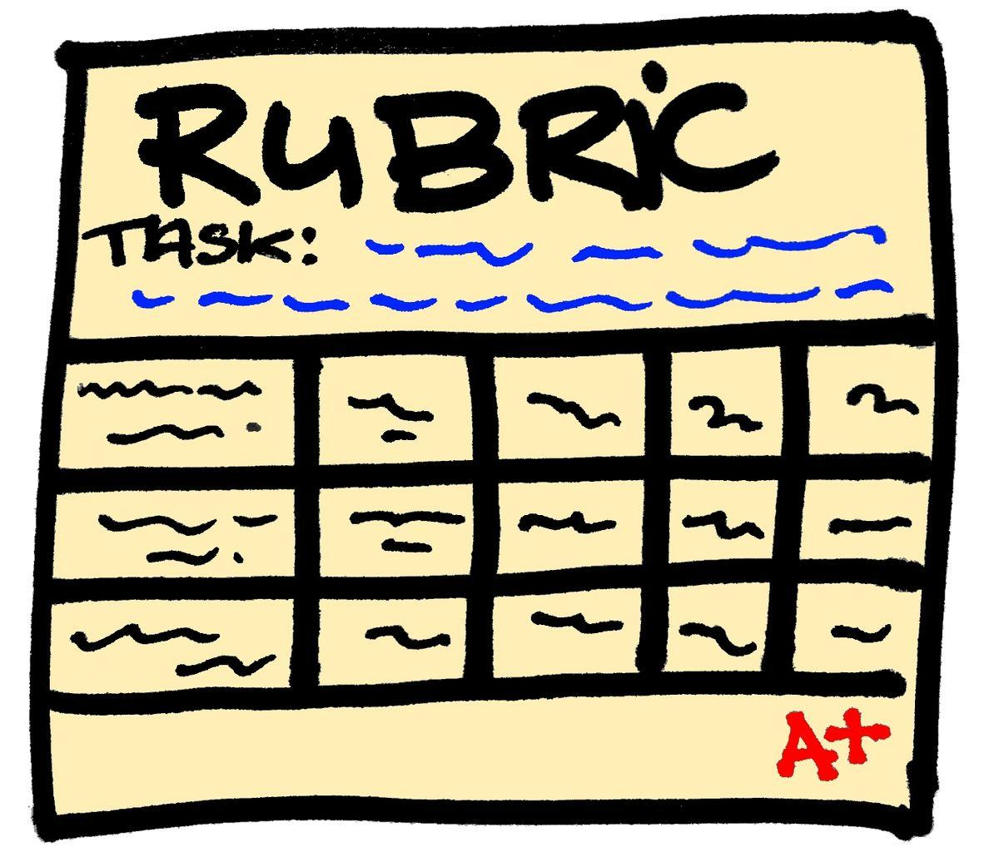
What Are Rubrics?
They provide:
a coherent set of criteria for students’ work that includes descriptions of levels of performance quality for the criteria.
details for each part of a performance assessment:
Scoring criteria
Behavioral descriptors for each score category (e.g., excellent to poor)
Effective rubrics identify the most important qualities of the work AND have clear descriptions of performance for each quality.
Notes:
Guiding Notes:
Read this slide outlining the purpose of rubrics. Remember: When using a rubric to assess student work, it is important to remember that you are trying to find the best description of the student work that you are assessing.

Slide 6
Why Use Rubrics? (2)
Rubrics can…
Help us to set anchor points along a quality continuum so that we can establish reasonable and appropriate expectations for learners and consistently judge how well they have met the expectations.
Provide feedback for students and teachers, including details about how to improve performance.
Allow students to understand what behavioral outcomes are expected.
Increase the reliability of an assessment by setting criteria that can be applied consistently and objectively.
Improve assessment validity.
Notes:
Guiding Notes:
Read the information provided in the slide. For participant clarity, behavioral outcomes are behaviors that can be observed, such as a student answering a question correctly/incorrectly and writing the answer down. It is important to note that when we consider how well a learner performed a speaking or writing task, we do not think of the performance as being right or wrong.

Slide 7
Why Use Rubrics? For Teachers and Students
For teachers:
Prompt a criterion-referenced assessment
Provide students with detailed and timely feedback
Encourage critical thinking
Facilitate communication with other individuals involved in scoring
Help to refine teaching skills and learning activities
For students:
Clarify the teacher’s expectations of student performance
Provide informative descriptions of expected performance
Help students to monitor and critique own work
Notes:
Guiding Notes:
Read through the slide. If you need more information on criterion referenced assessments, click on the link in the slide.
Resource:
University of Tasmania. Teaching & Learning: Criterion Referenced Assessment. https://www.teaching-learning.utas.edu.au/assessment/criterion-referenced-assessment#:~:text=Criterion%20referenced%20assessment%20(CRA)%20is,1998%3B%20Harvey%2C%202004).

Slide 8
Application: Evaluating a Rubric
Criteria | Advanced (4) | Proficient (3) | Emerging (2) | Not Yet or Missing (1)
3.E.ST.1: Describe examples of economic interdependence. | Menu item demonstrates understanding of economic interdependence. | Menu item shows limited understanding of economic interdependence. | Menu item shows inaccurate understanding of economic interdependence. | Menu item does not show an understanding of economic interdependence.
3.G.KGE.1: Describe the impact of cultural diffusion and blending on Kentucky in the past and today. | Menu item represents cultural diffusion and/or blending in Kentucky and the community. | Menu item shows limited representation of cultural diffusion and/or blending in Kentucky or the community. | Menu item shows inaccurate representation of cultural diffusion and/or blending in Kentucky or the community. | Menu item does not represent cultural diffusion and/or blending in Kentucky or the community.
3.I.UE.3: Construct responses to compelling and supporting questions about the interactions of diverse groups of people using evidence and reasoning. | Evidence and reasons from two or more sources is effectively used in the response to the compelling question. Evidence is accurately cited. | Evidence and reasons from two or more sources is used with limited errors in the response to the compelling question. Most evidence is accurately cited. | Evidence and reasons from one source is used with some errors in the response to the compelling question. Some evidence is accurately cited. | Evidence and reasons from sources contain significant errors or no sources are used in the response to the compelling question. Little to no evidence is accurately cited.
Does this rubric:
establish reasonable and appropriate expectations for learners?
provide feedback for students and teachers, including details about how to improve performance?
allow students to understand what behavioral outcomes are expected?
set criteria that can be applied consistently and objectively?
Notes:
Guiding Notes:
Read the slide and evaluate the rubric provided by answering the questions on the slide on your note catcher where it says Slide 8.
Note: The document provided also includes a sample performance assessment to provide context for the sample rubric. The sample rubric begins on page two.
Sample Rubric: https://education.ky.gov/curriculum/standards/kyacadstand/Documents/Sample_Task_and_Rubric_for_Evaluation.pdf

Slide 9
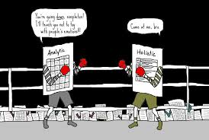
Reading- Know Your Terms: Holistic, Analytic and Single-Point Rubrics
Read the blog and underline the attributes of each type of rubric
Holistic
Analytic
Single-Point
Notes:
Guiding Notes:
Read through Know Your Terms: Holistic, Analytic, and Single-Point Rubrics and note the benefits and limitations of each on your note catcher where it says Slide 9.
Resource:
Gonzalez, Jennifer. (2014, May 1). Know Your Terms: Holistic, Analytic, and Single-Point Rubrics. Cult of Pedagogy. https://www.cultofpedagogy.com/holistic-analytic-single-point-rubrics/

Slide 10
Holistic Rubrics
A holistic rubric is the most general kind of rubric. It lists three to five levels of performance, along with a broad description of the characteristics that define each level.
Nitko (2001) states that use of holistic rubrics is probably more appropriate when performance assessments require students to create some sort of response and where there is no definitive correct answer.
Notes:
Guiding Notes:
Review the text on the slide and add any information to your note catcher for holistic rubrics that isn’t already captured in your notes.

Slide 11
Holistic Rubrics (2)
A single scale with all criteria to be included in the evaluation being considered together
Task Description:
Advantage:
Save time in developing and scoring
Disadvantage:
Do not provide specific feedback for improvement
 | Criteria
Level 5 | Overall description of Level 5
Level 4 | Overall description of Level 4
Level 3 | Overall description of Level 3
Level 2 | Overall description of Level 2
Level 1 | Overall description of Level 1
Notes:
Guiding Notes:
Review the information on the slide and add any information to your note catcher for holistic rubrics that isn’t already captured in your notes.

Slide 12
Analytic Rubrics…
break down the characteristics of an assignment into parts, allowing the scorer to itemize and define exactly what aspects are strong and which need improvement.
are usually preferred when a fairly focused type of response is required (Nitko, 2001)
result initially in several scores, followed by a summed total score; their use represents assessment on a multidimensional level (Mertler, 2001)
can cause the scoring process to be substantially slower; assessing several different skills or characteristics individually requires multiple reviews.
can be quite time consuming with both its construction and use.
Notes:
Guiding Notes:
Review the text on the slide and add any information to your note catcher for analytic rubrics that isn’t already captured in your notes.

Slide 13
Analytic (Descriptive) Rubrics
Task Description:
Components:
Task description
Assessment criteria
Performance levels
 | Criteria 1 | Criteria 2 | Criteria 3 | Criteria 4 | Total
Level 5
Level 4
Level 3
Level 2
Level 1
Advantage:
Provide judgment on each criterion
Disadvantage:
Time consuming to make
Notes:
Guiding Notes:
Review the information on the slide and add any information to your note catcher for analytic rubrics that isn’t already captured in your notes.

Slide 14
Single-Point Rubric
A single-point rubric is a lot like an analytic rubric because it breaks down the components of an assignment into different criteria.
“What makes it different is that it only describes the criteria for proficiency; it does not attempt to list all the ways a student could fall short, nor does it specify how a student could exceed expectations.”
Gonzalez, Jennifer. (May 1, 2014). Know Your Terms: Holistic, Analytic, and Single-Point Rubrics. Cult of Pedagogy. https://www.cultofpedagogy.com/holistic-analytic-single-point-rubrics/
Notes:
Guiding Notes:
Review the text on the slide and add any information to your note catcher for single-point rubrics that isn’t already captured in your notes.

Slide 15
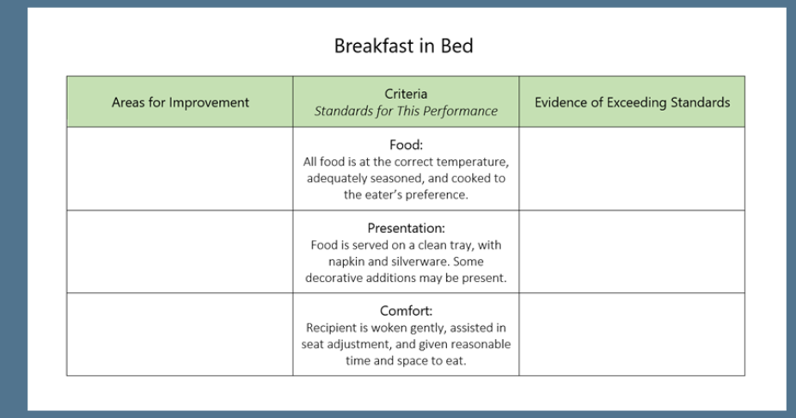
Single-Point Rubrics
Component:
Criteria
Advantage:
Allow for higher quality feedback, because teachers must specify key problem areas and notable areas of excellence for that particular student, rather than choosing from a list of generic descriptions
Disadvantage:
Require more writing on the teacher’s part
Notes:
Guiding Notes:
Review the text on the slide and add any information to your note catcher for single-point rubrics that isn’t already captured in your notes.

Slide 16
Which Rubric to Use?
Consider the purpose of the assessment:
How will results be used?
If a summative score is desired, a holistic scoring approach would be more desirable.
If formative feedback is the goal, an analytic or single-point scoring rubric should be used.
It is important to note that one type of rubric is not inherently better than another type; you must find a format that works best for your purposes (Montgomery, 2001).
Notes:
Guiding Notes:
Review when to use each rubric and answer the question “What determines the rubric type you should use when evaluating student work for your performance assessment? ” on your note catcher.

Slide 17
Identifying a Rubric for your Performance Assessment
Identify the Performance Assessment you will use to create your rubric.
List the goals of the Performance Assessment.
Group and label the learning goal and success criteria of the Performance Assessment.
Identify a rubric format that measures the learning goal and success criteria of the Performance Assessment.
Notes:
Guiding Notes:
Complete the steps on the screen to identity the rubric type needed for the performance assessment you created in Module Four. Pick the rubric type that best fits the task and will provide the most helpful feedback to students to enhance the learning process and facilitate student success on the task.

Slide 18
Next Steps: Rubric for your Performance Assessment
Create a rubric for the Performance Assessment.
Evaluate the rubric using the SCALE Quality Rubric Checklist and make any adjustments needed.
Notes:
Guiding Notes:
Now that you have identified the rubric type needed for your performance assessment, create a rubric for your performance assessment. Once your rubric is complete, evaluate it using the SCALE Quality Rubric Checklist and make adjustments, if needed.
Resource:
The Board of Trustees of the Leland Stanford University (​2017).​ SCALE​ ​ Checklist​ ​ for​ ​ Quality​ ​ Rubric​ ​ Design​ ​ was​ ​ authored​ ​ by​ ​ Stanford Center​ ​ for​ ​ Assessment,​ ​ Learning,​ ​ &​ ​ Equity​ ​ (SCALE). https://performanceassessmentresourcebank.org/system/files/SCALE%20Quality%20Rubric%20Checklist.docx.pdf

Slide 19
Performance Assessments in Social Studies2
Module Five:
How do I build rubrics for performance assessments?
Notes:
Guiding Notes:
This concludes Module Five.
The KDE needs your feedback on the effectiveness of this module, the learning platform and how the consultants may best support you as you take the next steps in the implementation process. Complete a short survey to share our thinking and provide them with feedback on how the KDE can best meet our needs. Feedback from our surveys will be used by the KDE to plan and prepare future professional learning.
Post-survey: https://docs.google.com/forms/d/e/1FAIpQLSd5pVVdKiDLKxM4wKq46V2JcO7UTMtFk8ELVR31du6HTO2Szg/viewform

