Slide 1
No Bake Playdough Introduction
Kentucky Family Math Night Game
No-Bake Playdough
Recommended for Grades K-2
This game will help your student build up the right amount of ingredients for a playdough recipe by using smaller measuring tools and generating equivalent fractions.
Kentucky Academic Standards for Mathematics Connections:
Kindergarten Measurement and Data
KY.K.MD.2 Directly compare two objects with a measurable attribute in common, to see which object has “more of”/ “less of” the attribute and describe the difference.
Second Grade Measurement and Data
KY.2.G.3 Partition circles and rectangles into two, three, or four equal shares; describe the shares using the words halves, thirds, half of, a third of, etc.; and describe the whole as two halves, three thirds, four fourths. Recognize that equal shares of identical wholes need not have the same shape.
First Grade Measurement and Data
KY.1.G.3 Partition circles and rectangles into two and four equal shares, describe the shares using the words halves, fourths and quarters, and use the phrases half of, fourth of and quarter of. Describe the whole as two of or four of the shares. Understand for these examples that decomposing into more equal shares creates smaller shares.
Standards for Mathematical Practice
MP.1 Make sense of problems and persevere in solving them.
MP.5 Use appropriate tools strategically. MP.6 Attend to precision.
MP.8 Look for and express regularity in repeated reasoning

Slide 2
No-Bake Playdough - Instructions
No-Bake Playdough – Instructions
Players: Two or more players
Goal: Use the correct ingredients for their playdough recipes, by using measuring tools
Ingredients
Recipe Instructions

Slide 3
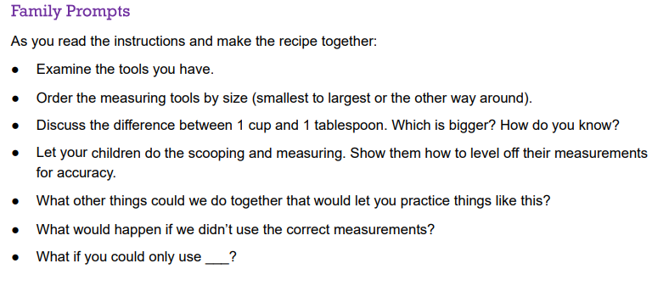
No-Bake Playdough – Family Prompts
No-Bake Playdough – Family Prompts
Ask any of the following questions as you play the game.

Slide 4
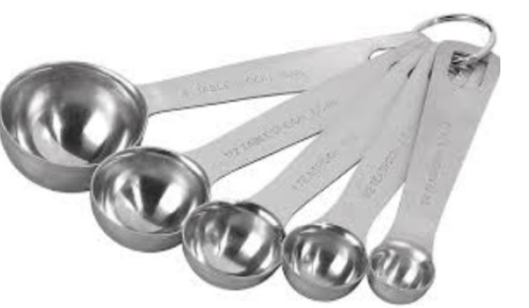
No-Bake Playdough – Measuring Spoons
No-Bake Playdough – Measuring Spoons
Family Prompts
As you read the instructions and make the recipe together:
Examine the tools you have.
Order the measuring tools by size (smallest to largest or the other way around).
Discuss the difference between 1 cup and 1 tablespoon. Which is bigger? How do you know?

Slide 5
No-Bake Playdough – Measuring
No-Bake Playdough – Measuring
Family Prompts
Let your children do the scooping and measuring. Show them how to level off their measurements for accuracy.
What other things could we do together that would let you practice things like this?
What would happen if we didn’t use the correct measurements?
What if you could only use ___?

Slide 6
No-Bake Playdough – Closing Slide
Kentucky Family Math Night Games
No-Bake Playdough
Thank you for playing!
Access more digital family math games at: https://www.education.ky.gov/curriculum/conpro/Pages/summer_support_math_resources.aspx

