Slide 1
Reinforcing Vocabulary Across Lessons/Texts
SESSION 11
STUDENT PROGRESS
1
Notes:
Session Summary: During this final session, teachers will engage in student work analysis to identify evidence of student progress toward goals and to suggest instructional next steps. Following the analysis, teachers will share feedback in order to prepare for individual or co-teaching team planning. Finally, teachers will have the opportunity to plan strategically in response to the analyzed data to ensure that all students demonstrate progress toward the overall intended learning.
Session Length: 90 minutes

Slide 2
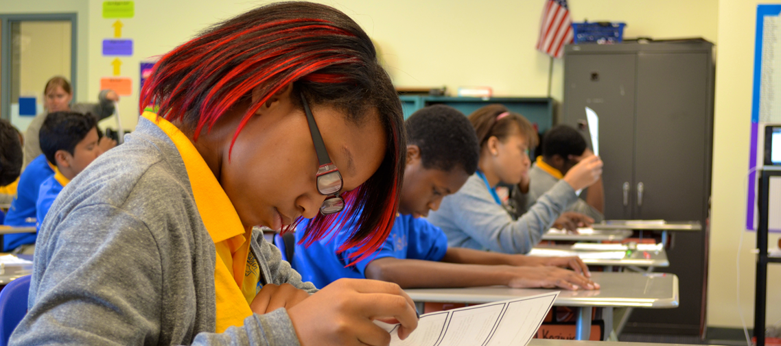
Do Now
ACADEMIC VOCABULARY SESSION 11
Think of one success you have had reinforcing vocabulary in your instruction. What was it? Why was it successful?
As you reflect on this experience, share a positive take-away with a partner.
2
Notes:
Do Now (3 min):
“Think of one success you have had in reinforcing vocabulary in your instruction. What was it? Why was it successful?”
1 min: Jot reflection on handout
2 min: Share with partner

Slide 3
Content Cycle Overview
Session | Type of Learning | Focus Area
1 | Shared Learning | Introduction to Vocabulary and Why It Matters
2 | Shared Learning | Implicit Vocabulary Instruction
3 | Planning & Practice | Implicit Vocabulary Instruction
4 | Shared Learning | Explicit Vocabulary Instruction
5 | Planning & Practice | Explicit Vocabulary Instruction
6 | Student Progress | Implicit and Explicit Vocabulary Instruction
7 | Shared Learning | Text Sets
8 | Planning & Practice | Text Sets
9 | Shared Learning | Maintaining & Extending Vocabulary
10 | Planning & Practice | Maintaining & Extending Vocabulary
11 | Student Progress | Text Sets, Implicit and Explicit Vocabulary
Notes:
Cycle Overview (1 min)
It’s our final session! Review the concepts covered in previous sessions.

Slide 4
Objectives
ACADEMIC VOCABULARY SESSION 11
Agenda
01. Identify strengths and gaps in student outcomes for all students
02. Prioritize instructional next steps to accelerate learning for all students
01. Welcome
02. Examining Student Work
03. Responding to Student Work
04: Enduring Understandings
05. Closing
4
Notes:
Session Objectives and Agenda (1 min)
Framing (1 min) “This final week, we’ll explore connections between our learning about how to effectively approach vocabulary instruction and our students’ growth. To do this, we’ll conduct student work analysis to analyze our instructional effectiveness through the lens of student outcomes on a learning task. As we uncover trends of growth and need, we’ll plan for instructional next steps that will support students in achieving learning targets.”

Slide 5
Preparing for Student Work Analysis
Gather the following:
ACADEMIC VOCABULARY SESSION 11
Exemplar student response completed for pre-work
The learning task and intended student outcome for the work
Sub-group student samples
The rubric/checklist you will use to assess proficiency
5
Notes:
Preparing for the Protocol (5 min)
Framing: “As we prepare for our student work analysis protocol today, take a moment to assemble the following materials:
The exemplar student response you completed for pre-work
The learning task and intended student outcome for the student work
Sub-group student work samples
The rubric/checklist you will use to examine the student work for proficiency.”
Teachers should locate a partner, ideally one who teaches the same grade. Other possible configurations: vertical grade partners, co-teachers, etc.

Slide 6
Examining Student Work
Protocol:
ACADEMIC VOCABULARY SESSION 11
Look Fors:
In analysis, teacher identifies 1-2 specific strengths for class and/or priority students, aligned to foundational skills standards taught
In analysis, teacher identifies 1-2 specific areas of growth for class and/or priority students, aligned to foundational skills standards taught
Teacher identifies next steps (including materials, type of support, which students, and dates) for addressing student needs determined by data
15 min: Analyze Partner 1 samples
Partner 1 shares intended outcome and exemplar student response.
Together, partners examine and annotate the student work.
Together, partners identify evidence of strength, growth, trends, and next steps on the student work analysis form.
15 min: Repeat for Partner 2
6
Notes:
Examining Student Work (30 minutes total; 15 minutes/partner)
For the following steps, assign one partner as the first presenter and then repeat the steps with the second partner presenting.
Intended Outcome & Exemplar Student Response: The presenting partner will share the intended outcome and exemplar student response for the learning task that was completed for pre-work.
Examine Student work (Sub-Group): Together, teachers will examine, and annotate the student work.
Identify Evidence and Instructional Next Steps: Teachers will identify evidence of students’ ability to meet the identified learning outcome aligned to the rubric/checklist and individual student goals, jotting evidence of strengths, areas of growth, and instructional next steps on a Capture Sheet.
*After 15 minutes, repeat process with other partner’s student work.

Slide 7
Considering Implications
Reflect individually:
ACADEMIC VOCABULARY SESSION 11
Look-For
Questions and tasks focus on academic or domain-specific words that are most likely to be encountered again in the future or are most critical for comprehending the text
Overall, what strengths and gaps did you observe in your students’ work?
Considering our content cycle look-fors, how might planning and practice have contributed to the strengths and areas for growth?
Where are the tracks of your vocabulary instruction most evident?
How can you transfer what you learned about the impact of vocabulary instruction from your sub-group of students to the larger class?
7
Notes:
Considering Implications (5 minutes)
Reflect Individually: Consider the following questions:
Overall, what strengths and gaps did you observe in your students’ work?
Considering our content cycle look-fors, how might planning and practice have contributed to the strengths and areas for growth?
Where are the tracks of your vocabulary instruction most evident?
How can you transfer what you learned from your sub-group of students to the larger class?

Slide 8
Enduring Understandings
ACADEMIC VOCABULARY
SESSION 11
Cycle Review
Selecting words
Implicit instruction
Explicit instruction
Text sets
Reinforcing vocabulary
For each of the five concepts we have explored, generate one key takeaway
Round 1: Write one takeaway on each poster.
Round 2: Read others’ takeaways. Respond in kind.
8
Notes:
Reflecting on the Entire Content Cycle (18 minutes)
[Have charts with headings prepared]
2 min: Framing: In our final session, it’s time to think about the impact of all that we have learned together. For each of the five areas we explored -- selecting words, implicit instruction, explicit instruction, text sets, and reinforcing vocabulary -- share one takeaway that will continue to inform your practice. What is it that you will ultimately hold on to with each concept?
To share our thoughts, we will add takeaways to the five charts around the room in a modified Write Around protocol.
7 min: Round 1: Find a chart at which to start. Make sure you have a marker. Jot your takeaway and move clockwise around the room.
[When everyone has had a chance to respond to all 5 -- about 7 min -- shift to Round 2]
7 min: Now, return to the charts and read what your colleagues have shared. You may respond in a variety of ways -- adding more, agreeing, disagreeing, reinforcing, connecting, etc. The idea is to have a conversation in writing.
2 min: Final walk: Read any comments you haven’t yet seen

Slide 9
Closing
Final Reflection:
Consider the learning you have experienced this cycle, and reflect on the impact of vocabulary instruction.
Share with the frame: I used to...but now I…
Notes:
Final Reflection (10 minutes)
Ask participants to close the cycle by reflecting on how vocabulary propels student achievement
Using the “I used to...but now I…” frame, conduct a whip share to hear from all participants
Thank participants for their work and commitment to students!

