Slide 1
Battleship – Introduction Slide
Kentucky Family Math Night Game
Battleship
Recommended for Grade 5
This game will help your student practice plotting points in the first quadrant of the coordinate plane and naming coordinates of points.
Kentucky Academic Standards for Mathematics Connections:
Fifth Grade Geometry
KY.5.G.1 Use a pair perpendicular number lines, called axes, to define a coordinate system, with the intersection of the lines (the origin) arranged to coincide with the 0 on each line and a given point in the plane located by using an ordered pair of numbers, called its coordinates. Understand that the first number indicates how far to travel from the origin in the direction of one axis and the second number indicates how far to travel in the direction of the second.
Standards for Mathematical Practice
MP.2 Reason abstractly and quantitatively.
MP.6 Attend to precision

Slide 2
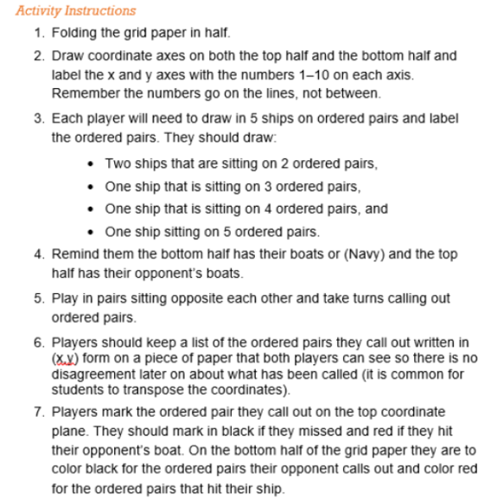
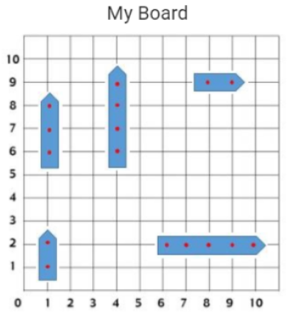
Battleship-Instructions
Battleship Instructions
Players: Two players
Goal: Sink your opponent's ships.

Slide 3
Battleship – Family Prompts
Battleship Family Prompts
Ask any of the following questions as you play the game.

Slide 4
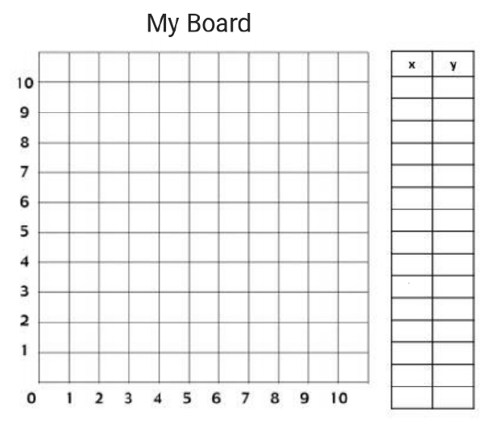
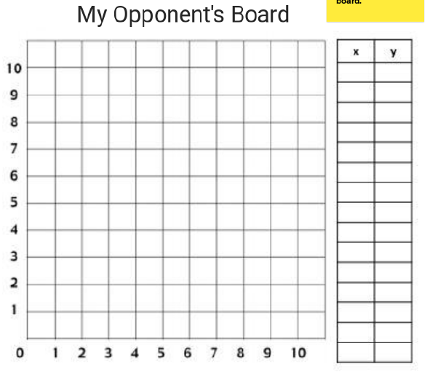
Battleship Game Board 1
Battleship Game
Place your 5 boats on your Board. Check mark ✓ the intersections that are hits!
X out intersections that are misses.
You want to make notes of hits and misses.
Use this board to record the hits and misses on your opponent’s board.
Family Prompts
When you plot your points how do you use the x-and y-axis?
What would happen if you and your opponent didn’t have a standard rule for calling out your points?

Slide 5
Battleship Game Board 2
Battleship Game
Place your 5 boats on your Board. Check mark ✓ the intersections that are hits!
X out intersections that are misses.
You want to make notes of hits and misses.
Use this board to record the hits and misses on your opponent’s board.
Family Prompts
How did you choose your coordinates? Was there a strategy you used to place your “battleships” ?
Was there a strategy you used to select the coordinates you guessed for your opponent’s “battleships”?

Slide 6
Battleship Game Board 3
Battleship Game
Place your 5 boats on your Board. Check mark ✓ the intersections that are hits!
X out intersections that are misses.
You want to make notes of hits and misses.
Use this board to record the hits and misses on your opponent’s board.
Family Prompts
Do you want to play again?
Did you try a method for guessing that did not work? Why didn’t it work?
Would it ever work? Why or why not?

Slide 7
Battleship Game Board 4
Battleship Game
Place your 5 boats on your Board. Check mark ✓ the intersections that are hits!
X out intersections that are misses.
You want to make notes of hits and misses.
Use this board to record the hits and misses on your opponent’s board.
Family Prompts
Can you give an example of how we use coordinates like this other than when playing Battleship?

Slide 8
Battleship – Closing Slide
Kentucky Family Math Night Games
Battleship
Thank you for playing!
Access more digital family math games at: https://www.education.ky.gov/curriculum/conpro/Pages/summer_support_math_resources.aspx

