Slide 1
Integrating Deeper Learning and HQIRs to Strengthen Tier 1 Instruction
Priming for Learning
Notes:
Hello everyone, and welcome to the first module of a four-module series to support “Integrating Deeper Learning and HQIRs to Strengthen Tier 1 Instruction.” This module will focus on the learning science-based stage of Priming for Learning. My name is Fox DeMoisey. I am joined today by Misty Higgins, and we are professional learning coordinators in the Division of Program Standards, Office of Teaching and Learning, at the Kentucky Department of Education.

Slide 2
Module Purpose
Module Objectives:
Build understanding of “priming for learning” and associated findings from learning science.
Explore indicators of priming for learning using examples from HQIRs.
Consider deeper learning practices to support potential adjustments to a HQIR.
Notes:
This module has three primary objectives:
Build understanding of “priming for learning” and associated findings from learning science;
Explore indicators of priming for learning using examples from HQIRs; and
Consider deeper learning practices to support potential adjustments to a HQIR.
Our intention is that the information within this session and accompanying curriculum analysis and adjustment tool provided at the end will enable districts to assess where an adopted HQIR is strong, foundationally and also with regard to characteristics of deeper learning, through the lens of learning science, and where it might need “smart adjustments” of the kind certain deeper learning practices can provide in order to more fully afford all students vibrant learning experiences and improved academic outcomes.
Moving into the module now, our first objective is “Build understanding of ‘priming for learning’ and associated findings from learning science.”

Slide 3
Phases of Learning
Notes:
The introductory document that frames this series—and there is a link back to it provided here in the speaking notes—shared how education leaders such as John Hattie, Doug Fisher and Nancy Frey have found it useful to divide the learning process into three phases: surface, deep and transfer (Hattie, et.al., 2017). The introduction then offered that core principles from learning science can also be laid out across a series of similar phases, adding an emphasis on “priming” for learning (Goodwin & Rouleau, 2023). The visual on the slide is figure 1.2 in that introduction, with the first stage enlarged here to signal the focus of this initial module, Priming for Learning. It is important to note these phases are not perfectly linear or distinct. Aspects of one phase may naturally occur in another, and there may be some movement back and forth between them.
Link: https://education.ky.gov/curriculum/standards/kyacadstand/Documents/Integrating_HQIRs_and_Deeper_Learning_to_Strengthen_Tier_1_Instruction.pdf

Slide 4
Priming for Learning
Occurs when curiosity is sparked and initial student interest, cognitive and emotional, is generated. Students connecting to meaning and purpose supports motivation to set goals and commit to the work of learning and mastery.
In priming for learning, students must:
Become Interested (cognitively, emotionally)
Commit to Learning
Notes:
The stage of priming for learning is driven by a need to trigger two key aspects of learning in students’ minds, curiosity and motivation, in order for new information to then pass through the filters of their sensory registers and enter immediate memory. Therefore, and to begin to establish a definition for it, priming for learning occurs when curiosity is sparked and initial student interest, cognitive and emotional, is generated. Cognitive science shows us that, neurobiologically, we can’t learn about what we don’t care about, or put another way, “we feel, therefore we learn” [Immordino-Yang, M. H., & Damasio, A., 2007).
Once curiosity, a feeling, is sparked and interest is generated, having students connect to meaning and purpose supports motivation to set goals and to commit to the work of learning and mastery.

Slide 5
Rationale From Research
Why Priming for Learning Matters
Notes:
Now, we want to look at findings from research to better understand why priming for learning matters. We will start by focusing on the specific findings around helping students become interested and then look at the research on helping them commit to learning. On each of the following slides, citations for the research that is referenced can be found in the slide notes for further exploration.

Slide 6
Become Interested: Big Picture
For learning to occur, new learning must first cut through the clutter of students’ sensory registers and the constant churn of internal emotions, ideas and thoughts they bring to the classroom¹
The brain’s filtering process reflects a pecking order:¹
Emotional Valence – brain pays attention first to stimuli that stir strong emotions
Novelty – brain also pays attention to new and dynamic objects, people and ideas in our environment
Curiosity – brain is next drawn to perplexing stimuli in the environment that fills a person with wonder or contradicts expectations
*References included in the slide notes.
Notes:
Let’s start with looking at the big picture around becoming interested. Our brains are constantly bombarded with stimuli from the environment, so for learning to occur, it must first cut through all the clutter coming into the students’ sensory register, as well as all that’s going on in their brain they bring with them into the classroom.
Essentially, we have to get the brain’s attention and it has a filtering process that reflects a sort of pecking order in terms of the types of stimuli that can cut through all the clutter:
The brain first and foremost pays attention to any stimuli that can stir up strong emotions- something referred to as emotional valence.
Next in the pecking order, the brain will pay attention to something that seems novel in the environment
Finally, brain’s filtering system pays attention to things that spark curiosity which comes from stimuli that the brain sees as perplexing and creates a sense of wonder or contradicts expectations.
Reference:
¹ Goodwin, B. (2020). Learning that sticks: A brain-based model for K-12 instructional design and delivery. Alexandria, VA: ASCD (ESSA Level IV)

Slide 7
Become Interested: Specific Findings
The quality of student engagement affects student success as much as teacher quality.²
Research demonstrates that when teachers focus on sparking student interest, they can have significant positive effects on student motivation—and, in turn, on learning outcomes.²
Analysis of factors linked to student success found a combination of motivated students and effective teachers can also more than offset the barriers of socioeconomic status.²
Interest and motivation are strongly linked to student success because motivation tends to translate into effort.¹
Experimental studies have also found that helping students draw personal connections to learning increases both their motivation and achievement.^{3, 4}
*References included in the slide notes.
Notes:
The first main takeaway from the research on becoming interested is that the quality of student engagement affects student success as much as teacher quality.
Digging further into the research we find that when teachers focus on sparking student interest it has significant impact on student motivation which then leads to improved learning outcomes.
Research also shows a powerful connection when combining motivated students with effective teachers. So much so, together these two factors can offset barriers due to socioeconomic status.
When students are interested, it leads to increased motivation which tends to translate into student effort. Additionally, the research shows that helping students draw personal connections to the learning increases their motivation and achievement, as well.
References:
¹ Goodwin, B. (2020). Learning that sticks: A brain-based model for K-12 instructional design and delivery. Alexandria, VA: ASCD (ESSA Level 4)
² Marzano, R. (2001). A new era of school reform: Going where the research takes us. McREL. (ESSA Level 4)
³ Anand & Ross. (1987). Using computer-assisted instruction to personalize arithmetic materials for elementary school children. Journal of Educational Psychology, 79(1), 72-78. Accessed at https://doi.org/10.1037/0022-0663.79.1.72 (ESSA Level 1)
⁴ Dombek, J., Crowe, E. C., Spencer, M., Tighe, E. L., Coffinger, S., Zargar, E., Wood, T., & Petscher, Y. (2107). Acquiring science and social studies knowledge in kindergarten through fourth grade: Conceptualization, design, implementation, and efficacy testing of content-area literacy instruction (CALI). Journal of Educational Psychology, 109(3), 301-320, Accessed at https://doi.org/10.1037/edu0000128 (ESSA Level 1)

Slide 8
Become Interested: Specific Findings
Becoming interested primes the brain for learning and supports retention of learning.
Brain research shows that sparking curiosity not only makes learning more rewarding but also supports better retention of learning.⁵
Students are more apt to recall learning when it’s attached to positive emotions, novel and/or perplexing stimuli by creating mental “hooks” for later recalling what they have learned. ^{6,7}
Emotions are essential to how, what, when and why people think, remember and learn. Learning is dynamic, social and context-dependent because that’s how emotions are.⁸
*References included in the slide notes.
Notes:
Another overall take-away from the research is that when students become interested it primes the brain for learning and supports retention.
One of the reasons we are more apt to recall learning when it is connected to positive emotions, novel stimuli and/or curiosity, is because it helps to create mental “hooks” that support later recall.
References:
⁵ Gruber, M. J., Gelman, B. D., & Ranganath, C. (2014). States of curiosity modulate hippocampus-dependent learning via the dopaminergic circuit. Neuron., 84(2), 486-496. Accessed at https://doi.org/10.1016/j.neuron.2014.08.060
⁶ Isen, A. M., Daubman, K. A., & Nowicki, G. P. (1987). Positive affect facilitates creative problem solving. Journal of Personality and Social Psychology, 52, 1122-1131. Accessed at https://doi.org/10.1037/0022-3514.52.6.1122
⁷ Isen, A. M., Shalker, T. E., Clark, M., & Karp, L. (1978). Affect, accessibility of material in memory, and behavior: A cognitive loop. Journal of Personality and Social Psychology, 36(1), 1. Accessed at https://doi.org/10.1037/0022-3514.36.1.1
⁸ Immordino-Yang, M. H. (2016). Emotions, learning, and the brain: Exploring the educational implications of affective neuroscience (First edition). New York, NY: W.W. Norton & Company. (ESSA Level 4)

Slide 9
Become Interested: Summary
When teachers take time to help students become interested in what they are learning, it helps to accelerate the entire process of learning.¹
Notes:
The key take-away from the research indicates that when teachers take the time to help students become interested in what they are learning, it helps to accelerate the entire learning process.
Reference:
¹ Goodwin, B. (2020). Learning that sticks: A brain-based model for K-12 instructional design and delivery. Alexandria, VA: ASCD (ESSA Level 4)

Slide 10
Commit to Learning: Big Picture
Learning anything deeply requires sustained mental energy.⁸
The brain must be convinced that it is worth the effort to remain powered up and focused on learning, which requires a commitment to learning. To be convinced, the brain must:⁸
Want to learn something
Need to learn something
Believe it should learn something
Students must see the path to mastery and how achieving a small series of successes will result in something larger and more valuable.¹
Notes:
As we turn now from “Become Interested” to “Commit to Learning,” we begin by underscoring the acknowledgement that “Learning anything deeply requires sustained mental energy,” it’s effortful, it’s work. Therefore, the brain must be convinced that what is to be learned is worth the effort for it to remain powered up and focused, which requires a commitment to learning. To be convinced, the brain must:
Want to learn something
Need to learn something
Believe it should learn something
With that initial convincing established, learning and motivational science tell us students must also see the path to mastery and how achieving a small series of successes can result in something larger and more valuable. This enables them to continually “reup” their commitment as the rigors of learning unfold over time.
¹ Goodwin, B. (2020). Learning that sticks: A brain-based model for K-12 instructional design and delivery. Alexandria, VA: ASCD (ESSA Level 4)
⁹ Goodwin, B., Rouleau, K., Abla, C., Baptiste, K., Gibson, T., & Kimball, M. (2023). The new classroom instruction that works : the best research-based strategies for increasing student achievement (Third edition). ASCD, ; McREL International. (ESSA Level 4)

Slide 11
Commit to Learning: Specific Findings
Students are more likely to pursue goals they find meaningful and achievable.⁸
For students to commit to learning, teachers need to help them set personal goals so they can see what they are learning as valuable and achievable.⁸
Combining “value” as student brains are convinced something is worth learning with “expectancy,” helping students break larger goals into smaller steps that create a path to success, drives student motivation.⁹
*References included in the slide notes.
Notes:
Looking now at specific findings from research under “Commit to Learning,” a first overarching idea is that “Students are more likely to pursue goals they find meaningful and achievable.”
We have already touched on the “meaningful” side of this equation, but “achievable” speaks to a necessary condition found in learning science that says while rigorous challenge is motivating to learners, they must also feel their efforts are likely to be rewarded and success is ultimately achievable.
To drill down a bit more tactically, “For students to commit to learning, teachers need to help them set personal goals so they can see what they are learning as valuable and achievable.” Students setting their own, personal goals for learning helps secure its value for them.
Moving to the second bullet, “Combining ‘value’ as student brains are convinced something is worth learning with ‘expectancy,’ helping students break larger goals into smaller steps that create a path to success, drives student motivation,” we have touched on value. Expectancy, however, is the idea that showing students a progression of smaller goals and steps can ease anxieties by making the end appear reachable and success seem expectable. This allows motivation to engage more fully.
⁹ Goodwin, B., Rouleau, K., Abla, C., Baptiste, K., Gibson, T., & Kimball, M. (2023). The new classroom instruction that works : the best research-based strategies for increasing student achievement (Third edition). ASCD, ; McREL International. (ESSA Level 4)
¹⁰ Brophy, J. (2004). Motivating students to learn. Routledge. Accessed at https://doi.org/10.1037/0022-0663.92.3.426 (ESSA Level 4)

Slide 12
Commit to Learning: Specific Findings
Mastery goals are more powerful than performance goals.^{8, 11}
For students to commit to learning, goals ought to be framed as goals for learning, not simply achieving a grade.¹⁰
Students who set mastery goals that reflected an innate desire to learn new skills, master new tasks or understand new things were more likely to persevere and accomplish their goals.¹⁰
*References included in the slide notes.
Notes:
A second overarching idea is “Mastery goals are more powerful than performance goals.”
To clarify terms here, the first bullet suggests mastery goals involve students gaining proficiency in the understandings and skills of learning rather than simply meeting quantified performance metrics like scores or letter grades. Mastering skills and understandings can have intrinsic value to learners, whereas simply receiving a score or grade is less rewarding when students consider the demands of a learning commitment and the perseverance required to accomplish their goals, which is the crux of the second bullet.
¹¹ Dweck, C. (2000). Self theories: Their role in motivation, personality, and development. Taylor & Francis. (ESSA Level 4)
¹² Midgette, E., Haria, P., & McArthur, C. (2008). The effects of content and audience awareness on goals for revision on the persuasive essays of fifth-and-eighth-grade students. Reading and Writing, 21(1), 131-151. Accessed at https://doi.org/10.1007/s11145-007-9067-9 (ESSA Level 1)

Slide 13
Commit to Learning: Specific Findings
Setting and achieving goals makes learning more rewarding.⁸
Achieving a goal, even a simple one, fills the brain with the reward molecule dopamine, creating a powerful addiction that can convince the brain all that effortful thinking was worth it.⁵
Goals are more meaningful when leaners set them for themselves; teachers, therefore, should invite students to take ownership of goals so they become meaningful and students are more able to commit to them.⁸
*References included in the slide notes.
Notes:
And our last overarching idea is “Setting and achieving goals makes learning more rewarding.”
There’s an obvious truth we can see in that, of course, but the two bullets deepen it. The first bullet helps us understand the mechanism, dopamine production, by which the brain is rewarded into continuing to think effortfully in ways that learning requires. The second bullet highlights the human needs learners have for agency and meaning. When those needs are met, and students setting their own goals is a way of doing that, firmer commitment to learning can follow.
⁵ Gruber, M. J., Gelman, B. D., & Ranganath, C. (2014). States of curiosity modulate hippocampus-dependent learning via the dopaminergic circuit. Neuron., 84(2), 486-496. Accessed at https://doi.org/10.1016/j.neuron.2014.08.060
⁹ Goodwin, B., Rouleau, K., Abla, C., Baptiste, K., Gibson, T., & Kimball, M. (2023). The new classroom instruction that works : the best research-based strategies for increasing student achievement (Third edition). ASCD, ; McREL International. (ESSA Level 4)

Slide 14
Commit to Learning: Summary
For students to commit to learning, they must tell themselves two things:¹
This is interesting and important.
I believe I can learn/master it because I can see a pathway to success.
Notes:
Summarizing now “Commit to Learning”: For students to commit to learning, they must tell themselves two things:
This is interesting and important. I believe I can learn/master it because I can see a pathway to success.
We recommend an emphasis on the word “must.” Students finding the learning they are asked to commit to interesting, important and masterable is not simply nice to have but imperative from a brain science perspective.
¹ Goodwin, B. (2020). Learning that sticks: A brain-based model for K-12 instructional design and delivery. Alexandria, VA: ASCD (ESSA Level 4)

Slide 15
Connections to Common Characteristics of Deeper Learning
Because deeper learning characteristics are affirmed by learning science, connections to research on priming for learning and to the indicators to follow may be noted.
Notes:
As we close this segment, let’s make a connection to deeper learning. On the slide you see the Common Characteristics of Deeper Learning laid out in the Integrating Deeper Learning and HQIR to Strengthen Tier 1 Instruction introduction document. Because deeper learning characteristics are affirmed by learning science, connections to research on priming for learning and to the indicators to follow may be noted. For Priming for Learning in particular, there are three it is important to begin to activate and create the enabling for:
Agency – Priming students to show initiative, take responsibility for learning and to make choices aligned to their learning needs.
Identity– Priming students to become invested in thinking of themselves as someone who does the work of an academic discipline and can connect that work to what matters to them.
Academic Mindsets [– Priming students to develop attitudes and beliefs that support rigorous learning.
These three can even be seen as drivers of the four characteristics above them, Mastery of Core Academic Content, Critical Thinking and Problem-Solving, Productive Collaboration and Effective Communication.

Slide 16
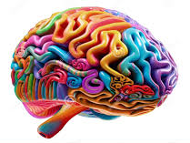
Module Purpose
Module Objectives:
Build understanding of “priming for learning” and associated findings from learning science.
Explore indicators of priming for learning using examples from HQIRs.
Consider deeper learning practices to support potential adjustments to a HQIR.
Notes:
Using our understanding of the research, we are now going to explore indicators of priming for learning, highlighting examples from HQIRs to help build understanding of what they might look like in practice.

Slide 17
Priming for Learning Indicators
Priming for Learning Indicators
Indicators
Learning is framed around big ideas, essential questions and/or anchoring phenomena. Students see the big picture of where learning is headed, and the big ideas, essential questions, and/or anchoring phenomena that drive learning throughout the unit. Students understand why the learning is important.
Strategies are used to spark student curiosity aligned to the intended learning outcomes.
Students make personal connections to the learning. Connections should help students see how learning: Relates to their lives; Has value outside of school; and/or Might be used to help others.
The cognitive challenge presented by the learning can increase student motivation. Learning experiences will engage students in complex ideas, texts and tasks that are of high interest and seem worth the commitment of sustained effort.
Students understand the learning progression and criteria for success and are encouraged to set related personal goals.
Notes:
Based on the research, we have identified 5 priming for learning indicators that need to be present/addressed in each unit of instruction. Those include:
Ensuring that learning is framed around big ideas, essential questions and/or anchoring phenomena that then drives learning throughout the unit.
Strategies are used to spark student curiosity aligned to the intended learning outcomes.
Students have opportunities to make personal connections to the learning.
The cognitive challenge presented by the learning helps to increase student motivation.
Students have a clear understanding of the learning progression and criteria for success and are encouraged to set related personal learning goals.

Slide 18
Priming for Learning
Examples from HQIRs
Notes:
What might the priming for learning indicators look like when included in part of the instructional design of a unit/module within an HQIR? We are going to look at three examples that can give us a better sense of how these indicators may be present.

Slide 19
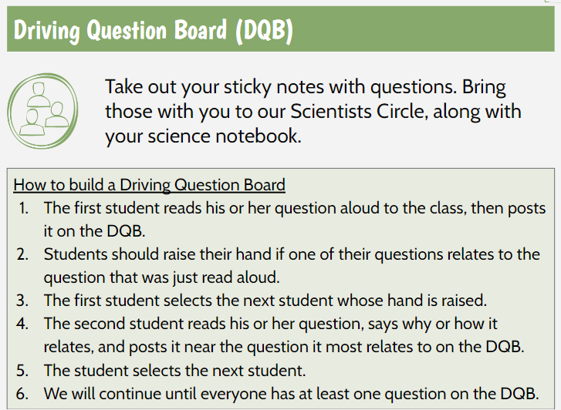
Learning is framed around big ideas, essential questions and/or anchoring phenomena.
Students make personal connections to the learning.
6th Grade Example
Notes:
This first example is from a 6th grade science unit in OpenSciEd. One of the priming for learning indicators is that learning is framed around big ideas, essential questions and/or anchoring phenomena. At the very beginning of this unit, (click) students are introduced to an anchoring phenomena to help them become interested and drive the learning throughout the unit.
Students continue to build interest and curiosity (click) as they generate questions around the anchoring phenomena. Since students are empowered to generate the questions they will explore, it helps to create a sense of ownership and motivation for the learning that follows.
Once students have generated their questions, (click) they are given an opportunity to draw on their own experiences as they think about related phenomena. This supports students in making personal connections to the unit’s learning.

Slide 20
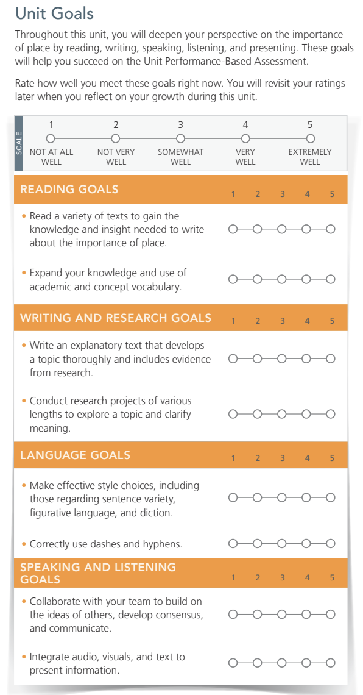
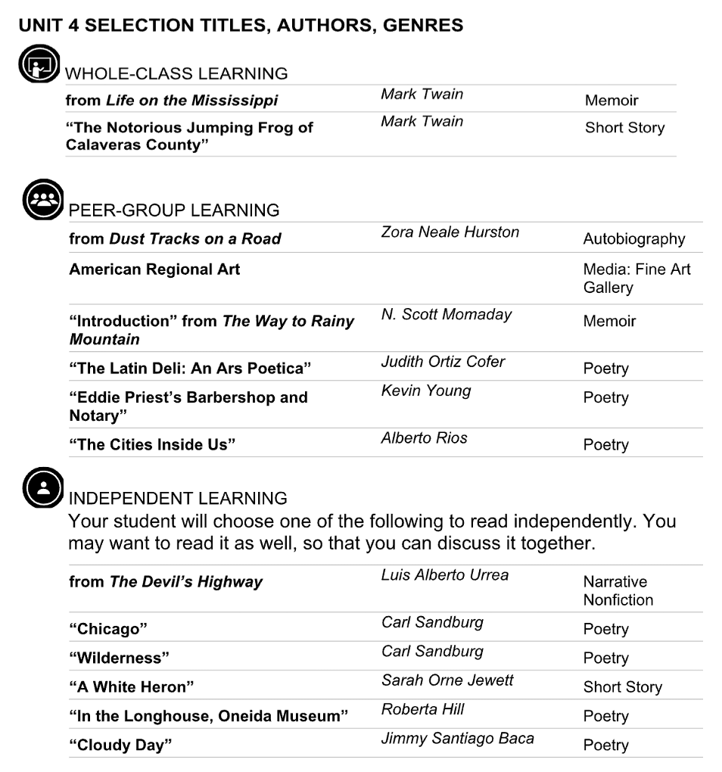
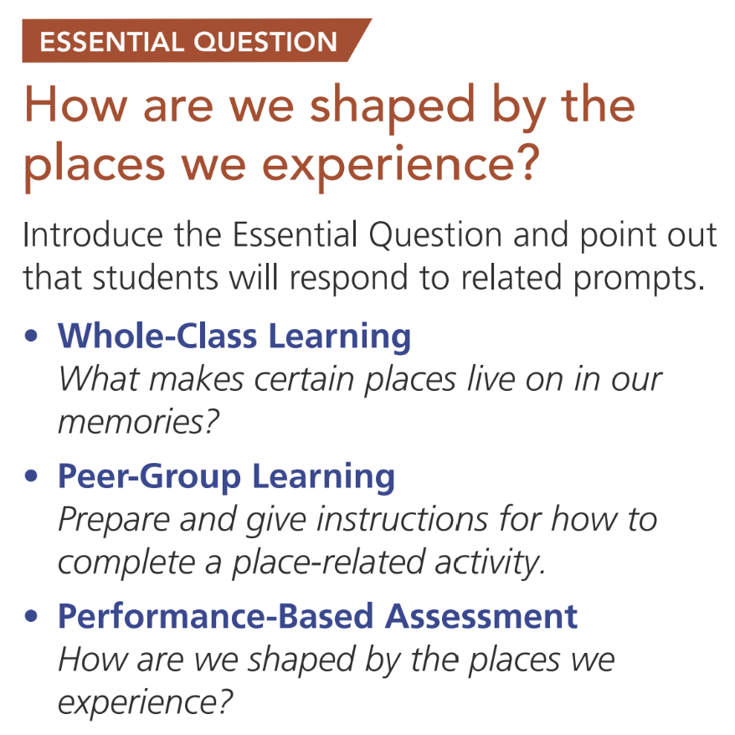
Students understand the learning progression and criteria for success and are encouraged to set related personal learning goals.
The cognitive challenge presented by the learning can increase student motivation.
11th Grade Example
Notes:
This 11th grade example from myPerspectives connects to the learning science indicators of:
Students understand the learning progression and criteria for success and are encouraged to set related personal learning goals.
The cognitive challenge presented by the learning can increase student motivation.
In it we have a learning frame to be made available to students that shows three key elements: [CLICK] how engagement through inquiry around an essential question will proceed, [CLICK] a corresponding progression of texts, [CLICK] and then the learning progression, here in the form of a sequence of unit learning goals. With this frame, students have the understanding of what’s ahead they need to effectively set personal goals.
The second dimension here is that of cognitive challenge. Students can also sense from this learning frame the worthwhile challenges this unit holds, and research confirms that a worthy challenge increases motivation for all learners, even those who have not always experienced academic success in this area, so long as they know they will have the supports they need to achieve their goals. A benefit of HQIRs is how skillfully they design those supports into the learning, enabling access without undermining challenge and rigor.

Slide 21
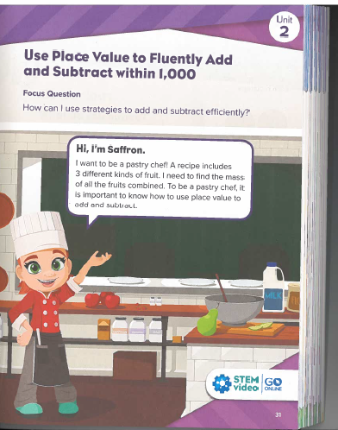
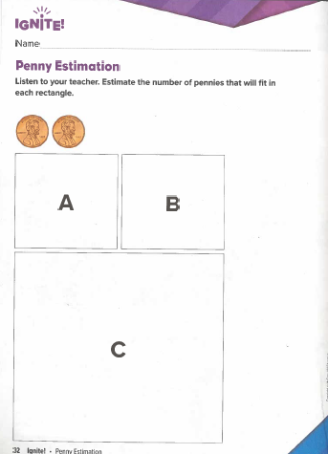
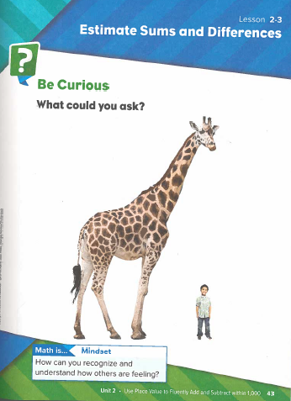
Strategies are used to spark student curiosity aligned to the intended learning and outcomes.
3rd Grade Example
Notes:
In this 3rd grade example from Reveal Math, we see a variety of strategies being used to spark student curiosity. The unit opens (click) with a focus question aligned with it’s intended learning outcomes and then connects the unit’s learning to a real-life example and sets up the project students will explore throughout the unit.
The unit (click) then engages students in an “Ignite” task and each lesson opens with a “Be Curious” task (click) aligned to the intended learning to continually spark and sustain student interest and motivation.

Slide 22
Module Purpose
Module Objectives:
Build understanding of “priming for learning” and associated findings from learning science.
Explore indicators of priming for learning using examples from HQIRs.
Consider deeper learning practices to support potential adjustments to a HQIR.
Notes:
Moving now to the last objective for this module, we will “Consider deeper learning practices to support potential adjustments to a HQIR.”

Slide 23
Common Deeper Learning Practices
Authenticity (learning includes real-world context, tasks, tools, products, audiences and/or impacts, while also connecting to personal concerns, interests and/or issues in students’ lives)
Inquiry (learning is framed by a meaningful question or set of questions to be responded to at the appropriate level of challenge; students engage in a rigorous, extended process of posing questions, exploring resources and applying information)
Structured Collaboration (Students are supported in contributing to the learning and work of their peers as they share, challenge and build upon each other’s ideas to co-create understanding and products of learning)
Voice & Choice (Students make some decisions about the learning, including how they work and what they create, and express their own ideas in their own voice)
Notes:
A pivot that may be noticed here is from the Common Characteristics of Deeper Learning from slide 15 to Common Deeper Learning Practices on this slide. If the common characteristics can help define our sense of what is meant by deeper learning, these aligned practices can help make those characteristics actionable. For any experienced in project-based learning, which is a frequently used vehicle for “doing deeper learning” in many districts, these practices will likely be familiar. We will take a moment to talk through them now in their more general sense since they will be returned to in stage-specific ways during each module when we are ready to think about potential ”smart adjustments” that might be made to a curriculum after analysis using learning science indicators.
For “Authenticity,” districts often increase it by having the learning include real-world context, tasks, tools, products, audiences and/or impacts, while also connecting to the personal concerns, interests and/or issues in students’ lives. Any of these aspects may be more or less present in a given unit or module from a HQIR, and each could potentially be added or enhanced to increase authenticity.
For “Inquiry,” districts often use it to have a unit’s/module’s learning framed by a meaningful question or set of questions to be responded to at the appropriate level of challenge, while also having students engage in a rigorous, extended process of posing questions, exploring resources and applying information. Again, aspects of inquiry may be more or less present in a given unit/module and adding or building upon these aspects can improve the quality of engagement.
For ”Structured Collaboration,” districts plan to provide appropriate structures and protocols for the different kinds of peer collaboration students will engage in throughout the learning process. This helps ensure collaboration feels safe and that it is conducive to reaching intended learning outcomes for all students. These structures and/or protocols can often be added to or built upon what may be present in a HQIR.
For “Voice & Choice,” districts embed ways for students to make some decisions about the learning, including how they work and what they create, and ways students can express their own ideas in their own voices. Many HQIRs offer aligned options for addressing voice and choice, and we would recommend beginning with those, however these aspects can also be increased through other smart adjustments. Both learning science and education research indicate that somewhat modest amounts of voice and choice can achieve the desired effects without having to make adjustments that could compromise the integrity of a HQIR’s design.
¹² PBL Works

Slide 24
Priming for Learning Indicators
Priming for Learning: Deeper Learning Practices and Considerations
Practices and Considerations
Authenticity See if the learning can become more relevant to learners through: Better connection to a real-world context (global, local) and/or Creation of a public product to be shared with an authentic audience.
Inquiry If there is an essential question that does not adequately drive learning throughout the module/unit, consider including a sequence of supporting questions that would help sustain inquiry toward responding to the essential question. Consider having students generate their own “supporting questions” to be revisited and revised as the learning unfolds.
Structured Collaboration Let students know when and how they will be working together to build understanding and create products to demonstrate learning during the unit/module and establish that the work will be supported by appropriate collaborative structures so it can feel safe and be productive.
Voice & Choice When learners set goals for their learning based on how it is framed at the unit/module level, consider encouraging them to reflect their current level of readiness and to use language that makes sense to them for their goals. See if there are Portrait of a Learner competencies that might best support this learning and invite goal setting around them as well. Notice where there is flexibility in what students will produce to demonstrate their learning and communicate how this flexibility allows space for voice and choice.
Notes:
Here we have the deeper learning practices with potential suggestions for the stage of priming for learning. These practices and considerations are included in the adjustment portion of the curriculum analysis and adjustment tool introduced on the next slide. For each practice, the underlying bullets and sub-bullets offer high-level suggestions as to the where a district could look to make adjustments. You will notice these assume a fairly significant degree of local understanding and capacity. If precisely what is meant by these or how to effectively act upon them is not as clear enough, this is where external partnership with a high-quality deeper learning provider and the tools those organizations may have can be invaluable.

Slide 25
Two Important Notes
On external partners, tools and professional learning:
Assess current capacity based on partnerships and trainings that have occurred and partner with high-quality deeper learning providers when capacity is lacking.
On curricular coherence:
Use the local curriculum document to record adjustments so that when and how they occur is visible across the system and any supporting materials can be accessed efficiently.
Notes:
Before we transition, an important note on external partners, tools and professional learning: The marketplace of deeper learning vendors and tools is a fairly crowded one because the work of effectively engineering these practices into a learning design is complex and requires a good degree of experience and skill. Therefore, we would recommend assessing current capacity based on partnerships and trainings that have occurred in a district and partnering with high-quality deeper learning providers when capacity is lacking.
And then an important note on curricular coherence: When adjustments are made to a local curriculum and its HQIR using any of these practices, it is important that those changes are reflected consistently across classrooms so that equitable access occurs for all. Therefore, we would recommend using the local curriculum document to record these adjustments so that when and how they occur is visible across the system and any supporting materials can be accessed efficiently.

Slide 26
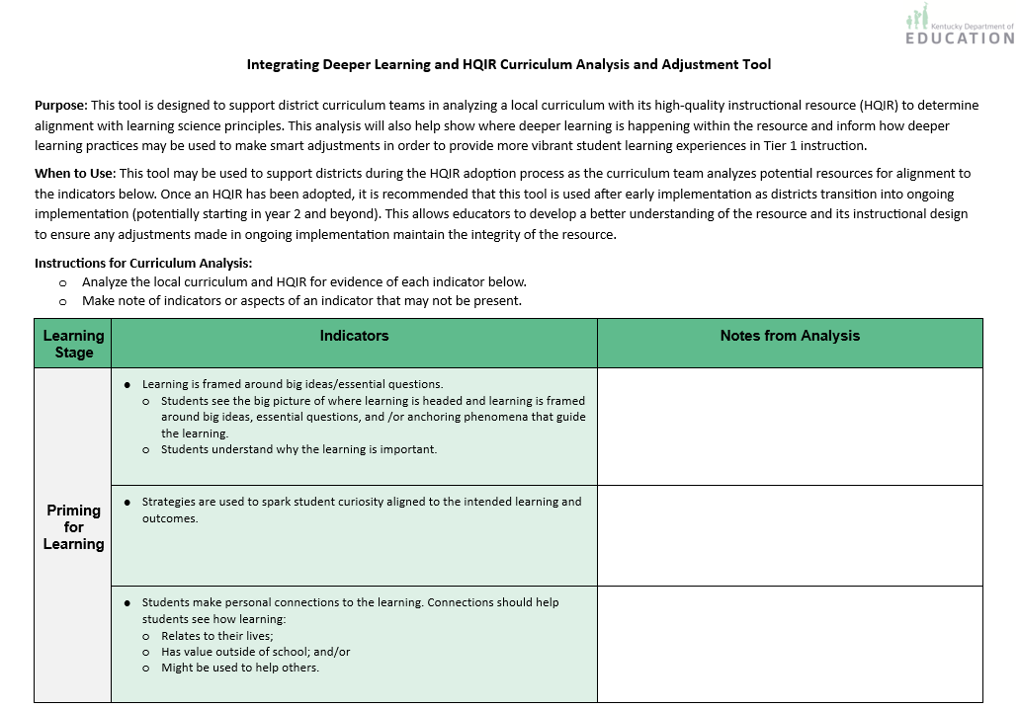
Curriculum Analysis and Adjustment Tool
The tool is designed to support:
Analysis of an HQIR using the Priming for Learning Indicators
Making curricular adjustments using deeper learning practices
Notes:
To help apply understanding from this module, the KDE created a Priming for Learning Curriculum Analysis and Adjustment Tool. The purpose of the tool is to assist a district curriculum team in analyzing their HQIR for evidence of each of the priming for learning indicators. The tool also offers suggestions for making curricular adjustments using deeper learning practices to further enhance their local curriculum in supporting vibrant learning experiences for all students.

Slide 27
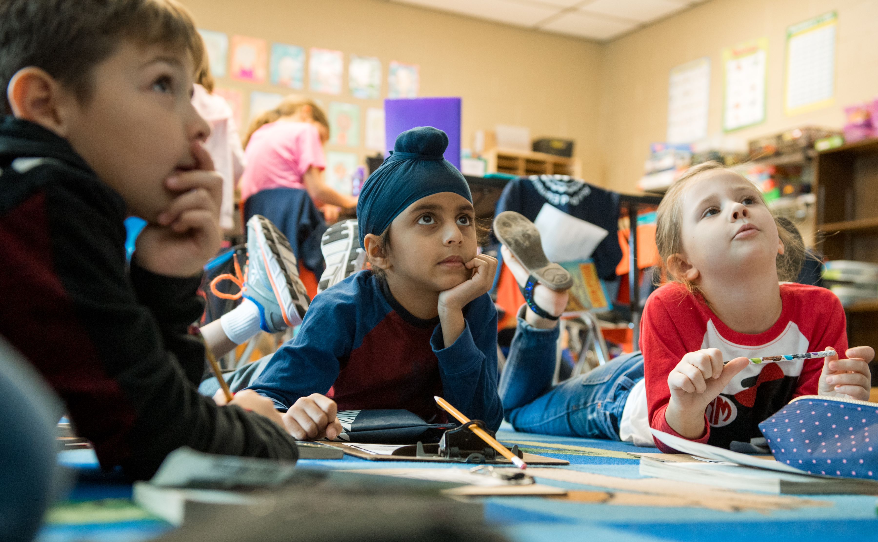
Closing Notes on Priming for Learning
Priming first needs to capture students’ immediate attention among all that is available in a classroom environment and engage it with things relevant to the upcoming learning.
Priming at the beginning of a unit/module begins to get relevant information, ideas and questions actively into working and then long-term memory so they can be built upon.
Priming needs to continue across the lessons of a module/unit so student attention is constantly reengaged and carried forward.
Notes:
We want to close with some final important notes about priming for learning. With so much stimuli coming into students’ sensory register, priming is about capturing their immediate attention with things relevant to the upcoming learning.
By gaining their immediate attention, the brain can then begin to actively take in relevant information, ideas and questions into short-term working memory, and eventually throughout the unit into their long-term memory to support sense-making, application and transfer.
Priming not only needs to happen at the onset of a unit; it should recur throughout a unit of instruction to help sustain student interest and their commitment to the intended learning outcomes. This includes continually returning to the unit’s essential question, big idea and/or anchoring phenomena and how new learning connects to the big understandings of the unit.

Slide 28
Questions?
Fox DeMoisey
fox.demoisey@education.ky.gov
Misty Higgins
misty.higgins@education.ky.gov
Notes:
Thank you for taking time to engage in this module and please reach out with any questions you might have.

