Slide 1
Getting to Know the Kentucky Academic Standards for Social Studies
Section B: Understanding the Architecture
Notes:
Note: Facilitators wishing to explore the standards revision process more deeply should access Section A: Revision Process Overview, as an Appendix.
Officially welcome the participants. Introduce yourself (if necessary).
Explain: This module is intended to provide an introduction to the new KAS for Social Studies. Section B builds knowledge of the architecture of the document. The architecture comprises the overall organizational structure of the document, the different ways to view the standards, and the design considerations of the specific components within the standards document.
Explain: “Group norms can help to create a safe space where participants feel comfortable sharing their ideas and experiences. Take a moment to read the norms.” After people are finished, ask: “Would you like to revise, edit or add any norms to the list?” If so, make changes on the slide; if not, move on to your discussion of the parking lot. NOTE: If participants made changes to this slide in the session over Section A, you will need to update this slide for their initial reading of the norms.
Explain: “I realize you may not want to pose every question to the whole group, or we may not have time in the session to get to every question. Therefore, I want us to have a place for those questions.” Point out the location of the parking lot for questions. For additional information on how to design the “parking lot” and address the questions, please see the note for the facilitator in Section A.

Slide 2
Group Norms
Assume best intentions.
Listen carefully to one another.
Be open to new ideas.
Be open to working outside your comfort zone.
Ask questions.
Allow a chance for everyone to participate.
Notes:
Go over the Group Norms on this slide.

Slide 3
Section B Learning Goals
Build a shared understanding of the architecture:
the design considerations of the specific components within the KAS for Social Studies,
the overall organizational structure of the document, and
Strengthen an understanding of the connection between the components of the KAS for Social Studies and the way those components support teachers and other stakeholders.
Notes:
Move on by explaining: There are two primary learning goals for Section B. Refer to the slide.

Slide 4
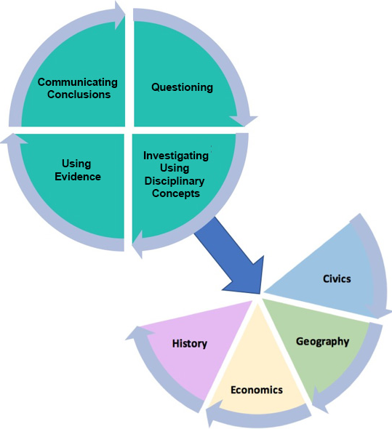
Organization of the Standards
Notes:
The diagram on this slide provides information on how to engage with the KAS for Social Studies.
Activate the voiceover on this slide to narrate and briefly expand upon the components. Text for this voiceover is found below.
Explain: Within the architecture, the standards place an equal importance on both the mastery of important social studies concepts and disciplinary practices. Throughout a child’s social studies education, students engage in the inquiry practices – questioning, investigating, using evidence and communicating conclusions. Students use these practices to acquire, refine and extend knowledge and understanding of key social studies concepts within the four disciplinary lenses of civics, economics, geography and history. As indicated by the graphic on this slide, concept knowledge cannot be achieved effectively without the practice of inquiry. Neither development of the practices nor development of the knowledge and understanding within the lenses is sufficient on its own to equip young people with the knowledge and skills necessary to carry on the ideals of the founders.

Slide 5
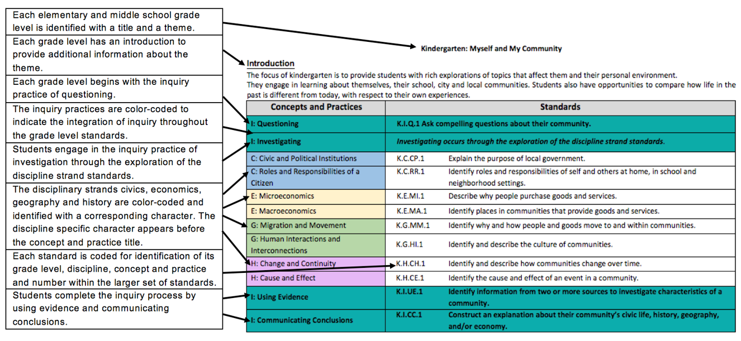
KAS for Social Studies – Standards View
Notes:
This slide provides information on the architecture of the KAS for Social Studies kindergarten through Grade 8.
Activate the voiceover on this slide to narrate and briefly expand upon the components. Text for this voiceover is found below.
Explain: When engaging with the KAS for Social Studies, it is important to understand the architecture of the standards. The image shown is an example of how the KAS for Social Studies are organized kindergarten through Grade 8. Each elementary and middle school grade level is identified with a title and a theme. This theme drives the grade level standards, meaning that the standards are connected to the theme. Each grade level has a short introduction to provide additional information about the grade level theme. Each grade level begins with the inquiry practice of questioning. The inquiry practices are color-coded to indicate the integration of inquiry throughout the grade level standards. Students engage in the inquiry practice of investigation through the exploration of the discipline strand standards. The disciplinary strands civics, economics, geography and history are color coded and identified with a corresponding character. The discipline specific character appears before the concept and practice title. Each standard is coded for identification of its grade level, discipline, concept and practice and number within the larger set of standards. Students complete the inquiry process by using evidence and communicating conclusions.
It is important to refer to the circular graphic on the previous slide when understanding how to engage with the KAS for Social Studies. While the standards were just reviewed by reading them from right to left and top to bottom, the standards are not meant to be engaged with linearly. Meaning, a student does not have to start with the questioning standards prior to engaging with the disciplinary strand standards; students do not have to engage with the discipline strand standards prior to engaging with the using evidence standards or communicating conclusions standards. Students should be asking questions, using evidence and communicating conclusions throughout their mastery of the discipline strand standards.

Slide 6
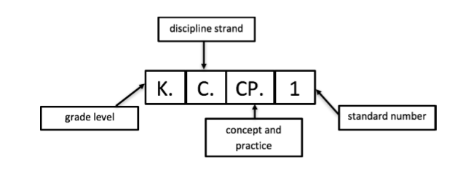
Standard Coding
Notes:
This slide provides an image of the Standard Coding.
Activate the voiceover on this slide to narrate and briefly expand upon the components. Text for this voiceover is found below.
Explain: For readability, each standard is coded for identification of its grade level, discipline strand, concept and practice and number within the larger set of standards. The diagram below uses the standard K.C.CP.1 to explain the coding.

Slide 7
K-8 Organization: Themes
Kindergarten: Myself and My Community
Grade 1: Impact on Community and State
Grade 2: North American Interactions
Grade 3: Global Interactions
Grade 4: Migration and Settlement
Grade 5: Colonization to Constitution
Grade 6: Development of Civilizations
Grade 7: Growth and Expansion of Civilization
Grade 8: The United States 1600-1877
Notes:
This slide provides information on the grade-level themes K-8.
Activate the voiceover on this slide to narrate and briefly expand upon the components. Text for this voiceover is found below.
Explain: In K-8, the standards are organized by grade-level themes. The grade-level theme drives the standards within the concepts and practices through the four disciplines of civics, economics, geography and history. This slide provides a list of the K-8 grade-level themes.

Slide 8
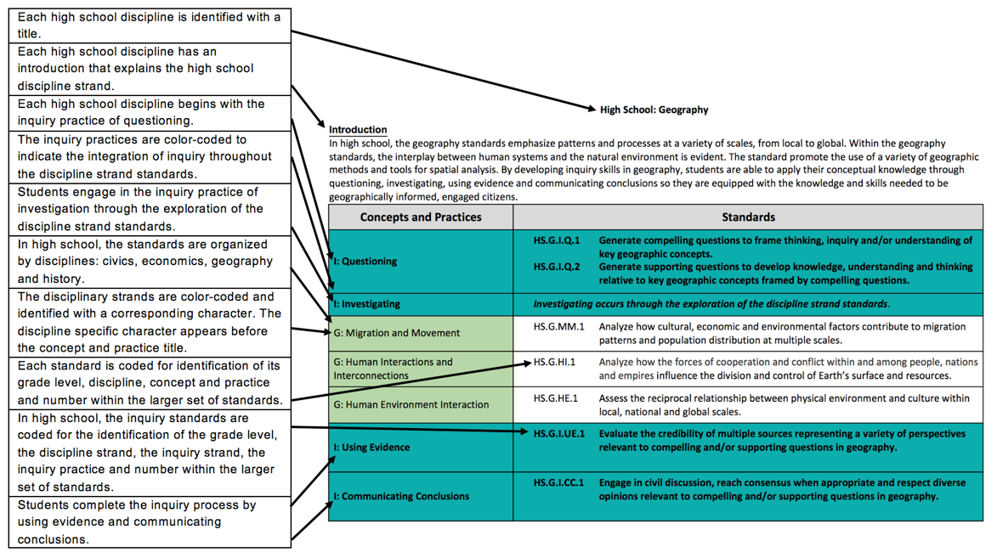
KAS for Social Studies – Standards View
Notes:
The KAS for Social Studies for high school is organized within a similar architecture as the K-8 standards, but the high school standards are organized around the disciplines of civics, economics, geography and US and World History rather than being organized by grade level and grade-level theme.
Each high school discipline is identified with a title and introduction that provides information about the discipline. Each high school discipline begins with the inquiry practice of questioning. The inquiry practices are color-coded to indicate the integration of inquiry throughout the grade level standards. Students engage in the inquiry practice of investigation through the exploration of the discipline strand standards. The disciplinary strands civics, economics, geography and history are color coded and identified with a corresponding character. It is important to note that in the high school standards, there is a separate architecture for each discipline. The discipline specific character appears before the concept and practice title. Each standard is coded for identification of its grade level, discipline, concept and practice and number within the larger set of standards. In high school, the inquiry standards are coded for the identification of the grade level, the discipline strand, the inquiry strand, the inquiry practice and number within the larger set of standards. Students complete the inquiry process by using evidence and communicating conclusions.
As discussed with the K-8 standards, it is important to refer to the circular graphic previously found in this presentation and on page 10 of the KAS for Social Studies when understanding how to engage with the standards. While the standards were just reviewed by reading them from right to left and top to bottom, the standards are not meant to be engaged with linearly. Meaning, a student does not have to start with the questioning standards prior to engaging with the disciplinary strand standards; students do not have to engage with the discipline strand standards prior to engaging with the using evidence standards or communicating conclusions standards. Students should be asking questions, using evidence and communicating conclusions throughout their mastery of the discipline strand standards.

Slide 9
Standard Coding- HS Inquiry
Notes:
This slide provides an image of the high school inquiry standards coding.
Activate the voiceover on this slide to narrate and briefly expand upon the components. Text for this voiceover is found below.
Explain: In high school, the inquiry standards are coded for the identification of the grade level, the discipline strand, the inquiry strand, the inquiry practice and number within the larger set of standards.

Slide 10
High School Organization: Disciplines
Civics
Economics
Geography
History
US. History: 1877 – present
World History: 1300 - present
Notes:
This slide provides information on the organization of the high school standards while highlighting the structure of the U.S. History and World History standards.
Activate the voiceover on this slide to narrate and briefly expand upon the components. Text for this voiceover is found below.
Explain: As stated previously, the KAS for Social Studies for high school is organized within a similar architecture as the K-8 standards, but the high school standards are organized around the disciplines of civics, economics, geography and US and World History rather than being organized by grade level and grade-level theme.
Within the high school history discipline strand standards, it is important to note the dates of the US. History and World History standards. The high school US. History standards address 1877 to the present while the high school World History standards address 1300 to the present. Additionally, it is important to note the date ranges provided within the individual standards. The specific date ranges provided were purposely selected and should be adhered to when engaging with either the high school US. History or World History standards.

Slide 11
Reflection Questions
How is the KAS for Social Studies organized?
In the KAS for Social Studies, which standards are more important- the inquiry practices or the discipline strands?
What are the inquiry practices as identified in the KAS for Social Studies?
What are the discipline strands identified in the KAS for Social Studies?
In the KAS for Social Studies, how has your grade level or high school discipline changed?
Where might you need additional support?
Notes:
Discovery Task – Ask participants, individually, with a partner or in a small grade-banded group, to discuss the reflection questions included below and as seen on the accompanying slide. Facilitate discussion over the reflection questions and address any comments that need further clarification or additional support.
How is the KAS for Social Studies organized?
In the KAS for Social Studies, which standards are more important- the inquiry practices or the discipline strands? (NOTE: They are equally important.)
What are the inquiry practices as identified in the KAS for Social Studies?
What are the discipline strands identified in the KAS for Social Studies?
In the KAS for Social Studies, how has your grade level or high school discipline changed?
Where might you need additional support?
Consider maintaining a Google document to house these reflections for continued consideration and further application.

Slide 12
Coming Up
Section C: Implementation Supports in the KAS for Social Studies
Section D: Deeper Dive into the Inquiry Practices: Questioning
Section E: Deeper Dive into the Inquiry Practices: Using Evidence
Section F: Deeper Dive into the Inquiry Practices: Communicating Conclusions
Section G: Deeper Dive into the Discipline Strands and the Concepts and Practices
Section H: Exploring a Strongly Aligned Assignment Example
Section I: Wrap up & Next Steps
Notes:
Explain: This slide shows the upcoming sections of the module.

Slide 13
End Slide for Section A
Stop here if you are completing Section B: Understanding the Architecture only.
If you would like to complete another section of the module at this time, continue onto the next slide to begin facilitating Section C: Implementation Supports in the KAS for Social Studies.
Notes:
Explain: The KDE needs your feedback on the effectiveness of this module, the learning platform and how the consultants may best support you as you take the next steps in the implementation process. We are going to complete a short survey to share our thinking and provide them with feedback on how the KDE can best meet our needs. Feedback from our surveys will be used by the KDE to plan and prepare future professional learning.
Post-survey:
Getting to Know the KAS for Social Studies for Teachers: https://www.surveymonkey.com/r/XH9NC3R
Getting to Know the KAS for Social Studies for School/District Leaders: https://www.surveymonkey.com/r/M23ZWM

Slide 14
Getting to Know the Kentucky Academic Standards for Social Studies
Section C
Implementation Supports in the KAS for Social Studies:
Grade-Band and Grade-Level Specific Overviews
Disciplinary Clarifications and Instructional Support
Progression Appendix
Notes:
Officially welcome the participants. Introduce yourself (if necessary).
Explain: This module is intended to provide an introduction to the new KAS for Social Studies. Section C builds knowledge of the architecture of the document to discuss the implementation supports found in the document: Grade-Band and Grade-Level Specific Overviews; Disciplinary Clarifications and Instructional Support; Progression Appendix.
Explain: “Group norms can help to create a safe space where participants feel comfortable sharing their ideas and experiences. Take a moment to read the norms.” After people are finished, ask: “Would you like to revise, edit or add any norms to the list?” If so, make changes on the slide; if not, move on to your discussion of the parking lot. NOTE: If participants made changes to this slide in the session over Section A, you will need to update this slide for their initial reading of the norms.
Explain: “I realize you may not want to pose every question to the whole group, or we may not have time in the session to get to every question. Therefore, I want us to have a place for those questions.” Point out the location of the parking lot for questions. For additional information on how to design the “parking lot” and address the questions, please see the note for the facilitator in Section A.

Slide 15
Group Norms
Assume best intentions.
Listen carefully to one another.
Be open to new ideas.
Be open to working outside your comfort zone.
Ask questions.
Allow a chance for everyone to participate.
Notes:
Go over the Group Norms on this slide.

Slide 16
Section C Learning Goals
Build a shared understanding of the architecture:
the built in supports for implementation found within the document.
the different ways to view the standards, and
Strengthen an understanding of the connection between the components of the KAS for Social Studies and the way those components support teachers and other stakeholders.
Notes:
Move on by explaining: There are two primary learning goals for Section C. Refer to the slide.

Slide 17
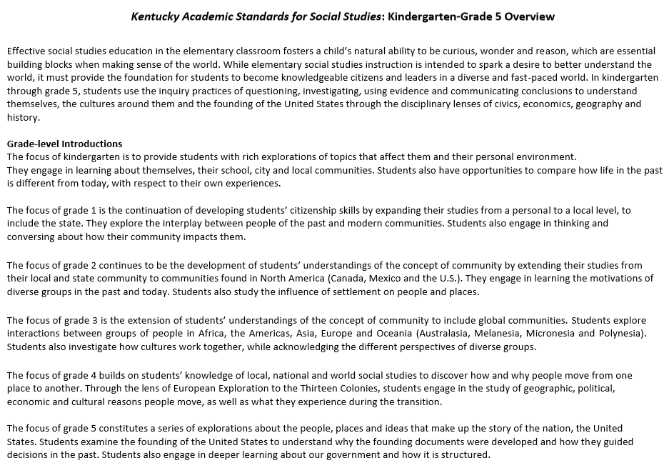
Grade Band Overviews
Notes:
This slide is an image of the Grade Band Overview for elementary level social studies.
Activate the voiceover on this slide to narrate and briefly expand upon the components. Text for this voiceover is found below.
Explain: Grade band overviews for K-5 (page 21), 6-8 (page 93) and high school (pages 139-140) are provided. At the top of each grade band page, information is included to provide guidance on what effective social studies education looks like in each grade band. As was stated previously in section B, short introductions are included with the architecture to provide a brief overview of the theme in K-8. In high school, each discipline includes an introductory paragraph that provides an overview of the standards within the concepts and practices that will be mastered prior to high school graduation. These short introductions have been included in the grade-band overview, below the introductory paragraph, to provide all of the introductions for K-5, 6-8 and high school so that stakeholders could obtain a more complete view of social studies during a particular grade band.

Slide 18
Grade Band Overview Reflection
Read through your grade band overview, and underline, highlight, circle, etc., elements that impact instruction.
With these elements in mind, how might the information in the grade band overview be useful in communicating with different stakeholders (parents, students, teachers, administrators, district leaders)?
Notes:
Discovery Task - Provide participants with a copy of their respective grade band overview from the KAS document. (The K-5 overview is found on page 21; the grade 6-8 overview is on page 93, and the high school overview is on page 139-140.)
Ask them to annotate or take notes on evidence for number 1.
Ask participants, individually, with a partner or in a small grade-banded group, to consider how this document may be useful to multiple stakeholders. See number 2. For example, for a principal or district leader who may not be an expert on the specific content standards, the overview document provides a snapshot of what he or she might look for in a walk-through or formal observation. Or at a parent conference, a parent might be better served by seeing a general overview of how the strands work together instead of processing each of his or her child’s grade-level standards.
Facilitate discussion over the reflection generated on this one-pager. Based on this discussion, consider asking if an additional document might need to be created for a particular stakeholder. What might be its purpose? Make-up? Design?
Consider maintaining a Google document to house these reflections for continued consideration and further application.

Slide 19
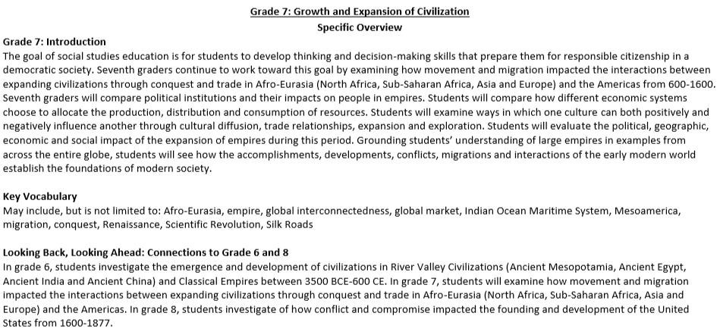
KAS for Social Studies
Notes:
his slide provides information on the grade-level introductions, the suggested key vocabulary and the progression snapshots found in the Grade-level Specific Overview.
Additional note for the facilitator: The following section of the module provides more information about the Grade-level Specific Overviews found in the KAS for Social Studies. The Grade-level Specific Overviews are only provided for K-8. While Grade-level Specific overviews are not provided for high school, it is still valuable for your high school teachers to review a K-8 example as the information contained in these sections provide additional information on the way in which the document functions.
Bring the group back together, and activate the voiceover on this slide to narrate and briefly expand upon the components. Text for this voiceover is found below.
Explain: Based on feedback provided during the standards revision process, grade-level specific overviews were added to the Kentucky Academic Standards (KAS) for Social Studies document in kindergarten through grade 8. In K-8, each grade level is introduced with a grade-level specific overview that includes an expanded grade-level introduction, suggested key vocabulary, connections to the previous and following grade, and an explanation of what inquiry looks like in practice. The grade-level theme presented in the introduction drives the standards within the concepts and practices through the four disciplines of civics, economics, geography and history.
Grade-level introductions: Feedback indicated that stakeholders valued the additional clarity of an expanded introduction specific to each grade level. The expanded introduction provides additional information on the grade-level theme and explains how the goal of social studies education connects with students as they progress through their social studies education. Additionally, the expanded introduction provides examples of how learners engage with each of the four disciplines during the year.
Suggested key vocabulary: Feedback also indicated that stakeholders valued suggested key vocabulary specific to each grade level. The writing committee identified terms that they felt were essential to understanding the content and skills in the standards. The identified key vocabulary terms listed are possible suggestions; they are not the only terms that may be used during instruction. Additionally, it is important to note that merely knowing the definitions of these terms is not enough to obtain mastery of the standards.
Looking Back, Looking Ahead: progression snapshots: Feedback indicated that stakeholders valued the progression snapshots found in the overviews. Short summaries of the previous and following grades are included to provide educators information on what a student’s social studies learning experience is focused on in the previous and following grade. This short snapshot provides a short narrative on how the current grade’s theme progresses.

Slide 20
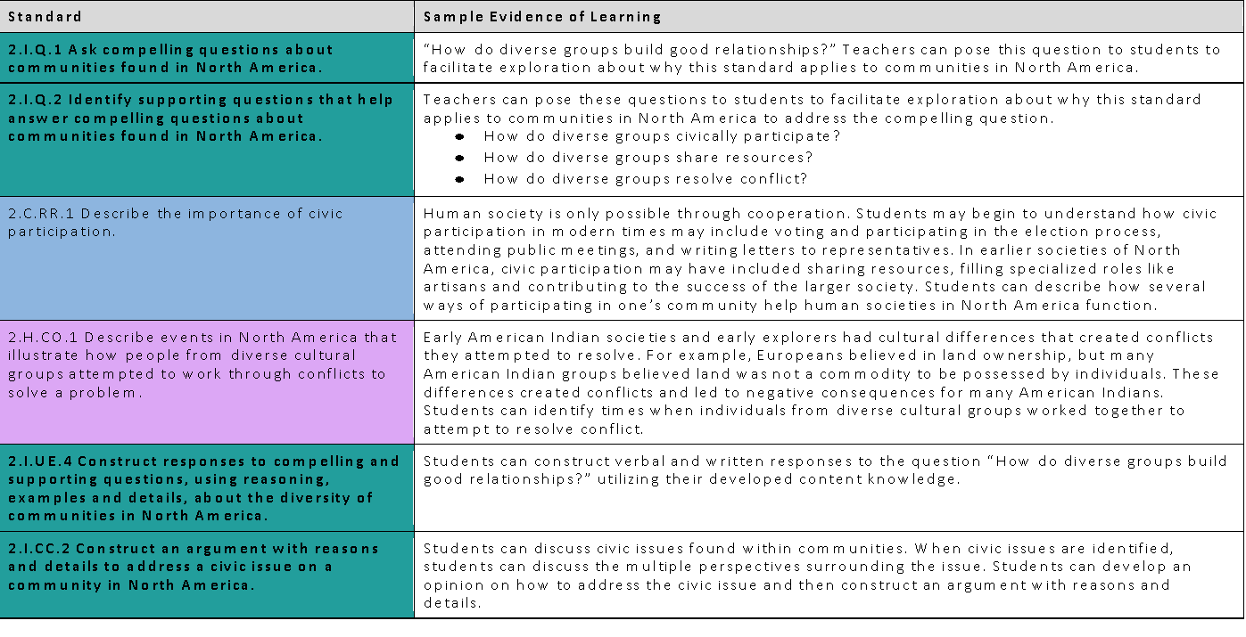
Specific Overview
What this would look like in practice
This example provides guidance on how to combine the standards into a learning experience for students and how the standards work together to ensure students are engaged in the inquiry practices throughout grade 2. The identified sample evidence of learning is a possible suggestion of how the disciplinary strand standards interact with the inquiry practices; however, it is not the only pathway and is not comprehensive to obtain mastery of the standards.
Notes:
This slide provides information on the “What this looks like in practice” chart.
Activate the voiceover on this slide to narrate and briefly expand upon the components. Text for this voiceover is found below.
Explain: Feedback provided indicated that further supports were needed to assist stakeholders in seeing how the inquiry and discipline strand standards interact in a learning experience. This section provides guidance on how to combine the standards into a learning experience for students and how the standards work together to ensure students are engaged in the inquiry practices throughout K-8. The identified sample evidence of learning is a possible suggestion of how the disciplinary strand standards interact with the inquiry practices; however, it is not the only pathway and is not comprehensive to obtain mastery of the standards.

Slide 21
Specific Overview
Notes:
This slide provides an image of an example of “Opportunities for Cross Disciplinary Connections.”
Activate the voiceover on this slide to narrate and briefly expand upon the components. Text for this voiceover is found below.
Explain: Opportunities for cross disciplinary connections were also identified. Feedback provided indicated that teachers needed support, especially at the elementary school level, when understanding how cross disciplinary connections could be made among the content standards. In this section, connections are made between the KAS for Social Studies and the Kentucky Academic Standards (KAS) for Reading and Writing.

Slide 22
Grade-level Specific Overview Reflection
How might this grade specific overview be useful to you in your role?
How will the “looking back, looking ahead” progression snapshots be helpful?
How will the “what this looks like in practice?” section be helpful?
How could the “opportunities for cross disciplinary connections” be useful?
Where might you need additional support?
Notes:
Discovery Task - Provide participants with a copy of their respective grade-level specific overview from the KAS document. See pages 22-24 for the kindergarten grade-level overview, pages 81-83 for grade 5, and pages 121-123 for grade 8. Additional examples of the specific grade-level overviews are identified in the Table of Contents.
Additional note for the facilitator: While Grade-level Specific Overviews are not provided for high school, have high school teachers work with the Grade 8 Grade-level Specific Overview with a partner or in a small grade-banded group, to identify any areas of the Grade-level Specific Overview that may be useful for curriculum and instruction.
Ask participants, individually, with a partner or in a small grade-banded group, to discuss the questions on the slide. Facilitate discussion over the reflection questions and address any comments that need further clarification or additional support.
Consider maintaining a Google document to house these reflections for continued consideration and further application.

Slide 23
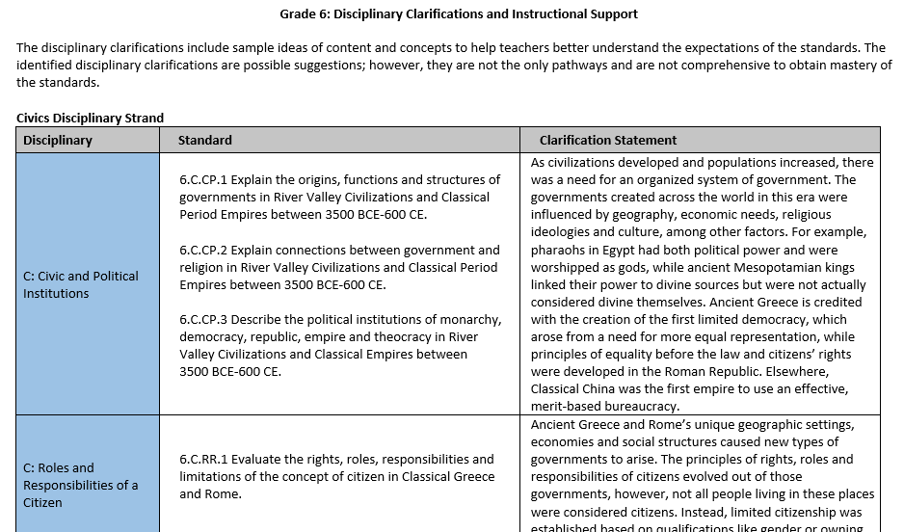
Disciplinary Clarifications
Notes:
This slide provides an image of the Disciplinary Clarifications.
Bring the group back together, and activate the voiceover on this slide to narrate and briefly expand upon the components. Text for this voiceover is found below.
Explain: Following the K-8 grade-level and high school discipline standards, disciplinary clarifications are provided. The disciplinary clarifications include sample ideas of content and concepts to help teachers better understand the expectations of the standards. The identified disciplinary clarifications are possible suggestions; however, they are not the only pathways and are not comprehensive to obtain mastery of the standards.

Slide 24
Disciplinary Clarification Reflection
How might the disciplinary clarifications be useful to you in your role?
When engaging with the disciplinary clarifications, what must you consider when developing curriculum?
Where might you need additional support?
Notes:
Discovery Task - See pages 27-31 for the kindergarten disciplinary clarifications and instructional support. Additional examples of the disciplinary clarifications and instructional support are identified in the Table of Contents.
Ask participants, individually, with a partner or in a small grade-banded group, to discuss the questions on the slide after reading through the disciplinary clarifications relevant for their students. Facilitate discussion over the reflection questions and address any comments that need further clarification or additional support.
Consider maintaining a Google document to house these reflections for continued consideration and further application.

Slide 25
Kentucky Academic Standards for Social Studies
Additional Highlights:
Organized in progressions from K-12 by grade level, inquiry practice, discipline, and concepts and practices
Notes:
Bring the group back together, and activate the voiceover on this slide to narrate and briefly expand upon the components. Text for this voiceover is found below.
Explain: The KAS for Social Studies has been organized in progressions from K-12 by grade level, inquiry practice, discipline, and concepts and practices to aid districts in curriculum development. (See pages 196-275.)

Slide 26
K-12 Progressions Reflection
How might the progressions be useful for vertical alignment? In PLCs?
Where might you need additional support?
Notes:
Discovery Task: Have participants go to the K-12 progression for at least one inquiry practice or disciplinary strand standard.
Ask participants, individually, with a partner or in a small grade-banded group, to reflect on the following questions:
● How might this view be useful for vertical alignment? In PLCs?
● Where might you need additional support?
Facilitate discussion over the reflection questions.
Consider maintaining a Google document to house these reflections for continued consideration and further application.

Slide 27
Coming Up
Section D: Deeper Dive into the Inquiry Practices: Questioning
Section E: Deeper Dive into the Inquiry Practices: Using Evidence
Section F: Deeper Dive into the Inquiry Practices: Communicating Conclusions
Section G: Deeper Dive into the Discipline Strands and the Concepts and Practices
Section H: Exploring a Strongly Aligned Assignment Example
Section I: Wrap up & Next Steps
Notes:
Explain: This slide shows the upcoming sections of the module.

Slide 28
End Slide Section B
Stop here if you are completing Section C: Implementation Supports in the KAS for Social Studies only.
If you would like to complete another section of the module at this time, continue onto the next slide to begin facilitating Section D: Deeper Dive into the Inquiry Practices: Questioning.
Notes:
End Slides for Section C.
Bring the group back together.
Explain: The KDE needs your feedback on the effectiveness of this module, the learning platform and how the consultants may best support you as you take the next steps in the implementation process. We are going to complete a short survey to share our thinking and provide them with feedback on how the KDE can best meet our needs. Feedback from our surveys will be used by the KDE to plan and prepare future professional learning.
Post-survey:
Getting to Know the KAS for Social Studies for Teachers: https://www.surveymonkey.com/r/XH9NC3R
Getting to Know the KAS for Social Studies for School/District Leaders: https://www.surveymonkey.com/r/M23ZWM

Slide 29
Getting to Know the Kentucky Academic Standards for Social Studies
Section D: Deeper Dive into the Inquiry Practices: Questioning
Notes:
Officially welcome the participants. Introduce yourself (if necessary).
Explain: This module is intended to provide an introduction to the new KAS for Social Studies. Section D builds knowledge of the architecture of the document to discuss the inquiry practices. Specifically, it focuses on the inquiry practice of Questioning.
Explain: “Group norms can help to create a safe space where participants feel comfortable sharing their ideas and experiences. Take a moment to read the norms.” After people are finished, ask: “Would you like to revise, edit or add any norms to the list?” If so, make changes on the slide; if not, move on to your discussion of the parking lot. NOTE: If participants made changes to this slide in the session over Section A, you will need to update this slide for their initial reading of the norms.
Explain: “I realize you may not want to pose every question to the whole group, or we may not have time in the session to get to every question. Therefore, I want us to have a place for those questions.” Point out the location of the parking lot for questions. For additional information on how to design the “parking lot” and address the questions, please see the note for the facilitator in Section A.

Slide 30
Group Norms
Assume best intentions.
Listen carefully to one another.
Be open to new ideas.
Be open to working outside your comfort zone.
Ask questions.
Allow a chance for everyone to participate.
Notes:
Go over the group norms on this slide.

Slide 31
Section D Learning Goals
Build a shared understanding of the architecture:
Understand the inquiry practices as outlined in the KAS for Social Studies,
Become familiar with the characteristics of compelling and supporting questions, and
Strengthen an understanding of the connection between the components of the KAS for Social Studies and the way those components support teachers and other stakeholders.
Notes:
Move on by explaining: There are two primary learning goals for this section. Refer to the slide.

Slide 32
What are standards?
Using the section entitled “The Kentucky Academic Standards (KAS) are Standards, not Curriculum” on page 9 of the KAS for Social Studies document, answer the following questions:
What are standards?
What do standards not provide?
Notes:
Discovery Task: Have participants go to the section entitled “The Kentucky Academic Standards (KAS) are Standards, not Curriculum” on page 9 of the KAS for Social Studies document.
Ask participants, individually, with a partner or in a small grade-banded group, to reflect on the following questions:
What are standards?
What do standards not provide?
Consider maintaining a Google document to house these reflections for continued consideration and further application.

Slide 33
Organization of the Standards
Notes:
Bring the group back together, and activate the voiceover on this slide to narrate and briefly expand upon the components. Text for this voiceover is found below.
Explain: The KAS for Social Studies is organized around the inquiry practices of questioning, investigating, using evidence and communicating conclusions. Students will consider or pose questions and then investigate those questions through the disciplinary lenses of civics, economics, geography and history. Students complete the inquiry process by communicating evidence-based conclusions.
The inquiry process is critical for effective student understanding of civics, economics, geography and history. Inquiry instruction requires teachers and students to ask questions that drive student investigation of the subject matter and eliminates the “skills vs. content” dilemma in social studies as both are needed to successfully engage in inquiry. Students will engage in inquiry using the tools, conceptual understandings and the language of political scientists, economists, geographers and historians at a developmentally appropriate level. Students will craft arguments, apply reasoning, make comparisons, corroborate their sources and interpret and synthesize evidence as political scientists, economists, geographers and historians.

Slide 34
Discovery Task: What are the inquiry practices outlined in the KAS for Social Studies?
Using pages 10-17 of the KAS for Social Studies document, answer the following questions:
1) What are the four inquiry practices according to the KAS for Social Studies?
2) What are the two types of questions found in the Questioning inquiry practice? Define both types.
3) How do students engage with the Investigating inquiry practice?
4) What skills are required by students to substantiate claims using evidence according to the Using Evidence inquiry practice?
5) What media forms may students use to communicate their conclusions?
Notes:
Discovery Task: Have participants go to page 10 of the KAS for Social Studies document.
Ask participants, individually, with a partner or in a small grade-banded group, to reflect on the following questions:
What are the four inquiry practices according to the KAS for Social Studies?
What are the two types of questions found in the Questioning inquiry practice? Define both types.
How do students engage with the Investigating inquiry practice? (NOTE: They engage with the Investigating inquiry practice through the discipline strand standards.)
What skills are required by students to substantiate claims using evidence according to the Using Evidence inquiry practice?
What media forms may students use to communicate their conclusions? (NOTE: The KAS for Social Studies states “In a world of ever-expanding communication opportunities inside and outside their school walls, students should also be able to utilize newer media forms in order to share their conclusions and hear the voices of those whose conclusions may be different.” The variety of media forms available to students was an intentional decision made by the writers to not limit the communication mediums available to students.)
Consider maintaining a Google document to house these reflections for continued consideration and further application.

Slide 35
Questioning
Compelling questions are open-ended, enduring and center on significant unresolved issues.
Focus on “big ideas”
Are intellectually challenging
Generate interest
Allow for multiple perspectives
Can be answered in a variety of ways
Inspire investigation through the discipline strands
Notes:
Bring the group back together.
Explain: The KAS for Social Studies is organized around the inquiry practices of questioning, investigating, using evidence and communicating conclusions. Students will consider or pose questions and then investigate those questions through the disciplinary lenses of civics, economics, geography and history. Within the inquiry practice of questioning, there are two types of questions: compelling and supporting.
Compelling questions are open-ended, enduring and center on significant unresolved issues. Characteristics of compelling questions are that they:
Focus on “big ideas”
Are intellectually challenging
Generate interest
Allow for multiple perspectives
Can be answered in a variety of ways
Inspire investigation through the discipline strands

Slide 36
Discovery Task: Which of the following are not compelling questions?
“Why do I have to be responsible?”
“What makes a community healthy?”
“What roles did subjects of various empires play within their societies and governments?”
“How do diverse groups build good relationships?”
“How does where we live affect how we live?”
“Why do diverse groups of people settle in new areas?”
“What actions taken by the British Parliament angered the colonists?”
“What unites Americans?”
“How do complex societies develop?”
“How do public services impact a community?”
“Can technology transform civilization?”
“Can conflict truly be resolved?”
Notes:
Discovery Task: Ask participants, individually, with a partner or in a small grade-banded group, to identify which of the questions on the accompanying slide are NOT compelling questions.
Note to the facilitator: On this slide, there are three questions that do not meet the characteristics of a compelling question. They are:
“What roles did subjects of various empires play within their societies and governments?”
“What actions taken by the British Parliament angered the colonists?”
“How do public services impact a community?”
When addressing why these questions aren’t compelling, have participants evaluate these questions based on the characteristics provided. It is important to note that just because a question is “big” or contains a lot of content (such as “What roles did subjects of various empires play within their societies and governments?”), it does not mean that the question is compelling. In the case of this specific question, it is asking about the roles of subjects in Empires which is very specific and not enduring, among others.
Additionally, it is important to note that these question examples can be found in the K-8 grade-level specific overviews. Specifically, these questions can be found in the “What this looks like in practice charts” for the various grade levels.
Consider maintaining a Google document to house these reflections for continued consideration and further application.

Slide 37
Questioning
Supporting questions:
These questions support the compelling question by asking more focused questions.
These can be answered through use of the concepts and practices of each social studies discipline.
Notes:
Bring the group back together.
Explain: Supporting questions support the compelling question by asking more focused questions. These can be answered through use of the concepts and practices of each social studies discipline. Supporting questions should provide students with knowledge that they can synthesize to answer the larger compelling question.

Slide 38
An example:
Compelling Question: What unites Americans?
Supporting Question examples:
Why did the British Parliament raise taxes on the colonists?
What actions taken by the British Parliament angered the colonists?
How do the founding documents establish an American identity?
Notes:
This slide contains an example from the KAS for Social Studies for Grade 5 to explain the connection between a compelling question and supporting questions.
A question such as “What unites Americans?” is compelling because it focuses on “big ideas,” allows for multiple perspectives and can be answered in a variety of ways, among other characteristics. The supporting questions below are supporting because they are more focused, discipline specific and the answers to these questions can be synthesized to answer the larger compelling question.
It is important to note that when crafting supporting questions for compelling questions, the supporting questions must be aligned to the compelling question to help build the knowledge required to answer the compelling question. For example, a question such as “What doesn’t unite Americans?” is not a supporting question for the compelling question of “What unites Americans?” because it requires students to construct knowledge that does not answer the compelling question.

Slide 39
Discovery Task
If you are a K-8 teacher, access your grade-level specific overview and find the “what this looks like in practice chart.”
When you have accessed this information, please review the compelling and supporting questions provided. Individually, with a partner or in a small grade-banded group, analyze why the examples provided are compelling and supporting questions.
If you are a high school teacher, analyze the relationship between the compelling and supporting questions in the Grade 8 “what this looks like in practice chart” and analyze why the examples provided are compelling and/or supporting questions.
Notes:
Explain: Ask participants, individually, with a partner or in a small grade-banded group, to complete the following:
If you are a K-8 teacher, please access your grade-level specific overview and find the “what this looks like in practice chart.”
When you have accessed this information, please review the compelling and supporting questions provided. Individually, with a partner or in a small grade-banded group, analyze why the examples provided are compelling and supporting questions.
If you are a high school teacher, analyze the relationship between the compelling and supporting questions in the Grade 8 “what this looks like in practice chart” and analyze why the examples provided are compelling and/or supporting questions.

Slide 40
Coming Up
Section E: Deeper Dive into the Inquiry Practices: Using Evidence
Section F: Deeper Dive into the Inquiry Practices: Communicating Conclusions
Section G: Deeper Dive into the Discipline Strands and the Concepts and Practices
Section H: Exploring a Strongly Aligned Assignment Example
Section I: Wrap up & Next Steps
Notes:
Explain: This slide shows the upcoming sections of the module.

Slide 41
End Slide Section B
Stop here if you are completing Section D: Deeper Dive into the Inquiry Practices: Questioning in the KAS for Social Studies only.
If you would like to complete another section of the module at this time, continue onto the next slide to begin facilitating Section E: Deeper Dive into the Inquiry Practices: Using Evidence.
Notes:
Bring the group back together.
Explain: The KDE needs your feedback on the effectiveness of this module, the learning platform and how the consultants may best support you as you take the next steps in the implementation process. We are going to complete a short survey to share our thinking and provide them with feedback on how the KDE can best meet our needs. Feedback from our surveys will be used by the KDE to plan and prepare future professional learning.
Post-survey:
Getting to Know the KAS for Social Studies for Teachers: https://www.surveymonkey.com/r/XH9NC3R
Getting to Know the KAS for Social Studies for School/District Leaders: https://www.surveymonkey.com/r/M23ZWM

Slide 42
Getting to Know the Kentucky Academic Standards for Social Studies
Section E:
Deeper Dive into the Inquiry Practices:
Using Evidence
Notes:
Officially welcome the participants. Introduce yourself (if necessary).
Explain: This module is intended to provide an introduction to the new KAS for Social Studies. Section E builds knowledge of the architecture of the document to discuss the inquiry practices. Specifically, it focuses on the inquiry practice of Using Evidence.
Explain: “Group norms can help to create a safe space where participants feel comfortable sharing their ideas and experiences. Take a moment to read the norms.” After people are finished, ask: “Would you like to revise, edit or add any norms to the list?” If so, make changes on the slide; if not, move on to your discussion of the parking lot. NOTE: If participants made changes to this slide in the session over Section A, you will need to update this slide for their initial reading of the norms.
Explain: “I realize you may not want to pose every question to the whole group, or we may not have time in the session to get to every question. Therefore, I want us to have a place for those questions.” Point out the location of the parking lot for questions. For additional information on how to design the “parking lot” and address the questions, please see the note for the facilitator in Section A.

Slide 43
Group Norms
Assume best intentions.
Listen carefully to one another.
Be open to new ideas.
Be open to working outside your comfort zone.
Ask questions.
Allow a chance for everyone to participate.
Notes:
Go over the group norms on this slide.

Slide 44
Section E Learning Goals
Build a shared understanding of the architecture:
Understand the inquiry practice of Using Evidence as outlined in the KAS for Social Studies,
Become familiar with the components of using evidence standards to answer compelling and supporting questions, and
Strengthen an understanding of the connection between the components of the KAS for Social Studies and the way those components support teachers and other stakeholders.
Notes:
Move on by explaining: There are two primary learning goals for this section of this module. Refer to the slide.

Slide 45
Using Evidence
In order for students to construct coherent arguments and explanations using their understanding of the social studies disciplines, they must understand how to substantiate those claims using evidence.
This skill requires students to collect, evaluate and synthesize evidence from primary and secondary sources to develop and support a claim.
Students are not only using sources to create claims; they are also using evidence to construct their knowledge relating to the disciplinary strand standards. Students should use evidence to not only evaluate but also to formulate their conclusions.
Notes:
Activate the voiceover on this slide to narrate and briefly expand upon the components. Text for this voiceover is found below.
Explain: In order for students to construct coherent arguments and explanations using their understanding of the social studies disciplines, they must understand how to substantiate those claims using evidence.
This skill requires students to collect, evaluate and synthesize evidence from primary and secondary sources to develop and support a claim.
Students are not only using sources to create claims; they are also using evidence to construct their knowledge relating to the disciplinary strand standards. Students should use evidence to not only evaluate but also to formulate their conclusions.

Slide 46
Purpose and Function
Students should have opportunities to use evidence to…
Spark compelling questions
Ask discipline specific supporting questions
Construct new knowledge when engaging with the disciplinary strand standards
Develop claims
Notes:
Activate the voiceover on this slide to narrate and briefly expand upon the components. Text for this voiceover is found below.
Explain: In order to prepare young people in the 21st century to carry on the ideals of the founders, students must apply reasoning, make comparisons, corroborate their sources and interpret and synthesize evidence as political scientists, economists, geographers and historians to develop students' knowledge of important social studies concepts and their use of disciplinary thinking skills.
Students should have opportunities to use evidence to…
Spark compelling questions
Ask discipline specific supporting questions
Construct new knowledge when engaging with the disciplinary strand standards
Develop claims

Slide 47
Using Evidence in the KAS for Social Studies
Within the Using Evidence standards, students are required to:
Use sources to answer compelling and supporting questions.
Analyze sources and apply relevant information to make evidence-based claims when answering compelling and supporting questions.
Notes:
Explain: Within the Using Evidence standards, students are required to:
Use sources to answer compelling and supporting questions.
Analyze sources and apply relevant information to make evidence-based claims when answering compelling and supporting questions.

Slide 48
Selecting Sources
Do the sources represent a variety of print and non-print sources which may include but is not limited to visuals, charts, data and traditional text?
Are the sources complex and grade-level appropriate?
Do the sources provide access and opportunity for grade-level work?
Do the sources incorporate multiple perspectives?
Notes:
Explain: When educators are selecting resources, they should ask the following questions:
Do the sources represent a variety of print and non-print sources which may include but is not limited to visuals, charts, data and traditional text?
Are the sources complex and grade-level appropriate?
Do the sources provide access and opportunity for grade-level work?
Do the sources incorporate multiple perspectives?
Note to the facilitator: Be sure to have participants consider the following when asking about whether or not a source is grade-level appropriate:
Students should engage with foundational documents, such as but not limited to the Declaration of Independence, throughout their social studies education. However, how students interact with this document should be grade-level appropriate, meaning that at Grade 5 students might need an adaptation whereas students in high school can read the document.

Slide 49
Connecting Supporting Questions and Sources
Be purposeful.
Be clearly aligned to the questions.
Provide evidence to support claims and refute opposing claims when students are answering supporting questions.
Provide opportunities for students to engage in disciplinary thinking.
Notes:
Explain: Students should be using sources at all points in their learning. However, specific considerations must be made when connecting supporting questions and sources. When connecting supporting questions and sources, the following must be considered:
The selected sources must:
Be purposeful.
Be clearly aligned to the questions.
Provide evidence to support claims and refute opposing claims when students are answering supporting questions.
Provide opportunities for students to engage in disciplinary thinking.

Slide 50
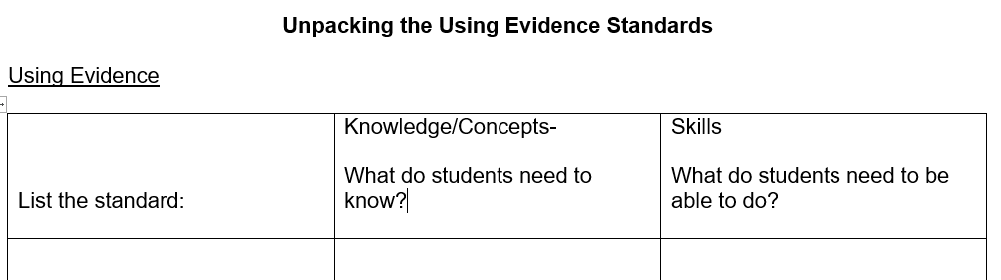
Discovery Task: Unpacking the Using Evidence Standards
Using the Using Evidence standards for the grade level identified, complete the following:
What is the inferred or possible content based on the nouns in the standard?
Vocabulary students will need to know.
Are there any other considerations to think about regarding the meaning of this standard?
Notes:
Discovery Task: Unpacking the Using Evidence Standards
Explain: Ask participants, individually, with a partner or in a small grade-banded group, to complete the following:
Access the Unpacking the Using Evidence template: https://www.education.ky.gov/curriculum/standards/kyacadstand/Documents/Unpacking_the_Using_Evidence_Standards.docx
Identify the Using Evidence standards for your particular grade-level.
Unpack each of the Using Evidence standards for your grade-level using the Using Evidence Standards template.
Example:
List the standard:
Knowledge/Concepts:
What do that students need to know?
Skills:
What do students need to be able to do?
7.I.UE.3 Gather relevant information from multiple sources while using the origin, authority, structure and context of the sources to guide the selection to answer compelling and supporting questions.
Relevant information to compelling and supporting questions
Origin of sources
Authority of sources
Structure of sources
Context of sources
Gather from multiple sources
Use origin, authority, structure, context of sources
Select relevant information
Answer compelling and supporting questions
Facilitate discussions around this work as needed.

Slide 51
Coming Up
Section F: Deeper Dive into the Inquiry Practices: Communicating Conclusions
Section G: Deeper Dive into the Discipline Strands and the Concepts and Practices
Section H: Exploring a Strongly Aligned Assignment Example
Section I: Wrap up & Next Steps
Notes:
Explain: This slide shows the upcoming sections of the module.

Slide 52
End Slide Section B
Stop here if you are completing Section E: Deeper Dive into the Inquiry Practices: Using Evidence.
If you would like to complete another section of the module at this time, continue onto the next slide to begin facilitating Section F: Deeper Dive into the Inquiry Practices: Communicating Conclusions.
Notes:
End Slides for Section E.
Bring the group back together.
Explain: The KDE needs your feedback on the effectiveness of this module, the learning platform and how the consultants may best support you as you take the next steps in the implementation process. We are going to complete a short survey to share our thinking and provide them with feedback on how the KDE can best meet our needs. Feedback from our surveys will be used by the KDE to plan and prepare future professional learning.
Post-survey:
Getting to Know the KAS for Social Studies for Teachers: https://www.surveymonkey.com/r/XH9NC3R
Getting to Know the KAS for Social Studies for School/District Leaders: https://www.surveymonkey.com/r/M23ZWM

Slide 53
Getting to Know the Kentucky Academic Standards for Social Studies
Section F:
Deeper Dive into the Inquiry Practices:
Communicating Conclusions
Notes:
Officially welcome the participants. Introduce yourself (if necessary).
Explain: This module s intended to provide an introduction to the new KAS for Social Studies. Section F builds knowledge of the architecture of the document to discuss the inquiry practices. Specifically, it focuses on the inquiry practice of Communicating Conclusions.
Explain: “Group norms can help to create a safe space where participants feel comfortable sharing their ideas and experiences. Take a moment to read the norms.” After people are finished, ask: “Would you like to revise, edit or add any norms to the list?” If so, make changes on the slide; if not, move on to your discussion of the parking lot. NOTE: If participants made changes to this slide in the session over Section A, you will need to update this slide for their initial reading of the norms.
Explain: “I realize you may not want to pose every question to the whole group, or we may not have time in the session to get to every question. Therefore, I want us to have a place for those questions.” Point out the location of the parking lot for questions. For additional information on how to design the “parking lot” and address the questions, please see the note for the facilitator in Section A.

Slide 54
Group Norms
Assume best intentions.
Listen carefully to one another.
Be open to new ideas.
Be open to working outside your comfort zone.
Ask questions.
Allow a chance for everyone to participate.
Notes:
Go over the group norms on this slide.

Slide 55
Section F Learning Goals
Build a shared understanding of the architecture:
Understand the inquiry practice of Communicating Conclusions as outlined in the KAS for Social Studies,
Become familiar with the components of communicating conclusions standards, and
Strengthen an understanding of the connection between the components of the KAS for Social Studies and the way those components support teachers and other stakeholders.
Notes:
Move on by explaining: There are two primary learning goals for this section of this module. Refer to the slide.

Slide 56
Communicating Conclusions
Communicating conclusions is defined by a student’s ability to effectively communicate their own conclusions and listen carefully to the conclusions of others.
Students should also be able to utilize newer media forms in order to share their conclusions and hear the voices of those whose conclusions may be different.
Depending on the grade level, the Communicating Conclusions standards generally require that students construct explanations and/or arguments and determine how to address problems.
Notes:
Activate the voiceover on this slide to narrate and briefly expand upon the components. Text for this voiceover is found below.
Explain: Communicating conclusions is defined by a student’s ability to effectively communicate his or her own conclusions and listen carefully to the conclusions of others.
Students should also be able to utilize newer media forms in order to share their conclusions and hear the voices of those whose conclusions may be different.
Depending on the grade level, the Communicating Conclusions standards generally require that students construct explanations and/or arguments and determine how to address problems.

Slide 57
Purpose and Function
Students should have opportunities to communicate conclusions to…
Synthesize information to construct new understandings, which will become the foundation for civic engagement.
Construct explanations and arguments
Engage in deliberative and democratic procedures
Act civically by identifying and addressing problems
Notes:
Activate the voiceover on this slide to narrate and briefly expand upon the components. Text for this voiceover is found below.
Explain: A student’s ability to effectively communicate their own conclusions and listen carefully to the conclusions of others can be considered a capstone of social studies disciplinary practices. Traditional products such as essays, reports, tables, diagrams, graphs, multimedia presentations and discussions can be used to share conclusions with a variety of audiences.
Students should have opportunities to communicate conclusions to…
Synthesize information to construct new understandings, which will become the foundation for civic engagement.
Construct explanations and arguments
Engage in deliberative and democratic procedures
Act civically by identifying and addressing problems

Slide 58
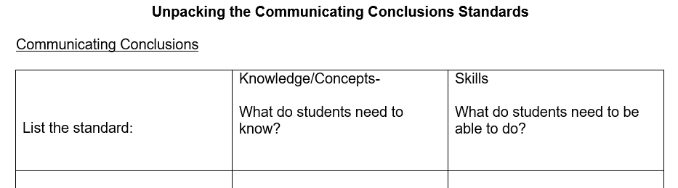
Discovery Task: Unpacking the Communicating Conclusions standards
Using the Communicating Conclusions standards for the grade level identified, complete the following:
What is the inferred or possible content based on the nouns in the standard?
Vocabulary students will need to know.
Are there any other considerations to think about regarding the meaning of this standard?
Notes:
Discovery Task: Unpacking the Communicating Conclusion Standards
Explain: Ask participants, individually, with a partner or in a small grade-banded group, to complete the following:
Access the Unpacking the Communicating Conclusions Standards template: https://www.education.ky.gov/curriculum/standards/kyacadstand/Documents/Unpacking_the_Communicating_Conclusion_Standards.docx
Identify the Communicating Conclusions standards for your particular grade-level.
Unpack each of the Communicating Conclusions standards for your grade-level using the Communicating Conclusions Standards template.
Example:
List the standard:
Knowledge/Concepts:
What do that students need to know?
Skills:
What do students need to be able to do?
8.I.CC.4 Apply a range of deliberative and democratic procedures to make decisions about ways to take action on current local, regional and global issues.
Ways to take action
Deliberative procedures
Democratic procedures
Current local, regional, global issues
Apply a range of deliberative and democratic procedures
Make decisions
Take action

Slide 59
Reflection Questions
What is the difference between students communicating “answers” versus communicating “conclusions”?
In what ways are students typically asked to communicate conclusions?
Why is purposeful planning important when asking students to communicate conclusions?
Notes:
Discovery Task: Ask participants, individually, with a partner or in a small grade-banded group, to answer the questions provided on the slide using their knowledge of the communicating conclusions standards.
Consider maintaining a Google document to house these reflections for continued consideration and further application.

Slide 60
Coming Up
Section G: Deeper Dive into the Discipline Strands and the Concepts and Practices
Section H: Exploring a Strongly Aligned Assignment Example
Section I: Wrap up & Next Steps
Notes:
Explain: This slide shows the upcoming sections of the module.

Slide 61
End Slide Section C
Stop here if you are completing Module Section F: Deeper Dive into the Inquiry Practices: Communicating Conclusions only.
If you would like to complete another section of the module at this time, continue onto the next slide to begin facilitating Section G: Deeper Dive into the Discipline Strands and the Concepts and Practices.
Notes:
End Slides for Section F.
Bring the group back together.
Explain: The KDE needs your feedback on the effectiveness of this module, the learning platform and how the consultants may best support you as you take the next steps in the implementation process. We are going to complete a short survey to share our thinking and provide them with feedback on how the KDE can best meet our needs. Feedback from our surveys will be used by the KDE to plan and prepare future professional learning.
Post-survey:
Getting to Know the KAS for Social Studies for Teachers: https://www.surveymonkey.com/r/XH9NC3R
Getting to Know the KAS for Social Studies for School/District Leaders: https://www.surveymonkey.com/r/M23ZWM

Slide 62
Getting to Know the Kentucky Academic Standards for Social Studies
Section G
Deeper Dive into the Discipline Strands and the Concepts and Practices
Notes:
Officially welcome the participants. Introduce yourself (if necessary).
Explain: This module is intended to provide an introduction to the new KAS for Social Studies. Section G builds knowledge of the architecture of the document to discuss discipline strands and the concepts and practices.
Explain: “Group norms can help to create a safe space where participants feel comfortable sharing their ideas and experiences. Take a moment to read the norms.” After people are finished, ask: “Would you like to revise, edit or add any norms to the list?” If so, make changes on the slide; if not, move on to your discussion of the parking lot. NOTE: If participants made changes to this slide in the session over Section A, you will need to update this slide for their initial reading of the norms.
Explain: “I realize you may not want to pose every question to the whole group, or we may not have time in the session to get to every question. Therefore, I want us to have a place for those questions.” Point out the location of the parking lot for questions. For additional information on how to design the “parking lot” and address the questions, please see the note for the facilitator in Section A.

Slide 63
Group Norms
Assume best intentions.
Listen carefully to one another.
Be open to new ideas.
Be open to working outside your comfort zone.
Ask questions.
Allow a chance for everyone to participate.
Notes:
Go over the group norms on this slide.

Slide 64
Organization of the Standards
Notes:
Note to facilitator: Remind the participants of the importance of this image.
Activate the voiceover on this slide to narrate and briefly expand upon the components. Text for this voiceover is found below.
When engaging with the KAS for Social Studies, it is crucial that participants understand that the organization of the standards requires a balance between the inquiry practices and the discipline strand standards as both are crucial to develop mastery understanding of the standards.
Explain: The KAS for Social Studies is organized around the inquiry practices of questioning, investigating, using evidence and communicating conclusions. Students will consider or pose questions and then investigate those questions through the disciplinary lenses of civics, economics, geography and history. Students complete the inquiry process by communicating evidence-based conclusions.
The inquiry process is critical for effective student understanding of civics, economics, geography and history. Inquiry instruction requires teachers and students to ask questions that drive student investigation of the subject matter and eliminates the “skills vs. content” dilemma in social studies as both are needed to successfully engage in inquiry. Students will engage in inquiry using the tools, conceptual understandings and the language of political scientists, economists, geographers and historians at a developmentally appropriate level. Students will craft arguments, apply reasoning, make comparisons, corroborate their sources and interpret and synthesize evidence as political scientists, economists, geographers and historians.

Slide 65
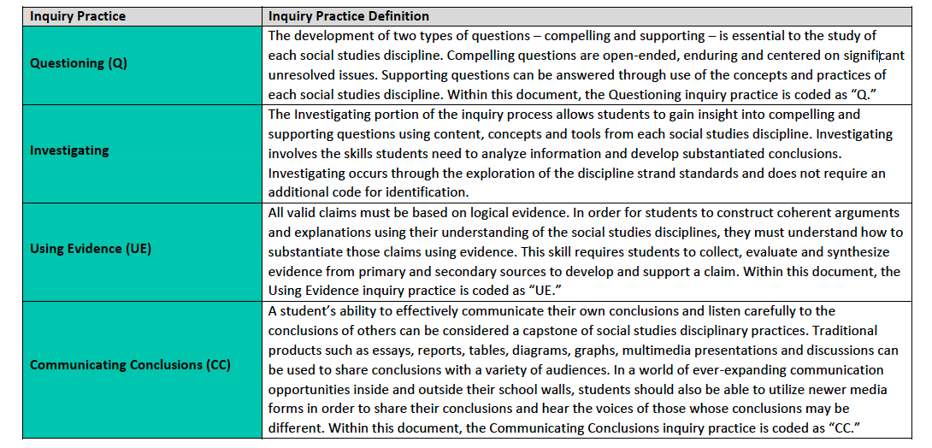
Disciplines Strands and the Inquiry Practices
Notes:
Activate the voiceover on this slide to narrate and briefly expand upon the components. Text for this voiceover is found below.
Explain: When engaging with the KAS for Social Studies, it is important to understand the relationship between the inquiry practices and the discipline strand standards. At the first glance of the architecture, it may appear that the discipline strand standards only interact with the inquiry standards through the inquiry practice of investigation. However, this is not the case. As can be seen in the annotated chart on this slide, students cannot successfully engage in inquiry without the discipline strand standards. The social studies disciplines and the concepts and practices of the disciplines are required to ask compelling and supporting questions, acquire new knowledge, substantiate claims using evidence and effectively communicate conclusions.

Slide 66
Culturally Literate Citizens
In order to be culturally literate, students must have knowledge of each of the four social studies disciplines and an appreciation for the interconnectedness of all four disciplines. This is central to students’ preparation for a successful transition into civic life.
See the top of page 2 of the KAS for Social Studies to read the indicators of prepared Kentucky graduates to understand the purpose of a multi-disciplinary approach to social studies education.
Consider:
How will students benefit from engaging with all four disciplinary lenses throughout their social studies education?
How will this prepare them to be culturally literate citizens beyond the classroom?
Notes:
Explain: In order to be culturally literate, students must have knowledge of each of the four social studies disciplines and an appreciation for the interconnectedness of all four disciplines. This is central to students’ preparation for a successful transition into civic life.
See the top of page 2 of the KAS for Social Studies to read the indicators of prepared Kentucky graduates to understand the purpose of a multi-disciplinary approach to social studies education.
Ask participants, individually, with a partner or in a small grade-banded group, to consider:
How will students benefit from engaging with all four disciplinary lenses throughout their social studies education?
How will this prepare them to be culturally literate citizens beyond the classroom?
Consider maintaining a Google document to house these reflections for continued consideration and further application.

Slide 67
Disciplinary Strands
The disciplinary strands identified in the KAS for Social Studies are civics, economics, geography and history.
In Kentucky, the discipline strands in social studies are meant to be taught in unison. Students recall and understand themes and topics better if the social studies strands are integrated and not taught in isolation.
Notes:
Explain: The disciplinary strands identified in the KAS for Social Studies are civics, economics, geography and history.
In Kentucky, the discipline strands in social studies are meant to be taught in unison. Students recall and understand themes and topics better if the social studies strands are integrated and not taught in isolation.

Slide 68
SB1 (2017) Standards Revision Requirements
The standards revision to the content standards shall:
Focus on critical knowledge, skills, and capacities needed for success in the global economy;
Result in fewer, but more in-depth standards to facilitate mastery learning;
Communicate expectations more clearly and concisely to teachers, parents, students and citizens;
Be based on evidence-based research;
Consider international benchmarks; and
Ensure that the standards are aligned from elementary to high school to post-secondary education so that students can be successful at each education level.
Notes:
Activate the voiceover on this slide to narrate and briefly expand upon the components. Text for this voiceover is found below.
Explain: When engaging with the Discipline Strand standards, it is important to review the requirements of SB 1 (2017). One of the standards revision requirements of SB 1 (2017) states that “the standards revision to the content standards shall… Result in fewer, but more in-depth standards to facilitate mastery learning.” This is critical to remember when engaging with the Discipline strand standards. In order to meet this requirement, the writers wrote standards that were more in-depth to facilitate mastery learning. As a result, educators may have to engage with a standard multiple times throughout a year in order to meet the full intent of the standard. Meaning, that an educator may revisit the standard in multiple lessons or unit plans throughout the year as an example.

Slide 69
Discovery Task: Disciplinary Strands
Individually, with a partner or in a small grade-banded group, read the definitions of the discipline strand standards found in the chart on pages 11-16 of the KAS for Social Studies and answer the following questions:
Summarize the definition of each disciplinary strand.
How does this definition change your understanding of the discipline?
Notes:
Discovery Task: Ask participants, individually, with a partner or in a small grade-banded group, read the definitions of the discipline strand standards found in the chart on pages 11-16 of the KAS for Social Studies and answer the following questions:
Summarize the definition of each disciplinary strand.
How does this definition change your understanding of the discipline?
Consider maintaining a Google document to house these reflections for continued consideration and further application.

Slide 70
Concepts and Practices
Within the discipline strands, students engage with disciplinary concepts and practices outlined in the chart on pages 11-16 in the KAS for Social Studies.
Disciplinary concepts are the broad ideas that enable a student to understand the language of each discipline and are designed to remain with students long after they are transition ready.
The disciplinary practices refers to the skills students are expected to learn and apply when engaging with the disciplinary concepts.
The concepts remain the same throughout the document and only appear when they are grade-level, theme and discipline appropriate.
Notes:
Explain: Within the discipline strands, students engage with disciplinary concepts and practices outlined in the chart on pages 11-16 in the KAS for Social Studies.
Disciplinary concepts are the broad ideas that enable a student to understand the language of each discipline and are designed to remain with students long after they are transition ready.
The disciplinary practices refers to the skills students are expected to learn and apply when engaging with the disciplinary concepts.
The concepts remain the same throughout the document and only appear when they are grade-level, theme and discipline appropriate.

Slide 71
Discovery Task: Concepts and Practices Reflection
Individually, with a partner or in a small grade-banded group, complete the following:
Read through each disciplinary concept and practice and underline, highlight, circle, etc., elements that impact instruction.
What areas do you feel are a strength? In what areas do you need additional support?
Notes:
Discovery Task: Ask participants, individually, with a partner or in a small grade-banded group, to complete the following:
Read through each disciplinary concept and practice and underline, highlight, circle, etc., elements that impact instruction.
What areas do you feel are a strength? In what areas do you need additional support?
Consider maintaining a Google document to house these reflections for continued consideration and further application.

Slide 72
Concepts and Practices
Traditionally, Kentucky studies was the focus of fourth grade. However, the KAS for Social Studies requires a disciplinary study of Kentucky throughout a child’s social studies education K-12.
Consider:
What are the advantages of studying Kentucky throughout the k-12 progression?
How does a more sophisticated understanding of Kentucky allow a student to better understand self, others and the world?
Notes:
Explain: Traditionally, Kentucky studies was the focus of fourth grade. However, the KAS for Social Studies requires a disciplinary study of Kentucky throughout a child’s social studies education K-12.
Ask participants, individually, with a partner or in a small grade-banded group, to answer the questions on the bottom of the slide:
What are the advantages of studying Kentucky throughout the K-12 progression?
How does a more sophisticated understanding of Kentucky allow a student to better understand self, others and the world?
Consider maintaining a Google document to house these reflections for continued consideration and further application.

Slide 73
Coming Up
Section H: Exploring a Strongly Aligned Assignment Example
Section I: Wrap up & Next Steps
Notes:
Explain: This slide shows the upcoming sections of the module.

Slide 74
End Slide Section D
Stop here if you are completing Section G: Deeper Dive into the Discipline Strands and the Concepts and Practices.
If you would like to complete another section of the module at this time, continue onto the next slide to begin facilitating Section H: Exploring a Strongly Aligned Assignment Example.
Notes:
End Slides for Section G.
Bring the group back together.
Explain: The KDE needs your feedback on the effectiveness of this module, the learning platform and how the consultants may best support you as you take the next steps in the implementation process. We are going to complete a short survey to share our thinking and provide them with feedback on how the KDE can best meet our needs. Feedback from our surveys will be used by the KDE to plan and prepare future professional learning.
Post-survey:
Getting to Know the KAS for Social Studies for Teachers: https://www.surveymonkey.com/r/XH9NC3R
Getting to Know the KAS for Social Studies for School/District Leaders: https://www.surveymonkey.com/r/M23ZWM

Slide 75
Getting to Know the Kentucky Academic Standards for Social Studies
Section H:
Exploring a Strongly Aligned Assignment Example
Notes:
Officially welcome the participants. Introduce yourself (if necessary).
Explain: This module is intended to provide an introduction to the new KAS for Social Studies. Section H focuses on exploring an assignment strongly aligned to the KAS for Social Studies.
Explain: “Group norms can help to create a safe space where participants feel comfortable sharing their ideas and experiences. This slide is a starter. Take a moment to read the norms.” After people are finished, ask: “Would you like to revise, edit or add any norms to the list?” If so, make changes on the slide; if not, move on to your discussion of the parking lot. NOTE: If participants made changes to this slide in a previous session, you will need to update this slide for their initial reading of the norms.
Explain: “I realize you may not want to pose every question to the whole group, or we may not have time in the session to get to every question. Therefore, I want us to have a place for those questions.” Point out the location of the parking lot for questions. For additional information on how to design the “parking lot” and address the questions, please see the note for the facilitator in Section A.

Slide 76
Group Norms
Assume best intentions.
Listen carefully to one another.
Be open to new ideas.
Be open to working outside your comfort zone.
Ask questions.
Allow a chance for everyone to participate.
Notes:
Go over the group norms on this slide.

Slide 77
Student Assignment Library
Notes:
Transition to student assignment library. Have participants access this page.

Slide 78
Student Assignment Library
The Student Assignment Library provides examples of student assignments that are weakly, partially and strongly aligned to standards. Strongly aligned assignments are provided for each grade Kindergarten through Grade 8 and one assignment is provided for the high school grade band. One weakly and/or partially aligned assignment example are provided for elementary, middle and high.
Teacher Notes are designed to support educators in implementing assignments that are strongly aligned to the Kentucky Academic Standards (KAS) for Social Studies. Teacher Notes, which are available for kindergarten – high school, contain guidance on how to scaffold student understanding of the inquiry practices and the disciplinary strands referenced in the strongly aligned assignments to the KAS for Social Studies.
The assignments can be used with the Assignment Review Protocol to develop a better understanding of the tool and how it can be applied to a teacher’s own work.
Notes:
Have participants access the student assignment library from www.kystandards.org when they learn about this page.

Slide 79
Strongly Aligned Assignments to the KAS for Social Studies
Writers’ Vision Statement
The writing team envisioned standards that would afford students an opportunity to provide social studies learning experiences that will prepare all K-12 students in Kentucky to be productive and involved members of society. Under this framework, Kentucky students actively will engage with the social studies concepts, ideas and practices needed to participate in and navigate the community, state, nation and world in which they live. In an ever-changing and increasingly interconnected world, students must be life-long critical thinkers and questioners who can undertake multidimensional, complex reasoning.
Throughout grades K-12, students have the opportunity to interact with diverse groups of people, ask thoughtful questions, think critically, evaluate sources, make informed decisions and communicate logically and effectively—all skills students need to engage in the world around them with consideration of the past, present and future.
Notes:
Have participants review the writer’s vision statement.

Slide 80
Strongly Aligned Assignments to the KAS for Social Studies
In Kentucky, the discipline strands in social studies are meant to be taught in unison. Students recall and understand themes and topics better if the social studies strands are integrated and not taught in isolation.
Page 10, the KAS for Social Studies
Notes:
Explain: Review with participants the importance of this graphic from page 10 of the KAS for Social Studies.

Slide 81
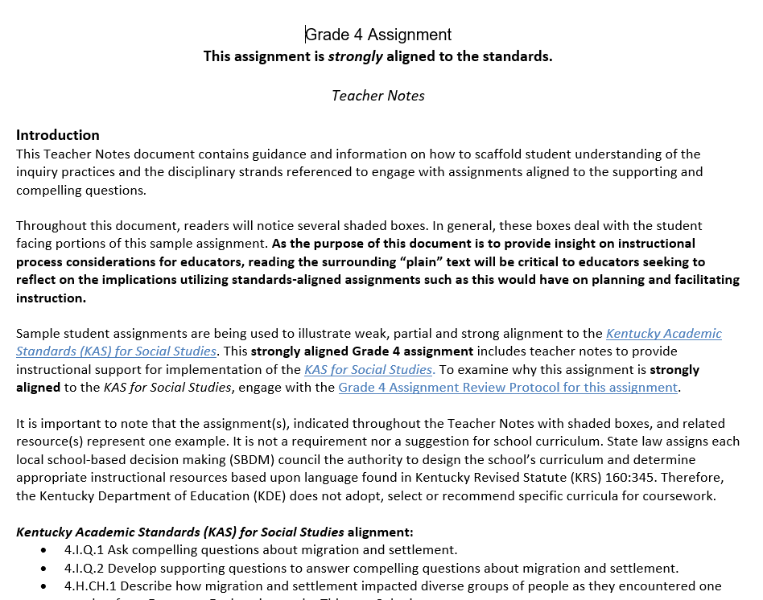
Access the Assignment with Teacher Notes for your grade-level/course from kystandards.org
K - 8
Access the Assignment with Teacher Notes for your Grade-Level from the Student Assignment Library at www.kystandards.org
High School:
If you teach…
Social Studies One, access Strongly Aligned 2.
Social Studies Three, access Strongly Aligned 3.
US History, access Strongly Aligned 3
World History, access Strongly Aligned 2.
Notes:
Have participants read the slide and access their grade-level or course Teacher Notes from https://www.kystandards.org/standards-resources/sal/ss_sal/.

Slide 82
Strongly Aligned Assignments to the
KAS for Social Studies
For this deeper dive, we ask that you access the Teacher Notes document for your grade level in the Student Assignment Library on www.kystandards.org. Once you have accessed this document, annotate the document by completing the following:
●Underline key ideas and major points.
●Write a ? next to anything that is confusing.
●Circle key words or phrases.
●Put an ! next to information that helps you make a connection to the writer’s vision.
If you are unable to annotate with the symbols above, use different highlighter colors to indicate each step in the directions.
Notes:
Introduce this slide by saying: We are going to take a deeper dive into the characteristics of a strongly aligned assignment to the KAS for Social Studies.
When participants are done annotating the assignments found in the Teacher Notes, have them indicate that they are done with the thumbs up signal.
If they cannot write a question mark or circle information, have participants use different highlighter colors to represent the topics above.
Participants will take up to 30 minutes to review the Teacher Note document. Note: participants can and should request more time to annotate the teacher note if needed.

Slide 83
Teacher Notes Discussion
After reading the Teacher Notes for your grade level, engage in a Think Pair Share thinking routine with a partner. Share the following in your discussions:
What were the key ideas and major points that you underlined.
How do your responses compare with your partner’s?
What parts, indicated with a ?, were confusing to you?
Is your partner(s) able to clarify any parts that you indicated?
What parts, indicated with a ?, were confusing to you?
Did your partner(s) identify any of the same key words or phrases?
What parts, indicated with a ?, were confusing to you?
How do your responses compare with your partner’s?
Notes:
Provide participants 20 minutes to discuss these questions with a partner. Once participants have completed their Think, Pair, Share, have participants share their responses in a whole group discussion.
View https://bokcenter.harvard.edu/leading-discussions for tips on how to conduct this discussion.

Slide 84
Reflection
1) How were the instructional shifts of the KAS for Social Studies reflected in the Teacher Note you annotated?
2) How will the instructional shifts of the KAS for Social Studies impact your classroom instruction?
Notes:
Ask participants to reflect on the questions provided on the slide. Then, ask individuals to share their responses to these questions with the whole group.

Slide 85
Coming Up
Section I: Wrap up & Next Steps
Notes:
Explain: This slide shows the upcoming section of the module.

Slide 86
End Slide Section D
Stop here if you are completing Section H: Exploring a Strongly Aligned Assignment Example.
If you would like to complete another section of the module at this time, continue onto the next slide to begin facilitating Section I: Wrap up & Next Steps.
Notes:
End Slides for Section H.
Bring the group back together.
Explain: The KDE needs your feedback on the effectiveness of this module, the learning platform and how the consultants may best support you as you take the next steps in the implementation process. We are going to complete a short survey to share our thinking and provide them with feedback on how the KDE can best meet our needs. Feedback from our surveys will be used by the KDE to plan and prepare future professional learning.
Post-survey:
Getting to Know the KAS for Social Studies for Teachers: https://www.surveymonkey.com/r/XH9NC3R
Getting to Know the KAS for Social Studies for School/District Leaders: https://www.surveymonkey.com/r/M23ZWM

Slide 87
Getting to Know the Kentucky Academic Standards for Social Studies
Section I:
Wrap Up & Next Steps
Notes:
Officially welcome the participants. Introduce yourself (if necessary).
Explain: This module is intended to provide an introduction to the new KAS for Social Studies. Section I focuses on a wrap up of this module and provides time for determining next steps for professional learning.
Explain: “Group norms can help to create a safe space where participants feel comfortable sharing their ideas and experiences. This slide is a starter. Take a moment to read the norms.” After people are finished, ask: “Would you like to revise, edit or add any norms to the list?” If so, make changes on the slide; if not, move on to your discussion of the parking lot. NOTE: If participants made changes to this slide in a previous session, you will need to update this slide for their initial reading of the norms.
Explain: “I realize you may not want to pose every question to the whole group, or we may not have time in the session to get to every question. Therefore, I want us to have a place for those questions.” Point out the location of the parking lot for questions. For additional information on how to design the “parking lot” and address the questions, please see the note for the facilitator in Section A.

Slide 88
Group Norms
Assume best intentions.
Listen carefully to one another.
Be open to new ideas.
Be open to working outside your comfort zone.
Ask questions.
Allow a chance for everyone to participate.
Notes:
Go over the group norms on this slide.

Slide 89
Goals of this module:
Build a shared understanding of the KAS for Social Studies document.
Strengthen the connection between the components of the KAS for Social Studies and the way those components can support teachers in the process of designing standards-aligned instruction and grade-level assignments.
Experience how the changes in the KAS for Social Studies can and will be reflected in student experiences within Kentucky classrooms.
Identify and prioritize areas where future professional learning opportunities will be needed in the implementation process with the new KAS for Social Studies and discuss plans to address those areas.
Notes:
Move on by explaining: Before we take some time today to consider our next steps, we are going to revisit the overall goals for this module. Read the slide.

Slide 90
Module Wrap Up
Getting to Know the Kentucky Academic Standards (KAS) for Social Studies Module
Section A: Revision Process Overview (Appendix)
Section B: Understanding the Architecture
Section C: Implementation Supports in the KAS for Social Studies
Section D: Deeper Dive into the Inquiry Practices: Questioning
Section E: Deeper Dive into the Inquiry Practices: Using Evidence
Section F: Deeper Dive into the Inquiry Practices: Communicating Conclusions
Section G: Deeper Dive into the Discipline Strands and the Concepts and Practices
Section H: Exploring a Strongly Aligned Assignment Example
Section I: Wrap & Next Steps
These sessions are intended to support the successful transition to and implementation of the Kentucky Academic Standards (KAS) for Social Studies in classrooms across the state.
Notes:
Explain: The seven sessions were designed to meet the four goals of this module and to support teachers, school leaders and district/state leaders in transitioning to and implementing the new KAS for Social Studies.

Slide 91
Consider:
How effective was the Getting to Know the KAS for Social Studies module in meeting its goals? Most effective components? Least?
During the implementation process, in what areas do you foresee you/teachers might need additional instructional support? Additional content support?
What supports will you/teachers need in your school(s) to make implementation successful?
Notes:
Explain: In light of the purpose and function of this module, I want you to consider the following questions. (Read slide.) Take 5 minutes to reflect individually, and take notes you will be willing to share with a partner.
After 5 minutes, ask participants to find a partner. Identify who should begin (person with the longest hair, person who is the tallest, person whose name comes first alphabetically, etc.). Partner A should answer question 1 while Partner B listens. Then Partner B shares answer 1 while Partner A listens. Partners should continue taking turns answering the questions until both have shared their responses for all three questions. Use a countdown timer to give them 2 minutes to get through the questions. You may provide an additional minute if the conversations are lively and engaging.

Slide 92
Planning for Next Steps
Where do we go from here?
The implementation of the KAS for Social Studies will mean that there are changes for educators across the state.
Districts and schools will need to prepare and prioritize the next steps in the implementation process.
Begin the Pain-Gain Map.
Notes:
Bring the group back together, and explain that they need to save their thoughts on the reflection questions because they will use this thinking for planning the next steps.
Continue by explaining: Our main objective for today is considering where we go from here. Begin reading the slide at bullet 2.
Explain: To help with generating and prioritizing the next steps in the implementation process, we’re going to do a Pain-Gain map.
This is an opportunity to collaborate within your work group to create a plan for how you are going to move forward. Essentially, now that you’ve gotten to know the KAS for Social Studies, what are the next most critical, manageable steps in the implementation process?
By framing your understanding of your “work ahead,” or the next steps in the process, your team (whether at the PLC, department, or district level) can collaborate to outline a plan to ensure you are addressing these issues. NOTE: Be sure participants understand they are to list or bullet the next steps for implementation relating to the principle for action in the “Work Ahead” box. Then, they will continue to frame the “Work Ahead” in the process by considering the pains, gains, supports needed and priorities for each element of the “Work Ahead.”
Allow participants to work individually, with a partner or in group to reflect, brainstorm, plan and/or discuss.
If time allows, guide participants into prioritizing the next steps so that work continues after this meeting.
NOTE: Distribute (or make available on a shared drive) the Participant’s Guide: Thinking Back to Plan for the Future. Participants can use this guide as a planning tool. There is a Participant Guide for Teachers, a Participant Guide for School Leaders, and a Participant Guide for District/State Leaders.
Hyperlinks for the three guides:
Teachers - https://www.education.ky.gov/curriculum/standards/kyacadstand/Documents/SS_Thinking_Back_to_Plan_for_the_Future_Teacher_Guide.docx
School Administration/Leadership - https://www.education.ky.gov/curriculum/standards/kyacadstand/Documents/SS_Thinking_Back_to_Plan_for_the_Future_School_Leadership_Guide.docx
District/State Leadership -
https://www.education.ky.gov/curriculum/standards/kyacadstand/Documents/SS_Thinking_Back_to_Plan_for_the_Future_District_State_Leadership_Guide.docx

Slide 93
Stop
This is the end of the Getting to Know the KAS for Social Studies module.
Please complete the KDE survey to provide feedback on the module and to share your needs.
Notes:
Bring the group back together.
Explain: The KDE needs your feedback on the effectiveness of this module, the learning platform and how the consultants may best support you as you take the next steps in the implementation process. We are going to complete a short survey to share our thinking and provide them with feedback on how the KDE can best meet our needs. Feedback from our surveys will be used by the KDE to plan and prepare future professional learning.
Post-survey:
Getting to Know the KAS for Social Studies for Teachers: https://www.surveymonkey.com/r/XH9NC3R
Getting to Know the KAS for Social Studies for School/District Leaders: https://www.surveymonkey.com/r/M23ZWM
Be sure to thank participants for their work throughout this module as it has provided a foundation for future knowledge and work.
To you, the facilitator, thank you for providing participants with knowledge and support throughout this process. The KDE greatly values your role in facilitating the Getting to Know the KAS for Social Studies module. We appreciate your time and effort in leading your school and district in the successful implementation of the KAS for Social Studies. Thank you!

Slide 94
Getting to Know the Kentucky Academic Standards for Social Studies
Appendix: Section A
Revision Process Overview
Notes:
Officially welcome the participants. Introduce yourself (if necessary).
Explain: This module is intended to provide an introduction to the new KAS for Social Studies.
Explain: “Group norms can help to create a safe space where participants feel comfortable sharing their ideas and experiences. This slide is a starter. Take a moment to read the norms.” After people are finished, ask: “Would you like to revise, edit or add any norms to the list?” If so, make changes on the slide; if not, move on to your discussion of the parking lot.
Explain: “I realize you may not want to pose every question to the whole group, or we may not have time in the session to get to every question. Therefore, I want us to have a place for those questions.” Point out the location of the parking lot for questions. This may be a poster on which participants write or post questions, or you may prefer to have a digital parking lot where participants can access a Google document, for example, to post questions and that you can modify as the participants work through the sections of the module. The purpose of the parking lot is to provide participants with a safe way of asking questions. Remember that you may not know all of the answers to the questions, and that is okay. Some may be answered in future sections of the modules or in the regular webinars for facilitators.
If the question is pressing and doesn’t appear to be addressed in the sections of this module, talk to your district team and determine who would be the best person to contact at the KDE. You may also email questions or feedback to standards@education.ky.gov.

Slide 95
Group Norms
Assume best intentions.
Listen carefully to one another.
Be open to new ideas.
Be open to working outside your comfort zone.
Ask questions.
Allow a chance for everyone to participate.
Notes:
Go over the Group Norms on this slide.

Slide 96
Module Goals:
Build a shared understanding of the KAS for Social Studies document.
Strengthen the connection between the components of the KAS for Social Studies and the way those components can support teachers in the process of designing instruction.
Experience how the changes in the KAS for Social Studies can and should be reflected in student experiences within our classrooms.
Identify and prioritize areas where future professional learning opportunities will be needed in the implementation process with the new KAS for Social Studies and discuss the plan to address those areas.
Notes:
Explain: The goals for this module are on this slide.

Slide 97
Revision Process Overview Essential Questions
Why were the standards revised?
What was the process for the revision?
Notes:
Move on by explaining: Section A of this module provides an overview of the standards revision process as required by Senate Bill 1 (2017) and the role that classroom teachers played in the revision process. Two essential questions will be answered by the end of Section A. Read the questions on the slide.

Slide 98
SB1 (2017) Standards Revision Requirements
The standards revision to the content standards shall:
Focus on critical knowledge, skills, and capacities needed for success in the global economy;
Result in fewer, but more in-depth standards to facilitate mastery learning;
Communicate expectations more clearly and concisely to teachers, parents, students and citizens;
Be based on evidence-based research;
Consider international benchmarks; and
Ensure that the standards are aligned from elementary to high school to post-secondary education so that students can be successful at each education level.
Notes:
Explain: The standards revision process occurs on a 6 year rotation per the directive of Senate Bill 1 (2017). These 6 main requirements from the law guided the work. The standards writers were intentional and thoughtful in meeting the requirements of the law. For example, they took great care in communicating expectations clearly and concisely to all stakeholders, while at the same time providing supports that are intended to aid teachers in aligning their instruction to the standards.

Slide 99
Standards Creation Process
The Social Studies Standards Advisory Panel (AP) was composed of practicing classroom teachers, public post-secondary professors from institutions of higher education and business/community members.
The function of the AP was to review the standards and make recommendations for changes to a Review and Development Committee (RDC).
In addition to revising the standards, the AP created a new architectural structure for the standards.
Notes:
Explain: The standards revision work was completed by two different teams of Kentucky educators and community members from across the state. This slide describes the membership and work of the Advisory Panel.

Slide 100
Standards Creation Process
The Social Studies Standards Review and Development Committee (RDC) was composed of practicing classroom teachers, public post-secondary professors from institutions of higher education and community members.
The function of the RDC was to review the work and findings from the AP and make recommendations to revise or replace existing standards.
Members of the AP and RDC applied and were selected based on their expertise in social studies and the need for statewide representation.
Notes:
This slide describes the membership and work of the Review and Development Committee. A list of the writing committee members is found in Appendix B of the KAS for Social Studies.

Slide 101
Writers’ Vision
The social studies standards were created by educators for educators with the purpose of preparing all K-12 students in Kentucky to be productive and involved members of society. In an ever-changing and increasingly interconnected world, students must be life-long critical thinkers and questioners who can undertake multidimensional, complex reasoning.
Throughout grades K-12, students have the opportunity to interact with diverse groups of people, ask thoughtful questions, think critically, evaluate sources, make informed decisions and communicate logically and effectively—all skills students need to engage in the world around them with consideration of the past, present and future.
Notes:
Explain: The writers had a clear vision of the purpose, function and goals of the KAS for Social Studies document.
NOTE: If participants would like more information on the standards revision process, direct them to the following sites:
https://www.education.ky.gov/_layouts/download.aspx?SourceUrl=/curriculum/standards/revision/Pages/default.aspx
https://www.education.ky.gov/curriculum/standards/revision/Documents/Kentucky%20Aca demic%20Standards_Review_and_Implementation_Timeline.pdf

Slide 102
Certificate of Completion
Thank you for completing this asynchronous module provided by the KDE.
Please use the link below to obtain your certificate of completion.
Kentucky Department of Education Professional Learning Modules
Educators can use the PLBB to find learning sessions, and it is the local school district who determines if they are acceptable for credit based on their district policies. See 704 KAR 3:035 for more details.

