Slide 1
Integrating Deeper Learning and HQIRs to Strengthen Tier 1 Instruction
Deep Learning
Notes:
[Fox 1-6] Hello everyone, and welcome to the third module of a four-module series to support “Integrating Deeper Learning and HQIRs to Strengthen Tier 1 Instruction.” This module will focus on the learning science-based stage of Deep Learning. My name is Fox DeMoisey. I am joined today by Misty Higgins, and we are professional learning coordinators in the Division of Program Standards, Office of Teaching and Learning, at the Kentucky Department of Education.

Slide 2
Module Purpose
Module Objectives:
Build understanding of “deep learning” and associated findings from learning science.
Explore indicators of deep learning using examples from HQIRs.
Consider deeper learning practices to support potential adjustments to an HQIR.
Notes:
[Fox] This module has three primary objectives:
Build understanding of “deep learning” and associated findings from learning science;
Explore indicators of deep learning using examples from HQIRs; and
Consider deeper learning practices to support potential adjustments to a HQIR.
Our intention is that the information within this session and accompanying curriculum analysis and adjustment tool provided at the end will enable districts to assess where an adopted HQIR is strong, foundationally and also with regard to characteristics of deeper learning, through the lens of learning science, and where it might need “smart adjustments” of the kind certain deeper learning practices can provide in order to more fully afford all students vibrant learning experiences and improved academic outcomes.
Moving into the module now, our first objective [CLICK] is “Build understanding of ‘deep learning’ and associated findings from learning science.”

Slide 3
Opening Notes for Deep Learning
The deep understandings at the heart of deeper learning require a significant bank of declarative and procedural knowledge so that it can be used for complex processes like developing interpretations, arguments and conclusions.¹
This bank of knowledge, skills and strategies is added to and refined during deep learning.
Direct instruction, modeling, practice and feedback are provided during deep learning to help students develop fluency with the key knowledge and processes required to engage in critical thinking and problem-solving. ²
Notes:
[Fox] In the previous module, [CLICK] we focused on the building of “a significant bank of declarative and procedural knowledge” so it can support “the deep understandings at the heart of deeper learning” and enable “complex processes like developing interpretations, arguments and conclusions.”
And pausing a moment, a clarifying distinction to make here is between “deep learning” as a phase of learning corresponding to findings from learning science, and initiatives around “deeper learning,” which refers to a set of pedagogical values and practices. As we help establish what is meant by “deep learning” as a learning phase during this module, you are invited to compare it to the characteristics of “deeper learning” found in the “Integrating Deeper Learning and HQIR to Strengthen Tier 1 Instruction” introduction document and to the deeper learning practices laid out in these modules. As surface learning is required for deeper learning to be possible, so is the deep learning addressed here, which is the next layer of that foundation.
Returning now to the slide [CLICK], as knowledge, skills and strategies are built upon during deep learning, [CLICK] direct instruction, modeling, practice and feedback are provided to help students develop the fluency with key knowledge and processes required to engage in critical thinking and problem-solving.
As we transition into deep learning now, an important note to keep in mind: If we want students to be able to transfer their knowledge, understandings and skills to new situations, we must be intentional about how knowledge, understandings and skills are processed, practiced, retrieved and applied.
References:
¹ Bransford, J., Brown, A. L., Cocking, R. R., National Research Council (U.S.). Committee on Developments in the Science of Learning, & National Research Council (U.S.). Committee on Learning Research and Educational Practice. (2000). How People Learn : Brain, Mind, Experience and School (Expanded Edition). National Academies Press. (ESSA Level 4)
² Goodwin, B. (2020). Learning that sticks: A brain-based model for K-12 instructional design and delivery. Alexandria, VA: ASCD (ESSA Level 4)

Slide 4
Phases of Learning
Notes:
[Fox] The introductory document that frames this series—and there is a link back to it provided here in the speaking notes—shared how education leaders such as John Hattie, Doug Fisher and Nancy Frey have found it useful to divide the learning process into three phases: surface, deep and transfer (Hattie, et.al., 2017). It then offered that core principles from learning science can also be laid out across a series of similar phases, adding an emphasis on “priming” for learning (Goodwin & Rouleau, 2023). The visual on the slide is figure 1.2 in that introduction, with the third stage enlarged here to signal the focus of the third module, Deep Learning. As we mentioned in the last module, it is important to note these phases are not perfectly linear or distinct. Aspects of one phase may naturally occur in another, and there may be some movement back and forth between them over the course of each unit of instruction.
Once we have the students’ immediate attention through priming for learning and have supported them in taking in new learning and moving it into working memory, the focus shifts to helping students actively process and consolidate learning to prepare them for application and transfer, which also includes explicitly building the skills and strategies needed to support consolidation and initial application.
Link: https://education.ky.gov/curriculum/standards/kyacadstand/Documents/Integrating_HQIRs_and_Deeper_Learning_to_Strengthen_Tier_1_Instruction.pdf

Slide 5
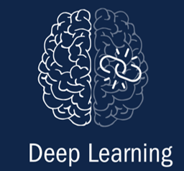
Deep Learning
Occurs when students consolidate knowledge, extend sensemaking and apply surface learning to support deeper conceptual understanding. It is also associated with “conditional knowledge,” students learning how to decide which knowledge, skills and strategies to use in a given situation.
Making sense of learning drives consolidation, which clusters and arranges the learning to help ensure it moves from working to long-term memory.
Notes:
[Fox] The stage of deep learning [CLICK] occurs when students consolidate knowledge, extend sensemaking and apply surface learning to support deeper conceptual understanding. It is also where [CLICK] students begin to develop “conditional knowledge,” which is learning how to decide which knowledge, skills and strategies to use in a given situation. All of this serves consolidation, allowing learning to cluster and organize to help ensure it moves into long-term memory.

Slide 6
Model of the Learning Process
Notes:
[Fox] This slide, introduced in the last module, offers an illustration of the basic dynamics of how memory works. In the first module, we saw an emphasis on sparking student interest and then securing a commitment to learn in order to ”prime” students for the learning to follow so they are optimally receptive to it. In surface learning, this readiness helps student attention tune into what is important in the learning environment as teachers work to have informational inputs reach students in a rich way, so they move from immediate memory to working memory [CLICK] ready to be effectively encoded. Now in deep learning, extended sensemaking, practice, guided application and feedback help learning [CLICK] reach long-term memory [CLICK] where it can be used over time. And for learning to endure without being forgotten, it must be actively worked with.
References:
³ Sherrington, T. (2023). WalkThru 5-step guides to build great teaching (USA edition). John Catt.

Slide 7
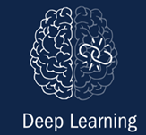
Rationale From Research
Why Deep Learning Matters
Notes:
[Misty 7-11] Now, we want to look at findings from research to better understand why deep learning matters. On each of the following slides, citations for the specific research referenced can be found in the slide notes for further exploration.

Slide 8
Deep Learning: Specific Findings
The process of consolidation allows for more bandwidth in working memory.^{2, 4}
Because working memory can only hold a limited amount of information at once, the process of consolidation allows the brain to overcome this by grouping disparate bits of knowledge, skills and strategies into larger groups, categories and coherent scripts.⁵
Students consolidate learning a new skill or strategy by bundling smaller steps into larger processes, scripts and learning aids (heuristics).⁶
Summarizing, synthesizing, comparing and categorizing all align with the brain’s directive to recognize patterns, and pattern linkage is the basis for long-term memory. ⁷
*References included in the slide notes.
Notes:
[Misty] The first main takeaway from the research related to deep learning (click) is that the process of consolidation allows for more bandwidth in working memory. I’ll pause and give you a moment to (click) read through specific findings from the research to support this.
Because working memory can only hold so much information at any given time, providing opportunities for students to consolidate their learning by grouping disparate bits of knowledge, skills and strategies into larger groups and categories helps the brain overcome this limitation. Consolidating learning of a new skill or strategy is supported by bundling smaller steps into larger processes, scripts and learning aids.
Research speaks to the importance of providing students opportunities to summarize, synthesize, compare and categorize as these help meet the need of the brain to recognize patterns. These pattern linkages are the basis for long-term memory.
References:
² Goodwin, B. (2020). Learning that sticks: A brain-based model for K-12 instructional design and delivery. Alexandria, VA: ASCD (ESSA Level 4)
⁴ Goodwin, B., Rouleau, K., Abla, C., Baptiste, K., Gibson, T., & Kimball, M. (2023). The new classroom instruction that works : the best research-based strategies for increasing student achievement (Third edition). ASCD, ; McREL International. (ESSA Level 4)
⁵ Bailey, F., & Pransky, K. (2014). Memory at work in the classroom: Strategies to help underachieving students. ASCD (ESSA Level 4).
⁶ Brown, P. C., Roedoger, H. L., III, & McDaniel, M. A. (2014). Make it stick: The science of successful learning. Harvard University Press (ESSA Level 4).
⁷ McTighe, J., & Willis, J. (2019.) Upgrade your teaching. Understanding by design meets neuroscience. Alexandria, VA: ASCD (ESSA Level 4)

Slide 9
Deep Learning: Specific Findings 2
Students need to develop metacognitive skills to monitor, manage and control their learning. ^{2, 8}
Metacognitive strategies increase retrieval strength of new learning as students ask themselves more complex how, why, and what questions about what they are learning. ²
Metacognition supports conditional knowledge, students knowing when, where and why to use what they have learned, which is essential to deep learning and to the transfer of learning. ⁷
As with all knowledge, strategies and skills, learners can be taught how to acquire, improve and hone their metacognitive strategies and skills to facilitate learning. ⁸
*References included in the slide notes.
Notes:
[Misty] The next takeaway (click) from the research is that students need to develop metacognitive skills to monitor, manage, and control their learning. I’ll pause and give you a moment (click) to read through the related findings.
Metacognition refers to the awareness of, and control over, one’s cognitive processes. It’s essentially thinking about our thinking – that voice in our heads that prompt us to pause, reflect, and redirect when we note a gap or something breaking down in our learning. When students engage in metacognitive strategies, it increases the retrieval strength of new learning as students ask themselves how, why and what questions about what they are learning. Students knowing when, where and why to use what they have learned supports conditional knowledge, which is essential to deep learning and, ultimately, the transfer of learning.
As with any new learning, students need to be explicitly taught how to acquire, improve and hone their metacognitive skills. Without engaging in these skills, students are often left with a mishmash of learning that’s disconnected, faulty or void of meaning and the knowledge is likely to quickly fade from memory.
References:
² Goodwin, B. (2020). Learning that sticks: A brain-based model for K-12 instructional design and delivery. Alexandria, VA: ASCD (ESSA Level 4)
⁷ McTighe, J., & Willis, J. (2019.) Upgrade your teaching. Understanding by design meets neuroscience. Alexandria, VA: ASCD (ESSA Level 4)
⁸ Kirschner, P. A., & Hendrick, C. (2024). How learning happens: Seminal works in educational psychology and what they mean in practice (2nd ed.). Routledge. (ESSA Level 4)

Slide 10
Deep Learning: Specific Findings 3
High-level questions are used to support consolidation of learning through cognitive and metacognitive processing of new knowledge and skills. ⁴
Encouraging students to explain their own thinking supports consolidation of new learning. ^{4,9}
Probing questions help students activate prior learning, see how ideas connect, understand how things work and why, and examine their preconceptions (and misconceptions). ²
Quality of questions is more important than quantity. ²
*References included in the slide notes.
Notes:
[Misty] Another overall idea (click) is that high-level questions are used to support consolidation of learning through cognitive and metacognitive processing of new knowledge and skills. Take just a moment (click) to read three related findings.
When students are asked to share their thinking and explain their problem-solving strategies, they must actively think about what they are learning which helps to encode the learning more elaborately and effectively. As students engage with probing questions, it helps them to activate prior learning, see how ideas connect, understand how things work and why. It also helps them to examine their preconceptions and misconceptions.
Research points to how the quality of the questions is more important that the quantity. Studies indicate that far too often, most of the questions being asked of students are low-level and fail to engage students in deeper learning. According to studies, it is more impactful to ask fewer, well-placed thoughtful questions that support consolidation and sense-making relevant to the intended learning.
References:
⁴ Goodwin, B., Rouleau, K., Abla, C., Baptiste, K., Gibson, T., & Kimball, M. (2023). The new classroom instruction that works : the best research-based strategies for increasing student achievement (Third edition). ASCD, ; McREL International. (ESSA Level 4)
⁹Fuchs, L. S., Malone, A. S., Schumacher, R. F., Namkung, J., Hamlett, C. L., Jordan, N. C., Siegler, R. S., Gersten, R., & Changas, P. (2016). Supported self-explaining during fraction intervention. Journal of Educational Psychology, 108(4), 493. https://www.doi. org/10.1037/edu0000073 (ESSA Level 1)
² Goodwin, B. (2020). Learning that sticks: A brain-based model for K-12 instructional design and delivery. Alexandria, VA: ASCD (ESSA Level 4)

Slide 11
Deep Learning: Specific Findings 4
Peer-assisted consolidation of learning draws upon experiential studies that show knowledge is socially constructed. ⁴
Peer-assisted learning follows direct instruction of knowledge and skills, providing students with opportunities to pause and process together. ^{4, 10}
In collaborative learning, multiple, limited working memories can create a larger, more effective, collective working space. When there is coordination between group members, information within the task and associated cognitive load can be divided across a larger reservoir of capacity. ¹¹
Peer-learning activities should be structured to support student consolidation of learning. ⁴
Effective peer-assisted learning integrates individual accountability with positive interdependence. ⁴
*References included in the slide notes.
Notes:
(Misty) The next overall finding (click) points to the importance of peer-assisted consolidation of learning that draws from studies that show knowledge is socially constructed. This occurs when groups or pairs of learners engage in processing, discussing and practicing new learning together. Take a moment (click) to read though the related findings.
The use of peer-assisted learning should follow direct instruction to provide students opportunities to pause and process together as they work to make sense of the new information. When students engage in collaborative learning, the limited working memories of each individual student creates a larger, more effective collective working space. As groups members work interdependently, the cognitive load can be divided across a larger reservoir of capacity.
According to research, for peer-learning activities to have a positive impact and support consolidation of learning, they must be structured and integrate both individual accountability and positive interdependence.
References:
⁴ Goodwin, B., Rouleau, K., Abla, C., Baptiste, K., Gibson, T., & Kimball, M. (2023). The new classroom instruction that works : the best research-based strategies for increasing student achievement (Third edition). ASCD, ; McREL International. (ESSA Level 4)
¹⁰Tong, F., Irby, B. J., Lara-Alecio, R., Guerrero, C., Fan, Y., & Huerta, M. (2014). A randomized study of a literacy-integrated science intervention for low-socio-economic status middle school students: Findings from first-year implementation. International Journal of Science Education, 36(12), 2083–2109. https://www.doi.org/ 10.1080/09500693.2014.883107 (ESSA Level 1)
¹¹ Sweller, J., van Merriënboer, J. J. G., & Paas, F. (2019). Cognitive architecture and instructional design: 20 years later. Educational Psychology Review, 31(2), 261–292. https://doi.org/10.1007/s10648-019-09465-5

Slide 12
Deep Learning: Specific Findings 5
Properly timed feedback supports initial application of knowledge, skills and strategies. ⁴
During initial application of knowledge, skills and strategies, timely formative feedback supports conceptual understanding, corrects misconceptions and error patterns, and develops automaticity while also helping students see what they have yet to master. ^{12, 13}
Feedback must inform self-adjustment and allow for students to use it to revise their thinking. ¹
*References included in the slide notes.
Notes:
[Fox 12-16] Another specific finding from the research is, [CLICK] “Properly timed feedback supports initial application of knowledge, skills and strategies.” I’ll pause to give you a moment to independently process two particular findings. [CLICK] (Allow time.)
As students are practicing with and initially attempting to master knowledge, skills and strategies, feedback supports arriving at conceptual understandings, correcting misconceptions and error patterns, and developing automaticity. It also helps them be clear on what still needs to be mastered and informs their adjustments to how they’re learning and revisions to their thinking.
References:
¹ Bransford, J., Brown, A. L., Cocking, R. R., National Research Council (U.S.). Committee on Developments in the Science of Learning, & National Research Council (U.S.). Committee on Learning Research and Educational Practice. (2000). How People Learn : Brain, Mind, Experience and School (Expanded Edition). National Academies Press. (ESSA Level 4)
¹² Cardelle-Elawar, M. (1990). Effects of feedback tailored to bilingual students' mathematics needs on verbal problem solving. The Elementary School Journal, 91(2), 165–175. https://doi.org/10.1086/461644 (ESSA Level 1)
⁴ Goodwin, B., Rouleau, K., Abla, C., Baptiste, K., Gibson, T., & Kimball, M. (2023). The new classroom instruction that works : the best research-based strategies for increasing student achievement (Third edition). ASCD, ; McREL International. (ESSA Level 4)
¹³ Roschelle, J., Feng, M., Murphy, R. F., & Mason, C. A. (2016). Online Mathematics Homework Increases Student Achievement. AERA Open, 2(4). https://doi.org/10.1177/2332858416673968 (ESSA Level 1)

Slide 13
Deep Learning: Specific Findings 6
Mental models are the key to deep learning. ⁴
Mental models, or schema, are integrations of declarative knowledge and procedural knowledge, and they help students translate new information into logical patterns that can be quickly committed to memory. ⁴
Mental models are used to categorize and construct representations of problems and then retrieve, apply and evaluate the effectiveness of problem-solving strategies. ⁴
For students to truly understand the logic, patterns or principles of what they are learning, they need to make their thinking visible to others and to themselves, which helps develop and refine their mental models. ⁴
Deep learning is the ability to organize discrete pieces of knowledge into a larger schema of understanding. ¹⁴
*References included in the slide notes.
Notes:
[Fox] A second-to-last finding from the research is, [CLICK] “Mental Models are the Key to Deep Learning.” I’ll pause to give you a moment to independently process four particular findings. [CLICK] (Allow time.)
A mental model is an organized way of cognitively perceiving and responding to a complex situation or stimulus and can be thought of as “know-how” gained from prior experience. This slide shows how many vital learning functions the development and refinement of mental models enable. They support memory formation as well as categorization and constructing representations, which are both key to conceptual understanding, and also metacognition as students use models to evaluate the effectiveness of their problem-solving strategies. And as a closing idea, cognitive scientists think of deep learning—or what might be called ‘learning for understanding'—as the ability to organize discrete pieces of knowledge into a larger schema of understanding.”
References:
⁴ Goodwin, B., Rouleau, K., Abla, C., Baptiste, K., Gibson, T., & Kimball, M. (2023). The new classroom instruction that works : the best research-based strategies for increasing student achievement (Third edition). ASCD, ; McREL International. (ESSA Level 4)
¹⁴ Mehta, J., & Fine, S. M. (2019). In search of deeper learning : the quest to remake the American high school. Harvard University Press. https://www.degruyter.com/doc/cover/9780674239951.jpg

Slide 14
Deep Learning: Specific Findings 7
Cognitively challenging writing tasks support high-level processing of learning. ⁴
Thinking skills and strategies, including those of “critical thinking,” require content knowledge, direct instruction and feedback, and they must be learned and employed in ways unique to each discipline. ⁴
Once critical thinking skills and strategies have been established, cognitively challenging writing tasks can strengthen them by providing opportunities for further direct instruction and feedback. ¹⁵
*References included in the slide notes.
Notes:
[Fox] A final finding from the research is, [CLICK] “Cognitively challenging writing tasks support critical thinking.” I’ll pause to give you a moment to independently process two particular findings. [CLICK] (Allow time.)
It is important to emphasize here that critical thinking skills are disciplinary in nature, that is they are specific to certain content areas, as we can see in examples such as “scientific thinking with scientific knowledge in science, textual analysis in literature, historical thinking in social studies and quantitative reasoning in mathematics.” Because they are discipline-specific, they require content knowledge, direct instruction, practice and feedback that are appropriate to the discipline. Once critical thinking skills and strategies have been established, cognitively challenging writing tasks can strengthen them by providing opportunities for further direct instruction and feedback.
References:
⁴ Goodwin, B., Rouleau, K., Abla, C., Baptiste, K., Gibson, T., & Kimball, M. (2023). The new classroom instruction that works : the best research-based strategies for increasing student achievement (Third edition). ASCD, ; McREL International (ESSA Level 4)
¹⁵ Kim, J. S., Olson, C. B., Scarcella, R., Kramer, J., Pearson, M., van Dyk, D., … Land, R. E. (2011). A Randomized Experiment of a Cognitive Strategies Approach to Text-Based Analytical Writing for Mainstreamed Latino English Language Learners in Grades 6 to 12. Journal of Research on Educational Effectiveness, 4(3), 231–263. https://doi.org/10.1080/19345747.2010.523513 (ESSA Level 1)

Slide 15
Deep Learning: Summary
If “learning is a change in long-term memory,”¹⁶ effective practices for moving knowledge, skills and strategies into long-term memory and then establishing networks for broader understanding are how learning happens.
Notes:
[Fox] A key take-away from the research would be that if “learning is a change in long-term memory,” which is a common phrase from cognitive science, effective practices for moving knowledge, skills and strategies into long-term memory and then establishing networks for broader understanding are how learning happens.
Reference:
¹⁶ Kirschner, P. A., & Hendrick, C. (2024). How learning happens: Seminal works in educational psychology and what they mean in practice (2nd ed.). Routledge.

Slide 16
Connections to Common Characteristics of Deeper Learning
Because deeper learning characteristics are affirmed by learning science, connections to research on deep learning and to the indicators to follow may be noted.
Notes:
[Fox] As we close this segment, let’s make a quick connection to deeper learning as we did in the prior module. On the slide, you see again the Common Characteristics of Deeper Learning laid out in the Integrating Deeper Learning and HQIR introduction document. For deep learning in particular, there are two we will call attention to:
[CLICK] Productive Collaboration – Students work in diverse teams to achieve shared goals.
[CLICK] Academic Mindsets – Students develop attitudes and beliefs that support learning, such as perseverance, resilience, and a growth mindset, and show greater awareness of themselves as learners.
These two characteristics are supported by the accompanying five, of course, but are worth highlighting on their own since they connect closely to the work of deep learning.
Link: https://education.ky.gov/curriculum/standards/kyacadstand/Documents/Integrating_HQIRs_and_Deeper_Learning_to_Strengthen_Tier_1_Instruction.pdf

Slide 17
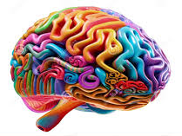
Module Purpose 2
Module Objectives:
Build understanding of “deep learning” and associated findings from learning science.
Explore indicators of deep learning using examples from HQIRs.
Consider deeper learning practices to support potential adjustments to a HQIR.
Notes:
[Misty 17-22] Using our understanding of the research, we are now going to explore indicators of deep learning, highlighting examples from HQIRs to help build understanding of what they might look like in practice.

Slide 18
Deep Learning Indicators
Indicators
Students have opportunities to develop and practice metacognitive skills (e.g., recognizing problem types, selecting strategies, self-questioning ) to monitor, manage and control their learning. Teachers are supported with explicitly instructing students in how to acquire, improve and hone their metacognitive strategies and skills to facilitate learning.
Students are provided opportunities to consolidate their learning and to develop and refine their mental models in a variety of ways. This may include: Summarizing, Comparing and contrasting, Categorizing , Synthesizing, Identifying patter ns, Making predictions
High-level questions allow students to make thinking visible while supporting consolidation of learning through cognitive and metacognitive processing of new knowledge, skills and strategies. Explanations require students to share their thinking and explain their cognitive/metacognitive strategies to encode learning more elaborately and effectively. Students should have opportunities to engage with high-level questions both cooperatively and independently. Students are provided opportunities to ask themselves reflective questions to support consolidation of learning.
Peer-assisted consolidation of learning engages pairs or groups of students in processing, discussing and practicing new learning. Students have structured opportunities to socially construct knowledge and understanding to help them process knowledge, skills and strategies introduced through teacher-facilitated learning.
Writing tasks are cognitively challenging and support critical thinking. Teachers are supported in providing direction in instruction for targeted critical thinking skills. Critical thinking in writing tasks draws upon specific disciplinary skills and background knowledge developed during the unit (e.g., analyzing theme in ELA, thinking geographically in social studies, arguing from evidence in science, quantitative reasoning in mathematics).
There are opportunities for guided initial application of new knowledge, skills and strategies with formative feedback to help students consolidate new skills, strategies and procedural knowledge effectively and accurately. Guided application should build upon “front-loaded” strategy instruction and modeling so students are more successful in their initial attempts to apply new skills and strategies. Formative feedback is intended to support student reflection and thinking so they consider their learning and how to correct errors.
Notes:
(Misty) Based on the research, we have identified 6 deep learning indicators that need to be present in each unit of instruction. These indicators address areas such as providing students opportunities to develop and practice metacognitive skills, engage in peer-assisted consolidation and opportunities for guided initial application with formative feedback. These indicators are included in the Curriculum Adjustment Tool that accompanies this module.

Slide 19
Deep Learning
Examples from HQIRs
Notes:
(Misty) What might the deep learning indicators look like when included in part of the instructional design of a unit/module within an HQIR? While there is no specific right way, we are going to look at three examples that can give us a better sense of how these indicators may be present.

Slide 20
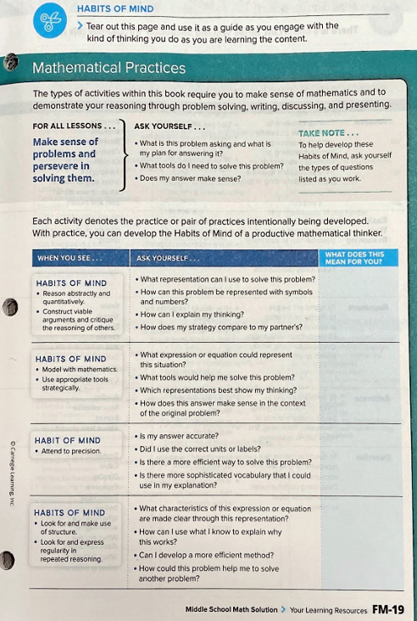
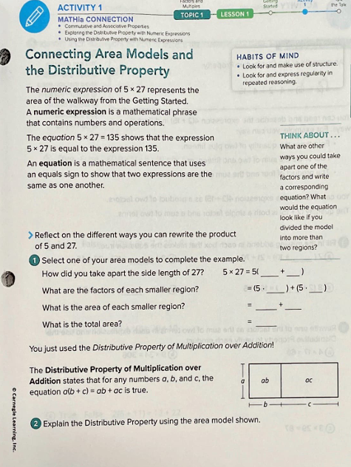
Algebra 1 Example
Students have opportunities to develop and practice metacognitive skills (e.g., recognizing problem types, selecting strategies, self-questioning ) to monitor, manage and control their learning.
Notes:
(Misty) In this Algebra 1 example from Carnegie Math, we see supports built in that allow students to develop and practice metacognitive skills. In the beginning of the course students are introduced to (click) habits of mind related to the mathematical practices, along with questions they can ask themselves as they work through various problems. Throughout each unit, (click) specific reminders of the habits of mind are provided relevant to working through the current task to support students in monitoring and managing their own learning.

Slide 21
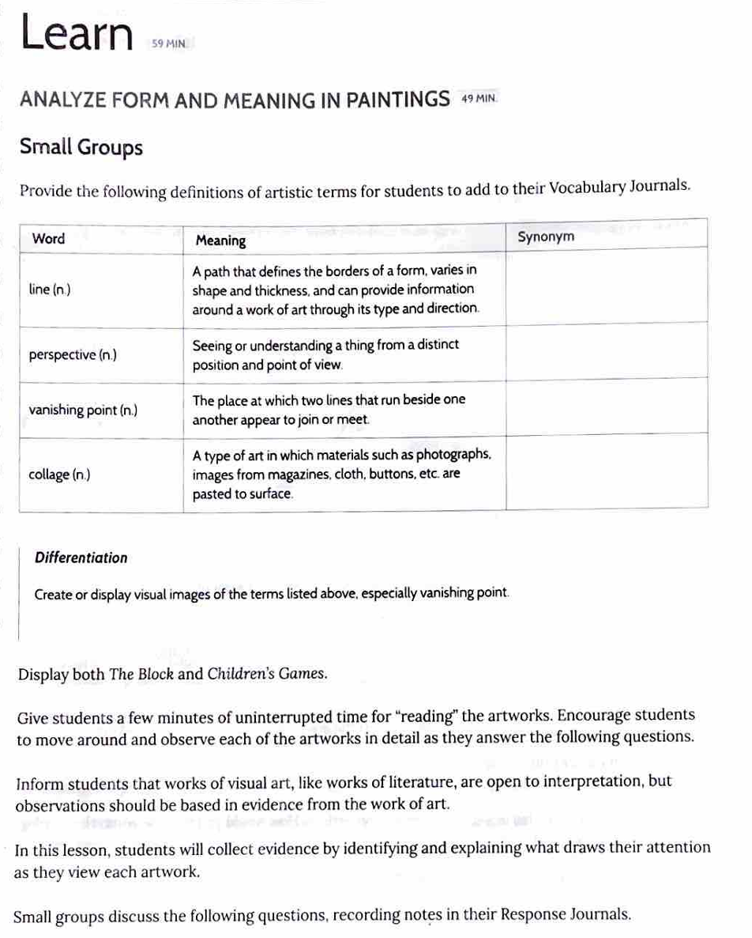
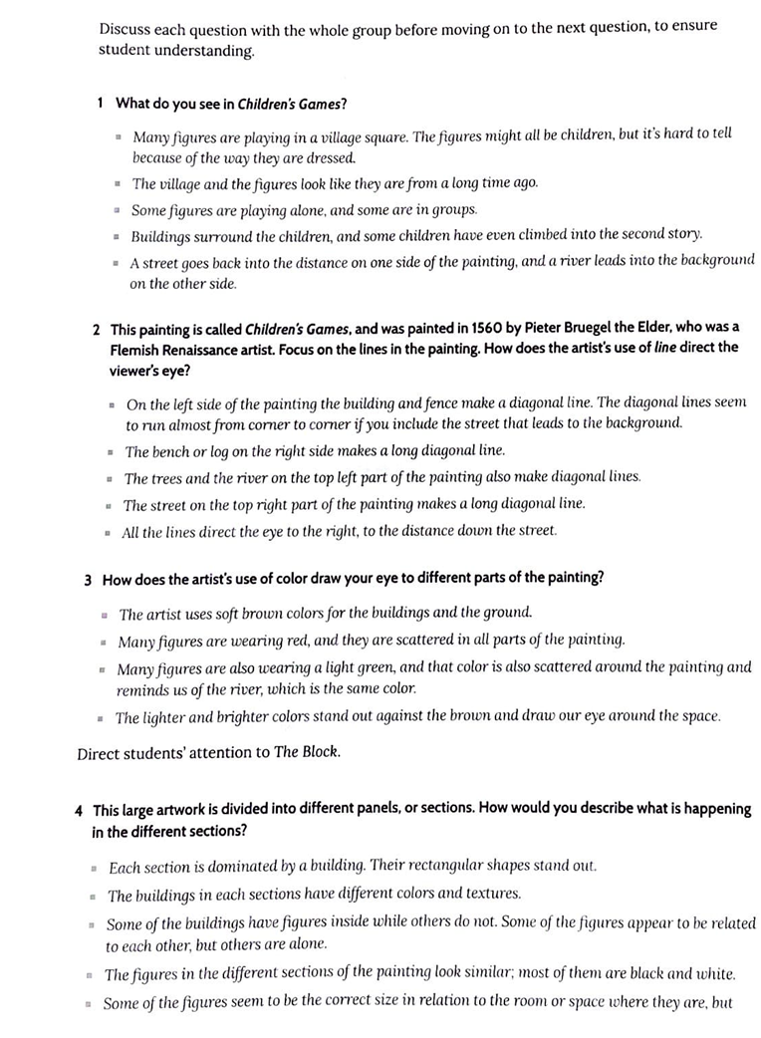
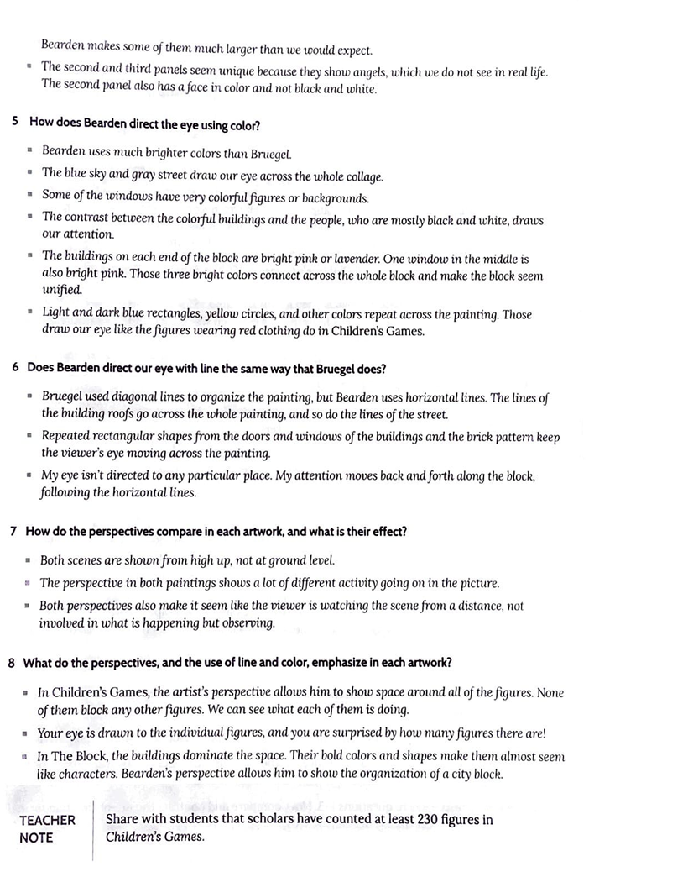
5th Grade Example
Students are provided opportunities to consolidate their learning and to develop and refine their mental models in a variety of ways.
Compare & Contrast, Synthesis
5th Grade Example
Notes:
(Misty) In this 5th grade R/W example from Wit and Wisdom, the focus of the unit is framed around helping students answer the question “How does form shape a story’s meaning?”. In this particular lesson, (click) students are examining two pieces of art. As they examine the art, (click) they engage with a series of guided questions that support consolidation of their learning around form that require them to compare, contrast and synthesize using elements of form in visual art.

Slide 22
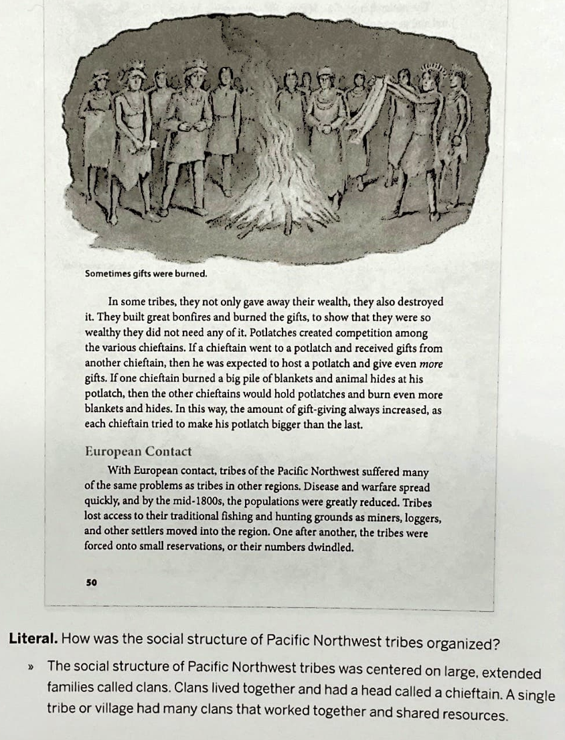
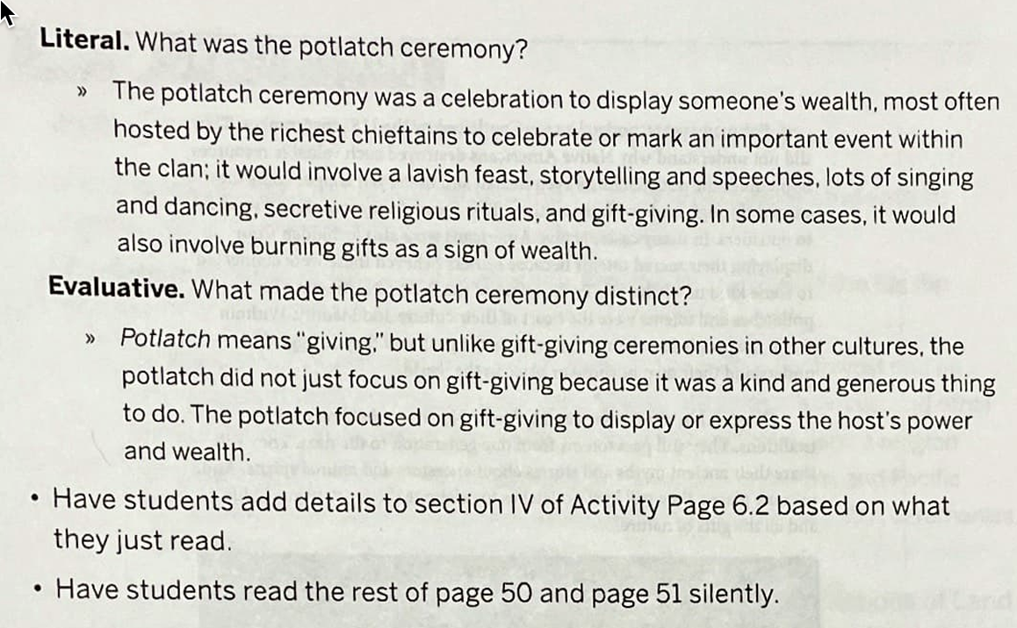
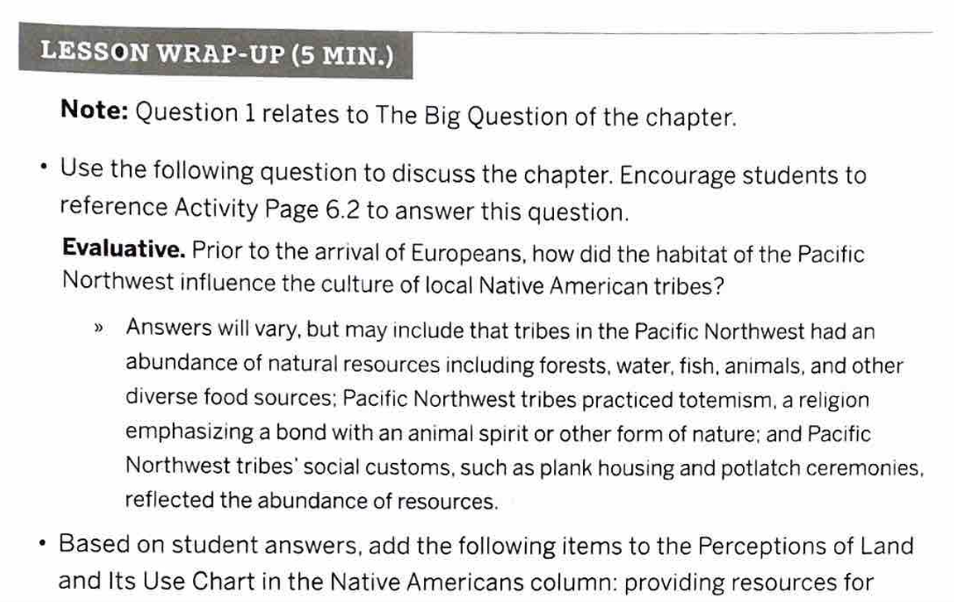
5th Grade Example
High-level questions allow students to make thinking visible while supporting consolidation of learning through cognitive and metacognitive processing of new knowledge, skills and strategies.
Notes:
(Misty) The use of high-level questions that allow students to make their thinking visible is evident in this 5th grade R/W example from CKLA. The big question for this chapter is “Prior to the arrival of the Europeans, how did the habitat of the Pacific Northwest influence the culture of local Native American tribes?” Throughout this lesson students respond to different types of questions and kinds of thinking including both (click) literal questions and (click) evaluative questions that allow for cognitive and metacognitive processing. The lesson wrap up also includes (click) an evaluative question that allows students to connect back to the overarching question of the chapter based on their learning up to this point.

Slide 23
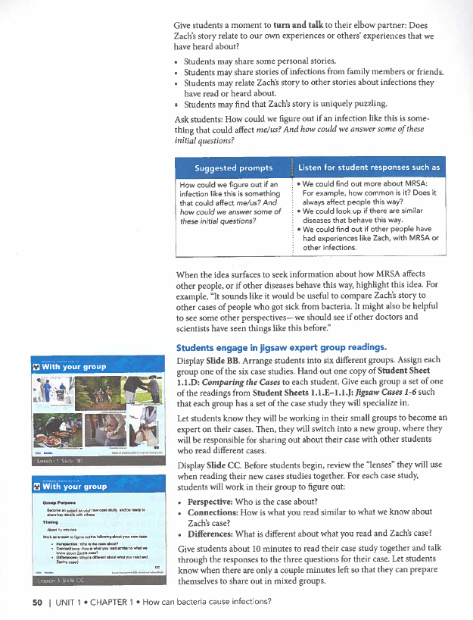
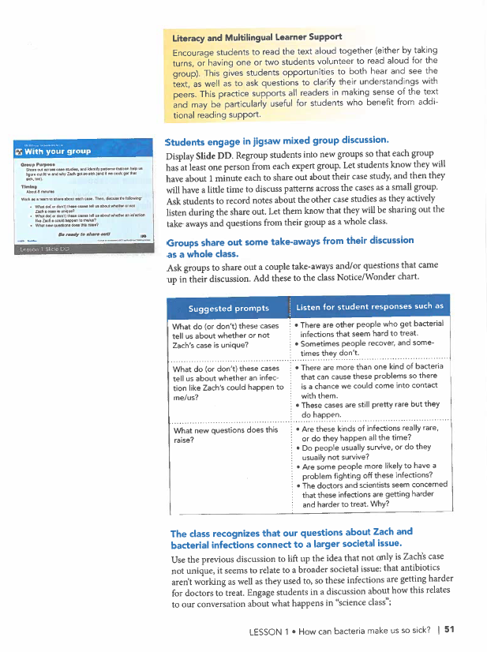
High School Biology Example
Peer-assisted consolidation of learning engages pairs or groups of students in processing, discussing and practicing new learning.
Notes:
[Fox 23-28] This high school biology example from BSCS ties into the learning science indicator:
Peer-assisted consolidation of learning engages pairs or groups of students in processing, discussing and practicing new learning.
In this example we have [CLICK] students engaging in jigsaw expert group readings, a collaborative strategy high in effect-size. And to anchor and extend learning, [CLICK] students engage in mixed-group discussion and also share take-aways from the discussion as a whole class.

Slide 24
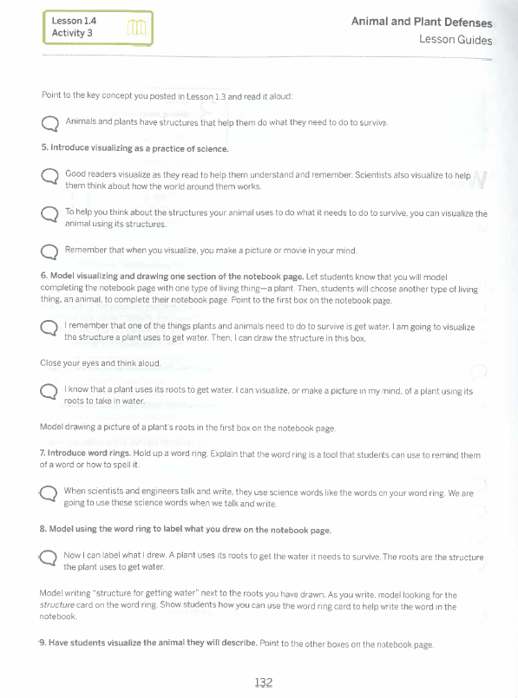
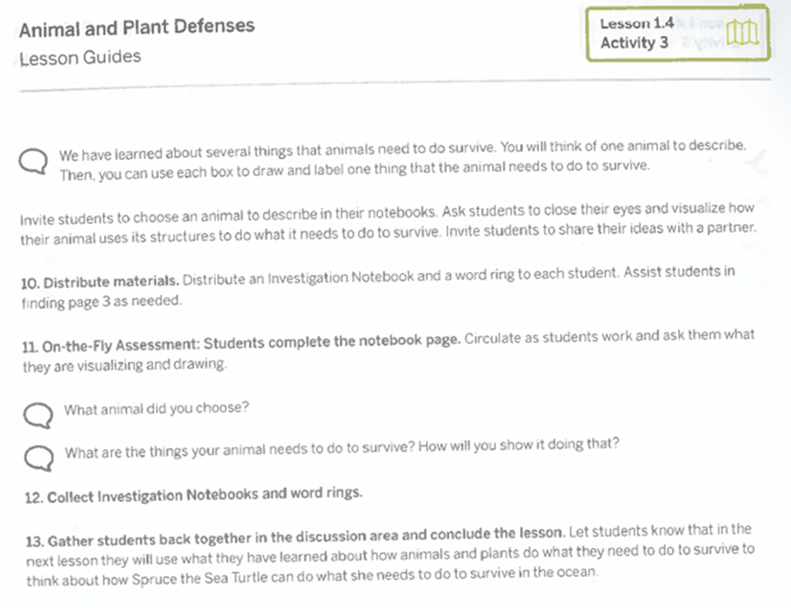
1st Grade Example
There are opportunities for guided initial application of new knowledge, skills and strategies with formative feedback to help students consolidate new skills, strategies and procedural knowledge effectively and accurately.
Notes:
[Fox] This first-grade science example from Amplify ties into the learning science indicator:
There are opportunities for guided initial application of new knowledge, skills and strategies with formative feedback to help students consolidate new skills, strategies and procedural knowledge effectively and accurately.
In this example [CLICK], students learn about and begin to use the science practice (strategy) of visualization [CLICK], with the teacher modeling visualizing and drawing one section of the notebook page. Next [CLICK], students practice what they’ve learned about visualization by completing the notebook page.

Slide 25
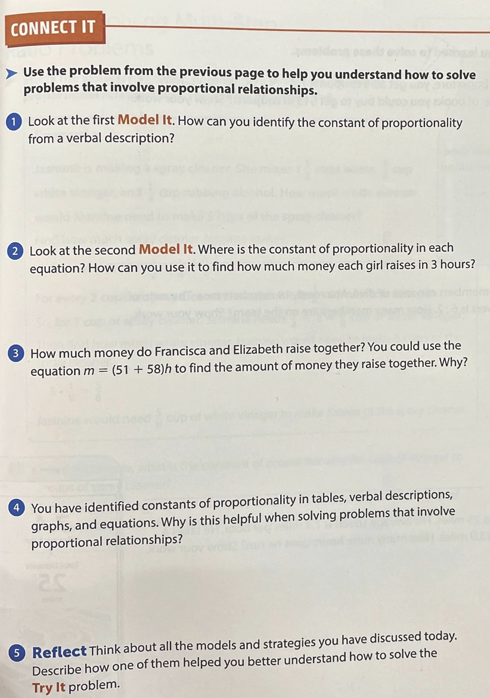
7th Grade Example
Writing tasks are cognitively challenging and support critical thinking.
Notes:
[Fox] This seventh-grade mathematics example from i-Ready ties into the learning science indicator:
Writing tasks are cognitively challenging and support critical thinking.
In this example [CLICK], students respond to a series of prompts which ask them how they will solve certain problems, why specific equations suit a particular problem as well as more general problem types, and then to reflectively consider how models and strategies discussed during the lesson help them better understand these types of problems.

Slide 26
Module Purpose 3
Module Objectives:
Build understanding of “deep learning” and associated findings from learning science.
Explore indicators of deep learning using examples from HQIRs.
Consider deeper learning practices to support potential adjustments to a HQIR.
Notes:
[Fox] Moving now to the last objective for this module [CLICK], we will “Consider deeper learning practices to support potential adjustments to a HQIR.”

Slide 27
Common Deeper Learning Practices
Authenticity (learning includes real-world context, tasks, tools, products, audiences and/or impacts, while also connecting to personal concerns, interests and/or issues in students’ lives)
Inquiry (learning is framed by a meaningful question or set of questions to be responded to at the appropriate level of challenge; students engage in a rigorous, extended process of posing questions, exploring resources and applying information)
Structured Collaboration (Students are supported in contributing to the learning and work of their peers as they share, challenge and build upon each other’s ideas to co-create understanding and products of learning)
Voice & Choice (Students make some decisions about the learning, including how they work and what they create, and express their own ideas in their own voice)
Notes:
[Fox] As we did in the first two modules, we will pivot again from the Common Characteristics of Deeper Learning on slide 16 to Common Deeper Learning Practices on this slide. If the common characteristics can help define our sense of what is meant by deeper learning, these aligned practices can help make those characteristics actionable. While we won’t take time to review them again here, it’s worth resetting they will be returned to in stage-specific ways during each module when we are ready to think about potential ”smart adjustments” that might be made to a curriculum after analysis using learning science indicators. For this module, we will look at adjustment options they afford for deep learning.
¹⁵ PBL Works

Slide 28
Deep Learning: Deeper Learning Practices and Considerations
Practices and Considerations
Authenticity Find outside/expert audiences for students to share their thinking with and receive feedback from, independently or collaboratively, as they develop conceptual understandings and engage in critical thinking within a discipline. As students begin guided application of knowledge, understandings, skills and strategies, connect this, when possible, to what will be expected of them when they work on a public product for a real-world audience.
Inquiry Maintain connection to the essential question so students see how deepening knowledge and beginning to apply skills and strategies will help them respond to it with greater sophistication. Continue connecting to supporting questions that follow from the essential question and are related to the learning being consolidated. Help students see how high-level questions provided by the HQIR can be linked to a larger arc of inquiry. As new topics, texts and tasks are experienced during deep learning, continue to look for opportunities for students to refine and add to questions they generated during priming and surface learning.
Structured Collaboration As students actively process and consolidate knowledge (including vocabulary), skills and strategies, embed collaborative structures that support doing so together to capitalize upon the benefits of making learning more dynamic and social. Match appropriate structures to intended learning outcomes for deep learning and follow key principles for effective collaboration .
Voice & Choice When students activate relevant prior (background) knowledge to support consolidation of new knowledge, see how their individual connections can be shared across the classroom community. Notice where needs for new learning (knowledge, understandings, skills and strategies) might be differentiated according to readiness levels individual learners identify. Offer students choice in how they develop and demonstrate their consolidations of learning (from summarizing, comparing and contrasting, categorizing, synthesizing, identifying patterns and/or making predictions). As students consolidate connections between subject-specific vocabulary and core concepts, notice where new vocabulary can be integrated into their own voices during challenging writing tasks and guided application. As students self-monitor and reflect on progress toward their individual goals (academic goals, Portrait of a Learning competency goals, interest goals, etc.) help them see how consolidating new learning supports reaching of those goals and how they can identify gaps in learning that would require seeking support.
Practices and Considerations
Authenticity Find outside/expert audiences for students to share their thinking with and receive feedback from, independently or collaboratively, as they develop conceptual understandings and engage in critical thinking within a discipline. As students begin guided application of knowledge, understandings, skills and strategies, connect this, when possible, to what will be expected of them when they work on a public product for a real-world audience.
Inquiry Maintain connection to the essential question so students see how deepening knowledge and beginning to apply skills and strategies will help them respond to it with greater sophistication. Continue connecting to supporting questions that follow from the essential question and are related to the learning being consolidated. Help students see how high-level questions provided by the HQIR can be linked to a larger arc of inquiry. As new topics, texts and tasks are experienced during deep learning, continue to look for opportunities for students to refine and add to questions they generated during priming and surface learning.
Structured Collaboration As students actively process and consolidate knowledge (including vocabulary), skills and strategies, embed collaborative structures that support doing so together to capitalize upon the benefits of making learning more dynamic and social. Match appropriate structures to intended learning outcomes for deep learning and follow key principles for effective collaboration
Voice & Choice When students activate relevant prior (background) knowledge to support consolidation of new knowledge, see how their individual connections can be shared across the classroom community. Notice where needs for new learning (knowledge, understandings, skills and strategies) might be differentiated according to readiness levels individual learners identify. Offer students choice in how they develop and demonstrate their consolidations of learning (from summarizing, comparing and contrasting, categorizing, synthesizing, identifying patterns and/or making predictions). As students consolidate connections between subject-specific vocabulary and core concepts, notice where new vocabulary can be integrated into their own voices during challenging writing tasks and guided application. As students self-monitor and reflect on progress toward their individual goals (academic goals, Portrait of a Learning competency goals, interest goals, etc.) help them see how consolidating new learning supports reaching of those goals and how they can identify gaps in learning that would require seeking support.
Notes:
[Fox] Here we have the deeper learning practices with potential suggestions for the stage of deep learning. These practices and considerations are included in the adjustment portion of the curriculum analysis and adjustment tool on the next slide. For each practice, the underlying bullets and sub-bullets offer high-level suggestions as to the where a district could look to make adjustments. You will notice these assume a fairly significant degree of local understanding and capacity. If precisely what is meant by these or how to effectively act upon them is not clear enough, this is where external partnership with a high-quality deeper learning provider and the tools those organizations may have can be invaluable.

Slide 29
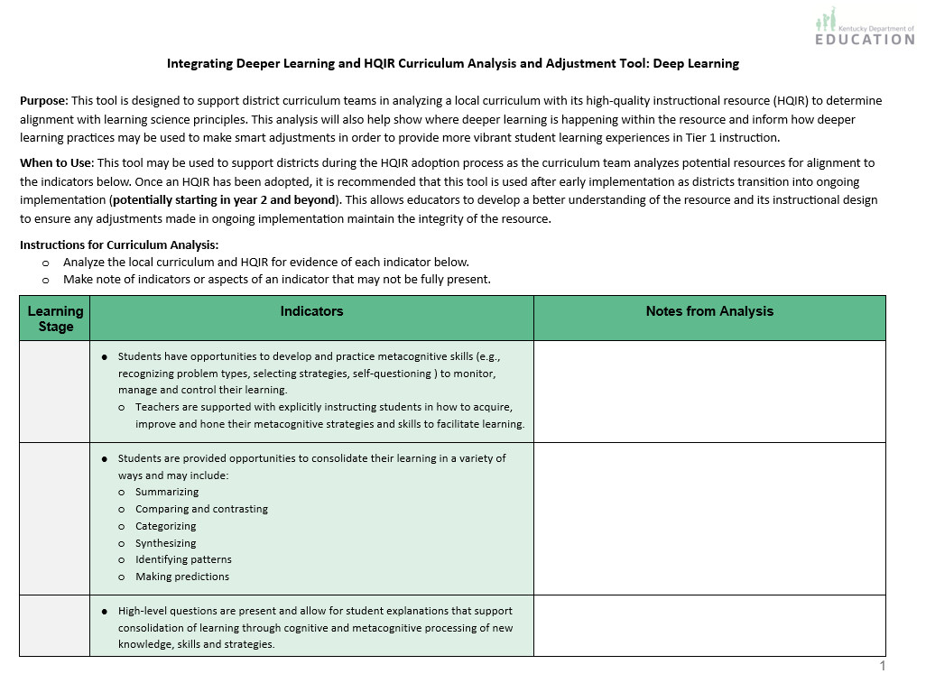
Curriculum Analysis and Adjustment Tool
The tool is designed to support:
Analysis of an HQIR using the Deep Learning Indicators
Making curricular adjustments using deeper learning practices
Notes:
[Misty 29-31] To help apply understanding from this module, the KDE created a Deep Learning Curriculum Analysis and Adjustment Tool. The purpose of the tool is to assist a district curriculum team in analyzing their HQIR for evidence of each of the deep learning indicators. The tool also offers suggestions for making curricular adjustments using deeper learning practices to further enhance their local curriculum in supporting vibrant learning experiences for all students.

Slide 30
Closing Notes for Deep Learning
During deep learning, consolidation arranges what has been learned into larger, coherent patterns. ²
The extended neural networks that develop link declarative knowledge with core disciplinary concepts, forming the basis for understanding and then for applying learning in novel ways, which is the transfer of learning. ⁷
For transfer of learning, students must develop retrieval hooks for new learning so they can readily conjure it up and apply it. ²
Students must also develop conditional knowledge, the ability to judge when, where and why to use what they have learned, during deep learning in order for independent transfer of learning to occur. ⁷
Notes:
(Misty) We want to close with some final important notes about deep learning.
(click) Students must engage in deep consolidation of learning that allows them to build on prior knowledge and arrange what they have learned into larger, coherent patterns.
(click) The extended neural networks that develop from this consolidation link declarative knowledge with the core disciplinary concepts that forms the basis for conceptual understanding. Conceptual understanding allows for relationship between concepts to emerge as the elements of one concept are connected to elements of another, new ideas arise and understanding broadens.
So, (click) if students are to transfer their learning, they must develop multiple retrieval hooks for new learning so the brain can readily access and apply it.
Finally, (click) part of the goal of deep learning is for students to also develop conditional knowledge in which they are able to determine when, where, and why to use what they have learned for them to independently transfer that learning.
References:
² Goodwin, B. (2020). Learning that sticks: A brain-based model for K-12 instructional design and delivery. Alexandria, VA: ASCD (ESSA Level 4)
⁷ McTighe, J., & Willis, J. (2019.) Upgrade your teaching. Understanding by design meets neuroscience. Alexandria, VA: ASCD (ESSA Level 4)

Slide 31
Questions?
Fox DeMoisey
fox.demoisey@education.ky.gov
Misty Higgins
misty.higgins@education.ky.gov
Notes:
Thank you for taking time to engage in this module and please reach out with any questions you might have.

