Slide 1
Race to 100 Introduction
Kentucky Family Math Night Game
Race to 100
Recommended for Grades K-1
This game will help your student practice combining and recombining in base 10.
Kentucky Academic Standards for Mathematics Connections:
Kindergarten Number and Operations in Base Ten
KY.K.NBT.1 Compose and decompose numbers from 11 to 19 using quantities (numbers with units) of ten ones and some further ones. Understand that these numbers are composed of ten ones and one, two, three, four, five, six, seven, eight or nine ones.
First grade Number and Operations in Base Ten
KY.1.NBT.2 Understand the two-digits of a two-digit number represent amounts of tens and ones. Understand the following as special cases:
a. 10 can be thought of as a bundle of ten ones — called a “ten.”
b. The numbers from 11 to 19 are composed of a ten and one, two, three, four, five, six, seven, eight or nine ones.
c. The numbers 10, 20, 30, 40, 50, 60, 70, 80, 90 refer to one, two, three, four, five, six, seven, eight or nine tens (and 0 ones).
Standards for Mathematical Practice:
MP.2 Reason abstractly and quantitatively.
MP.5 Use appropriate tools strategically.
MP.7 Look for and make use of structure.
MP.8 Look for and express regularity in repeated reasoning.

Slide 2
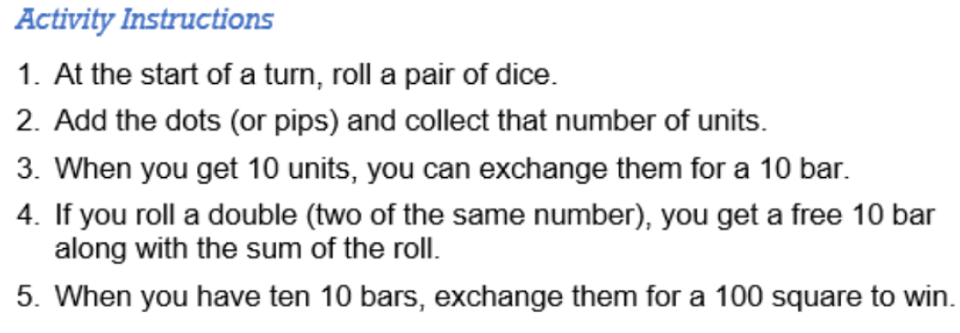
Race to 100 - Instructions
Race to 100 – Instructions
Players: One or more
Goal: Practice place value combining and recombining in base 10.

Slide 3
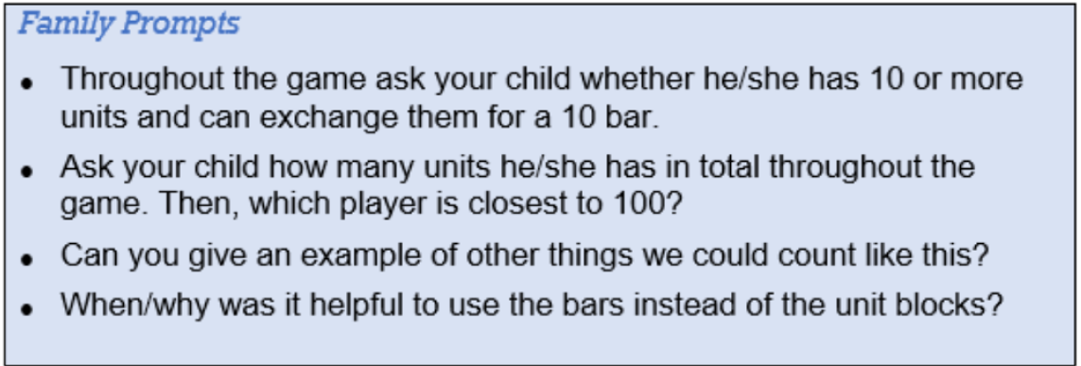
Race to 100 – Family Prompts
Race to 100 – Family Prompts
Ask any of the following questions as you play the game.

Slide 4
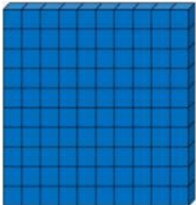
Race to 100 – Board 1
Race to 100 Game
Click each die to roll,
Click each again to stop.
My Race to 100
Family Prompts
Throughout the game ask your child whether he/she has 10 or more units and can exchange them for a 10 bar.

Slide 5
Race to 100 – Board 2
Race to 100 Game
Click each die to roll,
Click each again to stop.
My Race to 100
Family Prompts
Ask your child how many units he/she has in total throughout the game. Then, which player is closest to 100?

Slide 6
Race to 100 – Board 3
Race to 100 Game
Click each die to roll,
Click each again to stop.
My Race to 100
Family Prompts
Can you give an example of other things we could count like this?

Slide 7
Race to 100 – Board 4
Race to 100 Game
Click each die to roll,
Click each again to stop.
My Race to 100
Family Prompts
When/why was it helpful to use the bars instead of the unit blocks?

Slide 8
Race to 100 – Closing Slide
Kentucky Family Math Night Games
Race to 100
Thank you for playing!
Access more digital family math games at:
https://www.education.ky.gov/curriculum/conpro/Pages/family_math_games.aspx

