Slide 1
Improving Student Engagement in the Science Classroom Using a Driving Question Board (DQB)
Modified from Casandra Gonzalez, Ryan King and Missy Weatherly (2023). [What is a “Driving Question Board” and how can it improve student engagement in class? from the Advancing Coherent and Equitable Systems of Science Education (ACESSE) Project. This work is licensed under a Creative Commons Attribution-ShareAlike 4.0 Unported License. Educators and others may use or adapt. If modified, please attribute and re-title. CC BY-SA license details are at https://creativecommons.org/licenses/by-sa/4.0/.
Notes:
Officially welcome the participants. Introduce yourself (if necessary). Provide an opportunity for participants to introduce themselves and engage in a community building activity that is suitable for the needs of the group.
Explain:
This module is intended to build or reinforce your understanding on how to improve student engagement in the science classroom using a driving question board (DQB).

Slide 2
Group Norms
Presume positive intentions.
Listen carefully to one another.
Be open to new ideas.
Be open to productive struggle.
Ask questions.
Allow a chance for everyone to participate.
Notes:
Explain:
Group norms can help to create a safe space where participants feel comfortable sharing their ideas and experiences. This slide is a starting place for us to begin considering what norms would work best for us to work together. Take a moment to read and reflect on these norms. Would anyone like to revise, edit or add any norms to the list? We will continue to revisit these norms as we work through this module.
As we work together, feel free to write any unanswered questions down and add them to the parking lot. We will take moments throughout our time together to address those thoughts and questions as we grow in our learning together of the use of a driving question board in our science classrooms.
Facilitator Note:
Take a moment to discuss and revise. If a change is proposed, confirm with the rest of the group whether they want to make the change. If there is a consensus, note the changes to the slide or poster of where the norms will be placed in the space in a different color than the original text.

Slide 3
SESSION A
Notes:
Facilitator Note:
This is the beginning of session A.

Slide 4
Module Goals
Explain what a driving question board is and understand its purpose in the science classroom.
Identify ways that the driving question board can build a community of learners.
Analyze how a cohesive storyline can be built around an anchoring phenomenon.
Generate ideas for how a driving question board can be used as a formative assessment tool.
Notes:
Explain:
Listed on the screen are the goals for this module. Please take a moment to read through these goals. During this session, we will focus on being able to explain what a driving question board is and understand its purpose in the science classroom.

Slide 5
Sessions in this Module
Session A:
What is a driving question board and what is its purpose in the science classroom?
Session B:
How does the use of a driving question board foster a community of learners in terms of student engagement and motivation?
Session C:
How can a driving question board anchored in a phenomenon be used to build a cohesive storyline?
Session D:
Why should the driving question board be used as a formative assessment tool to foster an equitable learning community?
Notes:
Explain:
This slide shows the content incorporated within this module. At the end of each session, you should have a deeper understanding of the driving question board in order to answer the focus question aligned to the session.
Facilitator Note:
Allow participants time to read though each of the focus questions outlined for the sessions in this module.

Slide 6
Session A Meta Moment
Focus Question:
What is a driving question board and what is its purpose in the science classroom?
Notes:
Explain:
As we begin session A, our focus question for this section of the module is: What is a driving question board and what is its purpose in the science classroom? Please take a meta moment to individually respond to the focus question in your participant packet. A meta moment is a brief pause to capture your current thinking.
Facilitator Note:
Check to make sure participants have a copy of the participant packet as a digital file or printed. They will use this throughout the session to record their thoughts to various prompts embedded in the session.

Slide 7
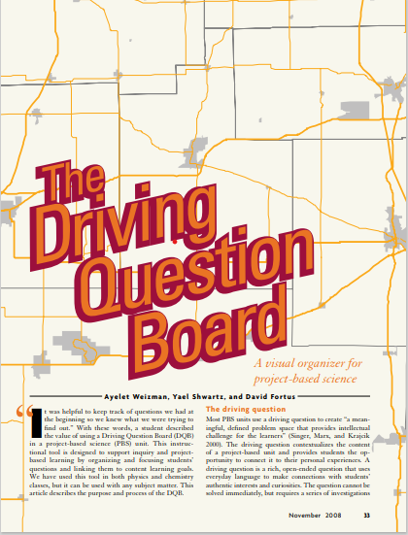
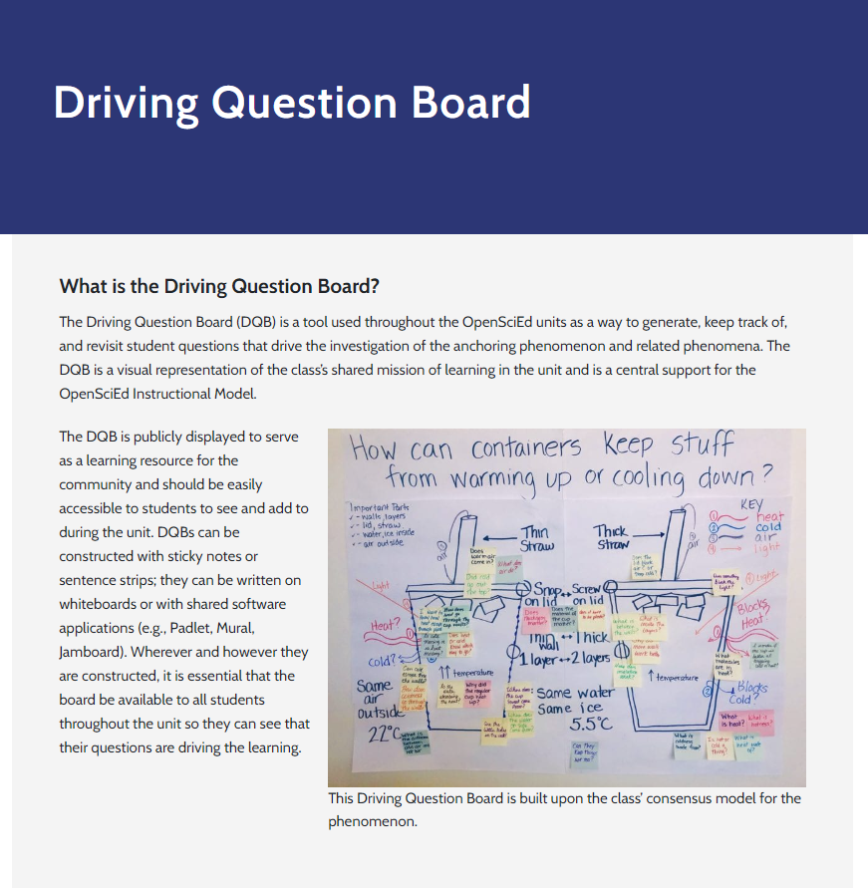
Articles to Read
Read the following two articles about a
driving question board. As you read, jot your responses to the following questions in the Session A: Notes section of your participant packet.
Focus Questions:
What is the driving question board?
What is the purpose of the driving question board in the science classroom?
How does the driving question board support equitable science classrooms?
What resonates with you in how this can be impactful in the classroom?
Article 1:
The Driving Question Board
[Used with permission from National Science Teaching Association (NSTA)]
Article 2:
Driving Question Board (OpenSciEd)
Notes:
Explain:
To ground our understanding of a driving question board we will engage in two reading experiences. Open the two resources on the right of the screen and turn to Session A:
Notes section of the participant packet. We will read the following two articles to gather information about the driving question board. The first article, The Driving Question Board” was used with permission from the National Science Teacher Association (NSTA). As you read, jot your responses to the following questions in the Session A Notes section of your participant packet. Advance the slide for discussion.
Focus Questions:
What is the driving question board?
What is the purpose of the driving question board in the science classroom?
How does the driving question board support equitable science classrooms?
What resonates with you in how this can be impactful in the classroom?
Facilitator Note:
Possible Set-ups for this exploration:
Although we recommend participants read both articles to develop a deeper understanding of the driving question board, due to time constraints, facilitators may choose to jigsaw the reading of the articles. Allow ample time for groups to discuss the articles they read. As the groups are sharing the findings from their articles, they should add to their responses of the focus questions.
References:
Weizman, A., Shwartz, Y. & Fortus, D., (2008, November).The Driving Question Board. The Science Teacher, 33-37.
OpenSciEd. (n.d.). On Demand Teacher Support: Driving Question Board. OpenSciEd Professional Learning. https://www.openscied.org/professional-learning/on-demand-teacher-support/driving-question-board/.

Slide 8
Stop and Discuss
Discuss each question with a colleague(s):
What is the driving question board?
What is the purpose of the driving question board in the science classroom?
How does the driving question board support equitable science classrooms?
What resonates with you in how this can be impactful in the classroom?
Group Synthesis
What common themes arose in your discussion?
What wonderings does your group have?
Notes:
Explain:
We are going to share our thoughts on the focus questions in small groups. As you discuss, add on to one another’s thoughts or ask clarifying questions. Point out evidence from the articles to support your thinking.
Facilitator Note:
Provide time for some discussion in small groups. As participants share in small groups encourage participants to add on to one another’s thinking and clarify statements that are made. As the discussion develops, anchor thoughts back to these documents and allow participants to point out what parts of the article that support their thinking.
Here are some things to listen for while participants are engaged in discussing the focus questions.
What is the driving question board?
An instructional strategy used to facilitate students learning focused around a guided question anchored to an engaging phenomenon.
Collective questions generated by students and the teacher at the start of the learning, grouped together by categories represented in a visible space in the room for all students to see.
A place where connections are made between the investigations and the driving question.
Allows for review of questions that have already been answered or additional student questions that may arise later on in the learning.
A collection of relevant artifacts placed beside questions that are being answered throughout the learning experience.
What is the purpose of the driving question board in the science classroom?
Provides explicit connections between the various activities and the context set by the driving question.
Organizes learning and serves as a road map that guides the student sensemaking as they work to figure out the anchoring phenomenon.
Scaffolds the science and engineering practice of asking questions.
Gives ownership to the community of learners.
Provides a visual reminder and organizer for the students and teacher.
Allows students to draw from their prior knowledge to make connections to newly learned concepts.
How does the driving question board support equitable science classrooms?
Engages all students in a common experience.
Questions are generated by all students and categorized together.
Values the diverse ideas and the backgrounds of all students.
Available to all students through the learning experience.
Explain:
As we come back together as a group, we are going to synthesize our group’s thinking. (Advance the slide.) What common themes arose in your discussion? What wonders does your group have?
Facilitator Note:
To make the thinking visible in the room, you might consider adding the group’s thinking to a poster. One poster could be “A DQB is…” and the other could be “The purposes of the DQB are...”.

Slide 9
Shared Definition for Consideration
The driving question board is a jointly constructed visual representation of a class’s shared mission of learning, a place for ALL students to record their questions about the anchoring phenomenon or problem used to drive the classroom instruction.
Notes:
Explain: Please take a moment to read the shared definition for your consideration. How does this definition align with what you discovered in your reading and discussion?
Facilitator Note:
The facilitator may choose to read it aloud or have the participants read it silently to themselves. Try to make connections to what has surfaced in their discussion. It may be beneficial for your group to revise this definition if needed. The participants need to take ownership of the definition, so it is important they feel comfortable with the definition moving forward. If revisions are made, consider having the participants use their text as evidence for why it should be revised. Make revisions in a different color. Consider transferring the working definition onto a poster to keep in the space as you work through the other sessions.

Slide 10
Session A Shared Understandings
The purpose of the driving question board is to:
build a classroom culture of appreciation and values diverse ideas.
provide students with a sense of ownership and shifts the focus of learning from an individual experience to a collective one that moves thinking forward.
capture students' wonderings about a phenomenon that is categorized to lead investigations to help students figure out the phenomenon.
serve as a “road map” for student learning - shows where students have been, what they have learned and done along the way, and where they will be going since it is revisited throughout the learning.
Notes:
Explain:
Share that, in summary, the purpose of the driving question board...
Facilitator Note:
Read aloud or allow participants to read as you advance through these shared understandings the group should have on the purpose of the driving question board. Again, try to make connections with what the group shared in the discussion of the purpose for the DQB.

Slide 11
After completing session A, you should be able to answer the following questions.
What is a driving question board?
What is its purpose in the science
classroom?
Notes:
Explain:
As we are completing session A, you should be able to answer the following questions:
What is a driving question board?
What is its purpose in the science classroom?
Take a moment to look over your notes and summarize your learning by adding to your “meta moment” response at the beginning of this session.
Facilitator Note:
Pause and see if anyone has a clarifying question they would like to ask before moving onto their reflection. Check the “Parking Lot” to address questions posted. Group questions by common categories to help save on time. Keep note of the questions that are not addressed in this session to be addressed later in another session.

Slide 12
Session A Overall Reflection
Take some time to record your responses to the following prompts in Session A: Overall Reflection of the participant packet.
What are your takeaways from this session?
What questions might you have as a result of your learning from this session?
Notes:
Explain:
Please take a moment to reflect on the learning experience from today’s session and record your thoughts in Session A: Overall Reflection.
Facilitator’s Note:
You may choose to have the participants write their questions on a post it and place in the center of their table or walk around to make note of their questions to address in the next session.

Slide 13
Session A Next Steps - Considerations for Implementation
Record in Session A: Next Steps- Considerations for Implementation in the participant packet.
How do you envision incorporating the
driving question board into your classroom routine?
Notes:
Explain:
Steve Maraboli says, “Take action! An inch of movement will bring you closer to your goals than a mile of intention.” Consider what small step you might take as a result of learning from this session that can lead you to reaching your goal. Encourage participants to Record in Session 1: Next Steps – Considerations for Implementation, how they envision incorporating the driving question board into their classroom routine.
Facilitator Note:
Allow the participants time to think about how they may be able to incorporate what they learned today into their classroom routine. Some may choose to share, and some may not. To ensure that all feel safe and supported in the space, allow them to decide if they want to discuss it or not. Some may feel more comfortable sharing with a thinking partner first before considering sharing with the entire group. Encourage participants as they share to add on to one another’s thinking or ask clarifying questions. You may encourage them to use sentence stems such as:
I want to add on to…
I was also considering…
Can you clarify…
How are you considering…
When might you…

Slide 14
SESSION B
Notes:
Facilitator Note:
This is the beginning of session B.
Review the norms the group agreed upon in Session A. Allow participants to reflect and offer any changes they want to propose to the group for them to consider. Make those adjustments the group decided on in a visual way where the norms are posted.

Slide 15
Module Goals (2)
Explain what a driving question board is and understand its purpose in the science classroom.
Identify ways that the driving question board can build a community of learners.
Analyze how a cohesive storyline can be built around an anchoring phenomenon.
Generate ideas for how a driving question board can be used as a formative assessment tool.
Notes:
Explain:
We will begin session B of Improving Student Engagement in the Science Classroom Using a Driving Question Board (DQB). These are the module goals, Please take a moment to read through these. While we will not take time to read the goals out loud again, please direct your attention to the second goal this evening, “Identify ways that the driving question board can build a community of learners.” During this session you will have the opportunity to consider ways that the Driving Question Board can assist in building a positive learning community in your science classroom.

Slide 16
Sessions in this Module (2)
Session A:
What is a driving question board and what is its purpose in the science classroom?
Session B:
How does the use of a driving question board foster a community of learners in terms of student engagement and motivation?
Session C:
How can a driving question board anchored in a phenomenon be used to build a cohesive storyline?
Session D:
Why should the driving question board be used as a formative assessment tool to foster an equitable learning community?
Notes:
Explain:
During session A, we answered the question, “What is a driving question board and what is its purpose in the science classroom?” During this session, we want to consider “How does the use of a driving question board foster a community of learners in terms of student engagement and motivation? If you remember back to session A that was one of the purposes of the driving question board.

Slide 17
In Session A, we learned...
The driving question board is
AND
serves these purposes
A visual representation
Builds a culture of appreciation and values diverse ideas
Functions as a collective approach to move thinking forward for all
Jointly constructed
A class’s shared mission of learning
Captures students' wonderings and ideas to figure out a phenomenon
Serves as a “road map” for student learning
A record of questions from ALL students
A driving force throughout instruction
Notes:
Explain:
To link the ideas learned from session A to session B, we want to review the learning from session A. We learned what the driving question board is and the purposes it serves in the classroom. Take a moment to review what the driving question board is and the purpose it serves in the science classroom.
Facilitator Note:
To link this learning with the previous learning, consider allowing the participants to recall what they learned about the previous session, then reveal the contents of this slide. Allow participants a moment to reflect on session A and add any questions they may have to the “Parking Lot” as they prepare to continue deepening their understanding of a DQB.

Slide 18
Session B Meta Moment
Focus Question:
How does the use of a driving question board foster a community of learners in terms of student engagement and motivation?
Notes:
Explain:
As we begin session B, our focus question for this section of the module is: How does the use of a driving question board foster a community of learner in terms of engagement and motivation? Take a meta moment to individually respond to the focus question in your participant packet.
Facilitator Note:
Check to make sure participants have a copy of the participant packet as a digital file or printed. They will use this throughout the session to record their thoughts to various prompts embedded in the session.

Slide 19
Teacher Hat Versus Adult Learner Hat (1)
Teacher Hat
Adult Learner Hat
While in teacher hat, we will:
grow our understanding of phenomena- based instruction and storylining.
reflect on our teaching and consider new shifts in our teaching practice.
analyze the Kentucky Academic Standards for Science.
While in adult learner hat, we will:
make sense of a phenomenon with other adult learners.
build and deepen our own science content knowledge.
engage in a learning opportunity that is symmetrical to the student experience.
Notes:
Explain:
During this learning session, you will be experiencing the learning from both a teacher and an adult learner perspective. When in “teacher hat,” we will grow our understanding of the phenomenon and take time to analyze the Kentucky Academic Standards for Science. Most importantly, we will reflect on our teaching and consider new shifts in our teaching practice.
As we shift our focus from the “teacher hat” to the “adult learner hat,” it is very important we do not speak as one of our students, but rather be engaged in the learning for ourselves. This will provide a safe space for all participants to engage in the phenomenon, ask questions and deepen their own understanding of the science. In the “adult learner hat” it is very important that the participant stays in the learner hat. Staying in the “adult learner hat” will honor the investigative process for the adult learning community as it is very likely that the adults in the room have varying past opportunities to make sense of the science content they are learning. There will be an opportunity in the session to visit those thoughts of what the students may think and say and engage in conversation around that once we shift back to the “teacher hat.” As we navigate between these two hats the corresponding symbol can be found in the upper right-hand corner of the slide.

Slide 20
Content Deepening
Respond to the following prompts in Session B: Notes- Teacher Hat in your participant packet.
How do you usually teach water, earth systems and structure and properties of matter?
What do you want students to learn?
How might you sequence the learning experiences?
What ideas do students struggle with?
Notes:
Explain:
As we begin session B, we first want to deepen our own content knowledge – to learn some science together. We’ll do that through a common learning experience from, open educational resource, called NextGen Storylines. Note the “teacher hat” in the upper right-hand corner of the slide. We will begin this common learning experience by first giving you some time to think and write about how you usually teach students about water, earth systems and structures and properties of matter. Collect your responses and thoughts to these questions by turning to Session B: Notes- Teacher Hat in your participant packet. To answer this question, you might consider what you want students to learn, how you would sequence the learning, and what ideas your students might struggle with.
Facilitator Note:
Provide time for the participants to think and write their ideas in session B notes. This open education resource can be found here:
​Where Does Our Clean Water Come from and Where Does it Go After We Make it Dirty?​ — Next Generation Science Storylines (nextgenstorylines.org)

Slide 21
Adult Learner Hat (1)
While in adult learner hat, we will:
make sense of a phenomenon with other adult learners.
build and deepen our own science content knowledge.
engage in a learning opportunity that is symmetrical to the student experience
Notes:
Explain:
In this section, you will note the “adult learner hat” symbol. As we reflected about our students’ thoughts and what they may have struggled with, let’s take some time to allow ourselves to engage in the activity as adult learners not as one of your students. To make the most of this time, set aside your “teacher hat” with your thoughts or questions about how you’d do this in your classroom with your students. Give yourself the time and opportunity to experience this as a science learner. When you find yourself within these expected wonderings about your students, capture them on a sticky note.

Slide 22
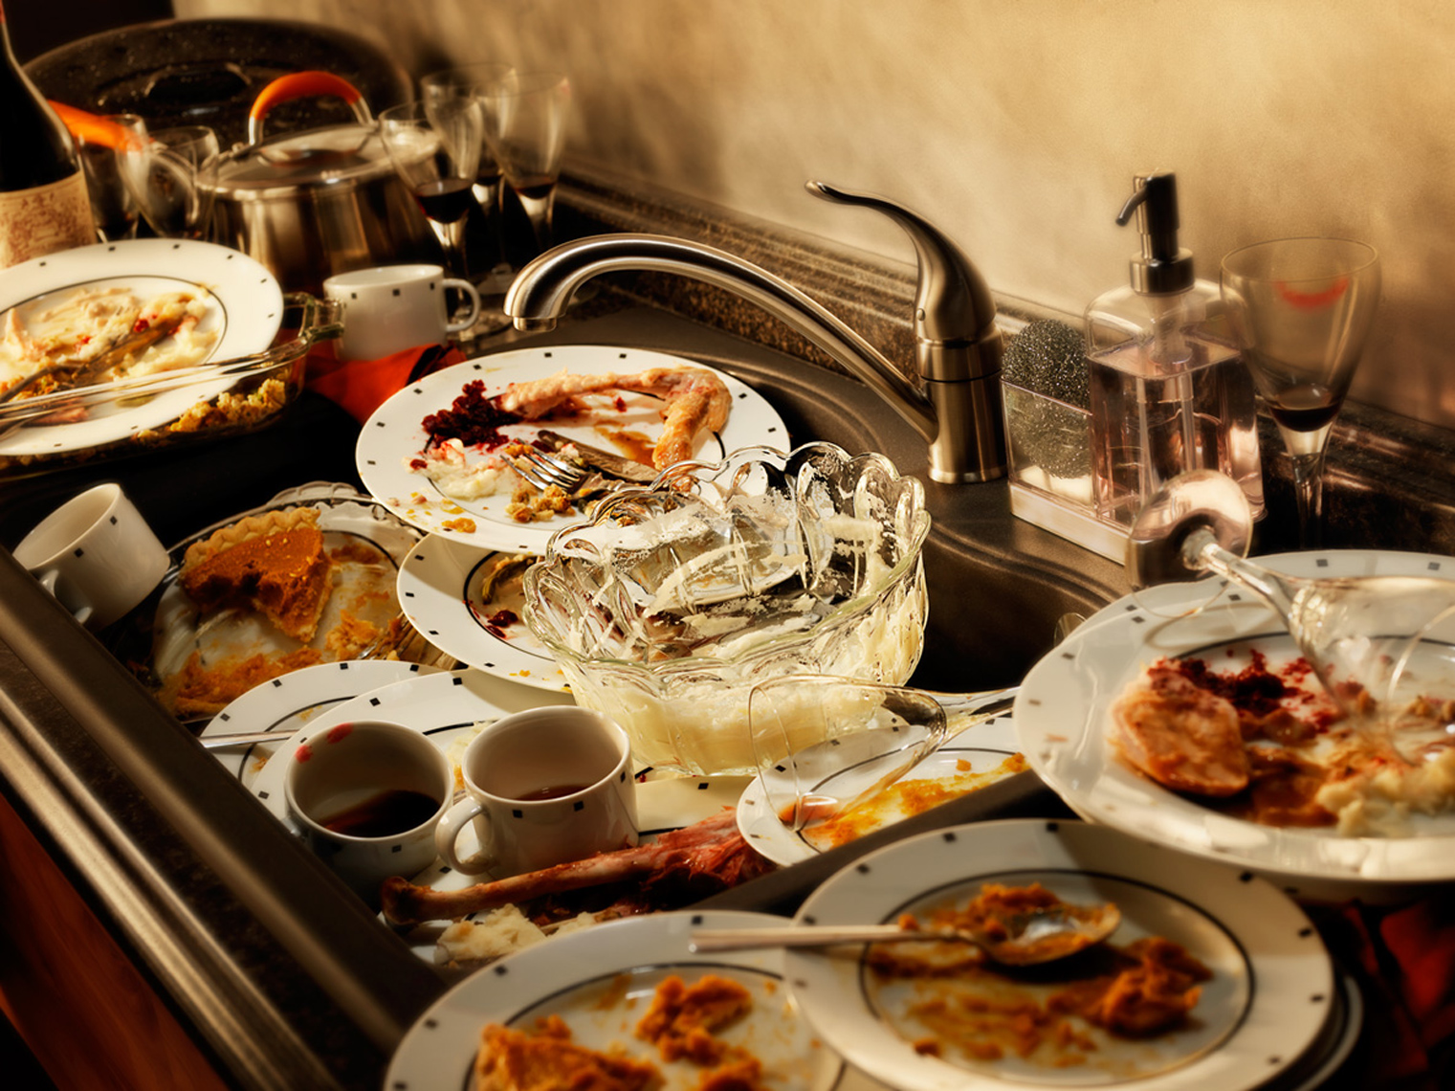
Anchoring Phenomenon
Think about the pile of dirty dishes sitting in your kitchen after you have finished eating a meal. Use the Session B: Adult Learner Notebook in the participant packet to record your thinking.
What do you notice and wonder from the picture?
What can you do to get the items clean?
What would happen to the dirty stuff on/in the items?
Notes:
Explain:
In the right-hand corner of this slide, you will note the “adult learner hat” symbol.
Tell participants a story about the messes you have in your kitchen (related to cups/plates/buckets that have dirty stuff in or on them and need to be cleaned.) Here is an example (feel free to add to the story or create one of your own to engage participants):
“This picture is typical of what my kitchen looks like after my family of 5 finishes eating dinner each night. I have three boys who like to eat, and they really enjoy it when I cook them a big meal with their favorite dishes. Unfortunately, it makes my kitchen a mess. I always have dirty pots and pans, dishes and cups lying around after eating a meal. It can seem like a big task, especially if we have accumulated more dishes to add to the pile from the day or didn't take the time the night before to clean up. I need to clean up this mess before it gets out of hand.”
Think about the pile of dirty dishes sitting in your kitchen after you have finished eating a meal. Use the Session B: Adult Learner Notebook in the participant packet to record your thinking.
Take a few minutes to jot down your thoughts as you consider...
What do you notice and wonder from the picture?
What can you do to get them clean?
What would happen to the dirty stuff on/in the items?
Take a moment and share some of the things that we notice and wonder about from the picture.
Facilitator Note:
Be sure to refer to this common experience as an “adult learner hat” not student hat. The focus for the participants is to engage in the activities as adult science learners not as one of their students. As participants engage in the learning experience keep in mind ways you may facilitate this to keep their thinking within this moment of the module.
You may consider the following:
Acknowledging that later within the session there will be a moment to return to their teacher questions and invite them to remain in the “adult learner hat” for now.
Turn their “teacher hat” question into an “adult learner hat” question.
Acknowledge this is something you would do with students and take the moment to show the importance of doing it within this learning experience as adults in the “adult learner hat.”
Brinza, G., Larson, K., McGreal, A. & Novak, M. (n.d). Where Does Our Clean Water Come From and Where Does It Go After We Make It Dirty? NextGenStorylines. ​Where Does Our Clean Water Come from and Where Does it Go After We Make it Dirty?​ — Next Generation Science Storylines (nextgenstorylines.org).

Slide 23
Developing a Plan
In a group develop a plan to get the dishes clean.
Share out each in whole group.
Look for similarities and differences within plans.
Notes:
Explain:
We will divide into small groups to begin developing a plan to get the dishes clean. Use the “Developing a Plan” section of the Session B: Adult Learner Notebook as a place to record your plan.
As groups are working on their plan to get the dishes clean, listen for participant ideas that refer to things like:
It smells bad.
There is stuff stuck on it.
One spot is a different color from the rest.
We should wash it off in the sink.
We could wipe it off with a sponge and soap.
We could dump it in the garbage can.
Have each group share their plans with the whole group. Discuss similarities and differences between cleaning methods.
Listen for responses such as:
Possible Similarities:
Everyone used water.
Everyone’s dirty stuff went down a drain (toilet or sink).
Clear water came out of a specific location (e.g., the faucet or the top of the toilet).
Possible Differences:
Some used soap/some didn’t.
Some of the solid stuff went into the toilet first, and some went directly into the sink.
Some of the water went down the sink drain, while other water went down the toilet.
Some of the water that was used came from a faucet.
Brinza, G., Larson, K., McGreal, A. & Novak, M. (n.d). Where Does Our Clean Water Come From and Where Does It Go After We Make It Dirty? NextGenStorylines. ​Where Does Our Clean Water Come from and Where Does it Go After We Make it Dirty?​ — Next Generation Science Storylines (nextgenstorylines.org).

Slide 24
Identify Related Phenomena
We decided getting clean water and getting ride of it when it was dirty was important for us when cleaning our dishes. Record your thoughts in Session B: Adult Learner Notebook.
Stop and Think
Where else might we use clean water
and make it dirty?
Notes:
Explain:
Besides cleaning dirty dishes, when have you done something similar and/or seen other examples of using clean water and making the water dirty? Take a moment to record your thinking in Session B: Adult Learner Notebook. We will share these out.
Listen for responses such as:
Washing dishes, doing laundry, taking a shower, going to the bathroom, brushing teeth, mopping the floor
Many of these examples seem to come from your experiences using water and making dirty water inside your homes. I wonder if we can come up with other ways people use clean water or make water dirty anywhere outside of your home or school. Let’s brainstorm those. Take a moment to add some of those experiences to your Session B: Adult Learner Notebook.
Give participants a couple minutes to write their ideas down and then ask them to share their responses. Add what they share to the poster of related phenomena. Make a list of these, too.
Listen for responses such as:
Fire hydrant
Water recreation (swimming pools, water/splash parks)
Washing the car
Sprinklers/watering plants
Street cleaners (spraying water)
Pollution (litter, outfall pipes, vehicles, oil, farms, etc.)
A key element of the anchoring phenomenon routine is letting participants share their experiences with related phenomena. By doing this, participants can connect their diverse experiences with a shared phenomenon that is the focus of the unit. Remember that phenomena are things that happen in the world that we have observed and can use our science understanding to explain.

Slide 25
Driving Question
Where does our clean water come
from and where does it go after
we make it dirty?
Notes:
Explain:
The driving question of this unit is: “Where does our clean water come from, and where does it go after we make it dirty?”
Facilitator Note:
Remind participants of the driving question as they go through this learning experience. Post the driving question in the room.
Brinza, G., Larson, K., McGreal, A. & Novak, M. (n.d). Where Does Our Clean Water Come From and Where Does It Go After We Make It Dirty? NextGenStorylines. ​Where Does Our Clean Water Come from and Where Does it Go After We Make it Dirty?​ — Next Generation Science Storylines (nextgenstorylines.org).

Slide 26
Initial Model
Create an initial model on a separate piece of paper showing where you think the clean water comes from and where the water goes after we make it dirty.
Things to keep in mind:
When engaging in modeling, the key should be on explaining the “how” (and why) of a phenomenon.
Consider adding labels that identify where the clean water comes from and where the water goes after we make it dirty. Labeling parts of your model helps to communicate your thoughts.
Notes:
Explain:
We are going to develop an initial model of where we think the clean water comes from and where the dirty water goes. Use the large chart paper provided to draw your initial model.
There are some things to keep in mind while your group constructs this initial model.
Remember that modeling is not just a drawing or an art activity. When engaging in modeling, the focus should be on explaining the how and why of a phenomenon, not just the what. For this model, you will need to focus on explaining where you think the water goes after the drain and where it comes from before the faucet.
Consider adding labels that identify where the clean water comes from and where the water goes after we make it dirty. Labeling parts of your model helps to communicate your thoughts.
When you are finished hang them on the wall.
Facilitator Note:
Consider giving groups a large chart paper, or a digital whiteboard if you are online for each group to draw their initial model on. As the facilitator, you can use these to conduct a pre-assessment of the adult learner ideas. In order to complete the gallery walk, the participants will need to post their initial models on the wall.
Brinza, G., Larson, K., McGreal, A. & Novak, M. (n.d). Where Does Our Clean Water Come From and Where Does It Go After We Make It Dirty? NextGenStorylines. ​Where Does Our Clean Water Come from and Where Does it Go After We Make it Dirty?​ — Next Generation Science Storylines (nextgenstorylines.org).

Slide 27
Comparing Models
Use a gallery walk to view the other models that were created.
As you explore other models, note the following in the
Session B: Adult Learner Notebook in your participant packet.
What was similar and different in the ideas that you saw represented in your model compared to the other models?
What did you notice was similar and different across all the models?
Notes:
Explain:
We will now take a gallery walk to view the other models that were created. As we explore other models, note your responses to the following questions in their Session B: Adult Learner Notebook.
What was similar and different in the ideas that you saw represented in your model compared to the other models?
What did you notice was similar and different across all the models?
Facilitator Note:
You may want to look for a few different models and ask those participants if they would be willing to share their thinking.
Brinza, G., Larson, K., McGreal, A. & Novak, M. (n.d). Where Does Our Clean Water Come From and Where Does It Go After We Make It Dirty? NextGenStorylines. ​Where Does Our Clean Water Come from and Where Does it Go After We Make it Dirty?​ — Next Generation Science Storylines (nextgenstorylines.org).

Slide 28
Consensus Building Discussion
Form a scientists circle to have a consensus building discussion.
What ideas do you all agree on?
What ideas were different across the models?
Notes:
Explain:
Invite participants to join in a “Scientists Circle” to have a consensus building discussion.
Use some of the following prompts:
What was similar in the ideas that you saw represented in the first model and the second model?
What ideas were different?
What did you notice was similar across all the models?
What did you notice was different across all the models?
Listen for responses such as:
Some (or all) had pipes.
Some showed water coming into or going out of the house.
Some showed water coming from or going to a place far away (a large body of surface water).
Some showed water towers.
Some showed different pipes for water coming in versus going out, while some showed the same pipes.
Some showed lots of pipes in the house.
Some showed a toilet, while others showed a sink.
We all agree that clean water is coming into the faucet from a pipe that gets it from somewhere.
We all agree that dirty water is going down the drain into a pipe that goes somewhere.
We are not sure how many pipes are involved. Do these go to and come from the same pipe? Does every sink have its own pipe? Are some connected together, and others aren’t?
We are not sure if the pipes go underground, but we know there isn’t a big container of dirty water being stored in our house or school. But some of us wondered if there was a big container of clean water in our house or school (because some of us have seen things like water heaters).
We are not sure where the dirty water goes to after it leaves a building.
We are not sure where the clean water comes from.
Facilitator Note:
A scientist circle reconfigures the learning space so students sit in a circle and can see and speak directly to each other. Scientist circles are most often used at moments in which the class needs to work towards consensus on ideas they have figured out. This formation leads to more opportunities for students to collaboratively make meaning through talk, because the students are better able to listen to one another, build upon ideas, and foster a sense of accountability to the group. See page 41 of the 2022 OpenSciEd Teacher Handbook.
Brinza, G., Larson, K., McGreal, A. & Novak, M. (n.d). Where Does Our Clean Water Come From and Where Does It Go After We Make It Dirty? NextGenStorylines. ​Where Does Our Clean Water Come from and Where Does it Go After We Make it Dirty?​ — Next Generation Science Storylines (nextgenstorylines.org).

Slide 29
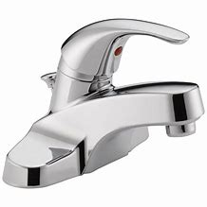
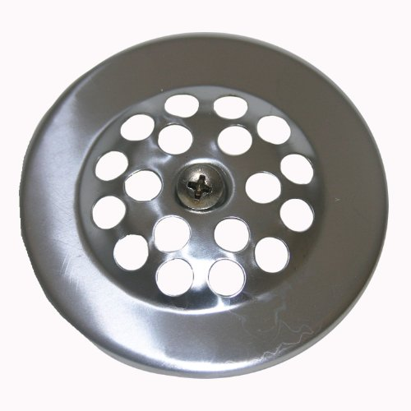
Making Sense of the Phenomenon
Where does our clean water come from? | Where does water go once we make it dirty?
Notes:
Explain:
Now we are going to take all the ideas from your discussion and begin to organize your thinking. We all had in common the water coming out of the faucet and going down the drain, but we had different ideas about where the water came from before it came out of the faucet. Let’s list all the places we saw from the models as to where the water came from before entering the faucet. Can you think of more places that were not captured in the initial models? How about where it goes once, we make it dirty? What ideas did you see represented in the models? Can you add to that list?
Brinza, G., Larson, K., McGreal, A. & Novak, M. (n.d). Where Does Our Clean Water Come From and Where Does It Go After We Make It Dirty? NextGenStorylines. ​Where Does Our Clean Water Come from and Where Does it Go After We Make it Dirty?​ — Next Generation Science Storylines (nextgenstorylines.org).

Slide 30
Consensus Building
Develop a consensus model as a whole group that represents everything we agreed upon.
Include question marks on the areas where there were different ideas.
Notes:
Explain:
We are now going to develop a consensus model to represent everything we agreed upon so that we can have a common foundation from which to build our understanding together. We are going to include question marks on the areas where we had different ideas.
In these models, there should be a question mark at the clean water source and a question mark on the arrow from the drain to the outside of our building.
The model should represent what the group all agrees is known (which will be very little) and what is unknown (lots of question marks). Here are some examples of class-constructed models. There may be additional ideas that the group wants to represent about water used outside the house.
Brinza, G., Larson, K., McGreal, A. & Novak, M. (n.d). Where Does Our Clean Water Come From and Where Does It Go After We Make It Dirty? NextGenStorylines. ​Where Does Our Clean Water Come from and Where Does it Go After We Make it Dirty?​ — Next Generation Science Storylines (nextgenstorylines.org).

Slide 31
Asking Questions
Where does our clean water come from and where does it go after we make it dirty?
Write at least two phenomena-related questions, one per sticky note that you are curious about.
One person will share their question. If anyone has a question that is related or similar, they will speak up and share their question and explain why/how it is related.
Notes:
Explain:
Consider all we have learned about so far. What questions do you have regarding the driving question, “Where does our clean water come from and where does it go when we make it dirty?” Write at least two phenomena-related questions on self-sticking notes, one question per sticky note that you are curious about and one phenomena-related question that the group generated earlier (refer to the consensus model poster) that you want to see on the class driving question board.
It can help to model questions that, though interesting, may not be productive toward answering the Driving Question, i.e., “How many drains do you have in your house?” or “Do you like hot or cold water?” While these are questions, finding the answers to them wouldn’t help answer the Driving Question (DQ).
Modeling these can help students start generating questions that pertain to the DQ.
Additionally, encourage participants to use language that is as specific as possible. For example, the question “Where does it go when it goes down?” can be rewritten to be “Where does the dirty water go once it enters a drain in a house?” The detailed language clarifies a question that is confusing when taken out of context.
Once participants have their questions, adult learners meet in a Scientists Circle around the large poster board containing the driving question and the initial model.
This space for the DQB should be pre-prepared with the question “Where Does Our Clean Water Come From, and Where Does It Go To After We Make It Dirty?” across the top. Put the initial consensus model off to the side of the driving question board. In the middle of the board should be a picture of a faucet, a drain, an arrow coming in from the left and an arrow pointing out to the right. Include any outdoor structures that participants agree are part of the story of where water goes outside.
To begin building the driving question board select a participant to share one of their questions with the group and post on the DQB. A participant with a similar question should read their question aloud, explain why/how it is related to someone else’s question (already posted on the board) and place alongside the related question. Once there are no more related questions, request a participant to share a different question and repeat the process.
Facilitator Note:
Emphasize that we need to hear from everyone, because we want to make a joint mission that reflects what the entire learning community wants to figure out. Reassure participants that when we get down to the last people who haven’t shared, it may simply be because there isn’t an obvious connection to another question they heard. At that point, we all can work together to help brainstorm ways we might be able to connect that person’s question to a previous one posted on the board.
Brinza, G., Larson, K., McGreal, A. & Novak, M. (n.d). Where Does Our Clean Water Come From and Where Does It Go After We Make It Dirty? NextGenStorylines. ​Where Does Our Clean Water Come from and Where Does it Go After We Make it Dirty?​ — Next Generation Science Storylines (nextgenstorylines.org).

Slide 32
Teacher Hat(1)
While in teacher hat, we will:
grow our understanding of phenomena- based instruction and storylining.
reflect on our teaching and consider new shifts in our teaching practice.
analyze the Kentucky Academic Standards for Science.
Notes:
Explain:
As we wrap up our immersion activity for this part of session B, we are going to take this moment to pause and return back to our “teacher hat”.
Facilitator Note:
As you come back into “teacher hat” allow participants to take a moment to place their questions on the parking lot or provide some time for discussion. Not all questions need to be answered at this time. Some may be quick to answer, and others may need to be addressed later within the module.

Slide 33
Retelling the Launch of the Phenomenon
Let’s look back to how we launched the phenomenon.
What were the pieces of the lesson we engaged in as adult learners that led to the development of the driving question?
Notes:
Explain:
Let’s look back to how we launched the phenomenon. What were the pieces of the lesson we engaged in the adult learners that led to the development of the driving question?
Encourage participants to use the artifacts that were created in adult learner hat to retell the launch of the anchoring phenomenon to support the building of the driving question board. Listen for the following sequence as participants start the discussion:
1. Story of a sink full of dirty dishes.
2. Notice and wonder of the image of the dirty dishes.
3. Groups made a plan to clean the dishes and shared them out with the group.
4. Look for similarities and differences in the plans to clean the dishes.
5. Identified other related phenomenon.
6. Introduced the driving question.
7. In groups, created an initial model.
8. Gallery walk to compare our initial model to other models looking for similarities and differences.
9. Consensus building discussion on what ideas we agreed on across the models.
10. Made a list of where the clean water comes from and where the water goes once we make it dirty from the initial models.
11. Developed a consensus model on what we agree upon and placed questions marked in areas where there were different ideas.
12. Constructed the driving question board.

Slide 34
Participant Driving Question Board
Continue until ALL questions are shared.
Continue listening to similarities and differences.
Continue to group/categorize them in the moment.
ALL voices are heard and valued.
Develop the shared mission of learning to reflect the thinking of the entire learning community.
Notes:
Explain:
Let’s take a moment to look at the questions on our driving question board through our “teacher hat.” As this discussion continues, it is important to note that in the classroom we would continue this opportunity for everyone to share their question out loud and listen for ways in which we have similar and different questions from one another. We want and need to hear from everyone to construct a joint mission that reflects what the entire learning community wants to figure out.

Slide 35
Big Ideas on Grouping Questions on the DQB
Categorizing in the moment with students is more powerful for the student learning because the students get to see how their questions connect and relate to other’s questions.
This process puts the student at the center of their learning experience, while the teacher acts as a facilitator who is learning along with the student.
This also helps with teacher management of the DQB. If the teacher has worked with students to categorize, they will not have to come back and do it later after class.
Students have the ownership to continue adding to groups, creating new groups, and checking groups of questions that are answered.
Notes:
Explain:
Here are some ideas you might consider when you are thinking about how to categorize the questions on the DQB.

Slide 36
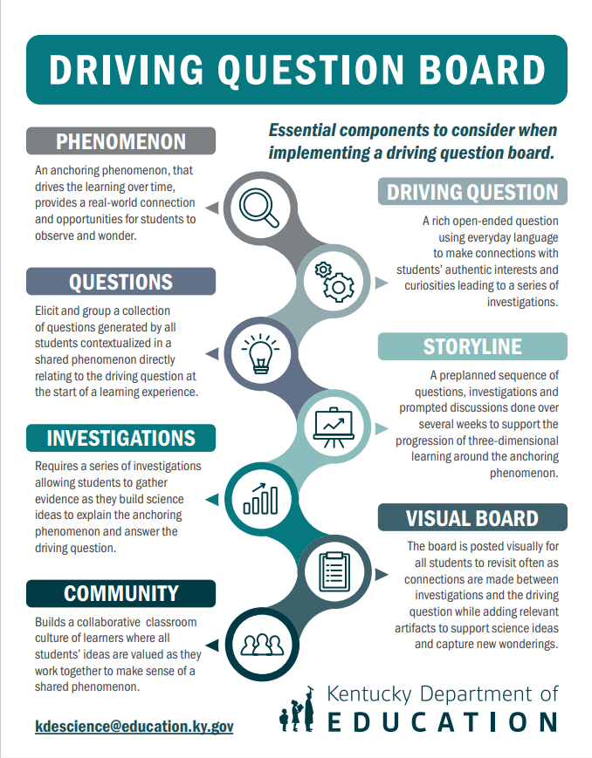
Stop and Reflect
Record your thinking in the Session B: Notes – Teacher Hat in your participant packet. You may use the Driving Question Board Poster to add to your thinking.
What did you learn from this experience?
How did the use of a driving question board impact your experience in terms of engagement and/or motivation for learning?
Notes:
Explain:
Take a moment and collect your thoughts in teacher hat to the following prompts in the Session B: Notes-Teacher Hat section of their packet.
What did you learn from this experience?
How did the use of a driving question board impact your experience in terms of engagement and/or motivation for learning?
Facilitator Note:
This graphic has been created to continue support ideas and discussion around the driving question board. It can be printed as a bookmark, a handout, or a poster.

Slide 37
Session B Shared Understandings
The driving question board…
connects to students’ experiences or the world around them.
encourages everyone to participate and share their voice.
focuses on the students’ curiosities.
allows students to build on each other’s ideas.
promotes collaboration among students.
builds a classroom community of learners as they work toward explaining the phenomenon.
Notes:
Explain:
In summary, a driving question board... (read the understandings on the screen). All these aspects of the driving question board help to foster a community of learners in terms of student engagement and motivation for learning.
Facilitator Note:
Read aloud or allow participants to read as you advance through these shared understandings the group should have on the purpose of the driving question.

Slide 38
After completing session B, you should be able to answer the following questions.
How does the use of a driving question board foster a community of learners?
How does the driving question board increase student engagement?
How does the driving question board motivate students to learn?
Notes:
Explain:
As we complete Session B, you should be able to answer the following questions:
How does the use of a driving question board foster a community of learners?
How does the driving question board increase student engagement?
How does the driving question board motivate students to learn?
Take a moment to look over your notes and summarize your learning by adding to your “meta moment” response at the beginning of this session.
Facilitator Note:
Pause and see if anyone has a clarifying question they would like to ask before moving onto their reflection. Check the “Parking Lot” to address questions posted. Group questions by common categories to help save on time. Keep note of the questions that are not addressed in this session to be addressed later in another session.

Slide 39
Session B Overall Reflection
Take some time to record your thoughts from today’s session by responding to the following prompts in Session B: Overall Reflection of the participant packet.
What?
So What?
Now What?
What inspired you during this session?
Why did that inspire you?
What are your goals as a result of this experience?
Notes:
Explain:
At this time, take a moment and reflect on your learning by recording your thoughts from today’s session by responding to the prompts on the screen. You can record this in Session B: Overall Reflection in the participant packet.
Facilitator Note:
Allow time for the participants to respond to the prompt for the reflection. Give them some time if they would like to share with their partner or table group.

Slide 40
Session B Next Steps - Considerations for Implementation
Examine your current science resource, how does the resource support the implementation of the DQB? If it does not, how might you incorporate a DQB within the learning experience? Record your ideas in Session B: Next Steps- Considerations for Implementation section of your participant packet.
Consider the following:
What standards are being addressed during the instruction?
What anchoring phenomenon might you use to frame the learning around?
What might be your driving question?
DRIVING QUESTIONS
Are a rich open-ended question that cannot be solved immediately
Use everyday language to connect with student’s authentic curiosities
Require a series of investigations that can be done over several weeks
Notes:
Explain:
Each session we will continue to take small actionable steps to implement the driving question board in your classroom. Take some time to think about your upcoming unit. Examine your current science resources, how does the resource support the implementation of the DQB? If it does not, how might you incorporate a DQB within the learning experience? If you do not have a science resource, you might want to consider some High-Quality Open Education Resources similar to the resource used within this module. Open Educational Resources can be found at Kentucky Department of Education Science Professional and Curricular Resource page. To help you think about this, there are some questions to consider on the screen and in your Session B: Next Steps- Considerations for Implementation section of your participant packet.

Slide 41
SESSION C
Notes:
Facilitator Note:
This is the beginning of session C.
Review the norms the group agreed upon in Session A and B. Allow participants to reflect and offer any changes they want to propose to the group for them to consider. Make those adjustments the group decided on in a visual way where the norms are posted.

Slide 42
Module Goals (3)
Explain what a driving question board is and understand its purpose in the science classroom.
Identify ways that the driving question board can build a community of learners.
Analyze how a cohesive storyline can be built around an anchoring phenomenon.
Generate ideas for how a driving question board can be used as a formative assessment tool.
Notes:
Explain:
We will begin session C of Improving Student Engagement in the Science Classroom Using a Driving Question Board (DQB). These are the module goals, Please take a moment to read through these. While we will not take time to read the goals out loud again, please direct your attention to the third goal this evening, “Analyze how a cohesive storyline can be built around an anchoring phenomenon.”

Slide 43
Sessions in this Module (3)
Session A:
What is a driving question board and what is its purpose in the science classroom?
Session B:
How does the use of a driving question board foster a community of learners in terms of student engagement and motivation?
Session C:
How can a driving question board anchored in a phenomenon be used to build a cohesive storyline?
Session D:
Why should the driving question board be used as a formative assessment tool to foster an equitable learning community?
Notes:
Explain:
Take a moment to remind yourself of our focus question from session A and B. You will notice in this session we will be looking at how a driving question board anchored in a phenomenon can be used to build a cohesive storyline.

Slide 44
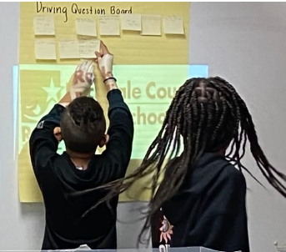
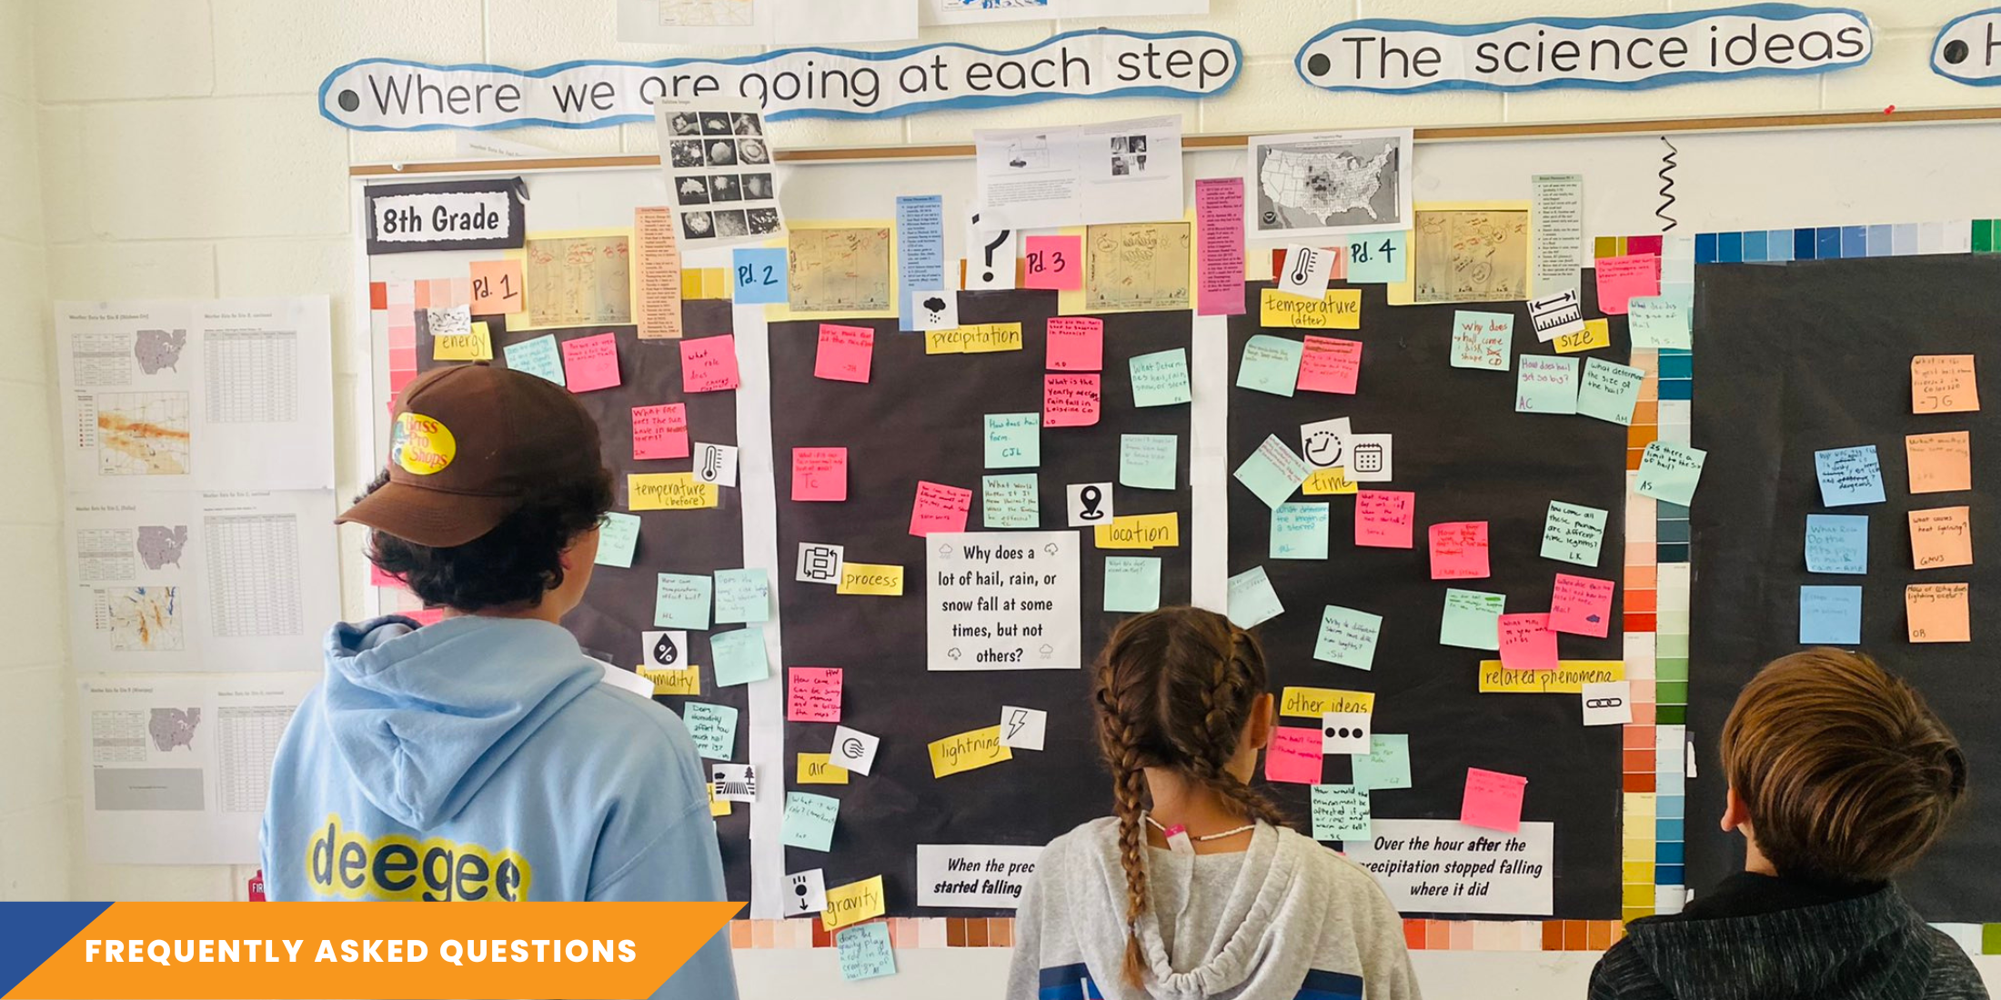
In the previous sessions, we learned…
The driving question board is an effective strategy for fostering student engagement and empowering them in their learning journey, fueling a strong motivation for learning.
What the student experience feels like when using a driving question board to engage in a learning experience that is symmetrical to the classroom.
Notes:
Explain:
In the previous sessions, we learned the driving question board is an effective strategy for fostering student engagement and empowering them in their learning journey, fueling a strong motivation for learning. We also experienced what the student experience feels like when using a driving question board to engage in a learning experience that is symmetrical to the classroom.
Facilitator Note:
Briefly review learning and experiences from the previous session, using information on this slide for guidance. You may also bring in any discussions that came out in the previous session.
Allow participants to add any questions they may have to the “Parking Lot” as they prepare to continue deepening their understanding of a DQB.

Slide 45
Session C Meta Moment
Focus Question:
How can a driving question board anchored in a phenomenon be used to build a cohesive storyline?
Notes:
Explain:
In the last session, we learned how the driving question board is an effective strategy for student engagement and motivation. We also had an opportunity in session B to experience learning symmetrical to the classroom. Take a moment to consider our focus question for Session C: How can a driving question board anchored in a phenomenon be used to build a cohesive storyline?
Take a meta-moment for participants to jot down their thoughts on the focus question.
Facilitator Note:
Check to make sure participants have a copy of the participant packet as a digital file or printed. They will use this throughout the session to record their thoughts.

Slide 46
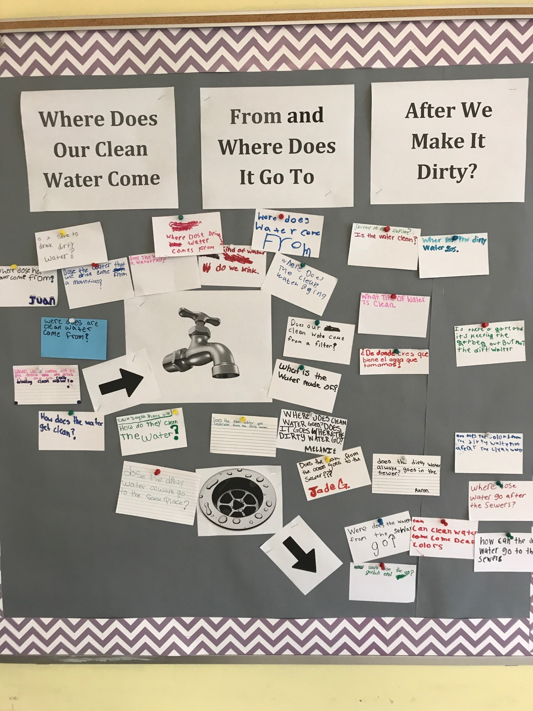
Questions on the DQB
Revisit and familiarize yourself with the questions on the DQB from session B.
Consider and discuss within small groups:
Which questions are testable?
Which questions might help us understand more about the driving question?
Which questions give us information “in addition to” the driving question?
Notes:
Explain:
In session B, the group created a driving question board together in the “adult learner hat.” Let’s take a moment to look at these questions through our “teacher hat.” Examining these questions allows us to gain a deeper understanding of how a driving question board can inform the teacher of initial students’ science ideas. As we begin looking let’s examine our own questions to gather initial science ideas and begin looking for patterns in our thinking.
Provide time within small groups to take a closer look at the questions that were created and consider:
Which questions are testable?
Which questions might help us understand more about the driving question?
Which questions give us information “in addition to” the driving question?
After groups have had time, allow for each group to share a few takeaways from their discussion.
Facilitator Note:
Assure the driving question board is visible for all participants.

Slide 47
Compare Questions
How does the water get clean?​Where does are clean water come from?​
Is it safe to drink dirty water?​
Where does drinking water come from?​
Where does water come from?​
Is the water clean?​
Where does the dirty water go?​
Does our clean water come from a filter?​
What is water made of?​
¿De dónde crees que viene el agua que tomamos?
Where does clean water go? Does it go where the dirty water goes?​
Where does the water from the sewer go?​
How does water go after the sewers?​
How does the color of the dirty water not stay when the water is cleaned?​
Does the dirty water always to the same place?​
​
​
Notes:
Explain:
Let's pause here for a moment and compare this community's DQB to one that was developed by students in a grade 5 classroom. Since it may be difficult to read the student questions, they are typed on this slide.
How did our DQB compare to the student DQB? What do you notice and wonder?
​
Open for discussion.
​
Student questions are very similar to your questions. What intentional teacher moves would lead to that result? The clarity of the anchoring phenomenon launch paired with intentionally planned questions to support the phenomenon and to guide the discussion. ​
One noticing is around one of the questions being written in Spanish. The English translation is: From where do you believe the water we drink comes from? What information can you gather from this? Equity is a must so that all student voices are heard and valued. Teachers need to consider how they may support all students to enter the discussion in a way that is comfortable and achievable (drawings, hand gestures, acting out, home language, etc…)​.
​
Some questions are similar or different. This gives us the opportunity to see that we are a part of a learning community, and my question is validated when someone shares the same thought. It also helps us to learn and draw from a question that is different from ours and may provide a different perspective to the phenomenon.

Slide 48
Your Ideas for Investigation
Reflect back to session B.
Identify the anchoring phenomenon
Review the driving question
View the driving question board
Jot down ideas for two to three in-class activities or investigations that could help answer some of the questions on the driving question board.
Share these ideas out and post them beside the questions they would address on the driving question board.
Notes:
Explain:
The science and engineering practice of “Planning and carrying out investigations requires us to figure out what kind of information and observations we need to address our questions about a phenomenon and to decide how to systematically collect and record it” (Schwarz, 2017). This experience will allow us to begin the practice of planning and carrying out investigations. Take a close look at the questions and jot down ideas for two to three in-class activities or investigations that could help answer some of the questions posted on the driving question board.
Have participants share their ideas. Make sure to record these ideas for investigations to pursue next to the question on the driving question board. You may want these on a different color post it so they will stand out.
Facilitator Note:
The “Ideas for Investigation” is the joint action plan for the class. Many ideas that arise will connect to future lessons in the unit. Make sure to refer to the ideas often throughout the unit (and add new ideas that students suggest in future lessons to the board) to help support the navigation routine.
Possible Ideas: use a camera to look down drain, search on google maps and images, blow up/knock down the wall and look at pipes, ask a plumber, using plumbing equipment, go to a water-filter building, practice filtering stuff in class (make the water dirty first).

Slide 49
Storyline
As you compare your thinking to the developers thinking, identify evidence of how the storyline connects back to our driving question board.
Notes:
Explain:
A storyline provides a coherent path toward building disciplinary core ideas and crosscutting concepts, piece by piece, anchored in students' own questions. The developers of this learning experience created the anticipated storyline. Navigate to the storyline found at the link provided or view the hard copy provided. In your small groups, compare your thinking to the developers’ thinking of the three dimensions. Identify evidence of how the storyline connects back to our driving question board.
Facilitator Note:
Allow participants to discuss in small groups and share their thinking. Continuously prompt them to identify how it connects back to the driving question board.
Brinza, G., Larson, K., McGreal, A. & Novak, M. (n.d). Where Does Our Clean Water Come From and Where Does It Go After We Make It Dirty? NextGenStorylines. ​Where Does Our Clean Water Come from and Where Does it Go After We Make it Dirty?​ — Next Generation Science Storylines (nextgenstorylines.org).

Slide 50
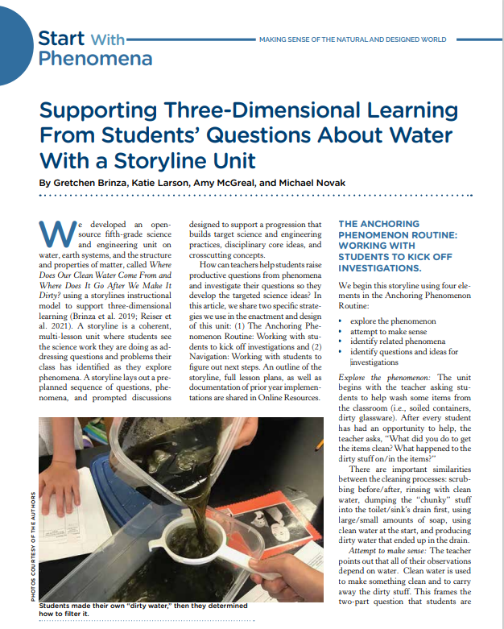
Article
As you read, Supporting Three-Dimensional Learning From Students’ Questions About Water With a Storyline Unit, jot your responses to the following questions in the Session C: Notes section of your participant packet.
How was the driving question board used throughout this learning experience as described in the article?
As the students were navigating through the learning experience, what were the actions of both the teacher and the students?
Notes:
Explain:
Now that you have had the opportunity to examine the writer’s storyline document, we will take a look into a classroom to see how the teacher supports three-dimensional learning from students’ questions. This is the same learning experience we have been engaged in. This article gives you a good idea of how this entire learning experience plays out with students. As you are reading this article, turn to Session C: Notes of your participant packet and record your thoughts to the following questions:
How was the driving question board used throughout this learning experience as described in the article?
As the students were navigating through the learning experience, what were the actions of both the teacher and the students?
Ideas to listen/look for:
Teacher
Supports students in asking questions
Collects thoughts, observations and wonderings in a visual way
Asks questions
Celebrates all ideas
Develops the storyline while anticipating students’ ideas and connections to the phenomenon
Invites students to consider investigations needed
Directs students back to the DQB often throughout the storyline
Students
Create questions around an anchoring phenomenon and organize their questions into clusters
Explain their observations and thinking
Share related initial ideas
Know and care why they are doing what they are doing
Develop models
Listen to one another and engage in discourse
Do the “figuring out”
Facilitator Note:
Since this article is a progression of the learning taking place in the classroom, it does not lend well to a jigsaw read. If you want to divide up the task, you can consider using partners. Each partner can read with a different focus in mind. One person reads and attends to the first question while the other partner focuses on the actions of the teacher and the students. You may encourage the participants to use a t-chart when examining the roles of the teacher and students.
Brinza, G., Larson, K., McGreal, A. & Novak, M. (2022, March 1). Supporting Three-Dimensional Learning From Students’ Questions About Water With a Storyline Unit. Science and Children. (75-79).

Slide 51
Kentucky Academic Standards for Science
When looking at the grade 5 standards, what standards do you think are addressed with this learning experience?
Kentucky Academic Standards for Science
Notes:
Explain:
This learning experience is targeting the grade 5 standards. Please navigate to KYStandards.org to access the Kentucky Academic Standards for Science. As you examine the grade 5 standards, what standards do you think are addressed with this learning experience? Take a moment to either mentally note those or jot a few of your ideas in the margin of your participant packet.
Facilitator Note:
You may need to assist the participants in navigating the Kystandards.org website if they are not familiar with the site. If teachers have a hard copy of the standards document, you may request participants bring it to this session to reference. You may also consider having them read through the grade 5 overview, which will give them a high-level overview for that grade.

Slide 52
Kentucky Academic Standards for Science Addressed in this Resource (1)
5-PS1-1: Develop a model to describe that matter is made of particles too small to be seen.
5-PS1-2: Measure and graph quantities to provide evidence that regardless of the type of change that occurs when heating, cooling or mixing substances, the total weight of matter is conserved.
5-PS1-3: Make observations and measurements to identify materials based on their properties.
5-PS1-4: Conduct an investigation to determine whether the mixing of two or more substances results in new substances.
5-ESS2-1: Develop a model using an example to describe ways the geosphere, biosphere, hydrosphere and/or atmosphere interact.
5-ESS2-2: Describe and graph the amounts and percentages of salt water and fresh water in various reservoirs to provide evidence about the distribution of water on Earth.
5-ESS3-1: Obtain and combine information about solutions individual communities use to protect the Earth’s resources and environment.*
3-5-ETS1-1: Define a simple design problem reflecting a need or a want that includes specified criteria for success and constraints on materials, time or cost. *
3-5ETS1-2: Generate and compare multiple possible solutions to a problem based on how well each is likely to meet the criteria and constraints of the problem. *
3-5ETS1-3: Plan and carry out fair tests in which variables are controlled and failure points are considered to identify aspects of a model or prototype that can be improved. *
Kentucky Academic Standards for Science
Notes:
Explain:
The standards on the slide are the Kentucky Academic Standards for Science that were identified by the writers of this learning experience. Compare these with the ones you identified. Do you see any similarities?
Facilitator Note:
If questions arise regarding a specific standard and how it fits into the learning, suggest that participants continue to learn more about the full storyline throughout this session. Participants may not see how each one of the standards align with the first questions on the DQB, remind them that the DQB is constantly evolving. As the students move throughout the storyline, their science ideas will grow and develop, naturally leading to more questions being added to the DQB.

Slide 53
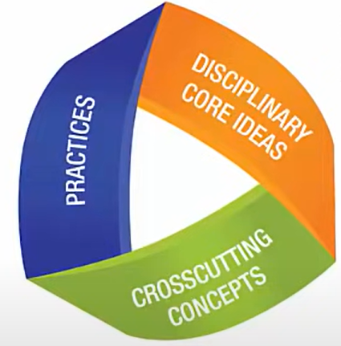
Three-Dimensional Standards (1)
Practices describe
behaviors scientists and engineers engage in
“What students DO”
Disciplinary core ideas describe the core ideas in the science disciplines
“What the students KNOW”
The crosscutting concepts describe concepts linking the different domains of science
“How the students think”
Notes:
Explain:
Each one of the performance expectations are three-dimensional. This means that the performance expectations are made up of a science and engineering practice, cross cutting concept, and a disciplinary core idea.
Science and Engineering Practices refers to what the students do and describes the way in which scientists and engineers engage in their work.
Disciplinary Core Ideas refer to what the students know. Core ideas found in the Kentucky Academic Standards for Science are foundational understandings so that students may later acquire additional information on their own.
Crosscutting Concepts are conceptual tools that are used as lenses for understanding the natural/designed world. They provide ways of thinking and reasoning about phenomena across disciplines, uniting core ideas throughout the fields of science and engineering.

Slide 54
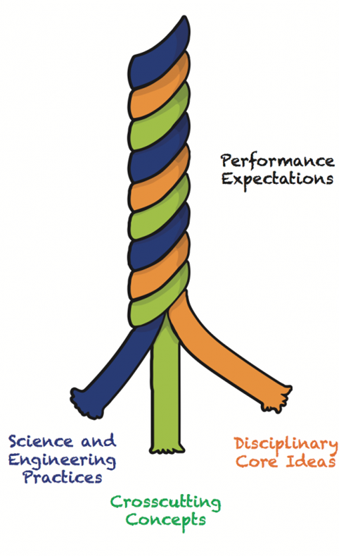
Three-Dimensional Standards (2)
Science and Engineering Practices | Disciplinary Core Ideas | Cross Cutting Concepts
Asking questions or defining problems Developing and using models Planning and carrying out investigations Analyzing and interpreting data Using mathematics and computational thinking Constructing explanations and designing solutions Engaging in argument from evidence Obtaining, evaluating and communicating information | Physical Sciences: (PS1) Matter and Its Interactions (PS2) Motion and Stability: Forces and Interactions (PS3) Energy (PS4) Waves Life Sciences: (LS1) Molecules to Organisms (LS2) Ecosystems (LS3) Heredity (LS4) Biological Evolution Earth and Space Sciences: (ESS1) Earth’s Place in the Universe (ESS2) Earth’s Systems (ESS3) Earth and Human Activity Engineering Design: (ETS1.A) Defining and Delimiting an Engineering Problem (ETS1.B) Developing Possible Solutions (ETS1.B) Optimizing the Design Solution | Patterns Cause and effect mechanisms and explanation Scale, proportion and quantity Systems and system models Energy and matter flows, cycles and conservation Structure and function Stability and change
Notes:
Explain:
Think of the three components of three-dimensional learning as three intertwining strands of a rope. While the rope can be separated into its three different strands, the strength of the rope is determined by the strands working together; separating the strands weakens the rope so that it is no longer effective for our intended use. In the past, we may have separated out the knowledge and skills students need in the study of science; however, knowing and doing cannot be detached if our goal is conceptual understanding. Students need to think, act, and learn like scientists. Three-dimensional learning (science and engineering practices, core ideas, and crosscutting concepts working together) is therefore a non-negotiable for science instruction. This table provides a summary of each science dimension.

Slide 55
Kentucky Academic Standards for Science Addressed in this Resource (2)
5-PS1-1: Develop a model to describe that matter is made of particles too small to be seen.
Science and Engineering Practice: Develop a model
Disciplinary Core Idea: Matter is made of particle
Cross Cutting Concept: too small to be seen (Scale, proportion, and quantity)
5-PS1-2: Measure and graph quantities to provide evidence that regardless of the type of change that occurs when heating, cooling or mixing substances, the total weight of matter is conserved.
Science and Engineering Practice: Measure and graph quantities to provide evidence
Disciplinary Core Idea: type of change that occurs when heating, cooling or mixing substances, conservation of matter
Cross Cutting Concept: total weight of matter (Energy and Matter)
Kentucky Academic Standards for Science
Notes:
Explain:
We will now explore the performance expectations in a bit more detail. You will notice how each one of the performance expectations have a science and engineering practice in blue, a cross cutting concept in green, and the disciplinary core idea in orange. As we look at these standards, this coloration will help us to determine what our students need to be doing throughout this learning experience. It is through engaging the students in the science and engineering practices and having them look through the lens of the cross-cutting concepts that the students learn the disciplinary core ideas to make sense of the phenomena. Here, the first two are broken down into each of the three dimensions. Take some time and see if you can identify each of the three dimensions in the other standards addressed in this learning experience from slide 43.
Facilitator Note:
Allow time for discussion. Remind participants of the learning experienced in this section, using information on the slide as guidance. You may also bring out any points or ideas that were brought out during any of the discussions.

Slide 56
Compare Your Investigations to the Performance Expectations
Refer back to the investigations posted by our group on the driving question board. Record your ideas in the Session C: Notes
section of the participant packet.
What science and engineering practices, disciplinary core ideas and cross cutting concepts will students be engaged in to figure out the anchoring phenomenon through the investigations identified?
Notes:
Explain:
Now that you have had some time to refer to the standards addressed within this experience, how do they compare with the investigations you identified? Turn to Session C: Notes section of your participant packet and answer the following question: What science and engineering practices, disciplinary core ideas and cross cutting concepts will students be engaged in to figure out the anchoring phenomenon through the investigations that were identified? Would you need to add any learning experiences to meet the intent of the standards? Would you need to think about setting some of the ideas aside?
Facilitator Note:
Once participants have some independent thinking time, allow them to discuss with their small group. You may also want to encourage the groups to share their thoughts with the whole group. Monitor the discussions and if you hear an important idea arise, ask the group to share their thoughts with the whole group.

Slide 57
Session C Stop and Think
In the Session C: Notes section of the participant packet, respond to the prompt on the right and be ready to share out with your colleague or table group.
How can the driving question board anchored in a phenomenon be used to build a cohesive storyline?
Notes:
Explain:
Take a moment to reflect on your experience by responding to the following question in the Session C: Notes section:
How can the driving question board anchored in a phenomenon be used to build a cohesive storyline?
Facilitator Note:
Allow time for the participants to respond to the prompt in their participant packet. You may want to allow them time to discuss their responses as a small group, then as a whole group.

Slide 58
Session C Shared Understandings
The driving question board...
allows students to see the science work they are doing as addressing questions and problems their class has identified as they explore phenomenon.
lays out pre-planned sequence of questions, investigations and prompted discussion designed to support a progression that builds targeted three-dimensional learning.
involves students as partners in identifying questions and problems, figuring out how to address them, and making sense of what they find.
provides real world connections and opportunities for students to observe, wonder and identify problems that they want to figure out how to solve.
Notes:
Explain:
In summary, a driving question board... (read the understandings on the screen). All of these aspects of the driving question board demonstrate how, when the DQB is anchored in a phenomenon, can be used to build a cohesive storyline.
Facilitator Note:
Read aloud or allow participants to read as you advance through these shared understandings the group should have regarding how the DQB anchored in a phenomenon is used to build a cohesive storyline.

Slide 59
After completing session C, you should be able to answer the following questions.
How can the anchoring phenomenon kick off the investigations and help to navigate the learning sequence?
How can the driving question board elicit student ideas that connect to investigations students will engage in to make sense of the phenomenon?
How can the driving question board be used to build a cohesive storyline?
Notes:
Explain:
Share that as we are completing session C, you should be able to answer the following questions:
How can the anchoring phenomenon kick off the investigations and help to navigate the learning sequence?
How can the driving question board elicit student ideas that connect to investigations students will engage in to make sense of the phenomenon?
How can the driving question board be used to build a cohesive storyline?
Take a moment to look over your notes and summarize your learning by adding to your “meta moment” response at the beginning of this session.
Facilitator Note:
Pause and see if anyone has a clarifying question they would like to ask before moving onto their reflection. Check the “Parking Lot” to address questions posted. Group questions by common categories to help save on time. Keep note of the questions that are not addressed in this session to be addressed later in another session.

Slide 60
Session C Overall Reflection
Take some time to record your thoughts from today’s session by responding to the following prompts in Session C: Overall Reflection of the participant packet.
What might be one thing you STOP based on today’s session?
What might be one thing you will CONTINUE based on today’s session?
What might be one thing you START based on today’s session?
Notes:
Explain:
At this time, take a moment to reflect on your learning by recording your thoughts from today’s session by responding to the prompts on the screen. You can record this in Session C: Overall Reflection of the participant packet.
Facilitator Note:
Allow time for the participants to respond to the prompt for the reflection. Provide some time if they would like to share with their partner or table group.

Slide 61
Session C Next Steps - Considerations for Implementation
Use the driving question board you planned for the last session with your students. Record your ideas in Session C: Next Steps- Considerations for Implementation section of your participant packet.
Consider how you might:
Facilitate the grouping of questions during the development of the driving question board.
Have students identify some investigations that may help them answer their questions.
Consider other investigations needed to answer their questions.
Organize questions/investigations in a logical order (Storyline) to help students make sense of the phenomenon.
Notes:
Explain:
Each session we will continue to take small actionable steps to implement the driving question board in your classroom. Refer back to the DQB you planned in session B. Use that plan to implement the DQB with your students. To prepare for the implementation, there are some things to consider on the screen and in your Session C: Next Steps- Considerations for Implementation section of your participant packet. Think through how you can attend to each of those considerations. When you leave today, you will be ready to implement your first DQB with students. Remember this quote from Robert Orben, “If at first you don’t succeed, try-try again. Don’t think of it as failure. Think of it as timed-release success.”

Slide 62
SESSION D
Notes:
Facilitator Note:
This is the beginning of session D.
Review the norms the group agreed upon in Session A, B and C. Allow participants to reflect and offer any changes they want to propose to the group for them to consider. Make those adjustments the group decided on in a visual way where the norms are posted.

Slide 63
Module Goals (4)
Explain what a driving question board is and understand its purpose in the science classroom.
Identify ways that the driving question board can build a community of learners.
Analyze how a cohesive storyline can be built around an anchoring phenomenon.
Generate ideas for how a driving question board can be used as a formative assessment tool.
Notes:
Explain:
We will begin session D of Improving Student Engagement in the Science Classroom Using a Driving Question Board (DQB). These are the module goals, Please take a moment to read through these. While we will not take time to read the goals out loud again, please direct your attention to the final goal this evening, “Generate ideas for how a driving question board can be used as a formative assessment tool to foster an equitable learning community?

Slide 64
Sessions in this Module (4)
Session A:
What is a driving question board and what is its purpose in the science classroom?
Session B:
How does the use of a driving question board foster a community of learners in terms of student engagement and motivation?
Session C:
How can a driving question board anchored in a phenomenon be used to build a cohesive storyline?
Session D:
Why should the driving question board be used as a formative assessment tool to foster an equitable learning community?
Notes:
Explain:
Take a moment and glance back through your notes or go on a mental journey to reflect on the learning so far. What are some ideas that have resonated with you throughout this experience?
The focus of this session is, “Why should the driving question board be used as a formative assessment tool to foster an equitable learning community?”

Slide 65
Builds a culture of appreciation and values diverse ideas
Requires a series of investigations that is done over a period of time
Class's shared mission of learning: the road map for student learning
What we’ve learned about the DQB
Engages and motivates students to want to learn
Captures student’s wonderings/ ideas to figure out a phenomenon
Provides an anchor to build a cohesive storyline
Notes:
Explain:
After reminding yourself of all we have learned so far, what are some ideas that have resonated with you throughout this learning journey? Allow participants to review their packets and share out. Let’s examine the concept map on the screen.
Facilitator Note:
Briefly review learning and experiences from the previous sessions, using information on this slide for guidance. You may also bring out any discussions that came out in the previous session. Allow participants to add any questions they may have to the “Parking Lot” as they prepare to continue deepening their understanding of a DQB.

Slide 66
Session D Meta Moment
Focus Question:
How can the driving question board be used as a formative assessment tool to foster an equitable learning community?
Notes:
Explain:
Remember our focus question for this section of the module is: “How can the driving question board be used as a formative assessment tool to foster an equitable learning community?”
Take a meta-moment for participants to jot down their thoughts on the focus question.
Facilitator Note:
Check to make sure participants have a copy of the participant packet as a digital file or printed. They will use this throughout the session to record their thoughts to various prompts embedded in the session.

Slide 67
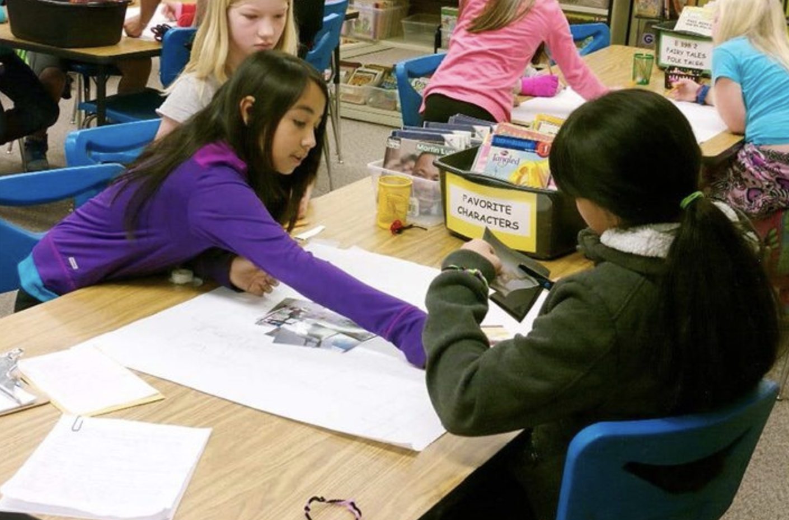
Shifting to a collectivist approach and positioning every student as a “knower” in the science classroom.
“Turns out our brains are wired to favor a communal view of the world. Humans have always sought to be in community with each other…Collectivist societies emphasize relationships, interdependence within a community, and cooperative learning.” (Zaretta Hammond, Culturally Responsive Teaching and the Brain)
STEM Tool #47
STEM Tool #54
Notes:
Explain:
"Turns out our brains are wired to favor a communal view of the world. Humans have always sought to be in community with each other. Collectivist societies emphasize relationships interdependence within a community, and cooperative learning.” The DQB shifts the classroom culture to focus more on the learning community of “we” and positions every student as a “knower” while allowing them to take ownership of their learning. The two STEM Teaching Tools on the screen will allow us to understand more about the collectivist approach and positioning the student as the “knower” in the science classroom. Let’s read these one-pagers from STEM tools to examine these ideas more closely.
Facilitator Note:
You may wish to divide these articles up for a partner group. One partner will read STEM Tool #47 and the other partner will read STEM Tool #54. The partners can read and discuss their article.
Miller, E., Simani, M. & Debarger, A. (2017, March). Practice Brief 47: How Can I Promote Equitable Sensemaking by Setting Expectations for Multiple Perspectives?. Stem Teaching Tools. https://stemteachingtools.org/brief/47.
Morrison, Deb & Bell, Phillip. (2018, May). Practice Brief 54: How to Build an Equitable Learning Community in Your Science Classroom. Stem Teaching Tools. https://stemteachingtools.org/brief/54.

Slide 68
Equitable Learning Community Discussion
As you read, consider jotting your thinking on these questions in the Session D: Notes section of the participant packet.
How might the driving question board help ensure all student ideas/questions/perspectives are shared, heard and considered?
Why is an equitable classroom community essential while using a driving question board?
How might you use the driving question board as an opportunity to build areas of agreement and disagreement?
How might you differentiate the driving question board to meet the needs of all students in your classroom?
Notes:
Explain:
As you read the one-pagers from the previous slide, make note of your responses to the following questions in your Session D: Notes section of your participant packet and be ready to discuss these in a small group then with the whole group.
How might the driving question board help ensure all student ideas/questions/perspectives are shared, heard and considered?​
Why is an equitable classroom community essential while using a driving question board?​
How might you use the driving question board as an opportunity to build areas of agreement and disagreement? ​​
How might you differentiate the driving question board to meet the needs of all students in your classroom?​
Facilitator Note:
Allow time for partners to share if you choose the partner read. Then in small groups, participants discuss the questions provided. Be sure to monitor the room so that you can listen for great ideas that you want brought up in the whole group discussion. Open the floor up for groups to share during a whole group discussion.

Slide 69
What is formative assessment?
In your own words, how would you describe formative assessment?
Take a moment and jot your initial ideas in the Session D: Notes section of your participant packet.
Share out in whole group
Notes:
Explain:
At this time, we are going to think about how the driving question board may be utilized in the formative assessment process. Think for a moment about how you would describe formative assessment. Turn to the Session D: Notes section of your participant packet and jot down your initial ideas about how you would describe formative assessment.
Facilitator Note:
Take some time to share these with the whole group. You may want to create a poster that has formative assessment is… at the top. This will make the thinking of the participants visible in the room and will allow you to return to it later in this session.

Slide 70
Shared Understanding of Formative Assessment
"Formative assessment is a planned, ongoing process used by all students and teachers during learning and teaching to elicit and use evidence of student learning to improve student understanding of intended disciplinary learning outcomes and support students to become self-directed learners."
[Council of Chief State School Officers (CCSSO), 2018]
Questions to Consider:
What key words jump out at you in this definition?
Does anything in the definition surprise you?
How does this definition align to your current schema for formative assessment?
Notes:
Explain:
The Council of Chief State School Officers has defined formative assessment as a “planned ongoing process used by all students and teachers during learning and teaching to elicit and use evidence of student learning to improve student understanding of intended disciplinary learning outcomes and support students to become self-directed learners.” Take some time to read the definition closely several times.
Questions:
What key words jump out at you in this definition?
Does anything in the definition surprise you?
How does this definition align to your current schema for formative assessment?
Facilitator Note:
Lead a whole group discussion as you think through these questions. This could be a great opportunity to refer back to the poster with their initial ideas to see how they align to this definition.
For more information on this definition, including the reasoning behind it, refer to this document: https://ccsso.org/resource-library/revising-definition-formative-assessment

Slide 71
Informal Formative Assessment Cycle
As you read, jot your responses to the following questions in the Session D: Notes section of your participant packet.
STEM Teaching Tool #16
How might the driving question board be used to give voice to all students in an informal assessment?
What supports do teachers need to enact robust informal formative assessment in their classrooms?
Notes:
Explain:
Formative assessment refers to assessment for learning rather than assessment of learning, allowing teachers to use knowledge of student understandings to inform their ongoing instruction (Black, 1993). Ruiz Primo and Furtak claim that formative assessments can be seen as falling on a continuum from formal to informal. They define informal formative assessments as ongoing strategies that help teachers acquire information from students that can immediately be used in instruction. We are going to take some time to read this research brief: The Informal Formative Assessment Cycle as a Model for Teacher Practice. As you read, respond to the following questions in Session D: Notes of your participant packet.
How might the driving question board be used to give voice to all students in an informal assessment?
What support do teachers need to enact robust informal formative assessment in their classrooms?
Facilitator Note:
Allow participants to discuss their findings with their small groups before sharing them out in whole group.
Listen for:
How might the driving question board be used to give voice to all students in an informal assessment?
Gives students the chance to get meaningful feedback in a low-stakes environment, which supports their learning and helps them develop confidence in their ability to express their understanding.
Gives voice to all students to fully engage students in inquiry-based lessons and effectively implement informal formative assessment practices with them.
Welcomes and integrates students' own experiences as part of the learning environment and development of knowledge.
Reveals the thinking of the students in that moment of time providing teacher with information about initial and growing science ideas of students.
Revisiting the DQB often gives students an opportunity to answer their questions, elaborate on their responses, and promotes explaining and argumentation through the sensemaking of a phenomenon.
What support do teachers need to enact robust informal formative assessment in their classrooms?
Formal vs informal assessment strategies (refer to chart)
Teacher must have practice to react on the fly by recognizing students' responses and comparing them to accepted scientific ideas.
Teacher repeats and revoice students' responses.
Teacher must ask students to elaborate/explain and prompts argumentation.
Teacher makes immediate use of information from the students during the ongoing classroom narrative.
ESRU Cycle: Teacher elicits response, student responds, teacher recognized student response, teacher uses student response
For teachers less attention is given to rote procedure in the science classroom, and more attention to knowledge generation for students to fully experience scientific inquiry.
It is essential for teachers to be able to take students ideas and use them to inform instruction and guide learning based on their existing understandings.
De Leo’n, Vanessa & Allen, Annie. (2015, May). Practice Brief 16: The Informal Formative Assessment Cycle as a Model for Teacher Practice. Stem Teaching Tools. https://stemteachingtools.org/assets/landscapes/STEM-Teaching-Tool-16-Informal-formative-assessment.pdf.

Slide 72
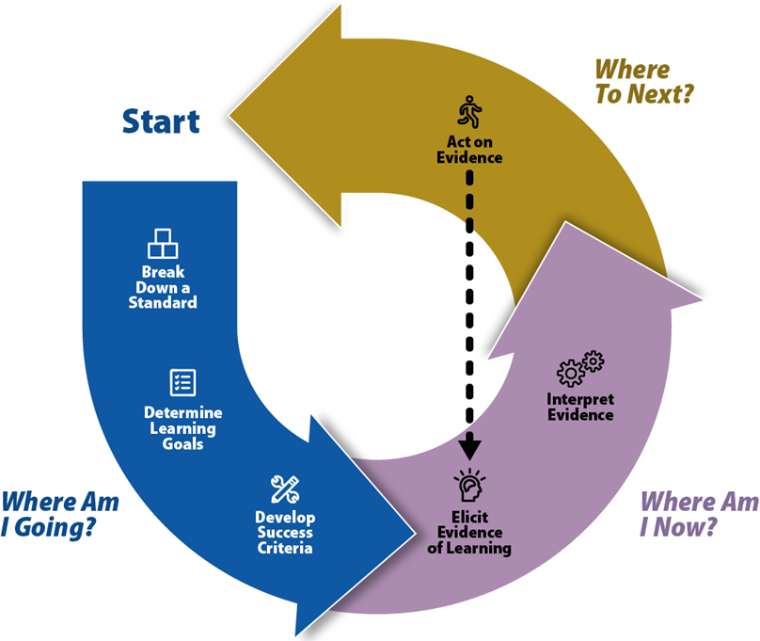
The Formative Assessment Process
As you examine this formative assessment graphic, respond to the prompt in the Session D: Notes section of your participant packet.
How might the driving question board support the formative assessment process as described in the graphic?
Graphic is from the Kentucky Department of Education Balanced Assessment Professional Learning Module.
Notes:
Explain:
On the screen you will see a graphic developed by the Kentucky Department of Education on the formative assessment process. As you examine this graphic, respond to the prompt in your Session D: Notes section of your participant packet. How might the driving question board support the formative assessment process as described in the graphic?
Facilitator Note:
Allow participants to share their thinking, first in small groups, then as a whole group.
Listen for:
Where am I going:
Launching the phenomenon.
Eliciting students’ ideas and questions on the DQB.
Where am I now:
When initial ideas are revealed on the DQB.
Go back to the driving question board to answer questions making sense of the phenomenon.
New questions added.
Evidence revealed to support claims.
Informal and formal checks of student learning.
Where to next:
Linking the previous learning to the current learning.
The science ideas that are being developed.
Tie learning back to the overall driving question.
Science ideas may need to be revisited.
New questions continue to be added as students grow in their science ideas.

Slide 73
Based on this DQB poster, in what ways could the driving question board be used as a formative assessment?
Notes:
Explain:
This graphic shows the process and components of the driving question board. Based on this DQB poster, in what ways could the driving question board be used as a formative assessment?
Facilitator Note:
Take a moment for the participants to look over this graphic carefully as they discuss the question in small groups, then allow them to share it out in whole group. You can print these out and supply each participant with one to hang in their classroom.

Slide 74
Session D Stop and Think
In the Session D: Notes section of the participant packet, respond to the prompt to the right and be ready to share out with your colleague or table group.
How can the driving question board be used as a formative assessment tool to foster an equitable learning community?
Notes:
Explain:
Take a moment to think about your experience by responding to the following question in the Session D: Notes section.
How can the driving question board be used as a formative assessment tool to foster an equitable learning community?
Facilitator Note:
Allow time for the participants to respond to the prompt in their participant packet. You may want to allow them to discuss their responses as a small group, then as a whole group once they have time to write down their individual thoughts.

Slide 75
Barriers and Ways to Overcome (1)
Complete your grouping of questions within the class with students.
Be intentional with times you revisit the DQB to complete a quick check of student learning.
Capture science ideas throughout the storyline as students gain understanding.
Management of time
Management of space
Use one driving question board that includes ideas and questions from all class periods: Use different color post its for each class.
Use technology to create a digital driving question board.
Use a tri-fold board for each class.
Use a flip chart stand and flip page for each class.
Notes:
Explain:
As with anything new, the temptation to give up is a common one, and nobody is exempt. Thomas Edison said, “Many of life’s failures are people who did not realize how close they were to success when they gave up.” On the screen you will see some common barriers to implementing a driving question board in the classroom. Since the DQB can be such a positive instructional move in the classroom, it is important to think about how you might overcome those barriers, rather than giving up on it. Along with the barrier, you will see some ideas to combat that barrier. In addition to these, find other teachers that have been using a DQB and talk to them for ideas and solutions to barriers.

Slide 76
Barriers and Ways to Overcome (2)
Allow students to research or investigate those in free time.
Encourage students to capture these questions in their notebooks.
Encourage students to take questions home and discuss with their families.
Collaborate with other colleagues such as a librarian.
Consider other learning opportunities the question may fit in.
Questions not addressed
Help students reformulate questions so they can lead to grade-appropriate investigations of important science ideas.
Think about ways to use these questions to differentiate instruction to meet the diverse needs of all learners.
Questions not grade appropriate
Notes:
Facilitator Note:
Continue to provide participants time to discuss through these barriers and ways to overcome implementing a DQB within their science classroom.
Open discussion on other barriers participants anticipate and work through those together.

Slide 77
Session D Shared Understandings
The driving question board can…
serve as an informal formative assessment in the classroom when a teacher elicits student thinking and makes immediate use.
provide students an opportunity to get meaningful feedback in a low-stakes environment, which supports their learning and helps them develop confidence in their ability to express their understanding.
give voice to all students in order to fully engage students in inquiry-based lessons and effectively implement informal formative assessment practices with them.
promote deep and equitable learning when planned purposefully to ensure the various perspectives that students bring to making sense of phenomenon are solicited, clarified and considered.
Notes:
Explain:
The driving question board can be used as a formative assessment tool to foster an equitable learning community. In summary a driving question board can ...
Facilitator Note:
Read aloud or allow participants to read as you advance through these shared understandings the group should have on the purpose of the driving question.

Slide 78
After completing session D, you should be able to answer the following questions.
How can the driving question board be used as a formative assessment tool?
How can the driving question board be used to foster an equitable learning community?
Notes:
Explain:
Share that as we are completing session D, you should be able to answer the following questions:
How can the driving question board be used as a formative assessment tool?
How can the driving question board be used to foster an equitable learning community?
Take a moment to look over your notes and summarize your learning by adding to your “meta moment” response at the beginning of this session.
Facilitator Note:
Pause and see if anyone has a clarifying question they would like to ask before moving onto their reflection. Check the “Parking Lot” to address questions posted. Group questions by common categories to help save on time. Keep note of the questions that are not addressed in this session to be addressed later in another session.

Slide 79
Session D Next Steps - Considerations for Implementation
Use the driving question board you planned for the last session with your students. Record your ideas in Session D: Next Steps- Considerations for Implementation section of your participant packet.
Use the driving question board you planned for the last session with your students.
Consider how you might:
Identify the science ideas or lack of ideas the driving question board revealed.
Revisit the driving question board throughout the unit.
Formatively assess the students using the driving question board process.
Elicit evidence that students were engaged in “making sense” of the science in the unit.
Notes:
Explain:
Hopefully you have implemented your driving question board with your students and are ready to reflect on that experience. As you look at the DQB created by your students, can you think of any science ideas or lack of ideas that the DQB revealed? Consider how you might use the DQB all throughout the unit for formative assessment and eliciting student evidence of sensemaking. Record your ideas in Session D: Next Steps-Considerations for Implementation.
Facilitator Note:
You may request that participants bring a picture of the DQB they implemented with their students to share with the group. Allow time for the participants to review the DQB created by students and plan for how they may continue to use it in their learning progressions.

Slide 80
Reflect on Your Experience
It's all in a Social
Media Post!
Think about the learning from this module. Compose a social media post consisting of a summary and your take aways to share. Consider sharing it on social media along with the link to the resource!
Notes:
Explain:
After participants have engaged with all sessions within this module, they will develop a social media post consisting of a summary and their take aways. Consider sharing it on social media along with the link to the resource.
As time permits, you may wish to have participants share their ideas with one another.

Slide 81
Certificate of Completion
Thank you for completing this module provided by the KDE.
Please use the link below to obtain your certificate of completion.
Kentucky Department of Education Professional Learning Modules
Educators can use the PLBB to find learning sessions, and it is the local school district who determines if they are acceptable for credit based on their district policies. See 704 KAR 3:035 for more details.
Notes:
Explain:
The KDE needs your feedback on the effectiveness of this module, the learning platform and how the consultants may best support you as you take the next steps. We are going to complete a short survey to share our thinking and provide them with feedback on how the KDE can best meet our needs. Feedback from our surveys will be used by the KDE to plan and prepare future professional learning.
Provide participants with the survey links:
Kentucky Department of Education Professional Learning Modules Feedback Survey
Be sure to thank participants for their work throughout this module as it has provided a foundation for future knowledge.
To you, the facilitator, thank you for providing participants with knowledge and support throughout this process. The KDE greatly values your role in leading the “Improving Student Engagement in the Science Classroom Using a Driving Question Board” Module. We appreciate your time and effort in leading your school and district in the successful implementation of a driving question board within science classrooms. Thank you!

