Slide 1
Introduction to Vocabulary Instruction and Why It Matters
SESSION 1
SHARED LEARNING
1
Notes:
Framing (1 min):
Welcome to the first session in our content cycle! Today’s session will serve as both an introduction to and foundation in vocabulary in literacy. We will dive into the ‘why’ behind this work and the role it plays in growing students, addressing equity in the classroom, and helping our instructional practice evolve to meet the needs of our kids. Over the next 11 weeks, we will explore how to put this into practice. Some of our beliefs may be challenged and reflection will be a key part of our work. By the end of today’s session you will be able to use that reflection to create personal planning and practice goals. To that end, let’s start with a reflection on an essential question that we will explore throughout our learning. We will continue to reflect more and more in depth on this question throughout the cycle, but it’s critical to ground our learning here.

Slide 2
Do Now
SESSION NAME
Why is vocabulary instruction critical for equity in literacy for all students, including (and especially) English Language Learners, students who are struggling readers, or students with special needs?
What does vocabulary instruction currently look like in your classroom? What is the impact?
What do you want to learn?
2
Notes:
Do Now (10 min total):
Let’s begin by reflecting on the pre-work article and our own practice. Take a moment to read our reflection questions. These are the same reflection questions from our pre-work:
Why is vocabulary instruction critical for equity in literacy for all students, including (and especially) English Language Learners, students who are struggling readers, or students with special needs?
What does vocabulary instruction currently look like in your classroom?
What is the impact?
What do you want to learn?
1 min: Considering notes from the pre-work article, reflect independently
7 min: Group in triads and share your reflections grounding your responses in evidence from the text
2 min: Share whole group
Key Takeaways:
Strong understanding of vocabulary is essential for reading comprehension, and in particular for accessing grade-level complex texts
English Language Learners and students who are struggling readers often have lower comprehension because they don’t know as many vocabulary words
Vocabulary instruction can help to create access to texts for all students

Slide 3
Content Cycle Overview
Session | Type of Learning | Focus Area
1 | Shared Learning | Introduction to Vocabulary and Why It Matters
2 | Shared Learning | Implicit Vocabulary Instruction
3 | Planning & Practice | Implicit Vocabulary Instruction
4 | Shared Learning | Explicit Vocabulary Instruction
5 | Planning & Practice | Explicit Vocabulary Instruction
6 | Student Progress | Implicit and Explicit Vocabulary Instruction
7 | Shared Learning | Text Sets
8 | Planning & Practice | Text Sets
9 | Shared Learning | Maintaining & Extending Vocabulary
10 | Planning & Practice | Maintaining & Extending Vocabulary
11 | Student Progress | Text Sets, Implicit and Explicit Vocabulary
Notes:
Cycle Overview (4 min)
1 min: Share 11 week path of learning for this cycle (on slide), explaining how the learning builds over the course of the cycle. Our 11 week cycle includes time for Shared Learning, planning and practice, and looking at student work to determine progress. We will front-load some shared learning experiences so that we are fully prepared to plan, practice, and analyze student work based on what we have learned together.
1 min: Reflect Independently. How will the learning in this cycle support your own development and your students’ learning?
2 min: Share out whole group.

Slide 4
Objectives
ACADEMIC VOCABULARY SESSION 1
Agenda
01. Explain why vocabulary instruction matters for equity
02. Identify which words to teach and why
03. Create personal planning and practice goals to accelerate learning for all students
01. Welcome
02. The WHY
03. Word Selection
04. Practice
05. Goal-Setting
4
Notes:
Session Objectives and Agenda (1 min)
Share the objectives and agenda for this session, connecting to the overarching goal of the cycle

Slide 5
Our Norms
ACADEMIC VOCABULARY SESSION 1
OWN your learning
RESPECT the learning space
CONNECT with the learning tools and each other
PROTECT learning time and minimize disruptions
HONOR every voice and experience
PRACTICE vulnerability and trust
5
Notes:
Norms (2 min) *Can replace with school norms*
Participants choose one norm that they would like to focus on for the session and/or day.
Then, participants turn-talk with an elbow partner who can hold them accountable.
Just want to remind you of our norms and call them back into the room. A few other norms to remember:
There will be lots of opportunities for partner/table conversation. Look for my hand when it’s time to come back together.
Use tech as a tool not a distraction. If you need to send a text or answer a call, please step in the hall and come back when you are ready to rejoin the session
Look or Listen Fors/Evidence of Mastery:
Listen to conversations.

Slide 6
Step into Students’ Shoes!
ACADEMIC VOCABULARY SESSION 1
6
Notes:
Frame (1 min): “Let’s take a minute to experience first-hand how knowledge of vocabulary is critical for reading comprehension, and step into the shoes of a student.”

Slide 7
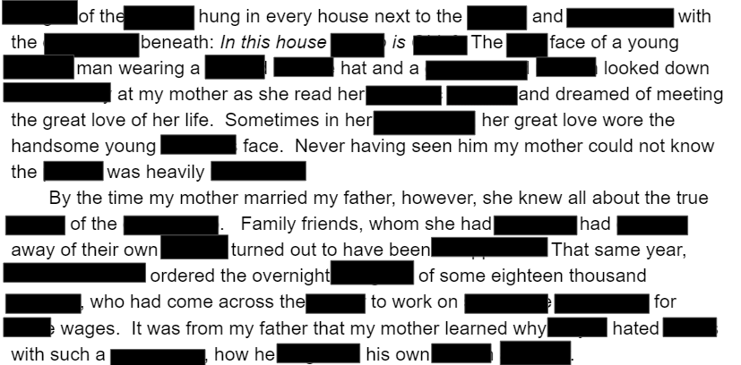
Summarize the Text
ACADEMIC VOCABULARY SESSION 1
7
Notes:
Experience the Learning (3 min)
2 min: Participants review the excerpt. “May I have a volunteer read this passage aloud for the group?”
1 min: Participants jot down notes of their summary of the passage. Facilitator can frame that if participants aren’t sure about the meaning of the word, they can just use the context clues.
(NOTE: Of course, given the number of words missing from the passage, participants can’t actually use context clues to figure out the words! However, this is something we as teachers commonly say to students and it’s helpful to simulate that same experience recognizing how hard it can be to use that strategy if too many words are unknown.)

Slide 8
Reflection
Discuss with a Partner:
ACADEMIC VOCABULARY SESSION 1
How well were you able to summarize the passage? Why?
Why didn’t you use context clues to figure out unknown words?
How did this experience feel for you?
8
Notes:
Reflection (5 min)
2 min: Reflect on the following with a partner:
How well were you able to summarize the passage? Why?
Why didn’t you just use context clues to figure out the words that were blacked out?
How did this experience feel for you?
3 min: Share reflections whole group
Key Takeaways:
We couldn’t understand the passage and answer the questions because there were too many words unknown.
We can’t use context clues to develop an understanding of unknown words because we know too few words to get the context.
This is frustrating and it’s not clear how to make meaning without knowing more words!

Slide 9
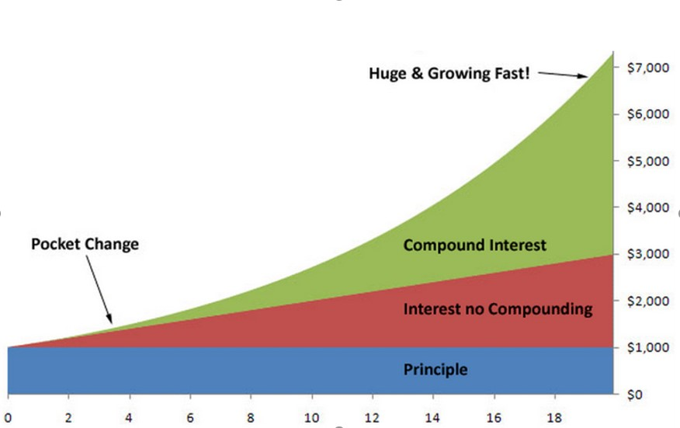
The Matthew Effect
ACADEMIC VOCABULARY SESSION 1
9
Notes:
Matthew Effect (2 min):
Explain graph. “There’s research that shows that one of the major reasons the gap between struggling readers is maintained over time – and in fact grows over time – is due to challenges with vocabulary, and something called the Matthew Effect.” This works like a compound interest curve. The idea of the rich getting richer while the poor get poorer can be extrapolated to reading. Students who know fewer vocabulary words struggle with comprehension, and often get fewer experiences to read grade level text with rich vocabulary as a result. Often, attempts to differentiate for struggling readers mean that those readers end up reading less challenging passages vs. getting supported opportunities to engage with challenging text and learn new vocabulary.
Vocabulary instruction is critical to instructional equity.

Slide 10
Kentucky Academic Standards:
Reading Literature & Informational Text
ACADEMIC VOCABULARY SESSION 1
“The standards place equal emphasis on the sophistication of what students read and the skill with which they read. For example, Reading Literature and Reading Informational Text Standard 10 defines a grade-by-grade “staircase” of increasing text complexity that rises from beginning reading and incorporates the reading strategies as the foundation to comprehension. Current research and best practice suggest that students comprehend texts best when they are able to activate schema, make meaning and recognize vocabulary. Exposing students to multiple texts and interdisciplinary content provides opportunities to build knowledge in meaningful ways.” (KAS, p.9)
Guiding Principle 4: Reading Literature and Informational Text
Notes:
Connect to the KAS (2 min)
Ask participants to read excerpt from KAS introduction to Reading Literature and Informational Text
Say: “The standards put vocabulary at the front and center of reading literature and informational text. While the Guiding Principle for Reading Standard 4 specifically addresses vocabulary, the overview makes it clear that vocabulary is a throughline for knowledge and comprehension in literary and informational texts.”
Ask volunteer to read the Guiding Principle for Reading Craft & Structure Standard 4 aloud

Slide 11
Kentucky Academic Standards: Language
ACADEMIC VOCABULARY SESSION 1
“Within these standards, students must demonstrate command of Standard English grammar, usage and mechanics as well as understand how language functions in various contexts. With prior support, students may independently determine or clarify the meaning of grade appropriate words, come to appreciate nonliteral and shades of meaning and expand their vocabulary in the course of studying content. Using interdisciplinary literacy practices to develop skills in a logical progression, students demonstrate competency of these standards in the context of authentic reading, writing, speaking and listening tasks.” (KAS, p. 9)
Guiding Principle 4: Language
Notes:
Connect to the KAS (3 min)
Ask volunteer to read excerpt from p. 9 of KAS, Language Section
Say: “The standards recognize the essential role of vocabulary in our students’ comprehension. Word knowledge leads students to better comprehension. While we see attention to vocabulary woven throughout the standards, let’s now focus our attention on Language Standard 4: Vocabulary Acquisition and Use.”
Ask volunteer to read the Guiding Principle for Standard 4 aloud
Say: “Again, the Kentucky standards make clear that vocabulary is an essential component of literacy instruction. Not only do students need to use strategies to figure out the meanings of unknown words they may encounter in their reading, students also need to acquire a range of words. The standards show us that we need to teach words in ways that allow students to own and hold on to them.”

Slide 12
Check for Understanding
Written Response
ACADEMIC VOCABULARY SESSION 1
Explain the relationship between vocabulary instruction and equity.
Use research in your response.
12
Notes:
Check for Understanding (5 min):
Say: Let’s bring together our knowledge of vocabulary instruction, standards, and equity. We are going to take 3 minutes to jot down responses to this prompt: Explain the relationship between vocabulary instruction and equity.
Give 3 minutes for responses. Circulate to check for understanding using the sample evidence below.
1 min: Ask for 2 volunteers to share responses.
Look or Listen Fors/Evidence of Mastery:
See Facilitator’s Handout: Sample Evidence

Slide 13
Key Takeaways
Strong understanding of vocabulary is essential for reading comprehension. Difficult vocabulary plays the largest role in student difficulty with grade-level complex texts. (Nelson et al 2012)
Lack of vocabulary is a primary cause of the achievement gap. (Becker 1977, Baumann & Kameenui 1991, Stanovich 1986)
The Matthew Effect explains the phenomenon whereby students who are behind stay behind. Vocabulary instruction is critical to disrupting this equity gap. (Stanovich, 1986)
English Language Learners often have lower comprehension because they don’t know as many English vocabulary words in the texts they encounter. (Calderón and Soto, 2017)
Students from low-income households often enter school with smaller vocabularies than their more affluent peers and need vocabulary instruction to help them better reach their academic potential. (Hart and Risley 1995, Biemiller 2010)
13
Notes:
Key Takeaways: Why Vocabulary Instruction is Important (2 min)
Directions/Framing/Key Points:
1 min: “Here are some key takeaways that you may have captured in your written reflection.”
1 min: Provide a minute for teachers to review and discuss the key takeaways.

Slide 14
Which Words Should We Teach?
Return to Your Pre-Work
ACADEMIC VOCABULARY SESSION 1
Define and give examples of Tier 1, Tier 2, and Tier 3 words.
How do we know which words to spend the most time on?
Tier 3
Tier 2
Tier 1
14
Notes:
Word selection (10 min) Share link to Prework: “Choosing Words to Teach”
Frame: “We know that vocabulary is critical to reading comprehension. How does a teacher know which words to teach? Let’s return to our pre-work, “Choosing Words to Teach”” to review which words to specifically teach. ”
5 min: In partners, participants return to their notes from the pre-work article, and share their answers to the following questions:
Define and give examples of Tier 1, Tier 2, and Tier 3 words.
How do we know which words to spend the most time on?
5 min: Whole group share out, with the facilitator soliciting and reinforcing the key takeaways.
Key Takeaways:
Tier 1 words
Words of everyday speech
Important to early learning since these Tier 1 words are used to explain more unusual words
Tier 2 words
Words that are not specific to a single content
Not commonly used in everyday conversation
Vital to comprehension
Referred to as academic language
Examples: obstacle, accumulate, adjust, cautious, broad, relative, determine, vary, etc.
Tier 3 words
Words that are domain specific
More common in informational text than in literary text
Often defined within the text using contextual clues
Usually not encountered in everyday conversations
Which words should we spend the most time on?
Words needed to fully comprehend the text,
Words likely to appear in future texts from any discipline, and
Words that are part of a word family or semantic network

Slide 15
Today’s Look For
ACADEMIC VOCABULARY SESSION 1
Questions and tasks focus on academic or domain-specific words that are most likely to be encountered again in the future or are most critical for comprehending the text
15
Notes:
Frame (1 min): Read slide: “Today’s ‘Look For’ - questions and tasks focus on academic or domain-specific words that are most likely to be encountered again in the future or are most critical for comprehending the text.”

Slide 16
Teacher Goals
Read the Look Fors under “Teacher Goals”
ACADEMIC VOCABULARY SESSION 1
How do these look fors connect to the focus of our learning for this cycle?
Are there any look fors you would add to this list? Add them in!
16
Notes:
Teacher Goals (5 min)
Teacher Look For Analysis (3 minutes): “Before we reflect on our own instructional practice, let’s take some time to internalize these look-fors using the following guiding questions: How are these look fors connected to the focus for our learning this cycle? Are there planning or practice look-fors that you would add to this list?” Teachers read teacher look-fors and annotate.
Share Out (2 minutes): Team discusses reactions to the list and any additions that may apply to their class/school needs.

Slide 17
Practice
ACADEMIC VOCABULARY SESSION 1
Using the charts from “Choosing Which Words to Teach”, identify Tier 2 & 3 words in a text you teach.
With a partner or independently:
Highlight Tier 2 words in yellow and highlight Tier 3 words in blue. Or, you may chart them on a sheet of paper.
With a partner, discuss the questions in the Your Turn Section of “Choosing Which Words to Teach”
Today’s Look For:
Questions and tasks focus on academic or domain-specific words that are most likely to be encountered again in the future or are most critical for comprehending the text
17
Notes:
Practice (25 min) [Participants need two different colored highlighters or markers]
Frame (1 min): “Now that you know what Tier 2 and Tier 3 words are and we’ve analyzed which of these words need to be specifically taught, let’s practice with a text from your own class.”
Practice identifying Tier 2 and 3 Words to teach
12 min: Participants will read Tier I and Tier II sections from the prework. With a partner or independently, they will highlight Tier 2 words in yellow and highlight Tier 3 words in blue from a text they are using in class. If text cannot be highlighted, teachers may also chart words on a sheet of paper. List highlighted words from text on table at the bottom of the text to indicate if the words require more time and attention or less time and attention. Participants note possible reasons for their thinking.
8 min.: Participants work with partners in discussion the questions in the Your Turn section of “Choosing Which Words to Teach”.
3 min: Facilitate whole group share. Which tier of words was more challenging to identify? What tools did you use to support your analysis of the vocabulary in the text? Share out possible words. Emphasize that Tier 3 words may need to be taught, but will need less time.
Key Takeaways:
In the prework article “Choosing Which Words to Teach”, participants can identify Tier 2 and Tier 3 words and can determine which of these words need more instructional time and attention or less instructional time and attention and can justify their thinking.
The vocabulary we prioritize depends on the needs of our students. In addition, while there are general guidelines for which words to spend more and less time on, if students are really struggling with the vocabulary and meaning of the text, the teacher will have to address more of the vocabulary and offer additional support. That is OK!

Slide 18
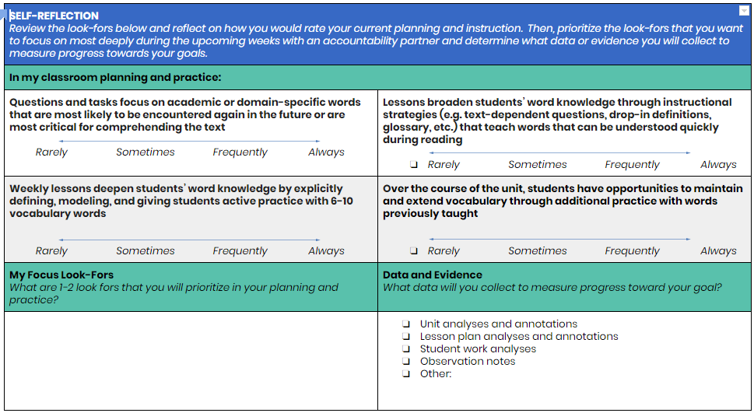
Self-Reflection
ACADEMIC VOCABULARY SESSION 1
Complete the Self-Reflection
Select 1-2 look fors that you will prioritize in your planning and practice
18
Notes:
Self-Reflection (7 min)
Framing (1 min): “Now take a few minutes to reflect on how often you currently implement the look fors we’re focusing on during this content cycle. Then, select one or two look-fors that you want to focus on most deeply during the upcoming weeks with an accountability partner. Determine what data you’ll collect to measure progress toward your goal.”
Individual Self-Reflection (4 min): Teachers complete self-reflection and determine a personal goal.
Partner Share (2 min): In partnerships, teachers will share their goals.

Slide 19
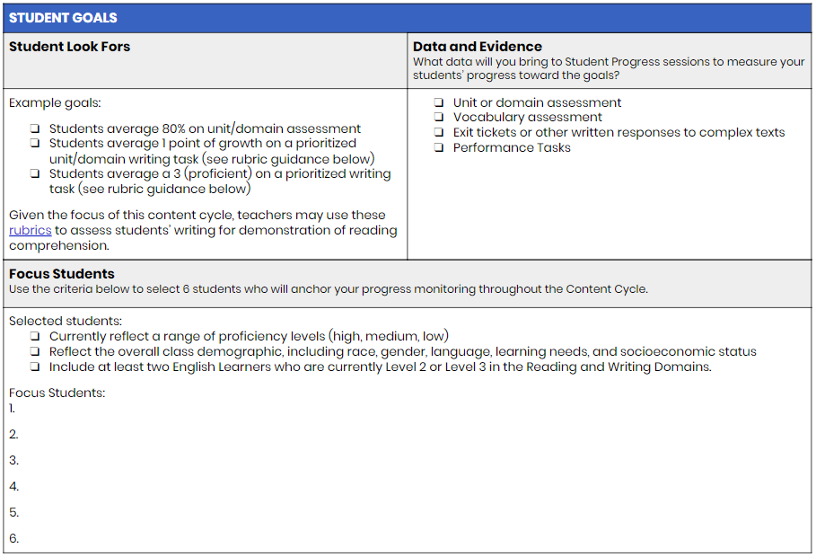
Student Goals
Read the student goals listed.
Select 6 students you will monitor progress on throughout the content cycle.
19
Notes:
Student Goals (7 minutes)
Directions/Framing/Key Points:
1 min: “Finally, let’s take some time to internalize the Student Goals for this content cycle. At various points during the content cycle, we’ll reflect on student data. This will help us connect the dots between our instructional practice and student learning, with an eye toward identifying any inequities that might exist in outcomes for subgroups of students. We know that every one of us wants all of our students to succeed, and we also know that inequities exist. Surfacing them will help us deepen our ability to adjust our practice in ways that meet the needs of all students. Take a few minutes to read the student goals. Then, select 6 students you will prioritize for progress monitoring throughout this content cycle. Make sure that this group of students is reflective of your overall class demographics, considering race, gender, language, learning needs, and socioeconomic status.”
4 min: Teachers read student goals and determine 6 students they’ll monitor throughout this content cycle.
2 min: With a partner, teachers share their list of students and how they selected them.

Slide 20
Next Steps
Implicit Vocabulary Pre-Work
Read the excerpt from Reading Reconsidered and capture your thinking in response to these questions:
What is implicit vocabulary instruction?
How do we determine which words to implicitly teach?
What are some strategies for implicit vocabulary instruction?
Notes:
Next Steps (3 min)
“Thank you for a wonderful start to our content cycle! To prepare for our next session, you will dive into an excerpt from Reading Reconsidered on implicit vocabulary instruction.”

