Slide 1
Three-Dimensional Science Tasks
Analysis and Development

Slide 2
Components of this Module
Session A: Using Task Evaluation to Understand Dimensionality
Session B: Developing 3-D Tasks

Slide 3
Group Norms
Presume positive intentions
Listen carefully to one another
Be open to new ideas
Be open to productive struggle
Ask questions
Allow a chance for everyone to participate

Slide 4
Three-Dimensional Science Tasks
Session A: Using Task Evaluation to Understand Dimensionality
This session has been modified from professional learning around the Science Task Screeners developed by Achieve

Slide 5
Session Goals
Identify what is valued in tasks
Use tools to evaluate tasks for key components

Slide 6
Why Tasks?

Slide 7
3D standards require us to think about assessment differently
DCIs
SEPs
CCCs
Phenomena and problems!

Slide 8
3D standards require us to think about assessment differently.
Shifting what it means for a student to demonstrate they “know science”
“knowing” shifts from recall to using scientific principles, skills, and behaviors to make sense of the world and address real-world problems
Application and reasoning shifts from the expectation for some standards, some students, some performances to all standards, all students, all performances
DCIs
SEPs
CCCs

Slide 9
Why Tasks?
Tasks elicit sense-making and problem-solving by focusing strongly on reasoning through the use of scientific and engineering evidence, models and principles.

Slide 10
Common Perspectives
As we begin to clarify our thinking about 3D performances, let’s explore some common perspectives...

Slide 11
Trade-Offs
Jack and Jill are discussing new 3D science assessments, and have run into some issues balancing different considerations for their tasks. They disagree about the “right” trade-offs to make to support all students, although they have a shared overall vision for science education for all students.

Slide 12
Thought Experiment #0
Jack
Jill
Do you agree with Jack or Jill?
1. Think.
2. Choose.
3. Write.
4. Share.
5. Discuss.
Notes:
~30 minutes,

Slide 13
Thought Experiment #1
Jill
Jack
“I think phenomena are useful for students in instruction, but are not necessary in assessment--they are a ‘nice-to-have’ not a ‘must-have’. ”
“Phenomena and problems are essential in 3D assessments.”
Do you agree with Jack or Jill?

Slide 14
Thought Experiment #2
Jack
Jill
“I care most about whether students learned what they were supposed to, as described by the standards (grade-specified PEs, SEPs, CCCs, DCIs).”
“I care most about whether students can flexibly make sense of different kinds of phenomena and problems, using the DCIs, SEPs, and CCCs as needed.”
Do you agree with Jack or Jill?

Slide 15
Thought Experiment #3
Jack
Jill
“If we focus on sense-making in assessments, the three dimensions will naturally emerge in student performance/responses.”
“Assessments need to be designed to specifically elicit each targeted dimension--the specific CCC, DCI, and SEP elements that we want to surface.”
Do you agree with Jack or Jill?

Slide 16
Thought Experiment #4
Jack
Jill
“It is more important that assessments value student agency, identity, and interest because they will never use the targeted science ideas if learning isn’t meaningful to them.”
“It is more important to assess the SEPs, DCIs, and CCCs, even if that means trading off factors like student interest, because that is how we ensure all students have the tools they need to engage with the world.”
Do you agree with Jack or Jill?

Slide 17
Thought Experiment #5
Jack
Jill
“It’s important that every task require students to use science core ideas.”
“It’s important that all tasks happen in a disciplinary context, but it’s okay if a task only requires students to use practices and crosscutting concepts.”
Do you agree with Jack or Jill?

Slide 18
Thought Experiment #6
Jack
Jill
“A task only counts as assessing the dimensions if the student understanding elicited is grade-appropriate.”
“The DCI needs to be grade-appropriate, but the other dimensions can be present at lower levels of sophistication.”
Do you agree with Jack or Jill?

Slide 19
Where did we land?
There are a range of different perspectives about what is most important to elicit from students.
Some of these perspectives are driven by different assessment purposes.
Some of them are grounded in more personal philosophies.
In a system of assessments, we can balance these goals.
It is important to keep these differences in mind as we are thinking about features of good assessments because these differences can shape the “flavor” of an assessment.

Slide 20
It is important that assessments truly measure what we value in student performance
Solving real world problems
flexible, creative reasoning
Transfer
figuring out phenomena
engagement and decision making
Equity
three dimensions

Slide 21
What features currently drive our thinking about assessments?
You have three tasks. By yourself:
Work through each task as a student might
For each task, Jot down what you like about the task and what concerns you about the task.
Based on your initial evaluation of these tasks, order the tasks
Make notes about what patterns in the tasks are driving your decisions.

Slide 22
Group Task
With your group, construct an argument for the “right” order of the tasks on chart paper. In your argument, make sure you include:
The order your group agreed upon
An alternative order you considered
Your evidence and reasoning for why the order you agreed on is right
Summary of the top 3-5 features that drove your decision making as a group.

Slide 23
Share Out
What criteria did your group use to order your tasks?

Slide 24
Up to This Point
Identified what we value in assessments through the Thought Experiments
Analyzed tasks to determine what our valued criteria may look like

Slide 25
Pre-screening tasks!
Phenomena
Reasoning/Sense-making
Three Dimensions

Slide 26
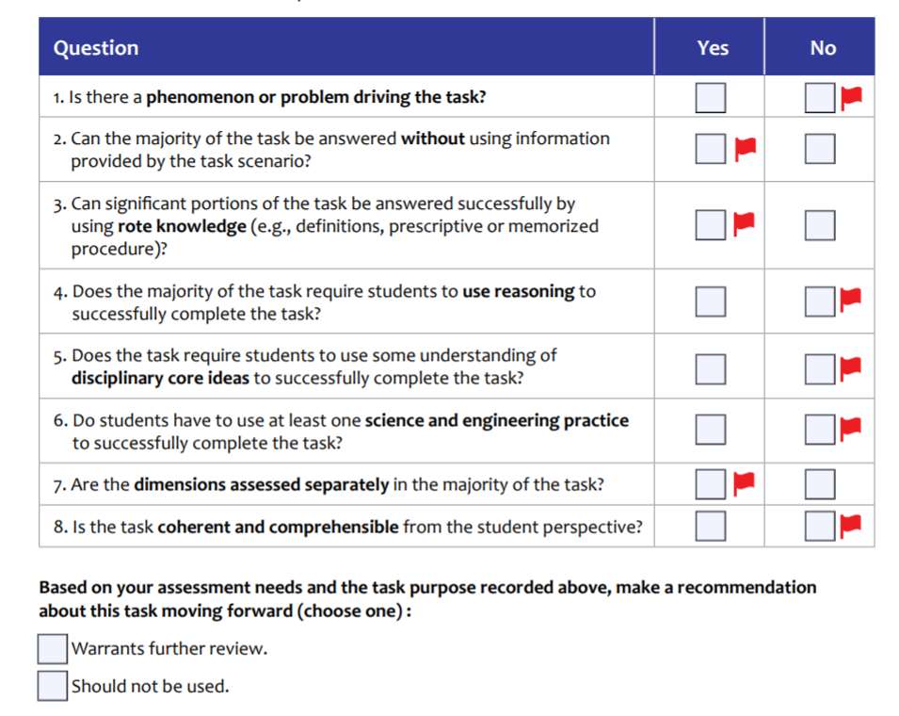
Checklist

Slide 27
Annotated Checklist
This tool is used at the task level.
At this stage, don’t worry yet about grade-appropriateness
Watch out for red flags!

Slide 28
Modeling Felix’s Jump
28

Slide 29
Verdict?

Slide 30
Next Step?

Slide 31
Task Screener
Use after a task has been deemed warranting further review.
Provides further look around 4 criteria
High-quality scenarios around a phenomenon or problem to solve
Sense-making using the 3 dimensions
Fairness and equity
Support intended targets and purpose

Slide 32
Task Screener
Using Natural Hazards
Each group will focus on one indicator
Evaluate the task for your indicator
Jigsaw with other groups

Slide 33
Verdict?

Slide 34
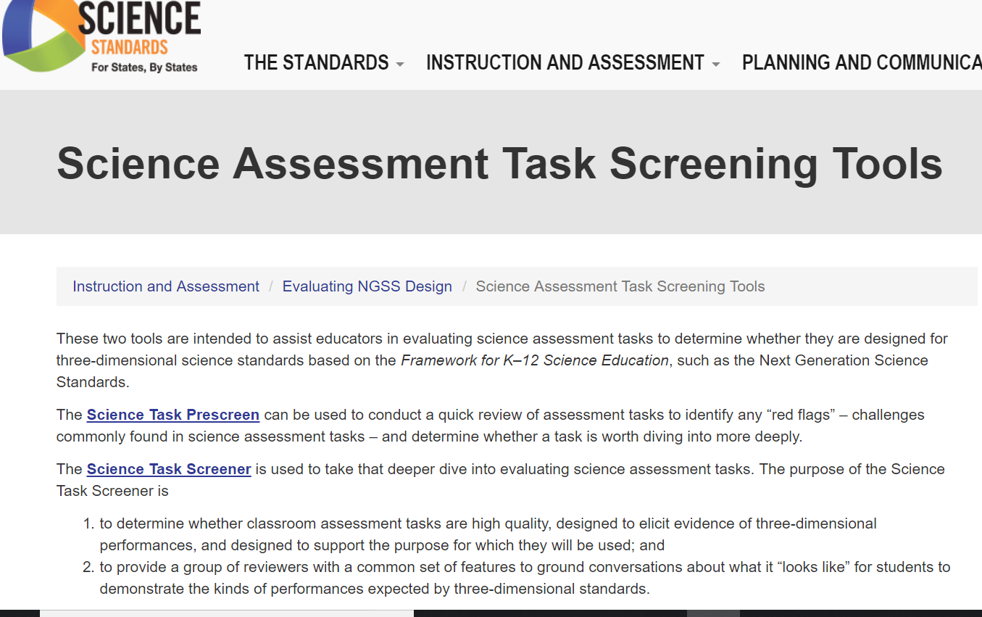
Where to Find these tools?
https://www.nextgenscience.org/taskscreener

Slide 35
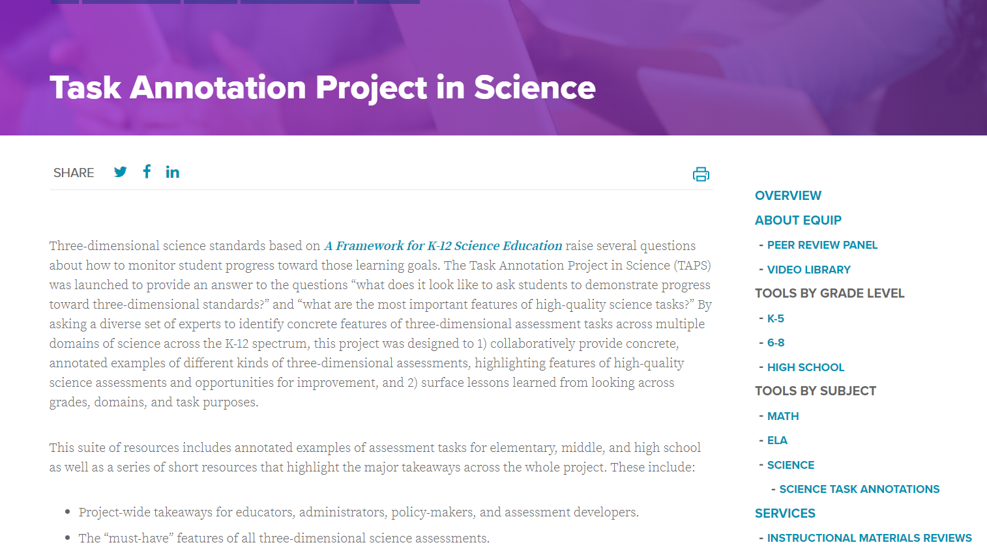
Task Annotation Project
https://www.achieve.org/our-initiatives/equip/tools-subject/science/task-annotation-project-science

Slide 36
In this Session
We’ve identified what is valued in tasks
We’ve used tools to evaluate tasks for key components

Slide 37
Three-Dimensional Science Tasks
Session B: Developing 3-Dimensional Tasks
Modified from Bell, P., & Morrison, D. (2017). How to Craft a Three-Dimensional Classroom Science Assessment. [OER Professional Development Session from the ACESSE Project] Retrieved from http://stemteachingtools.org/pd/SessionD

Slide 38
Session Goals
Develop 3D Learning Performances as lesson-level learning goals related to unit-level bundles of performance expectations
Craft a 3D classroom assessment focused on a specific 3D learning performance for formative use
Engage in peer review to study and refine “3dness” of our drafted assessments

Slide 39
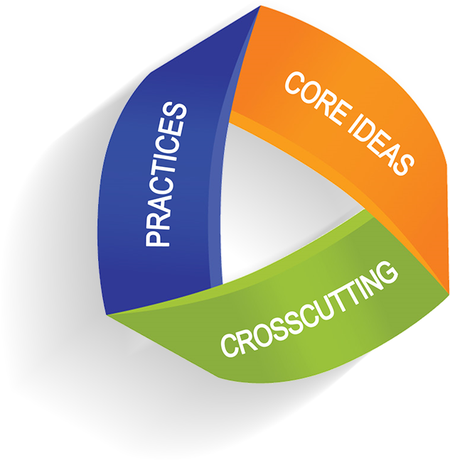
3D Formative Assessment

Slide 40
Formative Assessment
“A planned, ongoing process used by all students and teachers during learning and teaching to elicit and use evidence of student learning to improve student understanding of intended disciplinary learning outcomes and support students to become self-directed learners.”
— Formative Assessment for Students and Teachers (FAST) SCASS, 2017, p. 2
Goes beyond educational standards. Includes all instructional outcomes.

Slide 41
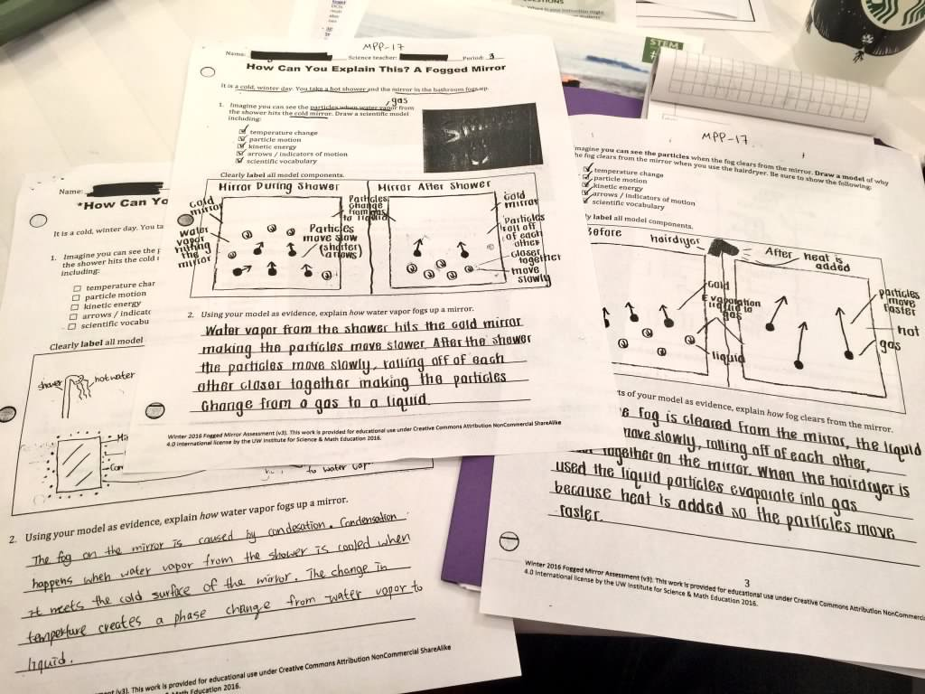
Formative Assessment Examples

Slide 42
3D Assessment Tasks
Should have multiple components that include connected use of different science and engineering practices focused on application of interconnected disciplinary ideas and crosscutting concepts;
Address progressive nature of learning by providing info about where students fall on a continuum between expected beginning and ending points in a given unit or grade; and
Include an interpretive system for evaluating range of student products that are specific enough to be useful for helping teachers understand the range of student responses and provide tools for helping teachers decide on next steps in instruction.

Slide 43
The Formative Assessment Process (Adapted by Simpson & McCulloch from Ruiz-Primo & Furtak, 2007)
Clarify
Intended
Learning
Elicit
Evidence
Act on
Evidence
Interpret
Evidence

Slide 44
Unit Assessment Sequences
Diagnostic
Pre-Test
Formative
(e.g., Daily Assessment)
Formative
(e.g., Classroom Conversation)
Formative (e.g., Presentation)
Formative
(e.g., Small Group Conversations)
Summative
End-of-Unit
(graded)
Background Resource: Seeing Student Learn Science

Slide 45
3D Learning Performance Sequence
LP
LP
UP
LP
…
Break down unit 3D learning goals (from a bundle of PEs) into more lesson-level 3D learning performances (LPs)
“The Bundle”
Formative Assessment Opportunities
Summative Assessment
LP = Learning Performance (at lesson level)
UP = Unit Performances related to the bundled PEs
Background: nextgenscienceassessment.org

Slide 46
Discussion
How do/might you use sequences of embedded formative assessment opportunities—of different kinds—in your teaching of a unit?

Slide 47
Approaching Learning and Teaching from a 3D Perspective

Slide 48
Develop a personal 3D learning performance…..
Select one of your favorite hobbies & think of a big learning goal that matters—a performance expectation
PE: Double-spin juggling of three pins using both hands
1. Unpack the important piece of core knowledge that is needed to do that
How “hard” to flip a juggling pin to get 2 rotations for a given arc
2. Unpack a practice that demonstrates that they know that piece of knowledge (knowledge-in-use)
Repeated, single-hand double flipping of a juggling pin
3. Unpack a cross-cutting concept learned as well
Hand-eye coordination that relies on peripheral vision & timing
My 3D Learning Performance: “The learner is able to double flip a pin over-and-over in one hand while looking away.”

Slide 49
Formative Assessment Examples

Slide 50
Crafting a 3D Task
Product: 3D Task (5-20 min task)
Assessment Development Process:
Select a target DCI component for a given classroom lesson or learning experience.
Identify SEP component and CCC component to focus on.
Define a 3D Learning Performance for a specific classroom lesson or learning experience.
Brainstorm and workshop possible scenarios for eliciting student understanding. Select one to use that is fair for non-dominant students (e.g., ELLs).
Write 2D/3D questions for the selected scenario.
Imagine (or collect) student responses (limited, partial, full understanding).
Share, review, and revise using workshop approach.

Slide 51
STEP 1: Identify a DCI Component
Explore the PEs and identify a DCI component (or perhaps two) that is a learning goal for a lesson or activity of interest. Focus on a specific piece of the DCI. Start small. Think about your instructional unit. Pick a conceptual idea (or “nugget”) that is challenging for students to learn— yet crucial.

Slide 52
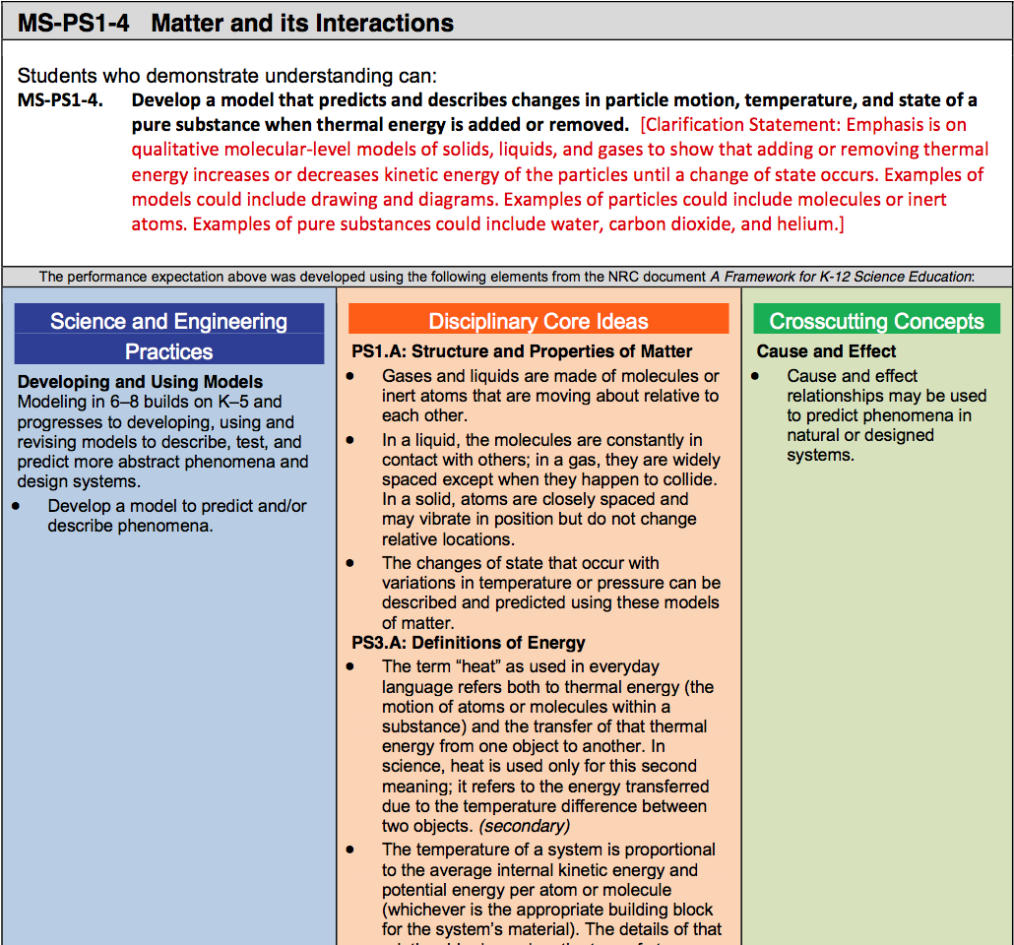
Standard MS-PS1-4

Slide 53
STEP 2a: Identify A Component of a Science & Engineering Practice
Use science and engineering practices task formats
Examine the task formats for your chosen focal practice(s).
Choose a specific task format for your question / item.
STEMteachingtools.org/brief/30

Slide 54
Task Formats for Science & Engineering Practices

Slide 55
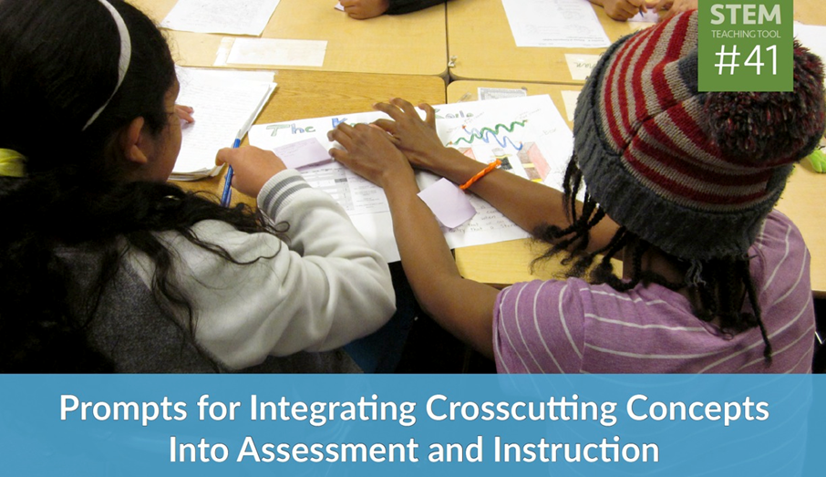
STEP 2b: Identify a Crosscutting Concept Component
Use crosscutting concept prompts
Examine the CCC prompts for your chosen focal CCC(s)
Choose a specific prompt for your question/item
STEMteachingtools.org/brief/41

Slide 56
Prompts for Assessing Cross-Cutting Concepts

Slide 57
STEP 3: Define a 3D Learning Performance

Slide 58
3D Learning Performances: Lesson-Level Learning Goals
How will you know if my students are making progress toward the unit-level bundle of performance expectations?
3D Learning Performances are specific ‘knowledge-in-use’ statements that include aspects of a disciplinary core idea, a practice, and a crosscutting concept from the bundle
They are smaller in scope than a PE
Background: nextgenscienceassessment.org

Slide 59
Sample 3D Learning Performances
Sample 3D Learning Performances
Weather Unit: Students will analyze climate data to determine the effects of latitude on average temperature.
Light Unit: Students will compare two models for how light from light sources makes objects visible to an observer and use evidence to support a claim about which they think is correct.
Genetics Unit: Students will construct a model to predict the relationship between the genotype and phenotype of an organism.
DCI: ESS2.D
Practice: Analyze & Interpret Data
CCC: Patterns
DCI: PS4.B
Practice: Modeling & Argumentation
CCC: Structure & Function
DCI: LS3.A
Practice: Model
CCC: Structure & Function

Slide 60
3D Learning Performance Mad Lib
“Students will ((science & engineering practice component verb clause)) in order to ((DCI element verb clause)) highlighting that ((cross-cutting concept clause)).”
—Julia Ward, Seattle Public Schools

Slide 61
Share & Refine
Share & Refine
What 3D Learning Performances did you come up with? Can we all identify the three dimensions?
How might we refine them to improve them?
What 3D learning performance did you come up with? Can we all identify the three dimensions?
How might we refine them to improve them?

Slide 62
STEP4: Identifying a Scenario
We want to identify a scenario to frame the assessment event to students. It needs to fit the intended learning goals and other criteria. There are different kinds of scenarios:
everyday situations,
science investigations,
classroom situations, or
hypothetical situations.

Slide 63
Keep Phenomenon Central
Keep phenomena central to instruction and assessment. Natural phenomena are observable events that occur in the universe that we can use our science knowledge to explain or predict.
http://STEMteachingtools.org/brief/28 http://STEMteachingtools.org/brief/42
Notes:
Optional: ACESSE Resource F will be focused on phenomena-focused instruction. Exploring that resource should deepen how you identify assessment scenarios.
[estimated time: 3-7 minutes]

Slide 64
Reflecting on Phenomena
The most powerful phenomena in instruction are personally relevant or consequential to students. Such phenomena highlight how science ideas help us explain aspects of real world contexts or design solutions to science-related problems that matter to students, their communities and society.
The same is true for task scenarios that involve phenomena you want students to reason about. Has that been your experience?

Slide 65
STEP 4: Brainstorm Scenarios
Criteria for a task scenario…
It should allow students from non-dominant communities (e.g., ELLs, students from poverty-impacted communities, differently abled) to fully engage with the task. We should design for them first!
It should involve a compelling phenomenon related to one or more of the DCIs being assessed—and not feel like a test-like task. It should beg for explanation! Make it more like an anchoring phenomenon for an awesome, month-long unit.
It should lend itself to a broad range of the science and engineering practices.
It must be understandable quickly by students. For this reason, selecting everyday situations can be useful.

Slide 66
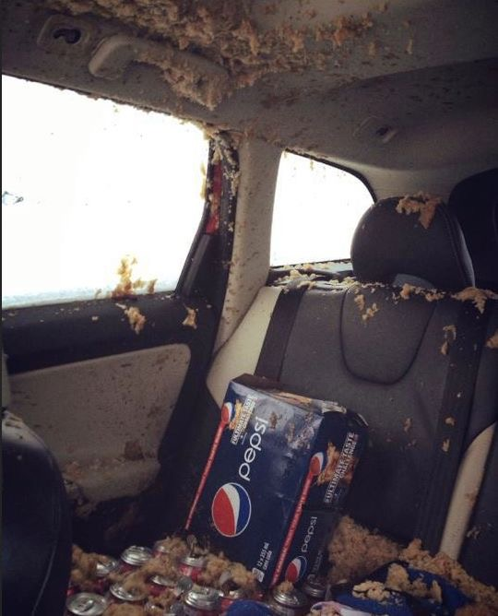
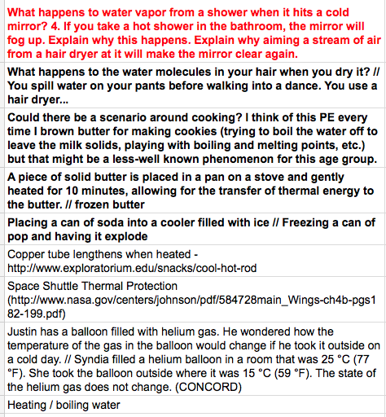
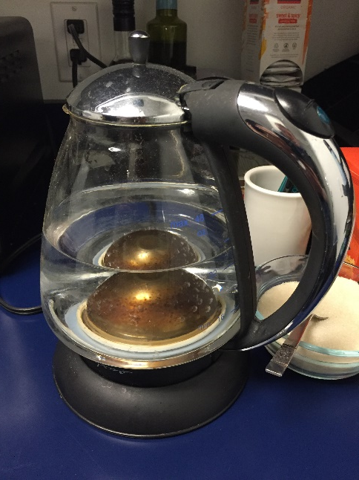
Sample Scenario Brainstorm
Sample Scenario Brainstorm

Slide 67
STEP 4: Workshop the Scenarios
How do you think the leading scenarios relate to your learning performance? Describe how.
Relate the criteria to the leading scenarios. Does it centrally focus on relevant phenomena? How interesting and relevant might each be to your students? Are there confusing cultural components?
After the discussion, select the best scenario and craft student-facing language for it. It should be lean, but clear. Perhaps include a clarifying picture or diagram.

Slide 68
Reflection
What did you learn about identifying a scenario so that it is relevant, clear and fair?

Slide 69
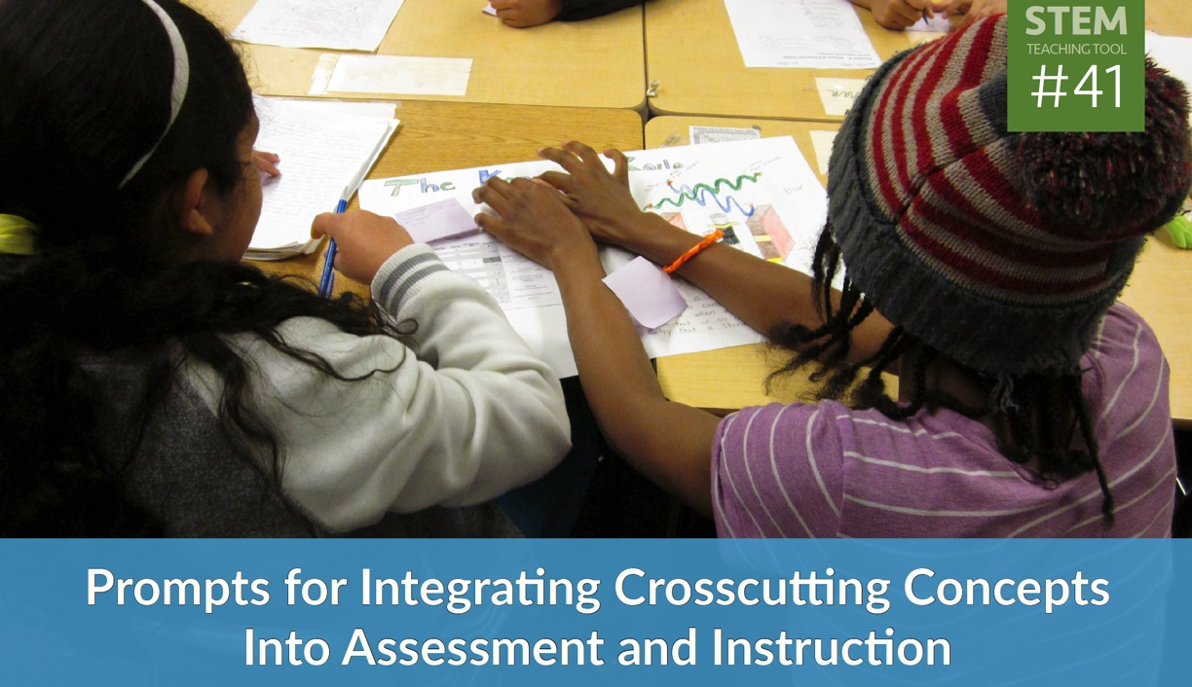
STEP 5: Build 2D or 3D Questions
Start with either your selected SEP or CCC. Use…
science and engineering practices task formats or
crosscutting concept prompts
Consider how are you connecting the chosen SEP and/or CCCs to the disciplinary concept (DCIs).
STEMteachingtools.org/brief/30
STEMteachingtools.org/brief/41

Slide 70
STEP 6: Imagine Student Responses
Read through your drafted question(s) and imagine how students might answer at three levels: (1) limited, (2) partial, and (3) full understanding. For the full understanding response, you should imagine the response an ELL student with deep conceptual understanding would provide.
Think of common facets of student thinking that might result from the cultural and experiential backgrounds of your students.
How might revisions to your questions/items:
elicit this variation in student thinking?
identify linguistic challenges facing students?

Slide 71
STEP 7a: Share, Review & Revise
Share your 3D classroom assessment with another individual / group and look over theirs to provide 3D feedback. Here are a few things to consider:
What is the “3Dness” of the items (or clusters)? Can you identify the focal DCI, SEP, and/or CCC?
Are there words that students would find confusing or misinterpret? Would a visual of some kind add clarity?
Would the assessment give you “actionable evidence” to guide instruction?
Is the scenario accessible to all students?
Is the scenario relevant and engaging to students? Is it a fair assessment task?

Slide 72
STEP 7b: Share, Review & Revise
Post your 3D daily classroom assessment around the edge of the room.
Take a walk through the gallery of assessment tasks.
With your colleagues, discuss specific tasks and reflect on what you learned (or struggled with) as you crafted your 3D classroom assessment.

Slide 73
The Formative Assessment Process (Adapted by Simpson & McCulloch from Ruiz-Primo & Furtak, 2007)
Clarify
Intended
Learning
Elicit
Evidence
Act on
Evidence
Interpret
Evidence

Slide 74
Crafting a 3D Task
Select a target DCI component for a given classroom lesson or learning experience.
Identify SEP component and CCC component to focus on.
Define a 3D Learning Performance for a specific classroom lesson or learning experience.
Brainstorm and workshop possible scenarios for eliciting student understanding. Select one to use that is fair for non-dominant students (e.g., ELLs).
Write 2D/3D questions for the selected scenario.
Imagine (or collect) student responses (limited, partial, full understanding).
Share, review, and revise using workshop approach.

Slide 75
Session Reflection
Session Reflection
How can 3D Learning Performances help you map out a series of formative assessment events across a unit that you teach?
After focusing closely on the three dimensions of science learning, what implications for your teaching occur to you?
How can 3D learning performances help you map out a series of formative assessment opportunities across a unit that you teach?
After focusing closely on the three dimensions of science learning, what implications for your teaching occur to you?

