Slide 1
KY Family Math Night Educator Training
March 2020

Slide 2
Our facilitators:
Maggie Doyle
Academic Program Consultant
Kentucky
Department of Education
Kerry Friedman
Deputy director and senior education researcher
REL Appalachia
SRI International
Erin Chavez
Academic Program Consultant
Kentucky
Department of Education

Slide 3
Our sponsors:

Slide 4
Our goals
Participants will expand their understanding of research on the importance of mathematics for future success and family and community engagement in mathematics and learn strategies to engage families in supporting mathematics learning.
Participants will develop a plan for leading the implementation of a Community/Family Math Night for their school.
Participants will consider how the KY Family Math Night materials might be adapted to be delivered via a virtual experience.
Notes:
Talking points: Facilitators will welcome participants and review the goals and agenda.

Slide 5
Our plan
Welcome and introductions
Review of resources available including
Facilitator guide
Growth mindset and math attitudes
Kentucky Standards Family Guides
Math stations
Training considerations
Action planning
Wrap-up

Slide 6
Review of Resources Available

Slide 7
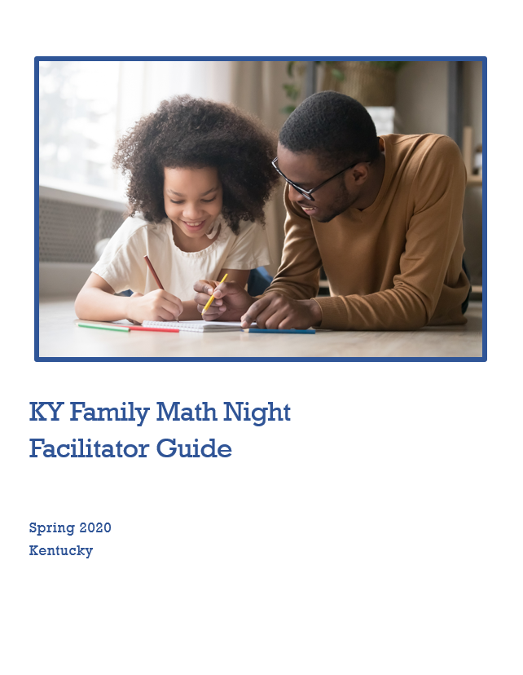
Facilitator guide
The facilitator guide includes all background information, activity instructions, facilitator notes, and materials/handouts for your Community/Family Math Night.
Contents
Overview
Math night at a glance
KY Standards Family Guides
Background and facilitator notes on math night activities
Table handouts
Parent handouts
Table materials
Notes:
Talking points: Facilitator will provide an overview of the facilitator guide that participants will be able to download on kystandards.org.

Slide 8
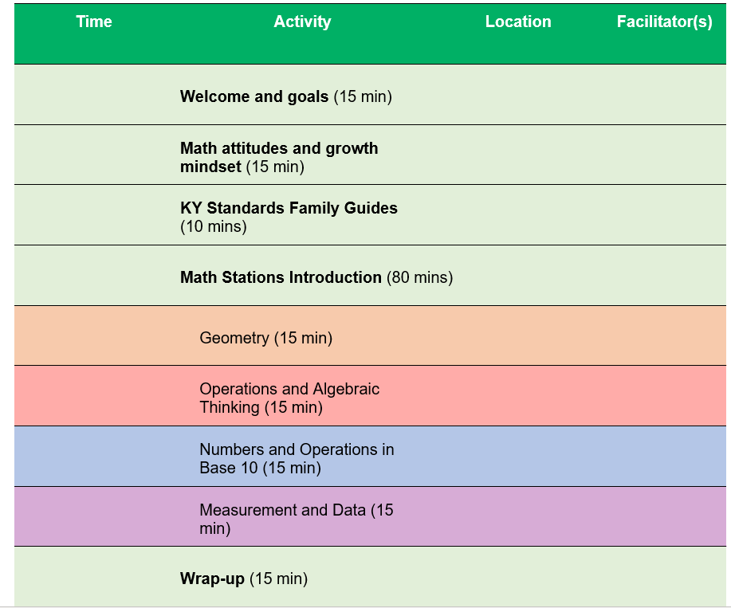
Math at a Glance Document
Consider as we move forward how you might adapt these experiences if they were to be delivered virtually.
Notes:
Talking points: This was originally created to be a face-to-face KY Family Math Night where families met at a central location to engage in grade level activities aligned to the KAS for mathematics. If there is not an opportunity for families to meet face-to-face, then a virtual setting will work too. As we talk about the resources and considerations for a KY Family Math Night we will also talk about how it can be implemented virtually.

Slide 9
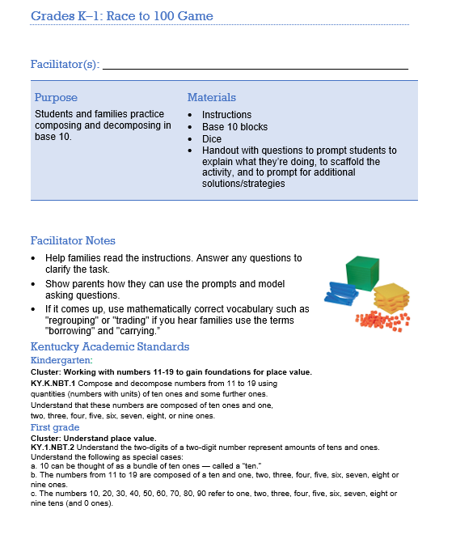
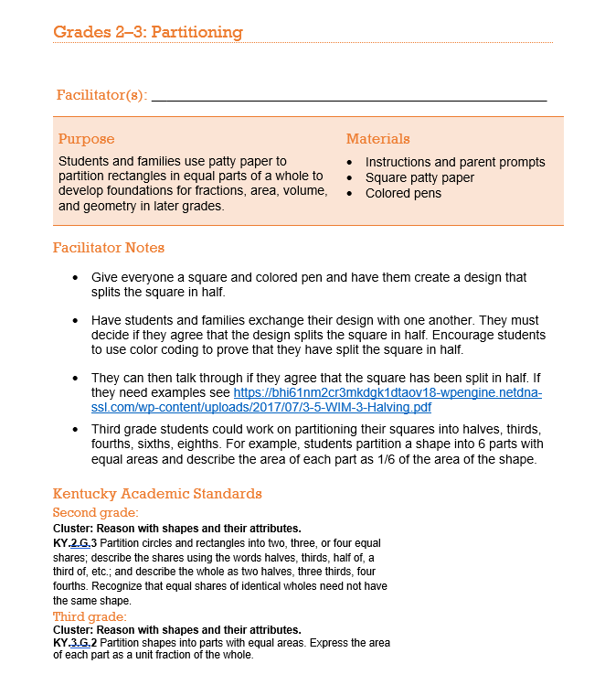
Digging Deeper
Notes:
Talking points: As we dig deeper into what is available in the facilitator’s guide (such as the two activities previewed above), we’ll take you through what is available to you as educators in the original guide, but also make suggestions for how these ideas might grow as we all become more flexible with how we serve families and students.

Slide 10
Why math?
Notes:
Talking points:
Let’s talk about why we are focusing on engaging families in math.
In the past, math was often taught as a set of rules to follow, but that's not what mathematics really is or how it’s taught today. Mathematics is about puzzling over problems, trying multiple strategies, and finding solutions.
Early math skills are essential to children’s learning and success in school (Claessens & Engel, 2013). Early math skills predict later math performance, as well as success in other subjects (Duncan et al., 2007).
Mathematics achievement is particularly important for students in Kentucky. Math skills are important not just for future success in school, but for employment in growing sectors of the workforce.
Claessens, A., & Engel, M. (2013). How Important Is Where You Start? Early Mathematics Knowledge and Later School Success. Teachers College Record, 115(6).
Duncan, G. J., Dowsett, C. J., Claessens, A., Magnuson, K., Huston, A. C., Klebanov, P., . . . Japel, C. (2007). School readiness and later achievement. Developmental Psychology, 43(6), 1428-1446. https://eric.ed.gov/?id=EJ779938

Slide 11
From the research
Notes:
Talking points: Now let’s review the goal of the KY Family Math Nights and why we think they are important. Family Math Nights are intended to engage the broader community (such as family members and community leaders) in understanding the importance of mathematics and learning how best to support their children in learning math.
From the research, we know that children who believe they can be successful in math will put in more effort and engage in productive struggle, which leads to better mathematics performance. Students who perform better in math in elementary school are more likely to succeed in middle and high school. Success in high school leads to higher incomes and opportunity in a growing number of STEM and non-STEM jobs.
Source: https://ies.ed.gov/ncee/edlabs/infographics/pdf/REL_AP_Supporting_Your_Child_in_Developing_Math_Skills_for_Future_Success.pdf

Slide 12
Fmailes are math role models
Notes:
Talking points: We also know that families are natural math role models, and they can support their children in developing math skills by praising effort and modeling positive math attitudes, encouraging children to seek help and try new strategies, and confronting stereotypes about who is good at math.
So we want families to understand the importance of math and feel comfortable and confident in supporting your children to learn math.

Slide 13
Growth mindset and math attitudes
Notes:
One way families can support children’s math learning is by promoting positive math attitudes and adopting a growth mindset.

Slide 14
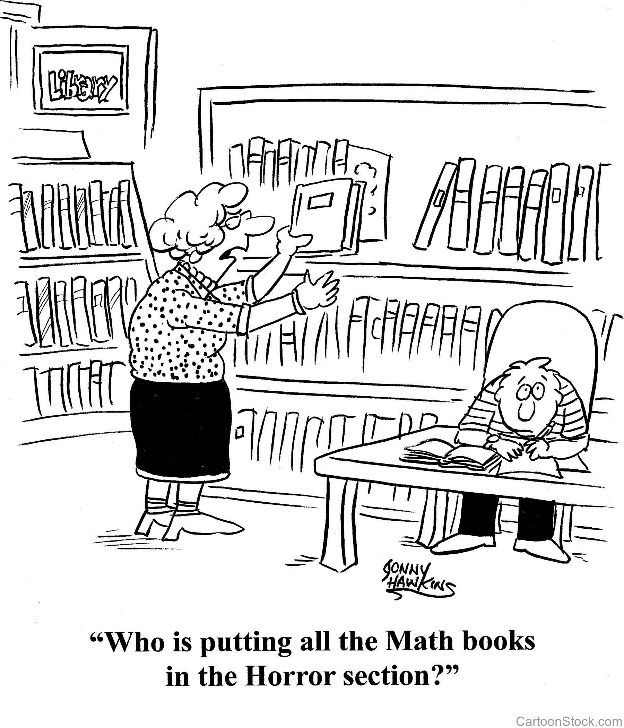
Math attitudes matter
Sometimes children and adults hold negative attitudes about math and their math abilities.
Research suggests that math attitudes and math skills affect each other.
A positive attitude about math can support math performance.
Notes:
Talking points: When students are learning math, how adults talk to them about the subject really matters. Research studies have found that adults’ reactions to a student’s work will impact the student’s achievement and attitudes toward the subject. For example, if a child is learning something new in math and asks a parent for help, some parents may react by saying that they are not good at math, or that they don’t know how to do the “new math”. While they may feel this way, it is important for them to think about what this communicates to the child. If the parent doesn’t react positively, how can we expect the child to react positively?
In addition to paying attention to how we react when children ask us for help with their work, we need to pay attention to how we communicate our expectations for them. When a child is struggling with math, a parent or teacher may try to comfort the student instead of offering strategies to succeed in math. For instance, take the phrase we may all have heard: “Plenty of people have trouble in math but go on to be very successful in other fields.” This communicates that you have low expectations for students in math, so why should they try harder? Parents can use phrases like “I know this is hard, maybe you can try another way to solve the problem?” or “I know this is hard, but you are learning something new, and sometimes that takes a lot of work. ”
Blackwell, L. S., Trzesniewski, K. H., & Dweck, C. S. (2007). Implicit theories of intelligence predict achievement across an adolescent transition: A longitudinal study and an intervention. Child Development, 78, 246-263.

Slide 15
Shifting your mindset
Fixed mindset
Growth mindset
The belief that people are born with the intelligence they have and there is not much you can do to change it.
The belief that people can increase their intelligence through hard work and persistence. You can work your brain like your muscles.
Notes:
Talking points: When we are engaging children in math, it is important to reflect on how we are approaching the subject and the attitudes we hold about math. There are two ways we categorize these attitudes, a fixed mindset and a growth mindset.
When a person has a fixed mindset, he believes his accomplishments are based on some innate traits and that his successes are made with little to no effort and based on his intelligence. People just are the way they are. Successful people are born to be successful.
With a growth mindset, a person believes she has the ability to succeed through hard work. While intelligence and innate traits may play a part, success is a result of hard work and time spent on a task or subject. Successful people are not born, they are made.
Often, adults talk about the ability to learn math as something that is fixed within a child, possibly using phrases that sound reassuring such as, “You completed that problem because you are really smart” or “You're good at so many other things, maybe math just isn’t your subject.” However, these phrases are not the best way to encourage young children. They are promoting the fixed mindset. Phrases such as “You completed that problem so fast! I bet you worked really hard at it,” or “I know you are struggling with math, maybe you need to try a new strategy/study method to get better” are phrases that promote a growth mindset.
The main message is that we want to praise children’s effort, not intelligence. We all can and should tell our kids they are smart; don’t stop doing that, but try to include praise on their efforts too.

Slide 16
Opening presentation: Math attitudes and growth mindset
Listen and engage in the opening presentation for the math night as a learner and facilitator.
As a learner consider:
How will family members engage or react to this information?
Is there anything that you think will be confusing or unclear for families in your community?
As a facilitator consider:
Are there any modifications I need to make to the content?
Are there any logistical considerations for presenting this information?
Who at my school should lead the presentation?
Notes:
Now that you have an understanding of the importance of math attitudes and growth mindset, I’m going to share the opening presentation for our Kentucky Family Math nights. As you listen and engage with the presentation please wear 2 hats. First as a learner think of yourself as a student and family member and consider… As a facilitator of the math night, consider….
The content of the presentation is based on the ideas we just discussed – building awareness about math attitudes and growth mindset and how families can shift their attitudes and mindsets to support their children.

Slide 17
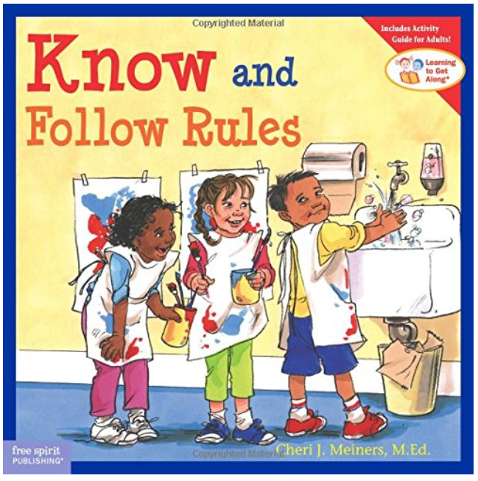
When you think about learning math, which book is most like you?
Why?
Notes:
Talking points:
The first things we do for our presentation is a little icebreaker – now we ask families to think about which book they identify with as a math learner. This may reveal some initial math attitudes and ideas about math learning.
As you have dinner and get settled in for activities, we want you to talk with the others sitting close to you. If this is virtual, the dinner will not apply.
To kick things off, introduce yourself and share which book you identify with when you think of being a math learner.
When you think of learning math are you…
The Little Engine That Could?
Oh, The Thinks You Can Think?
Know and Follow the Rules?
OR Alexander and the Terrible, Horrible, No Good, Very Bad Day?
Once we see most of you are done with dinner, we will get started with the activities.

Slide 18
Math attitudes
Notes:
Talking points: Now, we’ll get started with the presentation. Before we get into the math activities, we think it is important to talk with you about how adults’ attitudes toward math can influence children’s math learning.
“This is especially important right now since so many of our students are getting mathematical experiences outside of the traditional classroom setting.”
Source: http://readingismysuperpower.org/wp-content/uploads/2018/01/math-books-horror-section.jpg

Slide 19
Adult attitudes toward math can influence a child’s math achievement
Multiple studies suggest that adults’ reactions to a student’s work will impact the student’s achievement and attitudes toward the subject.
Students may feel you have low expectations for them, which can lead to lower motivation and lower expectations for their own success in math.
Notes:
Talking points: When students are learning math, how adults talk to them about the subject really matters. Research studies have found that an adult’s reactions to a student’s work will impact the student’s achievement and attitudes toward the subject. For example, if a child is learning something new in math and asks a parent for help, some parents may react by saying that they are not good at math, or that they don’t know how to do the “new math.” While they may feel this way, it is important for them to think about what this communicates to the child. If the parent doesn’t react positively, how can we expect the child to react positively?
In addition to paying attention to how we react when children ask us for help with their work, we need to pay attention to how we communicate our expectations for them. When a child is struggling with math, a parent or teacher may try to comfort the student instead of offering strategies to succeed in math. For instance, take the phrase that we may all have heard: “Plenty of people have trouble in math but go on to be very successful in other fields.” This communicates that you have low expectations for students in math, so why should they try harder? Parents can use phrases like “I know this is hard, maybe you can try another way to solve the problem?” or “I know this is hard, but you are learning something new, and sometimes that takes a lot of work. ”
Blackwell, L. S., Trzesniewski, K. H., & Dweck, C. S. (2007). Implicit theories of intelligence predict achievement across an adolescent transition: A longitudinal study and an intervention. Child Development, 78, 246-263.

Slide 20
Math mindset matters
Fixed mindset
Growth mindset
The belief that people are born with the intelligence they have and there is not much you can do to change it.
The belief that people can increase their intelligence through hard work and persistence. You can work your brain like your muscles.
Notes:
Talking points: When we are engaging children in math, it is important to reflect on how we are approaching the subject and the attitudes we hold about math. There are two ways we categorize these attitudes, a fixed mindset and a growth mindset.
When a person has a fixed mindset, she believes her accomplishments are based on some innate traits and that her successes are made with little to no effort and based on her intelligence. People just are the way they are. Successful people are born to be successful.
With a growth mindset, a person believes he has the ability to succeed through hard work. While intelligence and innate traits may play a part, success is a result of hard work and time spent on a task or subject. Successful people are not born, they are made.
Often, adults talk about the ability to learn math as something that is fixed within a child, possibly using phrases that sound reassuring such as “You completed that problem because you are really smart” or “You're good at so many other things, maybe math just isn’t your subject.” However, these phrases are not the best way to encourage young children. They are promoting the fixed mindset. Phrases such as “You completed that problem so fast! I bet you worked really hard at it,” or “I know you are struggling with math, maybe you need to try a new strategy/study method to get better” are phrases that promote a growth mindset.
The main message is that we want to praise children’s effort, not intelligence. We all can and should tell our kids they are smart; don’t stop doing that, but try to include praise on their efforts too.

Slide 21
Praise effort and learning
Praise effort and learning
Not everyone is a math person; you’re so good at other subjects.
Well done, you’ve worked really hard on that problem.
This Photo by Unknown Author is licensed under CC BY-SA
Notes:
Talking points: Now let’s try some different phrases. Read each phrase on the screen and talk with the person seated next to you. Which one praises effort?
[facilitator allows 1-2 minutes for participant discussion]
What do you think? Does phrase 1 praise effort? How about phrase 2? [facilitator allows for participants to respond nonverbally]
It is important to notice the strategies and different ways children are solving problems. You can also ask questions like:
Did you use good problem-solving skills?
On a scale of 1-10, 10 being the hardest you've ever tried to do something, how much effort did you put into this task?

Slide 22
Another example
Praise effort and learning
You got a higher grade on this assignment. You must have worked really hard.
You got a higher grade on this assignment. You must be really smart.
This Photo by Unknown Author is licensed under CC BY-SA
Notes:
Talking points: Let’s discuss these two phrases. They are more similar to one another than the last two. Discuss with your neighbor, which one do you think praises effort?
[facilitator allows 1-2 minutes for participant discussion]
What do you think? Does phrase 1 praise effort? How about phrase 2? [facilitator allows for participants to respond nonverbally]
Again, you can expand how you talk about your child’s effort to include asking questions like, “What do you think? Did you work hard?”

Slide 23
How children react
Lisa’s students
“Oh my goodness,
I got a bad grade on this test!
I’m just not good at math.
I don’t think I will ever like it.
I’m not sure what I can do to get better.
Luckily I’m good at English and science.”
I wasn’t expecting this grade.
I studied really hard, but not the night before the test.
I guess for the next test, I will study harder,
and study the day before the test.
Maybe my friend Martha can help me.
She got a good grade on this test.
Notes:
23
Talking points: Now I would like to tell you a story to illustrate the difference in how children may react to adult attitudes toward learning math. Lisa is a third-grade math teacher.
She just administered a test on measurement in her classroom.
Two students, Josh and Madison, received the exact same grade the test, a C.
Lisa asked them how they planned on improving their scores on the next test.
Josh explained, “Oh my goodness, I got a bad grade on this test! I’m just not good at math. I don’t think I will ever like it. I’m not sure what I can do to get better. Luckily I’m good at English and science.”
Madison responded to Lisa in another way, “I wasn’t expecting this grade. I studied really hard, but not the night before the test. I guess for the next test, I will study harder, and study the day before the test. Maybe my friend Martha can help me. She got a good grade on this test.”
Both student received the same grade, but reacted very differently.
Lisa recognized that Madison had a growth mindset for mathematics. She encouraged Madison to ask Martha for help, and provided her with additional study strategies to help her improve.
What can the teacher do for Josh? [wait for participants to respond]
The exact same thing! First, Lisa can encourage Josh to have a positive attitude toward learning math.
She can also remind him that she has the same high expectations for all her students, and he is no exception.
She can give him some study strategies to help him feel better about the math content.
Lastly, she can help Josh find a study partner who may be able to share different ways to tackle the problems that give difficulty.
What else can Lisa do?
[facilitator takes responses from participants]

Slide 24
Take home message
Adult attitudes toward math can influence a child’s math achievement.
Take-home message
Family and teacher feedback is important for math learning.
Changing your mindset and feedback can help your children succeed at math.
Praise effort
and learning
Notes:
Talking points: Share the take-home messages.

Slide 25
Discussion
How will family members engage or react to this information?
Is there anything that you think will be confusing or unclear for families in your community?
Are there any logistical considerations for presenting this information (virtual platform, projector, etc.)?
Do you have anyone in mind to lead this presentation at your math night?
Notes:
Talking points: How can you support families in having a growth mindset as they work with students?

Slide 26
Kentucky Family Guides Review

Slide 27
Family Guides The Kentucky Academic Standards (KAS) Family Guides have been developed to help families familiarize themselves with the content of each grade level’s standards. Each guide contains a standards overview for Reading & Writing, Mathematics, Science and Social Studies.
Notes:
Talking points: This tool provides information about the key ideas and skills teachers will introduce in mathematics, reading and writing, science and social studies. It also was designed to help parents understand how they can work with teachers to support the learning of their child at each grade level K-12.

Slide 28
Family Guides
Each content area contains the following sections:
Why are the Kentucky Academic Standards important?
How are the standards organized?
Overview of the grade level content
Examples of Your Child’s Work at School
How to Help Your Child at Home
Questions You Can Ask Your Child
Questions You Can Ask Your Child’s Teacher
Notes:
Talking points: This is a great resource in providing all shareholders access to understanding the Kentucky Academic Standards when conducting community events; whether its Family Math Night or Literacy Night or an open house event, this tool opens the door for conversations around a students’ success. Have participants find their child’s grade level in mathematics and look at the different components. Ask participants which component of the KY Standards Family Guides helps them the most and why? Have participants share out.

Slide 29
A Closer Look at the Math Stations

Slide 30
Station Layout
Station 1:
Geometry
Station 4:
Measurement and Data
Cafeteria
Station 2:
Operations and Algebraic thinking
Station 3:
Number and Operations in Base 10
Notes:
Talking points: If this is a face to face Family Math Night you would set up stations and families would rotate throughout the grade banded activities. If you choose to run the Virtual Family Math Night you might choose one activity to highlight a week. Facilitator will review the math stations section of the facilitator guide and point out the features common among all four stations. Note: If this is virtual, many families will not have pattern blocks at home, therefore you would need to choose an activity that best meets their needs or guide them to a virtual resource for those manipulatives.

Slide 31
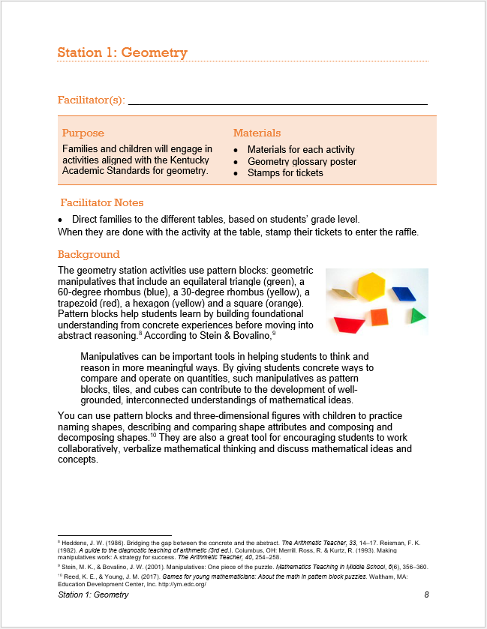
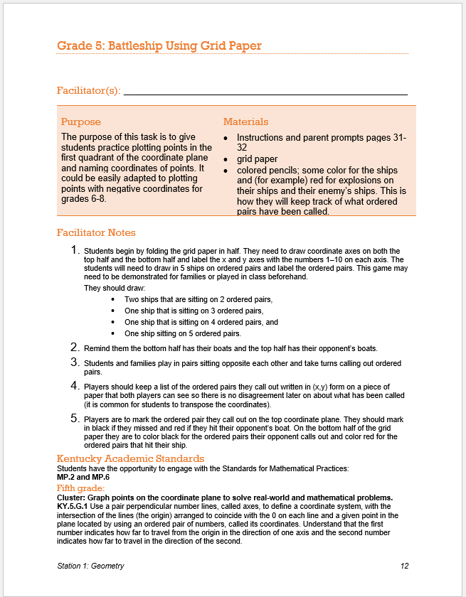
Station 1: Geometry
Notes:
Talking points: The grade 5 geometry activity/station has students playing Battleship to where families practice plotting points in the first quadrant of the coordinate plane and naming coordinates of points. This game could be easily adapted to plotting points with negative coordinates for grades 6-8 as well, but in grade 5 we only stay in the first quadrant with positive numbers.

Slide 32
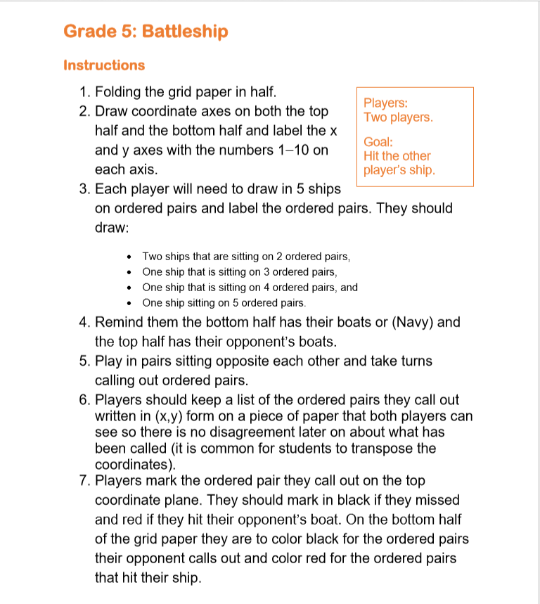
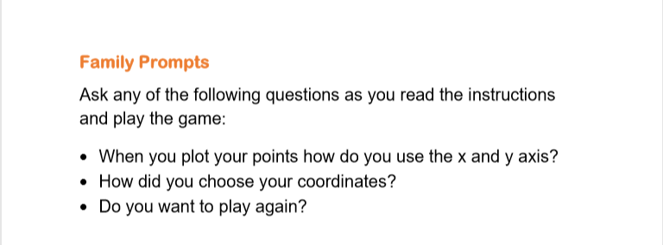
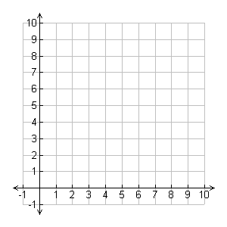
Instructions & Family Prompts are Included
Notes:
Talking points: For each math activity instructions and family prompts are given so that families are equipped with what they need to engage with mathematics at school or at home.

Slide 33
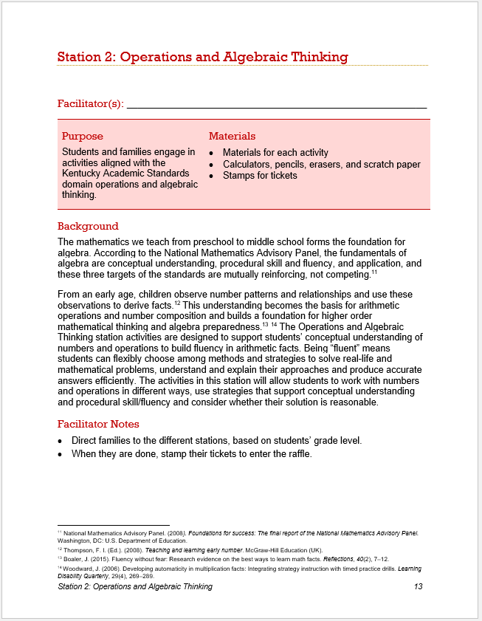
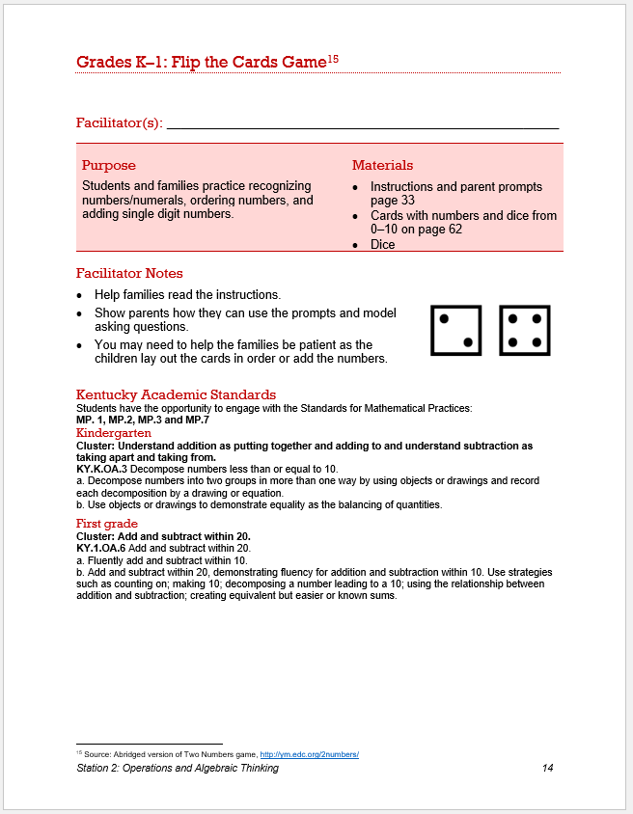
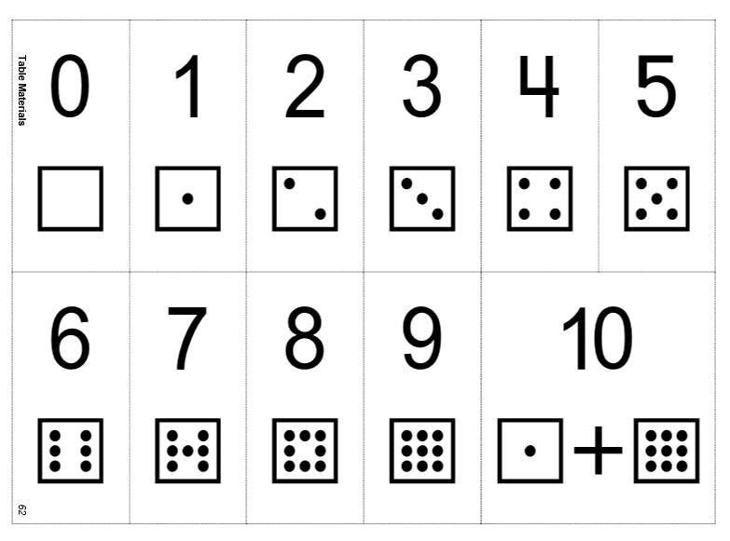
Station 2: Operations and Algebraic Thinking
Notes:
Talking points: In the operations and algebraic thinking station for grades K-1 is a flip the card game where students and families practice recognizing numbers/numerals, ordering numbers, and adding single digit numbers. Again there are facilitator notes for you as a teacher leading this activity as well as instructions and family prompts for students to engage in mathematics.

Slide 34
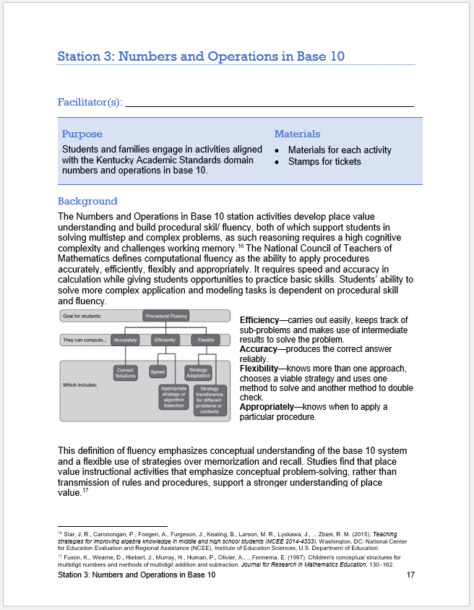
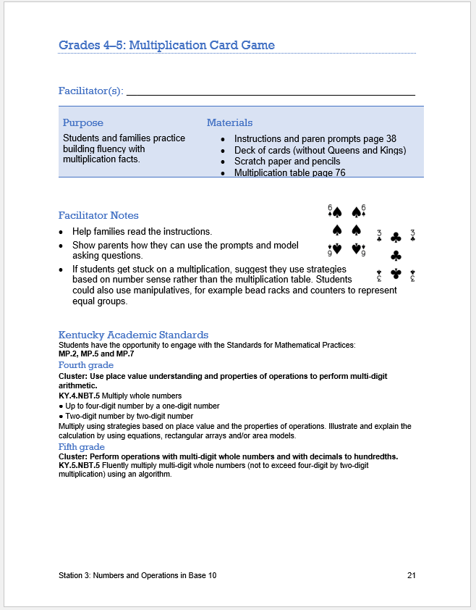
Station 3: Number and Operations in Base Ten
Notes:
Talking points: The Numbers and Operations in Base 10 station activities help develop place value understanding and build procedural skill/ fluency, both of which support students in solving multistep and complex problems, as such reasoning requires a high cognitive complexity and challenges working memory. The grade 4-5 activity has students and families practice building fluency with multiplication facts using a deck of cards.

Slide 35
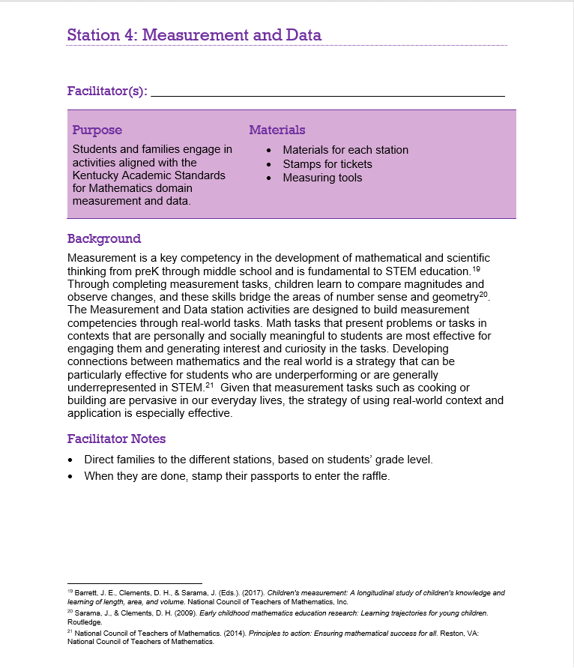
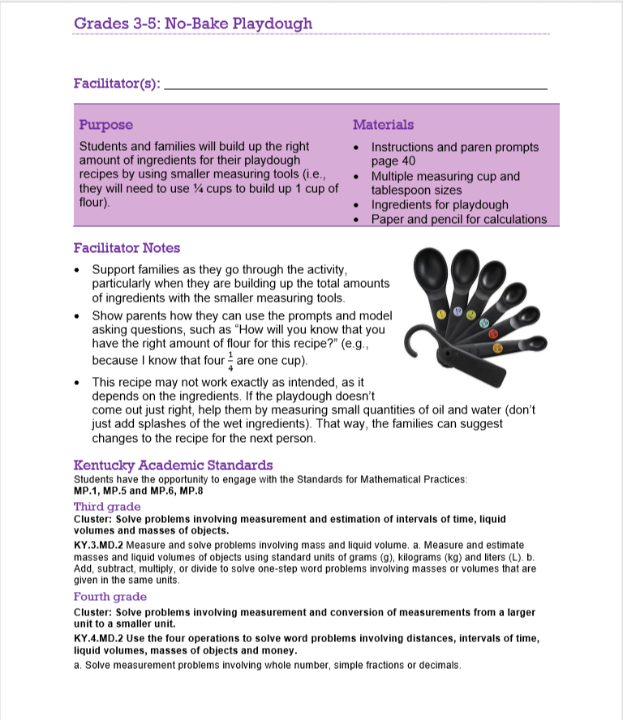
Station 4: Measurement & Data
Notes:
Talking points: Measurement is a key competency in the development of mathematical and scientific thinking from Pre K through middle school and is fundamental to STEM education. The grade 3-5 activity has students and families building up the right amount of ingredients for their playdough recipes by using smaller measuring tools (i.e., they will need to use ¼ cups to build up 1 cup of flour).

Slide 36
Implementation considerations
Notes:
To implement the math nights, you’ll need to closely review the facilitator guide and work with a team of teachers and school staff.
Here, we offer some considerations for collaborating with your colleagues to implement family math nights.

Slide 37
Collaborating with your colleagues
Consider ways to increase participant engagement, such as
Think about a time you participated in a learning session facilitated by a colleague
What strategies helped you engage in the session?
How might your engagement have been increased?
Is the strategy your colleague used one that would translate well in an online experience?
Explaining strategies briefly and giving participants a chance to practice or observe
Working through activities with partners
Building from teachers’ existing work
Presenting self as a continual learner
Strategic use of humor.
Notes:
Talking points: More and more teachers are taking leadership roles in their schools, and we’re starting to better understand how to increase engagement in teacher-led learning sessions. The slide offers a few approaches that appear to increase engagement, as shared by teachers who participated in teacher-led professional learning.
Read first bullet – identifying what has helped you as a learner can inform how you engage others. A few other tips include…
Read rest
This is an opportunity to connect and grow with your colleagues so you also want to present…
And use humor as you can to help others feel at ease and have fun!
Ask participants, “How does this list match with those you developed?”
Jason Margolis. (2008). When teachers face teachers: listening to the resource “right down the hall,” Teaching Education, 19(4), 293-310, DOI: 10.1080/10476210802425628

Slide 38
Facilitating KY Family Math Night
Considerations
Identify one or more teachers for each math station, with preferably with a mix of primary and upper elementary representation.
Ensure each math station lead has time to practice the activities and consider questions that math night participants might pose.
Ensure each math station lead understands the alignment between the activities and the Kentucky Academic Standards for Mathematics.
Remind each team that having "fun" while engaging families in the math activities is a goal for the evening.
Notes:
Talking points: If hosted virtually, you could gather a group of teachers and one teacher could share an activity one day or one per week. Then the next week another teacher could join and share another math activity from the Facilitator’s Guide.

Slide 39
Action planning
Notes:
Now we’ll discuss how to develop a plan for your math night.

Slide 40
Key considerations for planning
Timeline: Start planning your event at least 6 weeks in advance and work backwards.
Location: Select a location that is convenient to the school community and allows ample space for all activities.
Form a team: Form a Community Math Night facilitators team to implement the event. You’ll need at least five teachers/leaders plus the MIT.
Volunteers: Look outside school staff for help with prep work, set-up, and teardown.
Stakeholder and community engagement: Engage community support for promoting the event, recruiting volunteers, and securing raffle prizes.
Notes:
Talking points: Facilitator will review key considerations for planning a Community Math Night event, including setting a reasonable timeline, recruiting volunteers, selecting a location, and engaging community members.
Timeline: You will want to allow enough time to plan the event and engage stakeholders. We suggest you start planning at least 6 weeks in advance. Consider your local context when selecting a date, and adjust the planning timeline as needed
If you are implementing virtually, this will give families a little more flexibilities in scheduling, so you may be able to implement sooner.
Location: Your school gym or local community center may be ideal places to host the event. Ensure that you have enough room for seating families at dinner and the opening presentation. You will also want to ensure that you have ample space for families to participate in and rotate through station activities. If held virtually you will want to choose a virtual platform, such as Zoom or another platform where you can use a webcam and engage with participants.
Volunteers: School staff will be key volunteers for leading station activities. Also consider what additional help you will need to serve dinner, prepare for the event, and clean up afterward. If virtual, do you have a technology specialist or others who are particularly tech-savvy who can help.
Stakeholder engagement: Consider “who are the key stakeholders for planning Community Math Nights at my school?” Look for ways to involve these individuals early on in planning your Community Math Night.

Slide 41
KY Family Math Night Action Planning Template
Complete your action planning template. Consider:
Do you need to adjust the timeline to accommodate your school context?
Can you identify school staff or potential volunteers to lead each planning task?
Are there additional tasks you need to include to plan a successful event at your school?
Notes:
Talking points: Facilitator will review the action planning template. Participants will wear their facilitator hats for this activity to complete the template.
We have developed an action-planning template that can you help you plan your math night from start to finish. Review the template and consider….

Slide 42
Digital family engagement strategies
Host activities at multiple times and vary the days or times you offer so that parents with different schedules can still participate.
Consider sending activities out as short, daily assignments or suggestions, rather than hosting doing one single virtual event.
Identify a primary method and platform for communicating and working with parents and share this with parents. Be sure to coordinate with your local school district to ensure consistency in communication methods.
Don't forget Non-English-speaking families, who may need translated information.
Notes:
Talking points: Here are some digital family engagement strategies that you might consider if planning to move some of these activities online.

Slide 43
5 Things to Know Before You Go
Early mathematics achievement is associated with several success factors later in life.
Family and teacher feedback is important for math learning. Changing your mindset and feedback can help your children succeed at math.
KY Family Standards Guides are tools that can open the door for conversations around a students’ success.
Family math night activities can create a shared understanding of the math concepts and raise expectations for math knowledge and achievement. Work with your colleagues to see how you can use the resources in the KY Family Math Night Facilitator’s Guide to best serve students and their families.
At family math nights, educators, children, and family members can learn and talk about mathematics while participating in activities aligned to the Kentucky Academic Standards for Mathematics.
Notes:
Talking points: Helping family members participate in their child’s learning and support their child’s academic success, which promote success in school.

Slide 44
Please let us know about your experience at KY Family Math Night!
Host an in-person KY Family Math Night?
Share this survey with parents:
https://forms.gle/L4XTYMeZJPmVF161A
Did you use this resource virtually?
Email:
Erin.chavez@education.ky.gov
Maggie.doyle@education.ky.gov
kerry.friedman@sri.com

