Slide 1
Developing Skilled Adolescent Readers & Writers
Session 1: How Does the Brain Learns to Read?
Notes:
Guiding Notes:​
Welcome! Please see the Notes section of slides 2 and 3 for extensive planning and facilitation considerations:​
Slide 2: A Note to Facilitators Leading a Group​
Slide 3: A Note to Individuals Completing This Series​
Please contact ELATeam@education.ky.gov with any questions. ​

Slide 2
A Note to Facilitators Leading a Group:
For complete considerations for facilitators, see the Notes section of this slide.
These slides are part one of a six-part series.
See the Webinar Series Learning Plan on the Landing Page for a detailed view of session objectives and materials. You may wish to make this available to participants.
Print or make a digital copy of the Series Participant Guide for participants to complete the pre-work.
This series is built around the Institute for Education Science and What Works Clearinghouse 2022 Practice Guide, Providing Reading Interventions to Students in Grades 4-9, a free resource available for print. Consider making copies or providing digital access to participants to complete the pre-session readings.
Notes:
Series Overview:
This slide is purposefully hidden from participants.
The purpose of this series is to provide Kentucky 6-12 educators with declarative knowledge of how the brain learns to read, including ways to support all students in middle and high school access complex, grade-level text and skills through decoding multisyllabic words, fluency building, knowledge building, vocabulary building, comprehension and skilled writing.
The Developing Skilled Middle and High School Readers Webinar Series is intended to support classroom teachers across the state in engaging students in grade-level reading across subject areas; however, some content may be relevant for instructional leaders wishing to build their own knowledge of adolescent learners and their literacy needs. The sessions are designed to provide flexibility for districts and schools and, as such, can be viewed as stand-alone lessons or within the progression of the series as provided. You are supported in engaging with this series individually, if desired.
This entire series is six sessions and will take approximately 9 total hours to complete. We recommend accessing one session monthly; however, adaptations may be made to accommodate for more or less time. Each individual session is 1.5 hours.
Materials Needed:
The session slides with Guiding Notes
The Series Participant Guide
Access to the participants’ high-quality instructional resource (HQIR)
A Note about HQIRs:
The Reading and Writing HQIR Consumer Guide points districts to the markers of high-quality literacy instruction for Kentucky. Note that HQIRs are grounded in research and written by experts. While these resources do engage students in strategies that support reading, many students may need more targeted supports in Tier 1 instruction. As such, it is recommended that facilitators continually ground discussions in the texts, tasks and protocols provided in the district-adopted HQIR and prompt participants to make connections between this learning and their upcoming lessons or units.
Guiding Notes:
Guiding notes are provided in the Notes section of the PowerPoint to support your learning. The Notes section includes additional information and directions for the activities on the slide. It is critical that you read the material presented in the Notes section to ensure that you are acquiring the important knowledge, skills and understanding required when engaging with this series.
Virtual Training Note:
If you plan to engage with this series virtually as a group, consider directing participants to the Developing Skilled Middle and High School Readers landing page:
Intended Audiences:
Participants
Series participants may include, but are not limited to, district leadership, school administrators, instructional specialists/coaches, intervention specialists, department chairs, special educators and classroom teachers.
Facilitators
While this series is designed for a teacher to engage with it individually, it may be implemented with a group of educators led by a facilitator. If this series is being completed as a group, facilitators may include, but are not limited to, cooperative staff, district leaders, school administrators, instructional specialists/coaches, intervention specialists, department chairs, special educators, and classroom teachers. Facilitators may need to revise specific tasks in order to meet the needs of the participants or to be respectful of the time planned within the work session.
Helpful Hint for Facilitators:
The learning that will take place in this series may cause Kentucky educators to face changes in instructional practices amidst this transition. It is important to realize that while you are the facilitator of these work sessions, you may not have all the answers to the questions asked by participants, which is part of the learning process for all educators at all levels. Throughout the series, participants may have questions that will be addressed in future work sessions. When that happens, reflect on this quote from Graham Fletcher, “Every teachable moment doesn’t need to be a teachable moment in that moment.” Use these moments to encourage participants to attend future work sessions where those questions will be addressed. If participants ask questions you are not prepared to answer, offer to follow up on that during the next work session. Please contact ELATeam@education.ky.gov if you have questions or comments.
Planning Ahead for Facilitators:
Determine which stakeholders to invite as participants. In the invitation, describe how the work sessions will benefit them.
A few days before the meeting, you may want to remind participants to be prepared to have their Participant Guide available during the meeting. You may also choose to print these for participants.
Reserve adequate space and equipment. Tables or desks should be set up to support small-group discussion. If conducting this series virtually, ensure that your technology platform can support break out rooms to support small group collaboration.
Ensure that participants have access to the Internet.
Preparation
Participant Documents Needed:
Participant Guide
Access to upcoming lessons or units within their district-adopted curriculum supported by an HQIR
Supplies Needed:
These slides
Technology with projection and sound capability if in person. Technology platform where presenters have sharing ability and breakout room options if virtual.
Participant Guides printed or available virtually
Parking Lot for questions - If completing as a group, you may consider providing a poster on which participants can write or post questions, or you may prefer to have a digital parking lot where participants can access a Google document, for example, to post questions and that you can modify as the participants work through the sections of the series
Self-Sticking Notes (optional)
Poster paper (optional)
Highlighters and/or colored pens/markers (optional)
Building a Community:
Building a community is important for any group that will work together, especially if participants have not worked together before. The concept is the same as building a safe, respectful, productive classroom climate. Incorporating community-building into each session builds trust, shows participants that they are valuable as individuals and engages them in the learning process. It is also useful for creating a professional learning network where participants can be supported in their work. Community-building can be as simple as allowing participants to introduce themselves and their role in the school/district, developing or refining group norms, allowing for questions, and/or the sharing of answers to reflection questions or individual discovery task items that are included in this series. Again, time allotted for community-building will allow participants to have a voice and be engaged as active contributors and learners in the sessions.
Virtual Training Options: Be sure to conduct continual check-ins throughout the presentation. Build Google documents to continue to collect feedback, such as questions, hopes, and/or concerns to which participants may continually add.

Slide 3
A Note to Individuals Completing this Series:
For complete considerations for complete this series individually, see the Notes section of this slide.
Print or make a digital copy of the Participant Guide to capture your thinking.
These slides are part one of a six-part series.
See the Webinar Series Learning Plan on the Landing Page for a detailed view of session objectives and materials. You may wish to make this available to participants.
This series is built around the Institute for Education Science and What Works Clearinghouse 2022 Practice Guide, Providing Reading Interventions to Students in Grades 4-9, a free resource available for print. Consider making copies or providing digital access to participants to complete the pre-session readings.
Notes:
Series Overview:
This slide is purposefully hidden from participants.
The purpose of this series is to provide Kentucky 6-12 educators with declarative knowledge of how the brain learns to read, including ways to support all students in middle and high school access complex, grade-level text and skills through decoding multisyllabic words, fluency building, knowledge building, vocabulary building, comprehension and skilled writing.
The Developing Skilled Middle and High School Readers Webinar Series is intended to support classroom teachers across the state in engaging students in grade-level reading across subject areas; however, some content may be relevant for instructional leaders wishing to build their own knowledge of adolescent learners and their literacy needs. The sessions are designed to provide flexibility for districts and schools and, as such, can be viewed as stand-alone lessons or within the progression of the series as provided. You are supported in engaging with this series individually, if desired.
This entire series is six sessions and will take approximately 9 total hours to complete. We recommend accessing one session monthly; however, adaptations may be made to accommodate for more or less time. Each individual session is 1.5 hours.
Materials Needed:
The session slides with Guiding Notes
The Series Participant Guide
Access to the participants’ high-quality instructional resource (HQIR)
A Note about HQIRs:
The Reading and Writing HQIR Consumer Guide points districts to the markers of high-quality literacy instruction for Kentucky. Note that HQIRs are grounded in research and written by experts. While these resources do engage students in strategies that support reading, many students may need more targeted supports in Tier 1 instruction. As such, it is recommended that facilitators continually ground discussions in the texts, tasks and protocols provided in the district-adopted HQIR and prompt participants to make connections between this learning and their upcoming lessons or units.
Guiding Notes:
Guiding notes are provided in the Notes section of the PowerPoint to support your learning. The Notes section includes additional information and directions for the activities on the slide. It is critical that you read the material presented in the Notes section to ensure that you are acquiring the important knowledge, skills and understanding required when engaging with this series.
Intended Audiences:
Participants
Series participants may include, but are not limited to, district leadership, school administrators, instructional specialists/coaches, intervention specialists, department chairs, special educators and classroom teachers.
Facilitators
While this series is designed for a teacher to engage with it individually, it may be implemented with a group of educators led by a facilitator. If this series is being completed as a group, facilitators may include, but are not limited to, cooperative staff, district leaders, school administrators, instructional specialists/coaches, intervention specialists, department chairs, special educators, and classroom teachers. Facilitators may need to revise specific tasks in order to meet the needs of the participants or to be respectful of the time planned within the work session.
Helpful Hint for Completing this Series Individually:
Throughout the series, you may have questions that you would like to discuss with colleagues or leadership at your school. When that happens, make a note to share or discuss this resource with others. The creators of this series are also available should you have questions or want to discuss the content of the videos. Please contact ELATeam@education.ky.gov if you have questions or comments.
Preparation
Participant Documents Needed:
Participant Guide
Access to upcoming lessons or units within your district-adopted curriculum supported by an HQIR

Slide 4
Series Overview
Session 1 | Session 2 | Session 3 | Session 4 | Session 5 | Session 6
How Do We Learn to Read? Exploring Theoretical Frameworks for Reading Development | Decoding Multisyllabic Words within Complex, Grade-Level Texts | Fluency Building within Complex, Grade-Level Texts | Vocabulary and Knowledge Building Essentials | Comprehension as Both Process and Product | Connecting Skilled Reading to Skilled Writing
Notes:
Guiding Notes:
This slide provides an overview of this series. It is recommended to complete one session per month to allow time for implementation of practices between sessions.

Slide 5
Series Goals:
Learn what research says about supporting skilled adolescent reading of complex, grade-level texts.
2. Improve Tier 1, universal reading and writing instruction with strategies that support skilled reading for all students.
Notes:
Guiding Notes:​
This series may address the needs of educators in a variety of roles in districts. The primary goal is to support middle and high school readers with complex, grade-level texts in tier 1, universal instruction. While some secondary students may need intervention to build foundational skills, this series intends to strengthen Tier 1 instruction using evidence-based practices.

Slide 6
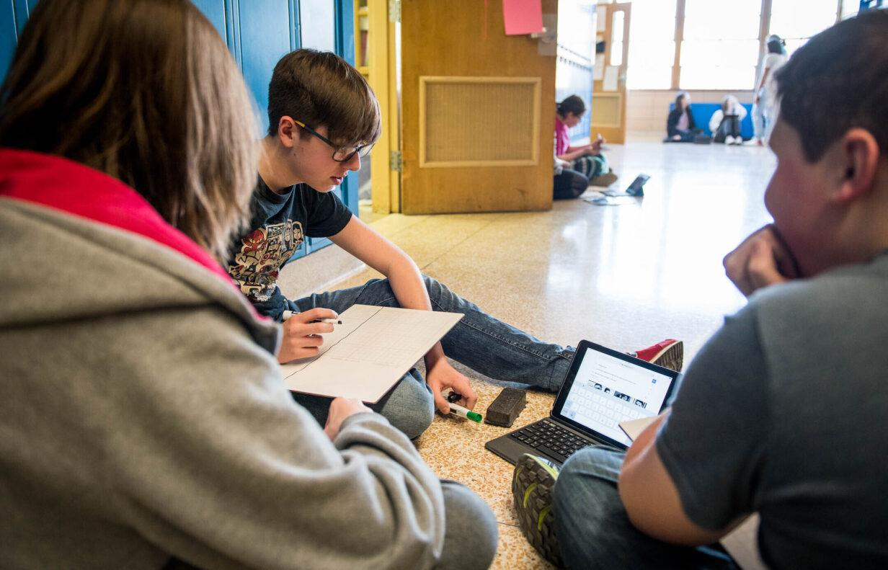
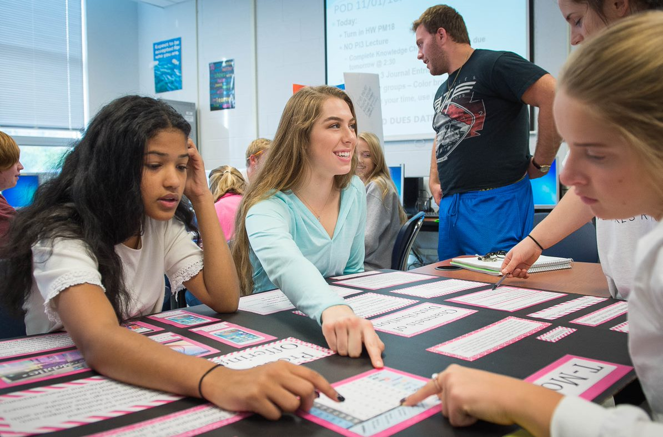
With small and intentional shifts, we can make a real difference for the students in our classes right now who need supports as readers.
Notes:
Guiding Notes:​

Slide 7
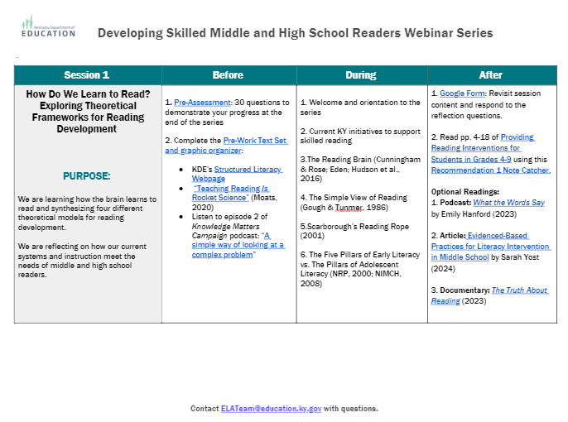
Sessions at a Glance
This document is a tool to know what to do before, during and after a learning session and is available on the Landing Page.
Notes:
Guiding Notes:​
Use this Learning Plan to monitor learning throughout the series.

Slide 8
Welcome!
Session 1: How Does the Brain Learn to Read?
Notes:
Guiding Notes:​
This slide ends the introduction to the series and begins Session 1.

Slide 9
Group Learning Agreements for a Professional Learning
Assume best intentions of facilitators and participants.
Look for opportunities to learn and grow.
Ask the next hard question.
Allow a chance for everyone to participate.
Center students in the conversation.
Preference learning over performing.
Put learning into action by processing with colleagues or modifying instructional practices.
Notes:
Guiding Notes:​
For groups working through this series together, these are recommended norms for collaboration. These may be modified to suit local needs and expectations.

Slide 10
Materials Needed for This Learning:
Access to Structured Adolescent Literacy Webpage
Print or ensure digital access to our text, Providing Reading Interventions for Students in Grades 4-9
Notes:
Guiding Notes:​
The text for this series is available free online and can be printed for individuals to access and study for each session.

Slide 11
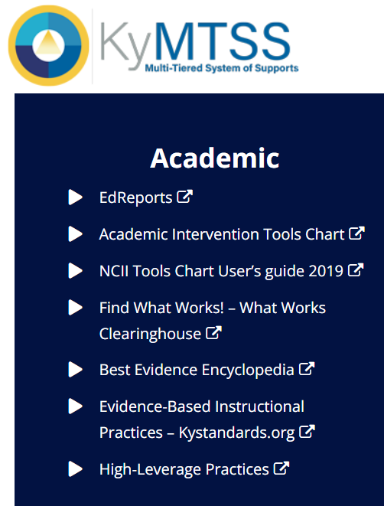
This slide details the topics from the IES Guide we will be using to study during this series.
Released March 2022
Build decoding skills so students can read complex multisyllabic words.
Provide purposeful fluency building activities.
Routinely use comprehension-building activities:
Build word and world knowledge (morphology & vocabulary);
Create opportunities to ask & answer questions about the text;
Teach a routine for summarizing;
Teach how to monitor comprehension as they read.
Practice with more challenging “stretch texts” to introduce more complex information.
Notes:
Guiding Notes:​
This slide outlines the recommendations provided in the IES Practice Guide. This series will address each of these recommendations.

Slide 12
Topics to Cover in This Session:
How is literacy instruction shifting in grades K-3 in Kentucky and what does that mean for grades 4-12?
Five Components of Early Literacy (2000) vs. Components of Adolescent Literacy (2007)
The Simple View of Reading (1986)
Scarborough’s Reading Rope (2001)
Next Steps for October session
Notes:
Guiding Notes:​
These are the topics that will be addressed in this session.

Slide 13
A note on language and acronyms:
This series uses the terms “striving or developing reader” to describe students who have gaps in their foundational reading skills.
HQIR: high-quality instructional resource
Notes:
Guiding Notes:​
This slide demonstrates the asset-based framing this series strives to uphold for middle and high school students who may not yet be proficient readers.
The acronym HQIR stands for high-quality instructional resources. To learn more about HQIRs and their importance for ensuring opportunity and access to grade-level learning for all students, see the HQIR Webpage on KyStandards.org:
https://kystandards.org/standards-resources/inst-mats-align-rubrics/

Slide 14
Intention Setting
What brings you to this series?
Think of a person you know whose challenges with reading or writing affected their ability to be successful in school or outside of school.
Share their initials (not their name) with a brief description of the challenges they faced.
Notes:
Guiding Notes:
If completing this series individually, spend some time reflecting on an individual who matches the description above.
If completing this series as a group, spend some time sharing the stories of the individuals who match the description above.
Possible Extension Questions:
How did these challenges impact their ability to be successful at school or in other settings?
What kinds of supports might they have needed that they didn’t have access to?

Slide 15
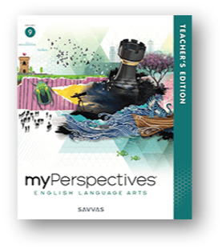
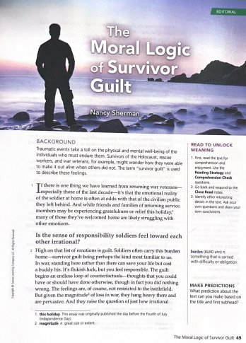
What does it feel like to read with 85% comprehension?
Notes:
Guiding Notes:
This portion of the session intends to simulate what striving readers experience when they only comprehend 85% of a text.
Note that this passage is adapted from myPerspectives Grade 9, Unit 1. myPerspectives is a green-rated high-quality instructional resource (HQIR).

Slide 16
This slide shows the text used to simulate what it is like to read with 85% comprehension.
[1] If there is one thing we have learned from _______ war _______ —especially those of the last decade—it's that the _______ reality of the soldier at home is often _______ with that of the _______ public they left behind. And while friends and families of _______ service members may be _______ _______ or _______ this summer, many of those they've _______ home are likely _______ with other _______ .
[2] High on that list of _______ is _______ . Soldiers often carry this _______ home—_______ guilt being perhaps the kind most familiar to us. In war, standing here rather than there can save your life but cost a buddy his. It's _______ luck, but you feel responsible. The guilt begins an _______ loop of _______ —thoughts that you could have or should have done otherwise, though, in fact, you did nothing wrong. The feelings are, of course, not _______ to the _______ . But given the _______ of loss in war, they hang heavy there and are _______ . And they raise the question of just how _______ those feelings are, and if they aren't, of what is the _______ of their _______ .
[3] Capt. _______ _______ , head of a unit in Afghanistan pondered those questions recently as he thought about _______ Jeremiah _______ , who was killed by police in the wake of a deadly bar fight shortly after he returned home. Back in _______ , _______ saved _______ life twice on one day, but when _______ needed help, _______ couldn't be there for him: "When he was in trouble, he was alone," Captain _______ said. "When we were in trouble, he was there for us. I know it's not _______ or _______ . There's nothing _______ about it. But I feel _______ ."
Notes:
Guiding Notes:
Take a few moments to make meaning of this text with only 85% of the language. Imagine what this experience is like for striving middle and high school readers expected to discuss, write or answer multiple choice questions about the passage.

Slide 17
[1] If there is one thing we have learned from returning war veterans—especially those of the last decade—it's that the emotional reality of the soldier at home is often at odds with that of the civilian public they left behind. And while friends and families of returning service members may be experiencing gratefulness or relief this summer, many of those they've welcomed home are likely struggling with other emotions.
[2] High on that list of emotions is guilt. Soldiers often carry this burden home—survivor guilt being perhaps the kind most familiar to us. In war, standing here rather than there can save your life but cost a buddy his. It's flukish luck, but you feel responsible. The guilt begins an endless loop of counterfactuals—thoughts that you could have or should have done otherwise, though, in fact, you did nothing wrong. The feelings are, of course, not restricted to the battlefield. But given the magnitude of loss in war, they hang heavy there and are pervasive. And they raise the question of just how irrational those feelings are, and if they aren't, of what is the basis of their reasonableness.
[3] Capt. Adrian Bonenberger, head of a unit in Afghanistan pondered those questions recently as he thought about Specialist Jeremiah Pulaski, who was killed by police in the wake of a deadly bar fight shortly after he returned home. Back in Afghanistan, Pulaski saved Bonenberger’s life twice on one day, but when Pulaski needed help, Bonenberger couldn't be there for him: "When he was in trouble, he was alone," Captain Bonenberger said. "When we were in trouble, he was there for us. I know it's not rational or reasonable. There's nothing logical about it. But I feel responsible."
Notes:
Guiding Notes:
Use this complete passage to see what you may have missed.

Slide 18
Describe your experience reading with only 85% comprehension.
On your Sticky Note:
Notes:
Guiding Notes:
Take a few moments to reflect on what school/learning experiences may be like for striving readers. If working with a group, spend a few moments discussing this experience and reflecting on how this may impact student attendance, behavior, socialization and postsecondary success.

Slide 19
Why focus on literacy?
“Virtually every teacher works with at least some, and sometimes many, students who struggle to read on grade level.
[This is] particularly troublesome when considering that so much of the curriculum in grades 4–9 (and beyond) requires the ability to read and understand increasingly complex texts. To understand the content taught in subject-area classes, students need to engage with and gain information from complex texts.”
IES Practice Guide: Providing Reading Interventions for Students in Grades 4-9
Notes:
Guiding Notes:
This slide contains a quote from the IES Practice Guide the series is based on. Take a few moments to read this quotation and reflect on the importance of supporting students towards grade-level reading.

Slide 20
How is literacy instruction shifting in KY?
Notes:
Guiding Notes:
This section highlights some of the ways literacy instruction is shifting in Kentucky with the Read to Succeed Act.

Slide 21
The Read to Succeed Act (SB 9, 2022):
Comprehensive actions to improve early literacy (K-3) outcomes:
Early Intervention, Screening, Diagnostics
Reading Improvement Plan​s
LETRS (Language Essentials for Teachers of Reading and Spelling)
Regional literacy coaches
Read-at-Home Family Guide​
Changes to teacher training based on these requirements
Notes:
Guiding Notes:
This slide outlines the major components of the Read to Succeed Act, which has been implemented in Kentucky since 2022. To learn more about the Read to Succeed Act, please visit the Early Literacy webpages: https://www.education.ky.gov/curriculum/EarlyLiteracy/Pages/default.aspx

Slide 22
As K-5 educators shift their practice, we as 6-12 educators can likewise be aware of structured literacy practices to support current and future students towards engaging deeply with grade-level, complex texts.
Notes:
Guiding Notes:
How can middle and high school teachers use what Kentucky elementary teachers are learning about reading and writing to support our students? This series is about making small and intentional shifts to support all students with access to grade-level, complex text.

Slide 23
Why Early Literacy?
KY Reading Proficiency Results
Year | Percent BELOW Proficient and Distinguished
2016 | 46.3%
2017 | 44.2%
2018 | 47.7%
2019 | 47.7%
2020 | NO TESTING due to Federal Waiver/ Covid-19 Emergency
2021 | 70.2%
2022 | 55%
2023 | 54%
Significance of Third-Grade Reading Proficiency
More likely to have continued academic success
Less likely to have problems with attendance, dropout rate and juvenile crime
More likely to feel higher self-esteem and feelings of adequacy
More likely to break the cycle of intergenerational poverty
Kentucky Department of Education. (2019). Kentucky School Report Card. Retrieved from: https://www.kyschoolreportcard.com/organization/20/academic_performance/assessment_performance/state_assessments_accountability?year=2019
Notes:
Guiding Notes:
This means that even prior to the pandemic, approximately 118,000 grade three students performed below proficiency between 2015-2019. No one would say they are happy with that number. ​
​
2021 marked the shift to the KY Summative Assessment vs. KPREP. ​

Slide 24
Current Data for
Reading in KY
Notes:
Guiding Notes:
This section gives participants an opportunity to see the current reality for eighth and tenth grade students in Kentucky.

Slide 25
What about Grade 8 reading in KY?
Grade 8 KSA Reading Scores by ​
Student Demographics for 2023
Subgroup​ | Total percentage reading BELOW proficiency (2022) | Total percentage reading BELOW proficiency (2023)
Black​/African- American | 78%​ | 77%
Economically Disadvantaged​ | 66%​ | 66%
English Learners​ | 93%​ | 94%
Hispanic​/Latinx | 65%​ | 66%
Students With Disabilities (IEP)​ | 85%​ | 86%
56%
of Kentucky eighth graders were reading below proficiency in 2023.
(55% were below proficient in 2022.)
Kentucky Department of Education. (2023). Kentucky School Report Card.
Retrieved from: https://www.kyschoolreportcard.com/organization/20/academic_performance/assessment_performance/state_assessments_accountability?year=2019
Notes:
Guiding Notes:
Take a moment to reflect on the eighth grade data for each of these groups of students and how this may impact their overall academic success and postsecondary success.

Slide 26
What about Grade 10 reading in KY?
Grade 10 KSA Reading Scores by ​
Student Demographics for 2023
Subgroup​ | Total percentage reading BELOW proficiency (2022) | Total percentage reading BELOW proficiency (2023)
Black​/African- American | 74%​ | 75%
Economically Disadvantaged​ | 65%​ | 64%
English Learners​ | 95%​ | 95%
Hispanic​/Latinx | 65%​ | 65%
Students With Disabilities (IEP)​ | 87%​ | 86%
54%
of Kentucky tenth graders were reading below proficiency in 2023.
(55% were below proficient in 2022.)
Kentucky Department of Education. (2023). Kentucky School Report Card.
Retrieved from: https://www.kyschoolreportcard.com/organization/20/academic_performance/assessment_performance/state_assessments_accountability?year=2019
Notes:
Guiding Notes:
Take a moment to reflect on the tenth grade data for each of these groups of students and how this may impact their overall academic success and postsecondary success.

Slide 27
DISCUSSION TIME:
So far we have reflected on a striving reader, experienced what it feels like to be a striving reader and learned about KY reading initiatives. What is resonating with you for your current students?
Notes:
Guiding Notes:
Spend a few moments reflecting on what we have discussed thus far.

Slide 28
How does the brain learn to read?
Notes:
Guiding Notes:
This section begins the discussion of the four theoretical models studied for this series.

Slide 29
Popular Misconception:
K-3 is for learning to read; 4-12 is for reading to learn.
In what ways are you still “learning” to read?
Notes:
Guiding Notes:
Consider how this misconception has been a part of our understanding of what we often believe intermediate, middle and high school grades students need to be successful readers. While foundational skills should be mastered in grade 3, we know that reading ability is not finite. Our fluency varies based on the complexity of the text read, the task performed with it and the reader themselves. Even proficient readers learn new morphological patterns, new uses for words, and new sentence structures and patterns. Additionally, as discussed in the Knowledge Matters Podcast, knowledge of a topic greatly impacts comprehension. Finally, students in K-3 likewise read to learn.

Slide 30
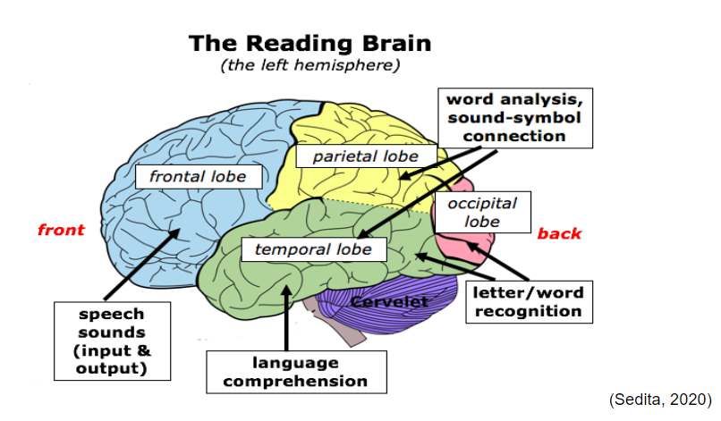
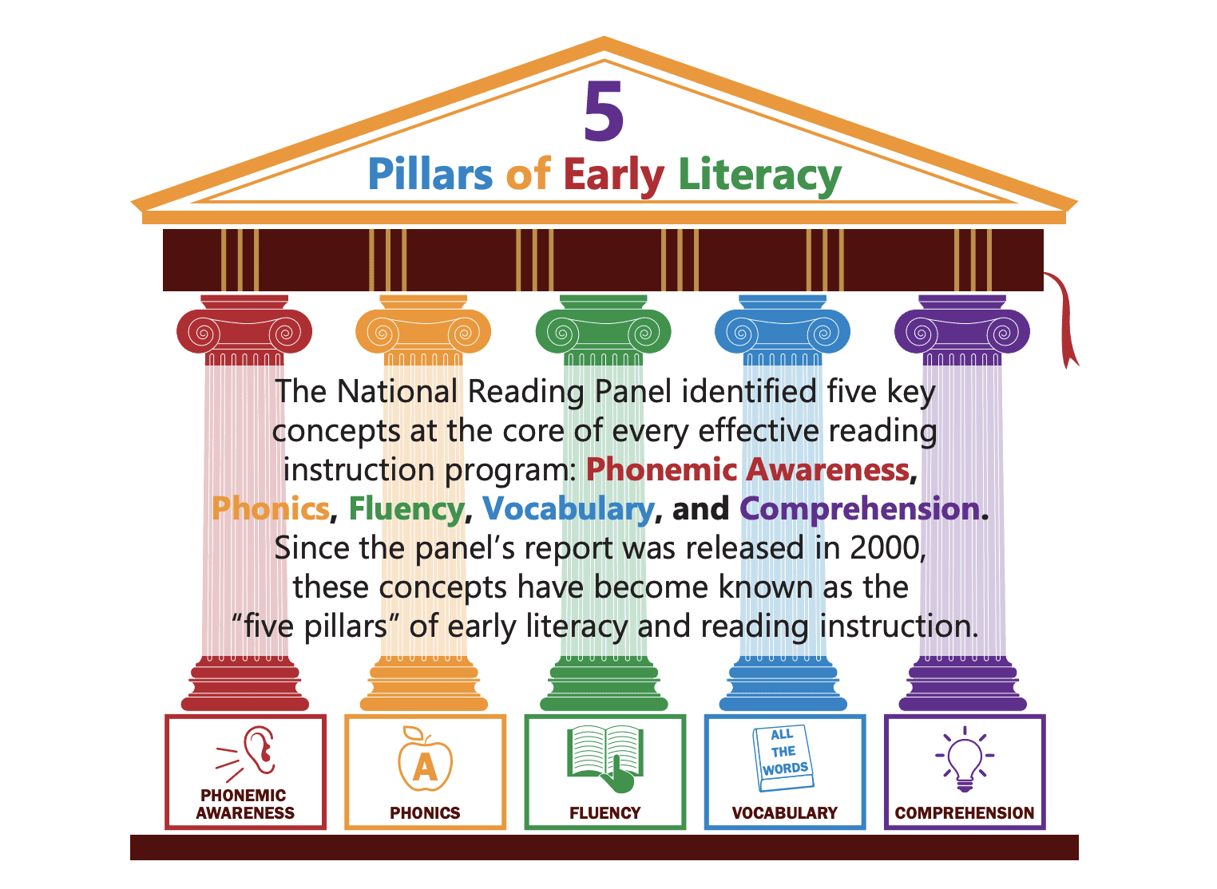
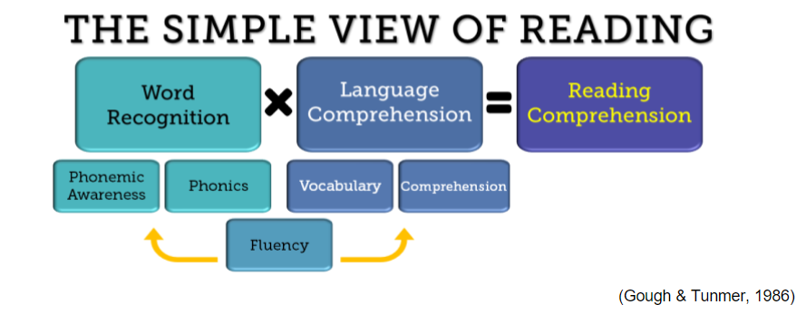
POLL: Have you seen these theoretical models online or in previous learning? Select
Notes:
Guiding Notes:
If working with a group, ask individuals to discuss or share which theoretical models are familiar to them.

Slide 31
The Reading Brain
Learning to read is a complex process.
Reading is not hard-wired in the brain.
The neural pathways must be developed through explicit, systematic instructional experiences.
(Sedita, 2020)
Find this and other resources at KDE’s Division of Early Literacy website.
Notes:
Guiding Notes:
While reading may seem innate to many individuals, reading is a complex process that must be taught. Humans are not born with the neural pathways connecting all of these parts of the brain, so these neural pathways must be created using explicit, systematic instructional experiences.

Slide 32
The Reading Brain, continued
People who become experienced readers use and integrate several regions of their brain, primarily in the left hemisphere including (Cunningham & Rose; Eden; Hudson et al., 2016).
(Sedita, 2020)
Notes:
Guiding Notes:
fMRI imaging has shown that proficient readers use several areas of the brain to read. See the next slide for an example of how these areas are integrated in skilled reading.

Slide 33
What happens in the brain?
/k/ /r/ /∧/ /ʃ/
“crush”
crush
crush
(Sedita, 2020)
Notes:
Guiding Notes:
Use the animations on this slide to see how the different areas of the brain are integrated in making meaning of one word:
Letter/Word Recognition: First, the eyes perceive a word and make sense of the letters and what the letters may represent.
Word Analysis/Sound-Symbol Connection: The brain processes what unique sounds those letters represent. Note this slide uses the phonetic alphabet to show the four phonemes in this word.
Speech Sounds (Input & Output): The brain blends those phonemes (individual sounds) together to say, “crush.”
Language Comprehension: The brain makes sense of the meaning of the word, often based on context.

Slide 34
National Reading Panel Report (2000)
Phonics is just one component of skilled reading.
Structured Literacy refers to all of the research and practice that supports, the ultimate goal of reading: COMPREHENSION.
Image courtesy of The Knowledge Matter Campaign.
Notes:
Guiding Notes:
Sometimes, some individuals believe that structured literacy emphasizes phonics alone for reading instruction. The goal of all reading instruction at all grade levels is comprehension. The National Reading Panel Report (2000) gathered the nation’s leading literacy experts with the goal of determining what students need in order to be able to comprehend texts. They determined that early readers need five concepts explicitly taught to them:
Phonemic awareness
Phonics
Fluency
Vocabulary
Comprehension

Slide 35
This slide demonstrates how the Five Pillars of Early Literacy translate to middle and high school instruction.
The National Reading Panel (2000) established five pillars of early reading instruction:
Phonemic Awareness
Phonics
Fluency
Vocabulary
Comprehension
The National Institute for Literacy (2006) amended those principles for adolescents:
Advanced Decoding
Morphology
Fluency
Vocabulary
Comprehension
6. Composition
7. Motivation
Notes:
Guiding Notes:
What Content-Area Teachers Should Know About Adolescent Literacy (NIL, 2006) was a follow-up report to the National Reading Panel Report (2000) that provides explicit guidance for how to support adolescents in reading. Instead of the five pillars of early reading instruction, the report established seven principles for adolescent instruction:
Advanced Decoding
Morphology
Fluency
Vocabulary
Comprehension
Composition
Motivation

Slide 36
POLL: Match these terms with their definitions.
1. the study of meaningful units within words, including roots, prefixes and suffixes
2. knowledge of, and memory for, word meanings
3. self-determination, self-regulation and engagement with text
4. the process of extracting or constructing meaning
5. written expression
6. translating a word from print to speech, usually by employing knowledge of sound-symbol correspondences
7. reading accurately and smoothly
Advanced Decoding
Morphology
Fluency
Vocabulary
Comprehension
Motivation
Composition
Notes:
Guiding Notes:
Use this opportunity to ensure you have a beginning understanding of these concepts we will discuss more in-depth throughout the series.
Answer Key:
Advanced decoding: translating a word from print to speech, usually by employing knowledge of sound-symbol correspondences
Morphology: the study of meaningful units within words, including roots, prefixes and suffixes
Fluency: reading accurately and smoothly
Vocabulary: knowledge of, and memory for, word meanings
Comprehension: the process of extracting or constructing meaning
Motivation: self-determination, self-regulation and engagement with text
Composition: written expression

Slide 37
The Simple View
of Reading
(Gough & Tunmer, 1986)
Notes:
Guiding Notes:
This section explains a theoretical model known as The Simple View of Reading (Gough & Tunmer, 1986).

Slide 38
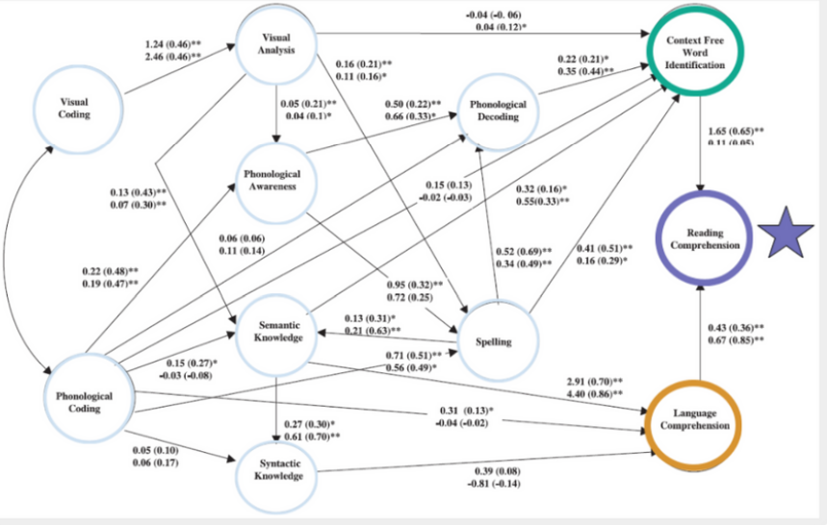
Reading is Far From Simple:
Convergent Skills Model (Vellutino et al., 2007)
However, the Simple View of Reading can help us understand how gaps in word recognition and/or language comprehension can affect older students accessing grade-level, complex texts.
Notes:
Guiding Notes:
While the Simple View of Reading contains the word “simple,” as we saw in the model of The Reading Brain, reading is far from simple. Note that the simple view of reading supports educators in using a simplified concept of reading to determine why students comprehension may be breaking down.

Slide 39
The Simple View of Reading
WORD RECOGNITION
LANGUAGE
COMPREHENSION
READING
COMPREHENSION
- Print Awareness
- Phonological and Phonemic Awareness
- Decoding (phonics, advanced phonics)
- Sight word recognition
x
- Vocabulary
- Background knowledge
- Language structures and conventions
- Verbal reasoning (e.g., making inferences)
- Literary knowledge
=
Ability to derive meaning from text
MAP, KSA, ACT, etc.
Notes:
Guiding Notes:
From Reading Rockets
The Simple View formula presented by Gough and Tunmer in 1986 is: Decoding (D) x Language Comprehension (LC) = Reading Comprehension (RC)
The Simple View formula and supporting studies show that a student’s reading comprehension (RC) score can be predicted if decoding (D) skills and language comprehension (LC) abilities are known. Notice that D and LC are not added together to predict RC. They are multiplied. In the Simple View formula, the values of D and LC must be between 0 and 1 (or 0% and 100%). A score of 0 means no skill or ability at all and 1 indicates perfection.
Gough and Tunmer (1986) proposed the Simple View of Reading to clarify the role of decoding in reading. Beginning and struggling readers are often taught to compensate for weak decoding by guessing an unfamiliar word based on the first letter or the picture, then asking themselves if the word makes sense after reading the sentence. In contrast, when decoding is the focus of instruction students are taught to sound out unfamiliar words using all the letters and to practice reading accurately until an adequate reading rate is achieved, along with accurate decoding.

Slide 40
Students with strong abilities in decoding and language comprehension:
WORD RECOGNITION
LANGUAGE
COMPREHENSION
READING
COMPREHENSION
- Print Awareness
- Phonological and Phonemic Awareness
- Decoding (phonics, advanced phonics)
- Sight word recognition
x
1
1
- Vocabulary
- Background knowledge
- Language structures and conventions
- Verbal reasoning (e.g., making inferences)
- Literary knowledge
Ability to derive meaning from text
=
1
Notes:
Guiding Notes:
From Reading Rockets
The Simple View formula presented by Gough and Tunmer in 1986 is: Decoding (D) x Language Comprehension (LC) = Reading Comprehension (RC)
The Simple View formula and supporting studies show that a student’s reading comprehension (RC) score can be predicted if decoding (D) skills and language comprehension (LC) abilities are known. Notice that D and LC are not added together to predict RC. They are multiplied. In the Simple View formula, the values of D and LC must be between 0 and 1 (or 0% and 100%). A score of 0 means no skill or ability at all and 1 indicates perfection.
Gough and Tunmer (1986) proposed the Simple View of Reading to clarify the role of decoding in reading. Beginning and struggling readers are often taught to compensate for weak decoding by guessing an unfamiliar word based on the first letter or the picture, then asking themselves if the word makes sense after reading the sentence. In contrast, when decoding is the focus of instruction students are taught to sound out unfamiliar words using all the letters and to practice reading accurately until an adequate reading rate is achieved, along with accurate decoding.

Slide 41
Student with strong decoding skills but gaps in language comprehension:
WORD RECOGNITION
LANGUAGE
COMPREHENSION
READING
COMPREHENSION
- Print Awareness
- Phonological and Phonemic Awareness
- Decoding (phonics, advanced phonics)
- Sight word recognition
x
- Vocabulary
- Background knowledge
- Language structures and conventions
- Verbal reasoning (e.g., making inferences)
- Literary knowledge
1
.5
Ability to derive meaning from text
=
.5
Notes:
Guiding Notes:
The Simple View formula presented by Gough and Tunmer in 1986 is: Decoding (D) x Language Comprehension (LC) = Reading Comprehension (RC)
The Simple View formula and supporting studies show that a student’s reading comprehension (RC) score can be predicted if decoding (D) skills and language comprehension (LC) abilities are known. Notice that D and LC are not added together to predict RC. They are multiplied. In the Simple View formula, the values of D and LC must be between 0 and 1 (or 0% and 100%). A score of 0 means no skill or ability at all and 1 indicates perfection.
Gough and Tunmer (1986) proposed the Simple View of Reading to clarify the role of decoding in reading. Beginning and struggling readers are often taught to compensate for weak decoding by guessing an unfamiliar word based on the first letter or the picture, then asking themselves if the word makes sense after reading the sentence. In contrast, when decoding is the focus of instruction students are taught to sound out unfamiliar words using all the letters and to practice reading accurately until an adequate reading rate is achieved, along with accurate decoding.

Slide 42
Student with needs in decoding AND language comprehension:
WORD RECOGNITION
LANGUAGE
COMPREHENSION
READING
COMPREHENSION
- Vocabulary
- Background knowledge
- Language structures and conventions
- Verbal reasoning (e.g., making inferences)
- Literary knowledge
.5
x
- Print Awareness
- Phonological and Phonemic Awareness
- Decoding (phonics, advanced phonics)
- Sight word recognition
.5
Ability to derive meaning from text
=
.25
Notes:
Guiding Notes:
The Simple View formula presented by Gough and Tunmer in 1986 is: Decoding (D) x Language Comprehension (LC) = Reading Comprehension (RC)
The Simple View formula and supporting studies show that a student’s reading comprehension (RC) score can be predicted if decoding (D) skills and language comprehension (LC) abilities are known. Notice that D and LC are not added together to predict RC. They are multiplied. In the Simple View formula, the values of D and LC must be between 0 and 1 (or 0% and 100%). A score of 0 means no skill or ability at all and 1 indicates perfection.
Gough and Tunmer (1986) proposed the Simple View of Reading to clarify the role of decoding in reading. Beginning and struggling readers are often taught to compensate for weak decoding by guessing an unfamiliar word based on the first letter or the picture, then asking themselves if the word makes sense after reading the sentence. In contrast, when decoding is the focus of instruction students are taught to sound out unfamiliar words using all the letters and to practice reading accurately until an adequate reading rate is achieved, along with accurate decoding.

Slide 43
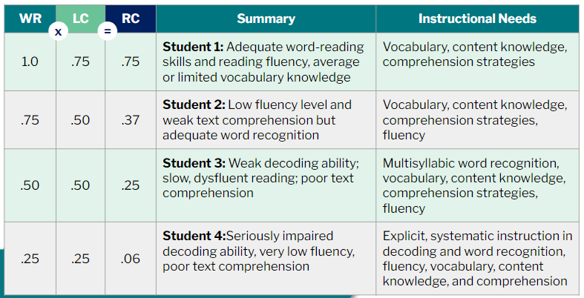
Adapted from Denton et al., 2011
These do not represent ALL possible student profiles.
Notes:
Guiding Notes:
This chart is adapted from Effective Instruction for Middle School Students with Reading Difficulties by Carolyn A. Denton, Ph.D., Sharon Vaughn, Ph.D., Jade Wexler, Ph.D., Deanna Bryan, Deborah S. Reed, Ed.D.
Note that this chart is not intended to diagnose reading difficulties or prescribe improvement measures for students. It also is not intended to represent all possible student needs or profiles. Use these sample profiles as a way to build understanding of what may be going on with some striving adolescent readers.

Slide 44
DISCUSSION TIME
These do not represent ALL possible student profiles.
1. Which of the profiles remind you of students from your classes this year?
2. How does your current curriculum address their needs?
3. What are some strengths of students in your classes?
4. What are some areas for growth?
Notes:
Guiding Notes:
This chart is adapted from Effective Instruction for Middle School Students with Reading Difficulties by Carolyn A. Denton, Ph.D., Sharon Vaughn, Ph.D., Jade Wexler, Ph.D., Deanna Bryan, Deborah S. Reed, Ed.D.
Spend a few moments reflecting on how these profiles are represented by current students using the questions on the screen.

Slide 45
Quote from the pre-reading podcast:
“The Reading Rope does a better job of conveying the complexity of comprehension.”
Notes:
Guiding Notes:
This quote comes from the Knowledge Matters Podcast, episode 2: “A Simple Way of Looking at a Complex Problem,” which discusses the reading models featured in this session.
While the podcast host Natalie Wexler and her featured guest, Hugh Catts, both believe the Simple View of Reading is helpful for educators, they conclude that the Reading Rope provides a more nuanced view of reading.

Slide 46
The Reading Rope
(Scarborough, 2001)
Notes:
Guiding Notes:
This section outlines the Reading Rope (Scarborough, 2001) model for understanding what is essential for skilled reading.

Slide 47
Recall the Simple View of Reading:
WORD RECOGNITION
LANGUAGE
COMPREHENSION
READING
COMPREHENSION
- Print Awareness
- Phonological and Phonemic Awareness
- Decoding (phonics, advanced phonics)
- Sight word recognition
- Vocabulary
- Background knowledge
- Language structures and conventions
- Verbal reasoning (e.g., making inferences)
- Literary knowledge
1
x
1
Ability to derive meaning from text
=
1
Notes:
Guiding Notes:
Remember the Simple View of Reading previously discussed. Scarborough’s Rope is a model that is very similar but expands on these concepts to demonstrate yet another visual.

Slide 48
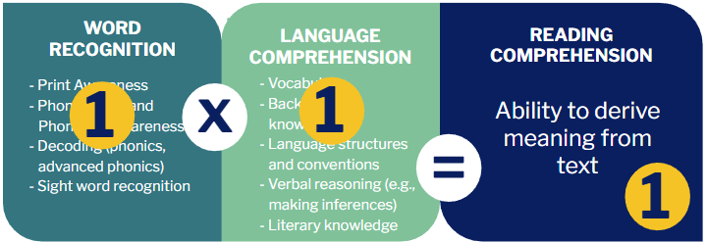
Scarborough’s Rope and the Simple View of Reading
Notes:
Guiding Notes:
Scarbourough’s Rope weaves together discrete skills needed for skilled reading.It not only describes what the students or grownup brain does or uses while reading, it also can help teachers narrow down what a student needs when they struggle.

Slide 49
Scarborough’s Rope and the Simple View of Reading, continued
facts, concepts, etc.
breadth, precision, links, etc.
syntax,
semantics, etc.
Inference, metaphor, etc.
print concepts, genres, etc.
syllables,
phonemes, etc.
letter-sound
correspondence
of familiar words
Notes:
Guiding Notes:
Use these definitions of the skills to support understanding of what students need in order to become more strategic and automatic readers.

Slide 50
Next Steps
Notes:
Guiding Notes:
This section provides an overview of next steps for Session 2.

Slide 51
To prepare for Session 2:
Read pp. 4-11 of the Practice Guide (Recommendation 1).
Access the Participant Guide on Adolescent Structured Literacy Landing Page.

Slide 52
Certificate of Completion
Developing Skilled Adolescent Readers and Writers
Session 1: How Does the Brain Learn to Read?
Depending on district policies and if approved at the local level, participants may receive professional development hours for their participation in the workshop. Participants who attend the live session also may receive an Effective Instructional Leadership Act (EILA) certificate to verify their attendance. Please work with your district or principal to determine if these hours are eligible.
Complete this survey to provide valuable feedback as well as receive a link to your certificate of completion which may be submitted to your district for PD or EILA credit.

