Slide 1
Developing Skilled Adolescent Readers & Writers
Session 2: Multisyllabic Words and Morphemic Analysis
Notes:
Guiding Notes:​
Welcome! Please see the Notes section of slides 2 and 3 for extensive planning and facilitation considerations:​
Slide 2: A Note to Facilitators Leading a Group​
Slide 3: A Note to Individuals Completing This Series​
Please contact ELATeam@education.ky.gov with any questions. ​

Slide 2
A Note to Facilitators Leading a Group:
For complete considerations for facilitators, see the Notes section of this slide.
These slides are part one of a six-part series.
See the Webinar Series Learning Plan on the Landing Page for a detailed view of session objectives and materials. You may wish to make this available to participants.
Print or make a digital copy of the Series Participant Guide for participants to complete the pre-work.
This series is built around the Institute for Education Science and What Works Clearinghouse 2022 Practice Guide, Providing Reading Interventions to Students in Grades 4-9, a free resource available for print. Consider making copies or providing digital access to participants to complete the pre-session readings.
Notes:
Series Overview:
This slide is purposefully hidden from participants.
The purpose of this series is to provide Kentucky 6-12 educators with declarative knowledge of how the brain learns to read, including ways to support all students in middle and high school access complex, grade-level text and skills through decoding multisyllabic words, fluency building, knowledge building, vocabulary building, comprehension and skilled writing.
The Developing Skilled Middle and High School Readers Webinar Series is intended to support classroom teachers across the state in engaging students in grade-level reading across subject areas; however, some content may be relevant for instructional leaders wishing to build their own knowledge of adolescent learners and their literacy needs. The sessions are designed to provide flexibility for districts and schools and, as such, can be viewed as stand-alone lessons or within the progression of the series as provided. You are supported in engaging with this series individually, if desired.
This entire series is six sessions and will take approximately 9 total hours to complete. We recommend accessing one session monthly; however, adaptations may be made to accommodate for more or less time. Each individual session is 1.5 hours.
Materials Needed:
The session slides with Guiding Notes
The Series Participant Guide
Access to the participants’ high-quality instructional resource (HQIR)
A Note about HQIRs:
The Reading and Writing HQIR Consumer Guide points districts to the markers of high-quality literacy instruction for Kentucky. Note that HQIRs are grounded in research and written by experts. While these resources do engage students in strategies that support reading, many students may need more targeted supports in Tier 1 instruction. As such, it is recommended that facilitators continually ground discussions in the texts, tasks and protocols provided in the district-adopted HQIR and prompt participants to make connections between this learning and their upcoming lessons or units.
Guiding Notes:
Guiding notes are provided in the Notes section of the PowerPoint to support your learning. The Notes section includes additional information and directions for the activities on the slide. It is critical that you read the material presented in the Notes section to ensure that you are acquiring the important knowledge, skills and understanding required when engaging with this series.
Virtual Training Note:
If you plan to engage with this series virtually as a group, consider directing participants to the Developing Skilled Middle and High School Readers landing page:
Intended Audiences:
Participants
Series participants may include, but are not limited to, district leadership, school administrators, instructional specialists/coaches, intervention specialists, department chairs, special educators and classroom teachers.
Facilitators
While this series is designed for a teacher to engage with it individually, it may be implemented with a group of educators led by a facilitator. If this series is being completed as a group, facilitators may include, but are not limited to, cooperative staff, district leaders, school administrators, instructional specialists/coaches, intervention specialists, department chairs, special educators, and classroom teachers. Facilitators may need to revise specific tasks in order to meet the needs of the participants or to be respectful of the time planned within the work session.
Helpful Hint for Facilitators:
The learning that will take place in this series may cause Kentucky educators to face changes in instructional practices amidst this transition. It is important to realize that while you are the facilitator of these work sessions, you may not have all the answers to the questions asked by participants, which is part of the learning process for all educators at all levels. Throughout the series, participants may have questions that will be addressed in future work sessions. When that happens, reflect on this quote from Graham Fletcher, “Every teachable moment doesn’t need to be a teachable moment in that moment.” Use these moments to encourage participants to attend future work sessions where those questions will be addressed. If participants ask questions you are not prepared to answer, offer to follow up on that during the next work session. Please contact ELATeam@education.ky.gov if you have questions or comments.
Planning Ahead for Facilitators:
Determine which stakeholders to invite as participants. In the invitation, describe how the work sessions will benefit them.
A few days before the meeting, you may want to remind participants to be prepared to have their Participant Guide available during the meeting. You may also choose to print these for participants.
Reserve adequate space and equipment. Tables or desks should be set up to support small-group discussion. If conducting this series virtually, ensure that your technology platform can support break out rooms to support small group collaboration.
Ensure that participants have access to the Internet.
Preparation
Participant Documents Needed:
Participant Guide
Access to upcoming lessons or units within their district-adopted curriculum supported by an HQIR
Supplies Needed:
These slides
Technology with projection and sound capability if in person. Technology platform where presenters have sharing ability and breakout room options if virtual.
Participant Guides printed or available virtually
Parking Lot for questions - If completing as a group, you may consider providing a poster on which participants can write or post questions, or you may prefer to have a digital parking lot where participants can access a Google document, for example, to post questions and that you can modify as the participants work through the sections of the series
Self-Sticking Notes (optional)
Poster paper (optional)
Highlighters and/or colored pens/markers (optional)
Building a Community:
Building a community is important for any group that will work together, especially if participants have not worked together before. The concept is the same as building a safe, respectful, productive classroom climate. Incorporating community-building into each session builds trust, shows participants that they are valuable as individuals and engages them in the learning process. It is also useful for creating a professional learning network where participants can be supported in their work. Community-building can be as simple as allowing participants to introduce themselves and their role in the school/district, developing or refining group norms, allowing for questions, and/or the sharing of answers to reflection questions or individual discovery task items that are included in this series. Again, time allotted for community-building will allow participants to have a voice and be engaged as active contributors and learners in the sessions.
Virtual Training Options: Be sure to conduct continual check-ins throughout the presentation. Build Google documents to continue to collect feedback, such as questions, hopes, and/or concerns to which participants may continually add.

Slide 3
A Note to Individuals Completing this Series:
For complete considerations for complete this series individually, see the Notes section of this slide.
Print or make a digital copy of the Participant Guide to capture your thinking.
These slides are part one of a six-part series.
See the Webinar Series Learning Plan on the Landing Page for a detailed view of session objectives and materials. You may wish to make this available to participants.
This series is built around the Institute for Education Science and What Works Clearinghouse 2022 Practice Guide, Providing Reading Interventions to Students in Grades 4-9, a free resource available for print. Consider making copies or providing digital access to participants to complete the pre-session readings.
Notes:
Series Overview:
This slide is purposefully hidden from participants.
The purpose of this series is to provide Kentucky 6-12 educators with declarative knowledge of how the brain learns to read, including ways to support all students in middle and high school access complex, grade-level text and skills through decoding multisyllabic words, fluency building, knowledge building, vocabulary building, comprehension and skilled writing.
The Developing Skilled Middle and High School Readers Webinar Series is intended to support classroom teachers across the state in engaging students in grade-level reading across subject areas; however, some content may be relevant for instructional leaders wishing to build their own knowledge of adolescent learners and their literacy needs. The sessions are designed to provide flexibility for districts and schools and, as such, can be viewed as stand-alone lessons or within the progression of the series as provided. You are supported in engaging with this series individually, if desired.
This entire series is six sessions and will take approximately 9 total hours to complete. We recommend accessing one session monthly; however, adaptations may be made to accommodate for more or less time. Each individual session is 1.5 hours.
Materials Needed:
The session slides with Guiding Notes
The Series Participant Guide
Access to the participants’ high-quality instructional resource (HQIR)
A Note about HQIRs:
The Reading and Writing HQIR Consumer Guide points districts to the markers of high-quality literacy instruction for Kentucky. Note that HQIRs are grounded in research and written by experts. While these resources do engage students in strategies that support reading, many students may need more targeted supports in Tier 1 instruction. As such, it is recommended that facilitators continually ground discussions in the texts, tasks and protocols provided in the district-adopted HQIR and prompt participants to make connections between this learning and their upcoming lessons or units.
Guiding Notes:
Guiding notes are provided in the Notes section of the PowerPoint to support your learning. The Notes section includes additional information and directions for the activities on the slide. It is critical that you read the material presented in the Notes section to ensure that you are acquiring the important knowledge, skills and understanding required when engaging with this series.
Intended Audiences:
Participants
Series participants may include, but are not limited to, district leadership, school administrators, instructional specialists/coaches, intervention specialists, department chairs, special educators and classroom teachers.
Facilitators
While this series is designed for a teacher to engage with it individually, it may be implemented with a group of educators led by a facilitator. If this series is being completed as a group, facilitators may include, but are not limited to, cooperative staff, district leaders, school administrators, instructional specialists/coaches, intervention specialists, department chairs, special educators, and classroom teachers. Facilitators may need to revise specific tasks in order to meet the needs of the participants or to be respectful of the time planned within the work session.
Helpful Hint for Completing this Series Individually:
Throughout the series, you may have questions that you would like to discuss with colleagues or leadership at your school. When that happens, make a note to share or discuss this resource with others. The creators of this series are also available should you have questions or want to discuss the content of the videos. Please contact ELATeam@education.ky.gov if you have questions or comments.
Preparation
Participant Documents Needed:
Participant Guide
Access to upcoming lessons or units within your district-adopted curriculum supported by an HQIR

Slide 4
Series Overview
Session 1 | Session 2 | Session 3 | Session 4 | Session 5 | Session 6
How Do We Learn to Read? Exploring Theoretical Frameworks for Reading Development | Decoding Multisyllabic Words within Complex, Grade-Level Texts | Fluency Building within Complex, Grade-Level Texts | Vocabulary and Knowledge Building Essentials | Comprehension as Both Process and Product | Connecting Skilled Reading to Skilled Writing
Notes:
Guiding Notes:
This slide provides an overview of this series. It is recommended to complete one session per month to allow time for implementation of practices between sessions.

Slide 5
Series Goals:
Learn what research says about supporting skilled adolescent reading of complex, grade-level texts.
2. Improve Tier 1, universal reading and writing instruction with strategies that support skilled reading for all students.
Notes:
Guiding Notes:​
This series may address the needs of educators in a variety of roles in districts. The primary goal is to support middle and high school readers with complex, grade-level texts in tier 1, universal instruction. While some secondary students may need intervention to build foundational skills, this series intends to strengthen Tier 1 instruction using evidence-based practices.

Slide 6
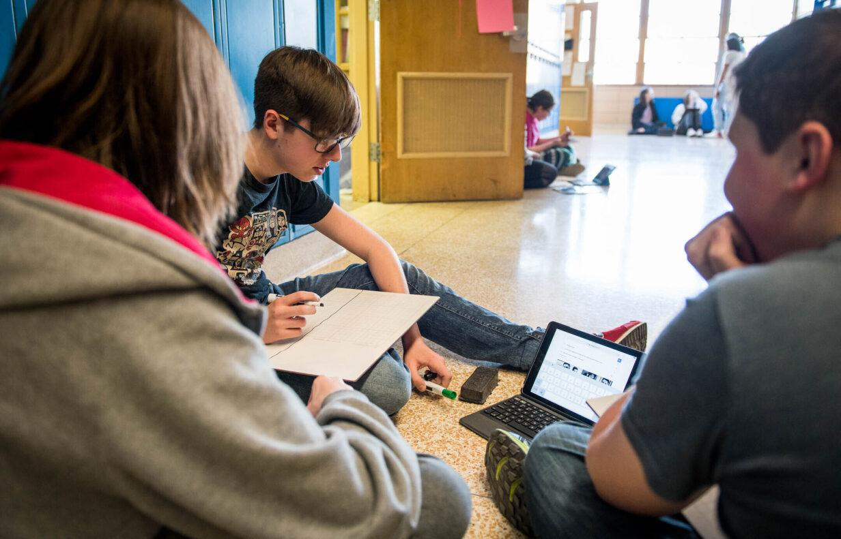
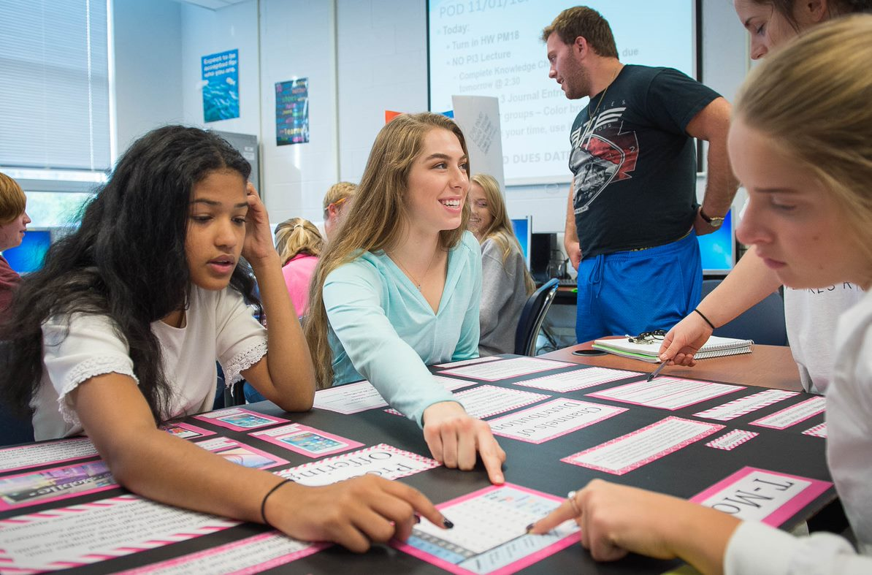
With small and intentional shifts, we can make a real difference for the students in our classes right now who need supports as readers.
Notes:
Guiding Notes:​

Slide 7
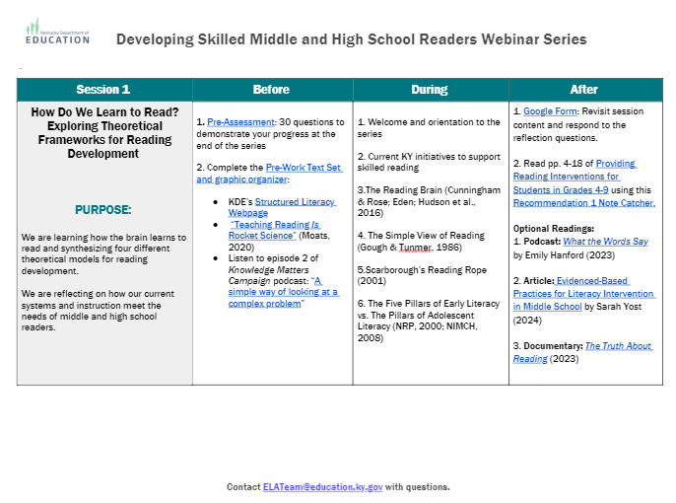
Sessions at a Glance
This document is a tool to know what to do before, during and after a learning session and is available on the Landing Page.
Notes:
Guiding Notes:​
Use this Learning Plan to monitor learning throughout the series.

Slide 8
Session 2: Decoding Multisyllabic Words

Slide 9
Session Learning Objectives:
Participants will see examples of phonological awareness and phonics lessons for younger grades.
Participants will learn a variety of routines for teaching middle and high school students to decode multisyllabic words and engage in morphemic analysis for meaning making.
Notes:
Guiding Notes:
This session provides participants with an understanding of how students learn to read in early grades as well as applications for teaching multisyllabic word decoding and morphemic analysis in middle and high school.

Slide 10
Learning Agreements
Assume best intentions of facilitators and participants.
Look for opportunities to learn and grow.
Ask questions on the sign out form. We will respond.
When in breakout rooms, allow a chance for everyone to participate.
Center students in the conversation.
Preference learning over performing.
Feel free to attend even if you haven’t completed the pre-work.
Process your learning with colleagues.
Notes:
Guiding Notes:
For groups working through this series together, these are recommended learning agreements for collaboration. These may be modified to suit local needs and expectations.

Slide 11
Materials Needed for This Learning:
Access to materials (on Google Classroom or Learning Plan)
Scrap paper or sticky notes
Print or ensure digital access to our text, Providing Reading Interventions for Students in Grades 4-9
Sample text ("Benjamin O. Davis")
Morphemic Analysis Strategy Sheet
Notes:
Guiding Notes:
The text for this series is available free online and can be printed for individuals to access and study for each session.

Slide 12
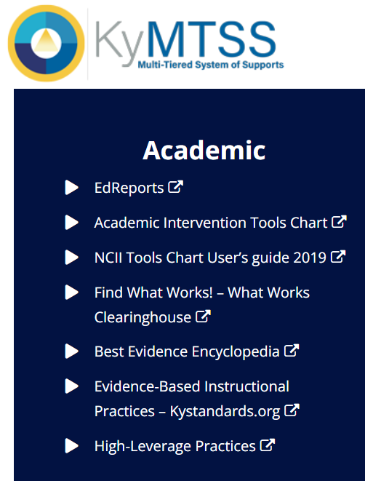
This slide details the topics from the IES Guide we will be using to study during this series.
Released March 2022
Build decoding skills so students can read complex multisyllabic words.
Provide purposeful fluency building activities.
Routinely use comprehension-building activities:
Build word and world knowledge (morphology & vocabulary);
Create opportunities to ask & answer questions about the text;
Teach a routine for summarizing;
Teach how to monitor comprehension as they read.
Practice with more challenging “stretch texts” to introduce more complex information.
Notes:
Guiding Notes:​
This slide outlines the recommendations provided in the IES Practice Guide. This series will address each of these recommendations.

Slide 13
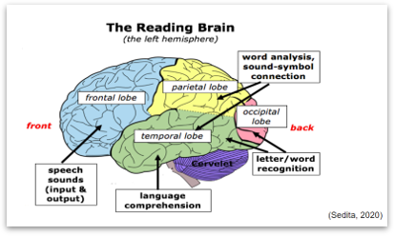
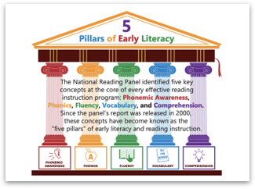
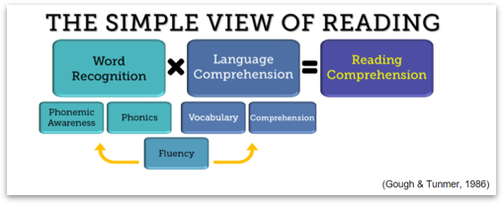
Warm-Up Exercise:
Share your thinking with a partner to prepare for a large group discussion.
Reflection:
Which theoretical model from Session 1 is most impactful for you in your role?
2. Which multisyllabic words might you identify from the “Benjamin O. Davis, Jr.”passage that striving adolescent readers might need support with?
Notes:
Guiding Notes:
These warm-up questions give participants an opportunity to reconnect with each other and with content from the previous session.

Slide 14
Multisyllabic Words Identified from the “Benjamin O. Davis” Passage:
List 5-6 words you identified as a group:
1.
2.
3.
4.
5.
6.
Notes:
Guiding Notes:
Use this slide to document the multisyllabic words participants identify as words students might need support with decoding. These will be a part of the application portion of the session.

Slide 15
Why are phonological awareness and phonics skills essential for developing readers?
Notes:
Guiding Notes:
The purpose of this section is to support participants to understand how morphemic analysis and multisyllabic word decoding builds on foundational skills typically mastered in grades K-5.

Slide 16
Phonemic
Awareness
Phonics
Notes:
Guiding Notes:
This graphic helps explain to participants that phonemic awareness supports students in distinguishing individual sounds within oral language. Phonics speaks to engage students in understanding which letters represent those sounds in speech.

Slide 17
Phonological awareness: The conscious awareness of all levels of the speech sound system, including word boundaries, stress patterns, syllables, onset-rime units and phonemes.
Rhyming
Counting syllables
Phonemic Awareness
Phonemic awareness: The ability to distinguish, produce, remember and manipulate spoken words' individual sounds (phonemes).
Isolating phonemes, or sounds, in words
Phonemic segmentation and blending
(breaking words into sounds and putting them back together)
Deletion, addition, and substitution of phonemes in words
Notes:
Guiding Notes:
Note that some (if not many) middle and high school teachers may not be familiar with these terms. The exercises below provide examples from the Phonological Awareness Screening Test (PAST) as examples to show what kinds of exercises may determine a student's skill level with phonological and phonemic awareness. Please note that it is not recommended to use an assessment like the PAST with middle and high school students without consultation from district-level literacy or MTSS staff.
Rhyme Recognition: top-hop, bed-said, run-soap, funny-bunny
Counting Syllables: basket (2), fantastic (3), maybe (2), helicopter (4)
Phoneme Isolation of Initial Sound: land /l/, farm /f/, apple /a/
Phoneme Isolation of Final Sound: pick /k/, tooth /th/
Phoneme Blending: /h/ /a/ /t/ hat, /m/ /u/ /s/ /t/ must, /sh/ /o/ /p/ shop
Phoneme Segmentation: in (2) /i/ /n/, name (3) /n/ /a/ /m/, ship (3) /sh/ /i/ /p/, sock (3) /s/ /o/ /k/
Phoneme Deletion: /s/un un, /t/ape ape, trai/n/ tray, sea/t/ sea, in/ch/ in
Phoneme Addition: Say ice. Now add /n/. Nice, Say top. Now add /s/. Stop
Phoneme Substitution: Replace the first sound in man with /k/ can, pig with /d/ dig, sack with /t/ tack

Slide 18
Phonics: Knowledge of the predictable correspondences between phonemes and graphemes (the letters or letter combinations representing phonemes) and correspondences between larger blocks of letters and syllables or meaningful word parts (morphemes).
Language Component | Analysis | Component Definition
Letters (11) | u-n-r-e-a-c-h-a-b-l-e | Single graphemes (a-z)
Graphemes/Phonemes (8) | u-n-r-ea-ch-a-b-le | A letter or letter combination that spells a sound (letter/sound correspondence)
Syllables (4) | un-reach-a-ble | A unit of pronunciation that is organized around a vowel
Morphemes (3) | un-reach-able | The smallest meaningful unit of language (prefix-base-suffix)
Notes:
Guiding Notes:
This chart demonstrates the ways words can be broken down into letters, graphemes/phonemes, syllables, and morphemes. Typically, students in middle and high school are still developing knowledge of morphemes (i.e., meaningful word parts such as affixes and roots from Greek or Latin that make up the English language).

Slide 19
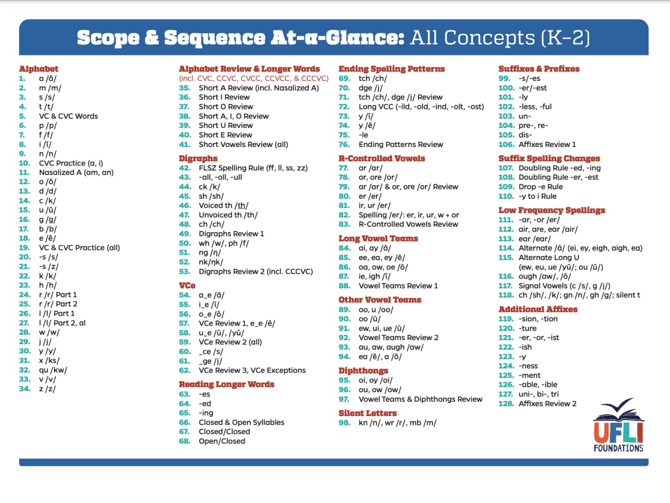
How might phonics lessons be systematic in early grades?
As we learned in session 1, structured literacy offers systematic and explicit instruction in the speech sounds and word parts of the English language so that students can become rapid, automatic readers.
Automaticity frees up brain space for deep comprehension and critical thinking!
Notes:
Guiding Notes:
Just as we were not able to read the first scientific, technical passage because of the decoding load in the warm-up exercises, students who need support decoding benefit from systematic and explicit instruction as they become more automatic readers.
This sample Scope & Sequence comes from the University of Florida Literacy Institute: https://ufli.education.ufl.edu/wp-content/uploads/2022/06/UFLI-Scope2.pdf

Slide 20
The Why
Underdeveloped phonemic awareness reflects phonological processing problems that can hinder reading development by making it difficult to learn phonics, sound out words, remember written words, and spell words phonetically. For example, a second grader who writes fog for “frog” or jup for “jump” is not perceiving the second sound in the beginning consonant blend /fr/ or the second to last sound in the final consonant blend /mp/. These sound combinations can be difficult for some students to notice until phonemic awareness instruction explicitly focuses their attention on the interior sound in spoken consonant blends.
Teaching Phoneme Awareness in 2023: A Guide for Educators
For more specific information about the importance of Phonemic Awareness with Multilingual Learners, see section 2.2 of Teaching Phoneme Awareness in 2023: A Guide for Educators
Notes:
Guiding Notes:
This link explains the difference in phonological and phonemic awareness. Additionally, it gives examples of when a student might have a phonological awareness deficit versus a phonics deficit. Save this link to use blurbs from it in the chat if the question arises.https://www.readingrockets.org/reading-101/reading-101-learning-modules/course-modules/phonological-and-phonemic-awareness

Slide 21
How do I know if a middle or high school student has gaps in foundational literacy skills (phonological awareness and/or phonics)?
What do I do?
Many middle and high school students need support in the word recognition strand of the reading rope.
Consult with your local leadership (i.e. reading specialist/interventionist, instructional coach, MTSS and/or special education coordinator) for assessments and instructional supports.
Notes:
Guiding Notes:
The purpose of this series is to find ways to strengthen Tier 1 instruction for all students; individual classroom teachers should not bear the burden of building literacy interventions without district- or building-level leadership support.

Slide 22
Routines for Decoding Multisyllabic Words & Morphemic Analysis
Notes:
Guiding Notes:
The purpose of this section is to re-visit recommended, evidence-based practices for decoding multisyllabic words and teaching morphemic analysis.

Slide 23
Where do I start?
Start with the texts you are teaching in Tier 1 instruction.
Use these texts to ground any work you do with multisyllabic words or morphemic analysis.
Notes:
Guiding Notes:
Many teachers report not having access to a resource to resources to support striving readers. Texts are at the center of reading and writing instruction; therefore, texts should be at the center of teaching multisyllabic word decoding and morphemic analysis.

Slide 24
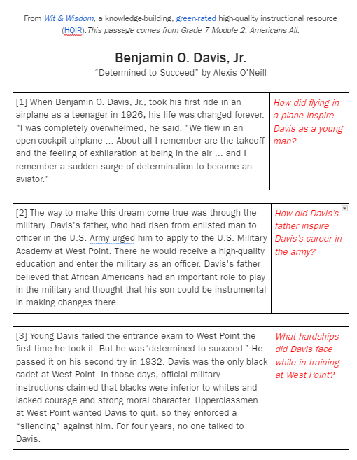
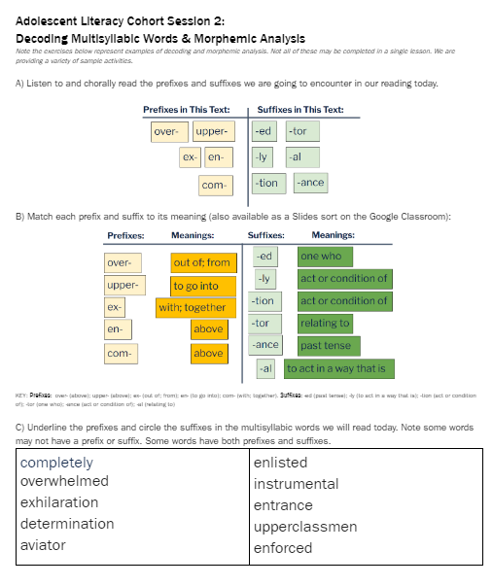
Access our resources for this session:
“Benjamin O. Davis, Jr.”
From Wit & Wisdom, a knowledge-building HQIR
Strategy Sheet: Decoding Multisyllabic Words & Morphemic Analysis Strategies
Notes:
Guiding Notes:
Ensure all participants have access to these materials.

Slide 25
Where do we see advanced decoding and morphology in the KAS for Reading and Writing?
Students begin decoding multisyllabic words in grade 3 and continue refining skills in determining meanings of words and phrases throughout high school.
Grades 4-5 Reading Foundational Skills (RF)
Notes:
Guiding Notes:
Many teachers and leaders wonder if the Kentucky Academic Standards (KAS) for Reading and Writing require students to engage in morphemic analysis. Emphasize that grades 4 and 5 are learning RF (Reading Foundational Skills), which includes the skills for decoding words using letter-sound relationships, syllabication, and morphology. In the middle grades, students build on this morphology

Slide 26
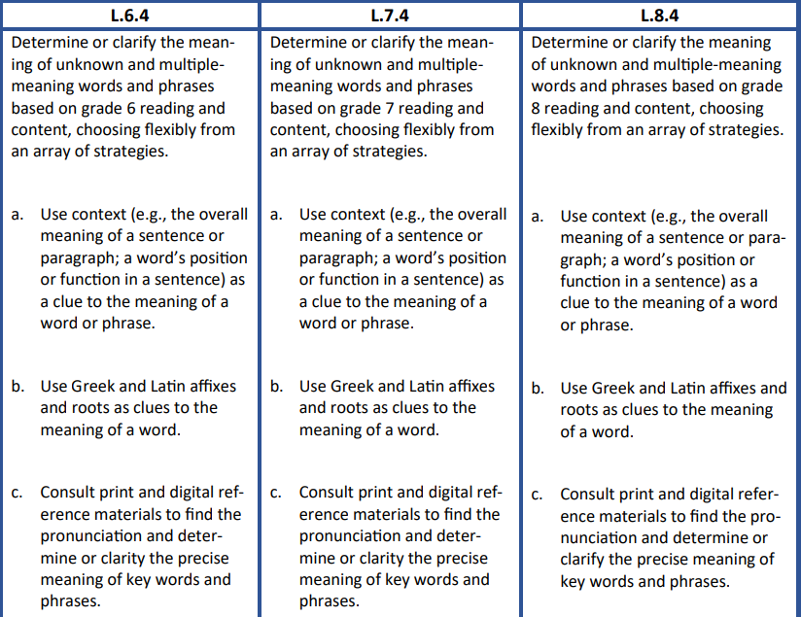
Decoding and Morphology in the Standards for Grades 6-8
Middle school students should determine or clarify unknown and multiple-meaning words using:
context clues
Greek and Latin affixes and roots
reference materials
Language (L) Standard 4
Notes:
Guiding Notes:
In middle school, students build on their intermediate knowledge of decoding and morphology with the addition of Greek and Latin affixes.

Slide 27
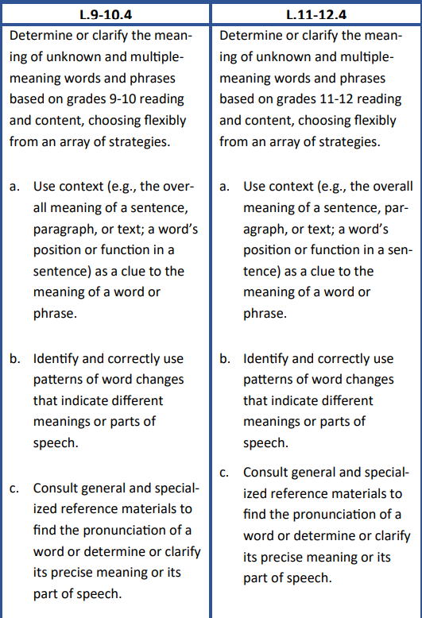
High school students should determine or clarify unknown and multiple-meaning words using:
context clues
Greek and Latin affixes and roots AND patterns of word changes
reference materialsf
Language (L) Standard 4
Notes:
Guiding Notes:
In high school, students build on their middle school knowledge of decoding and morphology with the addition of patterns of word changes.

Slide 28
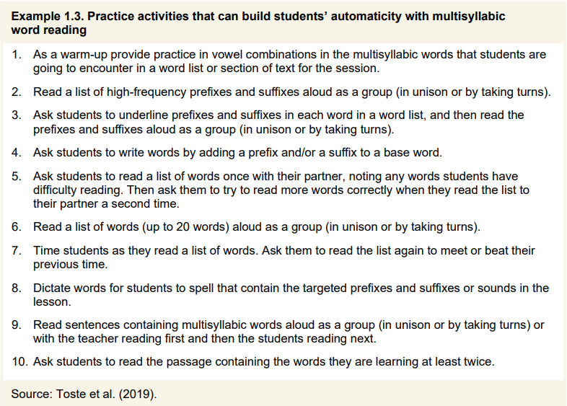
Activities to Support Automaticity
Our text provides this list of activities for building automaticity in multisyllabic word reading.
How can we use these activities to support comprehension?
p. 11
Notes:
Guiding Notes:
Page 11 of the IES Practice Guide used in this series provides this list of 10 potential excercises to support students with automatic word reading. This are evidence-based practices to support students, and we want to ensure all of these are grounded in complex, grade-level texts.

Slide 29
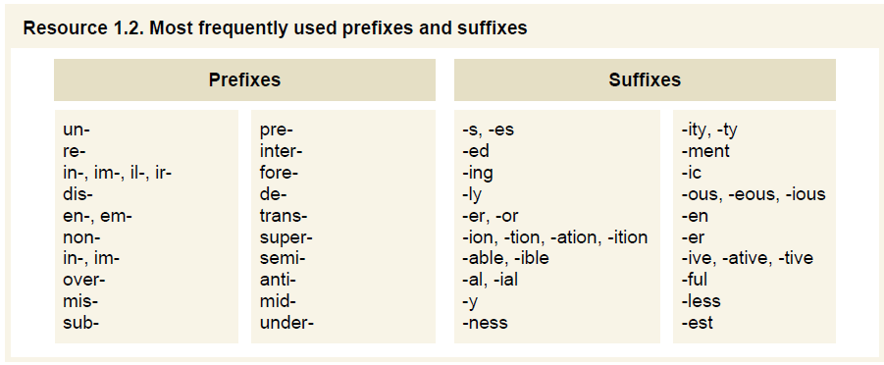
High-Frequency Affixes
Recommended Activity 2: Read a list of high-frequency prefixes and suffixes in words from the texts studied.
morphemes: meaningful units of language (word parts that carry meaning)
Vocabulary Through Morphemes: Suffixes, Prefixes, and Roots for Grades 4-12 (Ebbers, 2010)
Notes:
Guiding Notes:
Ocassionally, participants request a list of the most frequently used prefixes and suffixes for middle and high school students. If your district has an HQIR to support decoding and morphology, please use the scope and sequence provided OR the resources within each text.
While this list provides some guidance, we always want to ground any kind of word work in the grade-level complex texts we’re reading. In other words, students need to see the words in context multiple times and have opportunities to write the words in context rather than just read them in isolation.

Slide 30
Engaging with Affixes
Recommended Activity 2: Read a list of high-frequency prefixes and suffixes from the texts studied.
Prefixes in This Text:
Suffixes in This Text:
over-
upper-
-ed
-tor
ex-
en-
-ly
-al
com-
-tion
-ance
Notes:
Guiding Notes:
This recommendation emphasizes that students need opportunities to see high-frequency prefixes and suffixes in context. Teachers can preview a text studied in class to show students which prefixes and suffixes will be used in context.

Slide 31
Sorts engage students in multisensory and/or collaborative learning.
Sorts engage students in multisensory and/or collaborative learning.
Prefixes:
Suffixes:
over-
-ed
-al
-ly
upper-
-tion
ex-
-tor
en-
-ance
com-
Notes:
Guiding Notes:
One instructional option for supporting students with reading high-frequency morphemes is to have students sort the words (on cards or on a digital board) as you read the prefixes and suffixes.

Slide 32
Sorting Affixes
Meanings:
Meanings:
Suffixes:
Prefixes:
with; together
-ed
one who
over-
above
-ly
act or condition of
upper-
-tion
act or condition of
ex-
out of; from
-tor
relating to
en-
to go into
-ance
past tense
com-
above
-al
to act in a way that is
Notes:
Guiding Notes:
Another instructional option: Add in meanings of the prefixes and suffixes to the sort for students to match the meanings. These are currently unsorted.

Slide 33
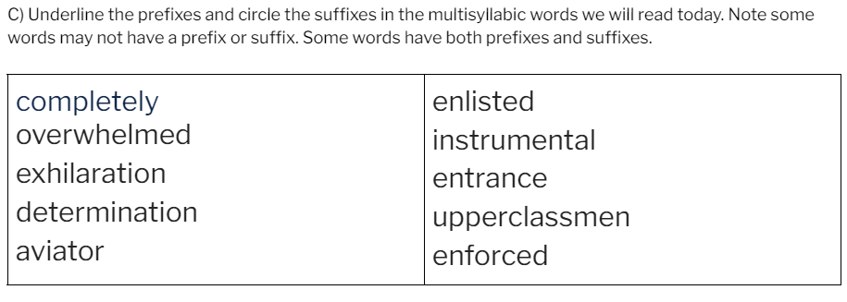
Recommended Activity 3: Ask students to underline prefixes and suffixes and read the words in unison or in a group.
Notes:
Guiding Notes:
Again, based on student population, this may not be appropriate. This exercise may serve as a warm-up for students encountering these words in a text.

Slide 34
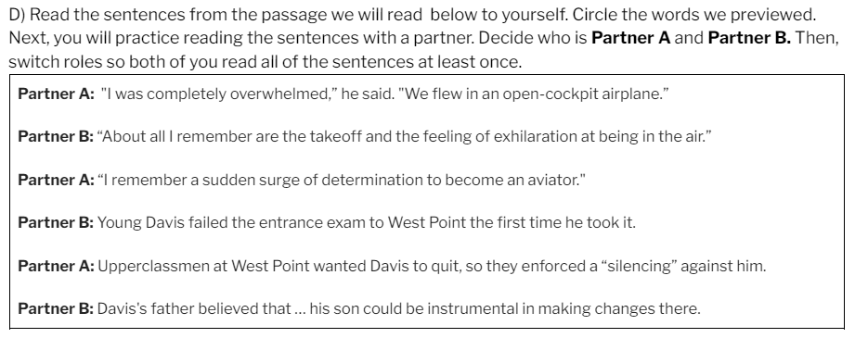
Recommended Activity 9: Read sentences containing multisyllabic words as a group or in response to a teacher model.
Notes:
Guiding Notes:
This exercise provides support for decoding in context as well as fluency, which is the bridge from decoding to comprehension. This type of activity can be scaled up with paragraphs for more advanced students.

Slide 35
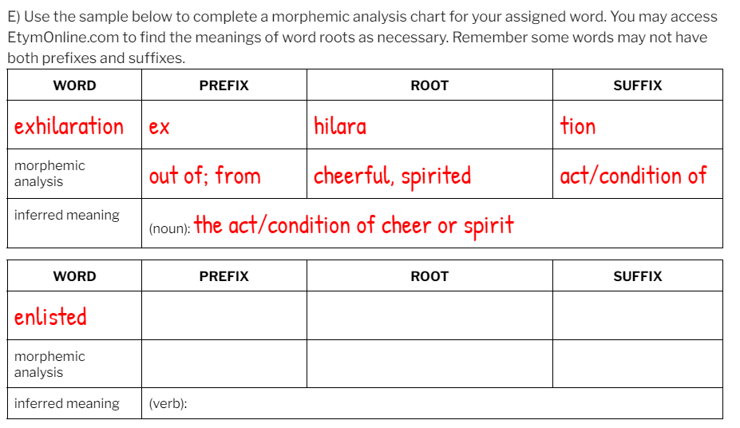
Recommended Activity 4: Write new words by adding prefixes and suffixes to base words.
Notes:
Guiding Notes:
This type of morphemic analysis takes practice and routine development. The more you practice this with students, the more accustomed they become to engaging in this type of word-level analysis.
Some teachers may find a website like EtymOnline.com helpful for Greek and Latin affixes.

Slide 36
Recommended Activity 4: Add prefixes and suffixes to base words.
to complete
completion
complete(d)
combination, friendly
to aviate
aviation
avian, director
Notes:
Guiding Notes:
The purpose of this exercise is to give students an opportunity to see how different morphemes (word parts) can be manipulated to form and understand new words. Participants may choose to practice this on their own to experience the engagement level students may have with this exercise.

Slide 37
Recommended Activity 10: Ask students to read a passage with the words they are learning at least twice with two different purposes.
Use text-dependent questions that give students opportunities to say and write the words in context.
Notes:
Guiding Notes:
The final recommendation from the IES Practice Guide states that students should read passages multiple times for different purposes. Students may read a passage first to decode or analyze morphemes and then read a second time to answer text-dependent questions. Text-dependent questions are those that require students to substantiate claims using textual evidence.

Slide 38
Final Discussion
Considering the students and texts you work with, which of the multisyllabic decoding strategies and/or morphemic analysis strategies might you use this school year? How might you use them?
Notes:
Guiding Notes:
Ask participants to share how they plan to put learning from this session into action.

Slide 39
Next Steps

Slide 40
To prepare for Session 3:
Read pp. 19-26 of the Practice Guide (Recommendation 2: Fluency).
Access the Participant Guide on Adolescent Structured Literacy Landing Page.
Notes:
Guiding Notes:
This slide shares how participants can prepare for the third session in the series.

Slide 41
Certificate of Completion
Developing Skilled Adolescent Readers and Writers
Session 2: Multisyllabic Words and Morphemic Analysis
Depending on district policies and if approved at the local level, participants may receive professional development hours for their participation in the workshop. Participants who attend the live session also may receive an Effective Instructional Leadership Act (EILA) certificate to verify their attendance. Please work with your district or principal to determine if these hours are eligible.
Complete this survey to provide valuable feedback as well as receive a link to your certificate of completion which may be submitted to your district for PD or EILA credit.

