Slide 1
2024-2025 Back to School Trainings- Module 1: WIDA Screener for Kindergarten and WIDA Screener Online
ACCESS for ELLs/WIDA Alternate ACCESS
Chris Williams, Program Consultant
Office of Assessment and Accountability

Slide 2
Module Trainings
Module 1-WIDA Screener for Kindergarten and WIDA Screener Online
Module 2-Identified EL Students
Module 3-WIDA Secure Portal
Module 4-WIDA AMS
Module 5-ACCESS/Alternate ACCESS

Slide 3
Module 1-WIDA Screener for Kindergarten and WIDA Online Screener

Slide 4
Home-Language Survey, WIDA Screener for Kindergarten and WIDA Online Screener
Give each new student in the district the Home-Language Survey (HLS).
If the answer to any of the four required HLS questions is any language other than English, then administer the screener, WIDA Screener for Kindergarten or the WIDA Online Screener for grades 1-12.
The WIDA Screener Online is in WIDA Assessment Management System (AMS). The WIDA Screener for Kindergarten (paper) is downloadable free to districts from the website: https://wida.wisc.edu.
Contact the DAC if school or district staff need a screener password. Chris Williams will create the accounts.
The results of the WIDA Screener for Kindergarten and the WIDA Online Screener must be shared with parents within the first 30 calendar days of enrollment or two weeks of enrollment during the school year and the scores entered into Infinite Campus (IC).
Notes:
The four required home-language survey questions are:
What is the language most frequently spoken at home?
Which language did your child learn when he/she first began to talk?
What language does your child most frequently speak at home?
What language do you most frequently speak to your child?
To print WIDA Screener for Kindergarten materials off the WIDA website, districts will need to use their WIDA Secure Portal username and password.
Trainings for the WIDA Online Screener are found on the ACCESS for ELLs page of the KDE website and WIDA Secure Portal.
http://education.ky.gov/AA/Assessments/Pages/EL-Testing.aspx
If districts need WIDA paper screener materials, then contact Chris Williams.

Slide 5
Beginning of School Year Guidance for the WIDA Screener for Kindergarten and WIDA Online Screener
The WIDA screeners can be administered to students who are attending in-person schooling or to students who are enrolled in virtual learning. The schools will arrange a time with the parents for the screener to be administered in-person this school year.
The WIDA online screener and the WIDA Screener for Kindergarten cannot be administered remotely.

Slide 6
WIDA Screener for Kindergarten
This screener replaced the Kindergarten WIDA-ACCESS Placement Test (K W-APT)
Paper/Pencil screener
Two quizzes for Test Administrators (TAs) to complete prior to screening students on the WIDA Secure Portal
WIDA Screener for Kindergarten: Administration and Scoring
Testing Times:
Up to 30 minutes - oral domains of listening and speaking- first semester
Up to 45 minutes - listening, speaking, reading, and writing- second semester
Materials needed to administer:
Storybook
Test Administrator (TA) script
Cards
Score Sheet
Response Booklet
Notes:
First semester kindergarten and first grade students take the oral domains of listening and speaking only. Second semester kindergarten students take all four domains of listening, speaking, reading, and writing.

Slide 7
WIDA Screener for Kindergarten Webinar
The WIDA Screener for Kindergarten webinar occurred on July 23 from 1-2 p.m. CT.
The webinar was recorded and available on the WIDA Secure Portal.

Slide 8
WIDA Screener for Kindergarten Scores
Kindergarten students regardless of their screener scores, must be administered ACCESS the following January.
Kindergarten students cannot exit an EL program until after taking the Kindergarten ACCESS for ELLs®.
Notes:
First semester first grade EL students also take the WIDA Screener for Kindergarten and listening and speaking domains only so they can’t exit from EL services until after Kindergarten ACCESS.
Parents can refuse EL services but still will have to take ACCESS for ELLs®.

Slide 9
WIDA Screener Online
Administered in Grade level clusters: 1, 2-3, 4-5, 6-8 and 9-12
Tested in all four language domains: Listening, Reading, Speaking and Writing
Scored in the domains Speaking and Writing by the Test Administrator (TA)
Materials needed to administer: TA script, Student Test Tickets and Student Test Roster, Writing Test Booklets for Grades 1-3 only, Scratch Paper if needed.
Notes:
Test tickets, and scratch paper should be destroyed securely after all screening is completed. All materials are to be kept in locked storage until screening is complete.
Reading Up to 15 minutes
Listening Up to 15 minutes
Speaking Up to 25 minutes
Writing Up to 25 minutes
TOTAL Up to 80 minutes

Slide 10
WIDA Online Screener Scores – Grades 1-12
For Grades 1-12 if a student scores an overall composite proficiency level of less than a 4.5 on the WIDA Online Screener, the student is considered an EL student and will be placed in an EL program. The student will take ACCESS for ELLs® in January.
For Grades 1-12 if a student scores an overall composite proficiency level of a 4.5 on the WIDA Online Screener, the student is considered Initially Fully English Proficient (IFEP). The student is not an EL student and will not take ACCESS for ELLs® in January.

Slide 11
WIDA Online Screener Webinars
WIDA Screener Online webinar will occur on Aug. 6 from 1-2 p.m. CT. Details about the webinar can be found on the WIDA Secure Portal.
The webinar will be recorded and available on the WIDA Secure Portal approximately one week after the presentation.
Watch the WIDA AMS and DRC Technical Enhancements for 2024-2025 webinar recording, located on the Webinars page in the WIDA Secure Portal.

Slide 12
WIDA Screener Online Resources in WIDA AMS
Watch the training video that provides brief overviews on common tasks in WIDA AMS.
Each one-to-two-minute segment of the video will show how to complete tasks on creating a student, creating a registration and downloading test tickets.
Videos are available in the WIDA Secure Portal under Resources-Screener Online.
Updated test demos, test practice, and online sample items available in WIDA AMS and DRC INSIGHT.
Review step-by-step directions on how to complete tasks in WIDA AMS through the WIDA AMS User Guide.
See Module 4-WIDA AMS for more details.

Slide 13
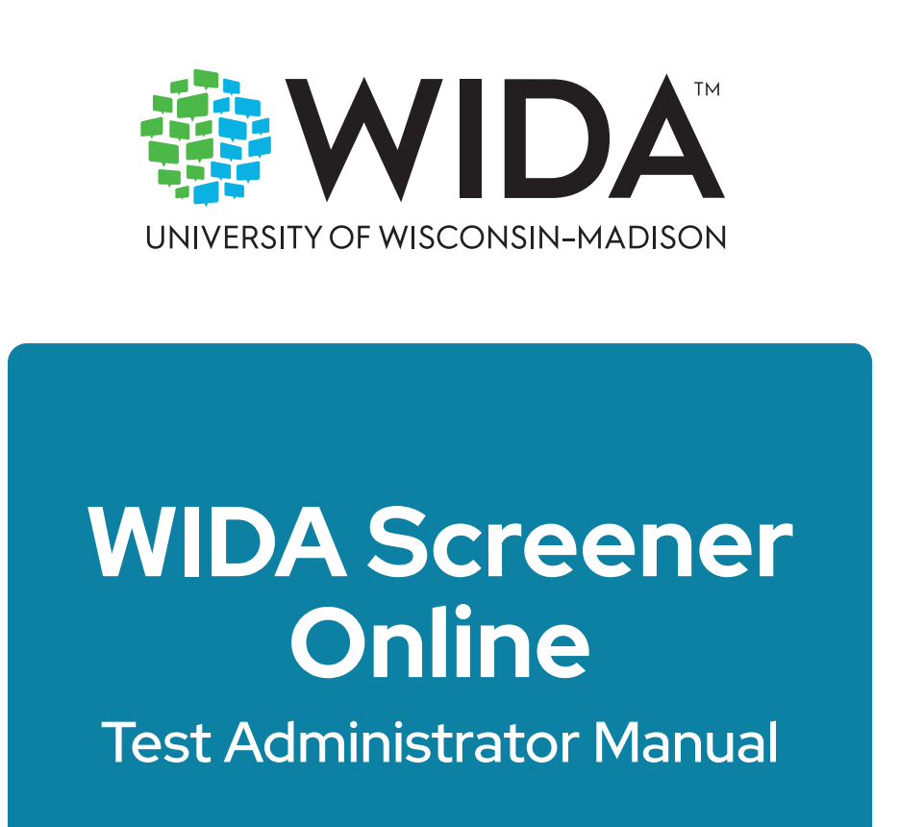
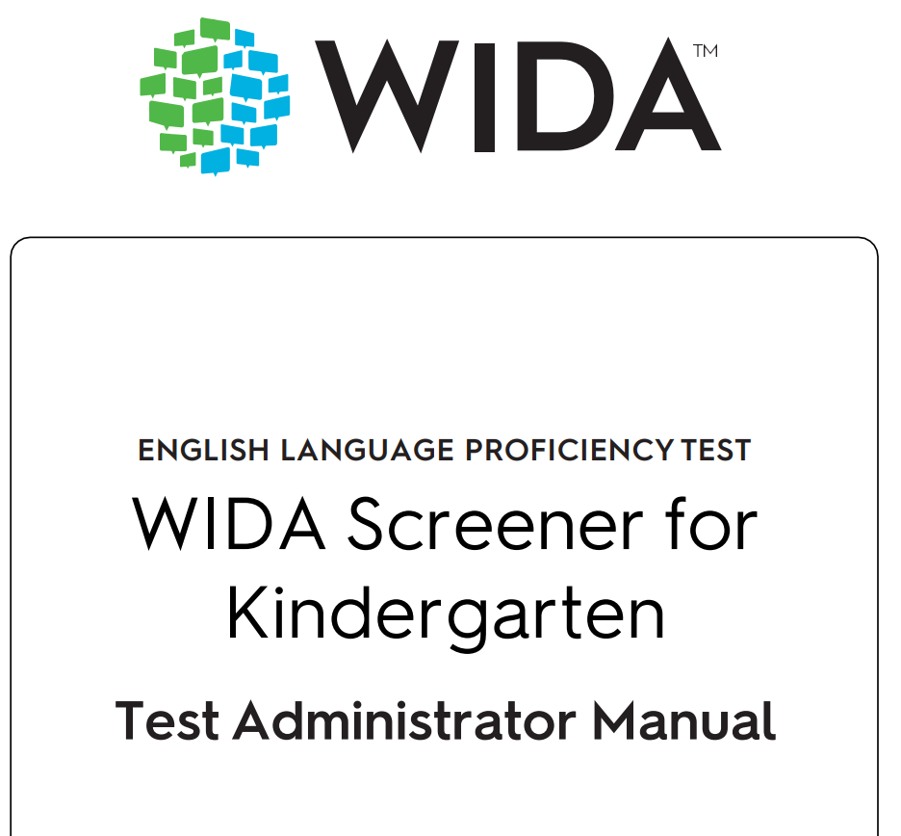
WIDA Screener Manuals
WIDA Screener Manuals can be viewed on the WIDA Secure Portal.

Slide 14
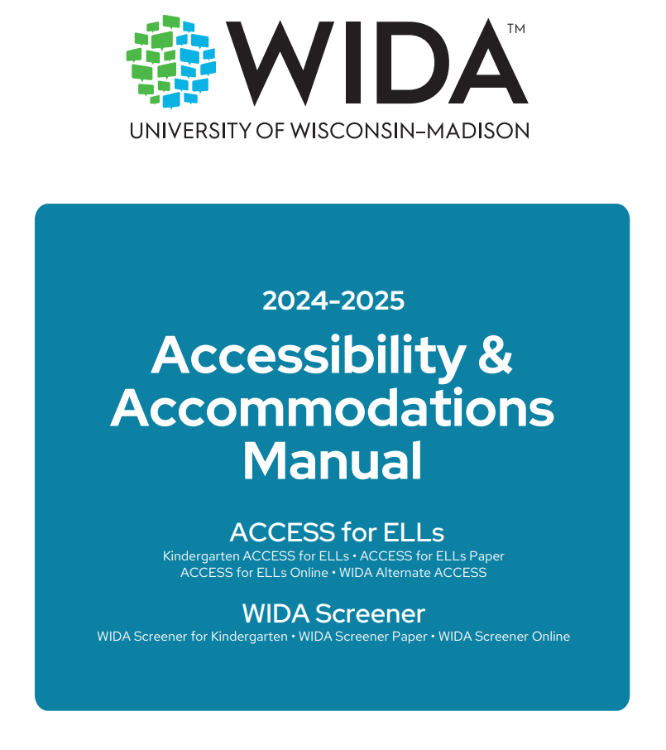
Accessibility and Accommodations Manual
Participation guidance
Framework
Types of supports
Alternate ACCESS for ELLs criteria
Keyboard shortcuts
Scribe and Transcription guidance
WIDA Screener for Kindergarten and Online
Accommodation checklists ACCESS online and paper, Kindergarten and Alternate
Manual- Appendix D: Checklists-p.31
Notes:
EL students who have an IEP or 504 Plan. Monday DAC Email July 8, 2024 (govdelivery.com)- resources for supporting ELs with disabilities. New guidance for administering the WIDA Screener to EL who are blind or visually impaired and or who are deaf or hard of hearing.

Slide 15
Timeline for WIDA Screener for Kindergarten and WIDA Online Screener (July/Aug./Sept.)
Within the first 30 calendar days of enrollment at the beginning of the school year and two weeks during the school year:
Give the Home Language Survey (HLS)
Administer the WIDA Screener for Kindergarten and WIDA Online Screener
Create a current Program Services Plan (PSP) for identified EL students
Enter in Infinite Campus (IC) under Program Participation (English Learners EL) the EL identification, assessments (screener scores), services and instructional and assessment accommodations
Enter the screener scores in IC –WIDA Screener for Kindergarten and Online Screener for Grades 1-12 (date administered and scores)

Slide 16
WIDA Online Screener
Make sure all Test Administrators (TAs) for WIDA screener and WIDA Screener for Kindergarten have:
Reviewed the screener trainings on the WIDA Secure Portal
Taken the screener quiz on the WIDA Secure Portal starting July 1 and,
Passed the quizzes with 80% or higher for this school year prior to administering to students
Read the WIDA Online Screener and WIDA Screener for Kindergarten Manual
District Assessment Coordinators (DACs) will keep the quiz scores on file in the district office
DACs will assign the “Educator Scoring” permission in WIDA AMS after TA has passed WIDA online screener quiz
DACs/Building Assessment Coordinators (BACs) provide Administration Code and Inclusion of Special Populations Training to TAs

Slide 17
WIDA Online Screener Continued
BACs/DACs set up test session in WIDA AMS
TA scores the student responses for Speaking and Writing domains in WIDA AMS. WIDA Screener Online will score the Listening and Reading domains automatically
Student Score Reports are available on-demand after scoring takes place in WIDA AMS
Most responses are available to score in WIDA AMS within 15 minutes but may take up to two hours
DACs must make sure that the scores are entered into IC correctly along with the other EL tabs at the beginning of school year and if EL student enrolls after within two weeks

Slide 18
Timeline for ACCESS and WIDA Screener Online (July/Aug.)
ACCESS Data Review of 2023-2024 information in the Student Data Review and Rosters (SDRR) application for DACs and BACs
DACs update test administrator spreadsheet for ACCESS/Alternate ACCESS/WIDA E-Learning Only
DACs update school and district permissions for WIDA Screeners and ACCESS in WIDA Assessment Management System (AMS)
Prepare Technology Coordinator with up-to-date information on the upgrades to the Central Office Service (COS) Device on all computers for WIDA Online Screener and ACCESS for ELLs and reads the DRC INSIGHT Technology User Guide

Slide 19
Assessment Webinars
The 2024-2025 assessment webinar dates and links are now available in the WIDA Secure Portal. This is a series of live webinars presented by World-Class Instructional Design and Assessment (WIDA) and Data Recognition Corporation (DRC). The webinars are intended to help test coordinators, test administrators and technology coordinators prepare to administer the ACCESS for ELLs and WIDA Screener assessments. Learn more and add these webinars to school and districts test administrator's calendars on the Webinars page (login required).
Mark school and district Test Administrators (TA) calendars for these upcoming assessment webinars focusing on WIDA Screener:
WIDA Screener for Kindergarten Tuesday, July 23 at 1-2 p.m. CT
WIDA Screener Online and Paper Tuesday, Aug. 6 at 1-2 p.m. CT
All assessment webinars are recorded and available on the WIDA Secure Portal approximately one week after the presentation.

Slide 20
Contact Us
Jennifer Stafford, Division Director
Helen Jones, Academic Program Manager
Shara Savage, Education Administration Program Manager
Ben Riley, Systems Consultant
Devon Avery, Program Consultant
Chris Williams, Program Consultant
Christen Roseberry, Program Consultant
Krista Mullins, Program Consultant
Melissa Chandler, Program Consultant

Slide 21
Other Back to School Trainings
Accountability Overview
ACCESS/Alternate ACCESS
AKSA (Attainment Tasks)
K Screen
Test Security

Slide 22
Division of Assessment and Accountability Support
OAA/DAAS (502) 564-4394 dacinfo@education.ky.gov
Chris Williams, Program Consultant,
chris.williams@education.ky.gov

Slide 23
Thanks for Attending

