Slide 1
HQIR Coordinator Convening
November 1, 2023
Virtual Meeting Tips
Remember to mute your microphone if you are not the one talking. This will reduce additional background sound and enable meeting attendees to hear better.
Utilize the chat box for specific questions or to share resources.
Minimize distractions and be present.

Slide 2
Welcome & Introduction

Slide 3
Agenda
Introduction & Welcome – Chrystal Rowland
Why High-Quality Instructional Resources Matter – Fox DeMoisey and Misty Higgins
The Law & High-Quality Instructional Resources for Literacy – Christie Biggerstaff
Fall Survey & HQIR Dashboard – Caryn Davidson and Ben Maynard
Moving Forward & Collaboration Opportunities – Fox, Misty, Christie, Caryn, Ben

Slide 4
Why High-Quality Instructional Resources Matter
Notes:
[Fox 4-10]

Slide 5
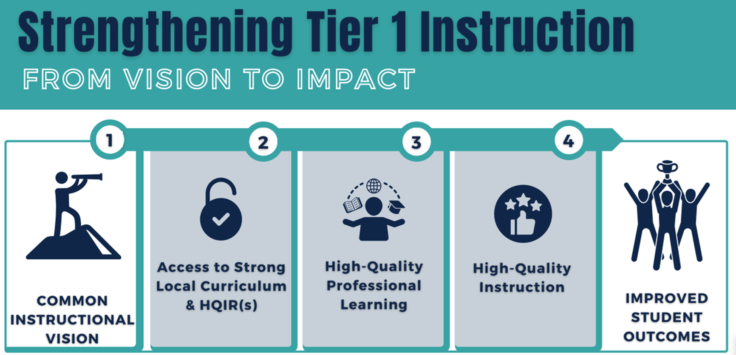
Strengthening Tier 1 Instruction From Vision to Impact
Notes:
[Fox] Vibrant student learning experiences and deeper learning are the ultimate intent of our standards. But we recognize schools and districts need support in implementing the standards at the local level in a way that truly impacts the classroom experience for our students. On this slide is a visual representation of critical actions necessary for this to occur; it focuses on the movement from vision to the impacts of High-Quality Instruction and Improved Student Outcomes.
The first step is for districts to ensure they have a common instructional vision in place for a particular content area. Then, based on the vision, they need to equip teachers and students with access to a strong local curriculum supported by High-Quality Instructional Resources that provide the necessary tools to actualize the vision. And we know that simply giving educators a HQIR is not enough to support them in making the instructional shifts necessary to provide vibrant student experiences. They need to engage in high-quality professional learning that builds the understandings and skills that are a part of high-quality instruction for every student. When districts intentionally ensure these pieces are in place, we see the full impact on instruction and student outcomes.

Slide 6
WHY HQIRs?
What resonates with you about why resources matter?
What information/data surprises you?
Notes:
[Fox] Why are we placing emphasis on HQIRs in our work? We want to take just a few minutes here to highlight some of the research on the adverse effects of teachers and students not having access to HQIRs, and then on the positive impacts of when they do.
As we move through the next few slides, we would like for you to make note of what resonates with you about why resources matter and of any information or data that surprises you. Please feel free to grab a piece of paper to capture your thinking. You will be invited to share your thoughts at the end of this segment.

Slide 7
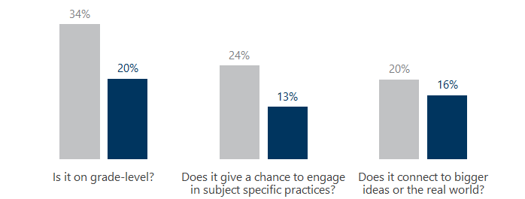
Teachers spent significant time creating or selecting their own assignments, but not often with good results
Teachers reported spending 7 hours per week or 250 hours per year developing or selecting instructional materials (resources).
Assignments Provided by District or State Teacher Created/Selected Assignments
But the assignments teachers created or selected tended to be lower quality than what the district or state provided.
TNTP. (2018). The Opportunity Myth. Retrieved from: https://opportunitymyth.tntp.org/
Goldberg, M. (2016). Classroom Trends: Teachers as Buyers of Instructional Materials and Users of Technology. K-12 Market Advisors. Retrieved from: https://mdreducation.com/reports/classroom-trends-teachersbuyers-instructional-materials-users-technology/
Opfer, V., Kaufman, J., Thompson, L. (2016). Implementation of K-12 State Standards for Mathematics and English Language Arts and Literacy. Santa Monica, CA: RAND Corporation. Retrieved from: https://www.rand.org/pubs/research_reports/RR1529-1.html
Notes:
[Fox] Research tells us that teachers spend around 7 hours per week, 250 hours per year, creating or curating resources. When looking for resources, they tend to go to Google, teachers-pay-teachers and Pinterest, to name a few, and this results in the use of unvetted resources that are often low in quality and lead to inequities in the student learning experience.
The graphs on this slide illustrate how these resources, found or made, tend to fall short.
In the first graph (click) looking at grade-level alignment, we see that teacher created or selected resources are aligned to grade-level standards only 20% of the time;
(click) What about subject-specific practices? Only 13% of teacher created/selected assignments allow students access to disciplinary practices;
(click) and in terms of authentic connection, only 16% of teacher created/selected assignments help students make rich connections to big ideas and to the world around them.
Reference: The Opportunity Myth from TNTP

Slide 8
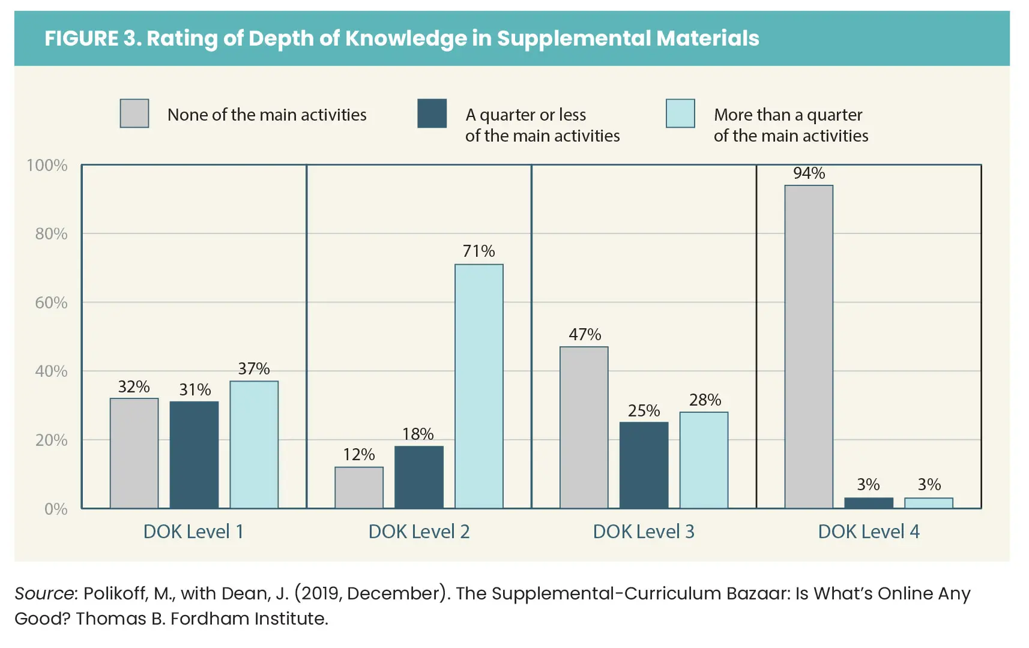
Supplemental online resources tend to be low DOK
Most content included in the main activity was DOK level 1 or 2.
Nearly half of main activities had no DOK level 3 content; only six percent scored higher than 0 for DOK level 4.
Dean, J., Arabo, M., & Northern, A. M. (2019, October 12). The Supplemental Curriculum Bazaar: Is what's online any good? The Thomas B. Fordham Institute. Retrieved March 2, 2023, from https://fordhaminstitute.org/national/research/supplemental-curriculum-bazaar
Notes:
[Fox] When reviewers evaluated supplemental materials found online for depth of knowledge (DOK), which, as we know, is the cognitive demand required for students to successfully engage with the content, most of the content included in the main activity of each [CLICK] was DOK level 1 or 2 (recall and reproduction, basic skills and knowledge). Nearly half of the main activities had no DOK level 3 content [CLICK] (strategic and critical thinking) and 94% percent [CLICK] had no DOK level 4 content (extended and applied thinking).

Slide 9
Students have inconsistent access to content that is grade-level appropriate
In a single school year, the average student spends
581 of 720 available hours on assignments that are NOT high-quality.
This is particularly significant for students of color and students living in poverty who have less access to high-quality, standards-aligned resources than their peers.
The Opportunity Myth, TNTP 2018
Reference: TNTP. (2018). The Opportunity Myth. Retrieved from: https://opportunitymyth.tntp.org/
Notes:
[Fox] What is the impact of this on the student experience…inconsistent access to grade-level work. Students are spending 581 of 720 hours–equivalent to 81% of a school year–on assignments that are not grade-level appropriate. This is particularly significant for students of color and students who are economically disadvantaged. Clearly, this is a matter of equity.
Reference: TNTP. (2018). The Opportunity Myth. Retrieved from: https://opportunitymyth.tntp.org/

Slide 10
Access to quality content also matters to students beyond high school.
Nationwide, 40% of COLLEGE STUDENTS (including 66 percent of Black college students and 53 percent of Latinx college students) take at least one remedial course, learning skills they were told they’d already mastered in high school.
A recent study found that college remediation costs students and their families $1.5 BILLION ANNUALLY.
Graduates who opt for a career straight out of high school aren’t faring much better, with many employers reporting high school graduates are MISSING SKILLS needed to do their jobs well.
Reference: TNTP. (2018). The Opportunity Myth. Retrieved from: https://opportunitymyth.tntp.org/endnotes#3
TNTP. (2018). The Opportunity Myth. Retrieved from: https://opportunitymyth.tntp.org/endnotes#4
28
Notes:
[Fox] And there are implications beyond HS. 40% of college students take at least one remedial course. These courses cover content that should have been mastered in HS, and this comes at a cost to students and their families, to the tune of about $1.5 billion annually. It also impacts our students going into the workforce out of high school with business and industry partners telling us students are missing skills needed for employability.

Slide 11
Impact of HQIRs
Improvements in Teacher Practice and Gains in Student Achievement
A 2017 study shows that the effect of learning when using a HQIR is the same as moving an average performing teacher to one at the 80th percentile.
A 2018 study illustrated that teachers using HQIRs engaged students in mathematical practices at a SIGNIFICANTLY HIGHER RATE than teachers who did not have access to aligned curriculum.
Jackson, K., Makarin, A. (2016-2017). Can Online O-the-Shelf Lessons Improve Student
Outcomes? Evidence from a Field Experiment. American Economic Journal: Economic Policy,
Vol 10 (3), pages 226-254. Retrieved from: https://www.nber.org/papers/w22398
Opfer, V., Kaufman, J., Bongard, M, Pane, J. (2018). Changes in What Teachers Know and Do in
the Common Core Era, American Teacher Panel Findings from 2015 to 2017. Santa Monica, CA:
RAND Corporation. Retrieved from: https://www.rand.org/pubs/research_reports/RR2658.html
Notes:
Fox just talked about what happens when teachers and students do not have access to HQIRs. However, when teachers have access and effectively implement HQIRs, research shows (click) that it results in improvements in teacher practice and gains in student achievement.
For example, (click) a 2017 study shows that the effect of using of an HQIR is the same as moving an average performing teacher to one at the 80th percentile.
(click) And a 2018 study showed that teachers using a high-quality math instructional resource engage students in the mathematical practices at a significantly higher rate than teachers without access to an HQIR connecting to supporting deeper learning by students engaging in the practices of the content.
And while this study looked at math specifically, this would likely hold true for other content areas as well because of the intentional research-based design of HQIRs and their emphasis on students engaging in the practices of the discipline.

Slide 12
HQIR Impact in Pilot Districts
Teachers:
Free up their time to leverage what is engaging in the resource and to meet individual student needs
Raise their expectations of what students are able to know and do, regardless of their ability or background
Students:
Build necessary background knowledge of the world by introducing them to places, cultures, and experiences they may not have had exposure to, given limited financial circumstances.
Increase interest and confidence in learning as they develop new skills and knowledge through challenging material.
Notes:
We have also heard about the impact of HQIRs on teachers and students from those districts participating in our pilots. Some common benefits (click) they have shared with us in terms of impact on teachers include:
(click) how it has freed up teachers’ time to leverage the key aspects of the HQIR and its built in-supports to meet students individual needs
(click) and how the teachers have raised their expectations of what their students are able to know and do, regardless of their ability or background
In terms of the impact (click) they are seeing on their students, they pointed to
(click) how the HQIR helps to build the necessary background knowledge students need to engage in grade-level content and introducing them to places, cultures and experiences they may not otherwise have access or exposure to, especially those from lower SES.
(click) How it has also increased students interest and confidence in learning as they engage with challenging material. Parents have even shared with teachers and leaders how students are coming home talking about what they are reading and learning

Slide 13
HQIRs: Whole Group Share Out
What resonated with you about why resources matter?
Which information seemed especially
surprising?
Notes:
Going back to our questions, as we looked at the need for HQIRs and the potential impact when teachers and students have access to them, what resonated with you and/or what information seemed especially surprising? We would like for everyone to post something you noted in the chat.
Would anyone like to unmute and elaborate more on something you posted?
So, we know that HQIRs are critical part of providing a vibrant learning experience and improving student outcomes. Let’s look at how KDE is defining HQIRs.
*Laura, get 10 rooms ready – 8 minutes

Slide 14
KDE Definition of HQIRs
Aligned with the Kentucky Academic Standards (KAS);
Research-based and/or externally validated;
Comprehensive to include engaging texts (books, multimedia, etc.), tasks and assessments;
Based on fostering vibrant student learning experiences;
Culturally relevant, free from bias; and
Accessible for all students.
"Vibrant student experiences spark curiosity, motivation and engagement, while cultivating enthusiasm for lifelong learning." (United We Learn)
Notes:
This slide shows KDE’s general definition of HQIRs. Please take a moment to read those 6 characteristics.

Slide 15
HQIR Breakout Room
Small Group Discussion:
What connections do you see to your work/role and the needs of educators and students in your district?
8 min. Share “airtime” equitably.
Notes:
Breakout time #1
Laura set random breakout rooms – 10 total rooms; 8 minutes
We want to take just a few minutes to send you into breakout rooms to process what we have shared around HQIRs. In your rooms, we would like for you to discuss the question you see here on the slide, what connections do you see to work in your district, your role and the ways HQIRs can help meet the needs of educators and students in your district. Before we send you into your rooms, we want to pause and give you a little think time around this question.
*Laura – open rooms
Breakrooms are open and we will see you back here in few minutes. Please make sure to equitably share airtime in your rooms.

Slide 16
Read to Succeed & High-Quality Instructional Resources for K-3 Literacy
Read to Succeed & High-Quality Instructional Resources for K-3 Literacy

Slide 17
Why Early Literacy?
KPREP and KSA Proficiency Results
Year | Percent Proficient and Distinguished
2015 | 54.3%
2016 | 53.7%
2017 | 55.8%
2018 | 52.3%
2019 | 52.7%
2020 | NO TESTING due to Federal Waiver/ Covid-19 Emergency
2021 | 29.8%
2022 | 45.0%
Significance of Third-Grade Reading Proficiency
More likely to have continued academic success
Less likely to have problems with attendance, dropout rate and juvenile crime (4x likely to drop out of school)
More likely to feel higher self-esteem and feelings of adequacy
More likely to break the cycle of intergenerational poverty
Kentucky Department of Education. (2019). Kentucky School Report Card. Retrieved from: https://www.kyschoolreportcard.com/organization/20/academic_performance/assessment_performance/state_assessments_accountability?year=2019
Notes:
Christie

Slide 18
Why Early Literacy?
Grade 3 Reading Scores by Student Demographics for 2022
Subgroup | Percent novice | Percent apprentice | Total percentage below proficiency
Black | 47% | 28% | 75%
Economically Disadvantaged | 34% | 29% | 63%
English Learners | 38% | 33% | 71%
Hispanic | 34% | 31% | 65%
Students With Disabilities (IEP) | 39% | 29% | 68%
We urge district leaders to think unconventionally and innovatively to serve all students because conventional methods clearly have not yielded the results we need.
Kentucky Department of Education. (2020). Kentucky Board of Education Resolution Affirming Its Commitment to Racial Equity in Kentucky Public Schools.
Kentucky Department of Education. (2019). Kentucky School Report Card. Retrieved from: https://www.kyschoolreportcard.com/organization/20/academic_performance/assessment_performance/state_assessments_accountability?year=2019

Slide 19
Today’s Challenge
You are going to design your own creation today! Read the following text and think about for whom you will design and what features you will include. You will produce a claim, evidence and reasoning to defend your design.
Questions to consider:
What special group of people will you be designing for?
What features are suitable?
What information can you include to defend your design?

Slide 20
Reading Passage: 70% Accuracy
In the ______ of ______, nothing is ______. Some ______ ______ life-size ______ out of tall, ______ and shrubs. A ______ careful ______ and ______ can ______ ______ paths. ______ cut and shape plants into ______, larger-than-life and ______ leafy ______. What would you do if you could ______ your own ______? Who would you design it for and what ______ features would you ______?

Slide 21
Reading Passage: 80% Accuracy
In the world of ______, nothing is ______. Some ______ create life-size ______ out of tall, bushes and shrubs. A ______ careful planning and clipping can ______ ______ paths. ______ cut and shape plants into ______, larger-than-life and ______ leafy ______. What would you do if you could design your own ______? Who would you design it for and what special features would you ______?

Slide 22
Reading Passage: 100% Accuracy
In the world of gardens, nothing is impossible. Some gardeners create life-size mazes out of tall, bushes and shrubs. A gardener's careful planning and clipping can create strange paths. Others cut and shape plants into awesome, larger-than-life and incredible leafy animals. What would you do if you could design your own maze? Who would you design it for and what special features would you include?

Slide 23
Adoption of High-Quality K-3 Comprehensive Reading Program
Senate Bill 156 (2023) amended KRS 158.305,which is part of the Read to Succeed Act, related to the adoption and implementation of high-quality instructional resources (HQIRs) for K-3 reading.
The law establishes that by July 1, 2024, “each superintendent shall adopt a common comprehensive reading program that is determined by the department to be reliable, valid, and aligned to reading and writing standards required by KRS 158.6453 and outlined in administrative regulation promulgated by the Kentucky Board of Education for kindergarten through grade three (3) for all schools or a subset of schools, with consultation of all affected elementary school councils," (emphasis added).
Notes:
NOTE: The bill requires new adoptions be made by July 1, 2024. That seems like plenty of time. But in actuality, there is a sense of urgency. Your instructional resource evaluation teams should target Feb. for the adoption of the selected HQIR. March at the absolute latest. This deadline will ensure your resources arrive on site and in time for curriculum-based professional learning to occur late spring and summer in preparation for implementation in 24-25.

Slide 24
Adoption of High-Quality K-3 Comprehensive Reading Program
“Common” means the adopted HQIR is utilized for K-3 by all elementary schools or a subset of schools within a district.
KRS 158.792 defines "Comprehensive reading program" as “any print, nonprint or electronic medium of reading instruction designed to assist students. For students in kindergarten through grade three (3), program instructional resources shall include instruction in five (5) key areas: phonemic awareness, phonics, fluency, vocabulary, and comprehension.”

Slide 25
Literacy HQIRs
ELA HQIR Materials | Previous ELA Materials (Basal)
Evidence-Based Phonics Scope and Sequence | Based on "Whole Word" Method
Decoding Strategies | Memorization Tactics
Authentic, Complex Texts | Simplistic, Repetitive Texts
Standards-Aligned Tasks | Disconnected Tasks
Decodables and Additional Texts Based on Unit/Theme | Disconnected "Readers"

Slide 26
Literacy HQIRs
Ineffective | Effective
Teach foundational skills only as they arise in texts | Follow a clear scope and sequence for instruction and practice that instruction in connected text including print concepts, phonological awareness, phonics, and fluency.
Spend only a few minutes daily on foundational skills | Spend the appropriate amount of time allotted for your grade level on direct instruction as well as additional remediation for those who need it.
Foundational skill development within HQIR should be aligned with explicit, systematic instruction.
Notes:
Turnover to Fox

Slide 27
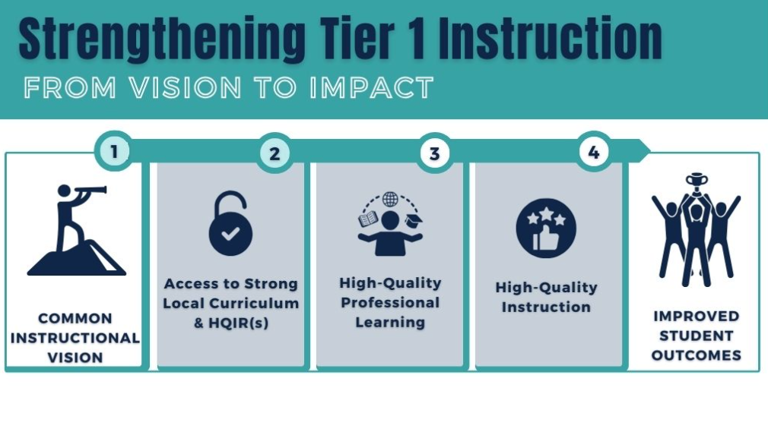
Strengthening Tier 1 Instruction
Notes:
[Fox 26-29] Returning to the visual we showed you earlier, we can see following from the first step toward improving student outcomes in a given content area, ensuring there is a common instructional vision in place, space two looks at providing Access to Strong Local Curriculum & HQIR to help actualize that vision.

Slide 28
Key Tools
Curriculum Development Process
Reading and Writing Consumer Guide
Notes:
[Fox] KDE’s two primary tools available to support this work are our Curriculum Development Process and our Instructional Resources Consumer Guides. We currently have the R/W and math guides available, with plans to release the science consumer guide this coming spring.

Slide 29
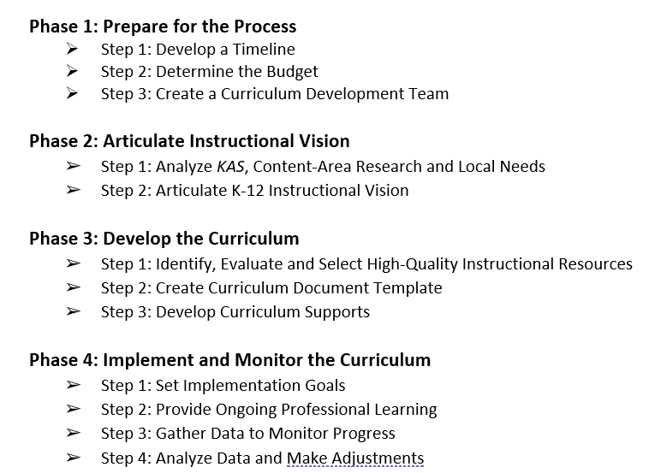
Curriculum Development Process
Notes:
[Fox] The Curriculum Development Process (CDP) is section one of the Model Curriculum Framework. This guidance lays out a process districts can use to develop and implement a strong local curriculum supported by high-quality instructional resources.
The first phase of the CDP is logistical in nature and focuses on preparing for the process.
Phase 2 (click) provides guidance on articulating a local instructional vision that reflects the Kentucky Academic Standards, current research for teaching and learning in the content area of focus and a district’s local context.
Phase 3 (click), step 1 (click) provides guidance using the instructional vision to drive selection of a HQIR(s) to anchor the local curriculum. This step is where the content area consumer guides fit in. The CDP itself focuses on general guidance, whereas the consumer guides provide content-specific characteristics of high-quality instructional resources.

Slide 30
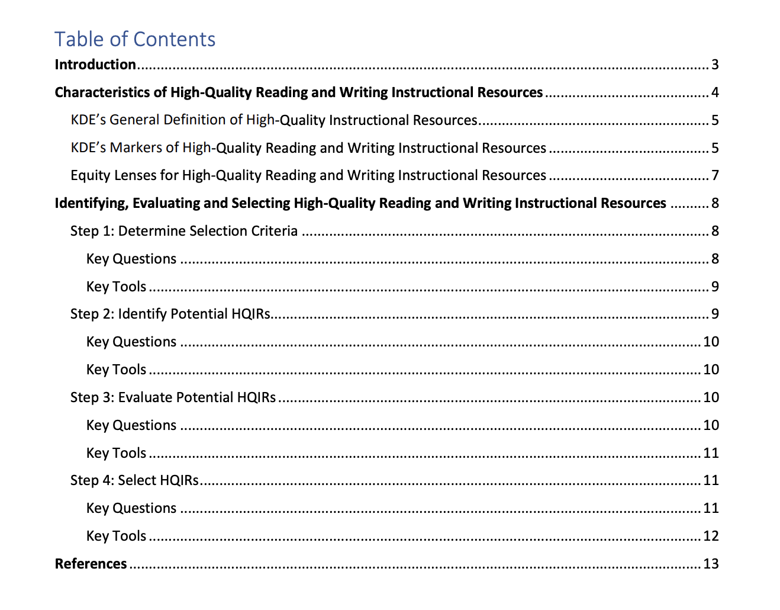
Instructional Resources Consumer Guides
Notes:
[Fox] This slide shows the layout and organization of the R/W Consumer Guide that can support your district’s work around SB 156.
(click) The introduction provides some background context, connections to the CDP and spotlights the importance of HQIRs.
(click) The second section focuses on the specific characteristics of high-quality R/W instructional resources.
It starts with KDEs general definition of HQIRs, then focuses on what that looks like in R/W.
The markers specifically point to characteristics of R//W resources you want to use as you evaluate to ensure alignment to the KAS for R/W.
The equity lenses with the specific R/W look-fors help in evaluating resources to ensure they are culturally relevant, free from bias and accessible for all students.
The final section (click) outlines a four-step local selection process. Each step will include a brief description, key questions to consider and key tools to support the work.
A common question we get is where to go to identify and evaluate potential HQIRs. Part of KDE’s general definition of HQIRs is that they are externally validated and/or researched-based and comprehensive in nature. To support steps 2 and 3 of the local selection process, the consumer guide will point you to EdReports.

Slide 31
EdReports is for Educators, by Educators
Curriculum review teams:
5 diverse review team members (roles, states, grade-level expertise)
Multiple sets of perspectives looking extensively at all elements of the core curriculum
Reviewers touch every page of the materials
Over 150 hours of review time per reviewer/series
Notes:
EdReports is a non-profit organization often described as the Consumer Reports of instructional resources. They are a “for educator, by educator” organization that publishes free reviews of K–12 instructional materials, using an educator led approach that measures standards alignment, usability, and other quality criteria. They review for-profit and non-profit resources, as well as open education resources.
Their curriculum review teams consist of 5 practicing educators, selected for their content-area expertise, who reflect a diversity of roles, regions, and grade levels. The reviewers spend over 150 hours evaluating each instructional resources series. Every reviewer on a team reviews every single page of the materials.
*Laura – get rooms set up, 10 rooms 5 minutes

Slide 32
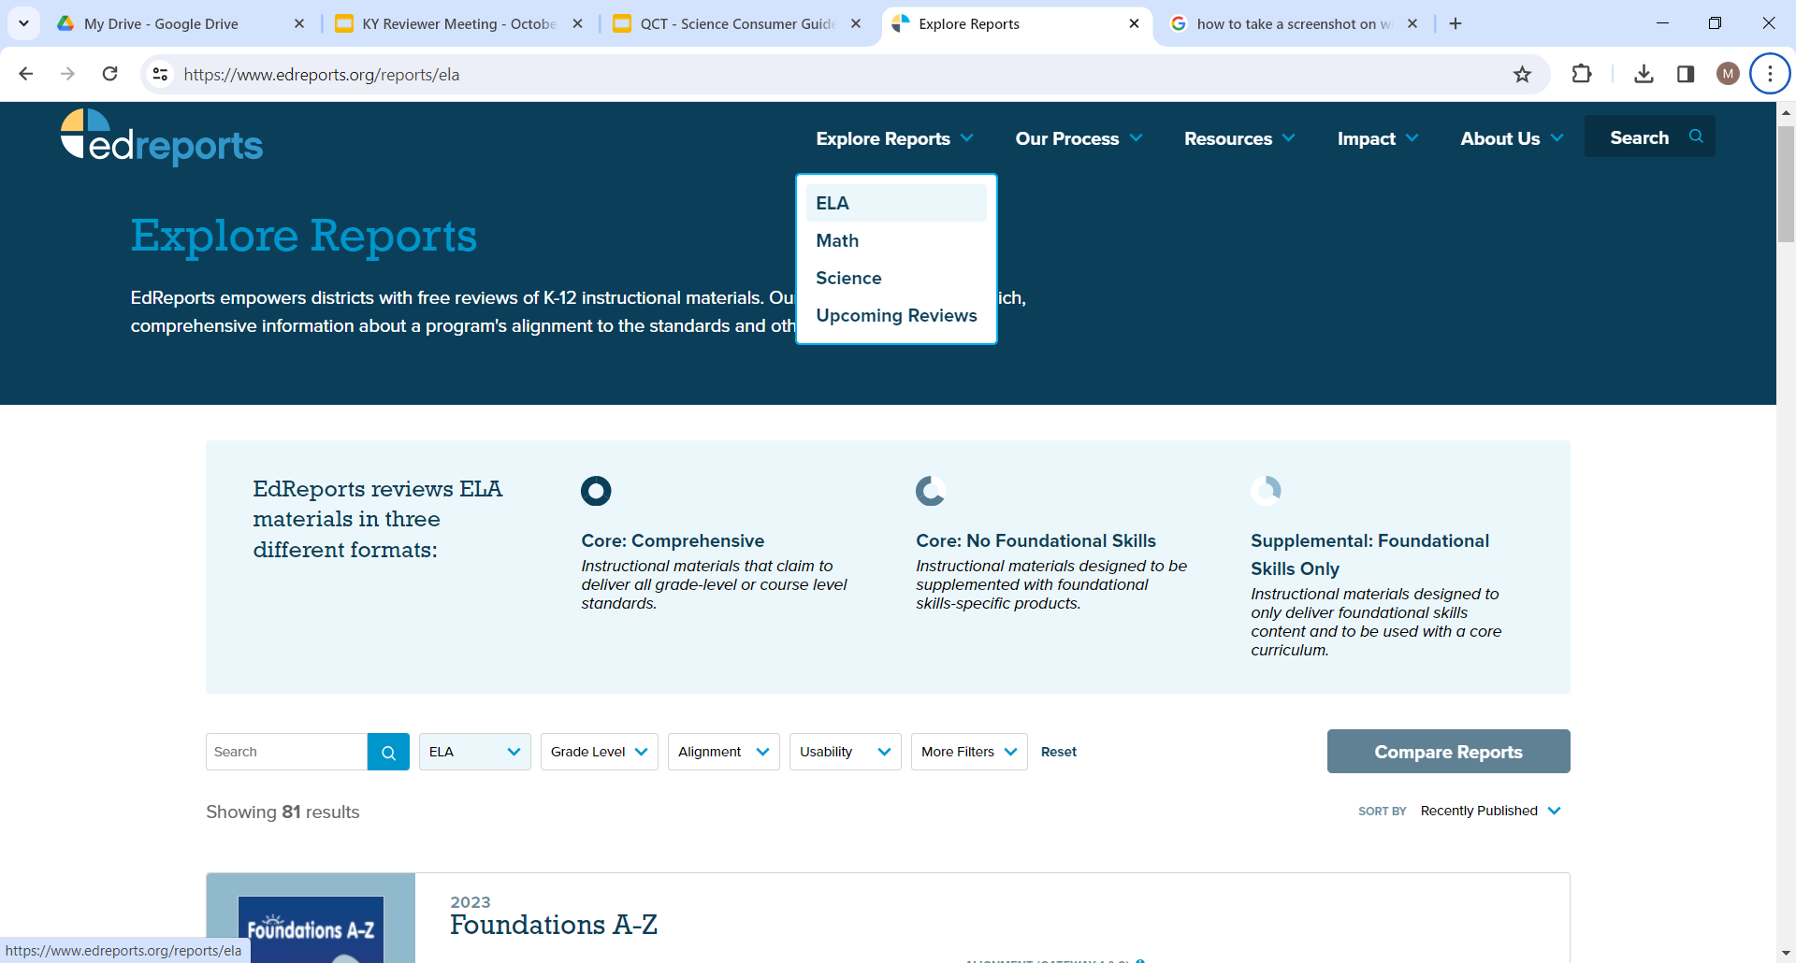
EdReports Website
Notes:
On their website, at the top, (click) select ELA under “Explore Reports.” Then, (click) you can use their filters to begin the process of identifying and evaluating potential HQIRs. In order to ensure you are starting with resources that meet KDE’s general definition of HQIRs, you would need to filter out resources that meet expectations for both alignment and usability, which are considered “green-rated.” It will then show you a list of all the reviewed resources that meet the criteria.
As you view the list, (click) make sure you focus on those marked as core comprehensive in alignment with SB 156.
The consumer guide includes a video tutorial and other resources to support districts in navigating EdReports’ website to help identify and evaluate potential green-rated HQIRS for adoption consideration.

Slide 33
Breakout Room
Small Group Discussion:
Where are you in the process toward the adoption of HQIR?
What resources did you see that will be useful in your district in the evaluation and selection process?
5 min. Share “airtime” equitably.
Notes:
Once again, we want to give you an opportunity to process and share out back in your breakout rooms around these two questions:
Where are you in the process toward adoption of a K-3 comprehensive reading HQIR?
What resources did you see from what we shared that might be useful in your district to support the evaluation and selection process?
We’ll give you a little think time before we send you into your breakout rooms.
*Laura – open rooms
Breakout rooms are open. Remember to equitably share airtime and we will see you back here in about 5 min.

Slide 34
Fall Survey & HQIR Dashboard
Notes:
Caryn & Ben (20 min.)

Slide 35
Fall HQIR Survey Collection
Wednesday, Nov. 1 – Friday, Dec. 8
District-Level Survey
Curriculum-Based Professional Learning Survey
School-Level Surveys
Reading & Writing/ELA Resources
Mathematics and Science Resources
Large district options for submission
Notes:
Caryn's slide -
Please respond again even if nothing's changed because we've added some new questions
after going over the slide, exit slide deck and go to Collection Site – walk through

Slide 36
HQIR District Coordinator Hub
Designed to help promote collaboration between districts
Access is restricted to officially identified HQIR Coordinators in those districts that complete the survey
Option to opt out at the district level
Access will be given to new completers after the conclusion of the survey window - new year view ready in 2024
Notes:
Ben's slide [Caryn keep sharing your screen]
Designed to help promote collaboration between districts.
You will see in just a minute how you can search for other coordinators across the state to encourage collaboration around common resources, or even ones your considering for adoption.
Access is restricted to officially identified HQIR Coordinators in those districts that complete the survey
Because you are voluntarily submitting these resources, we greatly respect your privacy. That's why we reserve access to the Hub for those of you that are appropriately identified in KDE's Open House as the HQIR Coordinator as well as those that complete the surveys.
Option to opt out at the district level
If you'd like to respond to the surveys but not quite ready for anyone else to see your resources, we completely understand. We will give all of you the opportunity 'opt out' of having your school's resources included in the updated version of the dashboard.
Access will be given to new completers after the conclusion of the survey window - new year view ready in early 2024
Those of you that participate for this round of surveys will be added to the dashboard when it opens up in what we hope to be early 2024
Next Slide

Slide 37
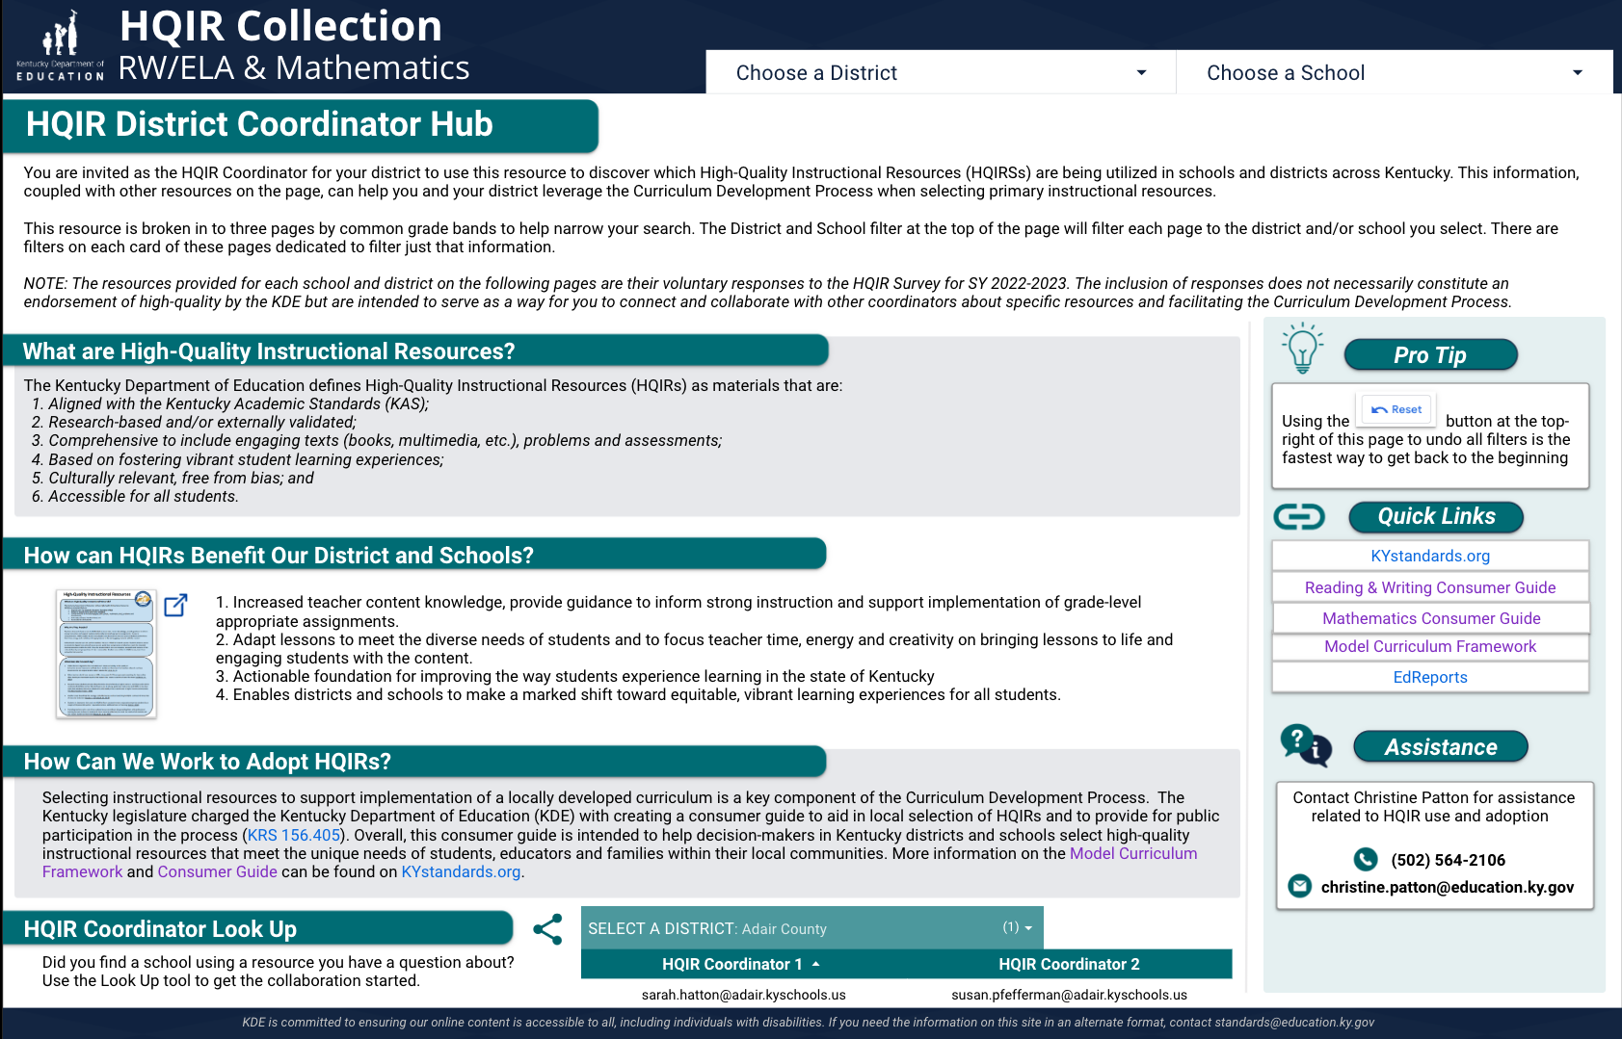
HQIR District Coordinator Hub
Quick hitting information about HQIR
Find other HQIR-C's around the state to discuss and collaborate
Notes:
Ben's slide -
We want to quickly show you the dashboard created from last years responses through a couple of screen shots. If you have access and used it in some way over the last year, let us know in the chat what you found helpful?
Quick hitting info about HQIR
Here's where you find other HQIR Coordinators to help create a community to discuss and collaborate around resources.
Next Slide

Slide 38
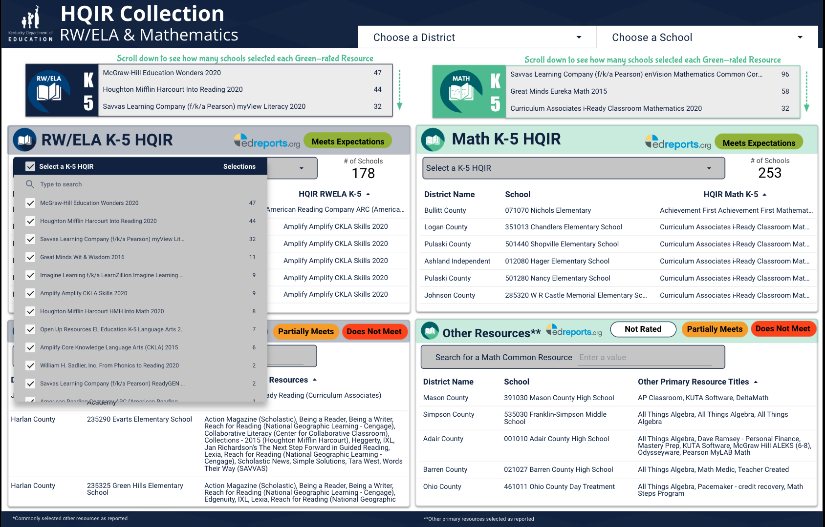
HQIR District Coordinator Hub
RW/ELA and Math resources for three grade bands
K-5
6-8
9-12
Select entire districts, search for schools, select resources to see who's using your resource, or the one you are considering
Notes:
Ben's slide
Hit the slide bullets
If you'd like to get more in depth about the dashboard, there will be an opportunity to do that in just a few minutes.
Laura, I'll hand it to you to tell everyone more about those opportunities.
*Laura – get rooms set up, 3 rooms 10 minutes
Resources to support local adoption (Navigating EdReports)
HQIRs and Read to Succeed
Fall Survey & HQIR Dashboard

Slide 39
Information, Collaboration, Discussion
Resources to support local adoption (Navigating EdReports)
HQIRs and Read to Succeed
Fall Survey and HQIR Dashboard

Slide 40
Moving Forward & Collaboration Opportunities
Local Adoption Process Webinar -
November 20 at 10:00-11:00 am ET
Feedback Survey & EILA Credit
Notes:
As we wrap up today's session, I want to share with you some opportunities for ongoing support.
To assist districts in effectively selecting an approved Tier 1 comprehensive reading program so that the resource adopted ultimately leads to high-quality instruction and improved student outcomes, the Kentucky Department of Education is offering a one-hour webinar on Monday, Nov. 20, from 10:00-11:00 a.m. ET. The webinar will offer a more in-depth understanding of how best to use some of the resources previewed today to support your local adoption process. The registration link can be accessed using the QR code on the left of your screen.
REgisteration link: Meeting Registration - Zoom
We will be offering another HQIR Coordinators' Convening in the spring and we are seeking your input on the topics addressed. We ask that you complete a brief survey about today's session and topics that you would like to see on the spring agenda. We are offering EILA credit for your participation today. You must complete the survey to request your certificate. The link to the survey will be placed in the chat or you may access by utilizing the QR code on the right of your screen.
Chrystal- Feedback survey and EILA credit -
https://forms.office.com/Pages/ResponsePage.aspx?id=H8Fgk-aQBketACX83J4u0R502Mh4cJZPnd5bIKZJykxUN1E4N0gzWkU0MzczTDdYMFNNWlY1NzNGTy4u

Slide 41
Contact Information
HQIRs and Supporting Resources:
misty.higgins@education.ky.gov,
fox.demoisey@education.ky.gov
Senate Bill 9:
christie.biggerstaff@education.ky.gov
HQIR Survey & Dashboard:
caryn.davidson@education.ky.gov,
ben.maynard@education.ky.gov

