Slide 1
Improving Literacy Tasks with
Text-Dependent Questions (TDQs)

Slide 2
Our Goal:
Review and strengthen the concepts and skills required to engage students deeply in text with text-dependent questions.

Slide 3
What are text-dependent questions?
Only answerable by referring to the text being read
May be literal, recall questions but should work towards analysis, synthesis and evaluation
May include prompts for writing and discussion
Relevant across all content areas as students should be engaging deeply with texts (anything that communicates a message) in all of their classes

Slide 4
Why use text-dependent questions?
To help students focus on difficult portions of text to enhance reading proficiency through deeper engagement
To deepen students’ understanding of a text by sequencing questions to build on each other, including analysis, synthesis and evaluation
To direct students to specific words, sentences and paragraphs meanings as well as large ideas, themes or events
Notes:
This slide is adapted from the Reading and Writing TDQ Webcast that aired on 3-19-20.

Slide 5
Text-Dependent Questions Promote Equity!
TDQs DO ground student responses in complex text–one of the key components of excellent literacy instruction. | TDQs DO NOT assume a student has background knowledge that can’t be found in text.
Notes:
This slide is adapted from the Reading and Writing TDQ Webcast that aired on 3-19-20.

Slide 6
Examples from “The Gettysburg Address”
TDQs DO ground student responses in complex text–one of the key components of excellent literacy instruction. | TDQs DO NOT assume a student has background knowledge that can’t be found in text.
What is the importance of meeting on the “portion of that field” and “this ground”? | Why did the North fight the Civil War?
Notes:
This slide is adapted from the Reading and Writing TDQ Webcast that aired on 3-19-20.

Slide 7
We need a variety of TDQs to support student engagement with text:
Vocabulary & Comprehension: Does the student understand what the text is saying?
Syntax & Structure: Does the student understand the elements of craft and authorial choice that make meaning?
Theme/Central Idea Analysis: Does the student understand how themes and central ideas develop over the course of a text?

Slide 8
Text-Dependent or Not?
(From “The Gettysburg Address”)
Who does Lincoln mean by “fathers” and what can we infer about the “fathers” from this sentence?
YES! This is a Vocabulary & Comprehension question that requires students to refer to the text and could not be answered with prior knowledge.
Notes:
This slide is adapted from the Reading and Writing TDQ Webcast that aired on 3-19-20.

Slide 9
Text-Dependent or Not?
(From “The Gettysburg Address”)
Why does Lincoln start this section with “but”?
YES! This is a Syntax & Structure question that requires students to refer to the text and could not be answered with prior knowledge.
Notes:
This slide is adapted from the Reading and Writing TDQ Webcast that aired on 3-19-20.

Slide 10
Text-Dependent or Not?
(From “The Gettysburg Address”)
What is a metaphor? Make up a metaphor for Lincoln’s role in the Civil War.
No! This question does not require students to engage with the text and requires knowledge not necessarily provided in the text.
Notes:
This slide is adapted from the Reading and Writing TDQ Webcast that aired on 3-19-20.

Slide 11
Remember, TDQs...
Are not low-level, recall, literal questions.
Are not questions that students can answer without reading the text.
Are not questions that rely on personal background/context to answer.
Are not questions that rely on speculation.

Slide 12
Going from Non-TDQ to TDQ
Not TDQ: What is a metaphor? Make up a metaphor that Lincoln could use in the Gettysburg Address.
Revised to TDQ: How does using the metaphor “new birth of freedom” impact the meaning/tone of the passage?
Why TDQ?: The revised version requires an answer grounded in the text and can only be answered by referring to the text.

Slide 13
TDQ Key Take-Aways
Level the playing field for all students
Help all students make meaning
Require students to closely examine complex text
Facilitate close reading in order build a deeper understanding of text
Guide readers back to the text to specific portions for specific answers

Slide 14
KYStandards.org
Understanding Text Dependent Question Module​
To access the interactive professional learning module,
"Understanding Text Dependent Questions,” go to KyStandards.org.

Slide 15
KYStandards.org
Notes:
Once you get to kystandards.org, you will access the Understand Text Dependent Questions Module through the Your Standards Resources link.

Slide 16
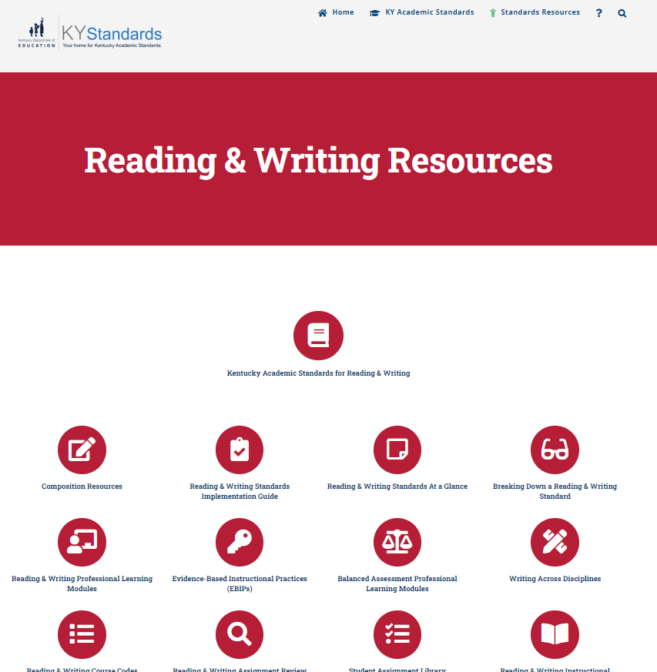
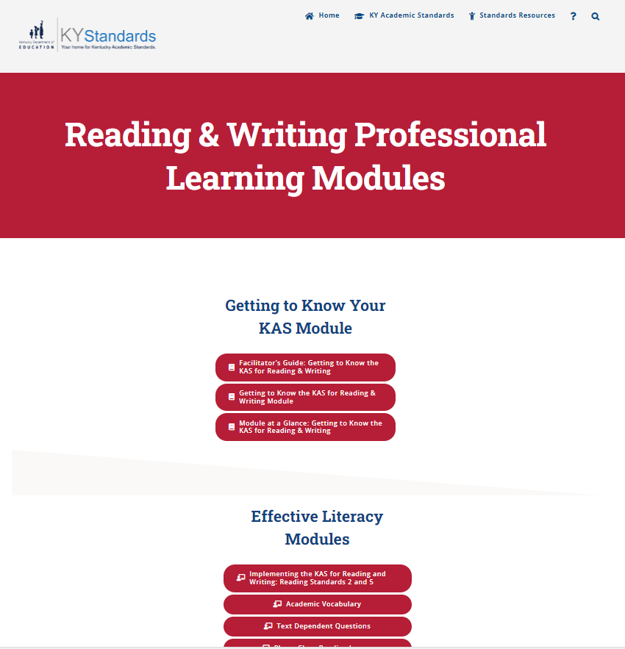
KYStandards.org
Notes:
Since the module is a reading and writing specific resource, we recommend going straight to the Content Area Resources and clicking on the RED Reading & Writing Resources button. Red icons will always represent reading and writing resources.

Slide 17
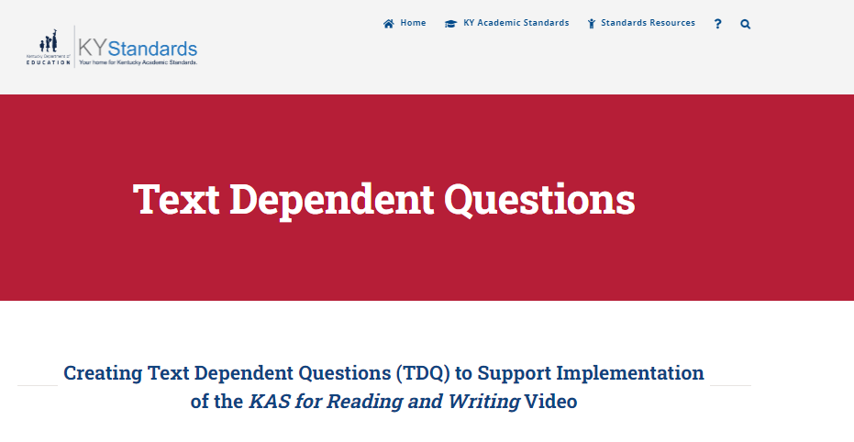
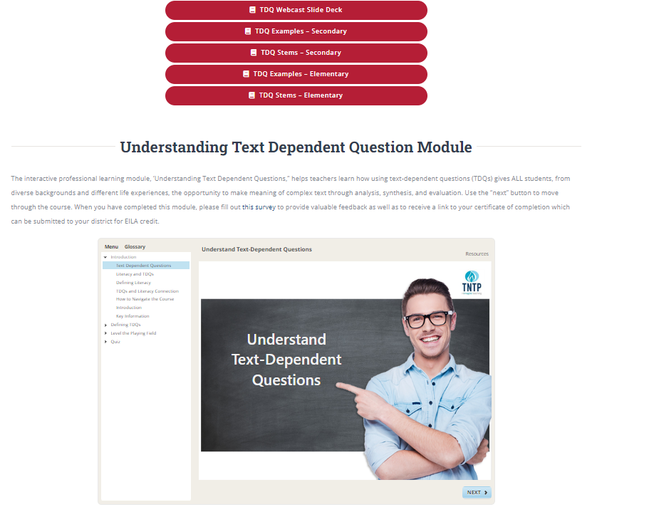
KYStandards.org
Understanding Text-Dependent Question Module
The interactive professional learning module, ‘Understanding Text Dependent Questions,” helps teachers learn how using text-dependent questions (TDQs) gives ALL students, from diverse backgrounds and different life experiences, the opportunity to make meaning of complex text through analysis, synthesis, and evaluation. Use the “next” button to move through the course. When you have completed this module, please fill out this survey to provide valuable feedback as well as to receive a link to your certificate of completion which can be submitted to your district for PD or EILA credit.
Notes:
The Understand Text Dependent Questions Module can be found by choosing the Reading & Writing Professional Learning Modules button on the far left of the second row of resources.

