Slide 1
Superintendents Webcast
March 11, 2025

Slide 2
Agenda
Welcome and Update
Dr. Robbie Fletcher, Commissioner of Education
Kentucky Department of Education Updates
Jennifer Ginn, KDE Director of Communications
2025 Approved HQIRs for Reading and Writing, Mathematics
Micki Ray Marinelli, KDE Chief Academic Officer
Kentucky Numeracy Counts Act Professional Learning Academies Update
Jennifer Fraley, KDE Director of Mathematics Education
Legislative Update
Brian Perry, Ph.D., KDE Director of Government Relations
Questions and Answers
Important Dates

Slide 3
Welcome and Updates
Dr. Robbie Fletcher
Commissioner of Education

Slide 4
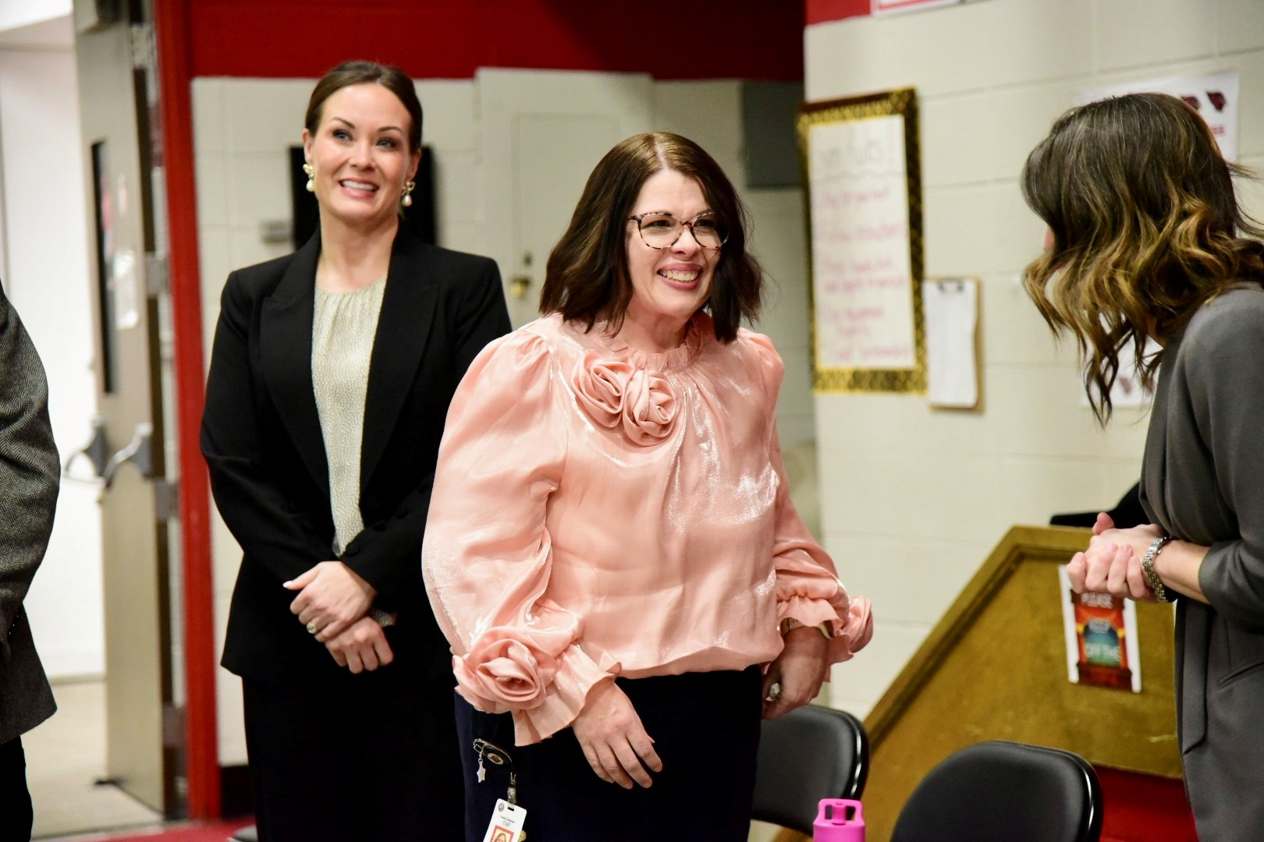
Latonia Elementary’s Kim Frank Earns 2024-2025 Kentucky Education Support Staff Professional Award
Kim Frank is one of the first people visitors see at Latonia Elementary School (Covington Independent), where she serves as a school administrative assistant.
Frank’s dedication to the students, staff and school was honored on Feb. 21 with the 2024-2025 Kentucky Education Support Staff Professional (KESSP) Award.
Lt. Gov. Jacqueline Coleman, Commissioner of Education Robbie Fletcher, school district officials and Frank’s friends and family celebrated her achievement at the school.
The KESSP award was created in 2020 by Gov. Andy Beshear and Lt. Gov. Coleman to recognize more than 46,000 classified school employees in Kentucky.
Read more about Frank’s award on Kentucky Teacher.

Slide 5
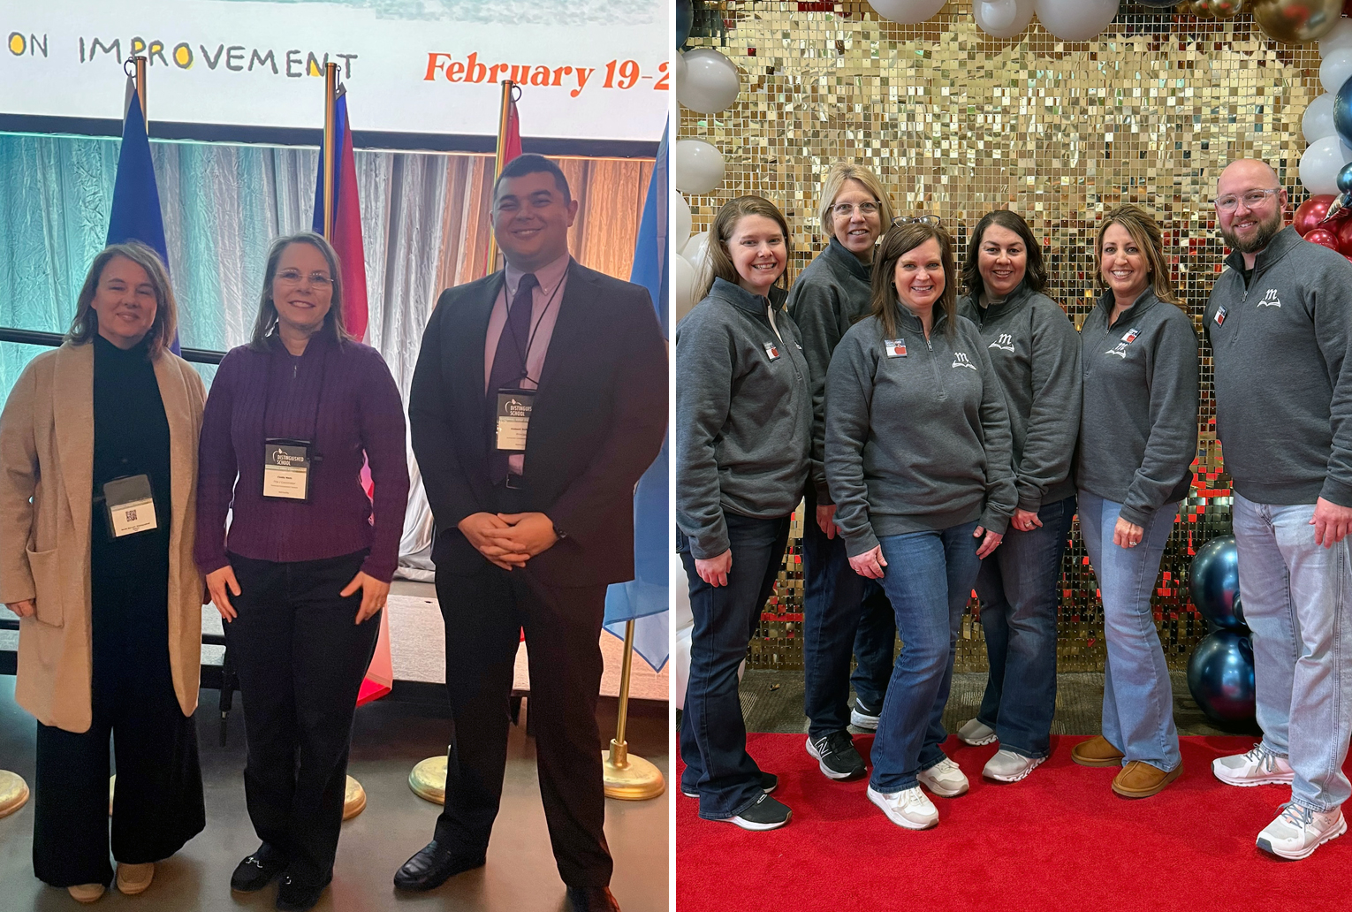
Two Kentucky Schools Named 2024 National ESEA Distinguished Schools
The National Association of ESEA State Program Administrators (NAESPA) named two Kentucky schools as National ESEA Distinguished Schools during its national conference on Feb. 19-21. The two are among 69 schools nationwide to receive the honor.
Glasscock Elementary School (Marion County) was recognized for exceptional student performance for two or more consecutive years.
Hopkins Elementary School (Somerset Independent) was recognized for excellence in serving special populations of students.
NAESPA implemented the National ESEA Distinguished Schools Program to highlight schools that have effectively used their federal Elementary and Secondary Education Act funds to improve education outcomes for students.

Slide 6
KBE Seeking Applicants for KHSAA Board of Control At-large Position
The Kentucky Board of Education (KBE), through KDE, is seeking an individual to serve on the Kentucky High School Athletic Association’s (KHSAA’s) Board of Control to fill an at-large position that will become vacant on June 30. The individual currently holding the position is eligible for reappointment.
The KHSAA is the KBE’s designee to manage statewide interscholastic athletic programs.
The KBE appointed Board of Control member must not be a current employee of a Kentucky public school district.
The deadline for applications is March 30. Materials should be mailed to Todd Allen, General Counsel, Kentucky Department of Education, 300 Sower Blvd., Frankfort, KY 40601, or emailed to Todd Allen.

Slide 7
KDE Updates
Jennifer Ginn
KDE Director of Communications

Slide 8
Competitive Grants from KDE
FY25 KYILN Travel Grant
Grant applications due: April 24 at 4 p.m. ET
Award Amount: Up to $3,000
Matching Funds Requirement: No
The Kentucky Innovative Learning Network (KY-ILN) Travel Grant is intended to support travel to model schools and/or exemplary conferences that promote and concern learner-centered and innovative practices at their programmatic core.
More information about grants can be found on the
KDE Competitive Grants webpage or by emailing Jennifer Bryant.

Slide 9
Applications Sought for Social Studies Standards and Assessment Review Committees
The review process for the Kentucky Academic Standards (KAS) for Social Studies will begin in April.
KDE is seeking current K-12 classroom teachers to participate in this work. Applicants will be required to meet in-person April 28-30, June 17-19 and Sept. 2-4.
If applicable, team members will receive reimbursement for travel expenses and the teacher’s school district will be reimbursed for substitute teacher expenses.
The online application for review committee and advisory panel members will be posted for 30 days. Applications will be accepted through March 21. Selected team members will be notified by March 28.
Questions on this process can be emailed to the Standards Team.

Slide 10

Feedback Sought on Draft of Kentucky Academic Standards for Career Studies and Financial Literacy
KDE is seeking feedback on the draft Kentucky Academic Standards (KAS) for Career Studies and the draft KAS for Financial Literacy.
The drafts were developed by the Advisory Panels and Review Committee, each made up of teachers, postsecondary educators, and business or industry partners from around the state.
To provide feedback on the draft KAS for Career Studies and the draft KAS for Financial Literacy documents, please use the Career Studies and Financial Literacy Public Comment Form. Feedback on the standards will be collected through March 28.
Questions on this process can be directed to Sharon Collins.

Slide 11
2025 Approved HQIRs for Reading/Writing and Mathematics
Micki Ray Marinelli
Chief Academic Officer
Office of Teaching and Learning

Slide 12
Current Marketplace for HQIRs
Educators have more options than ever for instructional resources.
Finding high-quality instructional resources (HQIRs) aligned to Kentucky Academic Standards (KAS) can be challenging in a crowded marketplace.
The approved lists are meant to provide clarity, not be a hinderance to local autonomy and decision-making.

Slide 13
State Law and the Role of Superintendent
Responsible for determining instructional resources for the district in consultation with local board of education, school principal and school council per KRS 160.345.
Shall adopt a common comprehensive reading program that is determined by the department to be reliable, valid and aligned to reading and writing standards required by KRS 158.6453 for K-3 for all schools or a subset of schools, with consultation of all affected elementary school councils (KRS 158.305).
Shall adopt an evidence-based curriculum along with high-quality instructional resources for mathematics that is determined by the department to be reliable, valid and aligned to the Kentucky Academic Standards for Mathematics required by KRS 158.6453 for K-3 (KRS 158.8402).

Slide 14
Kentucky Department of Education (KDE) Guidance
Model Curriculum Framework, Curriculum Development Process
Instructional Resources Consumer Guides for Reading/Writing, Mathematics and Science
Instructional Resources Alignment Rubrics
EdReports.org as the recommended starting point for local evaluation and selection:
  Free reviews of K-12 instructional resources
  Indicators of quality: Standards alignment and usability
  Assurance of at least 80% alignment to KAS for green-rated resources
Notes:
Independent, non-profit. Use expert educators as part of resource reviews. KY educators participate in the process.

Slide 15
KDE Approved Tier 1 Core Comprehensive HQIRs
List of approved Tier 1 core comprehensive HQIRs for reading/writing and mathematics developed using the green-rated resources from EdReports and feedback from the Quality Curriculum Taskforce.
A “core comprehensive instructional resource” is one that serves as the primary means of instruction in a content area for a grade level or course.
Lists will be updated as core comprehensive green-rated resources are added to EdReports.org. Local HQIR coordinators will be notified when resources are added to the list, and communications will be shared via KDE media outlets.
Historically approved resources will not be removed, but rather, KDE will add newly reviewed resources that meet the criteria and earn a green rating.
Notes:
Supplementary resources are not included.

Slide 16
Importance of Local Review and Selection
While all vendors on the approved list meet the KDE standards for HQIRs, districts should carefully review materials to determine which resource(s) best meets the local instructional vision, local priorities, and the needs of the teachers and students in the district.
Off-list notification is still protected and allowable per KRS 156.445:
  KAS alignment using the Instructional Resource Alignment Rubric or a vendor crosswalk to the KAS
  Research basis and/or external validation
  Local progress monitoring to determine impact on student learning
Notification is for off-list Tier 1 core comprehensive resources only, not supplemental resources (i.e., foundational reading skills or writing supplements).
Notes:
Off list notification: Not on the approved list; unrated by EdReports; not currently green-rated. (i.e., Amplify Desmos Math or updates to publications that do not fundamentally change the HQIR).

Slide 17
Local Adoptions
State-level vendor contracts and adoption cycles for materials are not currently applicable.
Superintendents have the authority to develop curriculum and select all instructional resources per KRS 160.345.
Therefore, districts should consider resource adoptions based on statutory requirements, academic standards review cycles, local needs assessments, student data and local contractual timelines.

Slide 18
2025 Approved HQIR Lists
Reading and Writing
Mathematics
For questions/concerns, please reach out to me at Micki.ray@education.ky.gov.

Slide 19

Kentucky Numeracy Counts Act Professional Learning Academies Update
Dr. Jennifer Fraley
Director of Mathematics Education
Office of Teaching and Learning

Slide 20
What is Numeracy?
“Numeracy” means the development of the basic concepts which include counting, place value, addition and subtraction strategies, multiplication and division strategies, and the concepts of time, money and length. (KRS 158.8401(14))

Slide 21
Numeracy ‘Myths’
The “gene myth” that you either have a math gene or you don't
The “gender myth” that one gender is better at math than another
The “speed myth” that math ability is based on how quickly you solve problems
The “memory myth” that math is just about memorizing facts
The “perfection myth” that mathematicians never make mistakes
The “creativity myth” that math is not creative

Slide 22
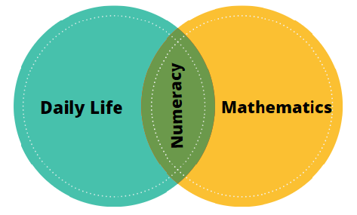
Numeracy is the intersection of mathematics classroom instruction and daily life.

Slide 23
Status of K-12 Implementation
Action Item | Timeline
Published List of Universal Screeners and Diagnostics | Universal Screener and Diagnostic list published. Superintendent selects by January 2026. Local implementation begins the 2026-2027 academic year.
K-8 Professional Learning Academies | EPIC Numeracy Alliance (3-8) – 200 math educators AdvanceKY’s Access to Algebra (MS) - 19 new schools PIMSER Numeracy Counts Administrator Academy (250 administrators). Application available March 17. Year One of Kentucky Center for Mathematics’ K-5 Numeracy Counts Academy (1,000 K-5 math teachers). Application available March 17
HQIR Grants | Purpose: To support K-3 HQIR adoption and/or Curriculum-Based Professional Learning. Funding for 40 districts at $70,000 each Applications closed March 6, 2025. Spring 2025 - Grants awarded
HQIR Adoption | No later than January 2026 KDE will be sharing an “approved list” with superintendents the week of March 10.

Slide 24

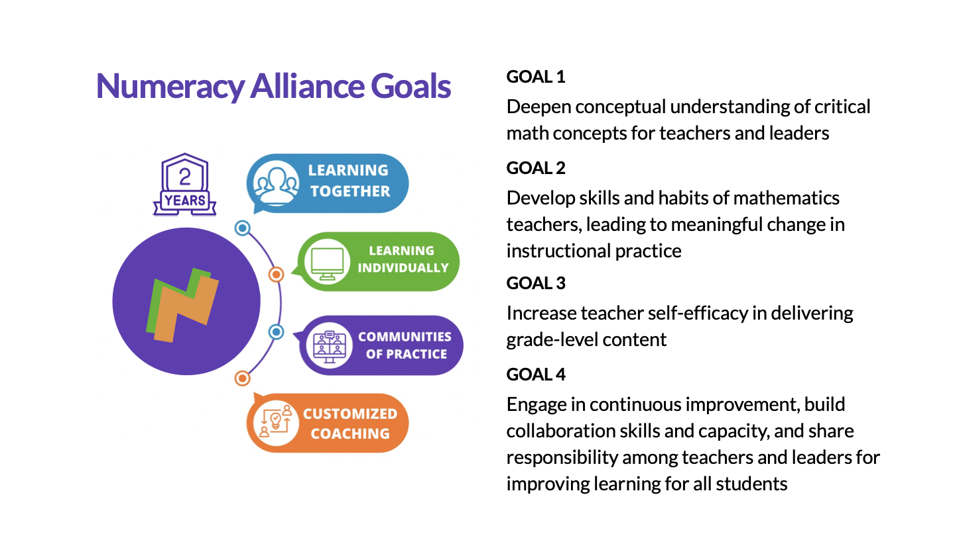
Numeracy Alliance Goals
Carnegie Patterns Professional Learning
Grades 3-5 focus on Early Fraction Concepts
Grades 6-8 focus on Proportional Reasoning
Engaging synchronous and asynchronous virtual learning
1:1 coaching sessions (onsite and virtual)
Learning Community
On-demand, just in time strategy videos
Resources

Slide 25
AdvanceKY Access to Algebra: 19 new sites funded by KYNC (Total of 28 for 2025-2026)
James E. Bazzell MS (Allen County)
Bernheim MS (Bullitt County)
Bullitt Lick MS (Bullitt County)
Eastside MS (Bullitt County)
Hebron MS (Bullitt County)
Mt. Washington MS (Bullitt County)
Zoneton MS (Bullitt County)
Caldwell MS (Caldwell County)
West Carter MS (Carter County)
East Carter MS (Carter County)
John W. Bate MS (Danville Independent)
Crawford MS (Fayette County)
Marion C. Moore (Jefferson County)
Marion County MS
Marion-Lebanon MS (Marion County)
Pineville Independent
Wayne County MS
Paintsville MS (Paintsville Independent)
Williamstown MS (Williamstown Independent
Notes:
Total of 28 sites for 2025-2026 school year

Slide 26


KCM and PIMSER Goals
KCM Numeracy Counts Academy launches in July 2025 - concludes in April 2027
Six research-based, mathematics content focused modules
Strengthen implementation of adopted HQIR
Active learning applied in teacher’s classroom
Collegial and collaborative by region and statewide grade levels
KCM Numeracy Counts mentors to guide the regional groups
PIMSER Administrator Academy launches in June 2025 and concludes June 2026
Four 2-day face-to-face meetings over the school year (Summer 2025, Fall 2025, Spring 2026, Summer 2026)
Ongoing (synchronous and asynchronous) and onsite support for administrators and their local leadership team by experienced mathematics leaders.
Network with practitioner experts and other leaders to learn and grow mathematics teaching and learning with content aligned to KCM K-5 Teacher Academy, including successful implementation of HQIR.

Slide 27




EPIC Contact Information
Rebecca Gaddie
rebecca.gaddie@grrec.org
Audrey Harper
audrey.harper@grrec.or
Professional Learning Academy Partners
Anthony Mires-Executive Director
amires@kstc.com
Annette Williams Program Director-Access to Algebra
awilliams@kstc.com
Kelly Delong, KCM Executive Director
delongk1@nku.edu
Kim Zeidler-Watters
kim.zeidler@pimser.org

Slide 28
Key Resources
House Bill 162 (2024)
House Bill 162 (2024) Kentucky Numeracy Counts Act Implementation Timeline
KY Numeracy Counts Webpage

Slide 29
Legislative Update
Brian Perry, Ph.D.
KDE Director of Government Relations

Slide 30
2025 Regular Session Schedule
The concurrence days are Thursday and Friday, March 13 and 14;
The veto recess is March 15 to March 26; and
The 29th and 30th (sine die) legislative days are Thursday and Friday, March 27 and 28.

Slide 31
How to Follow Along
Session calendar and committee schedule:
  House Primary and Secondary Education meets on Wednesdays at 8 a.m. ET.
  House Appropriations & Revenue meets on Tuesdays at 10 a.m. ET.
  Senate Education meets on Thursdays at 10 a.m. ET.
  Senate Appropriations & Revenue meets on Wednesdays at 9:30 a.m. ET.
How to watch committee meetings
  KET
  Legislative Research Commission (LRC) YouTube channel
  Follow bills on the LRC website

Slide 32
Committee Changes
House split the Education Committee
  Primary and Secondary Education committee
    Rep. Scott Lewis chairs
      Former superintendent of Hancock County and Ohio County
    Rep. Mike Clines serves as vice-chair
      27 years with the Roman Catholic Diocese of Covington school system as a teacher, guidance counselor and principal
  Postsecondary Education committee
    Rep. James Tipton chairs
    Rep. Shane Baker serves as vice-chair

Slide 33
Education Committee Members
SENATE
Stephen West - Chair
Lindsey Tichenor - Vice Chair
Danny Carroll
David P. Givens
Jimmy Higdon
Stephen Meredith
Gerald A. Neal
Steve Rawlings
Aaron Reed
Reginald Thomas
Gex Williams
Mike Wilson
Max Wise
HOUSE PRIMARY AND SECONDARY EDUCATION
Scott Lewis - Chair
Mike Clines - Vice Chair
Tina Bojanowski
Steve Bratcher
Emily Callaway
Josh Calloway
Adrielle Camuel
Steven Doan
Ken Fleming
Daniel Grossberg
David Hale
Kevin Jackson
Marianne Proctor
Felicia Rabourn
Steve Riley
James Tipton
Timmy Truett
Lisa Willner

Slide 34
Signed/Otherwise became Law
Senate Bill (SB) 23: AN ACT relating to administrative regulations and declaring an emergency.

Slide 35
Delivered to the Governor
SB 73: AN ACT relating to sexual extortion.

Slide 36
Back to Original Chamber for Concurrence/ Nonconcurrence
House Bill (HB) 241: AN ACT relating to school district calendars and declaring an emergency (now with SB 268, AN ACT relating to virtual education, included)

Slide 37
Passed One Chamber
HB 14: AN ACT relating to school safety.
HB 44: AN ACT relating to choking prevention in schools.
HB 48: AN ACT relating to education.
HB 73: AN ACT relating to employers of the Teachers' Retirement System.
HB 132: AN ACT relating to home and hospital instruction.
HB 190: AN ACT relating to advanced educational opportunities.
HB 193: AN ACT relating to dual credit scholarships.
HB 240: AN ACT relating to primary school.
HB 251: AN ACT relating to the evaluation of educator preparation programs.
HB 263: AN ACT relating to the student teacher stipend program.
HB 272: AN ACT relating to reading and writing in schools.
HB 298: AN ACT relating to schools identified for comprehensive support and improvement in schools.
HB 342: AN ACT relating to financial literacy.
HB 356: AN ACT relating to urban youth agriculture education.
HB 430: AN ACT relating to school bus safety training.
HB 433: AN ACT relating to school construction.
HB 441: AN ACT relating to reemployment after retirement in the Teachers' Retirement System.
HB 566: AN ACT relating to the Kentucky Horse Racing and Gaming Corporation and declaring an emergency.

Slide 38
Passed One Chamber (Continued)
HB 606: AN ACT relating to general obligation bonds
HB 661: AN ACT relating to the transportation of students and declaring an emergency.
HB 669: AN ACT relating to student attendance days and declaring an emergency.
HB 688: AN ACT relating to health care.
HB 694: AN ACT relating to Teachers' Retirement System benefit funding.
SB 4: AN ACT relating to protection of information and declaring an emergency.
SB 6: AN ACT relating to the Support Education Excellence in Kentucky Program.
SB 19: AN ACT relating to moments of silence and reflection.
SB 38: AN ACT relating to school bus safety.
SB 68: AN ACT relating to education.
SB 77: AN ACT relating to the Education Professional Standards Board.
SB 79: AN ACT relating to state personnel.
SB 83: AN ACT relating to KEES scholarships for students attending noncertified schools.
SB 120: AN ACT relating to interscholastic athletics
SB 181: AN ACT relating to school employee and volunteer misconduct.
SB 207: AN ACT relating to public school innovation.

Slide 39
Awaiting a Floor Vote
HB 208: AN ACT relating to technology in public schools.
HB 324: AN ACT relating to educators.
HB 758: AN ACT relating to career and technical education.
HB 809: AN ACT relating to student health.
SB 75: AN ACT relating to concealed deadly weapons.

Slide 40
Questions
Brian Perry, Ph.D., Director of Government Relations, Office of the Commissioner
brian.perry@education.ky.gov

Slide 41
Question and Answer Session
(Submit Questions in Teams)
KDE Leadership

Slide 42
Important Dates
Agriculture Education Week
March 17-21
Kentucky United We Learn Council
March 20
Kentucky Board of Education
March 26-27
Superintendents Webcast
April 8

