Slide 1
Superintendents Webcast
August 12, 2025

Slide 2
Agenda
Welcome and Updates
Dr. Robbie Fletcher, Commissioner of Education
Kentucky Department of Education Update
Jennifer Ginn, KDE Director of Communications
Continuous Improvement Summit
Associate Commissioner Kelly Foster, KDE Office of Continuous Improvement and Support
KY Learning Hub
Micki Marinelli, KDE Chief Academic Officer
Marty Park, KDE Chief Digital Officer
Essential Workplace Ethics Survey
Lauren Graves, KDE Policy Advisor, Office of Career and Technical Education
Fall 2025 Attend Hours
Amy Tracy, KDE Data Manager, Office of Career and Technical Education
Questions and Answers
Important Dates

Slide 3
Welcome and Updates
Dr. Robbie Fletcher
Commissioner of Education

Slide 4

KDE Seeking New Kentucky United We Learn Council Members
KDE is seeking new members – particularly high school students and their families – for the Kentucky United We Learn Council.
The council and KDE have worked closely together to create a new Model Framework that details recommendations for a new vision of the state’s assessment and accountability systems, focusing on more local input and encouraging vibrant learning experiences for every student.
Going forward, the council will help champion the work already underway in Kentucky schools and offer valuable input on bold, innovative next steps to shape the future of the high school experience in the Commonwealth.
If you’re passionate about education, please fill out the Kentucky United We Learn Council application and share it with members of your community. Applications will be accepted through Sept. 26.

Slide 5
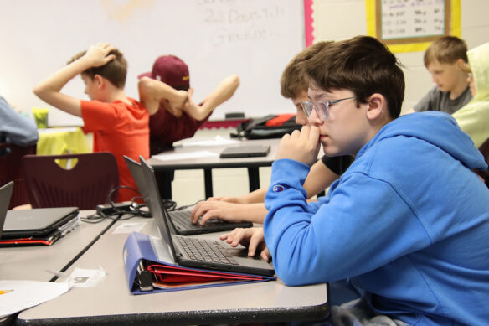
Kentucky to Participate in Middle School Career Learning Network Grant Program
Kentucky is participating in a new national grant program – the Middle School Career Impact and Learning Network – which will help establish the gold standard for what middle school career exploration should look like.
The program is run by American Student Assistance, a national nonprofit helping students learn about careers and prepare for their futures, with support from Education Strategy Group, an organization committed to expanding economic mobility by increasing educational attainment.
Kentucky is one of five inaugural member states identified as a leading state in the “Extending the Runway: A 50-State Analysis of Middle School Career Exploration report. The others are Arizona, Arkansas, Pennsylvania and Washington.
These states were invited to join the network because their leadership demonstrates a commitment to middle school career exploration with a strong policy foundation and infrastructure to build upon.

Slide 6

Chronic Absentee Campaign
KDE has kicked off another marketing campaign aimed at helping reduce chronic absenteeism.
Last school year’s campaign was aimed at raising awareness of chronic absenteeism. This year is focused on students feeling they belong at school.

Slide 7
Chronic Absentee Campaign (2)
KDE’s chronic absentee campaign will be heard and seen across the state
YouTube ad, audio streaming ad, online streaming, display ads
Rupp Arena exterior display board
Yum Center exterior display board, 400 interior display screens
38 billboards located around the state
All 48 LexTran buses will have two advertisements – one in English and one in Spanish – located on the interior; 12 buses will have exterior side panel graphics.
All 85 TARC Transit (Louisville) buses will have two advertisements located on the interior; four buses will have exterior side panel graphics; 50 bus shelters will have large interior and exterior graphics.
The main gates at the Kentucky Exposition Center will have ads running on the large screens above the ticketing booths

Slide 8
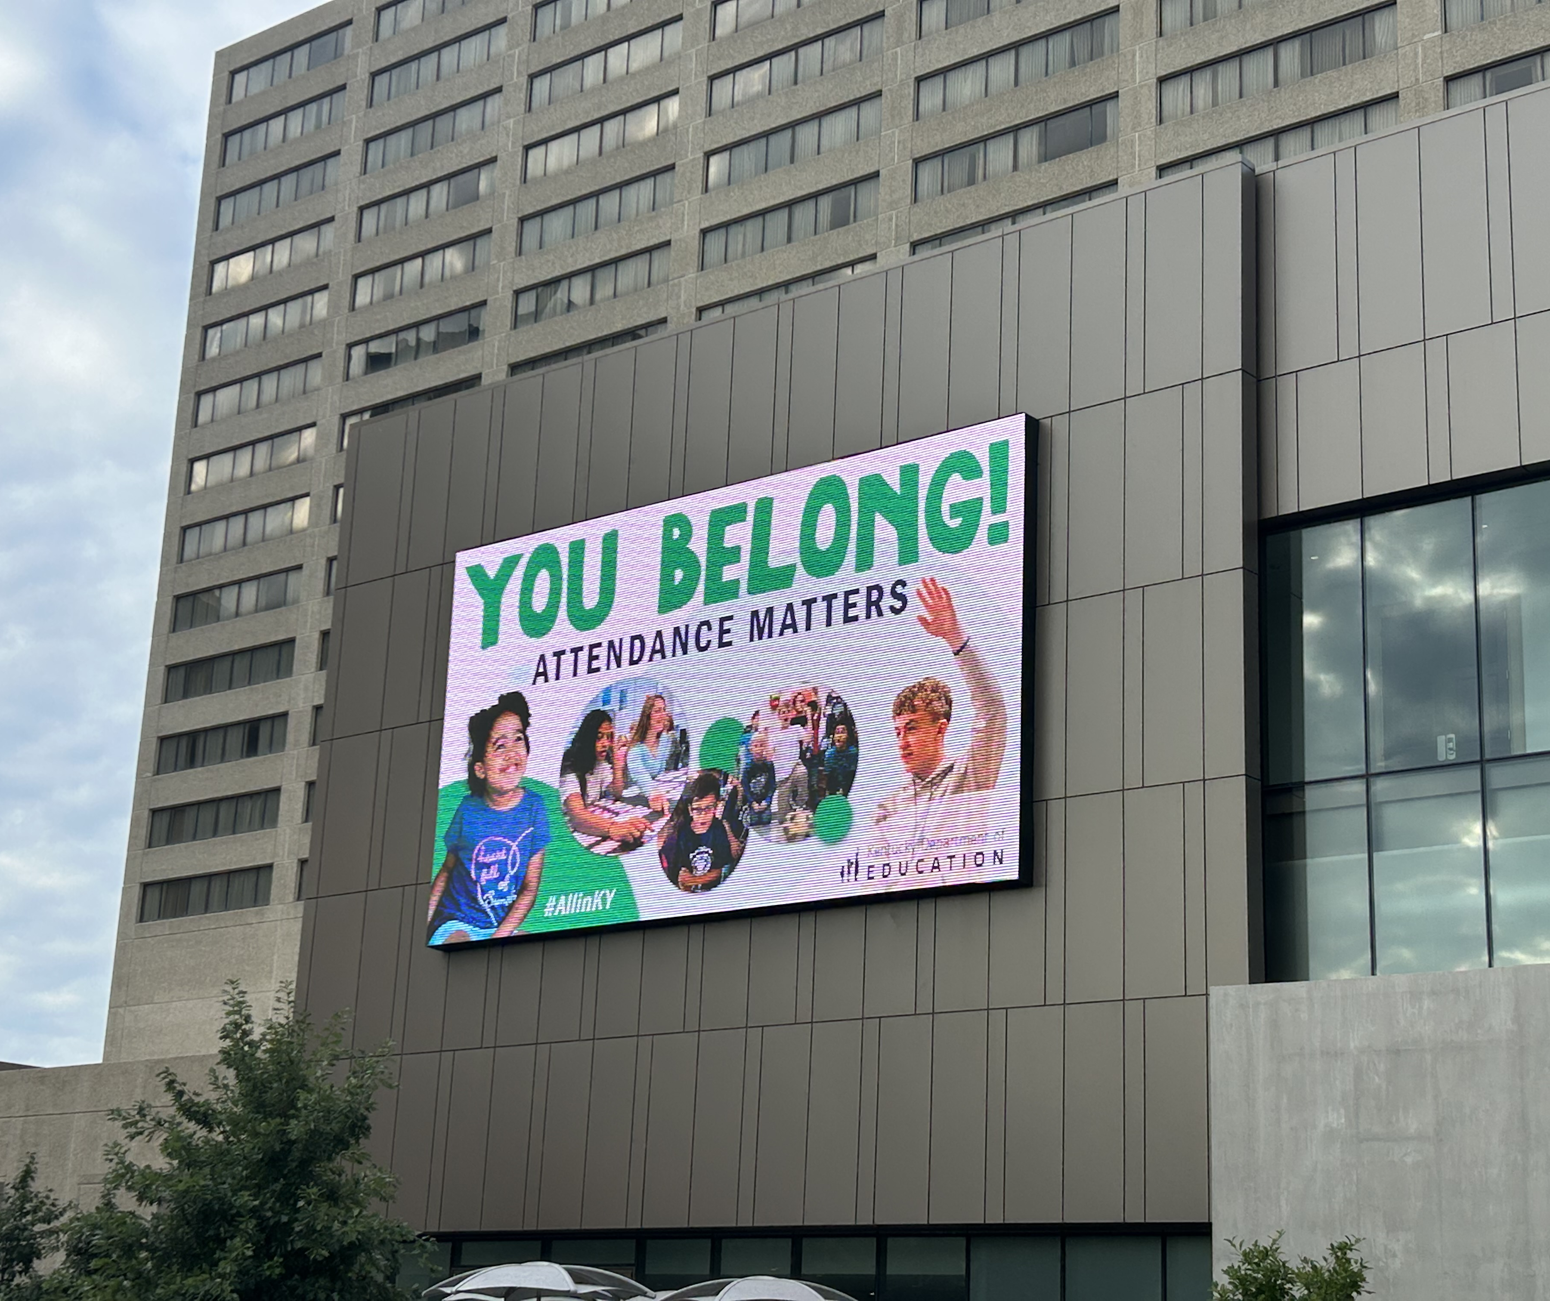
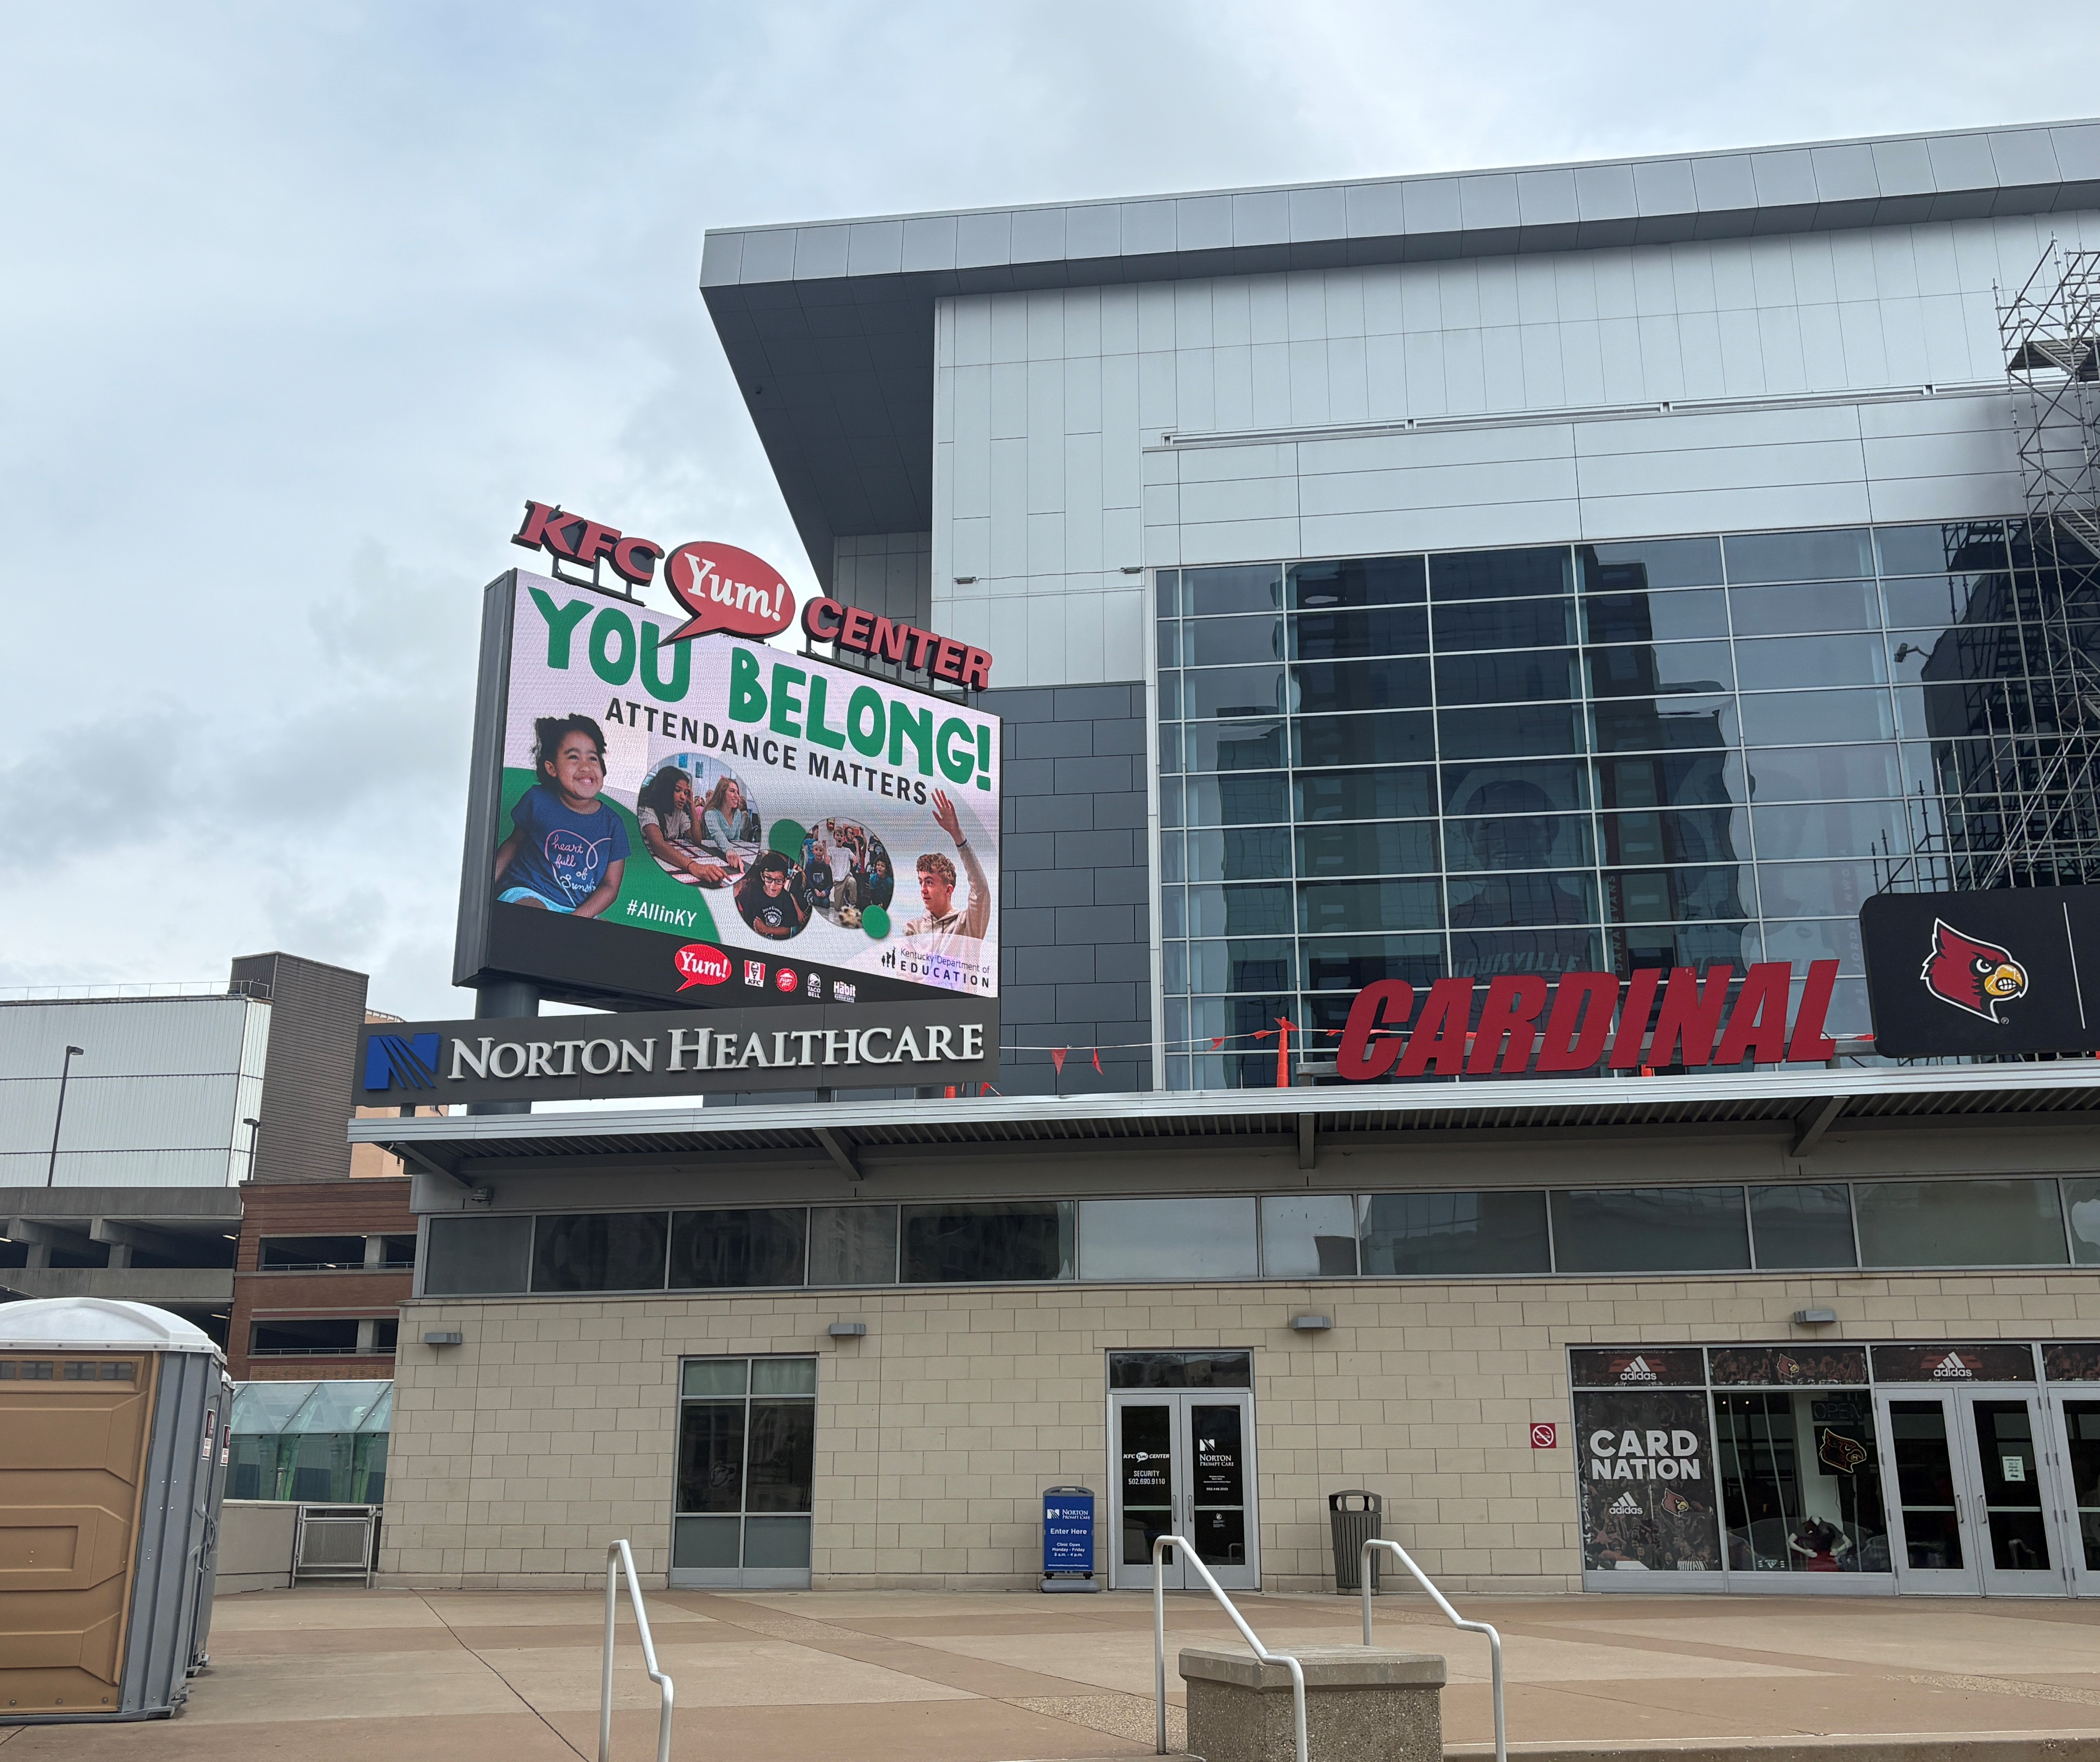
Chronic Absentee Campaign (3)

Slide 9

Watch KDE’s Chronic Absentee Ad
Watch the chronic absentee ad, featuring Kentucky public school students, on KDE’s YouTube channel.

Slide 10

Language Essentials for Teachers of Reading and Spelling
(LETRS) Professional Learning
Over 6,000 Kentucky educators and administrators in Cohorts 1-3 of LETRS professional learning.
Cohort 4 (2025-2027) registration closes in August.
            LETRS for Educators Cohort 4: This course is recommended for K-5 teachers, interventionists, reading specialists, instructional coaches and anyone providing reading instruction or intervention supports to early readers.
          LETRS for Administrators Cohort 4: This course is recommended for instructional coaches who have completed LETRS for Educators, district leaders and building administrators.

Slide 11
KDE Updates
Jennifer Ginn
KDE Director of Communications

Slide 12
Competitive Grants from KDE
The FY26 grant year begins on July 1, 2025, and ends on June 30, 2026. FY26 refers to the year the grant will be awarded, not when projects are expected to begin. Refer to the posted RFA for specific timelines.
FY26 CTE Innovation and Support Grant
Grant applications due: Nov. 20 at 4 p.m. ET
Award Amount: $100,000
Matching Funds Requirement: No
The purpose of the Career and Technical Education (CTE) Innovation and Support grant is to support innovation in new or emerging career fields. The school district must submit a separate application for each CTE school or CTE program in a comprehensive high school. Area Technology Centers can submit an independent application.
Applicants are responsible for monitoring KDE’s Competitive Grants webpage for amendments and updates to the posted RFAs and supporting materials. More information about grants can be found on the
KDE Competitive Grants webpage or by emailing Jennifer Bryant.

Slide 13

Applications Open for 2026 U.S. Senate Youth Program
The 2026 U.S. Senate Youth Program is a merit-based program that takes the most outstanding high school students from around the country to Washington, D.C., for a week-long study of the federal government and the people who lead it.
Two Kentucky high school students will be selected this fall as delegates and will each receive a $10,000 college scholarship in the name of the U.S. Senate, with encouragement to continue coursework in history, government and public affairs.
High school teachers and principals are encouraged to nominate qualified high school juniors and seniors to apply. Applications for the 2025 USSYP program are available online and are due Sept. 29.

Slide 14

Applications Open for the 2025-2026 Class of GoTeachKY Ambassadors
The mission of GoTeachKY, an initiative of KDE, is to ensure that all students across the Commonwealth have equitable access to effective educators.
Ambassadors act as the face of the GoTeachKY initiative, connecting with prospective educators and community members. They foster positive in-person connections with colleagues and students at secondary and post-secondary schools.
Visit the GoTeachKY Ambassador Program Application to get started today! Applications close on Sept. 30.
To learn more about eligibility guidelines for GoTeachKY ambassadors, visit Kentucky Teacher.

Slide 15
2025 Continuous Improvement Summit
Kelly Foster, Ed.D.
Associate Commissioner
Office of Continuous Improvement and Support

Slide 16
2025 Continuous Improvement Summit
Registration for KDE’s 2025 Continuous Improvement Summit is open!
The summit will be held Sept. 22–23 at the Central Bank Center in Lexington.
This year’s keynote speaker is Missy Testerman, the 2024 National Teacher of the Year. She teaches English as a second language to students from kindergarten through 8th grade and is a passionate advocate for her students, their families and fellow teachers. A Tennessee native and first-generation college graduate, Testerman takes pride in her former students’ success and is dedicated to ensuring the next generation receives a broadened education while living in a rural setting. She emphasizes the importance of teachers holding high expectations for all students from the moment they step into the classroom.
The registration form can be found on the 2025 Kentucky Continuous Improvement Summit event webpage​.

Slide 17
KY Learning Hub
Micki Marinelli, KDE Chief Academic Officer, Office of Teaching and Learning
Marty Park, KDE Chief Digital Officer, Office of Education Technology

Slide 18

Kentucky’s home for high-quality professional learning!
Proudly Introducing:

Slide 19




the WHY
H
Q
P
L
Inconsistent User Experiences
Unconfirmed Participant Growth
Characteristics and Structure of HQPL

Slide 20










Collaboration with other states
West Virginia
Virginia
Maryland
North Carolina
New Hampshire
Utah
South Dakota
South Carolina

Slide 21
Aligning to HQPL
Characteristics
Content-focused and standards-aligned
Considerate of adult learners
Symmetrical to vibrant student learning experiences
Using models of effective practices
Providing coaching and expert support
Focusing on feedback and reflection
Is sustained, continuous and scalable
Learning Structures that work
Workshops
PLC models
Communities of practice
Peer observation models
Coaching models
Consultation models

Slide 22
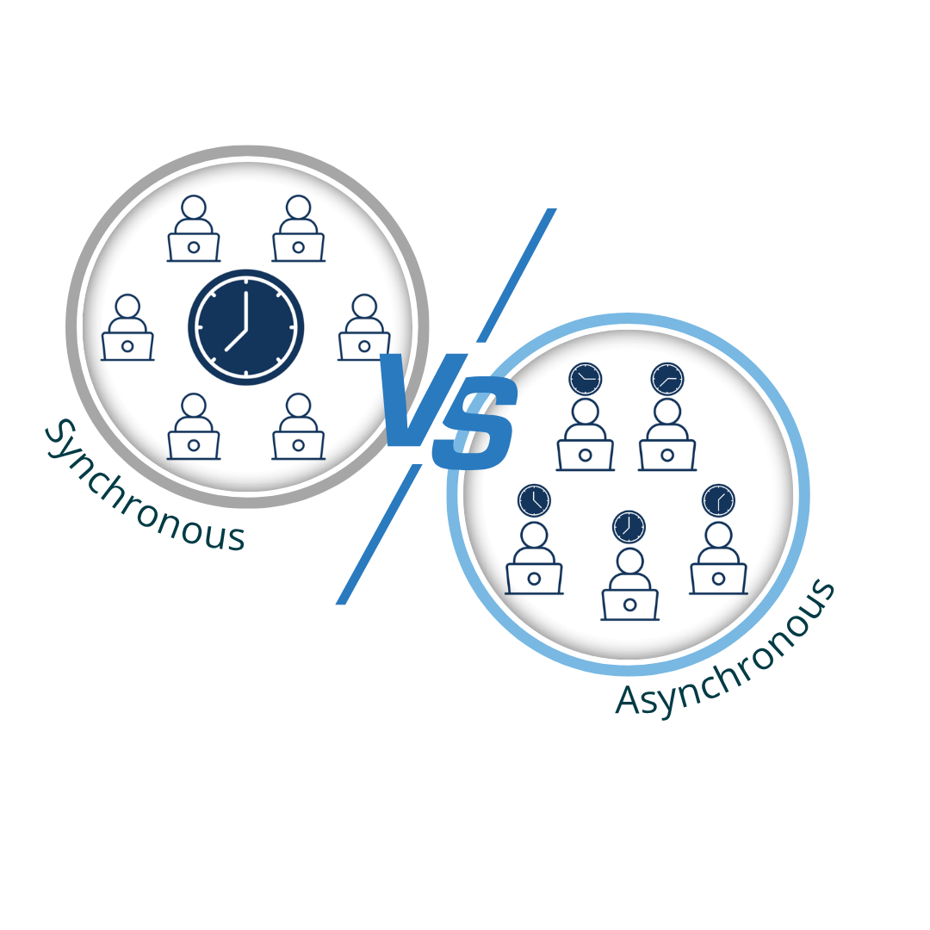
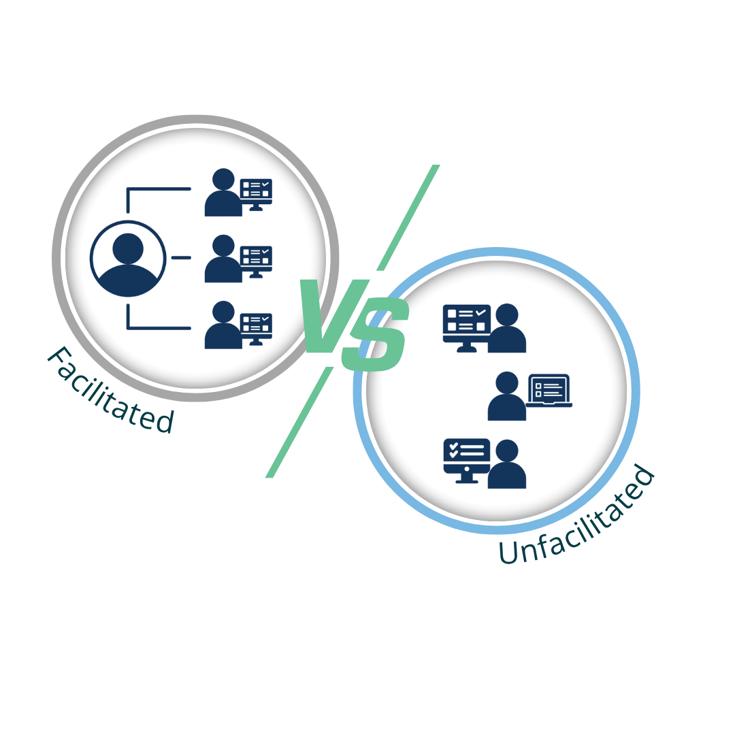


Adult Learning Designs
Intrinsically
Motivated

Slide 23






the WHO
Classified Staff
Certified Staff
Required Trainings
Invited to Learn

Slide 24
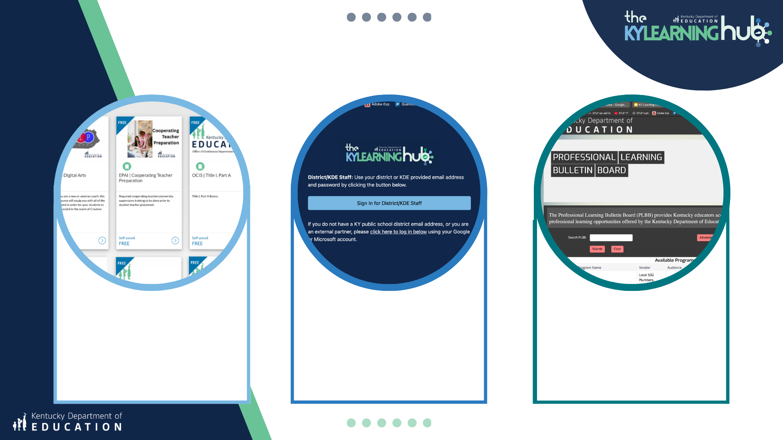
the WHAT
Catalog
Canvas
PLBB
Notes:
Marty

Slide 25
KyLearningHub.org
Notes:
Marty

Slide 26
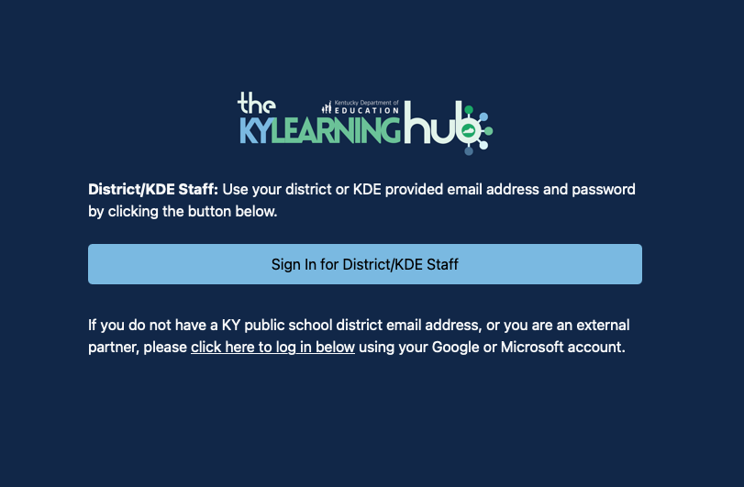
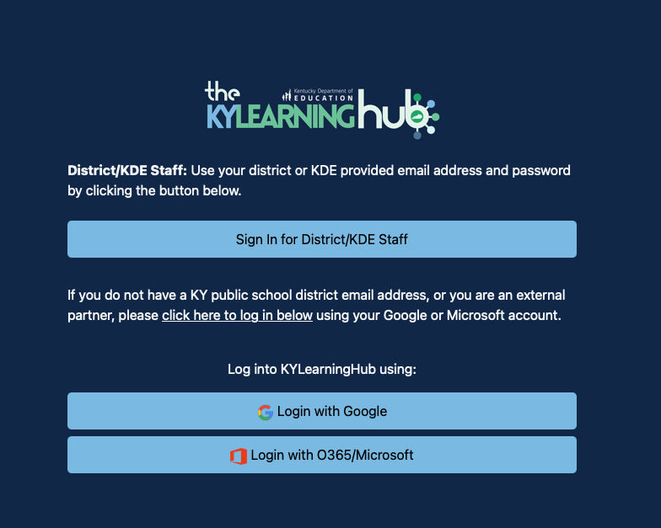
How to Access the KYLearningHub
Notes:
Marty

Slide 27
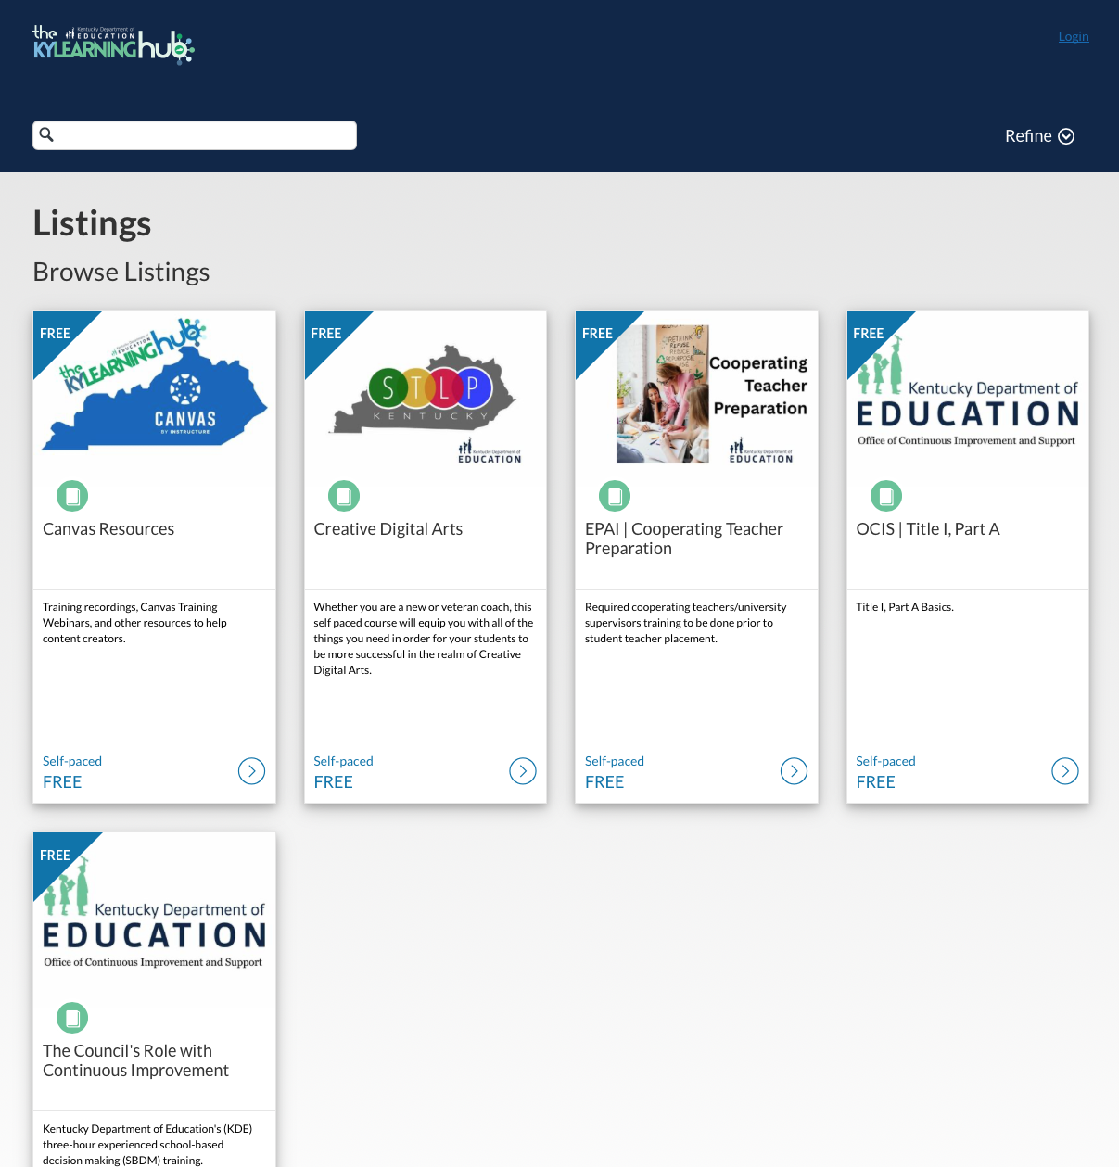
What’s Available on the KYLearningHub
?
?
?
Who’s next?
Who’s next?
Who’s next?

Slide 28
Questions?
Thank you!

Slide 29
Essential Workplace Ethics Survey
Lauren Graves, KDE Policy Advisor
Office of Career and Technical Education

Slide 30
Essential Workplace Ethics Survey
Per KRS 158.1413, Section 5:
By September 1, 2019, and every two years thereafter, the superintendent of each school district shall provide to the commissioner of education and the Kentucky Workforce Innovation Board a report, in a format specified by the commissioner, describing the school district’s essential workplace ethics programs and how they are being implemented at each school. A summary report compiled by the commissioner that includes information from all local school district reports shall be provided to the Kentucky Board of Education, the Interim Joint Committee on Education, the Kentucky Workforce Innovation Board and each Kentucky superintendent and principal in order to foster program improvement and sharing of best practices.

Slide 31
Survey
The survey covers program characteristics (adaptability, diligence, initiative, knowledge, reliability, remaining drug-free and working well with others), instructional programming overview, compliance, collaboration with local partners and student awards.
The link was provided via email on June 10, 2025.
One survey submission per district.
Due by Sept. 1, 2025.

Slide 32
Fall 2025 Attend Hours
Amy Tracy, KDE Data Manager
Office of Career and Technical Education

Slide 33
Attend Hours --- New Process
Change to Process
  New: We will pull these for your schools and email the reports to the career and technical education (CTE) point of contact (POC) listed on the KDE Open House webpage. We will request the CTE POC to verify the accuracy and approve this through email. This will be the deliverable for the CTE Supplemental Funding for the 2026-2027 year. (You will no longer need to pull this report and upload to SharePoint.)
  UPDATE: Please ensure your CTE POC is correct on the Open House webpage and update that role if necessary. This is to ensure your report will be sent to the appropriate person for verification and return approval as the deliverable for the district’s CTE Supplemental Funding for school year 2026-2027.
  QUESTIONS: If you have questions, please email Amy Tracy, Office of Career and Technical Education Data Manager, or call (502) 564-4286, ext. 4277.

Slide 34
Change to Dates
Attend Hours Due: Nov. 30 annually – Information in TEDS – no report to submit
Email Verification for Attend Hours Sent: CTE point of contact for the district should receive this by mid December. **Make sure this is updated and correct in Open House by Nov. 30.**
Email Verification for Attend Hours Approval: Return email of verification of Attend Hours due back by end of December.

Slide 35
Question and Answer Session
(Submit Questions in Teams)
KDE Leadership

Slide 36
Important Dates
Education Professional Standards Board
Aug. 19
Superintendents Advisory Council
Aug. 26
Superintendents Webcast
Sept. 9
All in for Ag Education Week
Sept. 15-19
Kentucky Board of Education
Oct. 1-2

