Slide 1
Superintendents Webcast
July 15, 2025

Slide 2
Agenda
Welcome and Updates
Dr. Robbie Fletcher, Commissioner of Education
Kentucky Department of Education Update
Jennifer Ginn, KDE Director of Communications
Agriculture Education Week
Bethany Mattingly, Kentucky Department of Agriculture
Impact KY
Elly Gilbert, Assistant Director, Division of Educator Recruitment and Development
Violence Prevention in Youth Dating Relationships
Indica Meeks, Behavioral Health Liaison, Administrative Office of the Courts
Nakela Cleveland, Senior Program Specialist, ZeroV.org
College Admissions Exam
Associate Commissioner Jennifer Stafford, KDE Office of Assessment and Accountability
Senate Bill 181 Questions and Answers
Deputy Commissioner Todd Allen, KDE Chief Legal Counsel
Important Dates

Slide 3
Welcome and Updates
Dr. Robbie Fletcher
Commissioner of Education

Slide 4
Important Due Dates
The Important Due Dates for Superintendents document is updated and available on SharePoint.

Slide 5
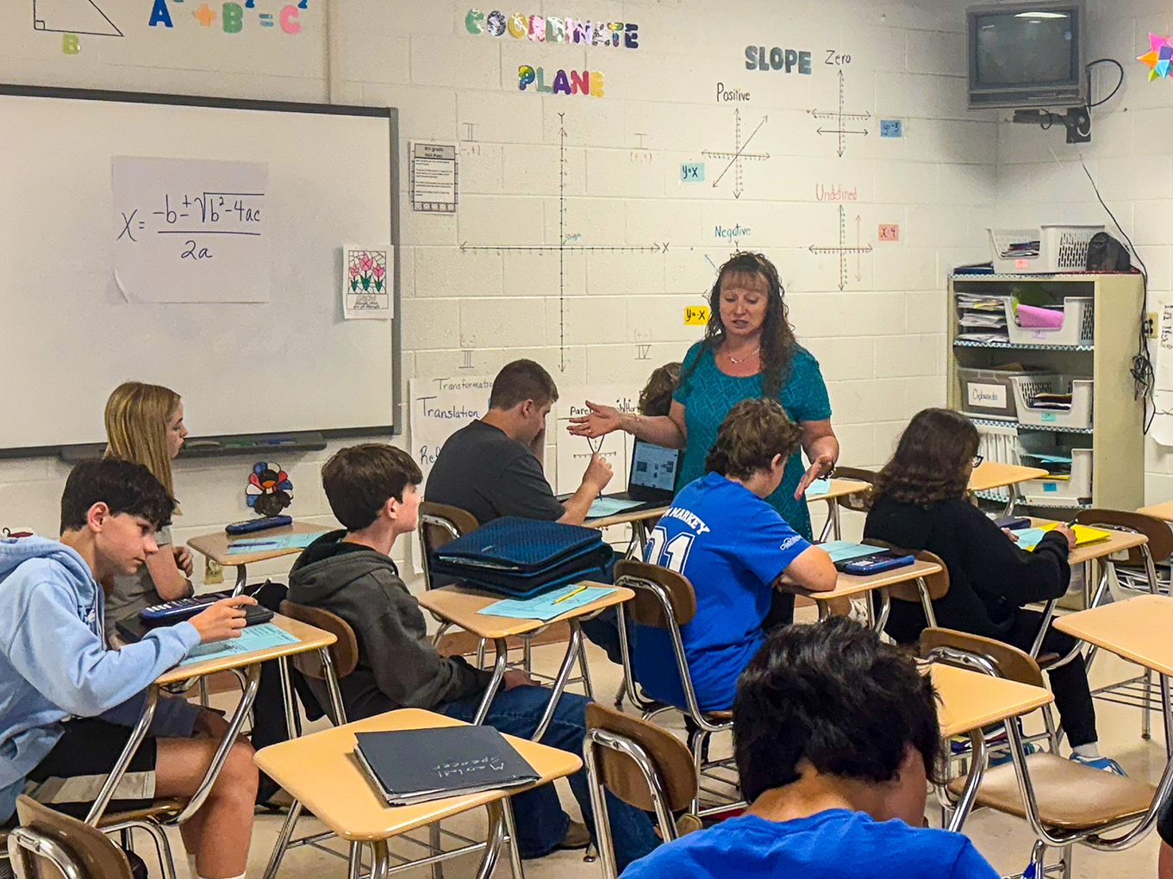
Wolfe County Ranks First in the Nation on Education Recovery Scorecard
The Wolfe County school district ranked as the number one district in the nation in math growth on the 2024 Education Recovery Scorecard by Stanford and Harvard.
The Education Recovery Scorecard is a collaboration between the Center for Education Policy Research at Harvard University and The Educational Opportunity Project at Stanford University. Each year, they issue a report on district-level student growth in math and reading.
The 2024 edition measures education recovery efforts in nearly 7,500 districts post COVID-19.
Wolfe County placed number one in math growth with 1.45 grade levels gained between 2022 to 2024. They placed as the number four district in reading scores with 1.03 grade levels gained between 2022 to 2024.

Slide 6
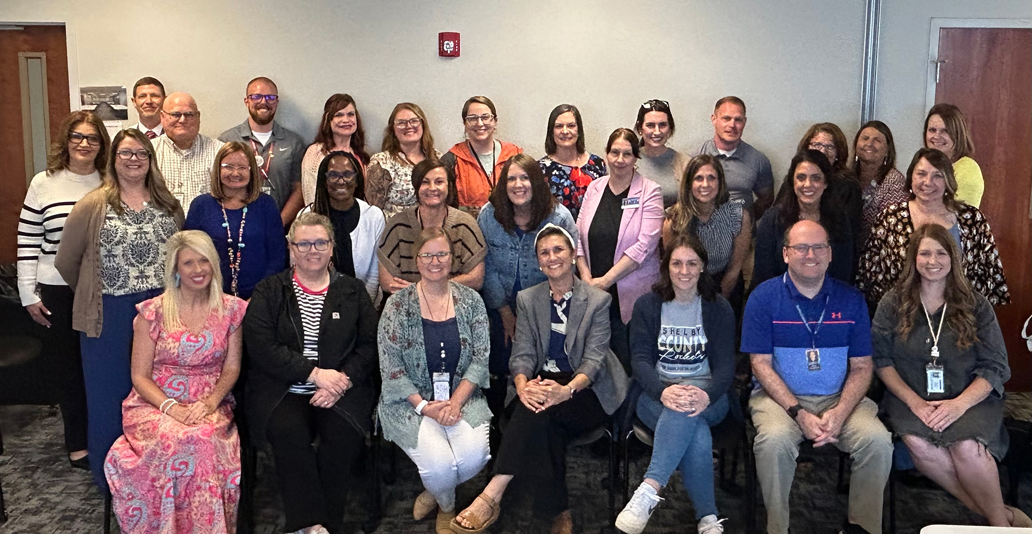
Kentucky Educators Complete NISL Leadership Program
A group of 68 Kentucky educators successfully completed the nationally recognized National Institute for School and System Leadership (NISL) program during the 2024-2025 school year.
Offered through a long-standing partnership between the KDE and the National Center on Education and the Economy, this leadership development experience equips school and district leaders with skills, strategies and vision to drive meaningful and sustainable change in their learning communities.
Learn more about the NISL program on Kentucky Teacher.

Slide 7

Educators Rising Kentucky Names State Officers for 2025-2026 Academic Year
Educators Rising Kentucky named six students to its team of state officers for the 2025-2026 academic year. This leadership team will begin their term on July 1.
The student state officers include:
  President: Hunter Carr, Graves County High School – Region 1;
  President-elect: Lily Russell, Ignite Institute (Boone County) – Region 6;
  Director of Membership: Alyssa Pollard, Ballard High School (Jefferson County) – Region 3;
  Co-director of Communications: Haley Chowning, Seneca High School (Jefferson County) – Region 3;
  Co-director of Communications: Kelly Esquivel Hernandez, Central High Magnet Career Academy (Jefferson County) – Region 3; and
  Director of Outreach and Service: Nia Serikali, Central High Magnet Career Academy (Jefferson County) – Region 3.
Educators Rising Kentucky is the career and technical student organization for middle and high school students interested in education-related careers.

Slide 8
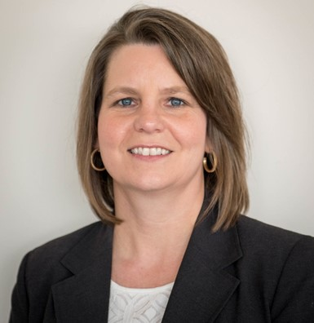
Jennifer Stafford Takes Over as KDE’s Associate Commissioner for OAA
Stafford began her new position on July 1, replacing longtime Associate Commissioner Rhonda Sims, who is retiring on June 30.
Stafford brings more than two decades of experience in education and assessment to her new role.
A long-time leader within KDE, she has served as the director of the Division of Assessment and Accountability Support since 2015. She also has been actively involved with the Kentucky United We Learn Council and its efforts to help transform the Commonwealth’s assessment and accountability systems.

Slide 9
KDE Updates
Jennifer Ginn
KDE Director of Communications

Slide 10
Competitive Grants from KDE
The FY26 grant year begins on July 1, 2025, and ends on June 30, 2026. FY26 refers to when the grant will be awarded, not when projects will begin. Refer to the posted RFA for specific timelines.
FY26 Community Education RFA
Grant applications due: July 17, 4 p.m. ET
Award Amount: $20,000 per awarded district
Matching Funds Requirement: Yes, $5,000 salary match.
KDE is issuing a request for application (RFA) to implement local community education initiatives. Community education allows all members in a community to become meaningfully involved in the decisions that impact community support of public education, helps students acquire the skills and competencies needed for success after high school, expands the use of public facilities to meet the needs of all community members, provides programs and services that address the needs of all ages, creates a spirit of collaboration among community agencies and works to improve home, school and community relations.
Current grantees do not need to reapply.

Slide 11
Competitive Grants from KDE (2)
FY26 Fresh Fruit and Vegetable Program (FFVP)
Grant applications due: July 25 at 4 p.m. ET
Award Amount: Varies by # of students served.
Matching Funds Requirement: No
The purpose of the Fresh Fruit and Vegetable program is to increase fresh fruit and vegetable consumption in elementary schools. Elementary schools that represent the state's highest free and reduced-price enrollment are eligible to participate in the program and are given priority for being selected due to their high level of need. ​
FY26 CTE Innovation and Support Grant(CTEI)
Grant applications due: Nov. 20 at 4 p.m. ET
Award Amount: $100,000
Matching Funds Requirement: No
The purpose of the Career and Technical Education (CTE) Innovation and Support grant is to support innovation in new or emerging career fields. The school district must submit a separate application for each CTE school or CTE program in a comprehensive high school. Area Technology Centers (ATC) can submit an independent application.
Applicants are responsible for monitoring KDE’s Competitive Grants webpage for amendments and updates to the posted RFAs and supporting materials. More information about grants can be found on the KDE Competitive Grants webpage or by emailing Jennifer Bryant.

Slide 12

Language Essentials for Teachers of Reading and Spelling
(LETRS) Professional Learning
Over 6,000 Kentucky educators and administrators in Cohorts 1-3 of LETRS professional learning.
Cohort 4 (2025-2027) registration closes in August.
            LETRS for Educators Cohort 4: This course is recommended for K-5 teachers, interventionists, reading specialists, instructional coaches and anyone providing reading instruction or intervention supports to early readers.
          LETRS for Administrators Cohort 4: This course is recommended for instructional coaches who have completed LETRS for Educators, district leaders and building administrators.

Slide 13
Agriculture Education Week
Bethany Mattingly
Kentucky Department of Agriculture

Slide 14

Next Ag Education Week Set for Sept. 15-19

Slide 15
Impact KY
Associate Commissioner Meredith Brewer, Ph.D.
Elly Gilbert, Assistant Director, KDE Division of Educator Recruitment and Development

Slide 16
Impact Kentucky 2025-2026
A statewide working conditions survey for certified public school staff
Administered Nov. 10 – Dec. 19, 2025
Implemented by KDE in partnership with Panorama Education
Collects educator voice on key priorities and concerns

Slide 17
Why is this survey important?
Trusted, data-driven tool for over 10 years (from TELL to Impact)
Shapes school and district improvement
Empowers educators to be heard
Results guide decisions around professional learning, culture and working conditions

Slide 18
Who makes it happen?
KDE and Panorama Education oversee statewide implementation
Aug. 15: Superintendents receive an email with survey instructions
Superintendents (or designees) contact principals
Principals, in partnership with their SBDM council, appoint a school survey coordinator
Coordinators support survey rollout at the school level

Slide 19
Each School Needs One Coordinator
Distributes survey access codes
Monitors participation
Main contact for survey-related communication
Must be a teacher leader

Slide 20
Steps to Identify Survey Coordinators
SBDM coordinators will contact all schools by Friday, Oct. 3
Schools will choose a teacher leader as survey coordinator
Two options to register:
  Have each coordinator register themselves via survey form
  Principal can register coordinator via survey form

Slide 21
Principals and Coordinators Should
Work Together to:
Provide an accurate count of certified staff working at least half-time in your building
Include teachers, counselors, assistant principals, principals, therapists
Do not overestimate – more codes can always be requested!

Slide 22
Important Dates
Aug. 15: Superintendent email goes out
Sept. 15: Principal email goes out
Oct. 3: All principals have been contacted to identify coordinators
Oct. 10: Deadline to register school survey coordinators
Nov. 10-Dec. 19: Survey administration window
February 2026: Results available

Slide 23
For Questions or Support
Elly Gilbert​
Assistant Director, Educator Recruitment and Development​
Office of Educator Licensure and Effectiveness​
Kentucky Department of Education​
elly.gilbert@education.ky.gov

Slide 24
Violence Prevention in Youth Dating Relationships
Indica Meeks, Behavioral Health Liaison, Administrative Office of the Courts
Nakela Cleveland, Senior Program Specialist, ZeroV.org

Slide 25

Kentucky Judicial Commission on Mental Health
Administrative Office of the Courts

Slide 26








What is the Kentucky Judicial Commission on Mental Health?
The Kentucky Judicial Commission on Mental Health
August 11, 2022, a Supreme Court initiative
Chaired by Deputy Chief Justice Robert B. Conley, Kentucky Supreme Court
10 workgroups
Charged with exploring, recommending and implementing transformational changes to improve system wide responses
Notes:
The Kentucky Judicial Commission on Mental Health was established on August 11th, 2022nd as a Supreme Court initiative
It is chaired by Deputy Chief Justice Conley of the Kentucky Supreme Court
The Commission has 10 different working groups each charged with exploring, recommending, and implementing transformational changes to improve system wide responses to justice-involved individuals experiencing mental health needs​, substance use, and/or intellectual and developmental disabilities.

Slide 27
The Domestic Violence Workgroup
Chaired by Judge Denise Brown, 30th Judicial Circuit
Comprised of 62 members
Workgroup’s goal is:
To understand, explore and implement trauma-informed and evidence-based solutions to assist the court community and stakeholders in best serving persons involved in domestic violence or interpersonal violence cases, including individuals who are or may be experiencing mental illness, substance use disorder, or intellectual and/or developmental disabilities, through a lens of physical and psychological safety, accountability, and effective implementation techniques.
Notes:
The Commission’s Domestic Violence Workgroup is chaired by Judge Brown and comprised of about 62 members.
The workgroup is focused on many different focus areas, such as creating education and training materials for our courts, mapping out domestic violence resources throughout Kentucky, and expanding domestic violence advocacy services in Kentucky schools.

Slide 28
KJCMH Domestic Violence Advocacy in Schools Subgroup: Healthy Relationships Initiative
The KJCMH Domestic Violence Advocacy in Schools Subgroup aims to strengthen awareness of dating violence and promote collaboration between schools and advocacy organizations. This effort underscores the importance of early education and support for youth who may be impacted. The initiative seeks to foster safe and supportive environments by promoting awareness and the promotion of healthy relationship education across school communities.
Two evidence-based curricula identified to support the KJCMH Subgroup’s Healthy Relationships initiative are Safe Dates and the Fourth R Program. Please explore each curriculum via the hyperlinks provided: Safe Dates and 4th R Program.

Slide 29
What the curriculums cover
Safe Dates
4th R Program
10 session program
45–50 minutes
Middle/high school students
Topics: defining caring relationships, defining dating abuse, why people abuse, helping friends, overcoming gender stereotypes, equal power through communication, how we feel/how we deal, and preventing sexual assault
Can be presented by classroom teachers or advocacy center certified presenters
Taught in the classroom
Skill-focused and relationship-based
Grades 7, 8 and 9
Topics: personal safety & injury prevention, substance use, addictions & related behaviors, human development & sexual health, and healthy eating
Grade 7: 27 lesson plans; 40-45 minutes
Grade 8: 28 lesson plans; 35-40 minutes
Grade 9: 26 lesson plans; 70 minutes
Can be presented by classroom teachers

Slide 30

Contact Us
Indica Meeks, MSCJ
Behavioral Health Liaison
AOC-Office of Statewide Programs
Nakela Cleveland, CSW
Senior Program Specialist
ZeroV.org- Education, Accountability and Change Program
502.209.5382
ncleveland@zerov.org
502.542.3855
indicameeks@kycourts.net

Slide 31

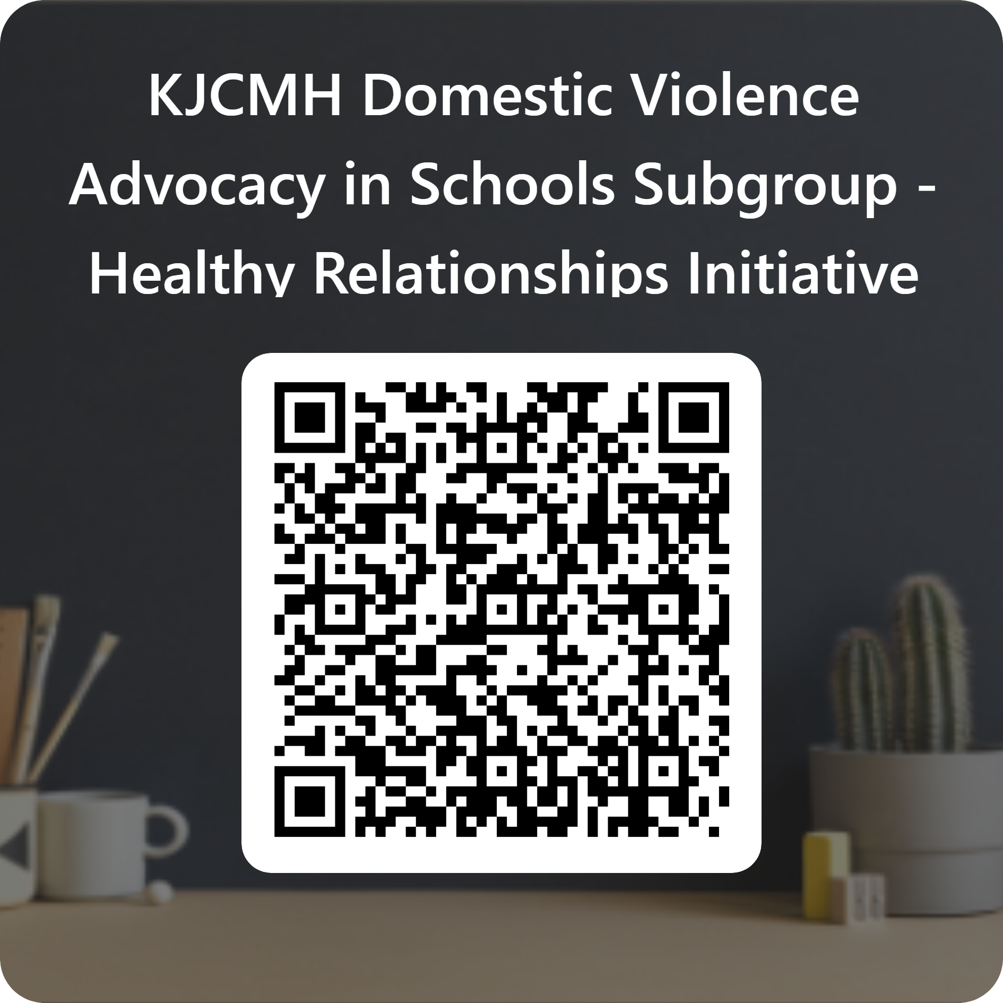
Tell us how we’re doing
We value your input—please take a moment to complete the evaluation form using the QR code provided. Your feedback helps us better understand and serve the unique needs of your community.

Slide 32
College Admissions Exam
Associate Commissioner Jennifer Stafford,
KDE Office of Assessment and Accountability

Slide 33
College Admissions Exam – New Vendor
Beginning with the 2025–2026 school year, College Board was awarded the contract to provide the SAT for the state administration of the college admissions exam as required by KRS 158.6453.
Rising seniors (Class of 2026) took the ACT. Rising juniors (Class of 2027) will be impacted by this contract.
Many districts are already familiar with College Board through the Advanced Placement (AP) courses and exams. This existing relationship is expected to ease the transition and support a smooth implementation across Kentucky high schools.
This transition will provide students with a high-quality assessment that continues to support Postsecondary Readiness. The SAT benchmark scores that determine academic readiness are established by the Kentucky Council on Postsecondary Education. More information can be found on how SAT assesses college and career readiness.

Slide 34
College Admissions Exam – SAT Assessment
The SAT Junior State Administration is an adaptive exam. It is a two hour and 14-minute exam that assesses students’ reading, writing, math and science skills. The test has two sections, Reading & Writing and Math, generating a score for each section on a 200-800 scale. Through its unique design, the SAT also delivers an Analysis in Science score generated by students’ performance on relevant questions within the Reading & Writing and Math sections.

Slide 35
College Admissions Exam – Resources & Schedule of Events
More details to come

Slide 36
Senate Bill 181 Questions and Answers
Deputy Commissioner Todd Allen,
KDE Chief Legal Counsel

Slide 37
Question and Answer Session
(Submit Questions in Teams)
KDE Leadership

Slide 38
Important Dates (2)
Education Professional Standards Board
July 28
Local Superintendents Advisory Council
July 29
Kentucky Board of Education
Aug. 6-7
Superintendents Webcast
Aug. 12

