Slide 1
Superintendents Webcast
May 13, 2025

Slide 2
Agenda
Welcome and Updates
Dr. Robbie Fletcher, Commissioner of Education
Kentucky Department of Education Update
Myles Young, KDE Assistant Director of Communications
School Health Updates
Jim Tackett, KDE School Health Branch Manager
New Teacher Survey
Associate Commissioner Meredith Brewer, Office of Educator Licensure and Effectiveness
Legislative Guidance Update
Brian Perry, Ph.D., KDE Director of Government Relations
Questions and Answers
Important Dates

Slide 3
Welcome and Updates
Dr. Robbie Fletcher
Commissioner of Education

Slide 4
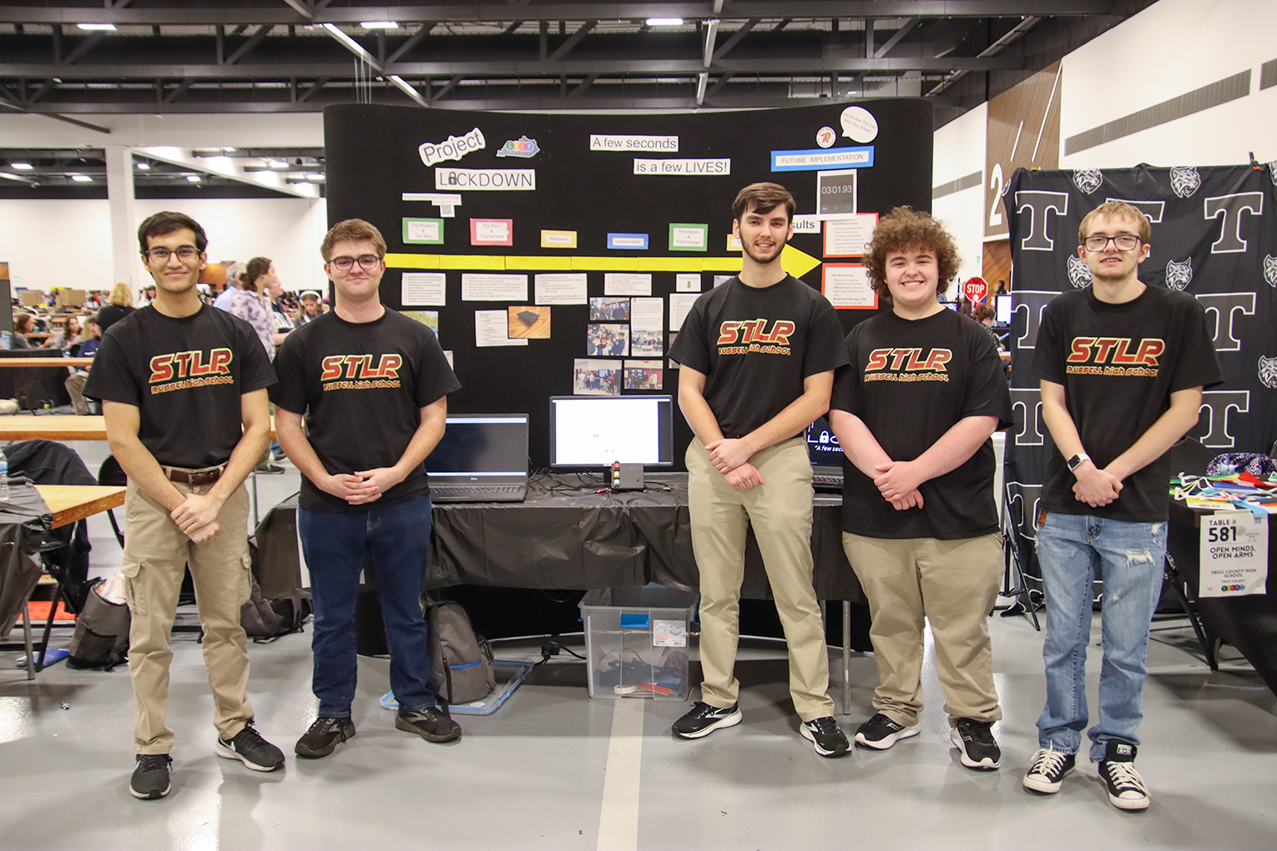
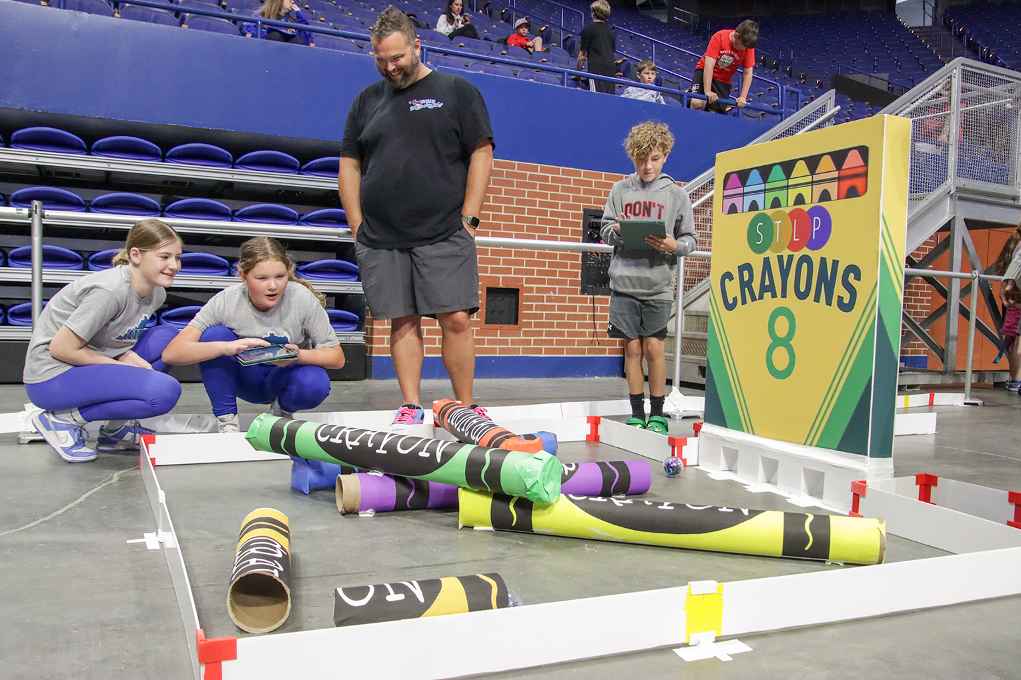
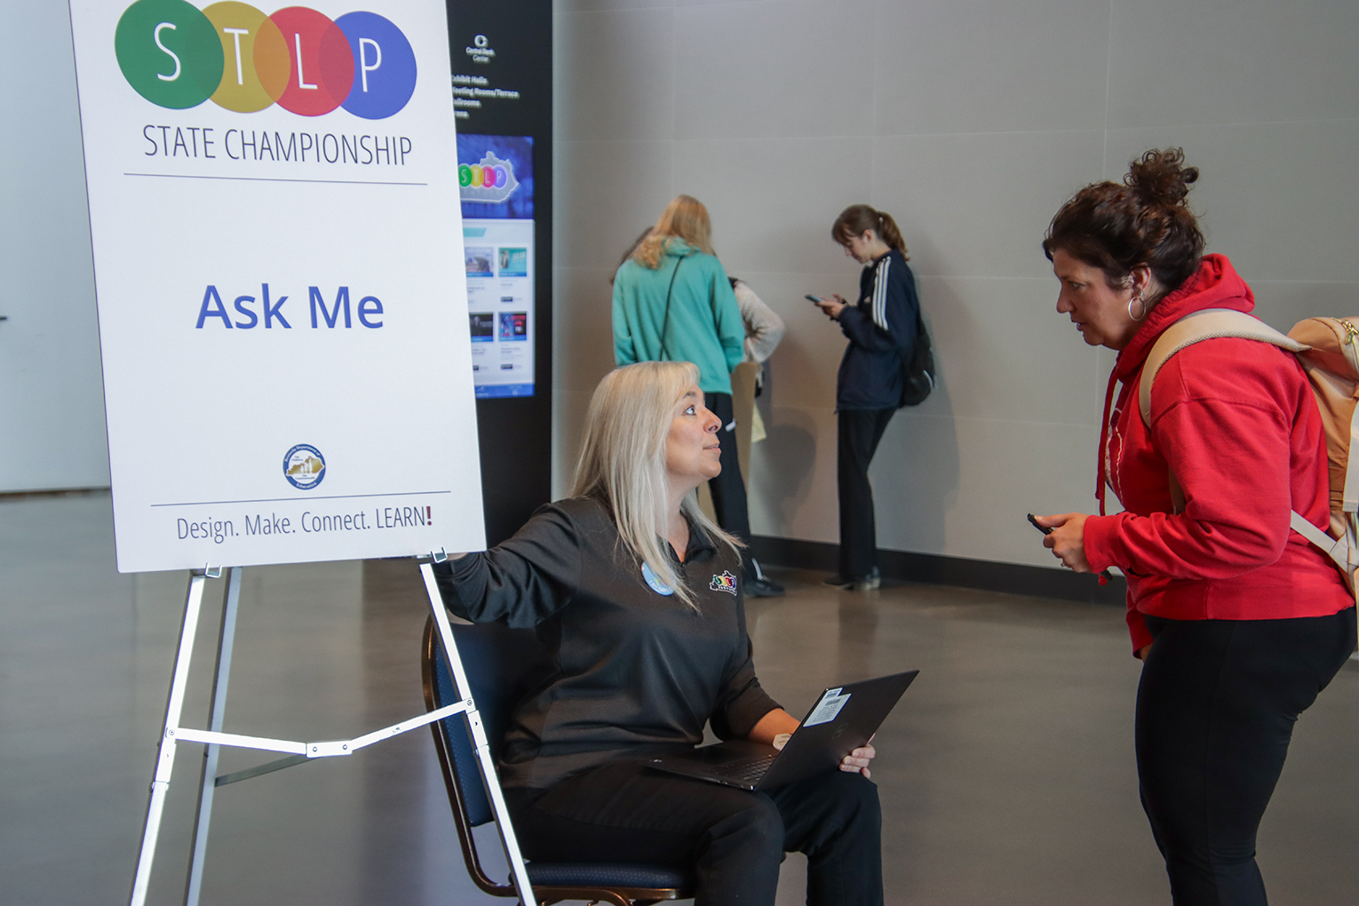
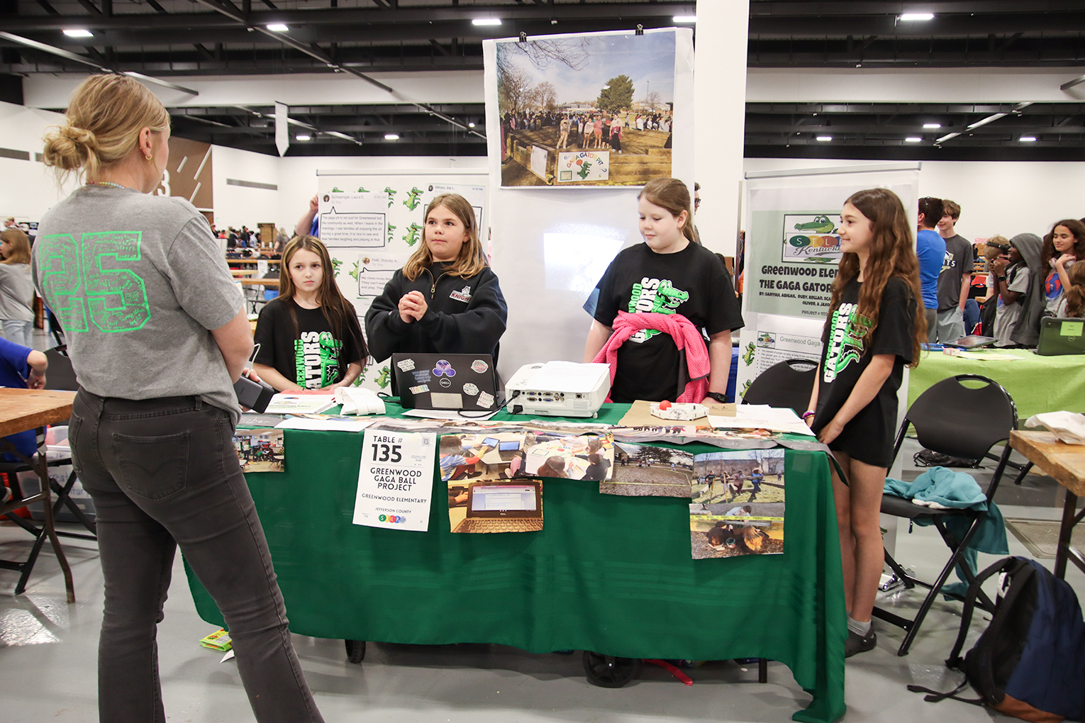
2025 STLP State Championship
Thanks to all of our districts who have students participating in STLP!

Slide 5

Educators Rising Kentucky Announces State Delegates
Educators Rising Kentucky has selected 10 students to represent aspiring educators from across the Commonwealth at the 2025 national conference, which will be held in June in Orlando, Fla.
Each year, Educators Rising hosts a national conference to bring together their network of rising educators and teacher leaders. It’s a unique opportunity for all attendees to compete, connect, network and gain knowledge.
Congratulations to the following students
Mckinley Heard, lead delegate, South Warren High School (Warren County);
Skylar Smith, Ballard High School (Jefferson County);
Abby Seavers, Graves County High School;
Kaylenn Morganti, Graves County High School;
Marley Cobb, Henry County High School;
Lily Russell, Ignite Institute (Boone County);
Makenzi Downs, Nelson County Schools/Grow Nelson;
Jermaine Hayden, Waggener High School (Jefferson County);
Jacob Ridener, Whitley County High School; and
Garrett Sharp, Whitley County High School.

Slide 6
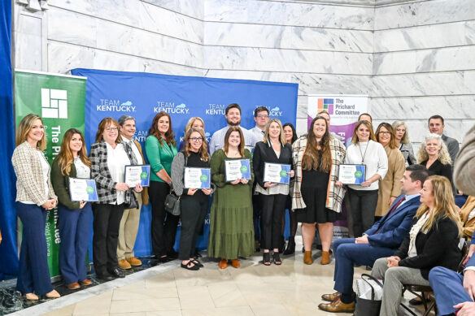
Seven Campbell County Schools Earn Family Friendly Certification
The Prichard Committee has recognized all seven schools in Campbell County as Family Friendly Schools, highlighting their commitment to creating supportive environments for students and their families.
This recognition comes after a rigorous year-long application process where schools submitted detailed narratives with evidence showcasing their efforts in fostering family engagement and support.
By being recognized as Family Friendly Schools, these schools demonstrate their dedication to building strong partnerships with families, ultimately enhancing the educational experience for students.

Slide 7

Two Middle School Educators Honored with 2025 SHAPE Teacher of the Year Award
Juli Neace of Highlands Middle School (Fort Thomas Independent) and Melanie Smith of Model Laboratory School in Richmond have been recognized as 2025 Southern District Teachers of the Year by the Society of Health and Physical Educators (SHAPE America).
Neace is being highlighted for her work in middle school physical education and Smith for her work in health education.
The Teacher of the Year awards are given in recognition of outstanding teaching performance and the ability to motivate today's youth to participate in a lifetime of physical activity.

Slide 8
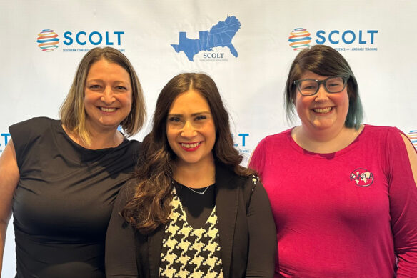
2025 Kentucky World Language Teacher of the Year Advances to Nationals
Stephanie Bellot-Donaldson, a Spanish Literacy teacher at Hawthorne Elementary School (Jefferson County) and 2024 Kentucky World Language Association (KWLA) Outstanding Teacher of the Year, has been selected as the recipient of the 2025 Southern Conference on Language Teaching regional Teacher of the Year award.
She received the award on March 21 at the SCOLT Conference in Nashville, Tenn.
This award is intended to elevate the status and the public profile of the language profession at the state, regional and national levels by creating opportunities to recognize accomplished members of the world languages profession.
Stephanie Bellot-Donaldson, center, a Spanish teacher at Hawthorne Elementary School (Jefferson County), stands with Nadine Jacobsen-McLean, left, a Spanish teacher at Hawthorne Elementary School, and M. Beck Sexton, a Spanish teacher at Eastern High School (Jefferson County) and Kentucky World Language Association president.

Slide 9

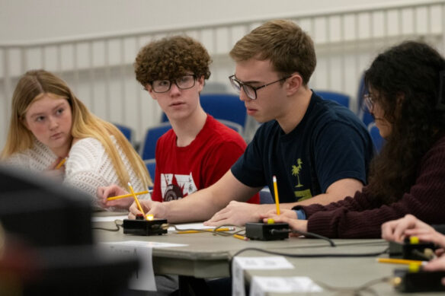
Calloway and Owensboro Teams Win Science Bowl
Calloway County Middle School and Owensboro High School (Owensboro Independent) emerged victorious in the U.S. Department of Energy (DOE) West Kentucky Regional Science Bowl, showcasing their dedication and expertise in science and mathematics.
Calloway County Middle and Owensboro High School each won $1,200 for their respective school.
The five-member team from each school traveled to Washington, D.C., for the National Science Bowl this spring. This marks Calloway County Middle School’s third trip to the finals.
Read more about the science bowl wins on Kentucky Teacher,

Slide 10
KDE Updates
Myles Young
KDE Assistant Director of Communications

Slide 11
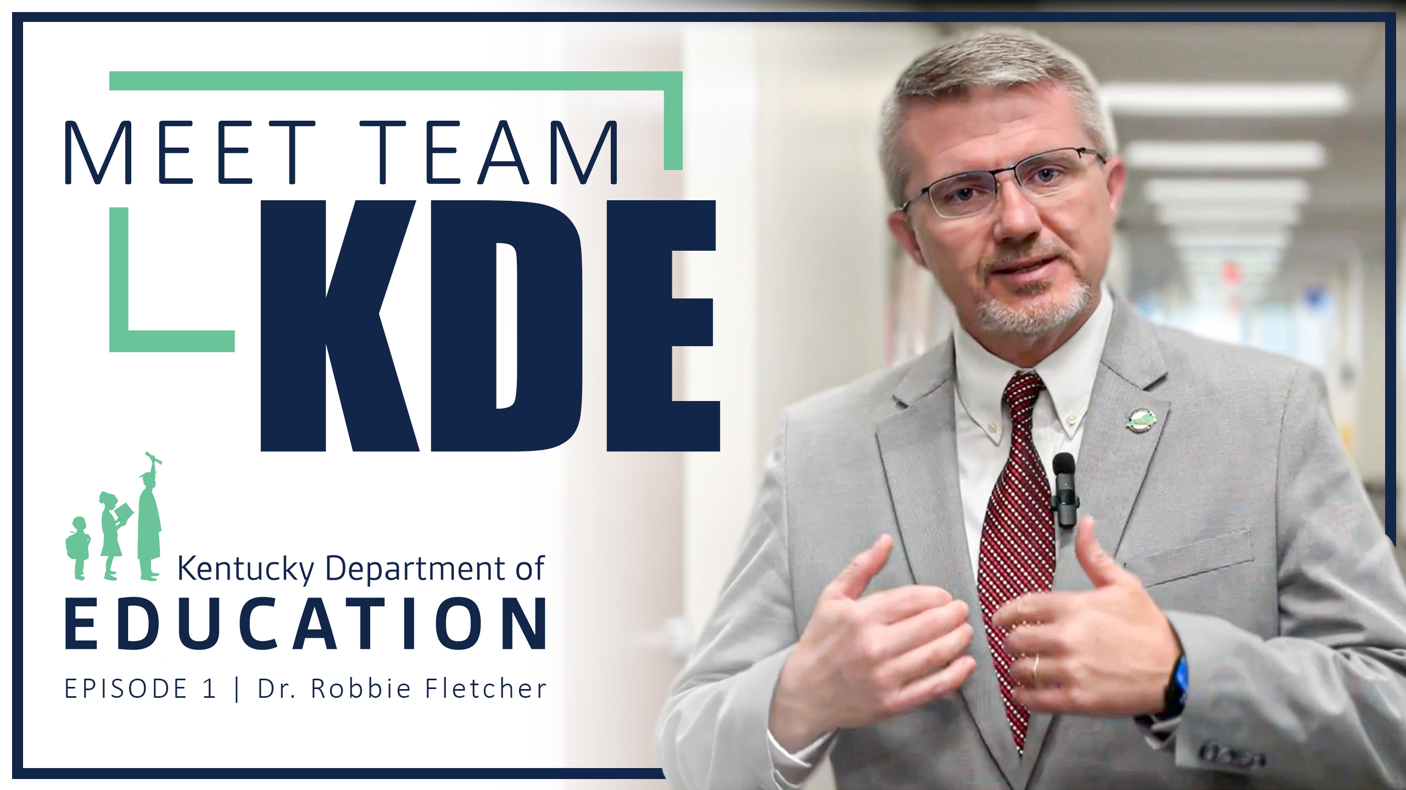
Meet Team KDE!
KDE communications staff are kicking off a new social media video series highlighting KDE staff and the work they do for the children of the Commonwealth.
Videos will feature staff from across the agency and the work they do for Kentucky’s schools and districts.
Check out the first Meet Team KDE video.

Slide 12

KY Reads to Succeed Summer Reading Conference
June 13
The Galt House, Louisville
FREE for all K-12 public educators and administrators to attend
Summer Reading Conference registration link
Keynote: Anita Archer, Ph.D.

Slide 13
Nominations Open for 2025 Kentucky Exemplary Educators Program
Superintendents, curriculum and professional development supervisors, principals, representatives from teacher training institutions and other education leaders are invited to recommend up to three individuals.
Those recommended should have at least five years of experience and showcase exceptional educational talent as evidenced by effective and innovative instructional practices and student learning results.
To nominate a candidate, visit the 2025 Kentucky Exemplary Educators Program recommendation form. Refer to the KEEP information sheet for required information and additional details about the recommendation process.
The deadline for nominations is May 16.

Slide 14
KDE Offering Kentucky Career and Technical Education Summer Program Scholarships
KDE’s Office of Special Education and Early Learning is offering a scholarship opportunity for special education teachers to attend the 2025 Kentucky Career and Technical Education Summer Program, scheduled for July 28-31 at the Galt House in downtown Louisville.
This scholarship opportunity is open to special education professionals dedicated to supporting students with disabilities in career and technical education (CTE) environments, including but not limited to directors of special education, special education teachers and paraprofessionals.
Scholarship recipients will receive an $800 stipend to support their attendance at the 2025 Kentucky CTE Summer Program.
The deadline to apply is May 15. Additional information can be found within the Kentucky CTE Summer Program special education teacher scholarship application.

Slide 15
School Health Updates
Jim Tackett
KDE School Health Branch Manager

Slide 16
District Health Coordinator (DHC)
The person designated shall meet the following minimum qualifications:
A valid license to practice as a registered nurse, issued under KRS 314.041 by the Kentucky Board of Nursing, and 3 years of registered nursing practice, as defined in KRS 314.011(6);
A school psychologist certificate, issued by the Education Professional Standards Board (EPSB) pursuant to 16 KAR 2:090, and a minimum of 3 years of related work experience in a school setting; or
A school social worker certificate, issued by the EPSB pursuant to 16 KAR 2:070, and a minimum of 3 years of work experience practicing social work in a school setting.
The school health coordinator shall work in cooperation with all school personnel, the local board of education, the department, the local health department and family resource and youth services centers, in promoting and implementing a school health services program.

Slide 17
Just a Few Examples of Responsibilities of District Health Coordinators …
Ensuring that a registered nurse has properly trained and properly delegated medical procedures/med administration to unlicensed staff, according to 201 KAR 20:400 and 702 KAR 1:160 Section 5.
Ensuring that staff are trained and automated external defibrillators are maintained, according to KRS 158.162 (Amended by HB 169, 2024).
Ensuring that medical director orders are on file for all student medications and procedures required to meet student health needs in the district.
Ensuring that all required data reports are correct and submitted to KDE at the end of the year (June 1).

Slide 18
New Medication Administration Training Program
This training manual will replace the current Medication Administration Training Material beginning July 1, 2025
Old training materials should not be used after this date
American Academy of Pediatrics 2024 policy statement has been incorporated.
National Association of School Nurses’ school nursing evidence-based clinical guideline: Medication Administration in Schools Implementation Toolkit (2022)
Kentucky Board of Nursing advisory opinions regarding school nursing include Advisory Opinion Statements 16 and 30.

Slide 19



What does this mean for schools and school nurses?
Beginning with the 2025 school year, trained school staff and school nurses will no longer be able to administer any medication, either prescribed or over-the-counter medications, without a medical provider’s order and parent/guardian’s signature
Parents can no longer send in a student supply of over-the-counter medications – such as Tylenol or allergy medication – with a parent note only. You must have a medical provider’s order as well
This will also prohibit parents from sending in short-term medication, such as antibiotics, with a parent note to administer unless they have a provider’s order to administer

Slide 20
School Health Data Reporting
2024-2025 School Year Data due June 1
Automated external defibrillator (AED) data is due:
  August 1 (AED building counts)
  November 1 (Trained staff listing, challenges, plan for improvement)
Health Services Infographic (2023-2024)

Slide 21
Contact Your KDE School Health Branch Staff
Branch Manager
  Jim Tackett
  jim.tackett@education.ky.gov
Whole School, Whole Community, Whole Child
  Stephanie Bunge
  stephanie.bunge@education.ky.gov
  Jalynn Stubbs
  jalynnstubbs@education.ky.gov
Data, Reporting and Infinite Campus
  Tonia Hickman
  tonia.hickman@education.ky.gov
State School Nurse Consultant
  Angela McDonald
  angela.mcdonald@education.ky.gov
Regional Field Staff
  Western Kentucky: Abby Henshaw
  abby.henshaw@education.ky.gov
  Central Kentucky: Crystal Dillingham
  crystal.dillingham@education.ky.gov
  Eastern Kentucky: Caitlyn Mounce
  caitlyn.mounce@education.ky.gov

Slide 22
New Teacher Survey
Associate Commissioner Meredith Brewer, Ph.D.
Office of Educator Licensure and Effectiveness

Slide 23
Kentucky Educator Mentorship Program
KRS 161.031 established the Kentucky Educator Mentorship Program (KEMP) and required the Education Professional Standards Board (EPSB) to develop standards and guidance for school districts to implement new teacher induction programs.
The Education Professional Standards Board (EPSB) is required to submit an annual report to the Legislative Research Commission (LRC) on KEMP implementation.

Slide 24
HB 48 (2025)
Section 8 of House Bill (HB) 48 amends KRS 161.031 by encouraging, rather than requiring, school districts to provide an induction program for new teachers.
Adds a new requirement for EPSB to identify in its annual report any school districts that have not implemented an induction program that aligns with the EPSB established standards and guidance.

Slide 25



New Teacher Survey Roles
District Administrator
New Teacher
Mentor

Slide 26
District Administrator
Components of district’s new teacher program
Types of training
Organization and management of induction program
Funding, duration and timeframe for induction program
Evaluation of induction program

Slide 27
New Teacher
Components of district’s new teacher program
Perception of effectiveness of their educator preparation program (EPP)
Suggestions for remediation or support not covered in EPP
Frequency of meetings with assigned mentor
Impact of participation in the induction program on professional plans

Slide 28
Mentor
Components of district’s new teacher program
Perception of effectiveness of the assigned new teacher’s educator preparation program (EPP)
Suggestions for remediation or support not covered in EPP
Frequency of meetings with assigned new teacher
Impact of participation in the induction program on professional plans

Slide 29
Next Steps
Identify an individual to complete the district administrator survey on behalf of the district.
Share the survey with school-level administrators to disseminate to all new teachers and mentors. Please note: School-level administrators should not complete the survey.
Please encourage all eligible respondents (new teachers/mentors) to complete the survey by the deadline.
Survey will close on Sept. 15, 2025.
Report due to LRC by Oct. 1, 2025.

Slide 30
Legislative Update
Brian Perry, Ph.D.
Director of Government Relations

Slide 31
KDE Non-regulatory Legislative Guidance
Guidance on passed bills will be released soon.
One main document plus supplemental guidance on specific bills as needed.
All materials will be posted on KDE’s Legislative Guidance webpage.
Please let KDE staff know if you have specific questions on bills.
Per Attorney General opinion OAG 25-05, the effective date of legislation passed during this session, other than general appropriation bills and acts containing emergency or delayed effective date provisions, is Friday, June 27, 2025.

Slide 32
Interim Period
Interim calendar
IJCE will meet at 11 a.m. ET on the following dates:
June 3
July 14
Aug. 19
Sept. 16
Oct. 14
Nov. 4
IJC A&R will meet at 1 p.m. ET on the following dates:
June 4
July 15
August 20
Sept. 17
Oct. 15
Nov. 5

Slide 33
Questions
Brian Perry, Ph.D., Director of Government Relations, Office of the Commissioner
brian.perry@education.ky.gov

Slide 34
Question and Answer Session
(Submit Questions in Teams)
KDE Leadership

Slide 35
Important Dates
Local Superintendents Advisory Council
May 27
Kentucky Board of Education
June 4-5
Persistence to Graduation Summit
June 12-13
Education Professional Standards Board
June 17
Superintendents Webcast
July 15

