Slide 1
Commissioner’s Performance Survey
Spring 2022

Slide 2
About the Survey
The performance survey has been administered at least once per year (often more!) since 2017
There are six areas and 37 questions:
  Commissioner’s Performance
  Leadership
  Communication
  Skills
  Culture + Climate
  Telecommuting

Slide 3
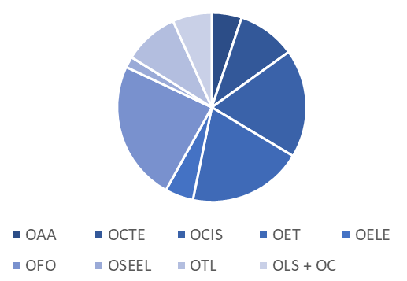
Who took the survey
385 Frankfort-based employees at KDE - down from 438 last year
By office:
  OAA 20
  OCTE 37
  OCIS 75
  OET 82
  OELE 19
  OFO 95
  OSEEL 43
  OTL 29
  OC/OLS 31

Slide 4
Snapshot of Results

Slide 5
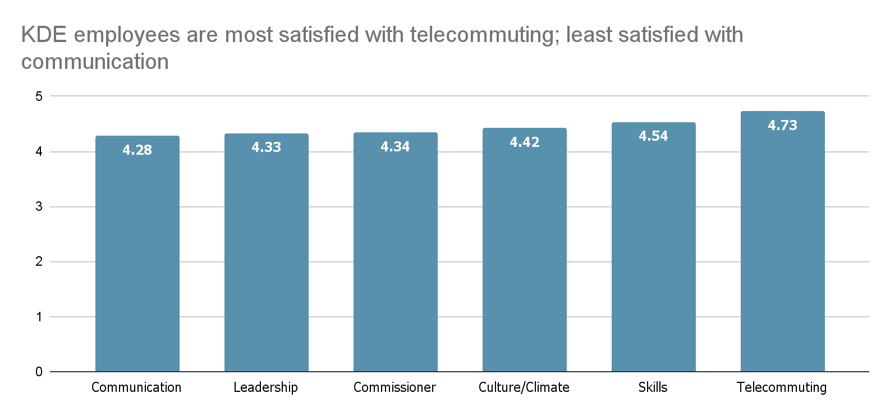
KDE employees most satisfied / least satisfied

Slide 6
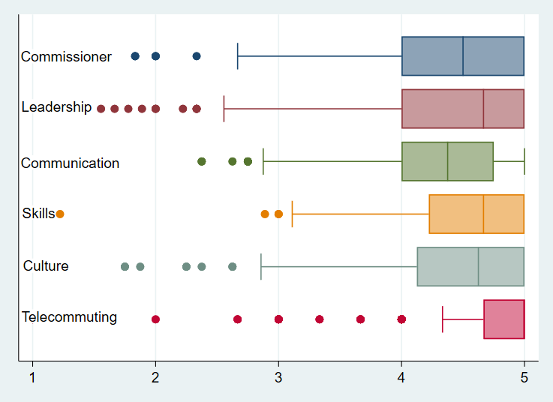
Quick review and findings
Quick review:
Box and whisker plots show you the distribution of responses. Shorter boxes and whiskers indicate more agreement; wider indicate more variation.
The line in the middle of the box is the median response; dots are outliers.
Findings:
People have most consensus on telecommuting and communication areas
There is most disagreement around leadership.
Highest median: Telecommuting
Lowest median: Communication

Slide 7
Section 1: Commissioner

Slide 8
Commissioner
# | Avg | Question Text
Q1 | 4.41 | The Commissioner exhibits visionary leadership.
Q2 | 4.44 | The Commissioner makes decisions in the best interest of Kentucky's children.
Q3 | 4.33 | The Commissioner provides clear direction for KDE.
Q4 | 4.28 | The Commissioner promotes strong internal communication to ensure integrated and cross-functional understanding of KDE's work.
Q5 | 4.28 | The Commissioner respects all levels of employees at KDE.
Q6 | 4.39 | The Commissioner listens to all levels of employees at KDE.
# | Avg | Question Text
Q1 | 4.41 | The Commissioner exhibits visionary leadership.
Q2 | 4.44 | The Commissioner makes decisions in the best interest of Kentucky's children.
Q3 | 4.33 | The Commissioner provides clear direction for KDE.
Q4 | 4.28 | The Commissioner promotes strong internal communication to ensure integrated and cross-functional understanding of KDE's work.
Q5 | 4.28 | The Commissioner respects all levels of employees at KDE.
Q6 | 4.39 | The Commissioner listens to all levels of employees at KDE.

Slide 9
Commissioner - Open Ended
Respondents described the Commissioner as visionary leader who is committed to public education in the state. Many noted that communication skills were one of his strengths, specifically his ability to listen and seek input from KDE staff and the community.
I like the way that the commissioner focused on community input for the direction of education in Kentucky–this ensures that the vision can remain in place even if the political positions change in the state.
The Commissioner shows genuine interest in the students in Kentucky.
I greatly appreciate Dr. Glass’ candor as he leads the State’s education efforts. He encourages two-way communication, promotes listening, & models the role of being an active learner.
One of the qualities that I appreciate most is his commitment to aligning his words with his actions. He follows through and remains true to the vision of the agency, even when it may not be most popular public opinion.

Slide 10
Section 2: Leadership

Slide 11
Leadership
# | Avg | Question Text
Q1 | 4.31 | Leadership provides clear direction for the agency.
Q2 | 4.45 | Leadership acts with integrity.
Q3 | 4.31 | Leadership promotes an atmosphere of collaboration within the agency.
Q4 | 4.15 | Leadership seeks feedback from employees on a regular basis.
Q5 | 4.24 | Leadership consistently supports employees.
Q6 | 4.52 | Leadership maintains high expectations for employees' quality of work.
Q7 | 4.16 | I feel comfortable raising issues and concerns to leadership.
Q8 | 4.34 | I am trusted to make decisions related to my work.
Q9 | 4.54 | Leadership provides consistent direction regarding telecommuting.
# | Avg | Question Text
Q1 | 4.31 | Leadership provides clear direction for the agency.
Q2 | 4.45 | Leadership acts with integrity.
Q3 | 4.31 | Leadership promotes an atmosphere of collaboration within the agency.
Q4 | 4.15 | Leadership seeks feedback from employees on a regular basis.
Q5 | 4.24 | Leadership consistently supports employees.
Q6 | 4.52 | Leadership maintains high expectations for employees' quality of work.
Q7 | 4.16 | I feel comfortable raising issues and concerns to leadership.
Q8 | 4.34 | I am trusted to make decisions related to my work.
Q9 | 4.54 | Leadership provides consistent direction regarding telecommuting.

Slide 12
Leadership - Open Ended
Overall, respondents indicated that KDE leadership was professional, supportive, and open to ideas from KDE staff. Respondents complained, however, of inconsistent communication, micromanaging, and sudden changes in telecommuting policy.
Could not ask for Leadership that is more dedicated to what we do.
Our Associate Commissioner and Director listen to our ideas, ask us to contribute during high-level issues and I feel confident in their final decisions. I am beyond happy with how they treat me and my staff.
The leadership in my office is outstanding. They are respectful, supportive, considerate and seek input from all stakeholders.
Information does not flow down to the folks doing the work. On several instances, outside peers knew information prior to those in the office.
Communication regarding telecommuting is inconsistent. One moment it seems to be strongly supported and the next I am left wondering if that option will be taken away…The loss of this work option would greatly impact my life, both at work and home and in full consideration, that of my health as well.

Slide 13
Section 3: Communication

Slide 14
Communication
# | Avg | Question Text
Q1 | 3.74 | I have a clear understanding of the work being conducted across the agency.
Q2 | 4.27 | I know where to go to get the information I need to do my work.
Q3 | 4.08 | I am informed of changes that impact my work in a timely manner.
Q4 | 4.43 | KDE employees communicate with colleagues in a professional manner.
Q5 | 4.25 | I get all the important information I need to do my work.
Q6 | 4.68 | I possess the necessary tools such as email, chat, and phone to communicate effectively with other KDE employees.
Q7 | 4.52 | I meet regularly with my direct supervisor.
Q8 | 4.27 | KDE communicates effectively with schools and districts.
# | Avg | Question Text
Q1 | 3.74 | I have a clear understanding of the work being conducted across the agency.
Q2 | 4.27 | I know where to go to get the information I need to do my work.
Q3 | 4.08 | I am informed of changes that impact my work in a timely manner.
Q4 | 4.43 | KDE employees communicate with colleagues in a professional manner.
Q5 | 4.25 | I get all the important information I need to do my work.
Q6 | 4.68 | I possess the necessary tools such as email, chat, and phone to communicate effectively with other KDE employees.
Q7 | 4.52 | I meet regularly with my direct supervisor.
Q8 | 4.27 | KDE communicates effectively with schools and districts.

Slide 15
Communication - Open Ended
Respondents described interoffice communication as an ongoing problem for the agency. Suggested improvements included: re-organizing SharePoint, promoting KDE work, sharing best practices and guidance for effective communication.
I do not know what the people in other offices or divisions are doing if it does not pertain directly to my job. I feel like we get too much email communication to really read it all. If KDE communicates effectively with the districts is a question that I feel the districts would have to answer.
I would like to know about the work taking place in other offices.
Communication within the office is good. If I was only answering based on that my answers would be different. I do not feel well-informed on a KDE level.
I have very little knowledge of what most KDE offices are working on currently.
The intranet is not organized and not consistently maintained across offices. Policies affecting all of KDE should be easy to find.

Slide 16
Section 4: Skills

Slide 17
Skills
# | Avg | Question Text
Q1 | 4.66 | I possess the necessary knowledge and expertise to ensure my work is of high quality.
Q2 | 4.65 | I possess the necessary technical skills to ensure my work is of high quality.
Q3 | 4.54 | I know how to measure the quality of my work.
Q4 | 4.55 | I can use measures of the quality of my work to make changes that will improve my work.
Q5 | 4.52 | I use data to inform my work.
Q6 | 4.64 | I reflect on how I do my work on a regular basis.
Q7 | 4.52 | I engage in talk on how to improve my work with colleagues in the workplace.
Q8 | 4.45 | I am able to develop my professional skills in my current position.
Q9 | 4.33 | My organization has the right people to do its work.
# | Avg | Question Text
Q1 | 4.66 | I possess the necessary knowledge and expertise to ensure my work is of high quality.
Q2 | 4.65 | I possess the necessary technical skills to ensure my work is of high quality.
Q3 | 4.54 | I know how to measure the quality of my work.
Q4 | 4.55 | I can use measures of the quality of my work to make changes that will improve my work.
Q5 | 4.52 | I use data to inform my work.
Q6 | 4.64 | I reflect on how I do my work on a regular basis.
Q7 | 4.52 | I engage in talk on how to improve my work with colleagues in the workplace.
Q8 | 4.45 | I am able to develop my professional skills in my current position.
Q9 | 4.33 | My organization has the right people to do its work.

Slide 18
Skills - Open Ended
In general, respondents indicated that the four innovative habits of inclusion, empathy, co-creation, and reciprocity are currently incorporated into their daily work. Others indicate that desire to learn more and suggested additional training that included real-world examples would be helpful.
I feel like my coworkers in this office are great with inclusion and reciprocity.
I would like to know how better to structure conversations and training materials to incorporate these habits.
Would generally like a better understanding of co-creation and reciprocity in the workplace.
I appreciate the opportunities for professional development that the Commissioner’s office has provided. This never happened before and it helps improve practice.

Slide 19
Section 5: Culture + Climate

Slide 20
Culture
# | Avg | Question Text
Q1 | 4.02 | I am recognized for my work.
Q2 | 4.63 | I have a safe workplace.
Q3 | 4.78 | I am committed to the agency's overall success.
Q4 | 4.38 | My bosses and the agency care about me.
Q5 | 4.25 | My bosses encourage me to develop my job skills so I can advance in my career.
Q6 | 4.53 | The people I work with cooperate and work as a team.
Q7 | 4.26 | KDE encourages new ideas (innovation).
Q8 | 4.55 | KDE is a good place to work.
# | Avg | Question Text
Q1 | 4.02 | I am recognized for my work.
Q2 | 4.63 | I have a safe workplace.
Q3 | 4.78 | I am committed to the agency's overall success.
Q4 | 4.38 | My bosses and the agency care about me.
Q5 | 4.25 | My bosses encourage me to develop my job skills so I can advance in my career.
Q6 | 4.53 | The people I work with cooperate and work as a team.
Q7 | 4.26 | KDE encourages new ideas (innovation).
Q8 | 4.55 | KDE is a good place to work.

Slide 21
Culture - Open Ended
Respondents were divided on how they felt about KDE’s culture and climate. Some described KDE as respectful, professional, safe, and supportive place to work with many caring teammates. Others, however, described KDE’s culture as a top-down, bureaucratic, and resistant to change.
Highly collaborative and very respectful of one another. It is a great place to work.
I honestly have never felt more included, appreciated, heard, respected in all my years of education.
I appreciate the caring culture. A high level of professionalism and work is expected but my direct supervisor and director understand my personal needs (family, etc).
Our agency is not set up to be innovative. The red tape and levels of approval slow down any ability to be creative or innovative, particularly across divisions.
It seems that things stay the way they have always been when it comes to innovation. Other than moving from paper to computer, it is all the same.

Slide 22
Section 6: Telecommuting

Slide 23
Telecommuting
# | Avg | Question Text
Q1 | 4.65 | Adequate instructions and guidance on working from home have been provided to me
Q2 | 4.78 | I have been able to collaborate effectively with colleagues via telecommuting
Q3 | 4.77 | My telecommuting experience has been positive
# | Avg | Question Text
Q1 | 4.65 | Adequate instructions and guidance on working from home have been provided to me
Q2 | 4.78 | I have been able to collaborate effectively with colleagues via telecommuting
Q3 | 4.77 | My telecommuting experience has been positive

Slide 24
Closing Ideas

Slide 25
Next Steps
Keep talking: Leadership continues to review and invest time into improving the culture/climate within KDE
Review the data: SPR is building a data dashboard - coming soon!
Reflect on your teams: See the next slide for a conversation guide to use within your office
Make it actionable: continue to weigh in on the internal capacity and operational efficiency areas of the strategic plan

Slide 26
Conversation starters:
In your office or division:
What does our team think is going well? What might we focus on?
Looking at your relative high area: what is making that area a positive experience for our group?
Looking at your relative low area: what can we do to make this better for those in our office?
  Ex: if communication is low, what structure could we create to make our office feel more connected to others in the agency?

Slide 27
Discussion:
What stood out to you as positive? Why do you think that is?
What area do you think we should work on as an agency? What ideas do you have to make this actionable?
How can we make this data more accessible and usable for you?

Slide 28
Other questions?
Reach out!
lauren.milam@education.ky.gov
aaron.butler@education.ky.gov

