Slide 2
KDE Strategic Performance Update
Hannah Poquette
Aaron Butler
Presentation for Kentucky Board of Education on December 5, 2018.

Slide 3
Frankfort-Based Employee Survey
Data from November 2018

Slide 4
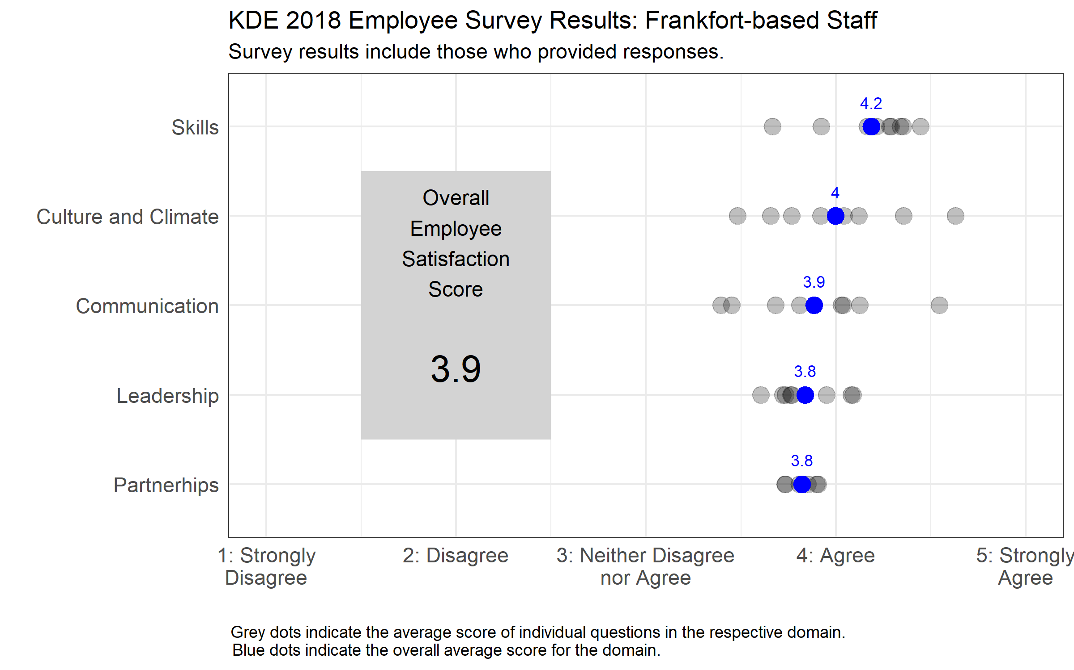

Slide 5
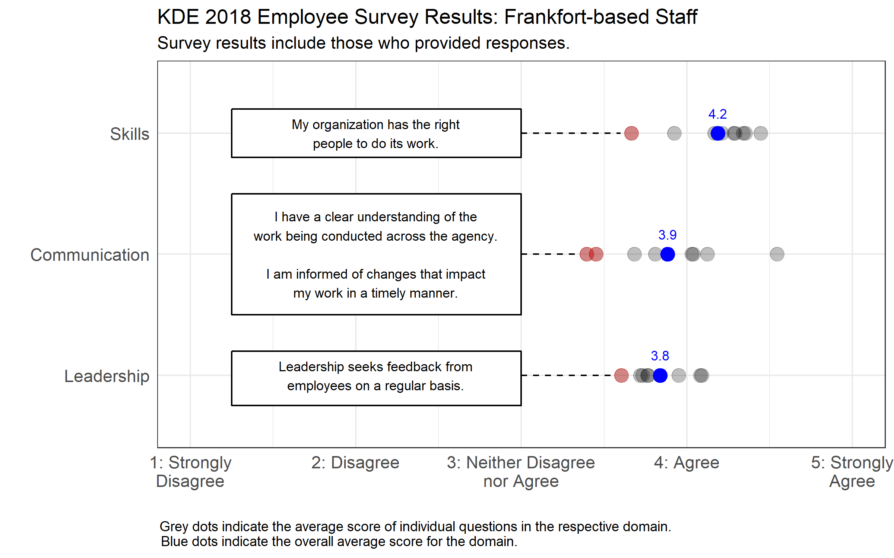

Slide 6
Customer Survey Superintendents, District Central Office Staff and Principals
Data from November 2018

Slide 7
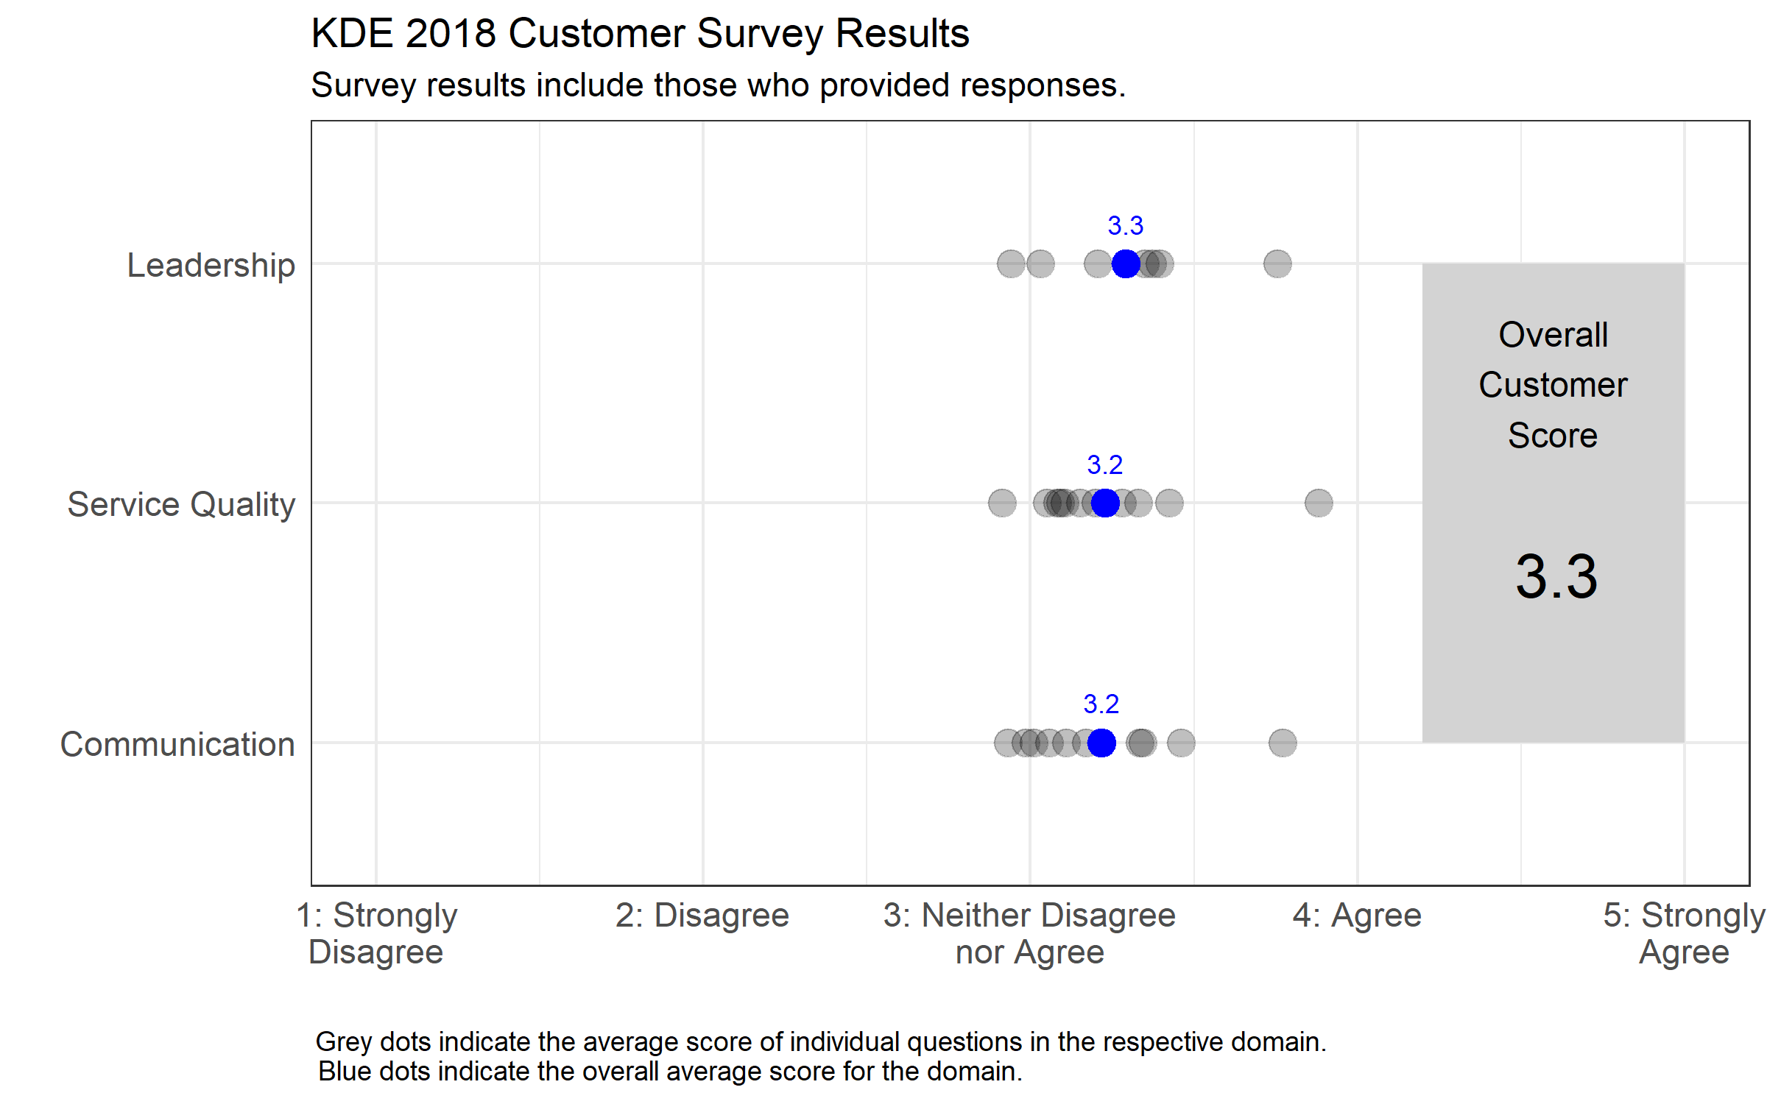

Slide 8
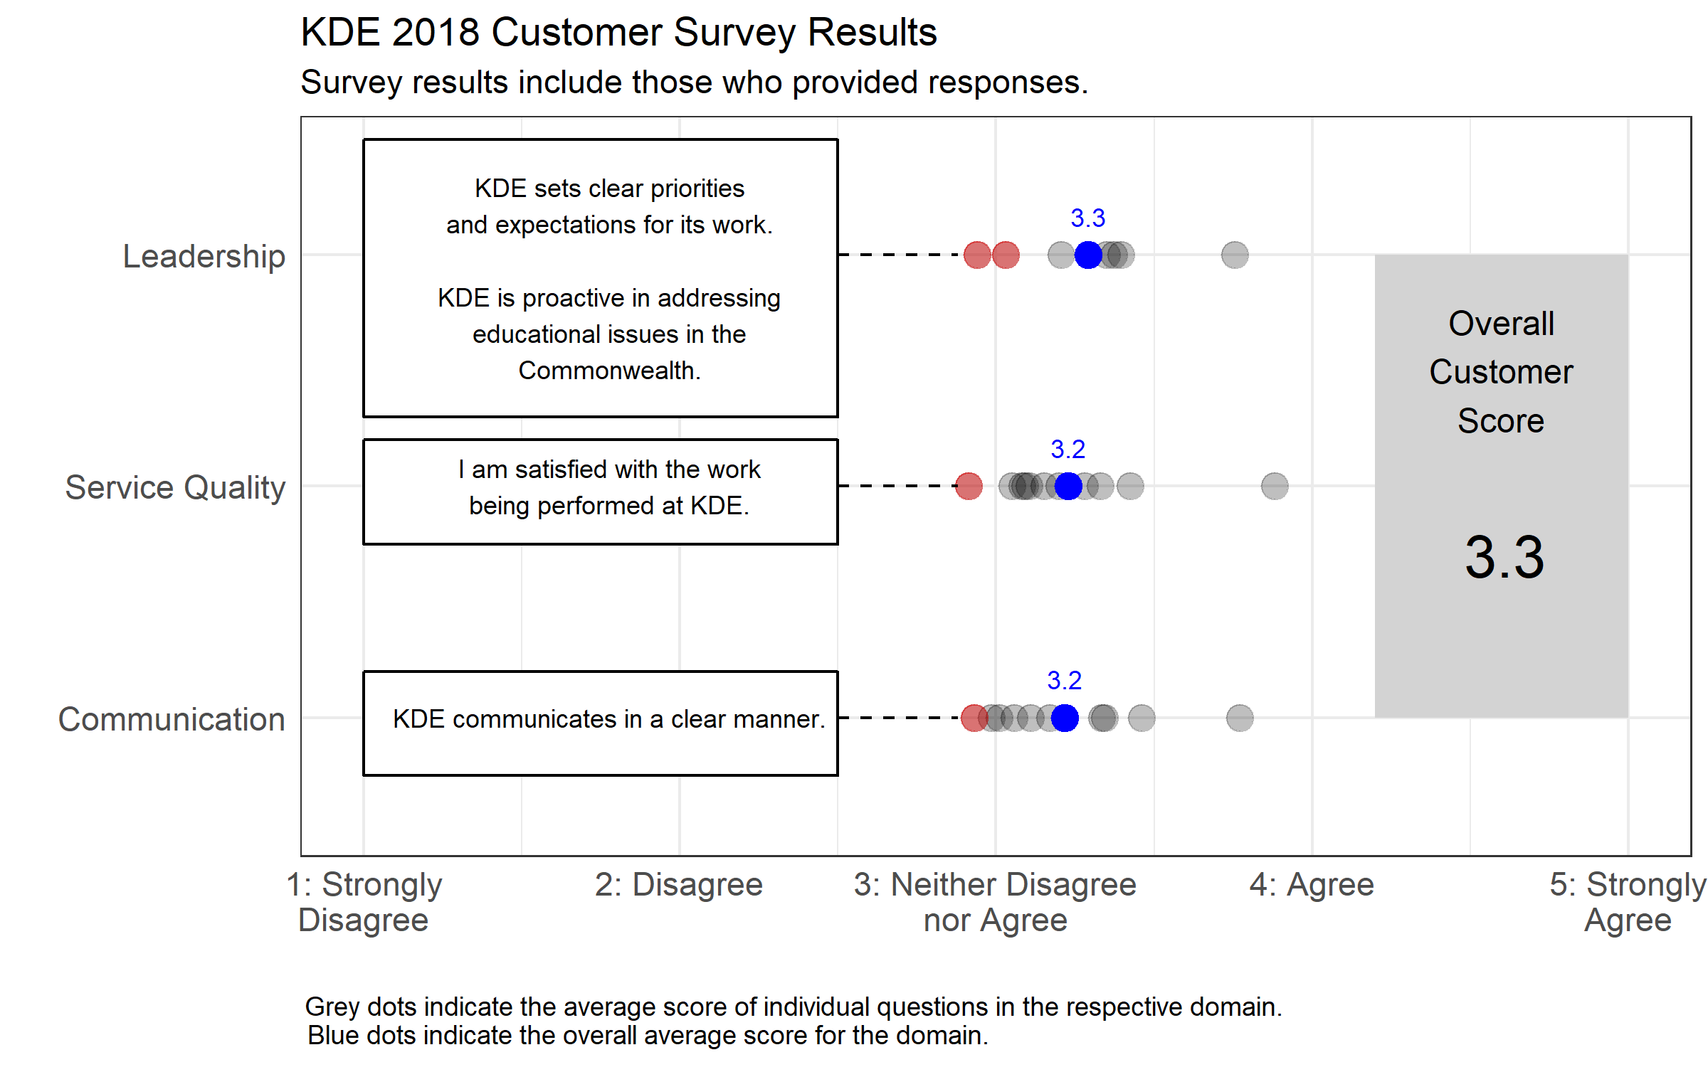

Slide 9
Strategic Management Maturity Matrix Frankfort-based staff
Data from October 2018

Slide 10
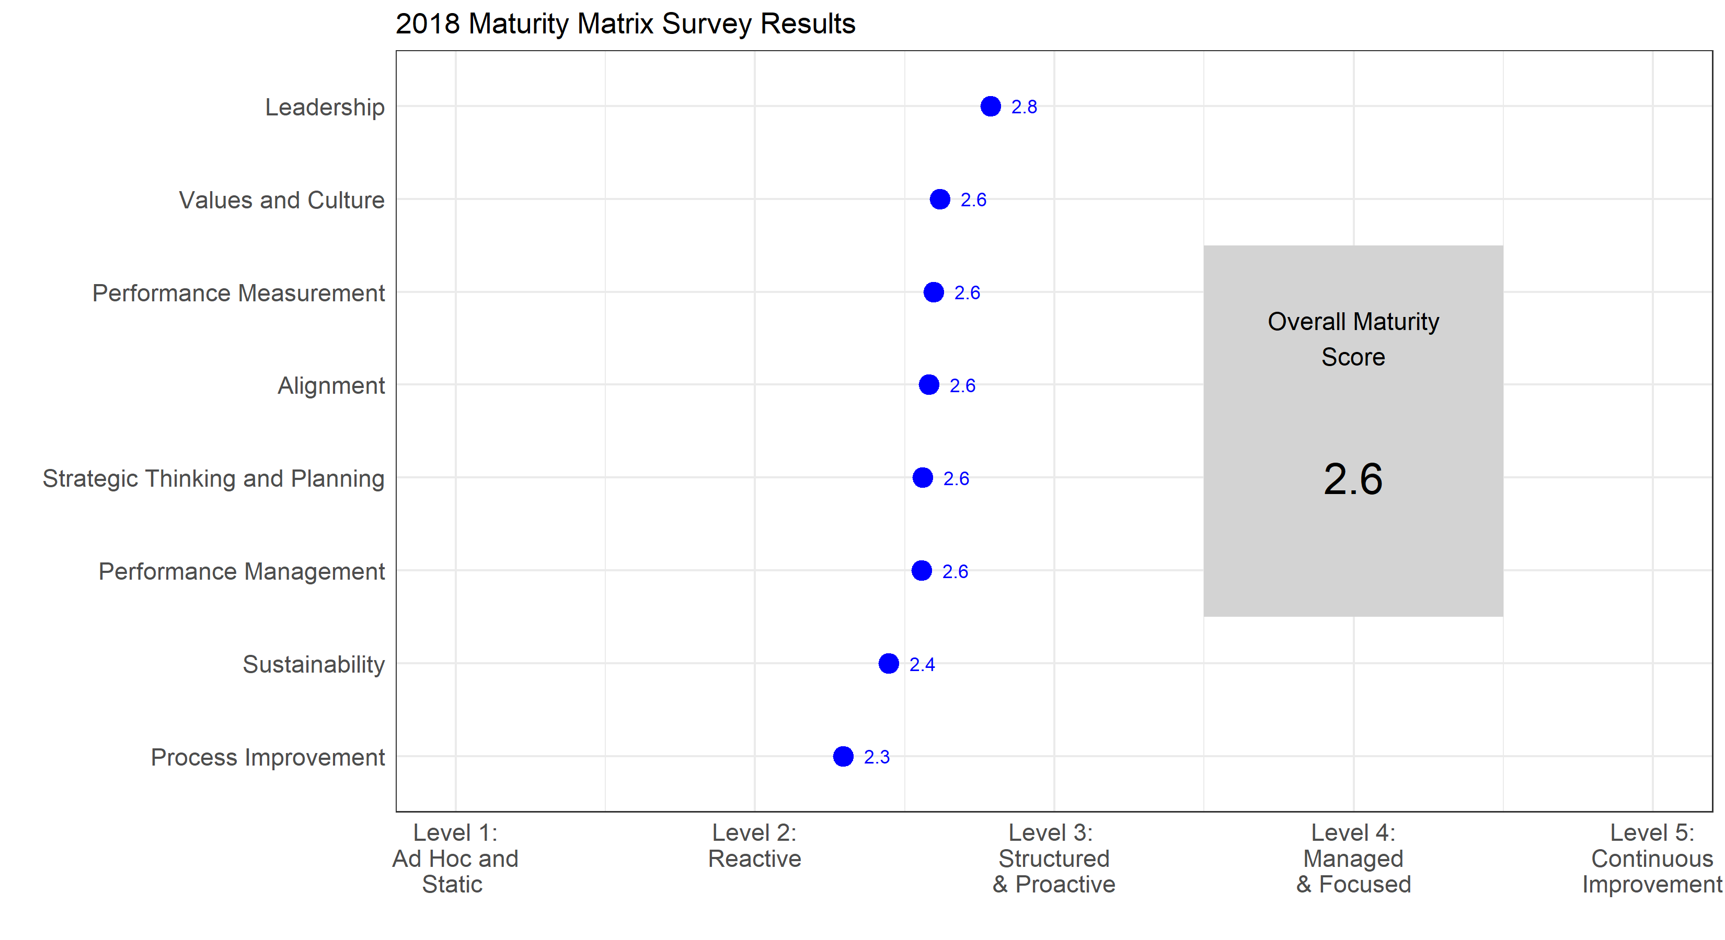

Slide 11
Student Success Proficiency
Data from October 2018
Spring 2017 KPREP Scores

Slide 12
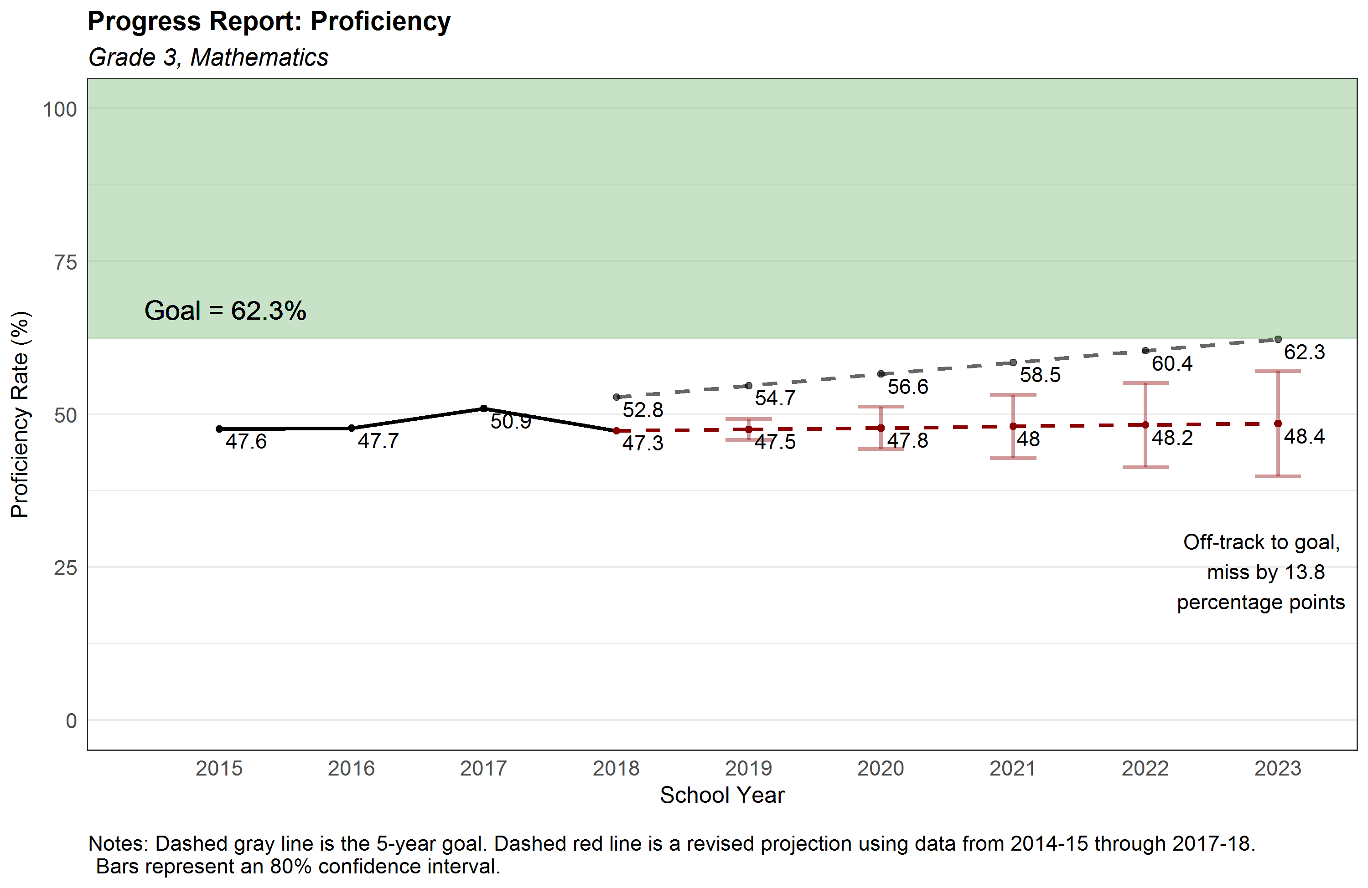
12

Slide 13
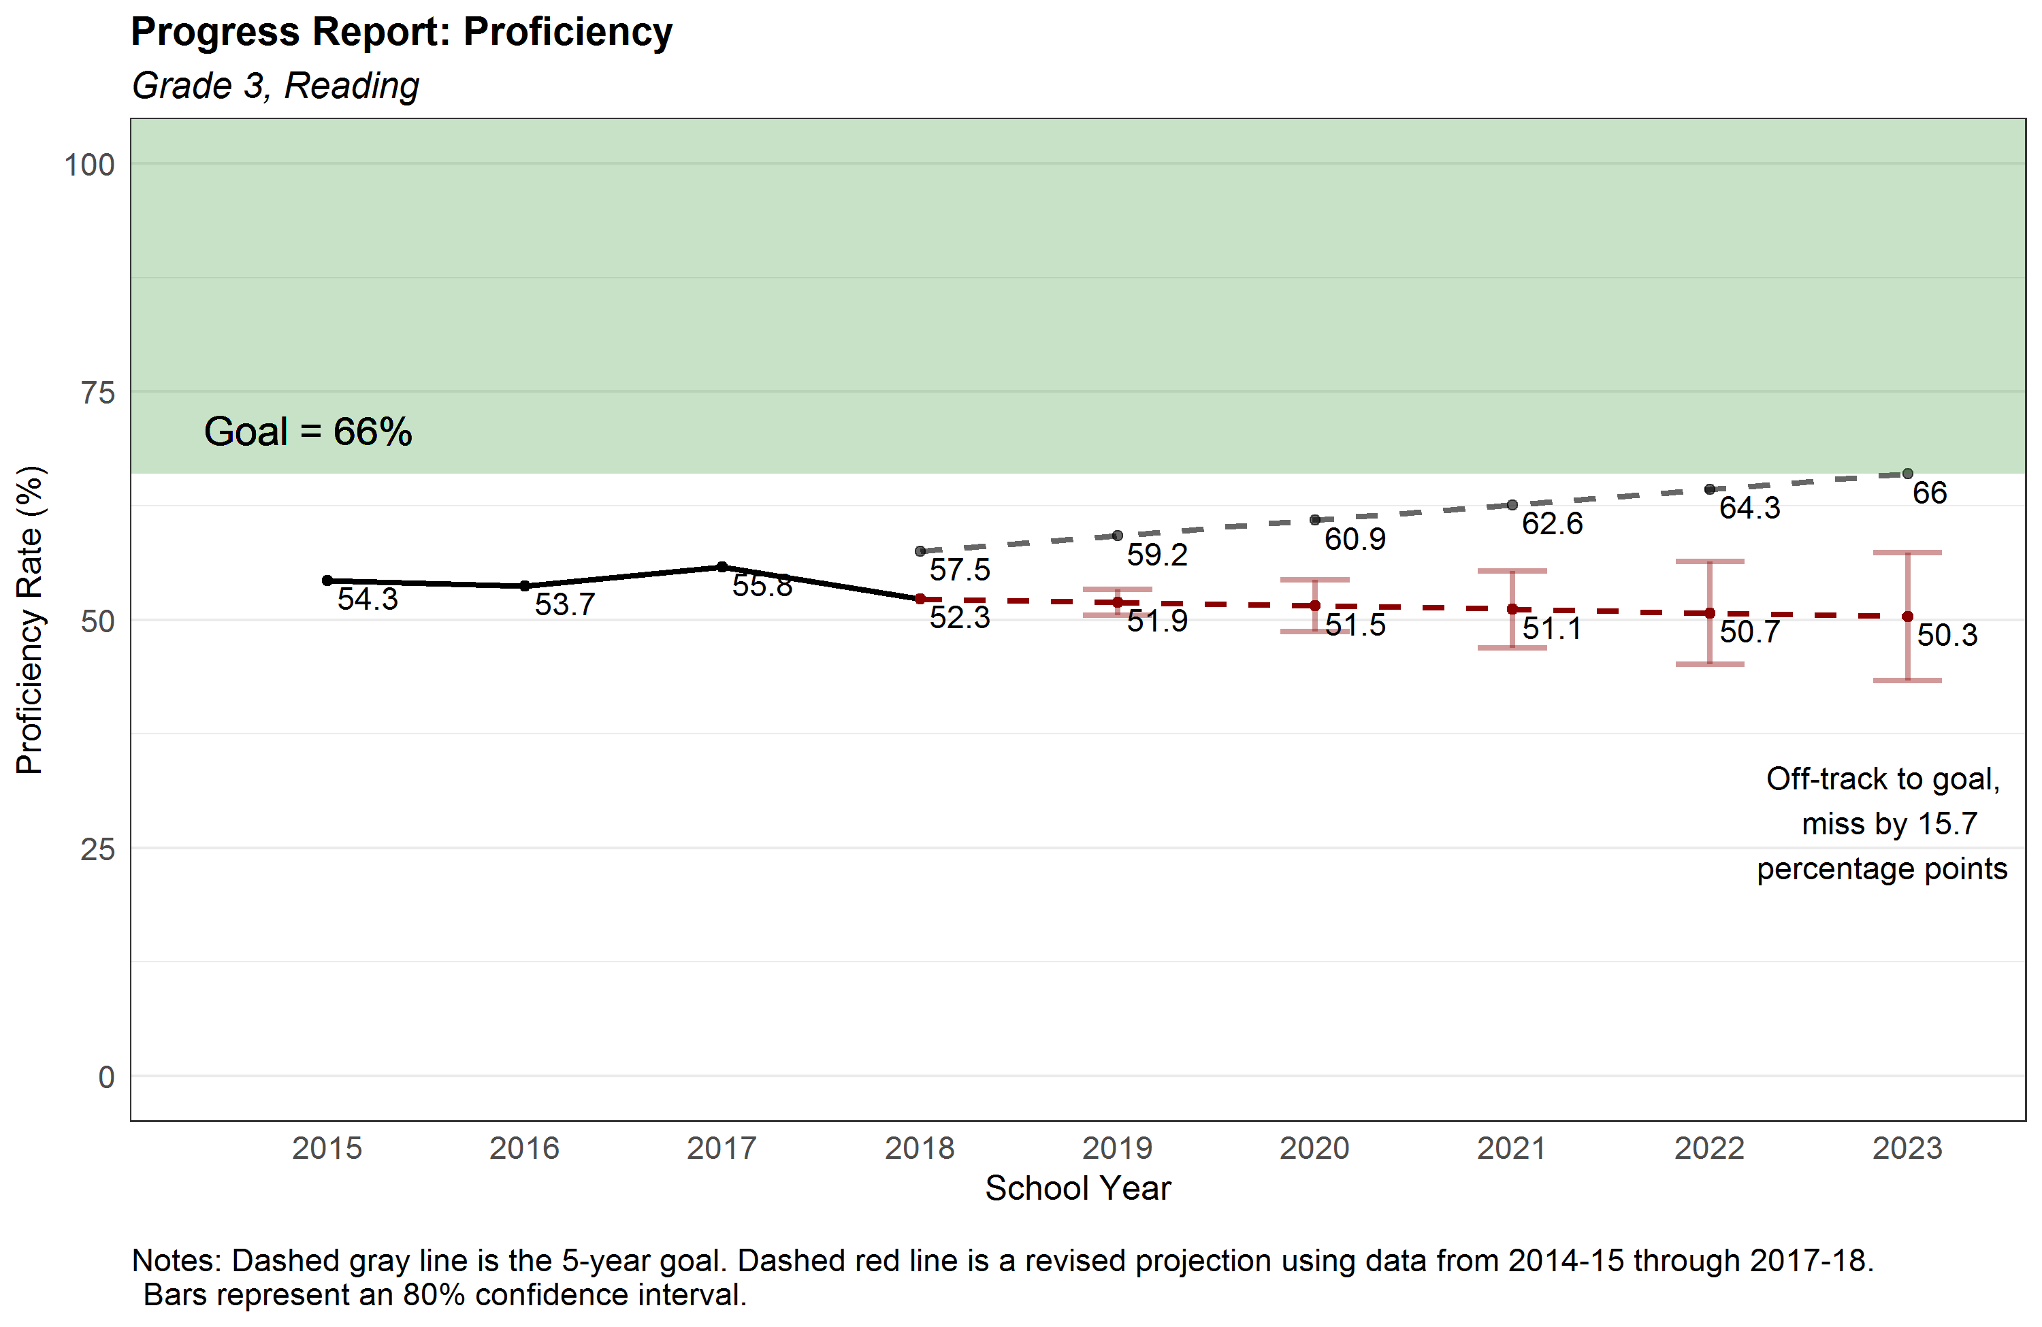
13

Slide 14
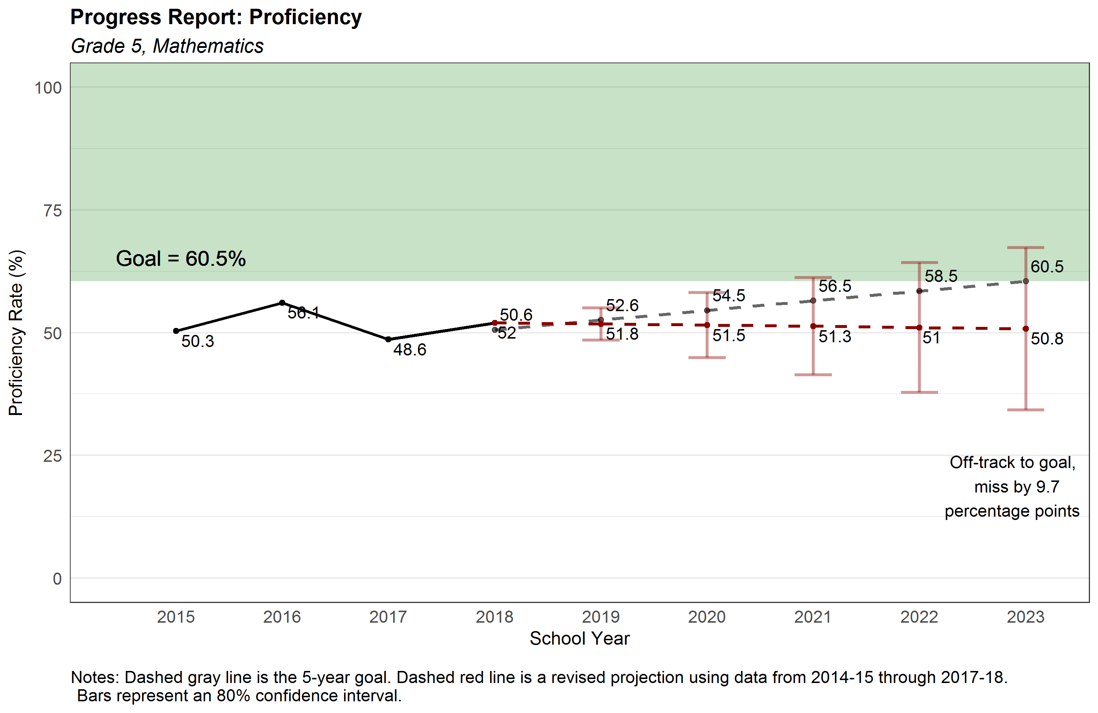
14

Slide 15
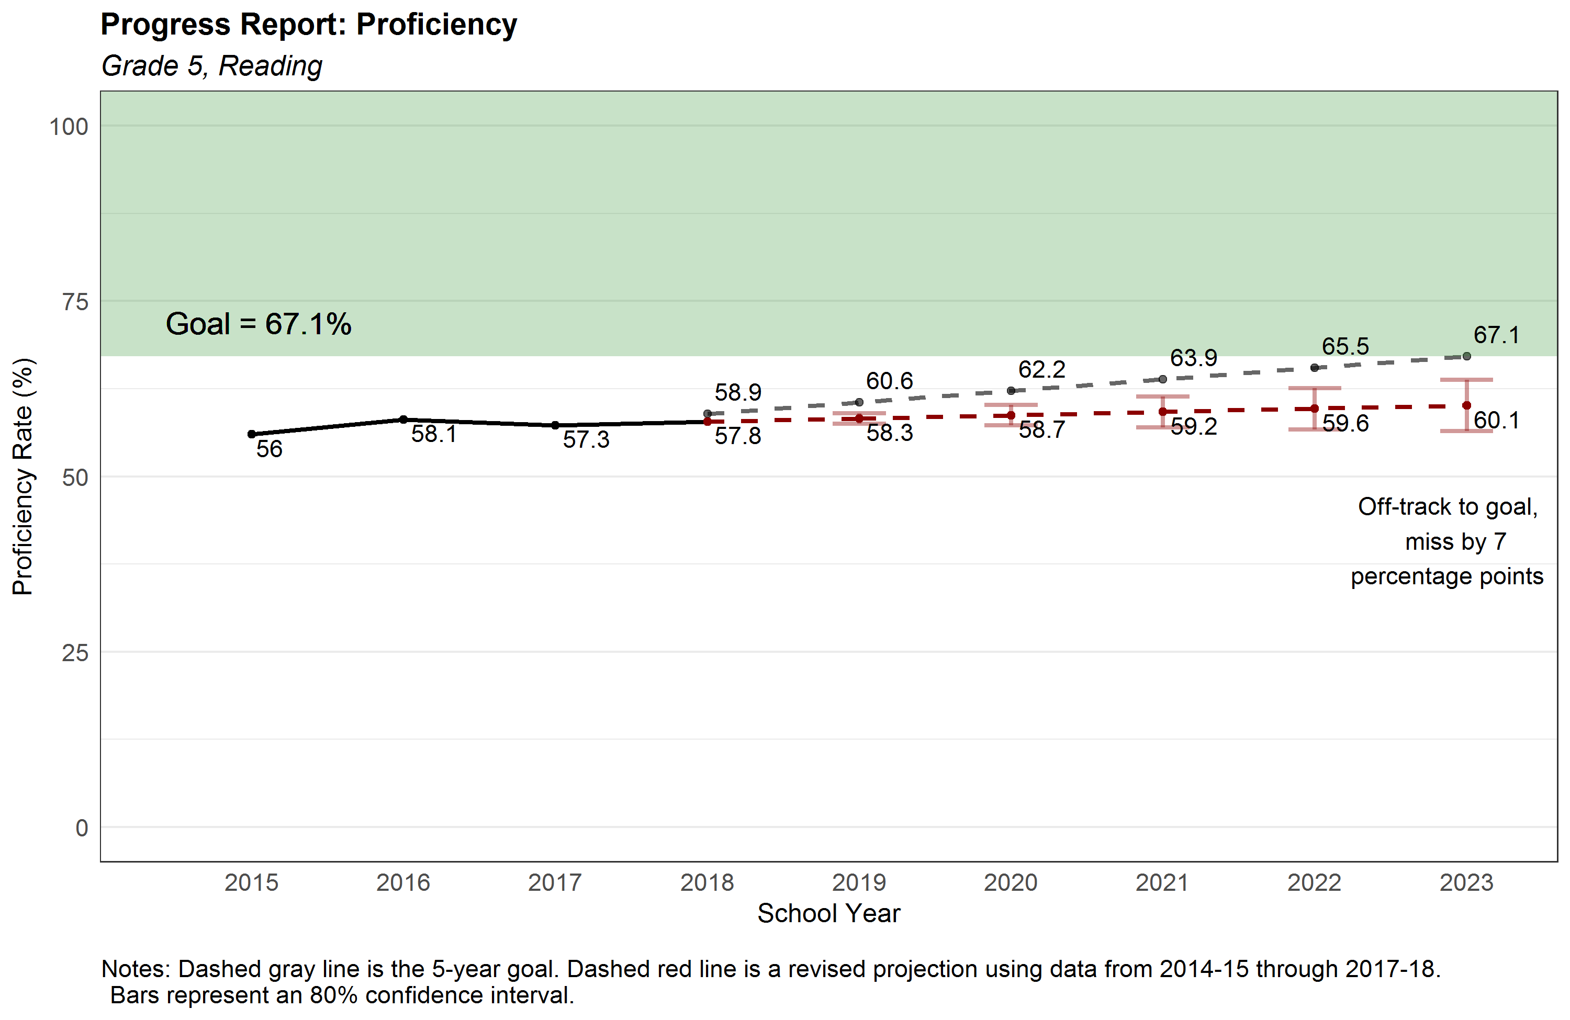
15

Slide 16
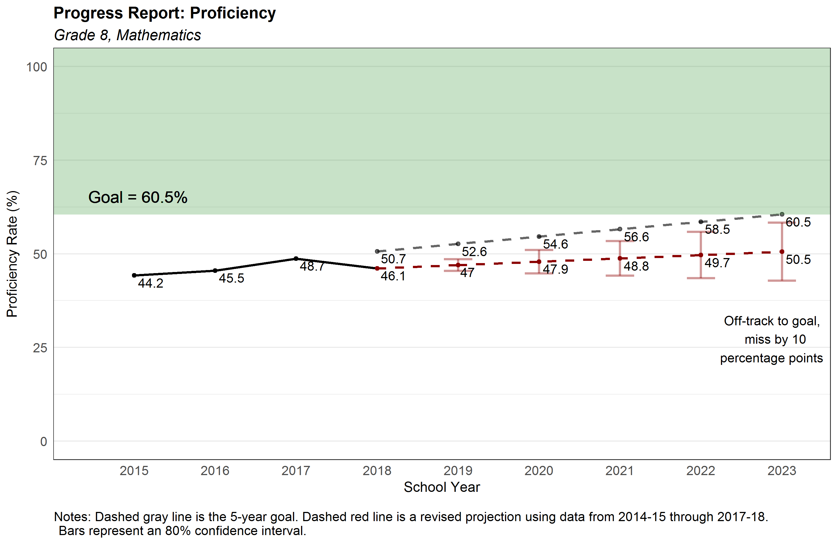
16

Slide 17
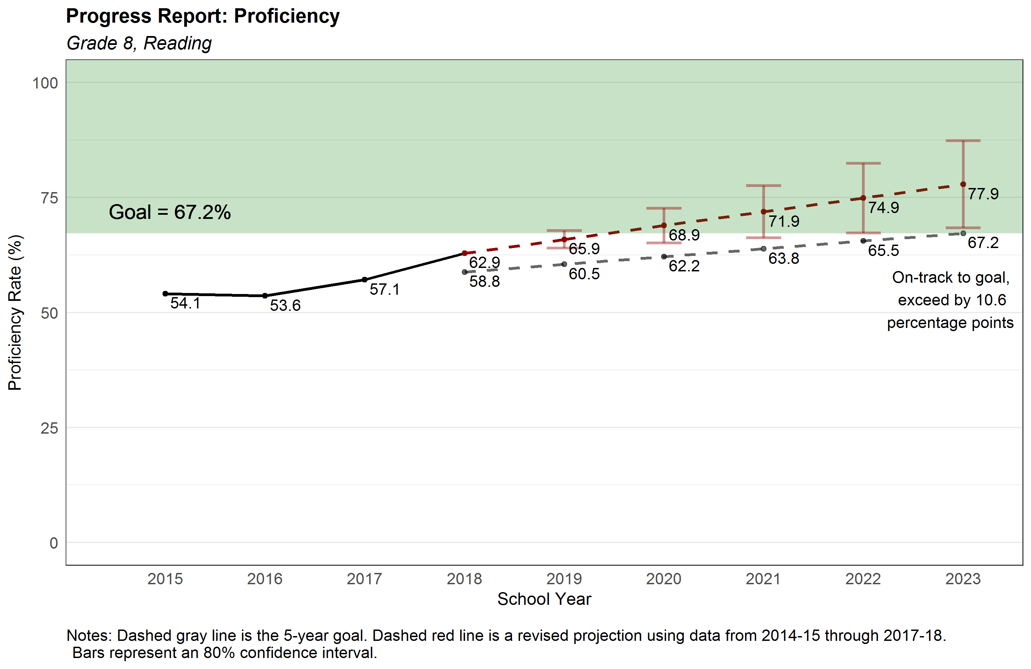
17

Slide 18
Student Success Achievement Gap
Forecast with goal lines included
October 2018

Slide 19
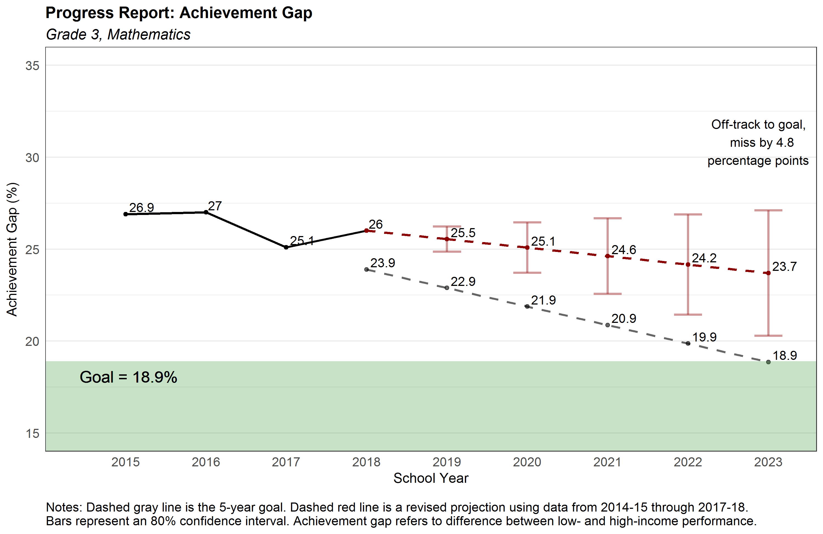
19

Slide 20
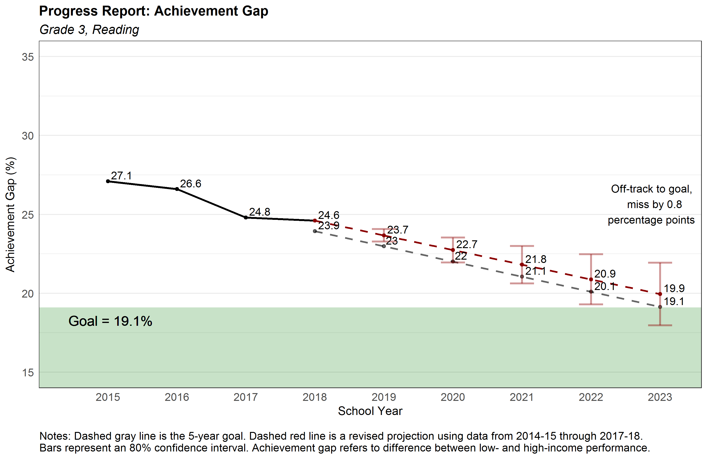
20

Slide 21
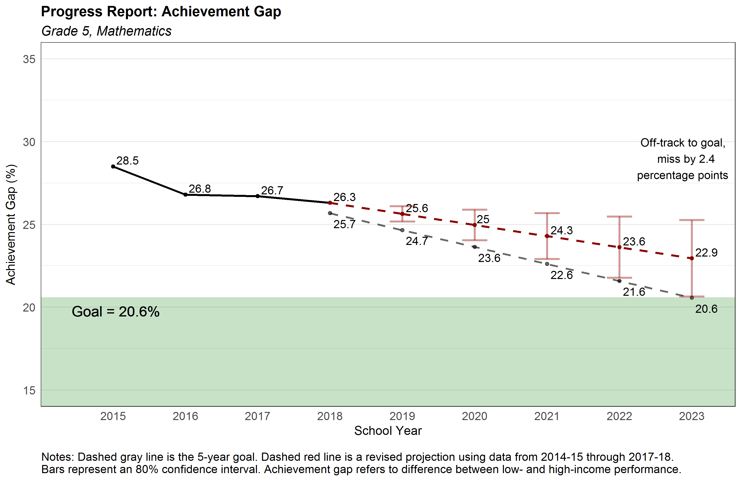
21

Slide 22
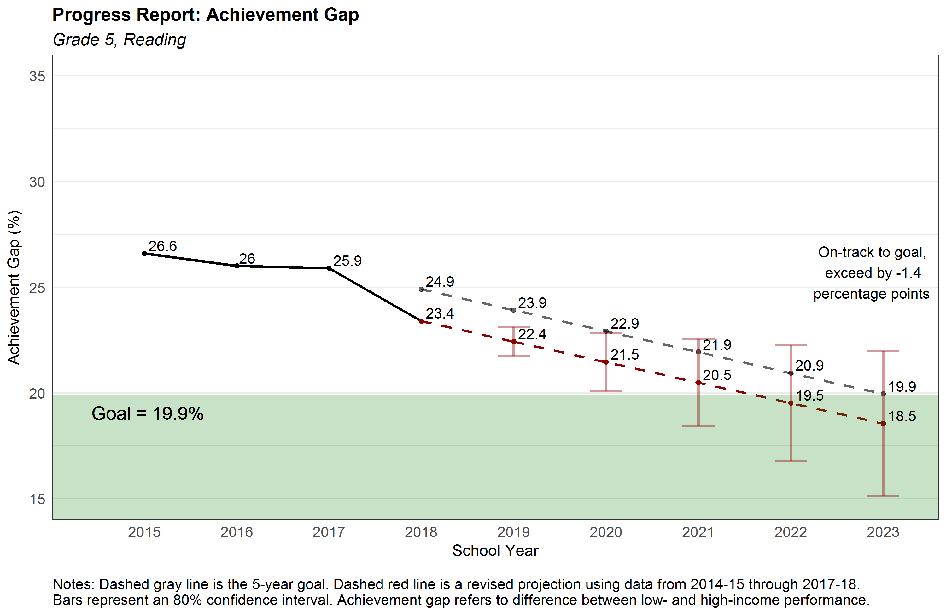
22

Slide 23
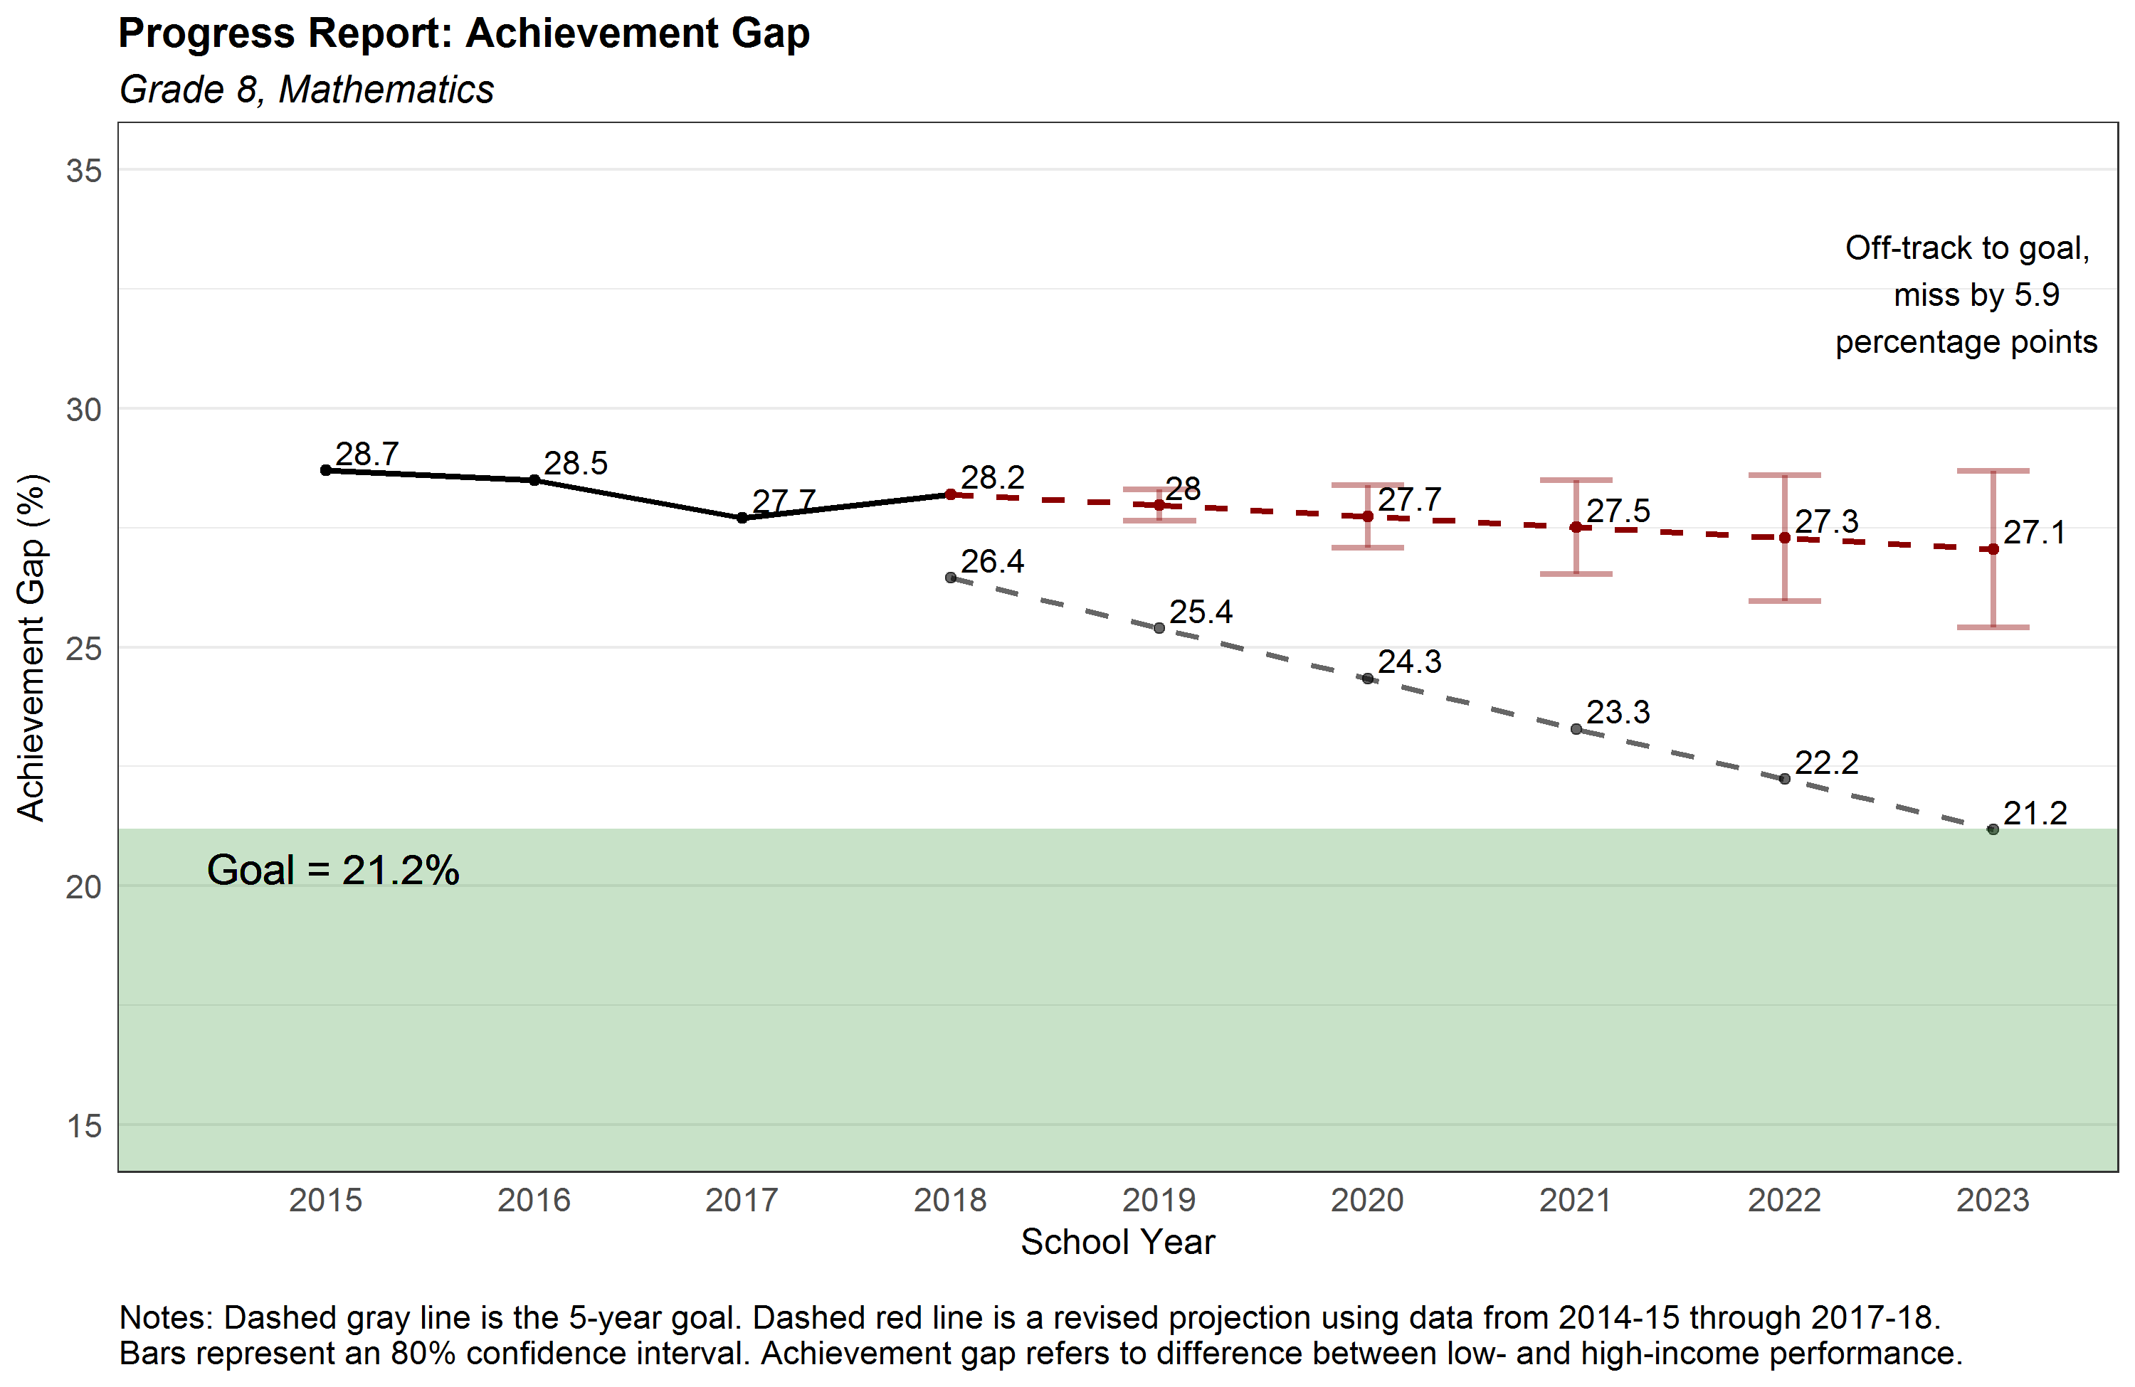
23

Slide 24
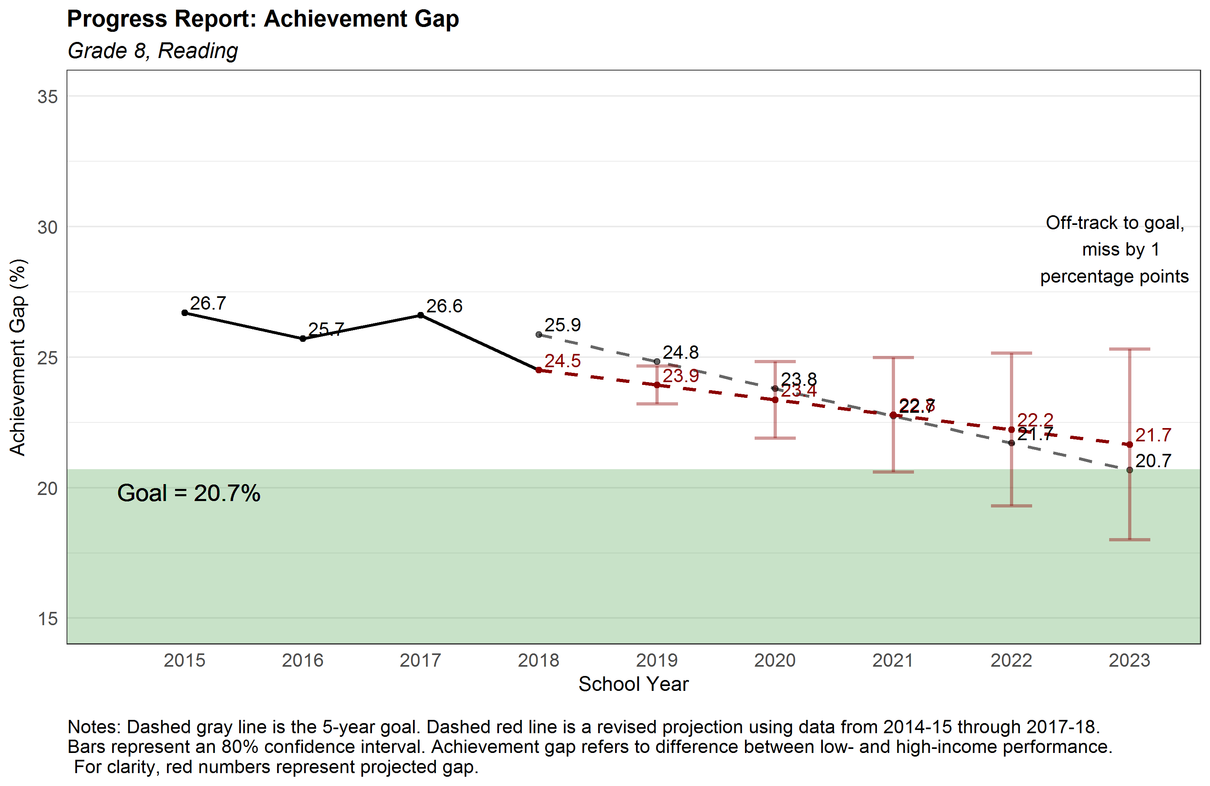
24

Slide 25
How Will We Move the Needle?
Student Success | Operational Excellence
Early Literacy/Early Numeracy School and District Improvement Standards Revision High School Graduation Requirements Career Pathways | Implement Strategic Management Action Plan Implement Agency Communication Plan New School Report Card Staff development

Slide 26
Next Steps
Identifying leading indicators for each initiative

