Slide 1
Committee for Mathematics Achievement (CMA)
First Meeting
September 21, 2023
We ask that you join with your cameras on as your bandwidth will allow.
As you join, please introduce yourself in the chat (who you are, where you’re from, if you have something fun planned for after the session, etc.)
Notes:
Erin

Slide 2
Committee for Mathematics Achievement
Seat on the committee per: KRS 158.842 | Person who serves in seat
the commissioner of education or designee | Erin Chavez
the president of the Council on Postsecondary Education or designee | Dr. Aaron Thompson or Dr. Amanda Ellis
the president of the Association of Independent Kentucky Colleges and Universities or designee | President Mason Dyer or his designee
the secretary of the Education and Workforce Development Cabinet or designee | Secretary Jamie Link or his designee
the executive director of the Kentucky Center for Mathematics | Kelly DeLong
Notes:
Erin

Slide 3
Committee for Mathematics Achievement
Serves a 3 year term expiring December 30, 2026
University of Kentucky | Dr. Lisa Amick
University of Louisville | Dr. Jenny Bay-Williams (temporary chair)
Eastern Kentucky University | Dr. Jamie-Marie Miller
Kentucky State University | vacancy
Murray State University | Ed Thome
Northern Kentucky University | Dr. Sarah Kasten
Western Kentucky University | Dr. Kanita Ducloux
Kentucky Community and Technical College System | Jason Taylor
Morehead State University | James Bowman
one adult education instructor | Tanner Strein
one adult education instructor | Zac Gibbins
one elementary mathematics teacher | Jeanie Stumbo
one elementary mathematics teacher | Alvia Littleton
one middle school mathematics teacher | Amy Leasgang
one middle school mathematics teacher | vacancy
one high school mathematics teacher | Joanna Stevens
one high school mathematics teacher | Ashley Adams
one elementary school administrator | Todd Wooldridge
one middle school administrator | Chris Barwell
one high school administrator | vacancy
Notes:
Erin

Slide 4
Group Norms
Assume best intentions.
Listen carefully to one another.
Be open to new ideas.
Be open to working outside your comfort zone.
Ask questions.
Allow a chance for everyone to participate.
Notes:
Maggie
Explain:
“Group norms can help to create a safe space where participants feel comfortable sharing their ideas and experiences. Take a moment to read the norms.”

Slide 5
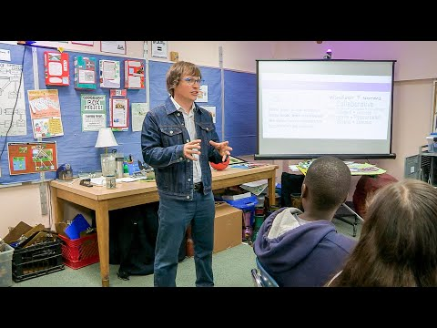
Norm Setting
Notes:
Maggie
This 3.5 minute video references group norms that are really a list of qualities the group is willing to commit to as each day. The suggested group norms will likely apply across participant groups, but there is value in building community by inviting participants to provide input into those norms - especially for participants who will be meeting regularly. Co-creating group norms may help create community within and across school/district participants. Teams could approach this in a variety of ways, but might consider inviting suggestions or providing a list of words for participants to choose from, such as
For the chat: Here are some values you might select if you need some ideas: https://daretolead.brenebrown.com/wp-content/uploads/2019/02/Values.pdf. When you are ready, enter your five words in at https://www.menti.com/alb39kihgoby.

Slide 6
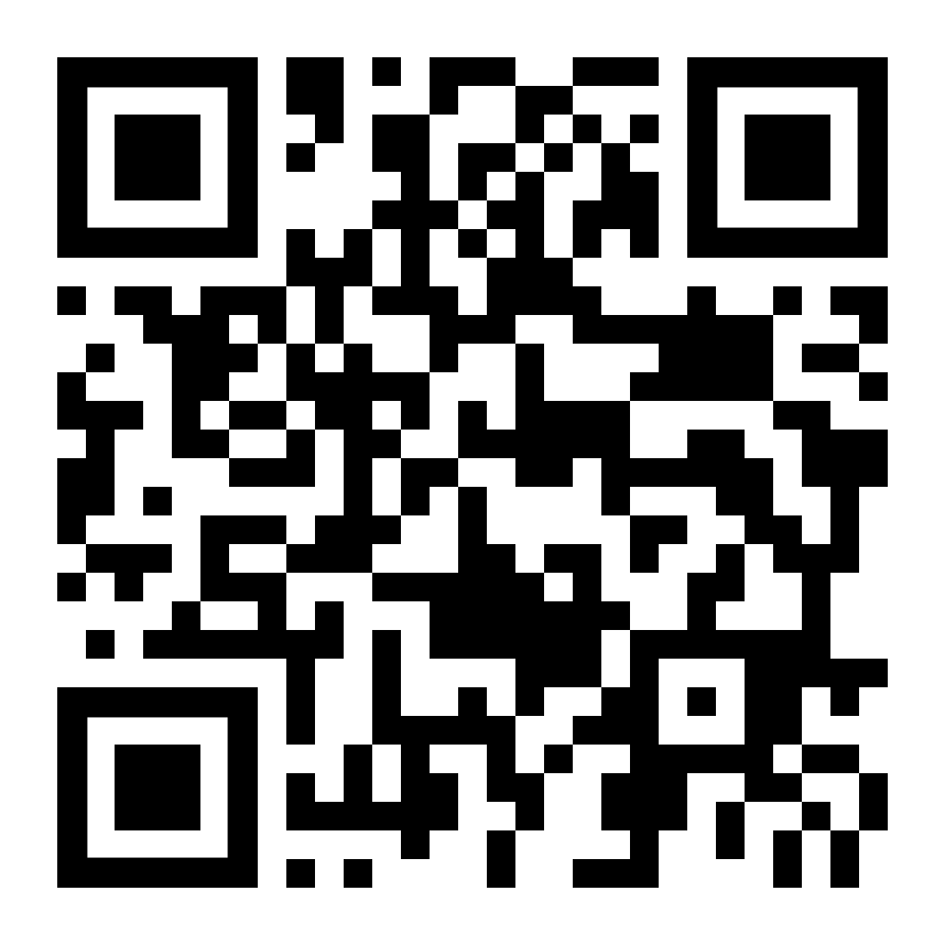
Co-Creating Meeting Values
Step 1:
Review the list of values from Brene Brown’s Dare to Lead and select five values that you most want to see reflected throughout this workshop.
Step 2:
Go to www.menti.com and use code:
5286 8360
to enter the values you selected.
Notes:
Maggie
For Chat Box: https://www.menti.com/alb39kihgoby

Slide 7

Values and Norms from group menti meter
Notes:
Maggie

Slide 8
Agenda
Welcome and Introduction
Approval of Agenda
Review of KRS 158.842
KDE Mathematics Information and Update
Review CMA Strategic Plan
Next Steps
Adjournment
Notes:
Erin
Notes: Motion to approve the agenda.

Slide 9
Review of KRS 158.844
Notes:
Erin
Notes: While the KDE historically requests appointments from the Governor’s Office, the Executive Order XXVII issued by former Governor Bevin in July 2019 abolished the committee and reconstituted the membership requirements. However, when the Executive Order was not codified into law during the 2019 session, the committee reverted back to its original membership composition

Slide 10

Review of KRS 158.844
Step 1:
Review KRS 158.844 on the jamboard slides. Use tools to annotate.
Step 2:
As a group address items from KRS 158.844 that you…
Know
Think you Know
Want to Know
Notes:
Erin
For Chat Box:https://jamboard.google.com/d/1FLC31tfVmVeKC3DWFgSmiGEPFFAetWqkbgp2AHxKFqo/edit?usp=sharing

Slide 11

For our breakout rooms:
To ensure equitable participation and keep the conversation moving, determine an order for sharing. Example-alphabetical:
#1 - Anna
#2 - Felicia
#3 - Kim
#4 - Kristopher
#5 - Lisa
ETC.
Notes:
Erin
You’ll be working with this “team” throughout our session this afternoon. Take just a moment to introduce yourself in your breakout room and share one of the words you want to keep front of mind during our learning experience tonight. Each person in the room should have about a minute to share.

Slide 12
Kentucky Department of Education Information and Update
Notes:
Erin

Slide 13
KDE Mathematics Information and Update
Mathematics Achievement Fund Math Coaching, 13 schools coaching 98 teachers and impacting 10,683 students
Mathematics Achievement Fund Mini-Grant, funds 75 schools at an estimated $40,000 per year for purchase of High Quality Instructional Resources needed for modification of instruction (tier one, tier two and tier three) in mathematics
Notes:
Erin

Slide 14
KDE Mathematics Information and Update
KDE and the Kentucky Center for Mathematics worked with 11 schools, 3682 students and family members participated in Kentucky Family Math Nights (KFMN). These nights communicate to parents effective ways of interacting with their children to improve their mathematics concepts, skills, and understanding.
Mathematics Instructional Resource Consumer Guide
Coming Soon: Roadmap to Implementing High Quality Mathematics Instruction Resource Library
Notes:
Maggie

Slide 15

Resources available at kystandards.org
Notes:
Maggie
Explain:
“The resources for today’s session can be accessed via kystandards.org. If you have not yet subscribed to kystandards.org, you may do so by clicking the gray plus sign on the left side of the page. Providing your email ensures you will be notified as new resources designed to support standards implementation are released. We will spend our time in the Standards Resources section for Mathematics.”
Facilitators might pause to allow participants to access the website and subscribe. Materials are pictured on the slides, but having access to the resources may help participants process.

Slide 16

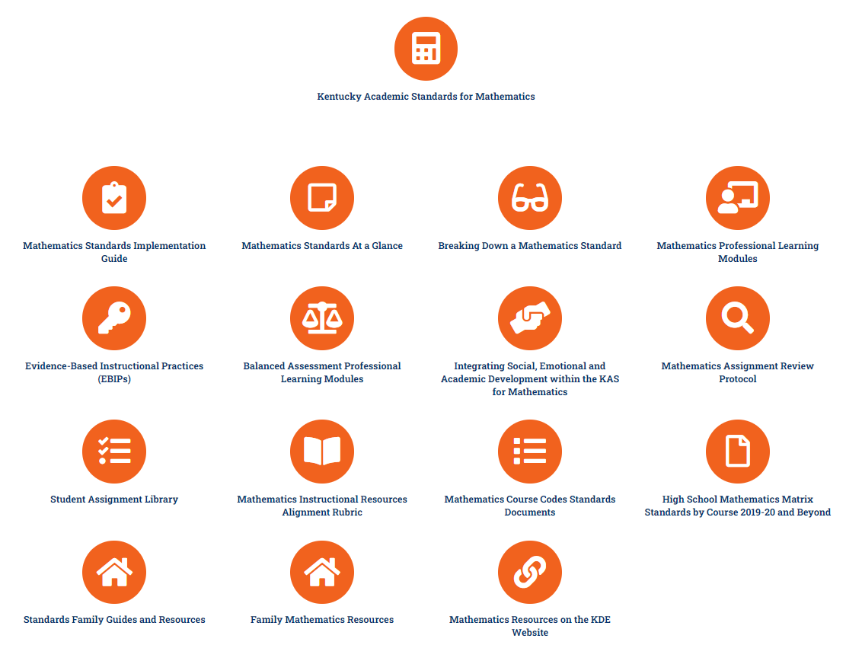




Resources from
kystandards.org:
Standards document
Breaking Down a Standard
Assignment Review Protocol
Integrating SEAD within
the KAS for Mathematics
Notes:
Maggie
Explain:
“Specifically, within the Mathematics Standards resources page, we will be accessing the KAS for Mathematics, the Breaking Down a Standard resource and the Assignment Review Protocol.”
*Reference pre-session survey results.

Slide 17
Review CMA Strategic Plan
CMA is charged with developing a multifaceted strategic plan to improve student achievement in mathematics at all levels of schooling, prekindergarten through postsecondary and adult.
Notes:
Erin

Slide 18
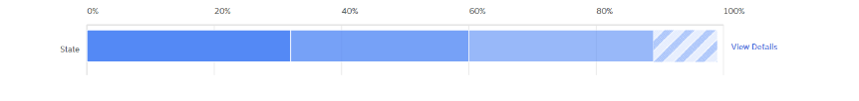
What do you Notice and Wonder?

Slide 19
What might the percentages represent?
Notes:
What new information did we just learn? How does it change your thinking about this graph?

Slide 20
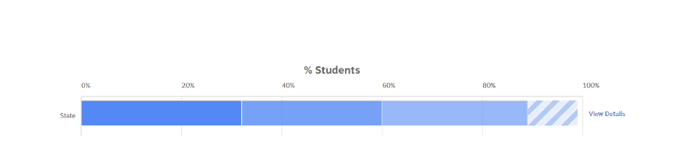
What do you think the different shading represents?
Kentucky

Slide 21
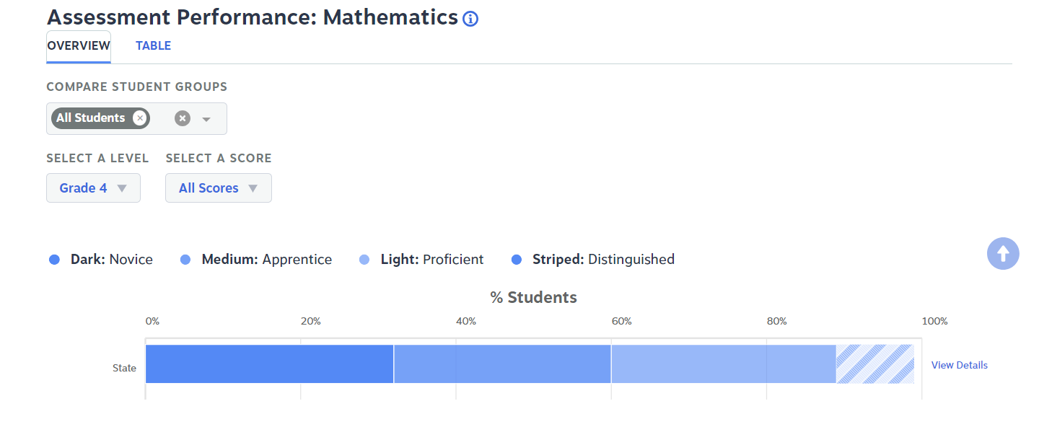
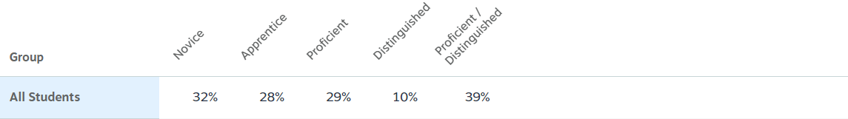
Assessment Performance Mathematics KSA Data
Notes:
Yikes, 60% of KY fourth grade students are novice and apprentice!
Final reveal. Who might use this data and why?
For more information see, Slow reveal graphs.

Slide 22
Review of CMA Strategic Plan
Step 1:
Review all four needs of the CMA Strategic Plan from 2019.
Step 2:
For each need;
what steps is Kentucky already taking to meet the need? (green post it)
what next steps might you envision being needed to move Kentucky forward? (yellow post it)
Notes:
Jenny
For Chat Box:
https://jamboard.google.com/d/1FLC31tfVmVeKC3DWFgSmiGEPFFAetWqkbgp2AHxKFqo/edit?usp=sharing

Slide 23
Next Steps
Complete the Google Form to share:
  feedback on CMA Strategic Plan
  availability for future meetings
Select a chair for CMA
Motion to adjourn the meeting
Notes:
Erin
For the Chat Box:
Google formhttps://forms.gle/mgyxBK1KsQVmCZoe6

