Slide 1
CTE Coordinators’, Principals’ and Counselors’ Meeting
July 27, 2020
Questions can be sent to:
App.gosoapbox.com
Access Code: CTEVirtual

Slide 2
Welcome to the CTE Virtual Summer Event
Kiley Whitaker, Assistant Director
Office of Career and Technical Education
Kiley.Whitaker@education.ky.gov
502-564-4286

Slide 3
Today’s Agenda
1:00-1:45
  Welcome
  State of CTE
  Perkins
  Financials
1:45-1:55 Break
1:55-2:50
  Q&A From First Section
  EOP/TRACK/Pilot
  Industry Certifications
  Dual credit
2:50-3:00 Break
3:00-4:00
  Q&A From Second Section
  Legislative Update
  Announcements
  Q&A From Third Section

Slide 4
State of CTE Address
David Horseman, Associate Commissioner
Office of Career and Technical Education
David.Horseman@education.ky.gov
502-564-4286

Slide 5
Perkins/Financial Reminders
Karla Tipton and Lea Lewis, Branch Managers
Office of Career and Technical Education
Karla.Tipton@education.ky.gov and Leaann.Lewis@education.ky.gov
502-564-4286

Slide 6
Size, Scope and Quality
In order to use Perkins funds, the expense must be linked to the Comprehensive Local Needs Assessment and meets the State Definition of Size, Scope and Quality.

Slide 7
Size
One secondary to postsecondary program of study (career pathway) alignment required for each program area for which districts will use Perkins funds
  KDE is developing a tool through TEDS for this purpose
  Districts/Schools should begin working with Postsecondary immediately to ensure these are in place for 21-22
  These will be due in the 2021-22 Local Perkins Application

Slide 8
Scope
The programs of study lead to industry-recognized certifications, articulated college credit and will link to dual credit opportunities for students and/or work-based learning. Dual credit may be in the academic or technical courses of the POS. Work-based learning should include areas outlined in Kentucky’s Work-Based Learning Manual.

Slide 9
Quality (Secondary)
be of sufficient size, which offer a sequence of four or more earned technical credits;
have a postsecondary connection through dual enrollment, dual credit, current agreement for a program of study and/or current local articulation agreement approved by the lead administrators of KDE and postsecondary institutions, or leads to KDE-approved industry recognized certifications;
have an active advisory panel;
have a certified and appropriately endorsed teacher;
have a co-curricular career and technical student organization (CTSO) that provides students the opportunity to engage in leadership development activities (beginning in the 2021-22 academic year); and
be supported by current labor market data.

Slide 10
Quality (Postsecondary)
lead to a post-secondary credential(s) that is industry recognized and supported by current labor market data and/or local needs assessment;
include career pathway progressions from secondary to postsecondary to employment or transfer; and
have an active advisory panel.
Additional Perkins trainings will be in the fall

Slide 11
2020-2021 Perkins Funds
Not all applications have been approved in GMAP
Please work to get applications approved as soon as possible
These funds may not be used until the application is approved and, NO “retroactive” expenditures are allowed

Slide 12
2020-2021 Perkins Funds
Karla Tipton will email when 2020-2021 revised allocations are uploaded in GMAP in August
Budgets will need to be amended at this time for the updated allocation

Slide 13
2020-2021 Perkins Funds
Deadline for budget amendments is
April 30, 2021

Slide 14
2019-2020 Perkins Funds
Reminder of Time Extension
Deadline to submit budget amendment is August 1, 2020
Deadline for districts to request 2019-2020 funds and carry forward funds, via FCR, is September 30, 2020
May only use these funds for:
    Items received by August 31, 2020
    Activities that occurred by August 31, 2020
    Can not request funds for items that were encumbered!

Slide 15
Other Items…
We are unsure, at this time, if funds will be available for Industry Certifications for Free/Reduced lunch students
We will keep you updated throughout the year around any changes to funding and timelines as they become available!

Slide 16
Break

Slide 17
Questions and Answers

Slide 18
Assessments and Dual Credit
Sherri Craig, Scott U’Sellis, Tom Thompson and Kiley Whitaker
Sherri.Craig@education.ky.gov
Scott.Usellis@education.ky.gov
Thomas.Thompson@education.ky.gov
Kiley.Whitaker@education.ky.gov
502-564-4286

Slide 19
CTE Assessments
  CTE End-of-Program (EOP) Assessment (for articulated postsecondary credit)
  Tech Ready Apprentices for Careers in Kentucky (TRACK) Assessments in the Skilled Trades of Carpentry and Electrical (component of a valid industry certification)
  And
  Pilot CTE End-of-Program (EOP) Assessments (field testing assessment items)
  CTE assessments are offered in-person utilizing an online testing platform, E-SESS

Slide 20
CTE End-of-Program (EOP) Assessments
2019-2020 CTE End-of-Program (EOP) Assessment testing windows closed March 13 due to statewide school closures related to COVID-19
  Results were released April 16, 2020 for students tested prior to March 13 2019-2020 CTE EOP Assessment State Report
  District Assessment Coordinators and CTE EOP Assessment Coordinator have access to performance results and certificates in E-SESS
  Statewide Articulation Agreements for a complete list and copy of articulation agreements
^{New} CTE EOP Assessments now available on student transcript

Slide 21
EOP Assessments
2019-2020 senior/early grads make-up testing tentatively planned fall 2020, if in-person classes are in session or permitted
Districts/schools may select from three make-up testing window options:
Aug. 3-7, Sept. 7-11 or Oct. 12-16
ONLY 2019-2020 seniors/early graduates who received a test ticket in spring 2020 and did not test are eligible
Districts and schools are responsible for scheduling and administering the proctored in-person assessments
  New student test tickets in E-SESS have been generated for eligible students at their home high school

Slide 22
EOP Assessments
2019-2020 senior/early grads make-up testing – planned fall 2020 (cont.)
  Assessment Regulation Trainings - Required all individuals participating in assessment administration
  Healthy at Work/School guidance, including COVID-19 Plan for Reopening Secondary Career and Technical (CTE) Facilities for Completion of Industry Certifications and Lab-Based Dual Credit Coursework (June 29, 2020)
Opportunity for students to earn postsecondary articulated credit and/or job advancement within the workforce
Make-up testing assessment results will not be reported or included within a school or district’s accountability

Slide 23
2019-2020 Pilot CTE EOP Assessment
Pilot EOP Assessments now planned fall 2020, October 19-30, if in-person classes are in session or permitted
  REVISED: Accounting, Financial Services
  NEW: Automation Eng., Civil Eng., Engineering Design, Mechanical Eng.
The same assessment instructions and security as for CTE EOP Assessments apply. Refer to the CTE EOP Assessment Coordinator and Test Administrator Manuals for more information.
  Teacher of record shall NOT administer the assessments
  Assessment Regulation Trainings - Required all individuals participating in assessment administration
  Healthy at Work/School guidance

Slide 24
Skilled Trades TRACK Assessments(Carpentry and Electrical )

Slide 25
Skilled Trades TRACK Assessments
(Carpentry and Electrical )
2019-2020 Skilled Trades TRACK Assessments (Carpentry, Electrical) testing windows closed March 13, 2020 due to statewide school closures related to COVID-19
Results were released for students tested prior to March 13 school closures
  Underclass students who tested and met benchmark on the assessment will count going forward
  Senior students who tested and met benchmark should have received their performance results as a component of a valid (TRACK) industry certification
  Skilled Trades TRACK Pre-Apprenticeship Completion Certification Form

Slide 26
Skilled Trades TRACK Assessments
(Carpentry and Electrical )
Make-up testing tentatively planned fall 2020, if in-person classes are in session or permitted, districts may select from three make-up testing window options: Aug. 3-7, Sept. 7-11 or Oct. 12-16
ONLY 2019-2020 seniors/early graduates who received a test ticket in spring 2020 testing and did not test are eligible
Districts and schools are responsible for scheduling and administering the proctored in-person assessments
  New student test tickets in E-SESS have been generated for eligible students at their home high school
  Pathway specific TRACK Assessment Instructions and Formula Sheets are required materials
Opportunity for students to earn postsecondary articulated credit and/or job advancement within the workforce
Make-up testing assessment results will not be reported or included within a school or district’s accountability

Slide 27
2020 - 2021 CTE EOP Assessment and
Skilled Trades TRACK (Carpentry, Electrical) Assessments
DATES | WINDOW/DEADLINE
Aug. 3-7, Sept. 7-11 or Oct, 12-16 (tentative) | 2019-2020 Senior/Early Grads Make-up Testing Window
Oct 19-30 (tentative) | 2019-2020 Pilot CTE EOP Assessments
Feb. 1 (tentative) | Deadline to identify students as concentrators in pathway for spring 2021 testing
Feb. 22 – Mar. 31 (tentative) | 2020-2021 CTE EOP Assessment / Skilled Trades TRACK Assessment Testing Windows

Slide 28
Industry Certifications
CTE Lab Reopening Guidance
2019-2020 Graduates
  Previously Purchased Certifications, Licenses, Vouchers can be used
  Graduates can come back and test per reopening guidance
2020-2021 Flexibility
  Vendor virtual proctoring allowable if in-person courses are not occurring
  Vendor virtual proctoring allowable if students or parents/guardians choose not to send students for in-person courses
  Perkins and State Free/Reduced Certification CTE funds can be used on virtual proctored industry certifications in these two circumstances
  TEDS Data Entry will be required for Industry Certifications that are earned through this process or through normal proctoring

Slide 29
Dual Credit
Dual credit tuition rate increased to 40% of the KCTCS amount.
KCTCS will be offering fall term classes in a variety of formats from fully online classes as well as face-to-face classes and some options that are a mixture of both. Face-to-face classes will have a strong online or remote instruction part, so if in-person classes must move online for a while everybody is prepared. KCTCS will offer a variety of scheduling options, including 16-week, 12-week, and 8-week sessions. For additional information, please see the KCTCS Welcome Back Plan.
Colleges are required to request an out of term parameter exception for any course that does not follow the college semester calendar. We believe most high schools will fall in this category, so we ask you to proactively work with your college contact to determine those dates as soon as possible.
Dual credit courses should be offered on a semester bases and as close to the regular college semester as closely as possible.
KCTCS is requiring all courses be set up in Blackboard in the event campuses are forced to close and move to remote learning.
Each partner must notify the other of any closures.
Additional Information

Slide 30
Break

Slide 31
Questions and Answers

Slide 32
Legislative Update, Resources, and Wrap Up
Leslie Slaughter, Executive Advisor
Office of Career and Technical Education
Leslie.Slaughter@education.ky.gov
502-564-4286

Slide 33
Senate Bill 101 (Sen. Wilson)
Requires the Council on Postsecondary Education (CPE) to facilitate the development and implementation of a statewide standardized articulation agreement to be executed by July 1, 2021, between public colleges and universities and the Kentucky Department of Education (KDE) for each approved high school career pathway that leads to a postsecondary credential, certification, license or degree.
Upon meeting the requirements of the standardized articulation agreement, a student must be awarded postsecondary credit for prior learning at any public college or university.

Slide 34
House Bill 352 (Rep. Rudy)
Establishes the Executive Branch budget for fiscal year 2020-2021. Rather than a two-year biennial budget, the executive branch budget bill covers only one fiscal year, 2020-2021. This means the General Assembly will have to craft a budget in the next regular session or through a special session called by the governor.
Major provisions related to CTE for fiscal year 2021 are as follows …

Slide 35
House Bill 352 (cont.)
Learning and Results Services (LARS): Local District Petitions to Assume Control of a State-Operated ATC
Funding and Governance Provisions:
Provides language for ATCs to become locally operated by a school district. In the first year, the local board of education receives 100% of funding allotted for that center. In the second year, the local board receives not less than 75% of the amount allocated to it the previous year.
The remaining 25% of funds previously allocated to the center must annually be allocated to locally operated secondary area centers and vocational departments that do not receive state supplemental funds.
The local board assuming control must continue to serve the additional school district or districts through an interlocal agreement that the ATC was serving.

Slide 36
House Bill 352 (cont.)
Learning and Results Services (LARS): Local District Petitions to Assume Control of a State-Operated ATC (Continued)
Personnel Provisions:
A certified employee who has earned continuing status in the state-certified personnel system may be granted a continuing service contract upon transfer to a local board of education.
A principal who has earned continuing status prior to transfer may be granted a continuing service contract, but the provisions relating to demotion of the principal under KRS 161.765 must apply.
A classified employee who has four years of continuous active service in the state certified personnel system at the time of transfer may be offered an employment contract at the time of transfer that must be considered a continuing service contract for a minimum of five complete school terms.

Slide 37
House Bill 352 (cont.)
Kentucky Higher Education Assistance Authority (KHEAA)
The dual credit tuition rate ceiling must be two-fifths of the per credit hour tuition amount charged by KCTCS for in-state students. Priority for awarding scholarships must be given in order to high school seniors, juniors, sophomores and freshmen.
Eligible high school students may receive a dual credit scholarship for two CTE dual credit courses per academic year and two general education dual credit courses over the junior and senior years, up to a maximum of 10 approved dual credit courses when combined with Work Ready dual credit scholarships.
Dual credit scholarships awarded for the spring 2020 semester must not be reduced if the dual credit course is not successfully completed by the student as a result of the student’s inability to properly access the new course delivery method due to the novel coronavirus (COVID-19).

Slide 38
HB 352 (cont.)
An additional $200,000 was appropriated for LAVEC funding within the 2020-2021 budget.
New provision within the language that provides LAVEC funds for any district that enrolls students to a state-operated ATC that is physically located within a different time zone.
  The only district that currently meets this definition and is eligible for the provision is Taylor County (Central Kentucky Career Academy).
The addition of centers established after June 21, 2001, shall be incorporated into the LAVEC formula, if approved by the commissioner of education.

Slide 39
LAVEC Regulation Waiver
705 KAR 2:140
Equalization of funding for locally-operated area vocational centers & vocational departments
Section 5 (1) – The Department of Education shall notify a local school district of its tentative allocation for operation of its locally-operated vocational center and vocational department for the following school year by June 30 based on the classification of the previous year’s secondary vocational program offerings and program FTE enrollment.
Section 5 (2) – The final allocation shall be determined by January 1 based on current year FTE enrollment with adjustments made for new programs.

Slide 40
Transition Readiness 20-21
Senate Bill 158 requires changes to the state accountability system
This information must be approved by the Kentucky Board of Education before it is finalized
Information will be released when finalized from the KDE Office of Assessment and Accountability
COVID-19 may affect state accountability for 20-21, once again information would be released from the KDE Office of Assessment and Accountability
Please be aware that Career Readiness and Perkins Federal Accountability are not identical – Dual Credit is not included in Federal Accountability, only Industry Certifications and End-of-Program Assessments
Schools will still be held accountable for Perkins Federal Accountability in 20-21 regardless of pending decisions on state accountability for 20-21
Exceptional Work Experience is no longer a part of Transition Readiness

Slide 41
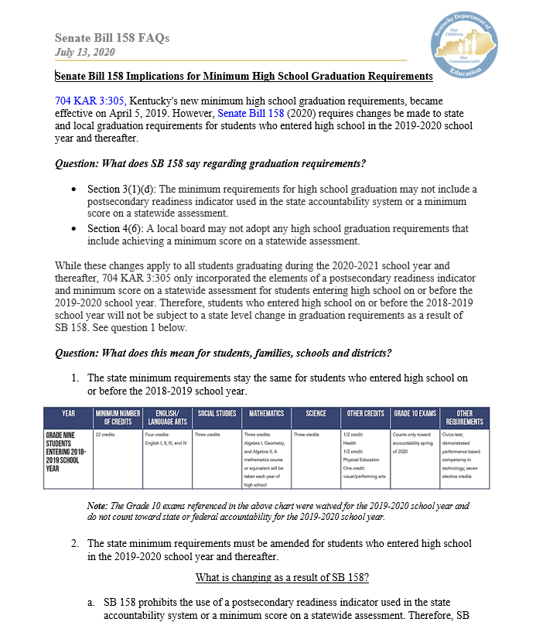
Minimum High School
Graduation Requirements
Senate Bill 158 requires changes to the current graduation requirements.
These changes affect the graduation qualifiers and the graduation prerequisites.
Senate Bill 158 also prevents a local board from adopting any high school graduation requirement that includes a minimum score on a statewide assessment.
Information released Monday, July 27 to districts from the KDE Office of Teaching and Learning related to these changes.

Slide 42
Senate Bill 193 (Sen. Raque Adams)
Establishes a goal of increasing the number and percentage of students in underrepresented groups participating in computer science courses in middle and high school. These populations include females, minorities, students with disabilities, English learners and students whose families are eligible for free or reduced-price lunch.
Dec. 1, 2020, and annually thereafter, KDE must submit a report to the Kentucky Board of Education (KBE) and the Interim Joint Committee on Education (IJCE) that includes an unduplicated count of the number and percentage of public school students participating in computer science courses and other computer science educational opportunities.

Slide 43
Congressional Legislation
Coronavirus Aid, Relief, and Economic Security Act (CARES Act)
Includes $30.75 billion in emergency education funding to governors in each state, state educational agencies (SEAs) and institutions of higher education (IHEs).
Two main K-12 funding sources:
Governor’s Emergency Education Relief (GEER) Fund
Elementary and Secondary School Emergency Relief (ESSER) Fund

Slide 44
Congressional Legislation (Cont.)
Governors Emergency Education Relief (GEER) Fund:
$43.79 million to Kentucky
$30 million of Kentucky’s allocation has been directed by Gov. Beshear to support elementary and secondary education.
Gov. Beshear’s K-12 Priorities for GEER Funds:
  Support for remote learning
  Continuation of food services

Slide 45
Congressional Legislation (P. 3)
Elementary and Secondary School Emergency Relief (ESSER) Fund:
$193 million to Kentucky
Distributed through the Title I-A formula. Funds flow from the U.S. Department of Education (USED) to SEAs, which then must allocate 90% of the funding to local education agencies (LEAs).
LEAs may use funds for:
Any activity authorized under ESEA, IDEA, Perkins or McKinney-Vento; and
Other activities in response to COVID-19 (including preparedness and response efforts, sanitation, professional development, distance learning and others).

Slide 46
Agency and Officewide COVID-19 Response Efforts
Development of KDE COVID-19 webpages
Implementation of weekly Special Superintendents’ Webcasts
Creation of Education Continuation Task Force
Cross-agency teams:
  Frequently Asked Questions (FAQs)
  District guidance (CARES Act funding, fall reopening scenarios, etc.)
  Project management – Phases 1 and 2
  Virtual professional learning

Slide 47
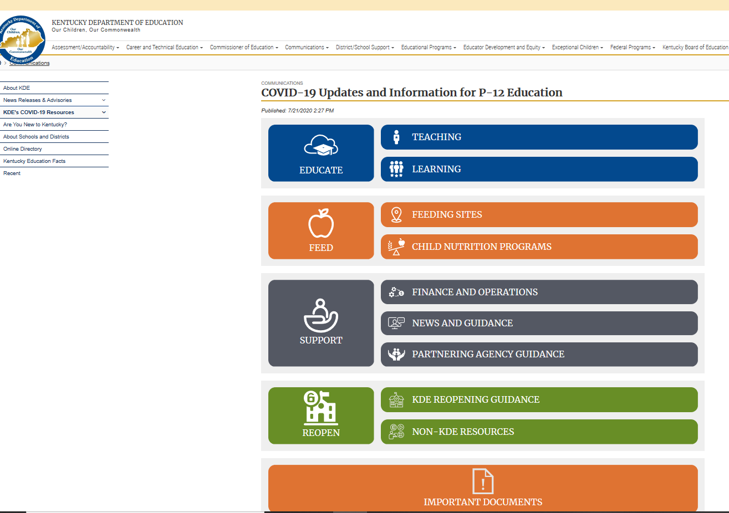
COVID-19 Resources
CTE Specific:
Six (6) COVID-19 CTE Webpages
Postsecondary Resources:
http://cpe.ky.gov/covid-19/
https://kctcs.edu/healthy-at-kctcs/
KDE General and Re-opening:

Slide 48
Announcements
Kiley Whitaker, Assistant Director
Office of Career and Technical Education
Kiley.Whitaker@education.ky.gov
502-564-4286

Slide 49
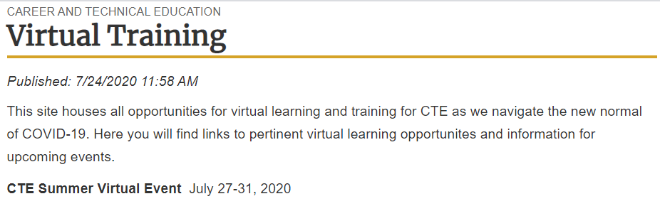
Fall Virtual Trainings and Sessions

Slide 50
Program of Studies Update
2021-2022 Program of Studies is available on the Career and Technical Education Resources webpage
Pathway Phase-out Update
  Agribiotechnology Systems (26.1200.00) will be phased out June 30, 2023; students may be moved to any appropriate agriculture pathway
  Computer Science (11.0701.01) will be phased out June 30, 2024; students may be moved to Computer Programming (11.0201.01)
  Computer Programming Blended Hybrid (11.0201.02) will be phased out June 30, 2024; students may be moved to Computer Programming (11.0201.01)

Slide 51
Program of Studies Update
Information Technology Program name change
  Computer Science beginning 2021-2022
  All pathways are aligned to the Kentucky Academic Standards for Computer Science
CTE Secondary to Postsecondary and Dual Credit Pathway Alignments are available on the Career and Technical Education Program Areas webpage.

Slide 52
Questions and Answers

Slide 53
An FAQ will be developed and distributed from this meeting.
Thank You!!

