Slide 1
Kentucky Spring 2023 Released Items Training
Image by Graphic Stock

Slide 2
Spring 2023 Released Item Data Files
For the spring 2023 released items, schools and districts received data files with information on each released item that was tested in their school and district. There was one data file at the School/District level and one at the student level. All data files were made available in PearsonAccess^{next} (PAN) within published reports.
Each data file has information for each of the released items.

Slide 3
School/District Data File
The data file will contain the following information:
School Code
District Code
District Name
School Name
Grade
Subject
Question ID
KAS Alignment
Objective
Item Type
Number of Students
Possible Points
Percent Correct
Average Item Score
Percent each response was chosen or Percent each score point was achieved
Answer Key

Slide 4
School/District Data File Item Specific Information
For each released item the following information is provided:
Subject – the subject the item was tested in.
Question ID – this corresponds to the item number on the materials posted on the Kentucky portal.
KAS Alignment – this is the Kentucky Academic Standard that the item aligns to.
Objective – this is the item objective with the Standard.
Item Type – this is the type of item as listed below:
MC = multiple choice
MS = multiple select
TE = technology enhanced
SA = short answer
ER = extended response

Slide 5
School/District Data File Item Specific Information: Number of Students and Possible Points
Number of Students – the number of students in the school or district that took the item.
Possible Points – the number of possible points for the item. Possible points for each item type is as follows:
Multiple choice – 1 point
Multiple select – 2 points
Technology enhanced – 1 or 2 points
Short answer – 2 points
Extended response – 4 points
On Demand Writing – 8 points per trait (Grade 5 has 5 traits and Grades 8 & 11 have 6 traits)
Notes:
On Demand Writing responses are evaluated on traits as described in the KSA writing rubrics.
Each trait is scored twice, once by Pearson’s Intelligent Essay Assessor and once by a human scorer. Those two scores are combined for a total of up to 8 points per trait. If the two scores are non-adjacent (more than one point difference), then a supervisor will score the trait a 3rd time to determine the score. Previously the ODW was not scored by trait but the move to trait scoring was made to provide more information on the student’s score.

Slide 6
School/District Data File Item Specific Information: Percent Correct for Multiple Choice
Percent Correct is calculated differently depending on the item type.
For multiple choice – the percent correct is the percent that selected the correct answer. The percent that selected each incorrect answer choice is also listed.

Slide 7
School/District Data File Item Specific Information: Percent Correct for Multiple Select, Short Answer, Extended Response, and Technology Enhanced
Percent Correct is calculated differently depending on the item type.
For all other item types – the percent correct is computed by taking the mean score, multiplying that by 100, then dividing by the max points for the question.
For example, for this item the mean score is 1 and the max points is 2, so 1 x 100 = 100,
then 100/2 = 50 so the percent correct is 50%.

Slide 8
School/District Data File Item Specific Information: Average Item Score for Multiple Choice
For Multiple Choice items the Average Item Score will be the same as the percent correct.

Slide 9
School/District Data File Item Specific Information: Average Item Score for Multiple Select, Short Answer, Extended Response, and Technology Enhanced items
For Multiple Select, Short Answer, Extended Response, and Technology Enhanced items the Average Item Score is calculated by taking the total number of points scored, dividing by the total number of students that took the item, and then rounded.
For example, 21% of the 42 students (9 students) got a score of 0, 62% of the 42 students (26 students) got a score of 1, and 17% of the 42 students (7 students) got a score of 2. The total points scored is (9x0) + (26x1) + (7x2) or 0+26+14 for a total of 40 points scored. Then you take 40/42 and you get .95. Then the .95 is rounded to get to 1.

Slide 10
School/District Data File Item Specific Information: Multiple Choice Percent for Each Response and Multiple Select, Short Answer, and Technology Enhanced Percent for each Score Point.
For Multiple Choice items you will see the percent each response was selected.
For Multiple Select, Short Answer, and Technology Enhanced items you will see the percent for each score point, Score 0 through Score 2.

Slide 11
School/District Data File Item Specific Information: Extended Response Percent for each Score Point and On Demand Writing Percent for each Score Point per Trait.
For Extended Response items you will see the percent for each score point, Score 0 through Score 4.
For On Demand Writing items you will see the percent for each score point at each trait.
Notes:
On Demand Writing responses are evaluated on traits as described in the KSA writing rubrics.
Each trait is scored twice, once by Pearson’s Intelligent Essay Assessor and once by a human scorer. Those two scores are combined for a total of up to 8 points per trait. If the two scores are non-adjacent (more than one point difference), then a supervisor will score the trait a 3rd time to determine the score. Previously the ODW was not scored by trait but the move to trait scoring was made to provide more information on the student’s score.

Slide 12
Student Data File
The student data file will contain the following information:
District/School Code
District Name
School Name
SSID
Last Name
First Name
Middle Name
Grade
Question ID
KAS Alignment
Objective
Item type
Max Points
Student Scored
Student Response
Test Code
Student UUID
Student Test UUID

Slide 13
Student Data File Item Specific Information
For each released item the following information is provided:
Question ID – this corresponds to the item number on the materials posted on the Kentucky portal.
Max Points – this is the maximum number of points a student could have scored.
Student Scored – this is the number of points that the student scored on the item.
Student Response – for Multiple Choice and Multiple Select items the response(s) that the student selected will be listed. For Short Answer, Extended Response, and Technology Enhanced items this will be blank.

Slide 14
Released Item Materials on the Kentucky Portal
For all Released items there is additional information on the KY Portal located at https://ky.mypearsonsupport.com
When you log onto the KY Portal you will see the following:
Select “Released Items”

Slide 15
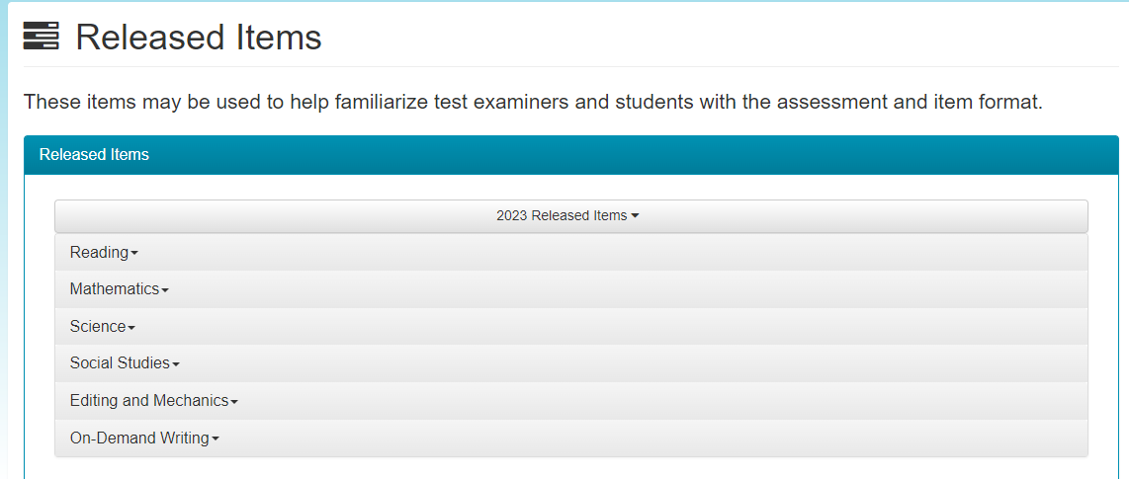
Released Item Materials are listed by Content
After selecting “Released Items” you will see the list of all contents that have released items.

Slide 16
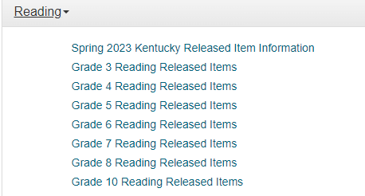
Kentucky Released Items Information
The first item listed on each content is the “Spring 2023 Kentucky Released Item Information”. This document contains important information regarding all the released item information that is posted on the Kentucky Portal.

Slide 17
Released Items in Test Book Format
If you click on “Grade 3 Reading Released Items” you will open a PDF test book with all the items shown in a test book format. The order of each book will be the same and will be as follows:
Released item, followed by the Released Item Performance statistics, followed by the Anchor sets with annotations (if applicable), followed by the next item, and so on through the book.
Note: if a released item is associated with a passage, then the passage will be listed before the item in the test book PDF.
When you look at an item, you will see the Item Number, which is the same as the Question ID, in the upper left-hand corner. The item number will be followed by an underscore and then a number. The number after the underscore is the answer key for that item.

Slide 18
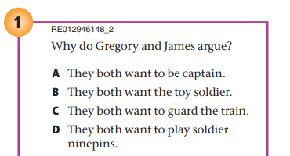
Where is the Question ID for an Item on the Test Book PDF?
In the example below, the Item Number is RE012946148, and the answer key is 2 or B.
Answer Keys:
1 = A
2 = B
3 = C
4 = D
5 = E (For Multiple Select Only)
The Item number that is listed will be the same as the Question ID that is listed on the data files.

Slide 19
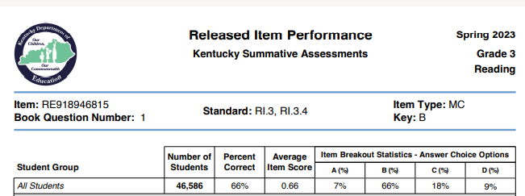
Where is the Question ID on the Released Item Performance Stats?
After the item, the next page in the PDF will be the Released Item Performance statistics. This will include the item number, associated standard, passage type (if applicable), and the item answer key. You will see the Item Number listed at the top of each table behind the “Item:”
In the example below, the Item Number is RE918946815.
The Item number that is listed will be the same as the Question ID that is listed on the data files.

Slide 20
Released Item Information for Short Answer and Extended Response Items
For grades and contents that have short answer or extended response items that were released there will be additional information provided. This includes the corresponding scoring rubric and the Anchor set with annotations. This additional information will be included in the test book PDF right after the Released Item Performance Stats.
Please refer to the “Spring 2023 Kentucky Released Item Information” document for more information on the Anchor sets that are provided for the short answer and extended response released items.

Slide 21
Contact Us
Pearson Help Desk:
(888) 437-1430
Office of Assessment and Accountability (OAA):
(502) 564-4394
dacinfo@education.ky.gov

