Slide 1
Kentucky Spring 2024 Training for Operational Testing
Image by Graphic Stock
Spring 2024

Slide 2
Overview
Notes:
Overview

Slide 3
Operational Administration
Spring 2024 Grades 3-8, 10 and 11
Grade 3 - Reading and Mathematics tests
Grade 4 - Reading, Mathematics, and Science tests
Grade 5 - Reading, Mathematics, Social Studies, Editing and Mechanics, and On-Demand Writing tests
Grade 6 - Reading and Mathematics tests
Grade 7 - Reading, Mathematics, and Science tests
Grade 8 - Reading, Mathematics, Social Studies, Editing and Mechanics, and On-Demand Writing tests
Grade 10 - Reading and Mathematics tests
Grade 11 - Science, Social Studies, Editing and Mechanics, and On-Demand Writing tests
All Grades - Quality of School Climate and Safety Survey

Slide 4
Online Test Timing Guidance-Recommended
Reading Test – 120-140 minutes
Mathematics Test – 120 minutes
Science Test – 90 minutes
Social Studies – 120 minutes
Editing and Mechanics Test – 45 minutes
On-Demand Writing Test – 90 minutes
Quality of School Climate and Safety Survey – 20 minutes
TestNav will not shut off on students once time has expired.

Slide 5
General Testing Information
Students should complete the test in a single, continuous test session per content area. There may be exceptions for students with accommodations.
Science, Editing and Mechanics, and On-Demand Writing have only Part A that must be tested in one session.
Reading, Mathematics, and Social Studies have Part A and Part B that may be tested over multiple days.
Multiple test sessions may be scheduled each day for each content area.
Note: DACs and BACs have the ability to override Part A so absent students can test the same section as the rest of the class. Contact OAA at KDE for more information.

Slide 6
Important Dates
Notes:
Overview

Slide 7
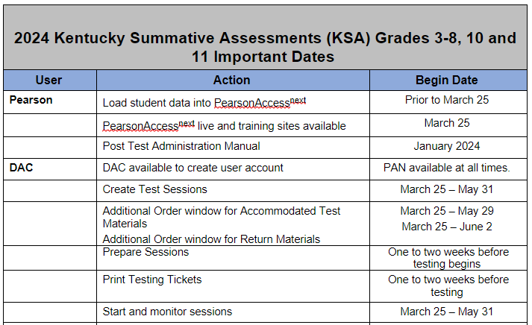
Operational Testing Important Dates

Slide 8
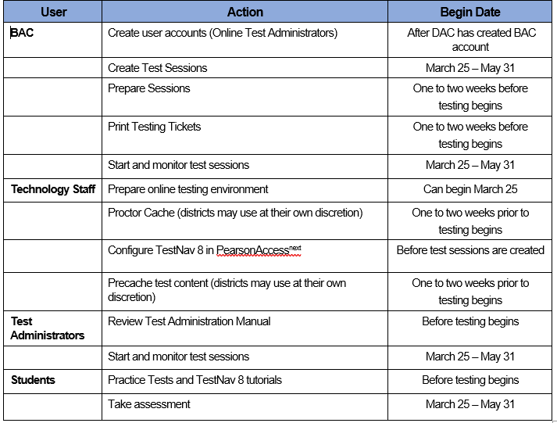
Operational Testing Important Dates (cont’d)

Slide 9
Specific Steps to Prepare for Operational Online Testing
Notes:
Overview

Slide 10
Operational Test Accommodations
The following accommodations will be available for the Operational Test:
Large Print (Paper)
Braille (Paper)
Text to Speech (Online)
Students using paper accommodations will be tested using a test booklet and a student response booklet (SRB). The accommodation kits for these students will be ordered in PearsonAccess^{next} via the additional order screen.
Human Reader-please refer to the Online Testing Toolbox for this process.

Slide 11
Operational Test Large Print and Braille Accommodations Kits
The Large Print and Braille test materials will be provided in kits. The kits will contain the following:
Large Print Kit – large print test booklet, regular test book/student response booklet, rulers, accommodation memo
UEB and/or Nemeth Braille Kit – Braille test booklet, regular test book/student response booklet, Test Administration Notes, and accommodation memo

Slide 12
Ordering Accommodated Test Kits
All accommodated test kits will be ordered via additional orders.
The Additional Order window is open March 25, 2024 through June 2, 2024.
Last day to order test materials is May 29
Return materials can be ordered until June 2
The process for ordering accommodated test materials is included in the PearsonAccess^{next} Navigational Instructions located on the Kentucky Portal.
When you get to that page, click on the PearsonAccess^{next} and then click on “PearsonAccess^{next} Navigational Instructions”.

Slide 13
Operational Test Text to Speech
For Spring 2024 the Online Text to Speech (TTS) functionality is available. KDE provides a student data file to Pearson, this file is loaded to PAN before the testing window opens on March 25, 2024. If the district data has been updated in Infinite Campus by March 15, 2024, with students that require TTS accommodation, TTS will be included on the student record in the data file from KDE.
If TTS has not been added to the student record via the file from KDE, DAC/BACs have two options to add the accommodation:
The DAC/BAC can enter the information into PearsonAccess^{next} via the UI (User Interface).
The DAC/BAC can export a file from PearsonAccess^{next}, make updates to the student record on the file, and import the file back into PearsonAccess^{next}.

Slide 14
Turning on Text to Speech
To turn on the TTS functionality in PearsonAccess^{next} there are two boxes, shown below, that will need to be checked. As mentioned on the previous slide, there are two ways for the DACs/BACs to check the boxes. One option will be to add in the User Interface (UI), go to each student’s record, and select the boxes.
The other option would be to export a file that indicates which student(s) will need the accommodation, then import the file in to PearsonAccess^{next}. Detailed Instructions will be on the Kentucky Portal under the PearsonAccess^{next} Guidance Documents tab.

Slide 15
Turning on the IEP Calculator, cont’d
The box shown below is the one that will need to be checked on the student record in PAN. As mentioned on the previous slide, there are two ways for the DACs/BACs to check the box. First option is in the User Interface on PearsonAccess^{next} and select the box on each student’s record.
Second option is to export a file, indicate on the file which student(s) need IEP Calculator, then import the file in to PearsonAccess^{next}.
Pearson has created specific instructions for both options, mentioned on the previous slide. The detailed instructions will be on the Kentucky Portal under the PearsonAccess^{next} Guidance, documents tab.
IEP/504 Calculator

Slide 16
Proctor Read Aloud Process
Test Administrator’s/Proctors will still be able to log into their own test on TestNav instead of having to read over a student’s shoulder or using a paper copy of the test to read to the student. The administrators will log in to a test using a Proctor Read Aloud testing ticket.
Pearson has detailed instructions for both options in the Creating Test Sessions Guide, on the Kentucky Portal under the PearsonAccess^{next} Guidance Documents tab.
It is imperative that the administrators do not give their Proctor Testing Ticket to the student to use to log into the test. If a student uses the proctor test ticket to log into the test, once the student submits their test, it will not be scored.
Note: Spring 2024, if a student logs in with a Proctor Testing ticket, the student will receive two error messages asking them if they are the Proctor. Error messages are on the next three slides.

Slide 17
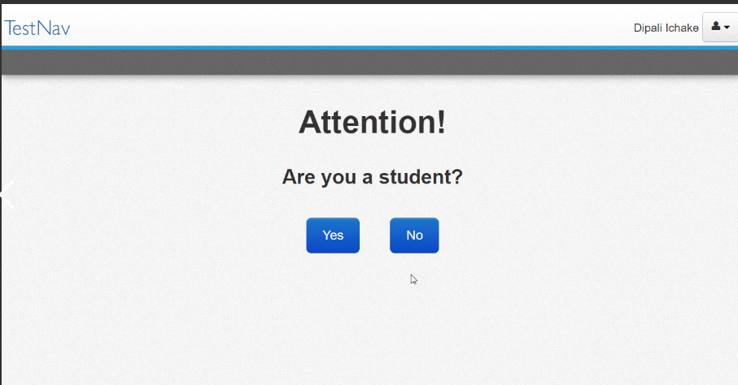
Error Messages for Read Aloud Slide 1
Prompts appear when a user is signed in with a proctor testing ticket to ensure that students do not unintentionally attempt to test and lose their answers. The prompt below appears when a user signs in with a Proctor Testing ticket.

Slide 18
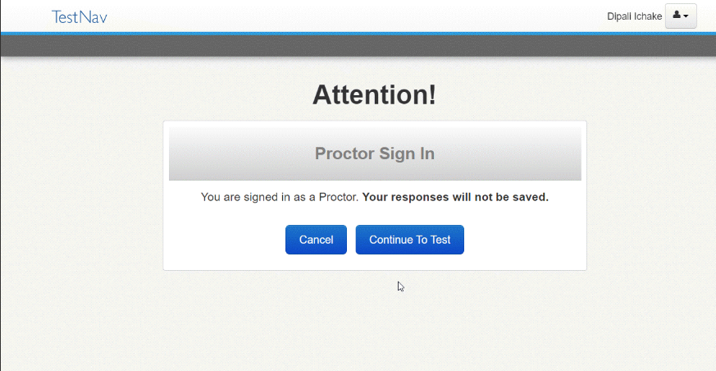
Error Messages for Read Aloud Slide 2
Proctor Prompts at Sign In
If the proctor selects No, TestNav displays the prompt below to confirm before continuing to the test.

Slide 19
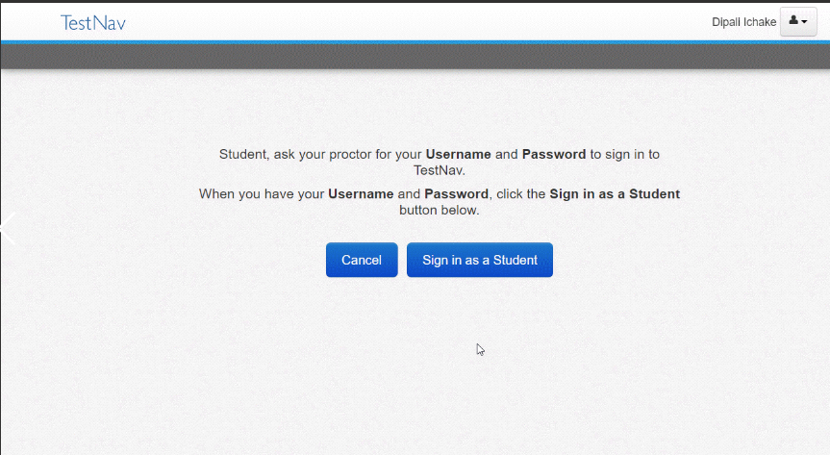
Error Messages for Read Aloud Slide 3
Proctor Prompts at Sign In
If a student selected Yes on the first prompt, indicating that they are a student, TestNav displays the prompt below. Students should select Sign in as a Student once they have their username and password.

Slide 20
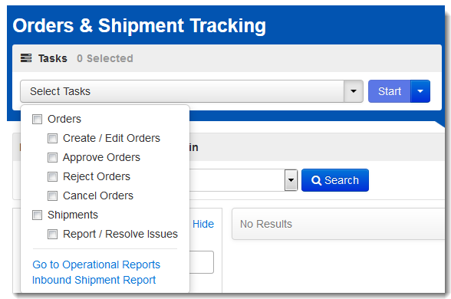
Orders & Shipment Tracking
Use Orders & Shipment Tracking to order paper accommodated materials kits. It is also used to check on the status of existing orders and track order shipments.
Click Setup
Click Orders & Shipment Tracking From Drop Down
Click the Select Tasks drop-down
Select Create/Edit Orders
Click Start.

Slide 21
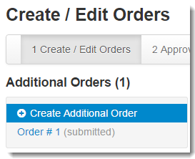
Orders & Shipment Tracking (slide 2)
Select Create/Edit Orders
Next Page is a Screen Shot For the Additional Order

Slide 22
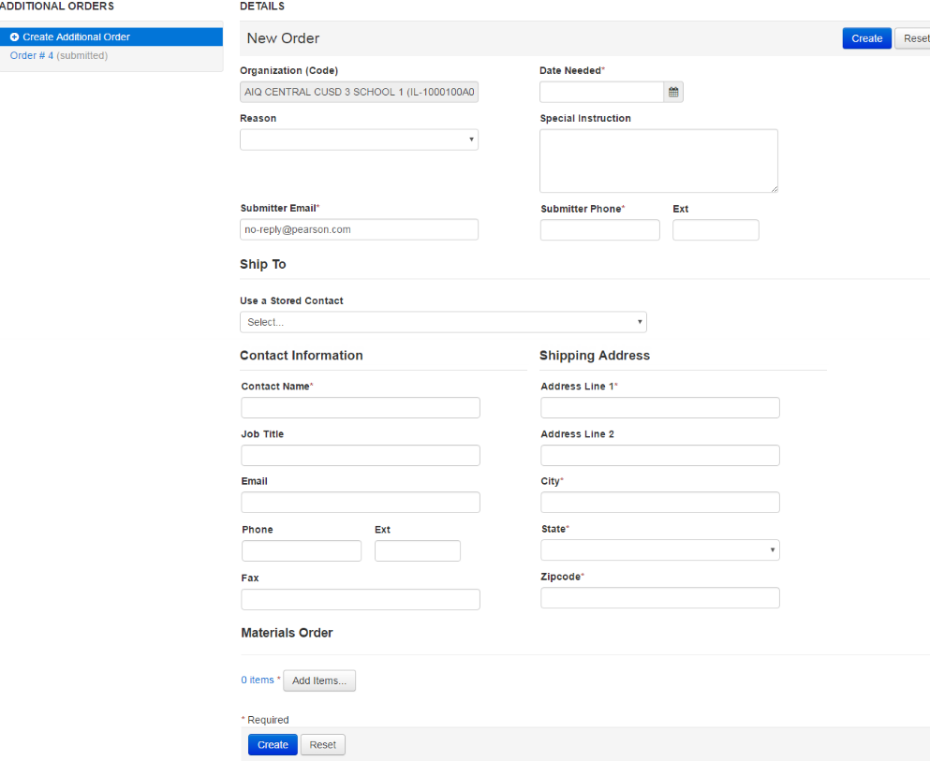
Orders & Shipment Tracking (slide 3)
Enter the Date Needed (allow at least 2-days before testing)
Click the Drop-Down Arrow for Stored Contact
Click On Add Items At The Bottom Of The Page
Enter Items Needed (Next Slide)
Click Save (Next Slide)
Click Create
1
6
2
3
6

Slide 23
Orders & Shipment Tracking (slide 4)
5
4
Once the additional order has been entered, click Save.

Slide 24
Create Test Sessions
You can begin to create test sessions on March 25, 2024.
You will need to create Test Sessions for Reading and Mathematics in Grades 3-8 & 10; Science in Grades 4, 7, & 11; Social Studies, Editing and Mechanics, and On-Demand Writing in Grades 5, 8, & 11. You will also need to create sessions for the Quality of School Climate and Safety (QSCS) Survey in all grades. The QSCS Survey is tested using grade bands, Grades 3-5 and Grade 6-11.
Each session will only contain one content area and one grade level. For example, you can not have a session that has some students that have a Reading test and other students that have a Mathematics test. All students in a session must have the same content.
There are detailed instructions on “Creating Test Sessions Guide” located on the Kentucky Portal under the PearsonAccess^{next} Guidance Documents tab.
Click the Guidance tab and click the pdf “Creating Test Sessions Guide ”.

Slide 25
Prepare Test Sessions
All sessions must be prepared before they can be started. Preparing the session assigns the correct test form to each student within the session.
If you have students that will need the TTS accommodation, you must add the accommodation to their student record before their session is prepared.
You can start to prepare your test sessions one to two weeks before testing.
There are detailed instructions in the “Creating Test Sessions Guide” located on the Kentucky Portal under the PearsonAccess^{next} Guidance Documents tab.
Click the Guidance tab and click the pdf “Creating Test Sessions Guide ”.

Slide 26
Student Testing Tickets and Seal Codes
Each student must have a student testing ticket (per content area) to sign into an online test. Each testing ticket contains the student’s unique username and password.
The student testing tickets, rosters, and seal codes are secure documents and must be kept in a secure location until the test is administered. Testing tickets and seal codes can be printed at least one week prior to testing. If the student testing tickets are printed early, they are secure and must be locked in a secure location.
Each student will have a student testing ticket for each content area that they are testing. Each student testing ticket is unique to each student and session, so they must be used for the correct session.
You will also need to print out the Seal Codes. Seal Codes are unique, four-digit numbers, that are used to control student access to each test section. There will be one seal code for science, editing and mechanics, and on-demand writing; there will be two seal codes for reading, mathematics, and social studies. There will be no seal codes for the Quality of School Climate and Safety Survey.

Slide 27
Student Testing Tickets and Seal Codes (slide 2)
The seal codes can be written on a white board so all students can clearly see what the codes are for each part of the test. Each individual script will inform the proctor when to write the seal codes on the white board.
There are detailed instructions in the “Creating Test Sessions Guide” located on the Kentucky Portal under the PearsonAccess^{next} Guidance Documents tab.
Click the Guidance tab and click the pdf “Creating Test Sessions Guide ”.

Slide 28
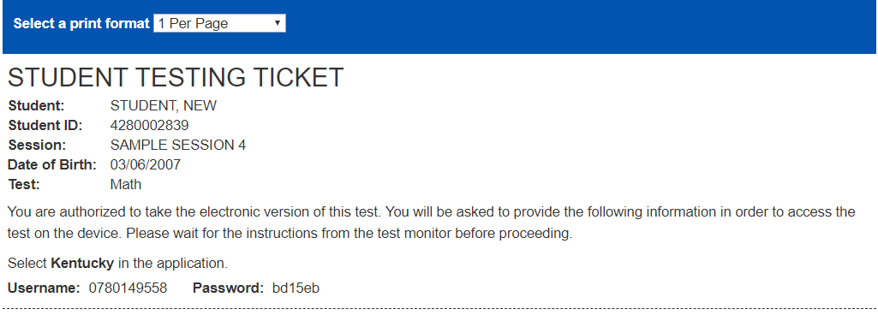
Sample Student Testing Ticket

Slide 29
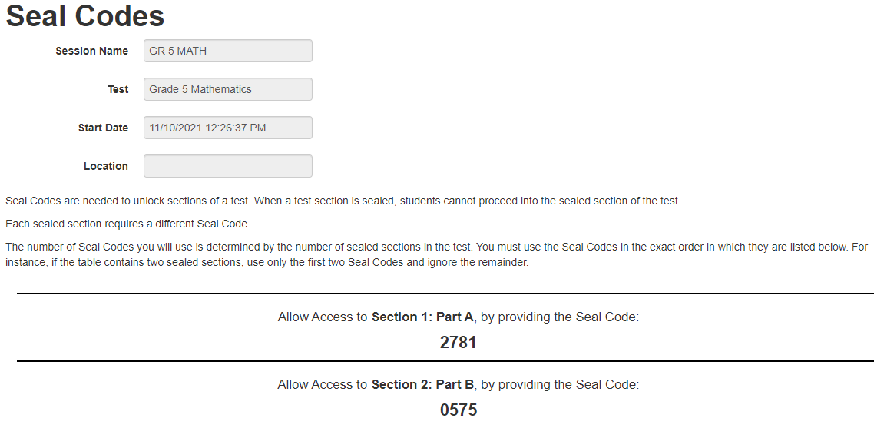
Sample Seal Code Sheet

Slide 30
Starting Test Sessions and Student Testing
All sessions must be started in PearsonAccess^{next} before students can log into TestNav. You can start sessions one at a time or you can start multiple sessions at the same time
There are detailed instructions on Preparing Test Sessions located at: “Creating Test Sessions Guide” located on the Kentucky Portal under the PearsonAccess^{next} Guidance Documents tab.
Click the Guidance tab and click the pdf “Creating Test Sessions Guide ”.

Slide 31
Starting Sessions and Student Testing
Be sure that the student testing tickets for each session are kept separate.
Each time you hand out the student testing tickets have each student verify that their name is the name on the testing ticket.
Students will launch the TestNav app from their device (desktop, laptop, tablet, Chromebook).
The Test Administrator will read instructions from the grade specific scripts, once the Test Administrator feels the class is ready to begin the test, they will write the seal code on the white board.
After the app is launched the TestNav sign in screen will appear. Students will enter the Username and Password from their student testing ticket.

Slide 32
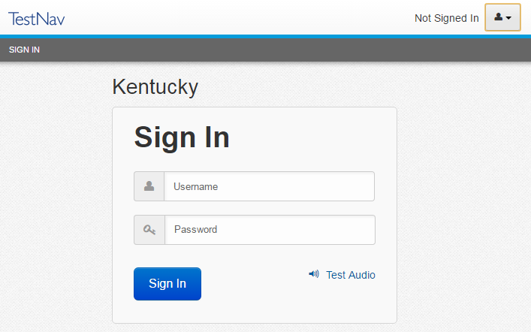
Student TestNav Sign In
After the TestNav app is launched, the TestNav Sign In screen will appear
Students will enter the Username and Password from the printed student testing ticket provided by the Test Administrator and click Sign In
Notes:
After selecting the TestNav app icon from their device, the Sign In screen will appear. Students will enter the Username and Password from the printed student testing ticket provided by the Test Administrator and click Sign In.

Slide 33
Starting Session and Student Testing cont’d
The students will then see the Student Honor Code. They will have to check the box in order to move forward.
After the honor code will be the seal code, once students enter the seal code, they will then be able to start testing.
For students in grades 5, 8, and 11 taking On-Demand Writing, the seal code is at the bottom of the Writer’s Reference Sheet after the Student Honor Code
When students are done testing make sure that they submit their answers and exit out of TestNav.

Slide 34
Student Transfers and New Students
Students that move or transfer into your district/school will need to be tested.
Students that transfer to a new district/school will be handled using a Work Request process in PearsonAccess^{next}. The process involves the DAC from where the student is coming and the DAC from where the student is now residing.
The Work Request process will be in the Test Administration Manual, it is also included on the next slide. DACs and BACs must monitor the “Work Requests” on PAN and approve transfers from other districts.

Slide 35
Work Request Process
Request Enrollment Transfer To move a student to your district/school, you must send a request to the student’s current district/school. Link to training module:
On PAN from the Setup, select Work Requests.
Click Select Tasks, select Request/Delete Enrollment Transfer, and click Start.
Type and select the student details to search for a student to transfer and click Search. Fill in the required fields with the exact information that the student file contains.
Under Change Enrollment To, select the organization to which you want to transfer the student.
Click Send Request.
Authorize Enrollment Transfer Used to move a student from your district/school, you must authorize the transfer request from the new district. Link to training module:
On PAN from the Setup, select Work Requests.
Click the Work Type filter and select Enrollment Transfer.
Select and enrollment transfer request(s).
Click Select Tasks, select Approve/Reject Enrollment Transfer, and click Start.
Review the enrollment request and Approve or Reject.

Slide 36
Student Transfers and New Students (Outside Kentucky Public Schools)
Students that are new to your District/School and are not coming from another District/School in Kentucky will need to be manually added into PearsonAccess^{next}. To add the student, they must have a current SSID.
To add a new student, click on “Setup” then select “Students” from the drop-down menu. Then in “Select Tasks” click on “Create/Edit Students” and then on “Start”. Here you will enter the information for the student.
After the student is entered into the system they will need to be registered. Since this student is new, they will not have a content already assigned. In this case you will select the content per the student’s grade level.

Slide 37
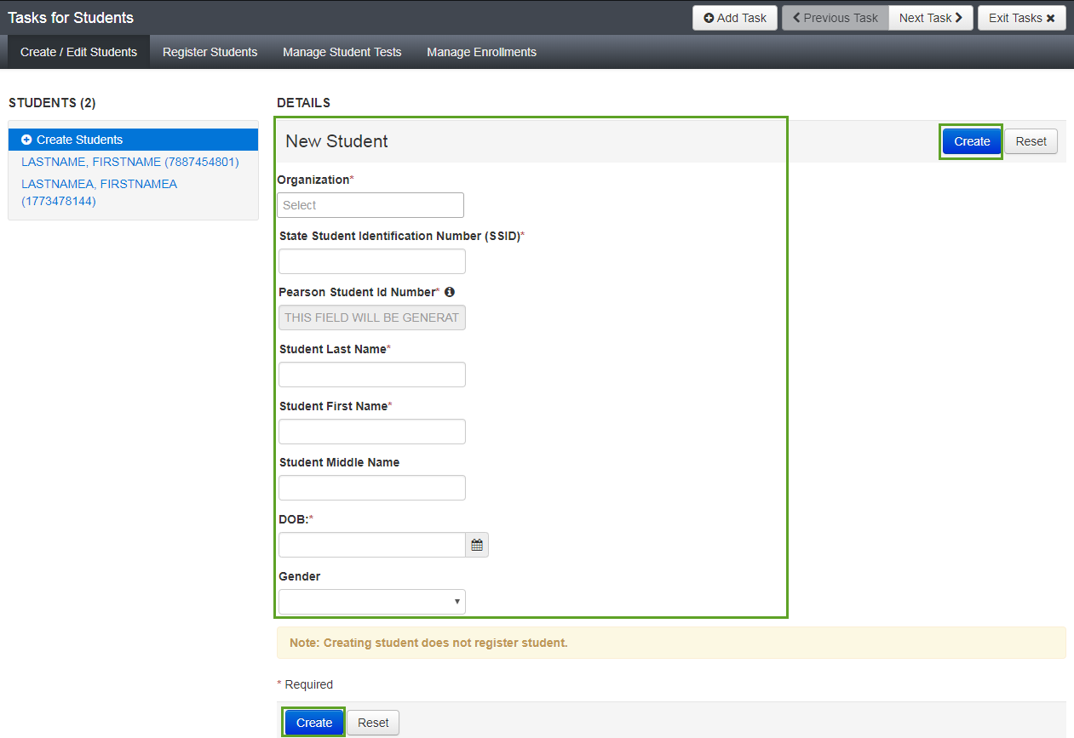
Create New Student

Slide 38
Register Students

Slide 39
Contact Information
Notes:
Overview

Slide 40
Contact Us
Office of Assessment and Accountability (OAA):
(502) 564-4394
dacinfo@education.ky.gov
Pearson Help Desk:
(888) 437-1430
Notes:
You can contact OAA at (502) 564-4394 or at dacinfo@education.ky.gov. For assistance with the PearsonAccess^{next} System, please contact the Pearson Help Desk at (888) 437-1430.

