Slide 1
2025 February DAC Training
Student Data Review and Rosters (SDRR)
Ben Riley, Systems IT Consultant
Chris Williams, Program Consultant
Office of Assessment and Accountability

Slide 2
Agenda
SDRR Spring Timeline
Training Sandbox in SDRR
SDRR and 100-Day Students
District Test Collection Windows
Rosters
Resources
SDRR “Hot Topic” Office Hours

Slide 3
SDRR Spring Timeline

Slide 4
Purpose of Data Quality
The purpose of data quality is to get the student data correct in the Student Data Review and Roster application (SDRR) and during Data Review correct prior to public reporting in the School Report Card (SRC).

Slide 5
SDRR Year at a Glance
Date/When | Event
January | Filing nonparticipations in SDRR if needed for ACCESS rosters. Dropout data is available.
February | Ensure the graduate data correct in Infinite Campus (IC) for Cohort.
Mid-March | Enter the districts test windows for elementary, middle and high school in SDRR. Updating district calendars in IC, so the students’ accountability will be pre-populated correctly in spring rosters starting mid/late April.
Mid/Late April | Spring rosters will open in SDRR for: demographic data, adding students, deleting students, making nonparticipations requests, change accountability if needed and marking accommodations for Individualized Education Program (IEP) and English Learner (EL) students
June | Look at Cohort Data in SDRR and fix the issues in IC
August | Data Review: this is the last time to make individual changes to the student data prior to public reporting.
Post Data Release-Fall | 10-Day Regulatory Review after public release to correct individual student data.

Slide 6
SDRR Spring Timeline (pt. 2)
ALL DATES TENTATIVE
SDRR
ACCESS and Alternate ACCESS Rosters: Jan. 6 - March 10
District Test Window Collection for KSA: March 12 - 28
Spring Rosters: April 23 - June 11

Slide 7
SDRR Highlights
The Sandbox is available for training staff in SDRR.
Rosters will be open and accepting new tickets. The process remains the same.
Data Review will start in late summer/early fall for final review.

Slide 8
Work in SDRR
2025 Spring Rosters
2025 Fall Data Review
Alternate Kentucky Summative Assessment (AKSA)
Kentucky Summative Assessment (KSA)
ACCESS (EL)
WIDA Alternate ACCESS
Postsecondary Readiness
Cohort (graduation rate)
AKSA: Grades 3-8, 10 and 11
KSA: Grades 3-8, 10 and 11
ACCESS (EL): Grades K-12
WIDA Alternate ACCESS: Grades K-12
Postsecondary Readiness and Scores: Grade 12 or current year graduate
Cohort (graduation rate): Grades 9-12 (View Only)

Slide 9
SDRR Features
Connection of SDRR to IC for rosters and demographics
Large buttons on the Home Page indicate which sections of SDRR are currently open in green, finalizing is yellow and closed is in red
Home Page: Announcements, Student Listing, Ticket Listing, Transfer Listing, and Task List
“In Progress” will show for 100-Day Students and Nonparticipation changes before they are approved or denied
Edit tickets
Inactivity logout = 20 minutes

Slide 10
SDRR Features (Continued)
Export button at the top of the student listing (EXCEL, PDF or CSV)
Filter menu displayed on screen
User controls how many students display at a time
Visible counts of students on screen, including filtered results
District/School codes included on all exports
Sandbox for staff training and practice without changing student information
Same login for SDRR as for Sandbox

Slide 11
Training Sandbox in SDRR

Slide 12
SDRR Sandbox
Available for districts to use for training purposes. The Sandbox will be populated with dummy data.
The Sandbox is open for spring rosters and is the same login as SDRR.

Slide 13
Data Accuracy for Public Reporting
Starts NOW in Infinite Campus!
Student demographics, attendance status, accommodations, nonparticipations, testing.
Demographic changes made in IC during Spring Rosters won't be reflected in SDRR until the next school/business day.
One student can make a difference.

Slide 14
SDRR and 100 Day Students

Slide 15
100-Day Students
Test Name | Grade(s) | 100 Days as of …
KSA | 3-8, 10-11 | Spring 2025 KSA Window
AKSA | 3-8, 10-11 | Spring 2025 KSA Window
ACCESS | K-12 | Spring 2025 KSA Window
Alternate ACCESS | K-12 | Spring 2025 KSA Window
Postsecondary Readiness | 12 or G-Code | Spring 2025 KSA Window
100 days as of the first day of the district (for all schools) 14-day testing window

Slide 16
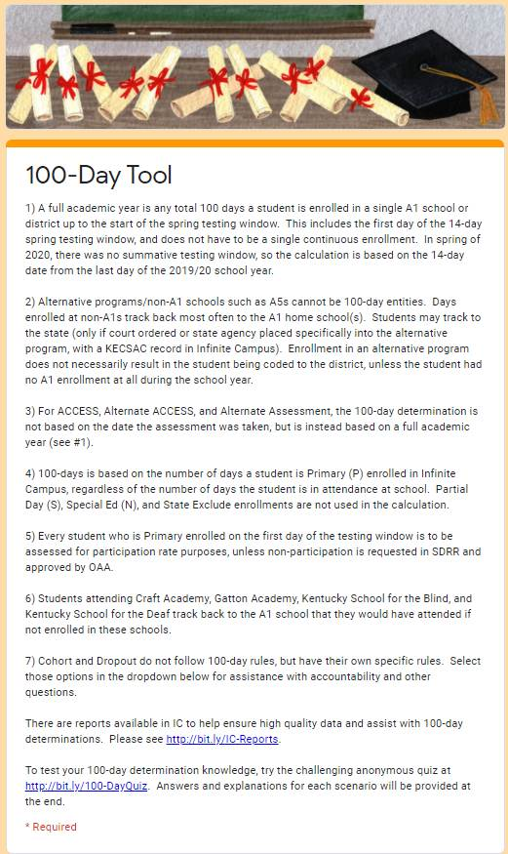
100-Day Tool
100 Day Tool
100 Day Quiz

Slide 17
District Test Collection Windows

Slide 18
KSA Test Windows
KSA test windows for elementary, middle and high schools will be collected in SDRR.
District level users will be able to make changes to the KSA test windows.
School level users will have read-only access and cannot make changes to the KSA testing windows.
Collection window opens on March 12 and closes on March 28 (tentative).
OAA will pull from IC on the Friday before to populate the earliest start dates.

Slide 19
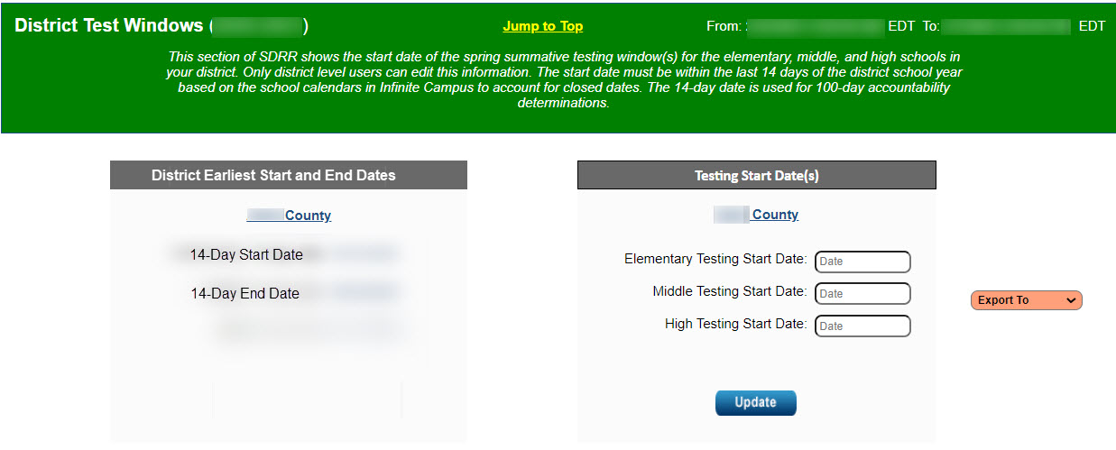
District Test Windows
Export to Excel
Downloads all test windows entered across the state.

Slide 20
Rosters

Slide 21
KSA Rosters
Data is pre-populated from IC
Verify student enrollment in grades 3 - 8, 10 - 11.
Include all students enrolled as of the first day of the district 14-day testing window.
Change requests created for Nonparticipation:
Exemption: First Year EL, Medical
Roster Clean-up: Student Withdrew After Testing Window Began, Expelled Without Services
100-Day Students
Save an electronic version of all rosters in Excel or PDF format

Slide 22
Updates for SDRR
Demographic data will be as the first day of the 14-day testing window based on the district calendar.
Districts will need to ensure that the school calendars are correct in IC.
The Office of Assessment and Accountability (OAA) will pull data from IC at the close of business on Friday prior to all rosters opening.

Slide 23
Medical Nonparticipation
Form allows the district to request the nonparticipation.
Required signatures on the form are the District Assessment Coordinator (DAC) and a medical doctor, Superintendent or Designee.
Nonparticipations can be requested for individual contents or the entire test.
AKSA Nonparticipations cannot be requested until Spring Rosters open in late April.
This request will encompass physical, mental, and emotional issues.
Keep a copy of this form on file in the district and upload the information into SDRR for approval.

Slide 24
IC Report Resources
District and school staff are strongly encouraged to utilize these tools to ensure accurate data in IC, which will then be reflected in SDRR.
IEP
IDEA Dec. 1 Count Extract
QA SPED report
Alternate Assessment
Alternate Assessment Tracking report
English Learners
English Learners Extract
Cohort Graduation Rate
Enrollment End Status Validation report
G-Code Validation High School-Aggregate report
IC Reports to Assist in Data Quality Document

Slide 25
Fields to Change on SDRR Roster in….
Infinite Campus (IC)
SDRR
Name
Grade
SSID
DOB
Gender
Race/Ethnicity
Lunch
IEP
EL
Annotations
Adding/Deleting Students
100-Day Entity Changes
Nonparticipation
Accommodations-IEP and EL
If IC change (except IEP) is not reflected in SDRR by the next day, contact kdedatarequest@education.ky.gov

Slide 26
IEP Field in SDRR (Helpful Hints)
IEP values in IC:
Verify the student has a current Individual Education Program (IEP) and is using the appropriate assessment accommodations.
IEP must be completed appropriately. Please contact the KDE program area for additional assistance.
Verify that the IEP is locked and current.
If IEP change is not reflected in SDRR by the next day, please contact Amy Patterson in the Office of Special Education and Early Learning

Slide 27
EL Field in SDRR (Helpful Hints)
Correcting the EL values in IC:
Mark the student as EL
Home language other than English:0400
Mark at least one instructional accommodation
Mark at least one program services type (cannot be just declined services)
If IC change (except IEP) is not reflected in SDRR by the next day, contact kdedatarequest@education.ky.gov

Slide 28
Roster Dates and Activities
ALL DATES TENTATIVE
Activity | Opens | Closes | Fields/Comments
District Test Window | March 12 | March 28
Spring Rosters | April 23 | June 11
AKSA KSA ACCESS Alternate ACCESS Postsecondary Readiness |  |  | Accommodations used on test collected (IEP, EL) with a yes/no option, Nonparticipation, 100-Day Students Spring Rosters as of the first day of the district 14-day test window and Annotations. Note: Same information during Spring Rosters will be available in August for Data Review
Districts will wait to mark the 100-day students during spring rosters.
Demographic changes are made in Infinite Campus (IC)

Slide 29
Resources

Slide 30
SDRR Resources
I Need Help
100-Day Tool
100-Day Quiz
Cohort Tool
Sandbox
Step-by-Step Instructions: Marking Accommodations, Change 100-Day Entity, Request Nonparticipation, etc.
Screencasts of the Step-by-Step Instructions.
Session for District and School Level Users on SDRR Functionality during Spring Rosters.

Slide 31
SDRR “Hot Topic” Office Hours

Slide 32
“Hot Topic” Office Hour Topics and Dates
Date | Topic (Links Included)
April 15 1-2p.m. ET | SDRR Resources: Where to Get Assistance
April 22- 1-2 p.m. ET | Spring Rosters Task List and Ticketing Basics
April 29 - 1-2 p.m. ET | Requesting Nonparticipations
May 6- 1-2 p.m. ET | Determining 100-Day Accountability: Rules and Tools

Slide 33
February DAC Sessions
Information

Slide 34
2025 February DAC Hybrid Q&A Session Dates/Locations
Feb. 3 – Frankfort – Sower Building (in-person only)
Feb. 11* – Ashland – Kentucky Education Development Corporation
Feb. 19* – Eddyville – West Kentucky Educational Cooperative
*In-person and virtual options available
Note: If weather or other circumstances impact the in-person session, the Q&A session will be held online only.
34

Slide 35
February DAC Hybrid Q&A Sessions
Time | Topic
9:00 | Welcome and Updates
 | Kentucky Summative Assessment (KSA) including PAN & TestNAV
10:15-10:30 | Break
 | Alternate Kentucky Summative Assessment (AKSA) & Accommodations
 | High School and Test Security
 | SDRR
 | Open Floor Questions
Noon | Conclusion
Please Note: The February DAC Q&A sessions will follow the same topics and timeframe at each location. The agenda and times on the slide will be followed; however, once an agenda item has no additional questions, staff will move on to the next topic. Participants planning to attend should plan for the entire meeting.

Slide 36
February DAC Trainings Available
Kentucky Summative Assessment (KSA)
KSA PearsonAccess^{Next} (PAN)
TestNAV
Alternate Kentucky Summative Assessment (AKSA)
Student Data Review and Rosters (SDRR)
Test Security
Accommodations
High School
Please Note: Since the live Q&A sessions will not include full presentations of content already covered in the video recordings, DACs and BACs should be prepared for the Q&A sessions. Before attending the Q&A Sessions, DACs and BACs can be prepared by watching all (or pertinent) training videos on the administration of Spring 2025 assessments.

Slide 37
Division of Assessment and Accountability Support
OAA/DAAS Staff:
Jennifer Stafford, Division Director
Helen Jones, Academic Program Manager
Shara Savage, Education Administration Program Manager
Ben Riley, Systems Consultant
Devon Avery, Program Consultant
Melissa Chandler, Program Consultant
Tiffany Christopher, Program Consultant
Krista Mullins, Program Consultant
Christen Roseberry, Program Consultant
Chris Williams, Program Consultant
Tammy Bradley, Division Administrator
OAA/DAAS (502) 564-4394 dacinfo@education.ky.gov

