Slide 1
2025 February DAC Training
Kentucky Summative Assessments (KSA)
Melissa Chandler and Tiffany Christopher
Program Consultants
Office of Assessment and Accountability

Slide 2
Agenda
Kentucky Summative Assessment
  Scheduling
  PearsonAccess^{next} (PAN)
Operational Test Details
KSA Administration Details
Monitoring Site Visits
2025 Resources
KDE Committee Work Opportunities

Slide 3
Kentucky Summative Assessment

Slide 4
Kentucky Summative Assessments (KSA)
Kentucky students take the Kentucky Summative Assessments (KSA) to meet federal and state testing requirements. The Kentucky Summative Assessments are developed by Kentucky teachers and align with the Kentucky Academic Standards (KAS) in each content area.

Slide 5
Who Does and Doesn't Take the KSA?
Required to Test
Students in grades 3-8, 10 and 11, including those with disabilities
In-person and students enrolled in virtual programs (unless medically exempt) ​
Foreign exchange students
Students who are retained or take supplemental year
Students who skip a grade will test at new tested grade level
Students who move within the state during the testing window
Students with a minor medical emergency
State Agency Children
First year EL students are required to attempt mathematics and science (four MC or one ER)
Second year EL students and later participate in all content areas

Slide 6
Who Does and Doesn't Take the KSA? (continued)
Not Required to Test
Students in Alternate Assessment
Students enrolled at Job Corp centers
Students with approved medical nonparticipation requests
Students expelled without services

Slide 7
Content and Grades
Reading – Grades 3-8 and 10
Mathematics – Grades 3-8 and 10
Science – Grades 4, 7 and 11
Social Studies – Grades 5, 8 and 11
Editing and Mechanics – Grades 5, 8 and 11
On-Demand Writing – Grades 5, 8 and 11
Quality of School Climate and Safety Survey – All Tested Grades

Slide 8
Scheduling

Slide 9
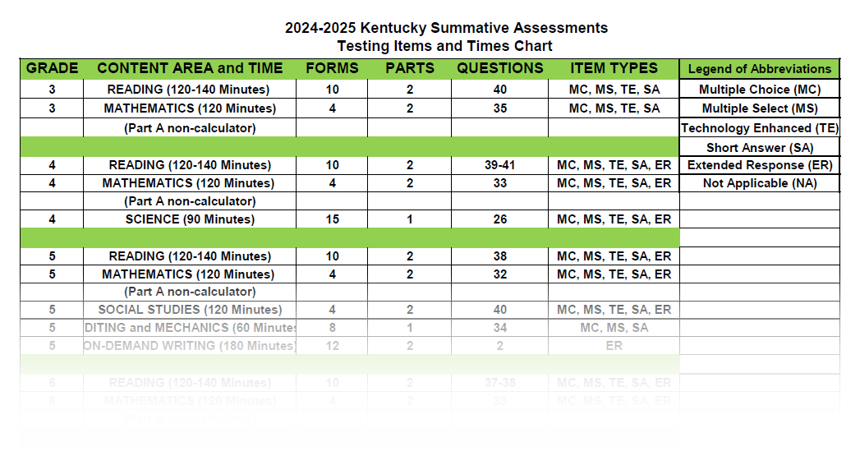
2025 KSA Testing Items and Times Chart

Slide 10
KSA Scheduling
Regular and makeup sessions may be completed within the last 14 days of instruction.
Initial in-person testing should be completed in content order: QSCS survey, reading, mathematics, science, social studies, editing and mechanics, and on-demand writing.
Multiple contents may be administered on the same day.
Follow requirements in testing regulations.
Follow testing policies in the guidance documents and test administration manual.
Breaks are permitted for content tests that have two parts. The test administrator scripts will give specific directions for providing breaks.

Slide 11
Makeup Schedule
Makeup sessions may be completed during the 14-day testing window.
Multiple grades/content areas may be administered in the same room for makeup testing sessions.
Schedule makeup sessions as soon as is reasonably possible.
There is an option to override Part A to allow a student to test with their class for Part B.
  DACs should email DACinfo for more information about this process as it is considered an “Advanced DAC Feature” and requires several steps to complete.

Slide 12
KSA Recommended Testing Time
Recommended test times are available for each content test (See Testing Items and Times Chart).
Students showing continued progress are allowed to work on the KSA past the recommended time. Record this occurrence as needed at the school.
Develop schedule in a manner that allows other students to return to instructional activities.

Slide 13
KSA Extended Time Scheduling
Extended time is only allowed for students with Individual Education Plans (IEPs), 504 Plans or Program Service Plans (PSP) specifying extended time.
Make arrangements for extended time in a manner that allows other students to go back to instructional activities.

Slide 14
New for 2025 – KSA Special Testing Request Form
  In an effort to streamline processes during KSA administration, the following form will be used for special testing requests:
  Schedule Exception Request – used to request early makeups, offsite/homebound, or after hours testing

Slide 15
Early Makeup Testing
If a student will not be present for all, or the majority of the 14-day KSA testing window, they may be approved for an early makeup schedule exception. A Schedule Exception Request must be submitted and approved. The following information is needed to submit the request:
  District and school name
  Student State Identification (SSID) Number(s)
  Grade Level
  Requested Testing Dates
  Reason for Early Testing Request

Slide 16
After Hours Testing
Exceptions may be made to allow students enrolled in virtual programs, alternative programs, etc. to test after regular school hours. A Schedule Exception Request must be submitted and approved. The following information is needed to submit the request:
  District and school name
  Grade Level
  Session name (exact name as it appears in PAN)
  Content

Slide 17
Homebound/Off-Site Testing Request
Homebound students and proctors can meet at off-site destinations (including the home setting) to complete the KSA if students are not able to test at a school or district facility.
The testing schedule in the off-site location may differ from the regular testing schedule, however the order of the content tests must still be followed.
All testing environments shall maintain test security at all times.
A Schedule Exception Request must be submitted and approved. The following information is needed to submit the request:
  District and school name
  Student State Identification (SSID) Number(s)
  Location of the Testing Site
  Proctor Name
  Testing Schedule

Slide 18
Students Enrolled in Virtual Programs
Virtual program students are required to test in-person at a school or district facility. There is not an option for remote testing.
All testing environments shall maintain test security at all times.
A Schedule Exception Request must be submitted and approved if an off-site testing location is needed.

Slide 19
PearsonAccess^{next} (PAN)

Slide 20
IC Data Updates for PearsonAccess^{next} (PAN)
KDE provides a student data file to Pearson to load in PAN.
Student data will be extracted on March 17 from Infinite Campus (IC) District Edition. The pull will be used to determine enrollment in testing grades. Any student that is enrolled in a public school in a testing grade at that time will have data included in the file provided to Pearson.

Slide 21
Resources for PearsonAccess^{next} (PAN)
PAN User Guide
TestNav 8 Online User Guide
Training Site
Practice Tests and TestNav 8 KY Tutorial
PAN Training Modules:
  System Overview
  Setup Organizers and Users
  Managing and Registering Students
  https://ky.pearsonaccessnext.com/customer

Slide 22
Create and Prepare Test Sessions
Create test sessions beginning March 24 in PAN.
The number of test sessions is a local decision.
Students will be preloaded into PAN .
DACs or BACs must create test sessions.
Students must be placed in the test sessions.
Students will take operational assessments in TestNav, Pearson’s online testing platform.
Detailed instructions can be found in the “Creating Test Sessions Guide” located on the Kentucky Portal under the PearsonAccess^{next} Guidance Documents tab.

Slide 23
Student Test Sessions
Reading, Mathematics, Social Studies and Writing have Part A and Part B that may be tested over multiple days.
  Each session started must be finished by the end of the school day.
Multiple test sessions may be scheduled each day for each content area. Content area assessments may be administered throughout the day.
  For example, reading may be given in first, second, third, and fourth periods.

Slide 24
Student Testing
Assessments must be given in order according to the grade level being tested:
  Quality of School Climate and Safety (QSCS) Survey
  Reading
  Mathematics
  Science
  Social Studies
  Editing and Mechanics
  On-Demand Writing

Slide 25
Student Testing Continued
For schools with a 1:1 student to computer ratio, work with technology staff to determine how many students can test simultaneously.
Makeup test sessions are administered during the testing window. Scheduling for makeup sessions can be flexible in terms of order, while still following the content sequence.
Students should understand the correct steps to sign out of a TestNav session.
As a reminder, paraphrasing directions is not an accommodation and may be utilized for all students.

Slide 26
KSA Student Honor Code
Upon logging in to a content test, the student will be asked to accept the honor code prior to entering the seal code.
The student will not be able to test without accepting the honor code.
This process is one of the critical pieces of test security used to monitor appropriate administration of the KSA assessment.
Students should be reminded of the importance of doing their own work and always putting forth their best effort.

Slide 27
Use of Electronics and Social Media Reminders
Review with students the Administration Code rules around use of electronic devices. Schools should have policies in place regarding use of cell phones during test administration.
Posting of secure materials to any social media platform (Facebook, Instagram, Snapchat, etc.) is not allowed and may lead to disciplinary issues.
Inappropriate use of electrics and social media are the most common reported testing allegations.

Slide 28
Operational Test Details

Slide 29
Quality of School Climate and Safety (QSCS) Survey
The QSCS online student survey covers items related to school climate and school safety.
Survey should be administered at every tested grade prior to the first content test (reading; science at grade 11).
  Administration time – will take approximately 20 minutes.
  No separate roster for the QSCS Survey; it is included as part of the KSA and Alternate Kentucky Summative Assessment (AKSA) rosters.
  Consider making the QSCS the first and only session for younger students, especially grade 3.

Slide 30
Reading
Assessed in Grades
3-8, and 10
Two Sessions/
Two Seal Codes –
Part A and Part B
(120-140 minutes)
10 Forms
Multiple Choice
Multiple Select
Technology Enhanced
Short Answer
Extended Response

Slide 31
Mathematics
Assessed in Grades
3-8, and 10
Two Sessions/
Two Seal Codes
120 minutes total
4 Forms
Part A – No Calculator
Part B – Calculator
Multiple Choice Multiple Select Technology Enhanced Short Answer
Extended Response

Slide 32
Mathematics Resources
Formulas are embedded in items within the online test and paper test.
Students will have access to resources whether testing online or paper.

Slide 33
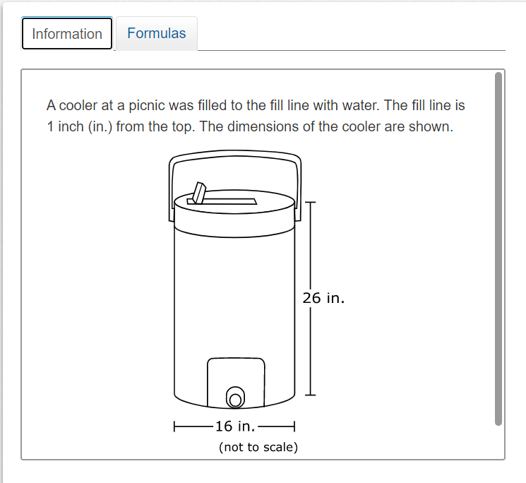
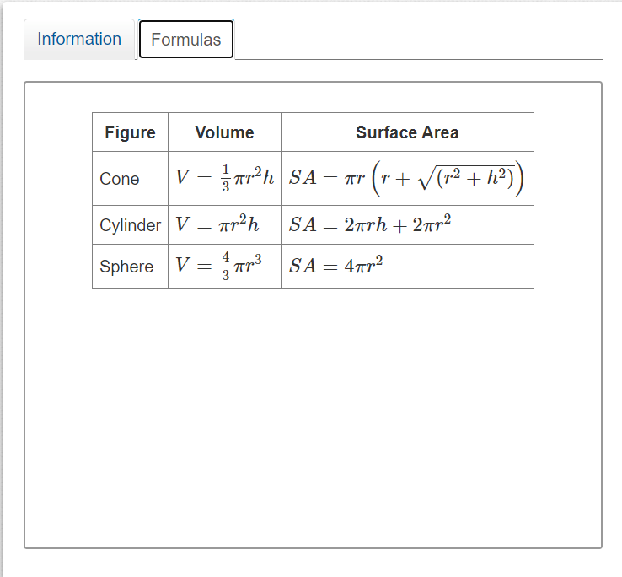
Mathematics Formulas Example
Fig. 1
Fig. 2

Slide 34
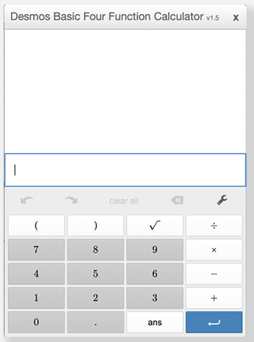
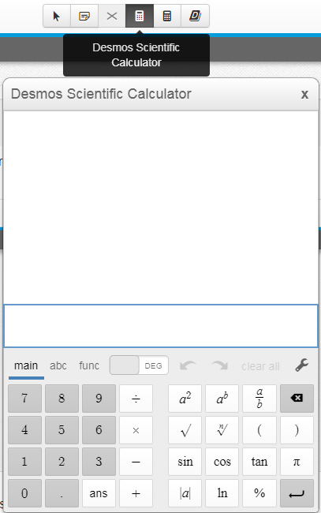
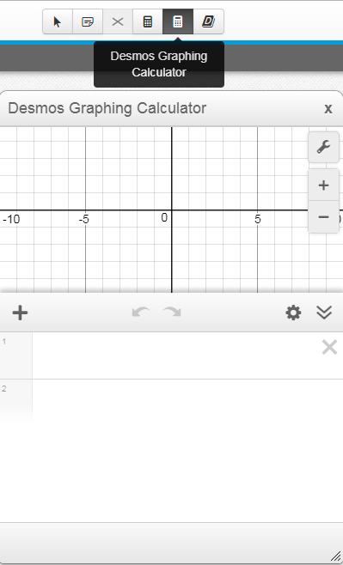
Online Calculators
KDE: OAA: DAAS: 2021-2022 February DAC Training: KSA : 1/31/2022
Four Function
Elementary 3-5
Scientific
Middle 6-8
Graphing
High 10, 11*
2025 Calculator Resources
KDE Calculator Policy
DESMOS Practice
Test Mode Calculator
* Students taking the Science assessment at grade 11 will have use of the scientific calculator

Slide 35
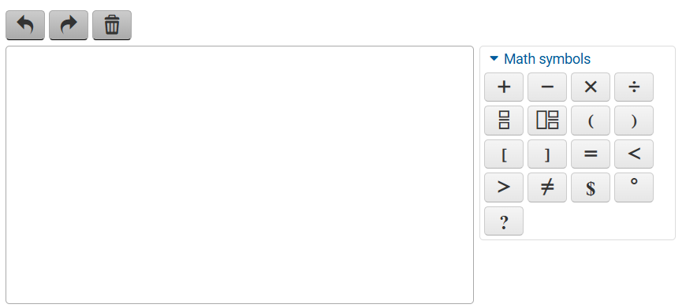
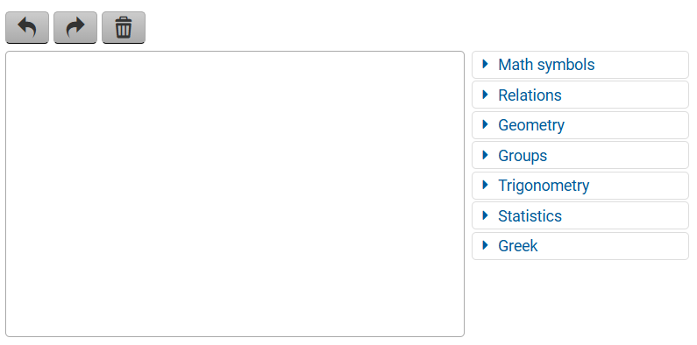
Equation Editor
Grades 3-5
Grades 6-11
The Equation Editor allows students to answer questions using a combination of words and math symbols. Students should be encouraged to become familiar with the Equation Editor by using the Test Prep Resources on the KY Portal.

Slide 36
Science
New for 2025
Updated Test Design
Addition of newly developed items
Fewer long cluster-based items
More standalone items
Additional item types
Assessed in Grades
4, 7 and 11
One Session
One Seal Code
90 Minutes Total
15 Forms
Multiple Choice Multiple Select
Technology Enhanced
Short Answer
Extended Response

Slide 37
Social Studies
Assessed in Grades
5, 8 and 11
Two Sessions
Two Seal Codes
120 Minutes Total
4 Forms
Multiple Choice
Multiple Select
Technology Enhanced
Short Answer
Extended Response

Slide 38
Editing and Mechanics
Assessed in Grades
5, 8 and 11
One Session
One Seal Code
60 Minutes Total
8-10 Forms
(depending on grade)
Multiple Choice
Multiple Select
Short Answer

Slide 39
On-Demand Writing
Assessed in Grades
5, 8 and 11
Two Sessions
Two Seal Codes
180 Minutes Total
12 Forms
Dictionary and Thesaurus Online
Notepad Tool*
(*scratch paper may be used)

Slide 40
KSA Administration Details

Slide 41
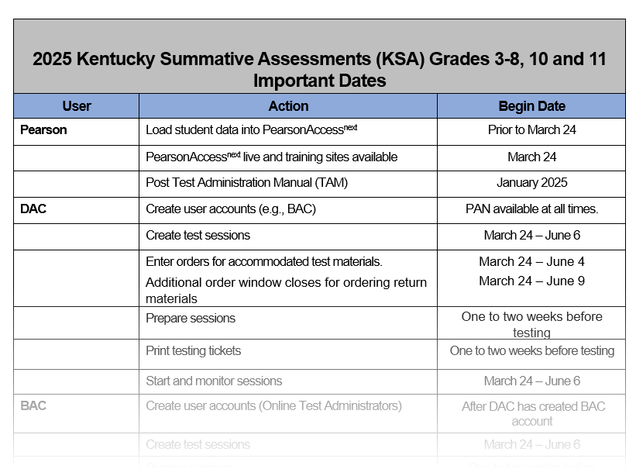
2025 KSA
Important Dates

Slide 42
Seating Charts
Seating charts are required for both individual and group testing for all state-required assessments.
A single chart can be used for multiple sessions; if seating arrangement and room location do not change, mark the date for each session.
Group Seating Chart and Individual Testing Seating Chart templates may be used. A customized form may be created to reflect the room arrangement.
Keep a copy on file for five years. These can be retained digitally.

Slide 43
Classroom Materials/Walls
Materials used during direct instruction, containing content or strategies/processes should not be displayed on classroom surfaces including walls, workstations or clothing.
Classroom materials shall not provide a testing advantage to any student.

Slide 44
Nonparticipation/Emergency Forms
Medical Nonparticipation
Cannot be filed based solely on a handicapping condition
Emergency Forms
Recent surgery on hand limiting a student's ability to type or write
Physical, mental, emotional, and social issues
Recent illness or accident
Undergoing chemotherapy
Chronic condition with acute changes relative to the testing window is appropriate for filing a request
Can test with accommodations
Broken eyeglasses
Homebound instruction is not a basis for filing a request
Medical Nonparticipation Requests are made in SDRR.
Nonparticipations can be requested for individual content tests or the entire test.
All form records are maintained at the district.

Slide 45
Accommodations for Online Operational Testing
Bilingual/English Dictionaries
Reader
Text to Speech
Oral Native Language Support
Extended Time
Scribe
Calculator
Manipulatives
Assistive Technology
Reinforcement and Behavior Strategies
Interpreter for Students with Deafness or Hearing Impairments
*Accommodations are available for students with an IEP, 504 or PSP.

Slide 46
Accommodated Kits Available
Braille
  Testing form 1 is used for all online Text to Speech (TTS) sessions, Braille and Large Print accommodations.
  Accommodated kits come with all testing materials needed except the calculator.
  Instructions for return shipping of the accommodated kits will be included with the materials.
Large Print

Slide 47
Tips For Online Testing
Prepare students using practice tests and tutorials.
Plan for additional staff to actively monitor students while testing.
Maintain test security.
Utilize technology staff for troubleshooting.
Print student test tickets prior to test day. Student test tickets must be handled as secure materials.
Recommended Test Preparation Practice – Print proctor test tickets on a different color paper than student test tickets.

Slide 48
Technology
PearsonAccess^{next} and TestNav products are updated regularly by Pearson. Please verify that student devices are using the newest version of TestNav, well in advance of the testing windows.
TestNav is compatible with a variety of devices (tablets, Chromebooks, laptops, etc.) and OSs (operating systems.)
Technology user guides and guidelines can be located on the KY| Pearson Technology Setup page.

Slide 49
Disable Game Bar
Game Bar is a software program that can capture screenshots, record and broadcast video games.
This is a feature used often by students participating in eSports.
Districts will need to verify that the game bar feature is turned off during the testing window.
Each time a district receives a Windows update from the Office of Educational Technology (OET), staff will have to disable the feature again.
If the Game Bar is not disabled, TestNav will shut down.

Slide 50
Disable Siri
Siri is an application enabled by default in Apple OS 10.13.x and newer Apple OSs.
Districts will need to verify that Siri is disabled during the testing window.
The Siri application may become enabled after OS upgrades, so follow the steps to disable after each update.
If Siri is not disabled, TestNav will shut down.

Slide 51
Disable Grammarly
Grammarly is an application/extension that runs in the background of the device’s operating system or browser.
The application can make spelling corrections, grammar corrections and other related benefits when writing.
Please ensure that the Grammarly application/extension is disabled prior to taking the KSA.

Slide 52
Monitoring Site Visits

Slide 53

In-Person and Virtual Monitoring Visits
In-Person and virtual monitoring will occur during the spring 2025 administration.
Details about monitoring visits can be found in the Test Security February DAC Training.

Slide 54
2025 Resources

Slide 55
KSA Resources
KY Pearson Portal
Test Administration Manual
Items/Times Chart
Online Testing Toolbox
Practice Tests and Tutorials
Scripts
Released Items
KSA Roadmap to Success
Schedule Exception Request Form

Slide 56
KSA Office Hours
Session 1 – Wednesday, March 26, 10-11 a.m. ET
Session 2 – Wednesday, April 16, 10-11 a.m. ET
Session 3 – Wednesday, May 14, 10-11 a.m. ET
Please note that the questions asked during the office hour sessions should be specific to the KSA administration.

Slide 57
Pearson Client Services
Hours of Operation:
7 a.m. – 8:30 p.m. ET
Contact Number:
888-437-1430

Slide 58
KDE Committee Work Opportunities

Slide 59
Opportunity for KDE Committee Work
Opportunities include:
  Science Research: Instructional Practices and Assessment Alignment
  Rangefinding
  Standard Setting
  Item Development/Bias Review
  Kentucky English Language Proficiency (ELP) Exit Criteria
A Google Form will be shared with DACs to forward to qualified teachers.

Slide 60
2025 February DAC Hybrid Q&A Session Dates/Locations
Feb. 3 – Frankfort – Sower Building (in-person only)
Feb. 11* – Ashland – Kentucky Education Development Corporation
Feb. 19* – Eddyville – West Kentucky Educational Cooperative
*In-person and virtual options available
Note: If weather or other circumstances impact the in-person session, the Q&A session will be held online only.

Slide 61
February DAC Hybrid Q&A Sessions
Time | Topic
9:00 | Welcome and Updates
 | Kentucky Summative Assessment (KSA) including PAN & TestNAV
10:15-10:30 | Break
 | Alternate Kentucky Summative Assessment (AKSA) & Accommodations
 | High School and Test Security
 | SDRR
 | Open Floor Questions
Noon | Conclusion
Please Note: The February DAC Q&A sessions will follow the same topics and timeframe at each location. The agenda and times on the slide will be followed; however, once an agenda item has no additional questions, staff will move on to the next topic. Participants planning to attend should plan for the entire meeting.

Slide 62
February DAC Trainings Available
Kentucky Summative Assessment (KSA)
KSA PearsonAccess^{Next} (PAN)
TestNAV
Alternate Kentucky Summative Assessment (AKSA)
Student Data Review and Rosters (SDRR)
Test Security
Accommodations
High School
Please Note: Since the live Q&A sessions will not include full presentations of content already covered in the video recordings, DACs and BACs should be prepared for the Q&A sessions. Before attending the Q&A Sessions, DACs and BACs can be prepared by watching all (or pertinent) training videos on the administration of Spring 2025 assessments.

Slide 63
Division of Assessment and Accountability Support
  OAA/DAAS Staff:
  Jennifer Stafford, Division Director
  Helen Jones, Academic Program Manager
  Shara Savage, Education Administration Program Manager
  Ben Riley, Systems Consultant
  Devon Avery, Program Consultant
  Melissa Chandler, Program Consultant
  Tiffany Christopher, Program Consultant
  Krista Mullins, Program Consultant
  Christen Roseberry, Program Consultant
  Chris Williams, Program Consultant
  Tammy Bradley, Division Administrator
OAA/DAAS
(502) 564-4394
dacinfo@education.ky.gov

