Slide 1
2025 February DAC Training
High School
Christen Roseberry, Program Consultant
Office of Assessment and Accountability

Slide 2
Agenda
ACT Administration Information
ACT Resources
Accountability, Student Data Review and Rosters (SDRR), and Postsecondary Readiness
Feb. DAC Q & A Sessions and Contact Information

Slide 3
ACT Administration Information

Slide 4
Spring 2025 Junior ACT State Administration: Initial - Test Window 1
Initial - Test Window 1
Administration | Dates
The ACT Online Standard & ACT- Authorized Online and Paper Accommodations Testing Window | March 11-14 & 17-21

Slide 5
Spring 2025 Junior ACT State Administration: Makeup - Test Window 2
Makeup - Test Window 2
Administration | Dates
The ACT Online Standard & ACT- Authorized Online and Paper Accommodations Testing Window | March 25-28 & March 31, April 1-4
Please Note: ACT and the Office of Assessment and Accountability (OAA) have worked to secure an Emergency Test Window 3. OAA will work with districts should a statewide emergency arise.

Slide 6
Spring 2025 Junior Testing Windows: Test Session Creation
Option 1
Initial Test Window 1
Makeup Test Window 2
Option 2
Initial Test/Makeup Window 1

Slide 7
Qualified Exception to the Deadline (QED) Window
QED for Test Window 1 - January 27 – March 7
QED for Test Window 2 - March 11 – 14
What qualifies a student for an exception?
NEW to the school
CHANGED grade level
NEW diagnosis
NEWLY identified as English Language Learner (ELL) and need supports
SUDDEN onset of medical condition.
Please note: This is NOT an extension to your request deadline, but for events that occur AFTER the deadline.

Slide 8
Late Start Policy
Districts may offer multiple test sessions within a test day
Sessions should be structured to avoid overlapping breaks
Last session must start by 10:30 a.m.
Do not alter the sequence or timing of tests
Administer breaks as outlined in the manual
Do not take lunch during the break
More information about the Late Start Policy can be found in the ACT Test Administration Manual.
Please note: If any school utilizes the staggered start times, an irregularity report must be completed.

Slide 9
Late Start Policy– Example
Group B - 9:00
English Test - 45 mins: 9:00-9:50
Mathematics Test - 60 mins: 9:50-10:55
Break - 15 mins: 10:55-11:10
Reading Test - 35 mins: 11:10 -11:45
Science Test - 35 mins: 11:45-12:25
Group C - 9:30
English Test - 45 mins: 9:30-10:20
Mathematics Test - 60 mins: 10:20-11:25
Break - 15 mins: 11:25-11:40
Reading Test - 35 mins: 11:40-12:20
Science Test - 35 mins: 12:20-12:55
Group D - 10:30
English Test - 45 mins: 10:30-11:20
Mathematics Test - 60 mins: 11:20-12:25
Break - 15 mins: 12:25-12:40
Reading Test - 35 mins: 12:40-1:20
Science Test -35 mins: 1:20-1:55
Group A - 8:30
English Test - 45 mins: 8:30-9:20
Mathematics Test - 60 mins: 9:20-10:25
Break - 15 mins: 10:25-10:40
Reading Test - 35 mins: 10:40-11:15
Science Test -35 mins: 11:15-11:50
Please note: The times will vary based on reading of script and extended time for accommodated students.

Slide 10
Parental Consent for the Educational Opportunity Service (EOS) and Score Recipients
Students with Consent
Students without Consent
Flexibility to complete non-test sessions at home
Nothing to complete in PearsonAccess^{next} (PAN)
Non-test Session must be completed at school
Testing Staff must complete State use Question in PearsonAccess^{next} (PAN)
Please note: Parental consent must be obtained for each administration and does not transfer over from any administration.

Slide 11
Parental Consent for EOS and Score Recipients- Reminders
Regardless of parental consent for a student to opt into EOS, the student is still required to test.
Do your best to collect parental consent for each student.
Consent can be electronic or written, but if collected electronically, please consult with district administrators to ensure you are following any local board policies regarding collecting consent electronically.
It is the expectation that schools hold two separate support sessions for students with consent and students without.
Testing staff will complete the State Use Question in PAN for students who do not have consent.

Slide 12
New for This Testing Cycle
Schools no longer return online test materials, including scratch paper and student authorization tickets. Those will need to be securely destroyed. For those documents, please see ACT’s recommended retention guidelines in the Test Administration Manual.
There is one administration form that does need to be returned to ACT, seating diagrams. This form will be returned via an electronic file upload in PearsonAccess^{next}. Directions to complete this step can be found in the Test Administration Manual.
All secure and non-secure materials will be shipped together based on the materials receipt week that is chosen. (Schedule of Events – Kentucky)
Schools will no longer receive Pre-ID barcode labels for students registered to test online.

Slide 13
ACT Resources

Slide 14
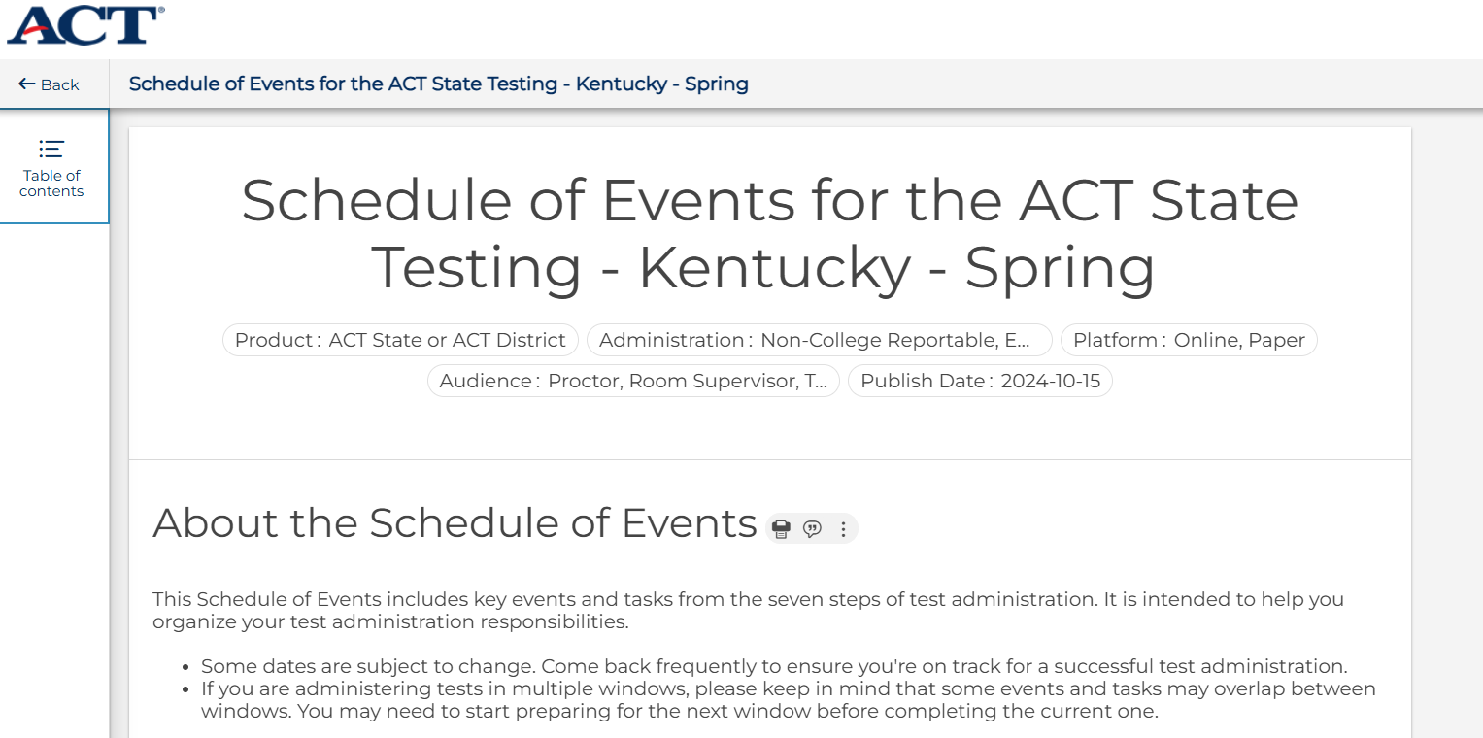
Spring 2025 Junior ACT State Administration: Schedule of Events
The ACT Schedule of Events provides deadlines for each testing window and outlines the various tasks completed during each administration cycle. Tasks will vary depending on which type of administration is being managed (online or accommodated paper).

Slide 15
KDE/ACT Guidance and FAQ Document
The KDE/ACT College Admissions Exam Guidance and FAQ Spring 2025 Junior Administration Document is an important resource that is updated with each administration and should be downloaded for reference.

Slide 16
Accountability, SDRR, and Postsecondary Readiness

Slide 17
ACT/KDE Accountability and Postsecondary Readiness
ACT is used as an option to meet benchmarks in postsecondary readiness set by the Kentucky Council on Postsecondary Education (CPE).

Slide 18
Council on Postsecondary Education (CPE) Academic Readiness Indicators (2025-2027)
Area | ACT | SAT | KYOTE | GED College Readiness | Accuplacer | ALEKS | EdReady Diagnostic
English (Writing) | 18 | 490 | 6 | 165 | 250 |  | 70
Reading | 20 | 490 | 20 | 165 | 250 |  | 70
Math (Quant Reasoning) | 19 | 510 | 22 | 165 | 250 | 30 | 55
Math (College Algebra) | 22 | 540 | 14 | 175 |  | 46 | 65
Math (Calculus) | 27 | 640 | 15 | N/A |  | 76

Slide 19
ACT and CPE Benchmarks
Subject | ACT Benchmarks | CPE Benchmarks*
English | 18 | 18
Mathematics | 22 | 19
Reading | 22 | 20
Science | 23 | n/a
*CPE Benchmarks for the ACT are set by the Kentucky Council on Postsecondary Education.

Slide 20
SDRR and Nonparticipation
The 2025 Spring Junior ACT Administration is a required state assessment.
ACT nonparticipation will not be collected in SDRR as part of the Spring 2025 Administration; however, any documentation should be kept in the district.
ACT will continue to be included in SDRR as part of the Postsecondary Readiness indicator in grade 12 and upon graduation in Spring Rosters and Fall Data Review.

Slide 21
Feb. DAC Q & A Session and Contact Information

Slide 22
2025 February DAC Hybrid Q&A Session Dates/Locations
Feb. 3 – Frankfort – Sower Building (in-person only)
Feb. 11* – Ashland – Kentucky Education Development Corporation
Feb. 19* – Eddyville – West Kentucky Educational Cooperative
*In-person and virtual options available
Note: If weather or other circumstances impact the in-person session, the Q&A session will be held online only.

Slide 23
February DAC Hybrid Q&A Sessions
Time | Topic
9:00 | Welcome and Updates
 | Kentucky Summative Assessment (KSA) including PAN & TestNAV
10:15-10:30 | Break
 | Alternate Kentucky Summative Assessment (AKSA) & Accommodations
 | High School and Test Security
 | SDRR
 | Open Floor Questions
Noon | Conclusion
Please Note: The February DAC Q&A sessions will follow the same topics and timeframe at each location. The agenda and times on the slide will be followed; however, once an agenda item has no additional questions, staff will move on to the next topic. Participants planning to attend should plan for the entire meeting.

Slide 24
February DAC Trainings Available
Kentucky Summative Assessment (KSA)
KSA PearsonAccess^{Next} (PAN)
TestNAV
Alternate Kentucky Summative Assessment (AKSA)
Student Data Review and Rosters (SDRR)
Test Security
Accommodations
High School
Please Note: Since the live Q&A sessions will not include full presentations of content already covered in the video recordings, DACs and BACs should be prepared for the Q&A sessions. Before attending the Q&A Sessions, DACs and BACs can be prepared by watching all (or pertinent) training videos on the administration of Spring 2025 assessments.

Slide 25
Division of Assessment and Accountability Support
OAA/DAAS Staff:
Jennifer Stafford, Division Director
Helen Jones, Academic Program Manager
Shara Savage, Education Administration Program Manager
Ben Riley, Systems Consultant
Devon Avery, Program Consultant
Melissa Chandler, Program Consultant
Tiffany Christopher, Program Consultant
Krista Mullins, Program Consultant
Christen Roseberry, Program Consultant
Chris Williams, Program Consultant
Tammy Bradley, Division Administrator
OAA/DAAS (502) 564-4394 dacinfo@education.ky.gov

