Slide 1

SAT Scores and Reports Training for Kentucky
Mark Yoho, Director
myoho@collegeboard.org

Slide 2












Agenda

Slide 3
Scores and Benchmarks
Cover Page

Slide 4
Student Scores on the SAT
Reading and Writing Section
Math Section
Total Score
Sum of Section Scores
SAT: 200-800
SAT: 1600
SAT: 200-800
The SAT is on a 1600 point scale
800 points are generated from the Reading and Writing Section and 800 from the Math section
Visit here for information on how to compare SAT and ACT scores
Further details here on understanding SAT scores for students and families

Slide 5
SAT Suite College and Career Readiness Benchmarks
The tests in the SAT Suite of Assessments provide college and career readiness benchmarks and consistent feedback for measuring student progress.
College and Career Readiness benchmarks
Set at the Section Level
Students who earn that score or higher have a 75% likelihood of earning a C or better in a first-year, credit-bearing course in the same subject area.
Grade-level benchmarks
Based on expected student growth toward the SAT benchmark
 | Grade 8 | Grade 9 | Grade 10 | Grade 11 | SAT
Reading and Writing | 390 | 410 | 430 | 460 | 480
Math | 430 | 450 | 480 | 510 | 530

Slide 6
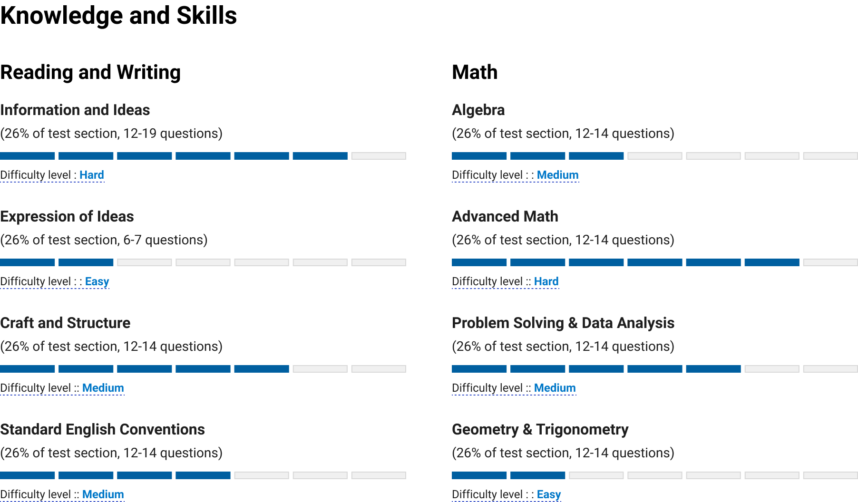
Content Domains and Students Practice Further information on content domains here
Progress bars represent student performance in each domain on their practice score report.
Provides a snapshot of their strengths and challenge areas

Slide 7
Accessing the K-12 Reporting Portal
Cover Page

Slide 8
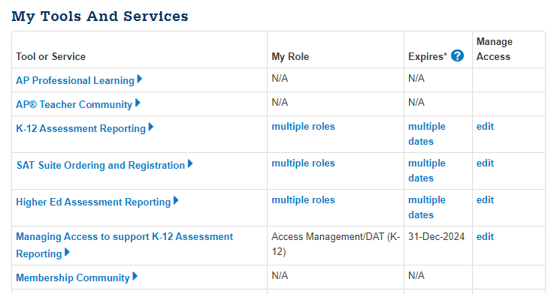
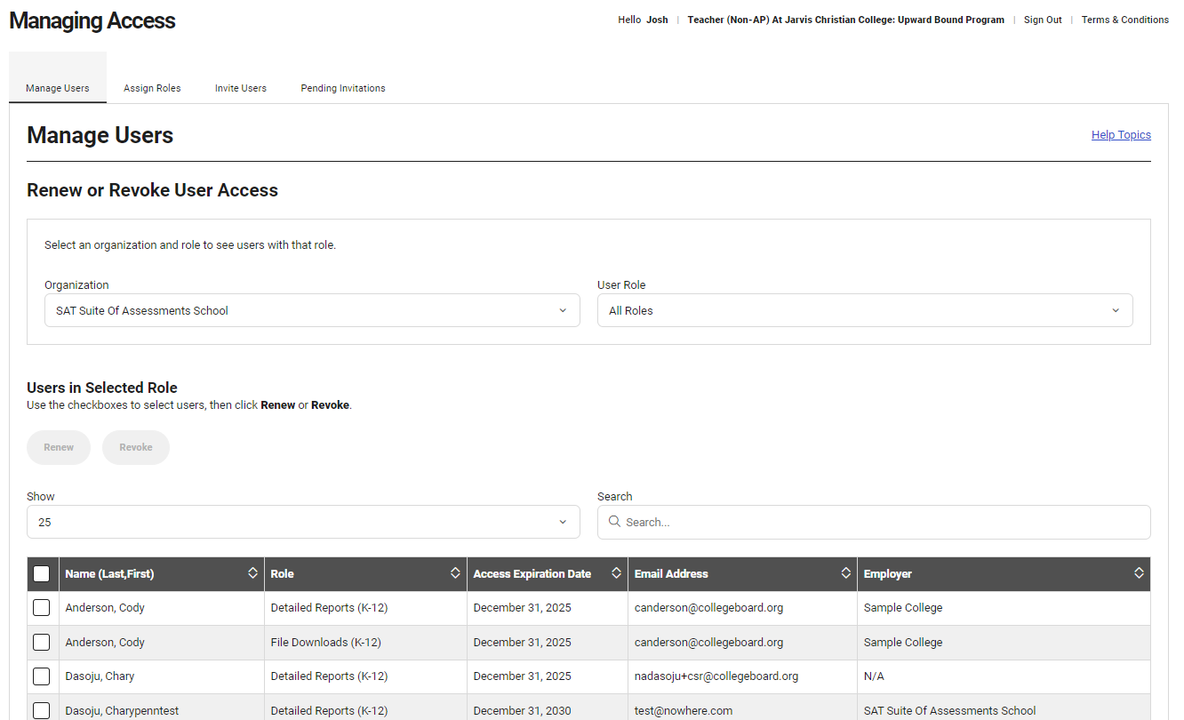
Managing Access Tool (MAT)
An access code is required to set up an Access Manager for the first time.
Call AP Educator Support at 877-274-6474 to request a Managing Access Tool access code if you have never had one generated
View details on setting up an Access Manager for the first time.
Your institution’s Access Manager is responsible for assigning K-12 Reporting Portal access to themselves and to their colleagues.
Reminder: Access Managers should monitor access on a regular basis, removing access for those that no longer need it, or extending access for those whose access is about to expire.

Slide 9
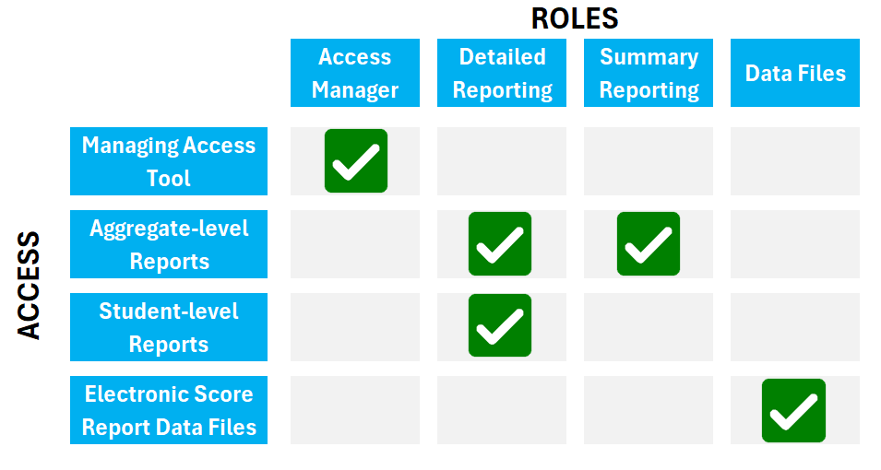
Assigning Roles Using the MAT
Access Managers use the Managing Access Tool to assign K-12 Reporting roles to individuals.
The roles assigned determine the level of access granted. More than one role can be assigned:
Access Management/DAT – Responsible for managing access to their institution’s K-12 Reporting Portal using the Managing Access Tool.
Detailed Reports – Can run and view aggregate and student-level reports.
Summary Reports – Can run and view aggregate reports only.
File Downloads – Can view and download electronic score report (ESR) data files in the Downloads section of the K-12 Reporting Portal.
View a brief training on using the MAT.
More resources are available here under Granting Access and Assigning Roles.

Slide 10
K-12 Assessment Reporting
Cover Page

Slide 11
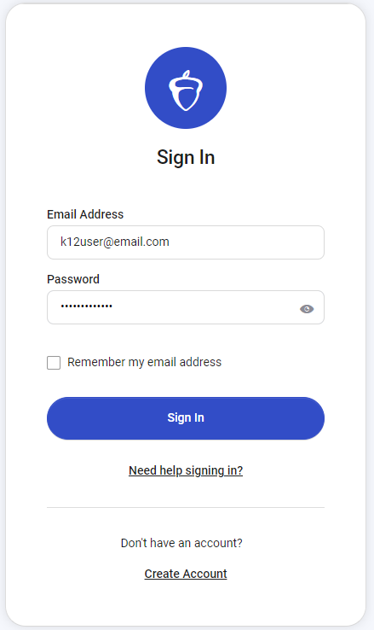
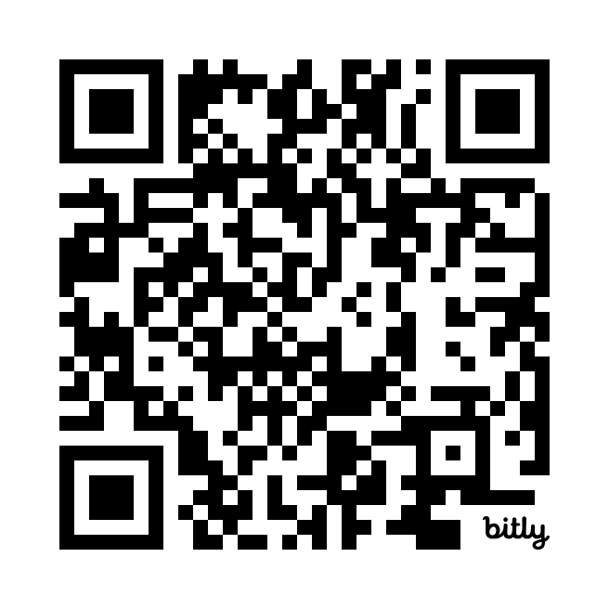
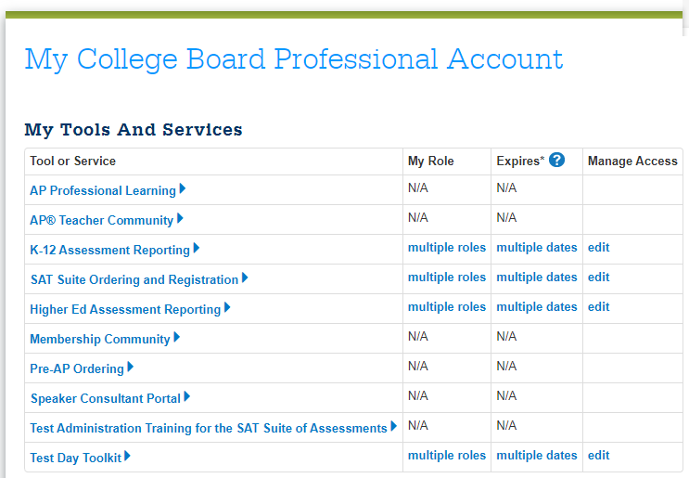
Login to K-12 Reporting Portal
Once access to the K-12 Reporting Portal has been granted by your Access Manager, you can log into the K-12 Reporting Portal.
Log in directly at: https://k12reports.collegeboard.org/login.
You can also click "K-12 Assessment Reporting" on your College Board dashboard to launch the portal.

Slide 12
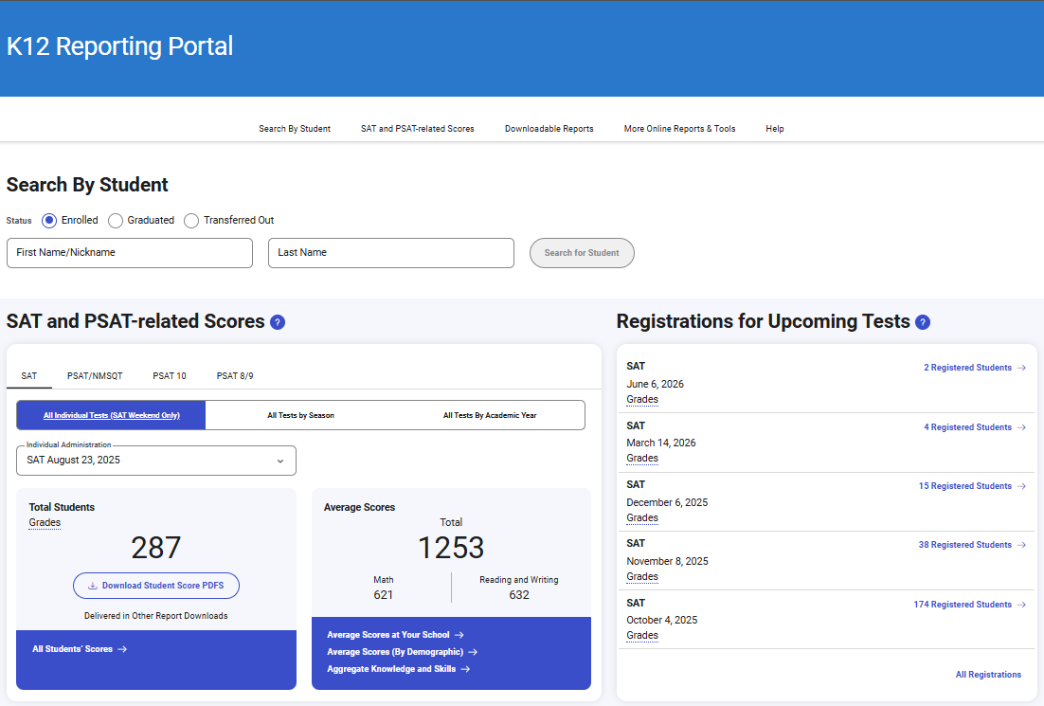
K-12 Reporting Portal Home Page
Quick Navigation Links
Search By Student
(available to schools and districts)
Upcoming Registrations
PDF Student Score Reports

Slide 13
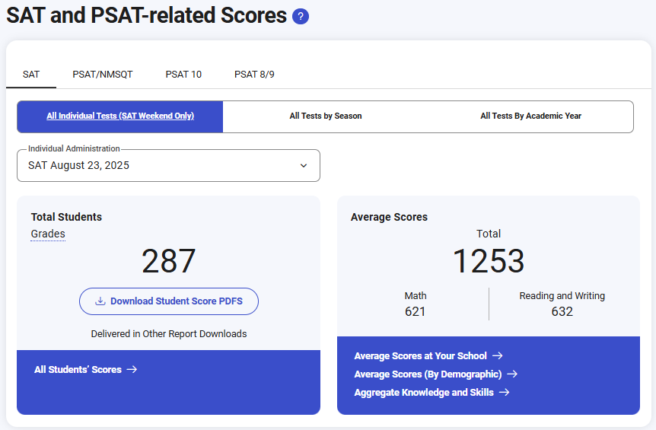
K-12 Reporting Portal Home Page – Find Scores
Select by Test or Administration
Student Roster (requires detailed access)
Upcoming Registrations

Slide 14
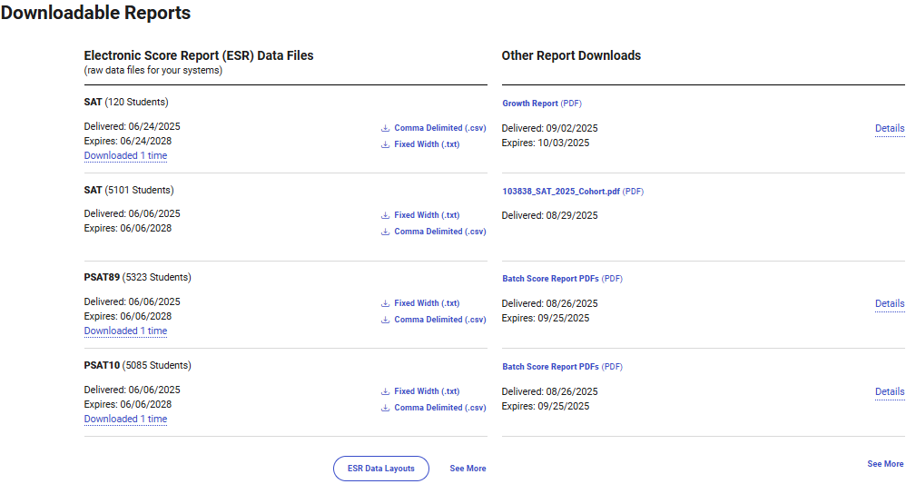
K-12 Reporting Portal Home Page - Reports
Scheduled and Requested Reports
Growth Reports
Fee Waiver Codes
Cohort Files
Batch PDF’s
Click to View Additional Reports

Slide 15
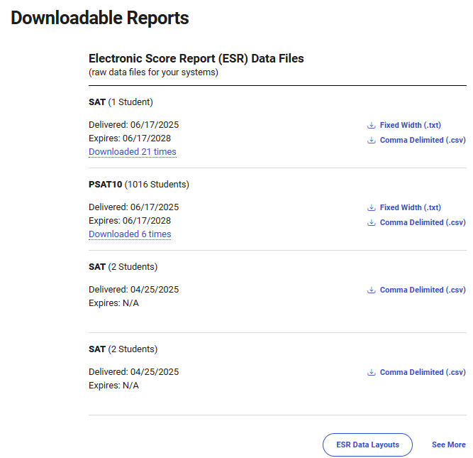
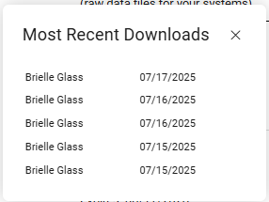
Electronic Score Report (ESR) Data Files
View the 4 most recent ESR data files delivered to your organization.
Test
Student record count
Delivery and expiration date
View a cross-organization download audit – see who at the organization has downloaded the ESR and when.
Quickly download the ESR in the desired format – fixed width (.txt) and/or comma delimited (.csv).
Access the current data file layouts.
Access a full list (See More) of all ESR’s delivered over the past 3 years.

Slide 16
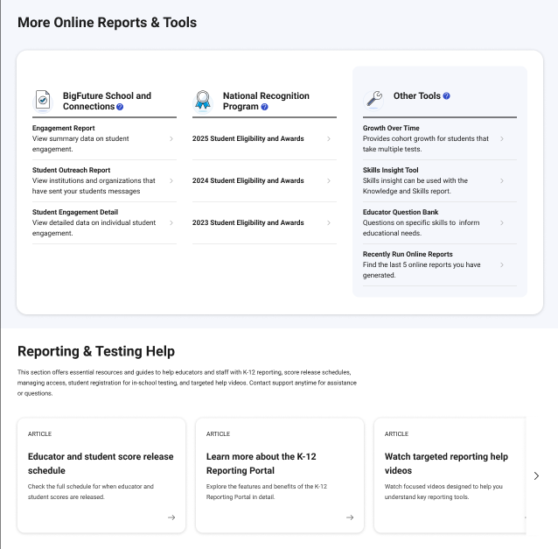
New Homepage
More Online Reports and Tools
Run BigFuture School and Connections reports
Run National Recognition Program reports
Other tools available include cohort growth over time report and links to the Skills Insight tool, Educator Question Bank, and recently run reports
Reporting and Testing Help
Includes Links to Helpful Resources for Educators
Score release schedule for students and educators
K–12 reporting portal quick help videos
K–12 reporting help page
Managing or requesting K–12 reporting access
Contact us for help
How to register students for in-school testing

Slide 17
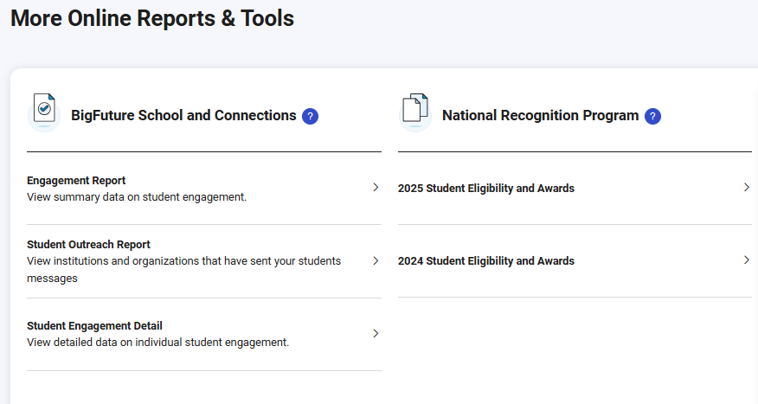
More Online Reports
View additional online reports available in your portal.
Reports related to student engagement with the BigFuture School App and Connections. Note - these reports are for In-School assessments only
Reports related to student eligibility and awards in College Board’s national recognition program.
Run each report with one click!

Slide 18
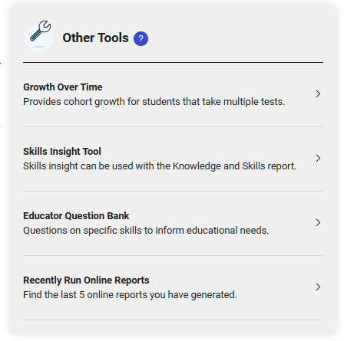
Other Tools
Access additional tools that may be helpful as you interpret the data provided in your reports.
Run a cohort growth report.
Access the Skills Insight Tool, a great resource when analyzing the aggregate Knowledge and Skills report.
Access the Educator Question Bank.
Access your most recently run reports and quickly run them again.

Slide 19
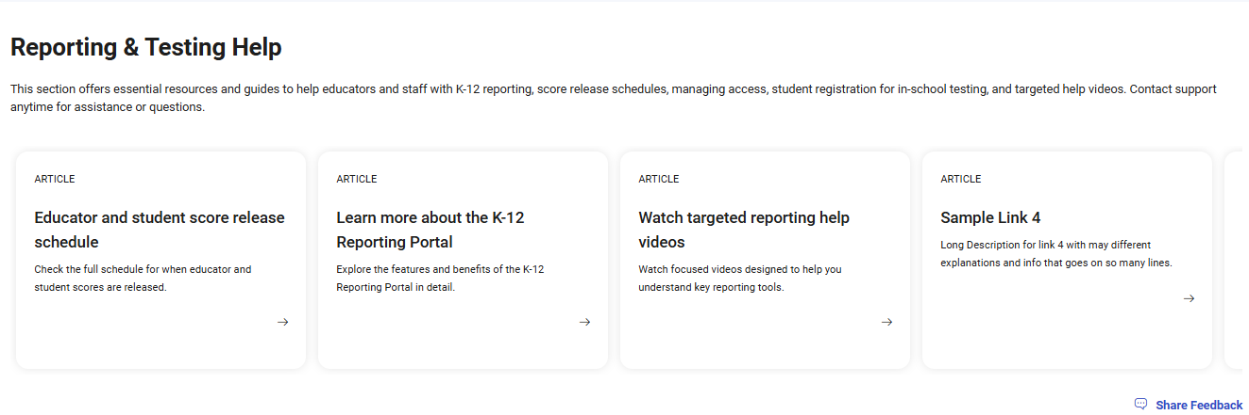
Reporting & Testing Help
Access help documentation and resources to help better understand the reporting portal and the reports/data provided in it.
Utilize the carousel features to scroll through available K-12 reporting resources.

Slide 20
Reports Available in the K-12 Reporting Portal
Cover Page

Slide 21
Aggregate Reports
Report | Brief Description
Performance by All Students | These reports provide score and benchmark performance aggregated for all students. You can also compare overall performance of a school to their district, state, and total group.
Performance by Demographics | These reports provide score and benchmark performance aggregated for different demographic groups.
Knowledge and Skills | This report shows aggregate student performance across four content domains in Reading and Writing and four content domains in Math, aggregated across defined performance score bands. You can compare overall performance of a school to their district, state, and total group..
Engagement | This report offers insights into students’ engagement in BigFuture School, a free mobile app that launched in fall 2023 and was available to in-school digital PSAT/NMSQT, PSAT 10, and SAT School Day test takers that were 13 and older.
Connections Outreach | This Report contains the list of nonprofit colleges/universities and scholarship organizations delivering messages through Connections™ to your students in the BigFuture School mobile app.
Growth | This report helps you track the growth of a group of students from test to test and to project their performance on a future test. Note: This is a scheduled report and will be delivered in Reports You Scheduled of Downloads within 24 hours for download

Slide 22
Student Reports
Report | Brief Description
Student Roster | This report provides a student roster for students that completed an administration. You’ll see details about their scores, benchmarks, knowledge and skills, and more. You can drill into students from this report to view their detailed scores and score insights online.
Batch Score Report PDFs | These reports generate individual student score report PDFs for students that completed a test administration. You can run this report for all testers that completed a test administration, or for specified grades. Note: This is a scheduled report and will be delivered in Reports You Scheduled of Downloads within 24 hours for download.

Slide 23
Running a Report
Cover Page

Slide 24
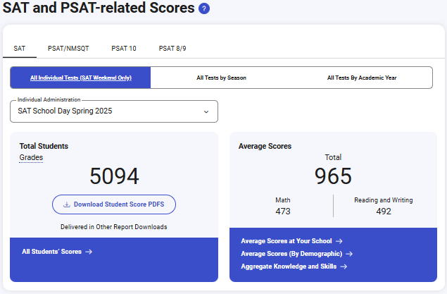
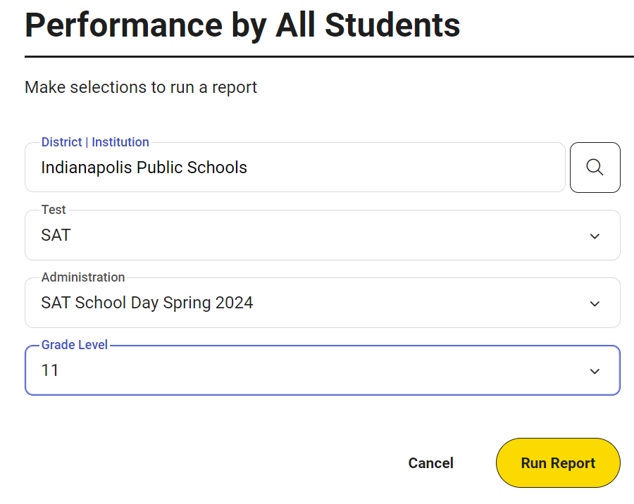
Performance Reports
These reports provide score and benchmark performance aggregated for all students or a demographic group.
You can also compare overall performance of a school to their district, state, and total group.
Select by Test & Administration
Select the Institution, Test, Administration, and Grade Level(s)
Sample Institution
SAT School Day Spring 2025

Slide 25
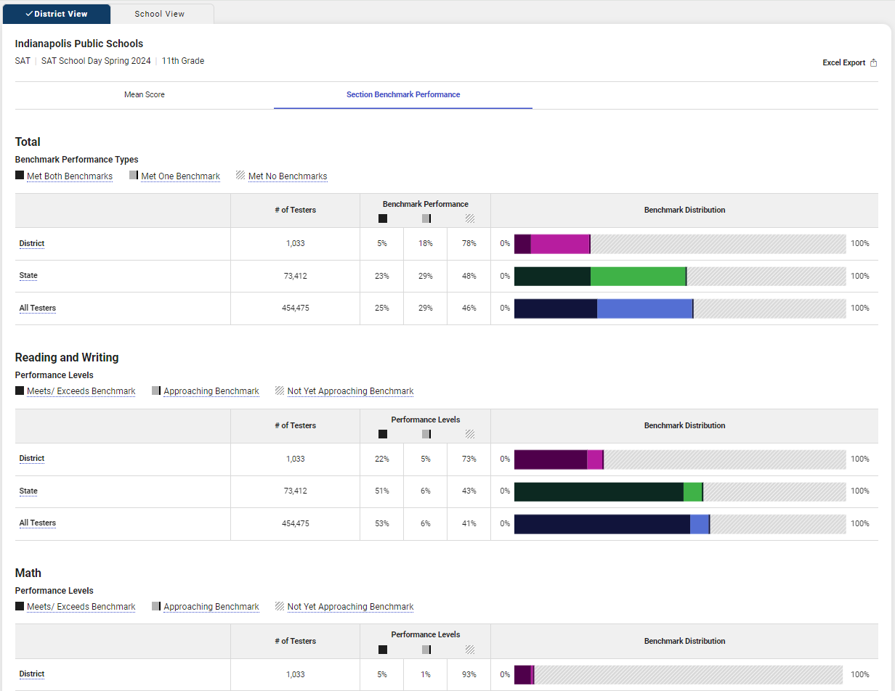
Performance by All Students – School View
Report Features:
Aggregate student mean scores and score band distributions
Aggregate student section-level benchmark performance
Meets/exceeds
Approaching benchmark (<1 year from meeting)
Not yet approaching benchmark (>1 year from meeting)
Performance comparisons to orgs in their hierarchy
Districts can also view school performance and states can also view district and school performance
Click a view students option to run a detailed roster report that includes all students in the report (available to Detailed Reporting role only)
Export to XLS

Slide 26
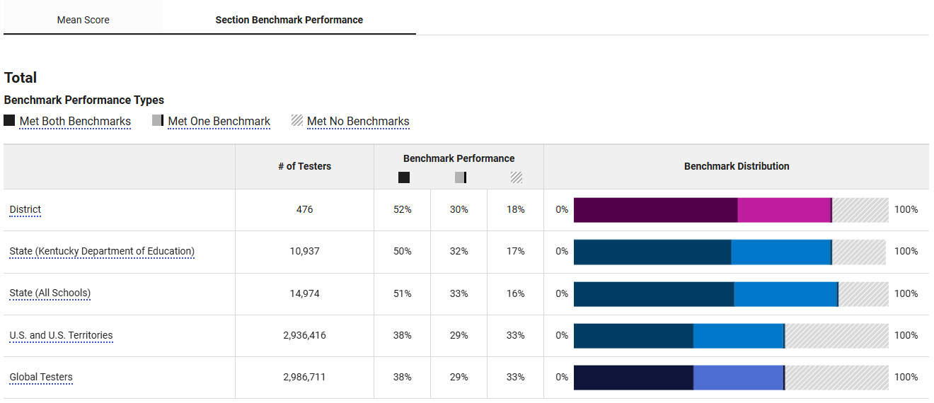
Performance by All Students Report - Benchmarks

Slide 27
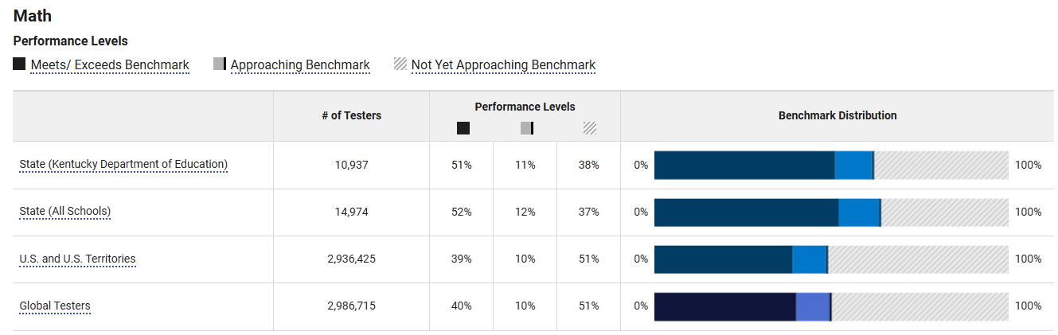
Performance by All Students Report – Performance Levels

Slide 28
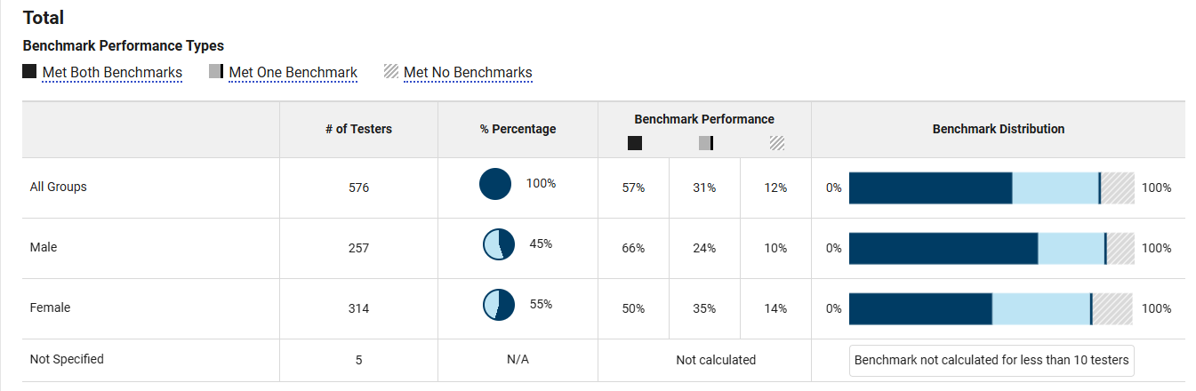
Performance by All Demographics
Report Features:
Reporting on 3 demographics: gender, race/ethnicity, fee waiver usage
Aggregate student mean scores and score band distributions by demographic
Aggregate student section-level benchmark performance by demographic
Meets/exceeds
Approaching benchmark (<1 year from meeting)
Not yet approaching benchmark (>1 year from meeting)
Districts can also view school demographic performance, and states can also view district and school demographic performance, by running this report for a specific school (district and state) or a specific district (state).
Click a view students option to run a detailed roster report of all students in the report (available to Detailed Reporting role only).
Export to XLS.

Slide 29
Review the Knowledge and Skills Report
Cover Page

Slide 30
Knowledge and Skills
Select the Test & Administration,
Adjust Selections to Run Reports
Sample Institution
SAT School Day Spring 2025

Slide 31
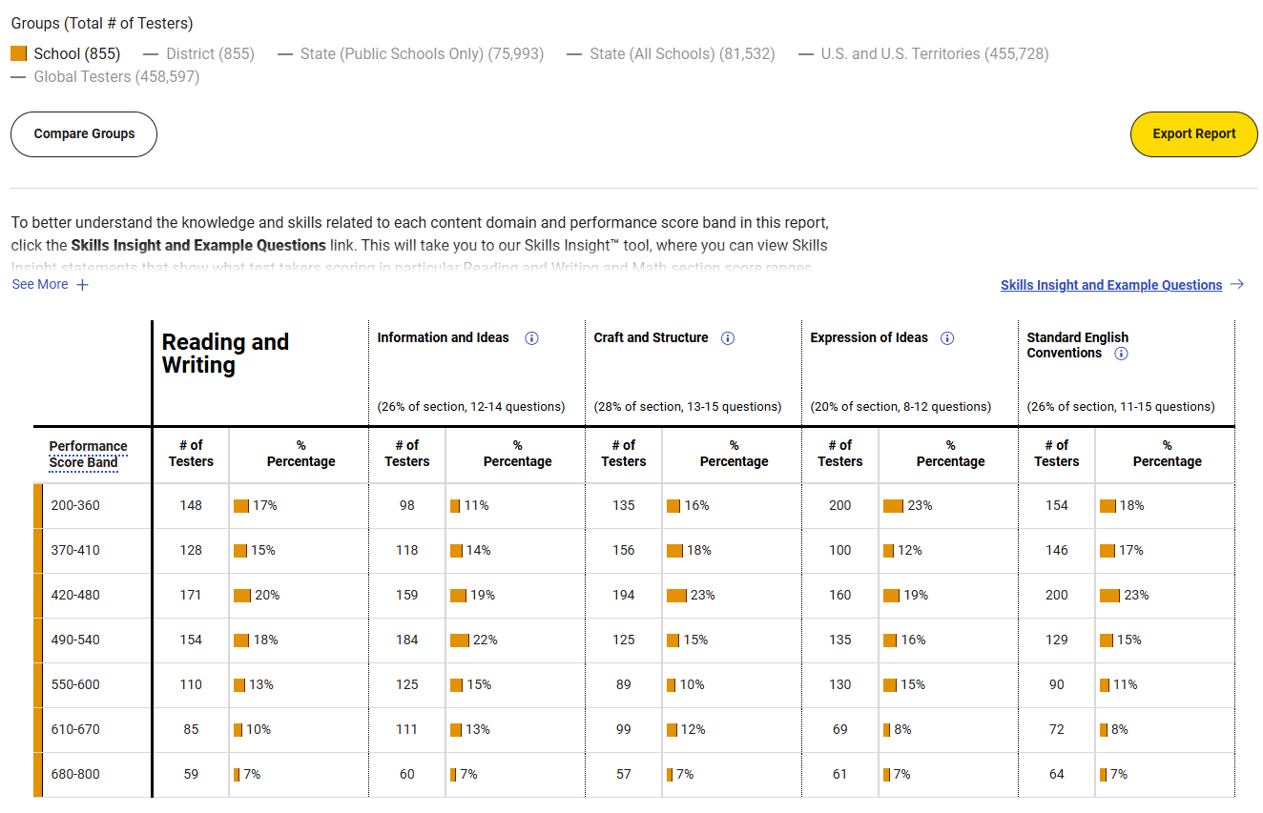
Knowledge and Skills – Reading and Writing
Groups Being Displayed
Export data
Content Domains
Link to Skills Insight
Section Performance Score Bands

Slide 32
Student Reports
Cover Page

Slide 33
Accessing Student Scores: 3 Methods
1
2
3
BigFuture School
Mobile App
College Board Website
Official Score Report PDF from School
Students 13 and older and located in the United States can use the free mobile app to quickly access PSAT/NMSQT scores, customized career possibilities, and information about colleges, financial aid, scholarships, and more!
Students log in to their College Board account at studentscores.collegeboard.org to access scores and get additional insights while exploring other post-secondary planning resources like BigFuture.
Students can receive a copy of their official score report from their school counselor.

Slide 34
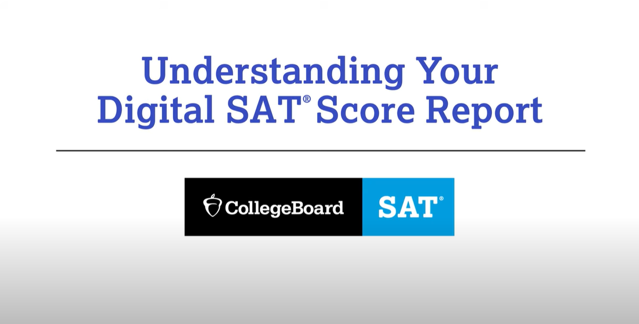
Understanding your digital SAT Score Report
Video Link: https://www.youtube.com/watch?v=T2lEDoOm8J4

Slide 35
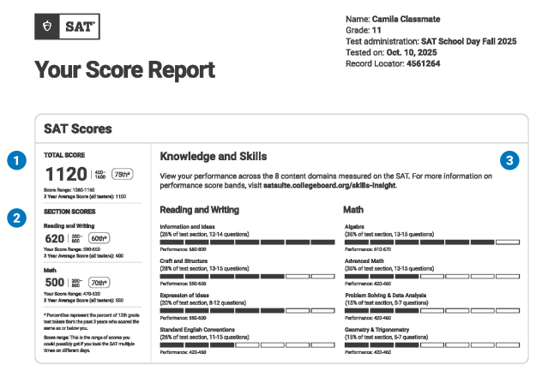
Student Score Report
Link to a pdf to help students and families understand their SAT scores.
Knowledge and Skill Performance for each domain.
Your Total Score
Section Scores for Reading/Writing and Math

Slide 36
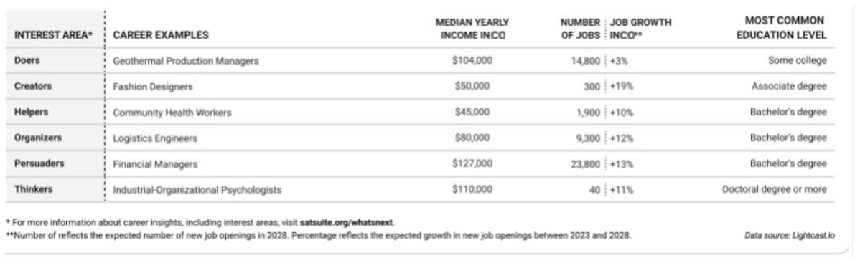
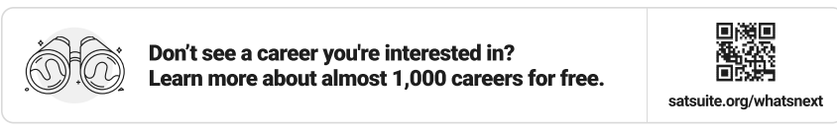
Career Insights Snapshot Your skills are in demand! Consider exploring these growing careers in your state that need skills like yours. These are examples, not recommendations to jump-start your career exploration.
Each career shown to a student:
Needs skills like theirs. Connects to math, reading and writing scores.
Is a growing career. Shows positive job growth within their state over 5 years.
Pays a living wage. Demonstrates careers with livable salaries in their state based on MIT Living Wage Calculator.
Spans 6 interest areas. Exposes students to a variety of career types.
Requires postsecondary education. Shows most common level of education and a variety of education options.
Plus, it encourages students to explore more careers that reflect their skills and interests at bigfuture.org

Slide 37
Thank You!

