Slide 1
2026 Fall Reporting
Module 1-Data Review Quality Control (QC)
Chris Williams, Program Consultant
Office of Assessment and Accountability

Slide 2
Fall Reporting Module Trainings
Module 1- Data Review QC
Module 2- Cohort and Postsecondary Readiness Scores QC

Slide 3
Agenda
SDRR Year at a Glance
Importance for Fall Data Review Process
Tentative Timeline for Reporting
Understanding the Data Review Process
Data Review Priorities
Student Data Review and Rosters (SDRR) Steps and Features
SDRR Resources for Data Review

Slide 4
SDRR Year at a Glance
Date/When | Event
January | File nonparticipations in SDRR if needed for WIDA ACCESS and WIDA Alternate ACCESS rosters. Dropout data is available.
February | Ensure the graduate data is correct in Infinite Campus (IC) for Cohort.
Mid-March | Enter the districts test windows for elementary, middle and high school in SDRR. Update district calendars in IC, so the students’ accountability will be pre-populated correctly in spring rosters starting mid/late April.
Mid/Late April | Spring rosters open in SDRR for: Demographic data, adding students, deleting students, making nonparticipations requests, changing accountability if needed and marking accommodations for Individualized Education Program (IEP) and English Learner (EL) students.
June | Look at Cohort Data in SDRR and fix the issues in IC.
August | Data Review: This is the final opportunity to make individual changes to student data prior to public reporting.
Post Data Release-Fall | 10-Day Regulatory Review after public release to correct individual student data.

Slide 5
Importance for Fall Data Review Process

Slide 6
Need for Fall Data Review QC Process
Data review is the final opportunity to review and modify data before it is publicly released.
Short and focused review of accountability, demographics and nonparticipations
  WIDA ACCESS (ACCR) and WIDA Alternate ACCESS (ACCA)
  Kentucky Summative Assessment (KSA) and Alternate Kentucky Summative Assessment (AKSA)
  Postsecondary Readiness (PR)
Limited effort so school and district staff can concentrate on reopening schools.

Slide 7
Tentative Timeline for Reporting

Slide 8
Tentative 2026 Data Reporting Timeline
Fall QC Data Review
  Aug. 12-20 (New Tickets),
  District Assessment Coordinators (DACs) Review Student Participation, Demographic, and Accountability Data​
Quality Control Day
  September 23
  DACs Have a First Look at Accountability to Identify Possible Systemic Issues​
Embargo to the District
  Mid-to-Late October
  DACs and Select District Staff
Public Reporting
  Mid-to-Late October
  Accountability Data Released Publicly
Ten-Day Regulatory Data Review Period
  Immediately Following Public Release
  DACs Final Opportunity to Review Publicly Released Data
Notes:
As staff look ahead to this year's assessment reporting, here is the tentative timeline.
Let's begin with the Fall Quality Control Data Review, which runs from August 12 to 20 for new tickets..
During this window, District Assessment Coordinators (DACs), Building Assessment Coordinators (BACs) and other school level users of SDRR will review student participation, demographic details, and accountability data through spreadsheets and make changes in the SDRR application under the KDE secure web application.
Then, on September 23, is Quality Control Day, when DACs will get the first look at accountability results. This is a critical opportunity to identify any potential systemic issues before the data is finalized. DACs will have a google form to see all the steps to this process and a discrepancy forms if any issues need to be reported.
The embargoed release of accountability data to districts will occur Mid-to-Late October, which means DACs and selected district staff will have access to the data before it becomes public.
Additionally, in mid-to-late October, the data will be available publicly for school and district staff.
Finally, immediately following the public release, the 10-day regulatory data review period. This is the final opportunity for DACs and BACs to submit new tickets and make changes to individual student demographics, mark accommodations for IEP and PSP, file any nonparticipation or 100-day entity changes.

Slide 9
Understanding the Data Review Process

Slide 10
Understanding the Process
Getting the Rosters Right
Data Review and Cleanup
Accurate Reporting
  SDRR rosters for WIDA ACCESS/WIDA Alternate ACCESS (Jan.- March roster window)
  Spring Rosters (Apr.-June)
  Make changes to individual student-level data
  Request nonparticipations if needed
  Request accountability changes
  Mark accommodations
  Public Release
  Ten-Day Regulatory Data Review follows Public Release

Slide 11
Data Review Priorities

Slide 12
Data Review Priorities Steps
Step 1 Demographics/Accountability
Step 2 Participation
(Priority One) SDRR
  All demographics are based on the district's first day of the 14-day testing window
  Check lunch status and students with disability status (IEP) since these have the potential to change over time
  Confirm ethnicity and race categories
  Tested school and grade cannot be changed
  Mark accommodations for students with an IEP or a Program Service Plan (PSP)
  Indicate the correct accountability for students who contribute to the school or district accountability and those who do not
  Resolve the nonparticipation status of students without test results
(Priority Two) KDE applications login
Check students' participation status using the spreadsheet

Slide 13
Data Review
Applications
Spreadsheets will be available in Student Data Detail
SDRR

Slide 14
Data Available in SDRR
Roster information has been loaded and matched with test vendor data
  For example, if a response book was submitted for a student to the vendor or the student tested online and the student was not on your roster, then the student was added to your roster by KDE
  Rosters must match vendor information
Most changes made during the Roster Window last spring are reflected in Data Review
Nonparticipation tickets must be submitted by the testing school
Tested School changes must be submitted to KDE Assessment
Data Review is your last opportunity to review and modify student data before public release
No scores are in SDRR, except academic readiness for Postsecondary Readiness. Refer to the Postsecondary Readiness Scores training Module 2 for more information

Slide 15
SDRR Steps and Features

Slide 16
Suggested Steps
Student Data Detail under KDE Applications Login
Download the spreadsheet from the Student Data Detail applications site under Other to get the district file
Filter to identify students who need resolution
SDRR
Make demographic and 100-day changes
Request nonparticipations if needed
Make changes in SDRR for Academic Readiness data for Postsecondary Readiness
Mark accommodations for IEP and English Learner (EL)

Slide 17
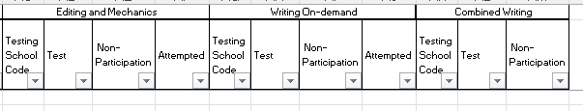
Examples – KSA and AKSA Spreadsheet

Slide 18
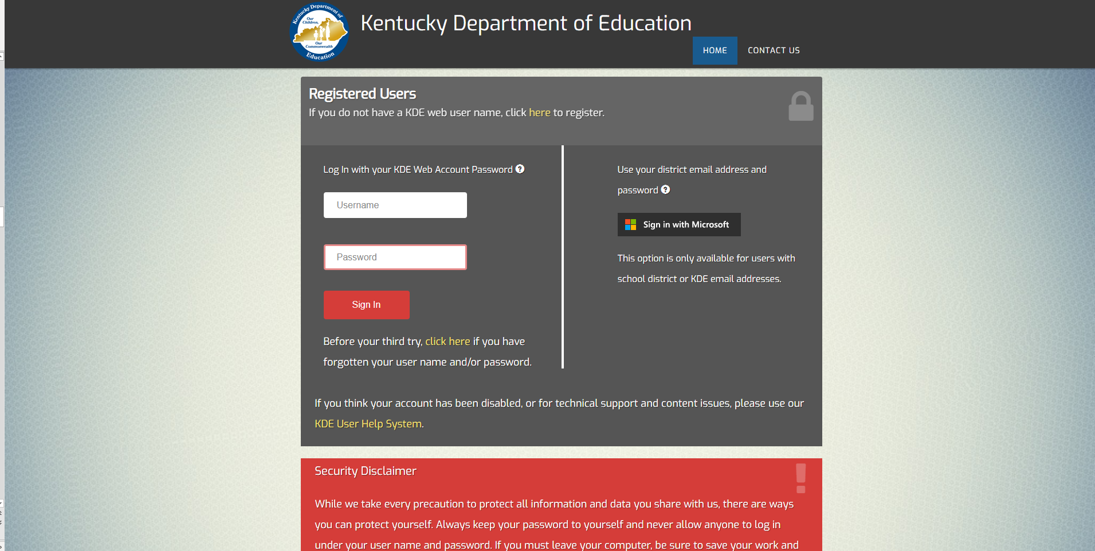
Login Page
KDE Secure Web applications

Slide 19
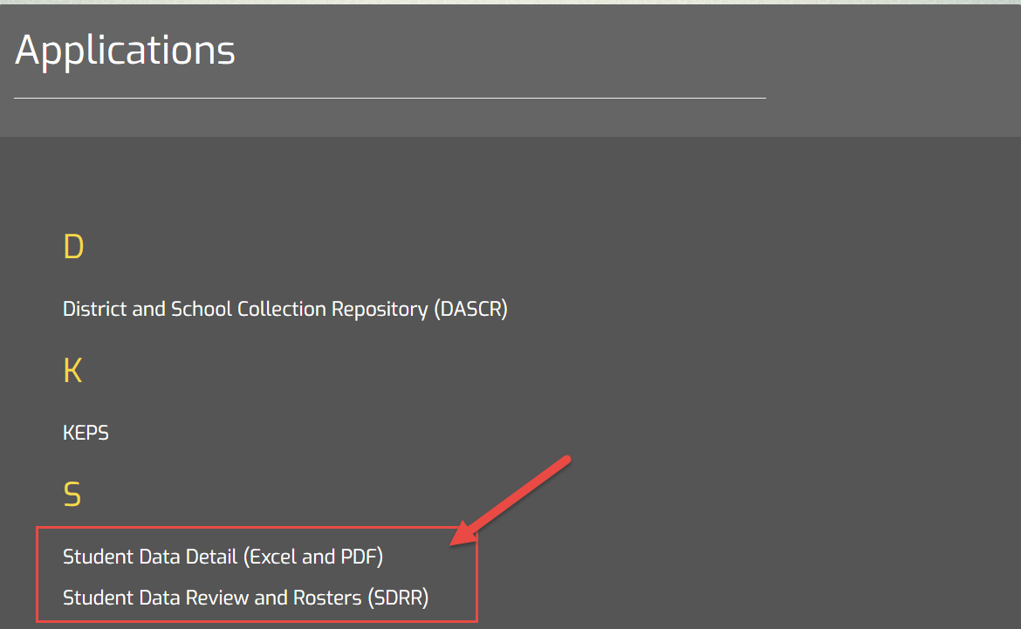
Student Data Detail or SDRR Applications After Login Page

Slide 20
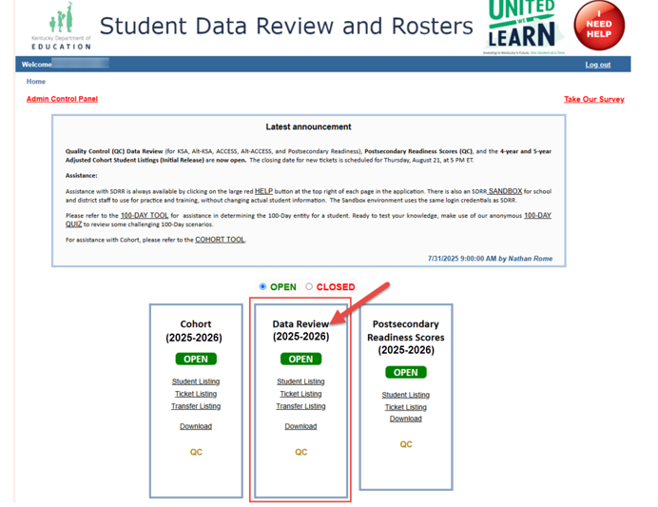
Welcome/Home

Slide 21
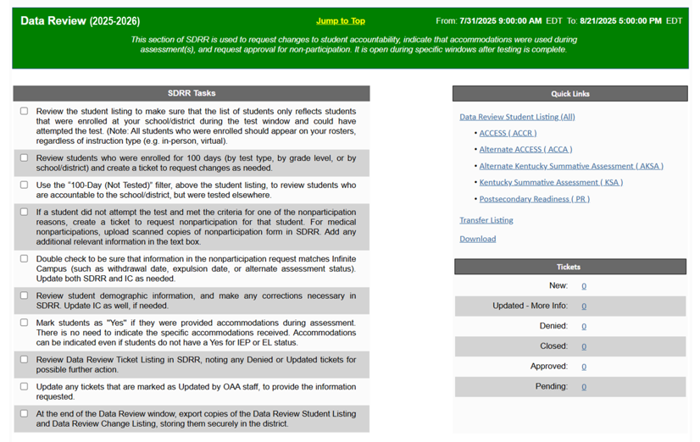
Home Page

Slide 22
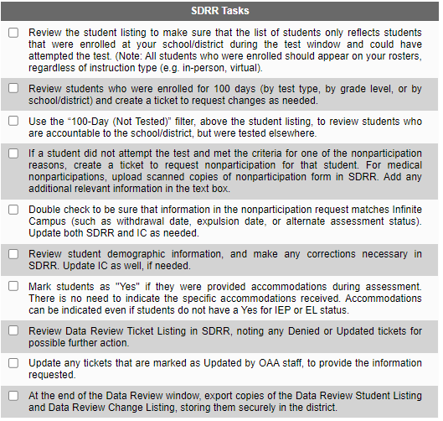
SDRR Tasks Checklist
Blank checkboxes = To be completed

Slide 23
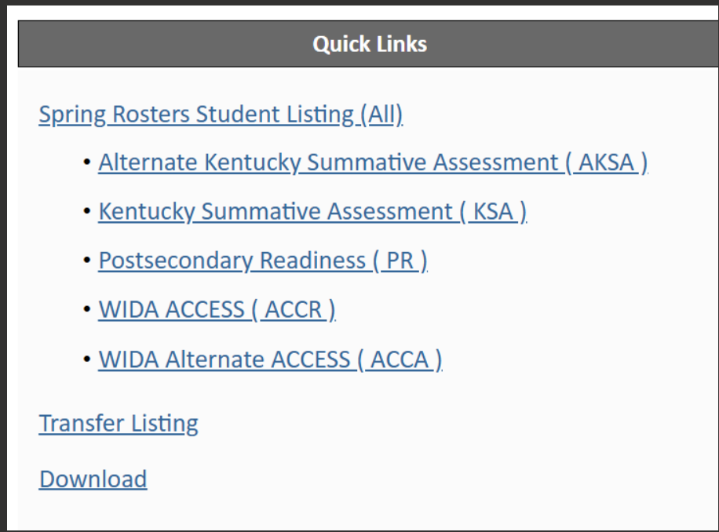
Quick Links

Slide 24
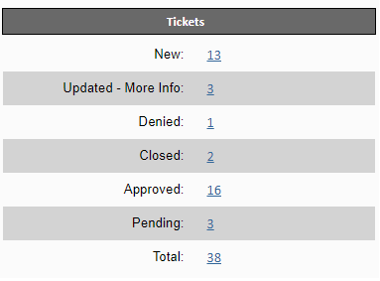
Tickets

Slide 25
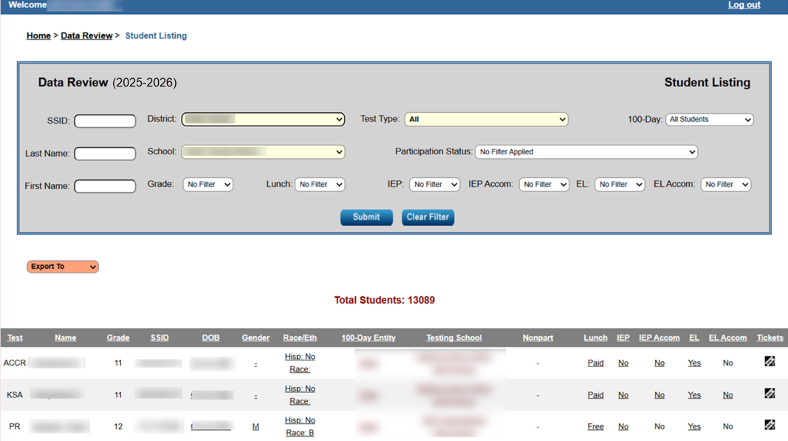
Data Review Student Listing

Slide 26
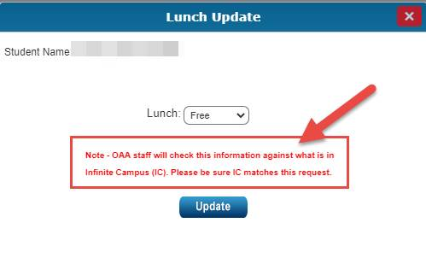
Changes to Demographics in SDRR

Slide 27
Medical Nonparticipation: What You Need to Know
The medical nonparticipation form allows the district to request an exemption from testing due to medical reasons.
Required signatures on the form are the District Assessment Coordinator (DAC) and a medical doctor, Superintendent or Designee.
Nonparticipations can be requested for individual contents (KSA or AKSA) or the entire test.
This request will encompass physical, mental and emotional issues.
Keep a copy of this form on file in the district and upload the information into SDRR for approval.

Slide 28
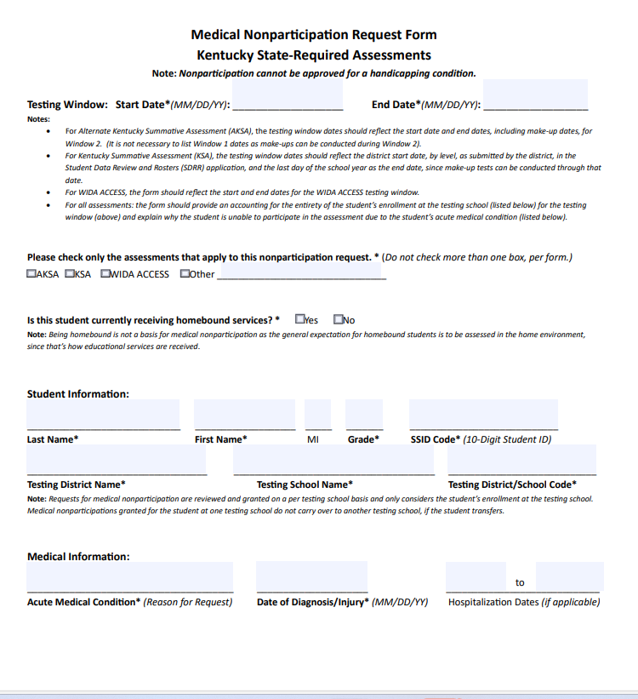
New Medical Nonparticipation Form
Notes:
The form for 2026 is now a fillable PDF.

Slide 29
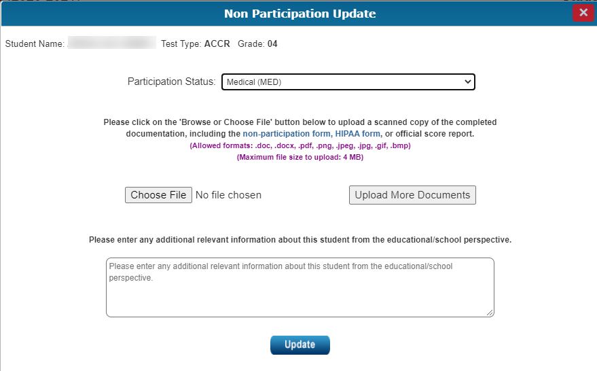
Uploading Medical Nonparticipation in SDRR

Slide 30
Nonparticipation of Roster Cleanup in SDRR
Roster Cleanup
Addresses situations when a student appears on the student listing in error
Please explain why the student was not deleted from the spring roster or why the student appears on the student listing in error in the text box
Only available during QC Data Review and Ten-Day Regulatory Data Review in the fall

Slide 31
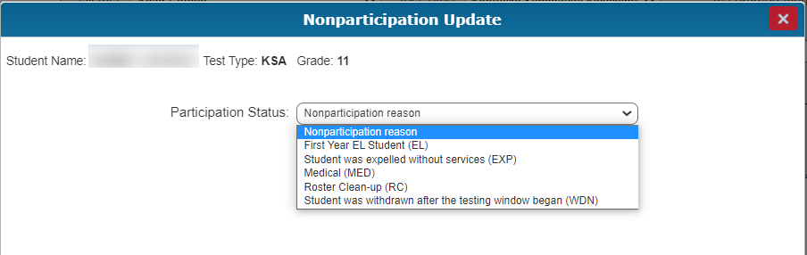
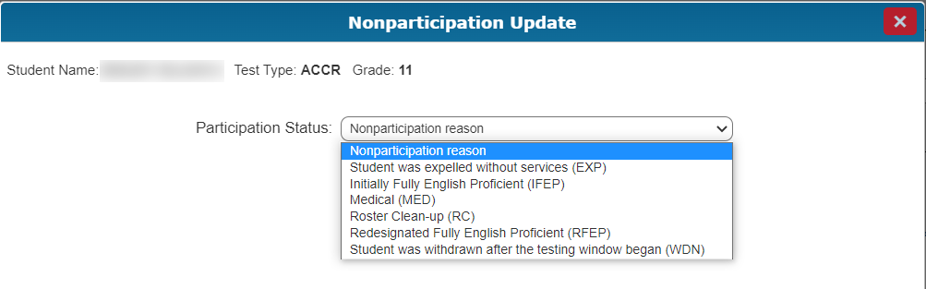
Nonparticipations by Test Type

Slide 32
Update or View Ticket
To Update/View ticket, take any of the following actions:
Review OAA comments or requests for more information (e.g. when a ticket is returned to the district in “Updated-More Info” status)
Upload additional attachments (e.g. Medical Nonparticipation tickets)
Make additional comments

Slide 33
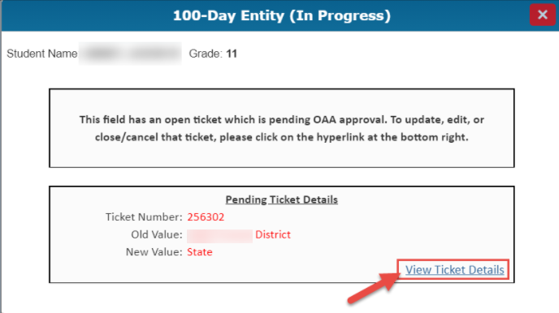
Update or View Ticket from the Student Listing
Locate the student who has an open ticket, indicated by IN PROGRESS in that field.
Click on IN PROGRESS for that student.
Click the “View Ticket Details” link, as shown.

Slide 34
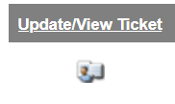

Update or View Ticket From the Ticket Listing
Locate the student who has an open ticket (either in “New,” “More Info” or “Pending” status).
Click on the icon under the “Update/View Ticket” column (the first column on the left-hand side) for the student
Make any necessary changes and click on the submit button.

Slide 35
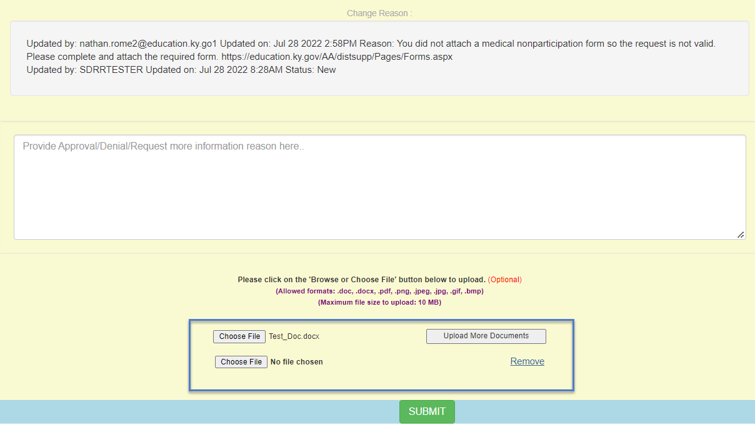
Medical Nonparticipation Update

Slide 36
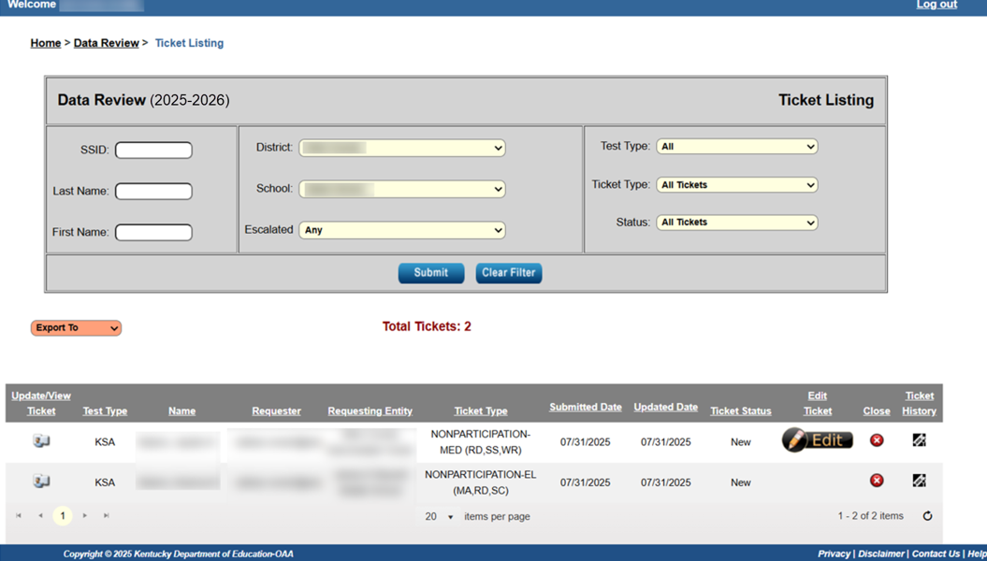
Ticket Listing

Slide 37
Edit a Ticket
Editing a ticket is reserved for instances where users need to change the actual details being requested on a ticket
Common examples include:
  Changing the 100-day entity requested in a 100-day ticket (a school, a district or the state) to a different 100-day entity than the one originally requested
  Changing the content areas that are being requested for nonparticipation for KSA or AKSA
Notes:
The TYPE of ticket being requested cannot be changed. (For example, a medical nonparticipation ticket can't be changed to a First Year EL nonparticipation ticket. Users can only edit the details of the existing ticket type)
Not all tickets are editable
  Some examples of editable tickets include 100-Day Entities, Withdrawal Nonparticipation Tickets, Medical Nonparticipations for KSA/Alt-KSA

Slide 38
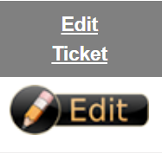

Edit Ticket From the Ticket Listing
Locate the student who has an open ticket (either in “New,” “More Info” or “Pending” status)
Click on the icon under the “Edit Ticket” column (on the right-side ticket listing) for the student
Make any necessary changes and click on the button.

Slide 39
SDRR Resources for Data Review

Slide 40
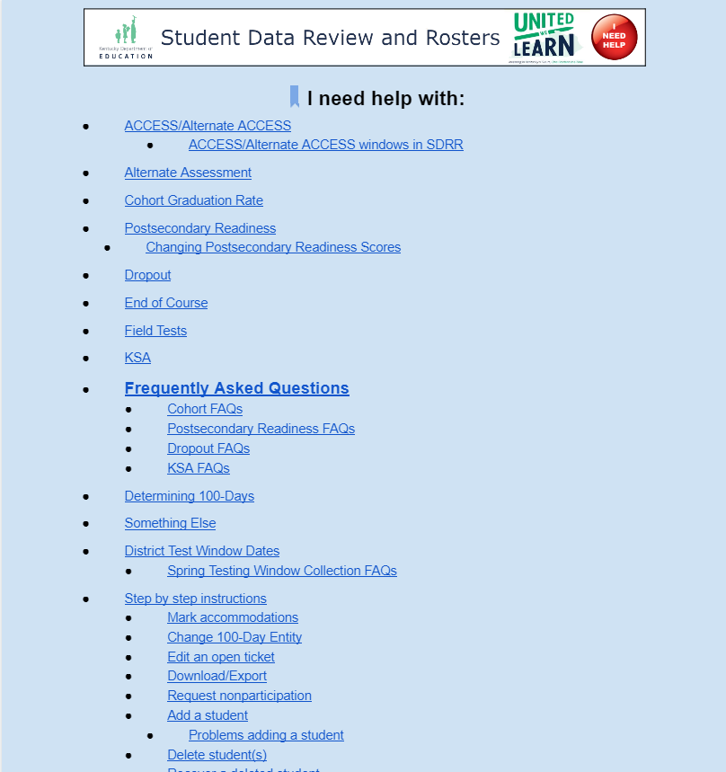

Resources for Data Review:
(Online Help Button)

Slide 41
Resources to Assist with Data Review
See Web Apps Admin Point of Contact (WAAPOC) for permissions to SDRR
Review the SDRR Page, Data Review PowerPoint and Video
Download the student listings from Spring Rosters in SDRR
Download the spreadsheets from the Student Data Detail app in the web applications login
Take the 100-day anonymous quiz to test accountability knowledge
Use the 100-day tool to look at different scenarios for accountability
The Sandbox is available for training staff in SDRR

Slide 42
Resources Continued: Step by Step Instructions
Review step-by-step instructions under the “I Need Help” button in SDRR to:
  Mark Accommodations
  Change the 100-Day entity
  Edit an open ticket
  Update/View Ticket
  Download/Export
  Request nonparticipation

Slide 43
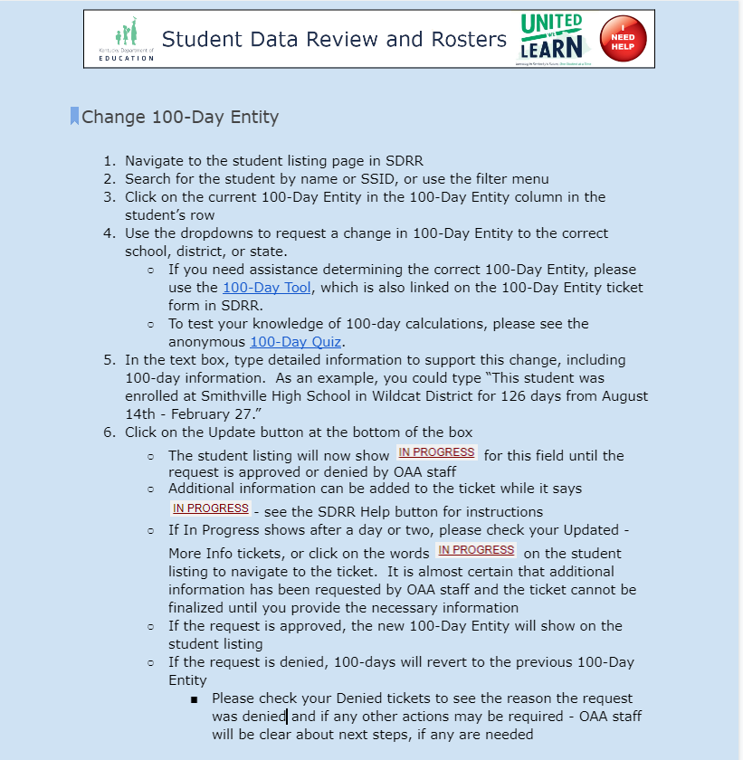
Step by Step Instructions Example: Change 100–Day Entity

Slide 44
SDRR Data Review Office Hour
TEAMS –August 13, 2-3 p.m. ET
  Join on your computer, mobile app or room device
    Click here to join the meeting
    Meeting ID: Meeting ID: 25486299238940 Passcode: Xh9zt2LL
    Download Teams | Join on the web
  Or call in (audio only)
    tel:+15026941960,751380975#United States, Louisville
    Phone Conference ID: 751380975#
Ask questions about the functionality of SDRR, accountability
Not for specific student information

Slide 45
Contact Information for Questions
OAA/DAAS
(502) 564-4394
dacinfo@education.ky.gov
  Other Data Issues and Cohort
  kdeassessment@education.ky.gov

Slide 46
Thanks for Watching

Slide 47

Closing Slide

