Slide 1
2025 Fall Reporting
Module 1-Data Review Quality Control (QC)
Chris Williams, Program Consultant
Office of Assessment and Accountability

Slide 2
Fall Reporting Module Trainings
Module 1- Data Review QC
Module 2- Cohort and Postsecondary Readiness Scores QC

Slide 3
Agenda
Need for Fall Data Review Process
Tentative Timeline for Reporting
Understanding the Data Review Process
Data Review Priorities
Student Data Review and Rosters (SDRR) Steps and Features
SDRR Resources for Data Review

Slide 4
SDRR Year at a Glance
Date/When | Event
January | Filing nonparticipations in SDRR if needed for WIDA ACCESS and WIDA Alternate ACCESS rosters. Dropout data is available.
February | Ensure the graduate data correct in Infinite Campus (IC) for Cohort.
Mid-March | Enter the districts test windows for elementary, middle and high school in SDRR. Updating district calendars in IC, so the students’ accountability will be pre-populated correctly in spring rosters starting mid/late April.
Mid/Late April | Spring rosters will open in SDRR for: Demographic data, adding students, deleting students, making nonparticipations requests, change accountability if needed and marking accommodations for Individualized Education Program (IEP) and English Learner (EL) students
June | Look at Cohort Data in SDRR and fix the issues in IC
August | Data Review: this is the last time to make individual changes to the student data prior to public reporting.
Post Data Release-Fall | 10-Day Regulatory Review after public release to correct individual student data.

Slide 5
Need for Fall Data Review Process

Slide 6
Need for Fall Data Review QC Process
Data review is the final opportunity to review and modify data before it is publicly released.
Short and focused review of accountability, demographics and nonparticipations
  ACCESS and Alternate ACCESS
  Kentucky Summative Assessment (KSA) and Alternate Kentucky Summative Assessment (AKSA)
  Postsecondary Readiness
Limited effort so school and district staff can concentrate on reopening schools.

Slide 7
Tentative Timeline for Reporting

Slide 8
Tentative Timeline for Fall Reporting
Data Review Aug. 13-21 (Tentative)
Closes on Aug. 21 at 5 p.m. ET for (New Tickets) in SDRR
Demographics, Accountability and Nonparticipation for Individual Students will be the focus
District/Media Release
Mid-Late Nov. (Tentative)
Data is Embargoed until Public Release
Public Release
Mid-Late Nov. (Tentative)
Data is Released to districts and school
Quality Control (QC) Review Oct. 23 (Tentative)
Spreadsheets –KDE applications login and
Google form
Systemic issues
Ten-Day Regulatory Data Review after Public Release
Mid-Late Nov. (Tentative) in SDRR
Demographics, Accountability and Nonparticipation for Individual Students

Slide 9
Understanding the Data Review Process

Slide 10
Understanding the Process
Getting the Rosters Right
SDRR rosters for ACCESS/Alternate ACCESS (Jan.-Mar. roster window)
Data Review and Cleanup
Make changes to individual student level data
Accurate Reporting
Public Release
Request nonparticipations if needed
Spring Rosters (Apr.-June)
Request accountability changes
Ten-Day Regulatory Data Review follows Public Release
Mark accommodations

Slide 11
Data Review Priorities

Slide 12
Data Review Priorities Steps
Step 1 Demographics/Accountability
Step 2 Participation
(Priority Two) KDE applications login
Check students' participation status using the spreadsheet
(Priority One) SDRR
All demographics are based on the first day of the 14-day testing window
Check lunch status and students with disability status (IEP) since these have the potential to change over time
Confirm ethnicity and race categories
Tested school and grade cannot be changed
Mark Accommodations for students with an IEP or a Program Service Plan (PSP)
Indicate the correct accountability for students who contribute to the school or district accountability and those who do not
Resolve the nonparticipation status of students without test results

Slide 13
Data Review
Applications
SDRR
Spreadsheets will be available in KDE applications login

Slide 14
Data Available in SDRR
Roster information has been loaded and matched with test vendor data.
  For example, if a response book was submitted for a student to the vendor or the student tested online and the student was not on your roster, then the student was added to your roster by KDE.
  Rosters must match vendor information
Most changes made during the Roster Window last Spring are reflected in Data Review
Nonparticipation tickets must be submitted by the testing school.
Data Review is your last opportunity to review and modify student data before QC Day
No scores are in SDRR, except academic readiness for Postsecondary Readiness- refer to the Postsecondary Readiness Scores training module 2 for more information

Slide 15
SDRR Steps and Features

Slide 16
Suggested Steps
SDRR
Make demographic and 100-day changes
Request nonparticipations, if needed
Make changes in SDRR for Academic Readiness data for Postsecondary Readiness
Mark accommodations for IEP and EL
Student Data Detail under KDE Applications Login
Download spreadsheet from the Student Data Detail applications site
Filter to identify students who need resolution

Slide 17
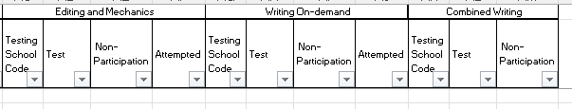
Examples – KSA and AKSA Spreadsheet

Slide 18
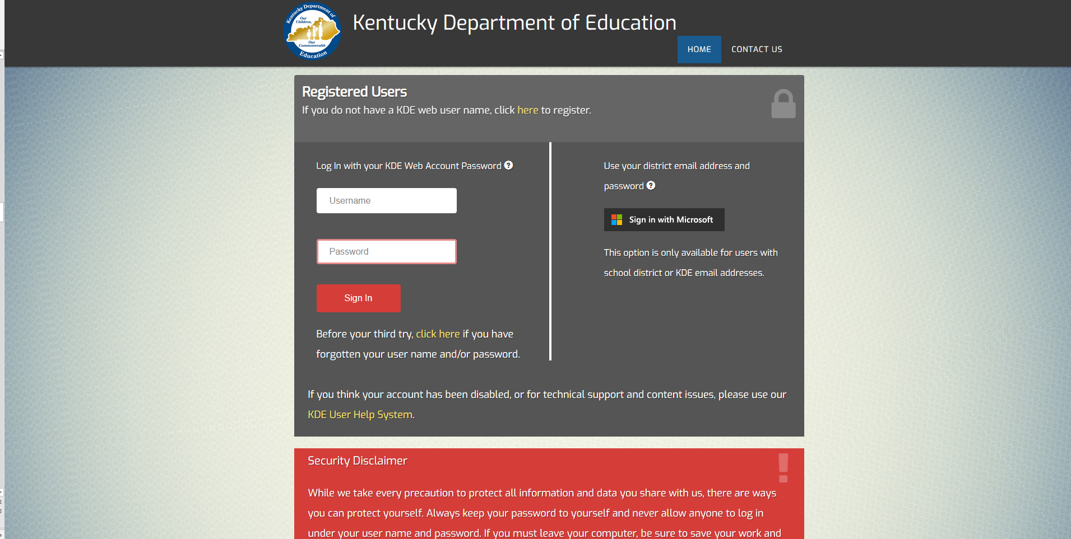
Login Page
https://applications.education.ky.gov/login/default.aspx

Slide 19
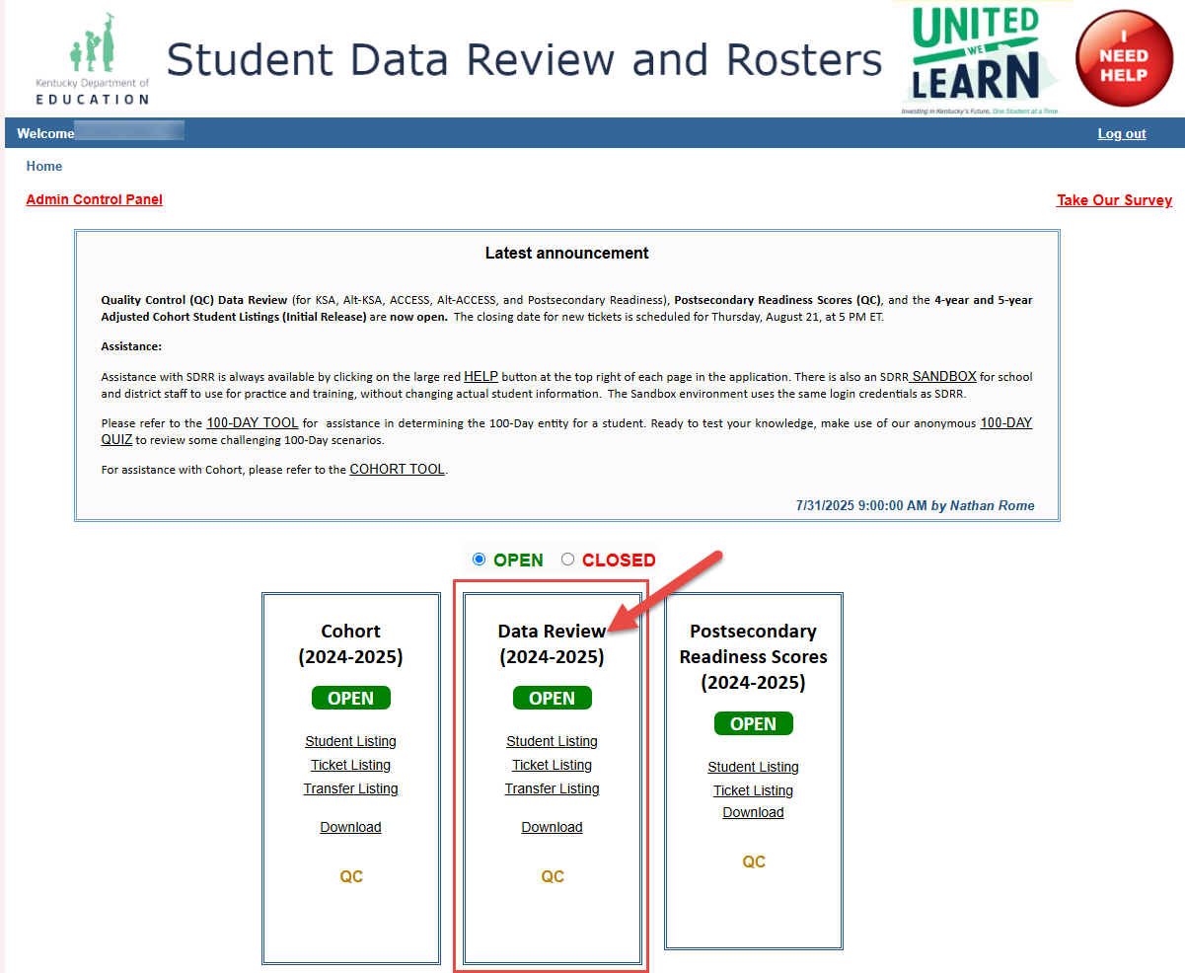
Welcome/Home

Slide 20
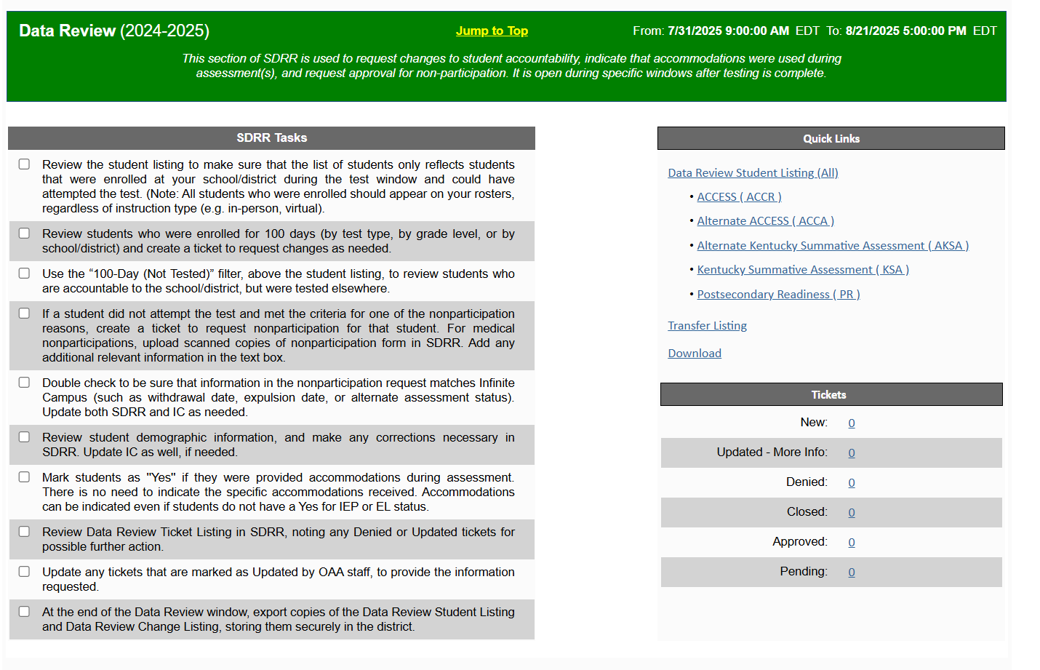
Home Page

Slide 21
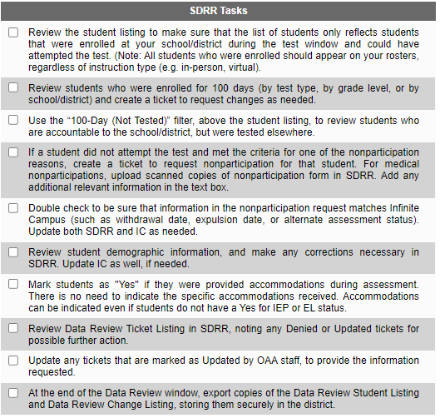
SDRR Tasks Checklist
Blank checkboxes = To be completed

Slide 22
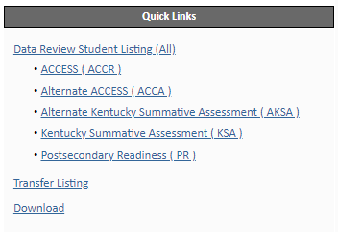
Quick Links

Slide 23
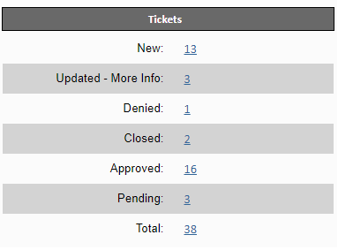
Tickets

Slide 24
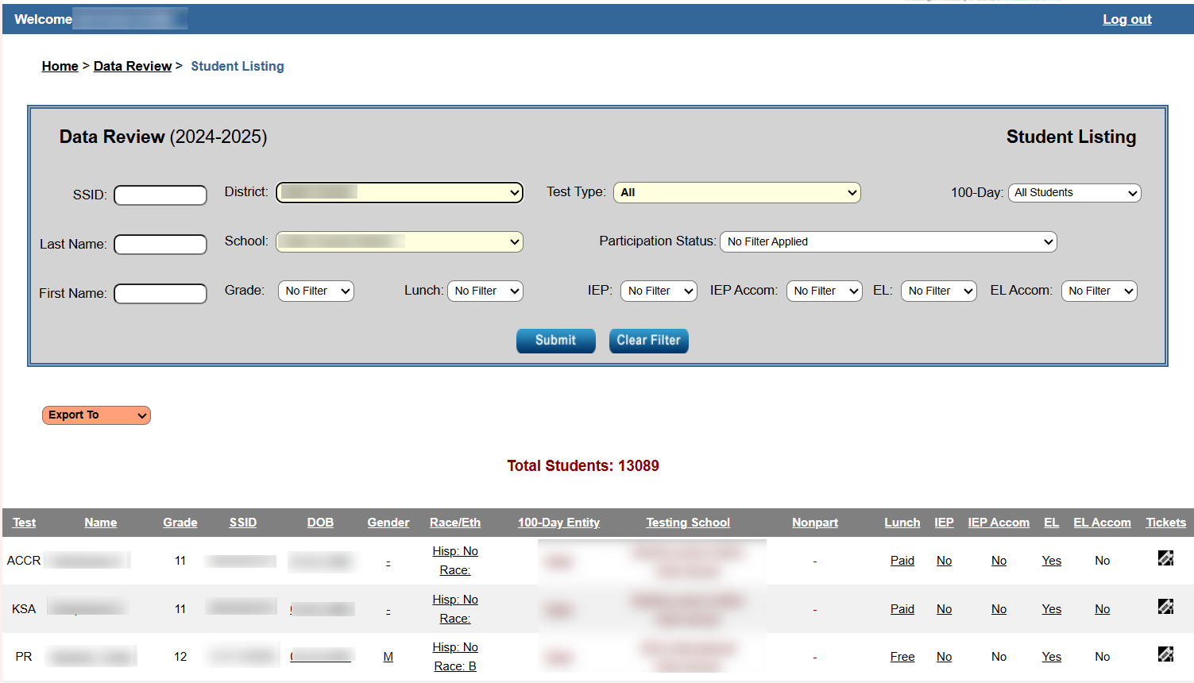
Data Review Student Listing

Slide 25
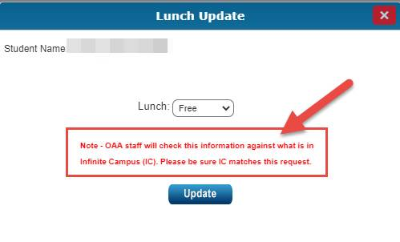
Changes to Demographics in SDRR

Slide 26
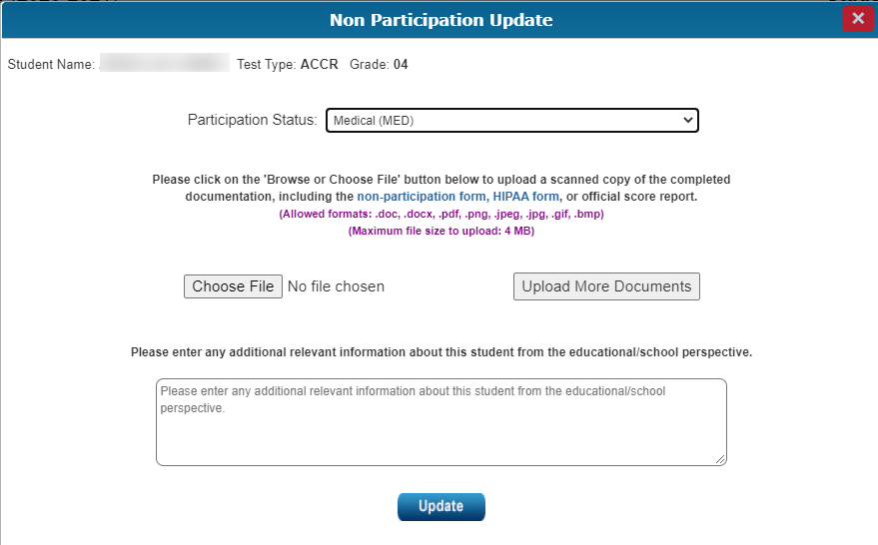
Uploading Medical Nonparticipation in SDRR

Slide 27
Nonparticipation in SDRR
Roster Cleanup
Addresses situations where the student appears on the student listing in error
Please explain why the student was not deleted from the spring roster or why the student appears on the student listing in error in the text box

Slide 28
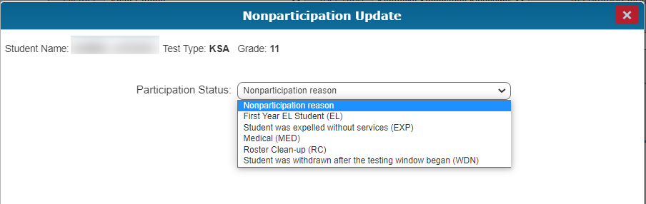
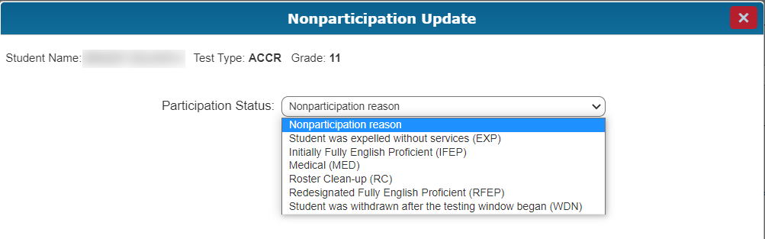
Nonparticipations by Test Type

Slide 29
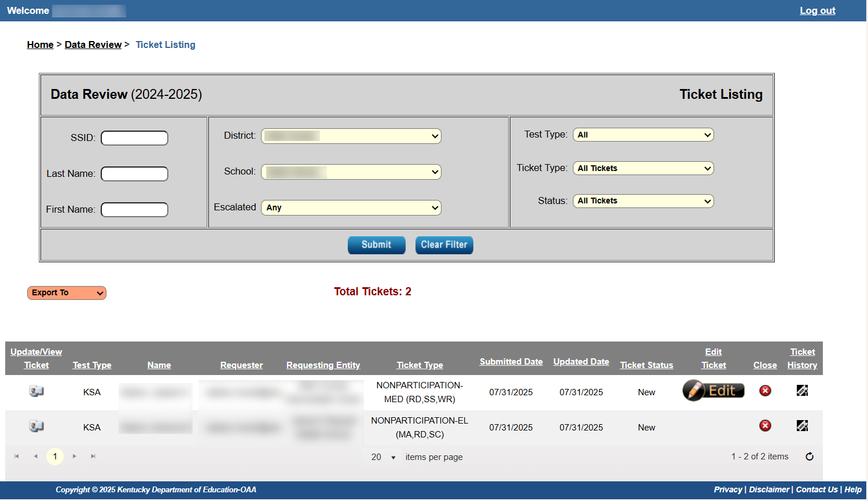
Ticket Listing

Slide 30
SDRR Resources for Data Review

Slide 31
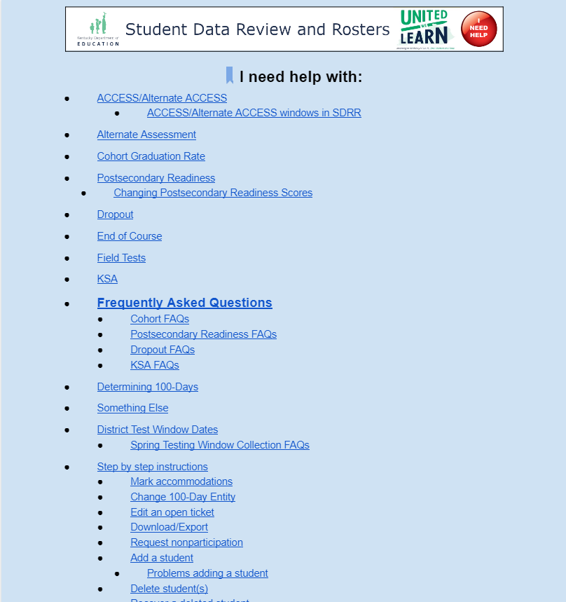

Resources for Data Review:
(Online Help Button)

Slide 32
Resources to Assist with Data Review
See Web Apps Admin Point of Contact (WAAPOC) for permissions to SDRR
Review the SDRR Page, Data Review PowerPoint and Video
Download the student listings from Spring Rosters in SDRR
Download the spreadsheets from the Student Data Detail app in the web applications login
Take the 100-day anonymous quiz to test accountability knowledge
Use the 100-day tool to look at different scenarios for accountability
The Sandbox is available for training staff in SDRR

Slide 33
Resources Continued: Step by Step Instructions
Review step-by-step instructions under the “I Need Help” button in SDRR to:
  Mark Accommodations
  Change the 100-Day entity
  Edit an open ticket
  Download/export
  Request nonparticipation

Slide 34
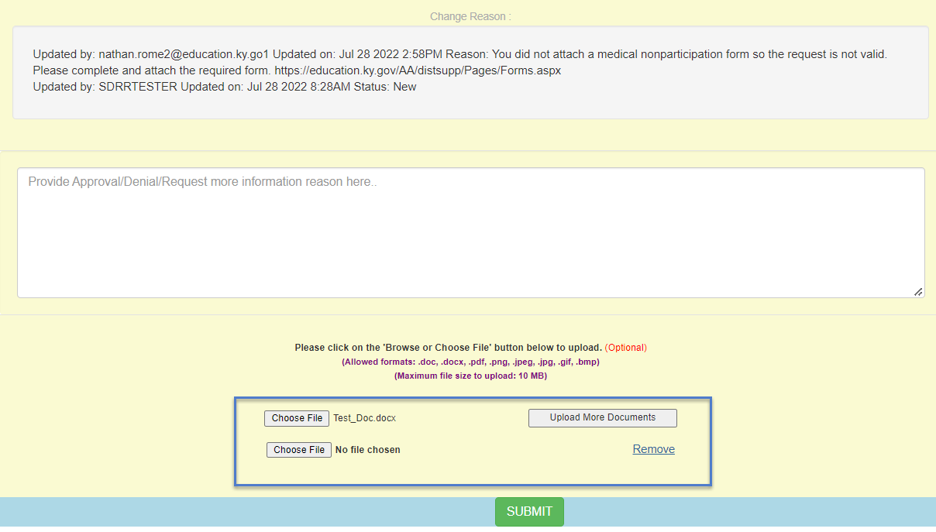
Medical Nonparticipation Update

Slide 35
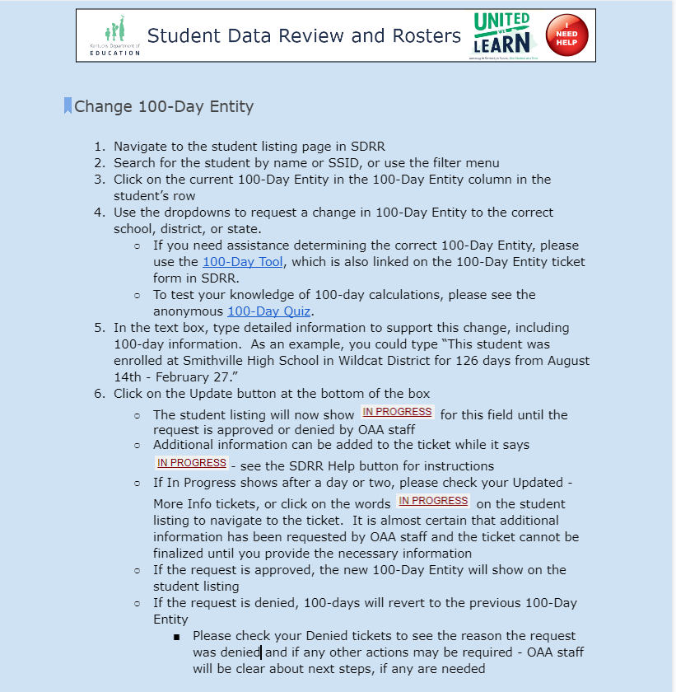
Step by Step Instructions Example: Change 100–Day Entity

Slide 36
SDRR Data Review Office Hour
TEAMS –August 14, 2-3 p.m. ET
  Join on your computer, mobile app or room device
    Click here to join the meeting
    Meeting ID: Meeting ID: 2474367050506 Passcode: jN7QC2Wx
    Download Teams | Join on the web
  Or call in (audio only)
    tel:+15026941960,813715725#United States, Louisville
    Phone Conference ID: 813715725#
Ask questions about the functionality of SDRR, accountability
Not for specific student information

Slide 37
Contact Information for Questions
OAA/DAAS
(502) 564-4394
dacinfo@education.ky.gov
  Other Data Issues and Cohort
  kdeassessment@education.ky.gov

Slide 38
Thanks for Watching

