Slide 1
2026 Fall Reporting
Module 2- Cohort and Postsecondary Readiness Scores QC
Chris Williams, Program Consultant
Office of Assessment and Accountability

Slide 2
Fall Reporting Module Trainings
Module 1- Data Review Quality Control (QC)
Module 2- Cohort and Postsecondary Readiness Scores QC

Slide 3
Agenda
Understanding the Process
Student Data Review and Rosters (SDRR) Features and Steps
Cohort
Postsecondary Readiness Scores
Resources

Slide 4
Understanding the Process

Slide 5
Understanding the Process for Cohort
Getting the Rosters Right
Data Review and Cleanup
Make changes to individual student level data in Infinite Campus (IC) and SDRR
Accurate Reporting
Public Release
Request nonparticipations if needed
Cohort (Feb.-July)
Request accountability changes
Ten-Day Regulatory Data Review follows Public Release

Slide 6
SDRR Features and Steps

Slide 7
Data Review
Applications
SDRR
Spreadsheets will be available in KDE applications login
Technical Education Database System (TEDS)

Slide 8
Suggested Steps
Student Data Detail under KDE Applications Login
Download the spreadsheet from the Student Data Detail applications site under Other to get the district file
Filter to identify students who need resolution
SDRR
Make demographic and 100-day changes
Request nonparticipations if needed
Make changes in IC and SDRR for Cohort if needed
Make changes in SDRR for Academic Readiness data for Postsecondary Readiness if needed
TEDS
Contact the Office of Career and Technical Education for Career, Dual Credit Data and Bonus questions
Notes:
Request nonparticipations in SDRR for Cohort. There are no nonparticipations for Postsecondary Readiness.

Slide 9
Example – Cohort Spreadsheet
Notes:
Kentucky House Bill 562, signed into law in April 2026, requires the Kentucky Board of Education to create two new high school diploma pathways: an alternate high school diploma and a modified high school diploma for students with disabilities. The changes to Alternate HS Diploma Modified HS Diploma will not take effect until 27-28 school year.

Slide 10
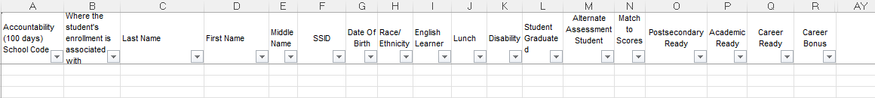
Example – Postsecondary Readiness Spreadsheet

Slide 11
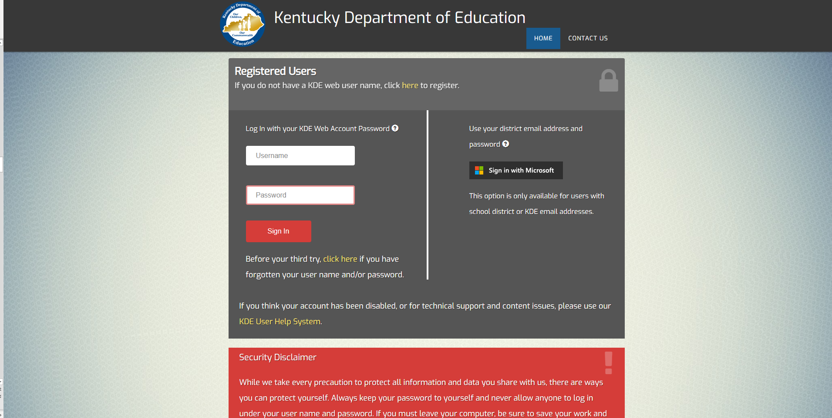
Login Page
https://applications.education.ky.gov/login/default.aspx

Slide 12
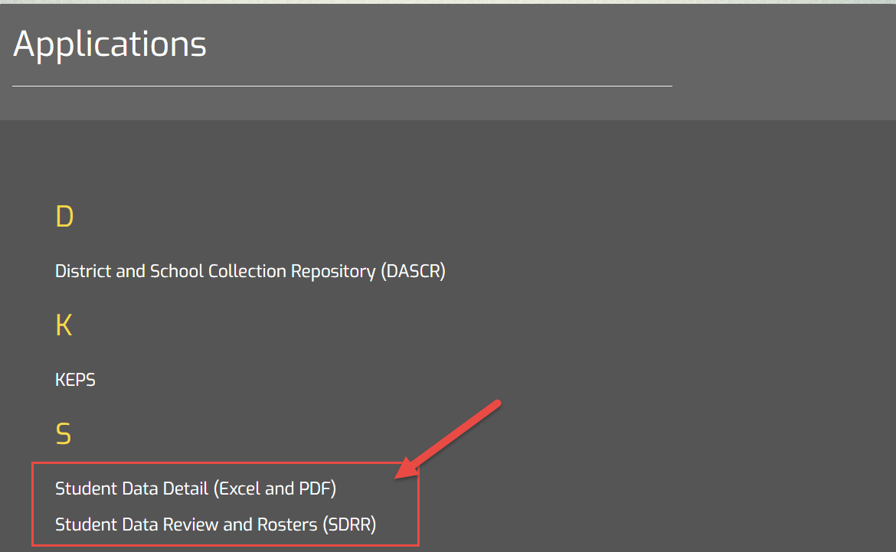
Student Data Detail or SDRR Applications After Login Page

Slide 13
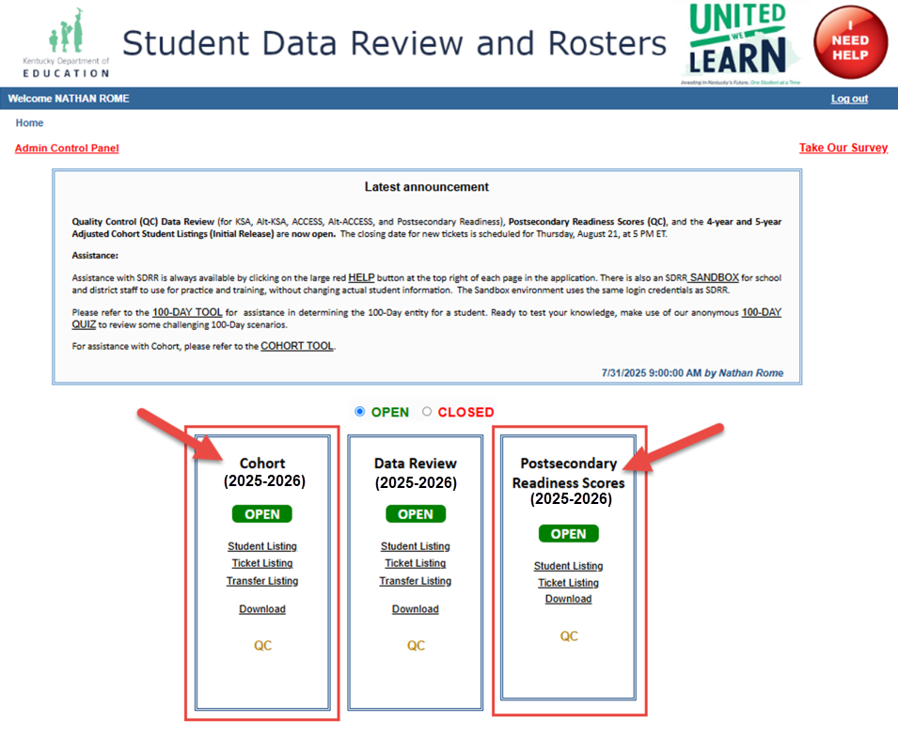
Welcome/Home

Slide 14
Cohort

Slide 15
Cohort Graduation Rate
The Adjusted Cohort Graduation Rate data provides an accurate graduation model that follows students from their first year in high school through their expected cohort graduation school year
The “4-year adjusted cohort graduation rate” is defined as the number of students who graduate in four years with a regular high school diploma divided by the number of students who entered high school four years earlier, adjusting for transfers in and out, émigrés and deceased students
The “5-year adjusted cohort graduation rate” is defined as the number of students who graduate in five years with a regular high school diploma divided by the number of students who entered high school five years earlier, adjusting for transfers in and out, émigrés and deceased students

Slide 16
Cohort Student Listing
Enrollment changes (ex. G-code and Graduation tab) should have been made in IC or the students will show Not On Time Status in SDRR
Demographic changes should be made in SDRR
Cohort does not follow the 100-day rule
Tickets to change reporting location for public reporting and nonparticipation requests in SDRR will require matching IC enrollment records for approval
Request verified transfers if necessary
Data last updated from IC is reflected in SDRR as of July 31

Slide 17
Cohort Student Listing (Continued)
Students track to the A1, A5 or A6, etc. school where the student was last primarily enrolled (for in-person and virtual students), unless the student was a Verified Transfer or Kentucky Educational Collaborative for State Agency Children (KECSAC)
Notes:
KECSAC students are accountable to the state for 100-day entity.

Slide 18
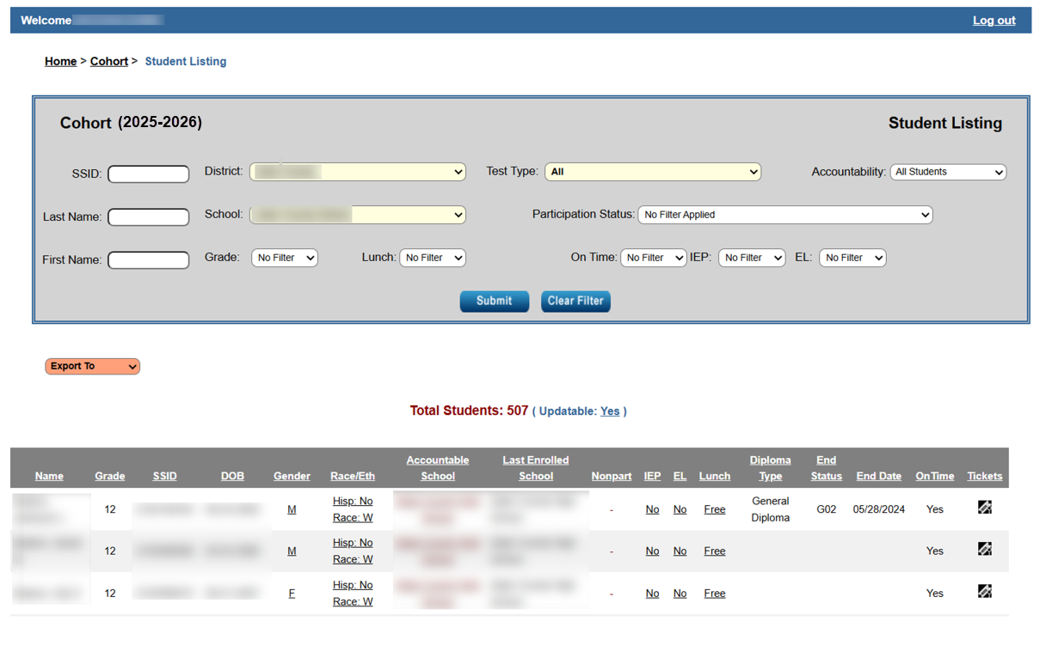
Cohort Student Listing in SDRR

Slide 19
Verified Transfers
W07- A pupil withdrawn due to those communicable medical conditions that pose a threat in school environments listed in 902 KAR 2:020, Section 1(1), accompanied by a doctor's statement certifying the condition or any other health-related condition for which the student is too ill to participate in regular school attendance or local homebound instructional services or if the student has obtained a doctor's statement certifying the condition.
W08 - A pupil withdrawn due to death.
W20 - A pupil transferred to a home school. The re-entry code to use with W20 shall be R20.
W21 - A pupil transferred to a nonpublic school (excluding home school).
W22* - A pupil who has transferred to another public school district and for whom a request for student records has been received or enrollment has been substantiated or a pupil who is known to have moved out of the United States.
*Note: A W22 is not a verified transfer if there is no subsequent enrollment into a Kentucky public school. Beginning with the 2014-2015 school year, a W29 must be used to indicate an enrollment in another state. This applies to students with No Show enrollments at the beginning of the school year.
W29 - A pupil who has transferred to an out-of-state school for whom a request for student records has been received or enrollment has been substantiated.

Slide 20
Dropouts or GED Recipients Not On Time
C01 - A pupil who completes the school year in the school of the most current enrollment. No subsequent enrollment without a graduation end status (G01-G04) is a dropout.
W12 - A pupil under the jurisdiction of the court.
W22 - This end status is a dropout if there is no subsequent enrollment into a Kentucky public school* beginning with the 2014-2015 school year. Also beginning with the 2014-2015 school year, a W29 must be used to indicate an enrollment in another state. This applies to students with No Show enrollments at the beginning of the 2014-2015 school year.
*If withdrawal is to Appalachian Challenge Academy or to a Job Corp that is providing high school curriculum courses toward a regular high school diploma, change the end status from a W22 to a W21. Even though these schools are in IC, it is for funding purposes only, and they are not considered Kentucky public schools.
*Bluegrass Challenge Academy, beginning with the 2017-2018 school year, is considered a public alternative school under the realm of Eminence Independent. Therefore, the appropriate withdrawal status for a student enrolling in this academy is W22: A pupil who has transferred to another public Kentucky school district and for whom a request for student records has been received and enrollment has been substantiated.

Slide 21
Dropouts or GED Recipients Not On Time (Continued)
W23 - A pupil withdrawn for a second or subsequent time who initially withdrew as a W24 or W25 during the current school year.
W24 - A pupil who has moved out of this public school district for whom enrollment elsewhere has not been substantiated.
W25 - A pupil who is at least 16 years of age and has dropped out of public school.
W26 - A pupil who has withdrawn from school after completing a secondary GED Option program and receiving a GED certificate.
W27- A student who has withdrawn from school and subsequently received a GED.
W28 - A student who has reached the maximum age for education services without receiving a diploma or an alternative high school diploma.

Slide 22
Postsecondary Readiness Scores

Slide 23
Understanding the Process for Postsecondary Readiness Scores
Getting the Rosters Right
Data Review and Cleanup
Accurate Reporting
  Postsecondary Readiness (April-June)
  Postsecondary Readiness Scores (August)
  Make changes to individual student demographics in Data Review
  Request accountability changes in Data Review
  Upload Postsecondary Readiness Academic Scores (Only) if needed
  Public Release
  Ten-Day Regulatory Data Review follows Public Release

Slide 24
Postsecondary Readiness – Academic Readiness
Assessments approved by Council on Postsecondary Education (CPE) for Postsecondary Readiness:
  KYOTE
  KDE – approved dual credit courses - updated in TEDS
  SAT
  ALEKS
  GED College Readiness
  Transition Attainment Record (Alternate KSA)
  Advanced Placement (AP) Examinations
  International Baccalaureate (IB) Examinations
  Cambridge Advanced International Examinations
  Accuplacer
  The ACT
Notes:
GED College Readiness is specific one in legislation. More information about the specific GED College Readiness in statue 158.143 is available from HB 194. The council for Postsecondary Readiness publishes an approved list of Academic Readiness measures for Postsecondary Readiness Indicator.

Slide 25
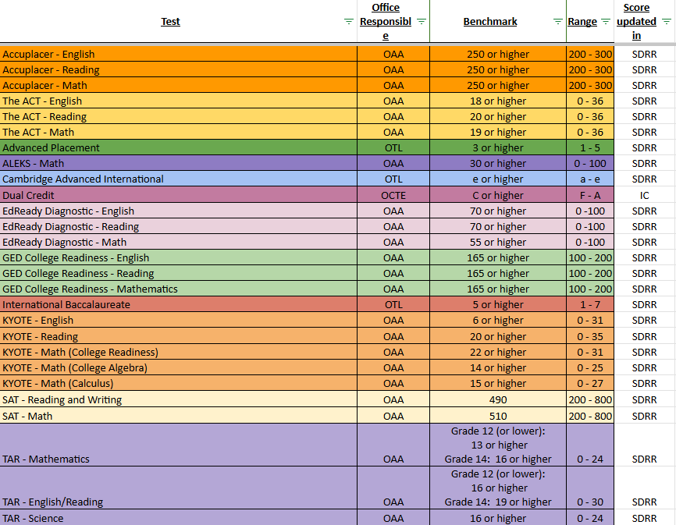
Academic Readiness for Postsecondary Readiness Resource
Notes:
Students only need to meet readiness in one of the areas for Academic Postsecondary Readiness or Career Readiness.

Slide 26
Postsecondary Readiness Scores
If the student met the benchmarks
Shows in SDRR: met benchmark and the test
If the student did not meet the benchmarks
Shows in SDRR: click on update score, upload a scanned official copy of the score report from the vendor and, if approved, it will locate in the tickets
NOTE: Demographics may be reviewed and accountability changes for Postsecondary Readiness may be requested in the Data Review Section of SDRR.

Slide 27
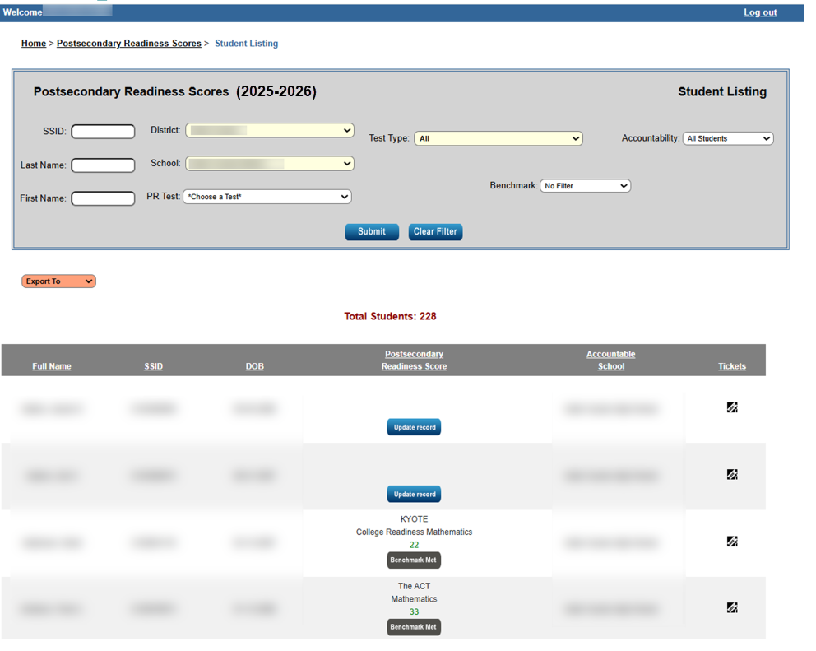
Postsecondary Readiness Scores in SDRR

Slide 28
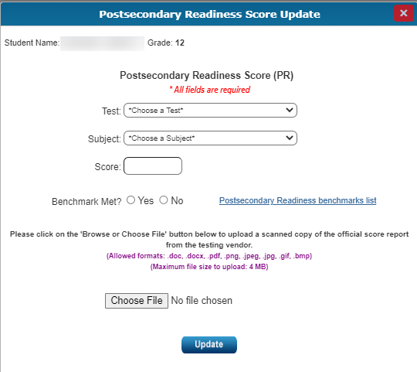
Postsecondary Readiness Score Update
Please note:
The score report must be a scanned copy of the official score report from the vendor.

Slide 29
SDRR Resources for Cohort and Postsecondary Readiness Scores

Slide 30
Resources to Assist with Cohort and Postsecondary Readiness Scores
See Web Apps Admin Point of Contact (WAAPOC) for permissions to SDRR
Review the SDRR Page, Cohort and Postsecondary Readiness Score PowerPoint and Video
Download the student listings from Spring Rosters in SDRR
Download the spreadsheets from the Student Data Detail app in the web applications login
Take the 100-day anonymous quiz to test accountability knowledge
Use the 100-day tool to look at different scenarios for accountability
Cohort Tool
The Sandbox is available for training staff in SDRR

Slide 31
Contact Information for Questions
OAA/DAAS
(502) 564-4394
dacinfo@education.ky.gov
  Other Data Issues and Cohort
  kdeassessment@education.ky.gov

Slide 32
Thanks for Watching

Slide 33

Closing Slide

