Slide 1
DAC Webcast
September 10, 2026
Shara Savage, Director
Division of Assessment and Accountability Support
Office of Assessment and Accountability

Slide 2
Agenda
Kentucky Alternate Assessment Program (KAAP) Reminders
K Screen Updates
Fall 2026 Data Reporting
House Bill (HB) 257 Update
English Language Proficiency
703 KAR 5:270 and Kentucky’s Accountability System Update Timeline

Slide 3
Kentucky Alternate Assessment Program Reminders
Krista Mullins, Program Consultant
Division of Assessment and Accountability Support
Office of Assessment and Accountability

Slide 4
KAAP Important Dates
Date | Information
Friday, Sept. 4 | Career Work Experience Certification (CWEC) Training and Quiz Opened
Friday, Sept. 11 | Visual Impairment (VI) Orders Due
Monday, Sept. 28 | Transition Attainment Record (TAR) Training and Qualification Quiz Open
Friday, Oct. 2 | Final day to have changes in Infinite Campus (IC) before final data pull. Individual Education Programs (IEPs) must be locked
Friday, Oct. 2 | Final day to update Rosters for Grades 12 and 14 students for CWEC and Employability Skills Attainment Record (ESAR) IC pull
Friday, Oct. 9 | ESAR Qualification Quiz Opens
Monday, Oct. 12 | TAR Administration may begin once required trainings and qualification quiz are completed

Slide 5
Alternate Kentucky Summative Assessment (AKSA) Training and Quiz
The AKSA Training and Quiz opened on Monday, Aug. 24.
  The training will remain open and available on KDE's Kentucky Alternate Assessment Combined Resources webpage.
The quiz will close on Friday, Nov. 6.
  If a new teacher moves into the district and needs to complete the quiz, the teacher must complete all required trainings prior to the District Assessment Coordinator (DAC) emailing DAC Info to request the quiz be opened.
If a teacher becomes locked out of a quiz, the system will unlock the quiz after 24 hours.
  If a teacher gets locked out of the quiz a second time, the system will send an email to the DAC with further instructions.

Slide 6
Visual Impairment (VI) Orders
For students taking the AKSA who have a verified Visual Impairment on their IEP, tactilely enhanced materials are available for order.
  VI Materials do not contain large print or enlarged pictures due to test administrators having the opportunity to enlarge materials if needed.
All VI Material requests must be submitted using the VI Order Application.
VI Orders are due Friday, Sept. 11.

Slide 7
K Screen Updates
Tiffany Christopher, Program Consultant
Division of Assessment and Accountability Support
Office of Assessment and Accountability

Slide 8
K Screen Office Hours
The Office of Assessment and Accountability (OAA) and Curriculum Associates will hold a final virtual office hour on Thursday, Sept. 10, to support the K Screen process.
  K Screen Office Hour #2 - Thursday, Sept. 10, 2026, 1-2 p.m. ET
This session provides an opportunity to ask questions, receive guidance and ensure readiness for upcoming tasks.
Participation is encouraged for all, whether experienced or new to the role.
Contact Tiffany Christopher with questions.

Slide 9
Fall 2026 Data Reporting
Shara Savage, Director

Slide 10
Quality Control Day Confirmed
Quality Control (QC) Day will occur on Wednesday, Sept. 23 from 9 a.m. to 4 p.m. ET.
QC Day resources will be released in the upcoming Monday DAC email.

Slide 11
QC Day Purpose
Purpose​
  Ensure accurate public reporting​.
  Identify statewide systemic data issues that potentially impact multiple schools and districts.
Preparation
  ​Review the 2026 Accountability Indicator Trainings.
  Nondisclosure form must be completed by all viewers and maintained by DAC.
Review Data​
  Changes to individual student data were requested in the Student Data Review and Rosters (SDRR) application during QC Data Review.
  Review accountability data, including color ratings, indicator data and federal classifications.
  Conduct a final review of data to ensure data quality for schools and districts.​
  Carefully review individual student groups for federal classification (TSI).

Slide 12
Tentative 2026 Data Reporting Timeline
Embargo to the District
  October 13-14
  DACs and Select District Staff
Public Reporting
  October 15
  Accountability Data Released Publicly
10 Day Regulatory Data Review Period
  Immediately Following Public Release
  DACs’ Final Opportunity to Review Publicly Released Data

Slide 13
House Bill (HB) 257 Update
Shara Savage, Director

Slide 14
2026 – 2027 Assessment & Accountability Changes
Assessment Changes (KSA and AKSA) for grades 3 through 8, 10 and 11
  The following will be removed from the state testing program:
    Editing and Mechanics
    On-Demand Writing
    Quality of School Climate and Safety Survey (QSCS)
  Accountability Changes for Fall 2027
    Chronic Absenteeism will be a new indicator
    Individual Student Growth will be a new indicator
    Evaluation of Change for each indicator is removed
    Writing is removed from the State Assessment Results indicator
    One Overall Score will be used in the state accountability system that meets federal requirements

Slide 15
2026-2027 New Accountability Indicators
The state indicators shall exclusively include:
  State Assessment Results - Reading and Mathematics
  State Assessment Results - Science (SC) and Social Studies (SS)
  Individual Student Growth - Reading and Mathematics
  English Learner Progress
  Chronic Absenteeism
  Postsecondary Readiness
  Graduation Rate

Slide 16
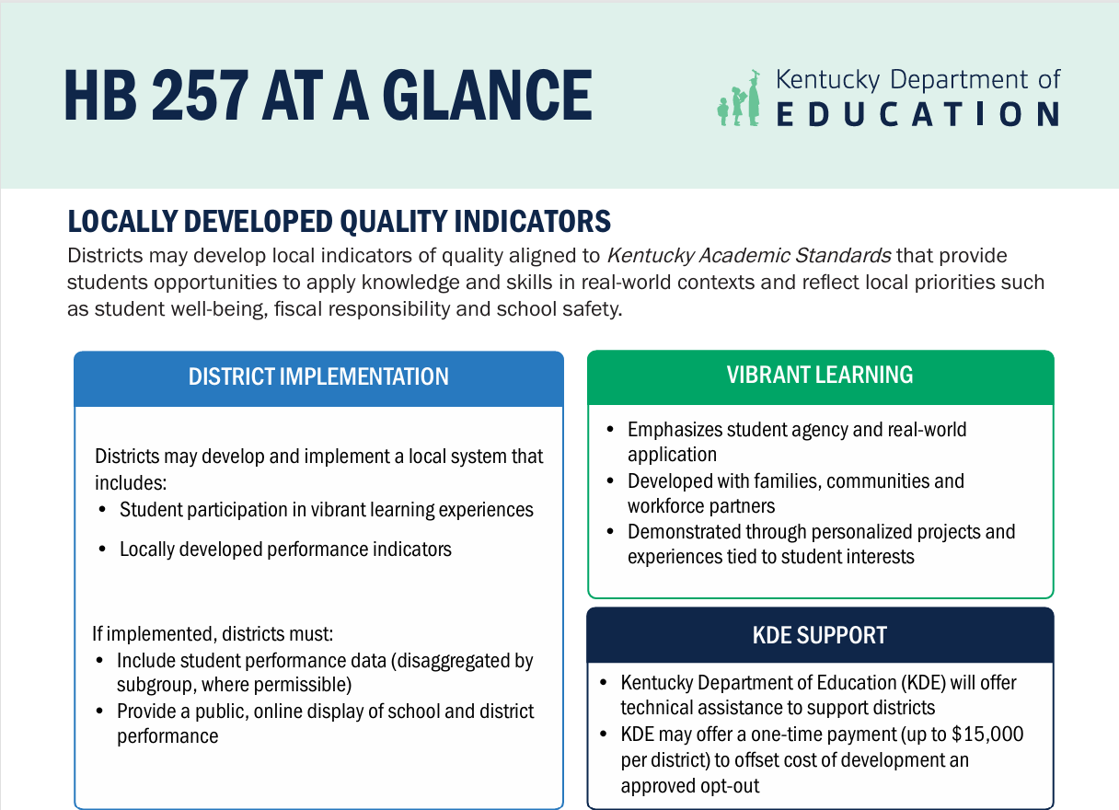
HB 257 Resource
House Bill 257 at a Glance

Slide 17
English Language Proficiency
Shara Savage, Director

Slide 18
Testing and Accountability Changes for First-Year EL Students
Beginning with the 2026–2027 school year, Kentucky will implement ESSA Flexibility Option 2.
English Learner (EL) students, including those enrolled in U.S. schools for less than 240 days, must complete all required grade-level Kentucky Summative Assessments (reading, mathematics, science and social studies).
EL students must participate if enrolled on or before the first day of the district’s testing window.
First-year EL student results will be included in accountability as follows:
  Year 1: All scores reported in assessment results in the School Report Card (SRC) but NOT included in accountability calculations
  Year 2: All scores reported in assessment results in the SRC, and reading and mathematics will be included in the Individual Student Growth indicator
  Year 3: All scores will be fully included in assessment reporting and accountability calculations
EL students will continue to complete the annual English Language Proficiency assessment.
Note: Inclusion in accountability must be federally approved through the ESSA Consolidated State Plan.

Slide 19
703 KAR 5:270, Kentucky’s Accountability System Update Timeline
Shara Savage, Director

Slide 20
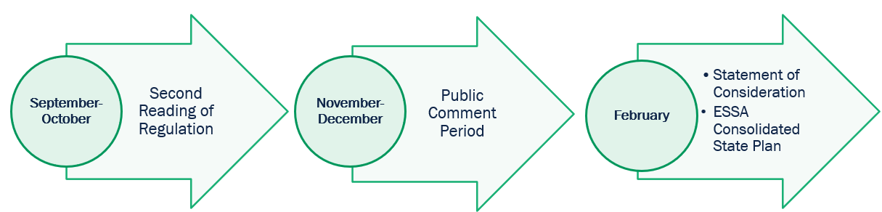
Next Steps for 703 KAR 5:270, Kentucky’s Accountability System
Date | Advisory Group
Aug. 19 | Kentucky Technical Advisory Committee
Sept. 1 | Education Assessment and Accountability Review Subcommittee
Sept. 15 | School Curriculum, Assessment and Accountability Council
Sept. 29 | Local Superintendents Advisory Council
Oct. 7-8 | Kentucky Board of Education
KRS 158.6455(1)(g): Prior to promulgating administrative regulations to revise the accountability system, the board shall seek advice from the School Curriculum, Assessment, and Accountability Council; the Office of Education Accountability; the Education Assessment and Accountability Review Subcommittee; and the department's technical advisory committee.

Slide 21
Questions and Answers
Please submit questions or comments to the OAA DAC Webcast Q&A Form.
The next monthly DAC Webcast is scheduled for Oct. 8 at 11 a.m. ET.
Thank you for your participation!

Slide 22
Division of Assessment and Accountability Support
Contact Information
KDE DAC Information
dacinfo@education.ky.gov
(502) 564-4394

