Slide 1
DAC Webcast
August 13, 2026
Shara Savage, Director
Division of Assessment and Accountability Support
Office of Assessment and Accountability

Slide 2
Agenda
New Consultant
Legislative Updates
Assessment Literacy Training Series
AKSA Updates
K Screen Updates
Fall 2026 Tentative Reporting Timeline
SDRR Fall Reporting Data Review

Slide 3
Legislative Updates
Shara Savage, Director
Division of Assessment and Accountability Support
Office of Assessment and Accountability

Slide 4
Procurement Process Update for the College Entrance Exam
As a result of SB 197, KDE must conduct a new procurement for the state‑provided college entrance exam for 2026–2027.
The 2026–2027 school year will begin without a selected exam, creating uncertainty for students, families and educators.
KDE is working with the Finance and Administration Cabinet to repeat the competitive procurement process following the requirements in the statute.
The goal is to have a vendor or vendors in place by October.

Slide 5
Next Steps for 703 KAR 5:270, Kentucky’s Accountability System
July and August
September and October
November and December
First Reading of Regulation
Second Reading of Regulation
Public Comment Period
Date | Advisory Group
July 21 | School Curriculum, Assessment and Accountability Council
July 28 | Local Superintendents Advisory Council
Aug. 5-6 | Kentucky Board of Education
Aug. 19 | Kentucky Technical Advisory Committee
Date | Advisory Group
Sept. 15 | School Curriculum, Assessment and Accountability Council
Sept. 29 | Local Superintendents Advisory Council
Oct. 7-8 | Kentucky Board of Education
KBE Meeting – August 6
Additional groups will be consulted in August and September.

Slide 6
Assessment Literacy Training Series
Shara Savage, Director
Devon Avery, Database Administrator III
Division of Assessment and Accountability Support
Office of Assessment and Accountability

Slide 7
Assessment Literacy Training
Collection of self-paced microlearning modules offering concise, targeted learning opportunities
Focus on building understanding of Kentucky's state assessments, assessment processes and the use of assessment information to support student learning
Free and available through the KY Learning Hub

Slide 8
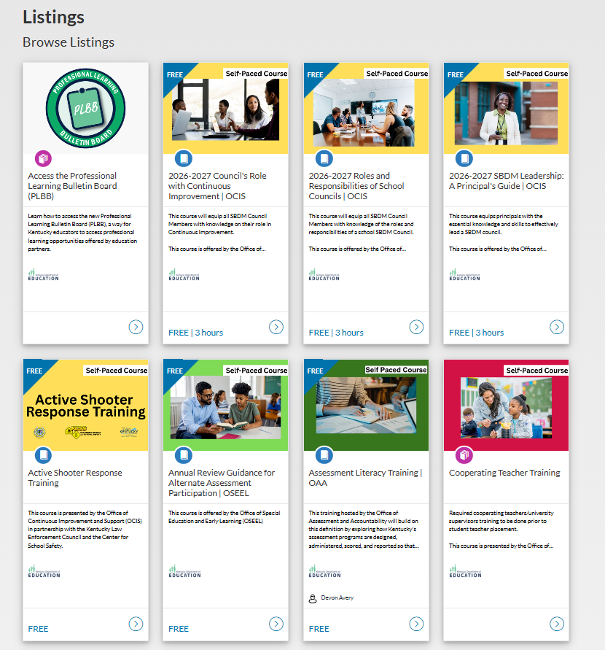
Accessing the Course
Find the Assessment Literacy Training Series in the catalog listings.
Click on the course title.

Slide 9
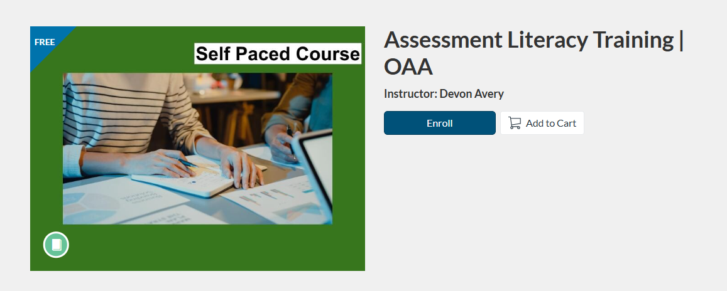

Enrolling in the Course
Select Enroll.
District/KDE staff will use their email address and password by clicking the Sign In for District/KDE Staff button.
Users without a KY public school district email address will need to use a Google or Microsoft account.

Slide 10
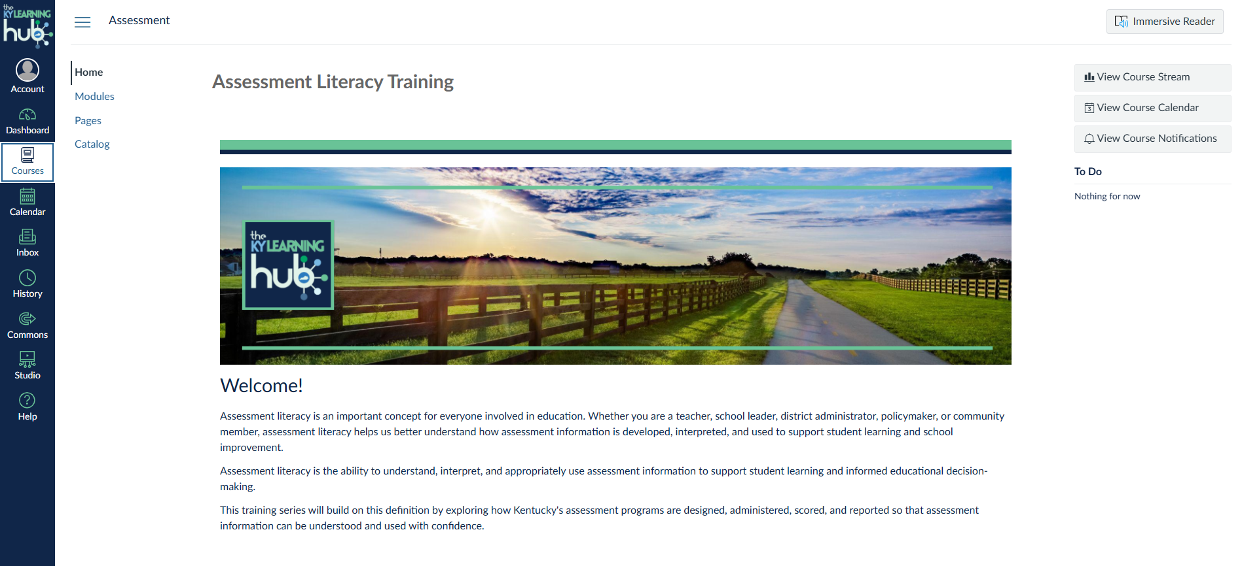
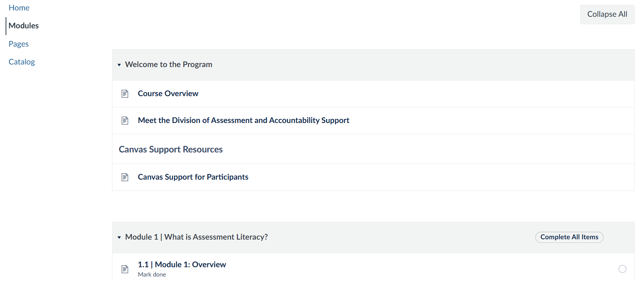
Navigating the Course
The course will appear in the Learning Hub under ‘Courses’ in the navigation menu.
Within the Modules tab, the “Welcome to the Program” highlights the overview, objectives, course expectations and support resources.

Slide 11
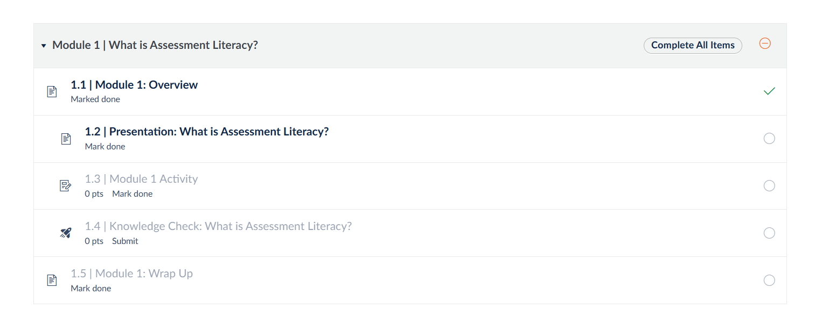
Navigating the Course, cont.
Each module features the same layout.
Remember to select “Mark as Done” at the bottom of each page to progress through the course.

Slide 12
AKSA Updates
Krista Mullins, Program Consultant
Division of Assessment and Accountability Support
Office of Assessment and Accountability

Slide 13
Important Reminders
District Assessment Coordinator (DAC) Binder orders due Friday, Aug. 21.
  Use the DAC Binder Pre-Order for Window 1 link to place an order.
  If a DAC Binder is not ordered, districts may keep one binder per grade band (elementary, middle and high) to use for Window 1 makeups.
The Alternate Kentucky Summative Assessment (AKSA) Training and Qualification Quiz releases Monday, Aug. 24.
  This will be one complete training this year instead of two like in prior years.
  The 1% Modules Trainings found on the KY Learning Hub (previously on the Human Development Institute [HDI] website) are separate from the test administration training.

Slide 14
K Screen Updates
Tiffany Christopher, Program Consultant
Division of Assessment and Accountability Support
Office of Assessment and Accountability

Slide 15
K Screen Office Hours
The Office of Assessment and Accountability (OAA) and Curriculum Associates will hold virtual office hours on Thursday, Aug 20 and Thursday, Sept. 10 to support the K Screen process.
  K Screen Office Hour #1 – Thursday, Aug. 20, 2026, 1 p.m.-2 p.m. ET
  K Screen Office Hour #2 - Thursday, Sept. 10, 2026, 1 p.m.-2 p.m. ET
These sessions provide an opportunity to ask questions, receive guidance and ensure readiness for upcoming tasks.
Participation is encouraged for all, whether experienced or new to the role.
Contact Tiffany Christopher with questions.

Slide 16
K Screen Train the Trainer
Curriculum Associates and the Office of Assessment and Accountability (OAA) will host a virtual Train the Trainers session on Wednesday, Aug. 26 and Thursday, Aug. 27 from 4 – 6:30 p.m. ET.
Train the Trainers is required for anyone who will train others in the district to implement the screener.
Participants can register using the K Screen Train the Trainer Registration.
Registration will remain open until the close of business on Friday, Aug. 21.
Participants will need to have access to the following items during the virtual training:
  Copy of the K&1 Screen III
  The manipulatives (packages of blocks and shapes)
  Children's books with at least 3 sentences on each page

Slide 17
Fall 2026 Data Reporting Timeline
Shara Savage, Director
Division of Assessment and Accountability Support
Office of Assessment and Accountability

Slide 18
Tentative 2026 Data Reporting Timeline
Assessment Student Data Released
  August 5-7
  Kentucky Summative Assessment (KSA) and AKSA Data Released to Districts in Pearson Access Next (PAN)
Fall QC Data Review
  Aug. 12-20 (New Tickets)
  District Assessment Coordinators (DACs) Review Student Participation, Demographic and Accountability Data​
Quality Control Day
  September 23
  DACs Have a First Look at Accountability to Identify Possible Systemic Issues​
Embargo to the District
  October 13-14
  DACs and Select District Staff
Public Reporting
  October 15
  Accountability Data Released Publicly
10 Day Regulatory Data Review Period
  Immediately Following Public Release
  DACs’ Final Opportunity to Review Publicly Released Data

Slide 19
Embargoed Data Sharing
School/District Data
(QC Day)
Preliminary data that can change, provided in secure KDE Applications site
Data should only be shared at the school/district leadership level (superintendent, DAC, district level staff with a vested interest, principals, BACs, etc.) until after public release.
Pre-Release Data
(post-QC Day/pre-Public Release)
Aggregate data are confidential until specific date/time
School and district staff may discuss the data internally and with media; however, data cannot be shared in public meetings or by the media until embargo is lifted.
Nondisclosure form must be completed by all viewers and maintained by DAC.
Publicly released data does not include individual student level information.
Nondisclosure form must be completed by all viewers and maintained by DAC.
Individual Student Level Data
(Fall Data Review)
Scores provided by vendor, not likely to change
Individual student level data are appropriate for sharing with school/district leaders and teachers who could use it to make instructional decisions. A teacher would only need to see data for students who were or are on his/her own class roster(s).
Implement confidentiality rules used locally for students.

Slide 20
SDRR Fall Reporting Data Review
Chris Williams, Program Consultant
Division of Assessment and Accountability Support
Office of Assessment and Accountability

Slide 21
SDRR Data Review Support Resources
Office Hour- August 13, 2-3 p.m. ET
  Held via Microsoft Teams
  Staff will be available to answer questions about the functionality of SDRR and accountability
  Not for specific student information
Fall Reporting Data Review Training Materials
  Data Review PowerPoint
  Cohort/Postsecondary Readiness PowerPoint
  Training Videos

Slide 22
Questions and Answers
Please submit questions or comments to the OAA DAC Webcast Q&A Form.
The next monthly DAC Webcast is scheduled for Sept. 10 at 11 a.m. ET.
Thank you for your participation!

Slide 23
Division of Assessment and Accountability Support
Contact Information
KDE DAC Information
dacinfo@education.ky.gov
(502) 564-4394

