Slide 1
DAC Webcast
August 10, 2023
Jennifer Stafford, Ed.D, Director
Division of Assessment and Accountability Support
Office of Assessment and Accountability

Slide 2
Agenda
  Fall 2023 Senior (Optional) ACT State Administration Reminders
  K Screen Updates
  Data Quality Control Process

Slide 3
  Fall 2023 Senior (Optional) ACT State Administration Reminders
Shara Savage, Program Consultant
Division of Assessment and Accountability Support
Office of Assessment and Accountability

Slide 4
Fall 2023 Senior (Optional) ACT State Administration – Test Window 1
Administration | Dates
The ACT Online Standard & ACT- Authorized Accommodations Testing Window | October 3-5 & October 10-12
The ACT-Authorized Accommodations Testing Window (Paper) | October 3-13
Notes:
ACT and OAA have set the Fall 2023 Senior (Optional) ACT State Administration dates.
The ACT Online Standard & ACT- Authorized Accommodations Testing Window in the table refers to dates used for online test administration. It includes the dates available for testing with ACT online. Notice that online testing only occurs on Tuesday, Wednesday or Thursday of each week, All testing for the fall will be online. Paper test books will only be available for accommodated testing with no online equivalent. Please note that all online testing, including online accommodations, must be completed in the online window. Please note: If a school or district is unable to test online due to an internet outage or a weather event, please contact Shara Savage for alternative plans.
In the ACT-Authorized Accommodations Testing Window (Paper). All paper testing must occur on those dates. Test Coordinators (TCs) would test students during the paper accommodations testing window if testing students with paper-accommodated materials. As a reminder, all testing for the fall will be online. Paper test books will only be available for accommodated testing with no online equivalent.
The ACT Schedule of Events for each testing window outlines the various tasks completed during each administration cycle. Tasks will vary depending on which type of administration is being managed (online or accommodated paper).

Slide 5
Fall 2023 Senior (Optional) ACT State Administration – Test Window 2
Administration | Dates
The ACT Online Standard & ACT- Authorized Accommodations Testing Window (Online only) | October 17-19 & October 24-26
The ACT-Authorized Accommodations Testing Window (Paper) | October 17-27
Please Note: ACT and OAA have worked to secure an Emergency Test Window 3. OAA will work with districts should a statewide emergency arise.
Notes:
Here are the dates for test window 2.
Please Note: ACT and OAA have worked to secure an Emergency Test Window 3. OAA will work with districts should a statewide emergency arise.

Slide 6

Deadline Reminders
August 25 – Select Test Date Task Deadline
August 31 – Complete Site Readiness Deadline
September 1 – Accommodation Request Deadline
6

Slide 7
ACT Fall 2023 Senior Administration: Schedule of Events
The ACT Fall Schedule of Events outlines the various tasks that must be completed during the testing cycle. Tasks will vary depending on which type of administration is being managed (standard time/accommodated online or accommodated paper).
In addition to the fall 2023 schedule of events, please download and utilize the ACT Interactive Checklist. It is a valuable tool to assist DACs and BACs in navigating through the testing cycle.
7

Slide 8
ACT Fall 2023 Senior Administration Office Hour - Reminder
ACT and KDE have partnered to offer office hours beginning late August through the fall 2023 administration.
ACT Office Hours: (All times listed below are eastern standard time.)
Tuesday, Aug. 22, 2023, 11 a.m. – 12 p.m.
Wednesday, Sept. 6, 2023, 11 a.m. – 12 p.m.
Wednesday, Sept. 27, 2023, 11 a.m. – 12 p.m.
Wednesday, Oct. 11, 2023, 11 a.m. – 12 p.m.
8

Slide 9
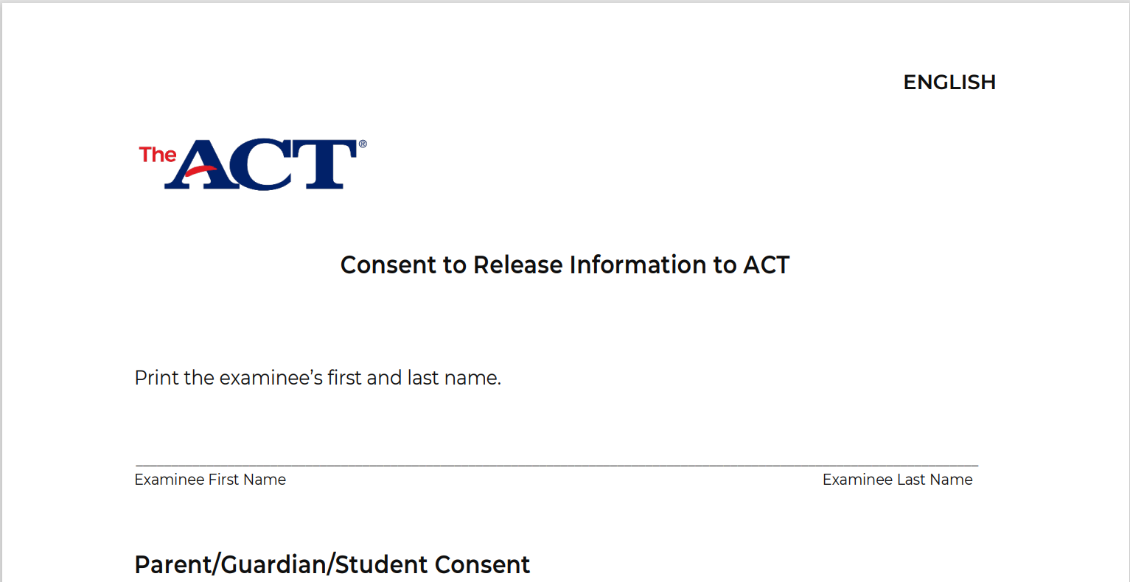
Policy Change Reminder - Accommodations Consent Form
The ACT Consent to Release Form for accommodations is no longer recommended or required.
9
Notes:
New for the 2023-2024 school year and beyond the consent to release form you see on your screen for accommodations is no longer required or recommended.
KDE has reviewed the document and the policy requiring the form. We have determined that the form is not required.

Slide 10

Policy Change Reminder - Collecting Parent Consent
Written
Paper form sent home in back-to-school packet
Paper form mailed home
Electronic
Email
Google Form
Please note: Verbal consent is no longer an option for collecting consent. Additionally, Parental consent must be obtained for each administration and does not transfer over from any administration, including this past spring administration.
10
Notes:
Now, let’s review options for collecting parent consent signatures.
Written signatures -
Paper form sent home in back-to-school packet
Paper form mailed home
Electronic signatures -
Email
Google Form
Please note: New for this year -Verbal consent is no longer an option for collecting consent.

Slide 11
  K Screen Updates
Lisa Jett, Program Consultant
Division of Assessment and Accountability Support
Office of Assessment and Accountability

Slide 12
K Screen Reminders
K Screen Window
  15 calendar days before the first instructional day and no later than the 30th instructional day
Please check the Online Management System to ensure teachers and students are showing up
All data entered in the Online Management System by Oct. 15
Self Help and Social Emotional Scales must be completed during the K Screen Window
12

Slide 13
K Screen Office Hours
Curriculum Associates and KDE will be offering Office Hours during the K Screen window to assist Kentucky's educators with the K Screen process.
These virtual meetings will be bi-weekly starting next Tuesday, Aug. 15 from 2–3 p.m. E.T.
Topics for the first office hour will include Infinite Campus preparations and Online Management Accounts
K Screen Office Hours

Slide 14
  Data Quality Control Process
Jennifer Stafford, Ed.D, Director
Division of Assessment and Accountability Support
Office of Assessment and Accountability

Slide 15
Understanding the Data Quality Control Process
Spring (@April – June) -
Getting the Rosters Right
Fall (@Oct..) –
Quality Control Day
Ensure accurate public reporting​
Late Fall (@Oct./Nov.) -
Accurate Reporting
Public Reporting School Report Card (SRC)
Ten-Day Regulatory Data Review follows Public Release
Identify students who should be tested, non-participation, demographic data, accommodations, English Learner status
Fall (@Aug.) -
Data Review and Roster Cleanup
Request changes to individual student level data
Request nonparticipations if needed
Request accountability changes
Verify 100 Day
Identify statewide systemic data issues that potentially impact multiple schools and districts ​(not individual student changes)
Request individual student changes
Cohort

Slide 16
Systemic Issue Found During Fall Data Review
A systemic issue was identified during the fall data review
Impacted accountability, nonparticipation, English Learner accommodations, and IEP accommodations for Kentucky Summative Assessment (KSA), Alternate Kentucky Summative Assessment (AKSA), and ACCESS/Alternate ACCESS
Updated Spreadsheets were made available Aug. 7
Fall Data Review concludes at 12 noon ET Aug. 10
16

Slide 17
Questions and Answers
Please send questions or comments to dacinfo@education.ky.gov.
The next monthly DAC Webcast is scheduled for Sept. 14 at 11 a.m. ET.
Thank you for your participation!

Slide 18
Division of Assessment and Accountability Support
Contact Information
KDE DAC Information
dacinfo@education.ky.gov
(502) 564-4394
18

