Slide 1
DAC Webcast June 12, 2025
Shara Savage
Education Administration Program Manager
Office of Assessment and Accountability

Slide 2
Agenda
Spring 2025 Testing Highlights
K Screen Updates
Nominations for the Kentucky Association of Assessment Coordinators (KAAC) DAC and BAC of the Year Award
Celebrating Rhonda Sims

Slide 3
Spring 2025 Testing Highlights
Shara Savage
Education Administration Program Manager
Office of Assessment and Accountability

Slide 4
Spring 2025 Testing
Despite the severe weather across the Commonwealth that affected many communities, the administration of the ACCESS, ACT, Kentucky Summative Assessment (KSA), and Alternate Kentucky Summative Assessment (AKSA) were successfully completed. This achievement is a testament to the dedication and resilience of everyone involved.

Slide 5
Online Testing Highlights
KSA Online Testing:
Largest Number of Tests Completed in a Single Day: 196,491
Total Number of Tests Completed: 1,589,675
ACT Online Testing:
Total Number of Tests Completed: 46,497
ACCESS Online Testing:
Total Number of Online Tests Completed: 44,885

Slide 6
K Screen Updates
Tiffany Christopher, Program Consultant
Office of Assessment and Accountability

Slide 7
Train the Trainer
Curriculum Associates and the Office of Assessment and Accountability (OAA) will host an in-person Train the Trainers at Sower on Tuesday, July 15, 10 a.m. – 3 p.m. ET.
Train the Trainers is required for anyone who will train others in the district to implement the screener
Participants can register using the K Screen Train the Trainer In-Person registration
Registration will remain open until COB Friday, July 11.
Participants will need to bring the following items with the in-person training:
Copy of the K&1 Screen III
The manipulatives (packages of blocks and shapes)
Children's books with at least 3 pages of text on each page

Slide 8
Nominations for DAC and BAC of the Year Award
Shara Savage
Education Administration Program Manager
Office of Assessment and Accountability

Slide 9
DAC and BAC of the Year Award – Nominations Open
The Kentucky Association of Assessment Coordinators (KAAC) Board is now accepting nominations for the DAC of the Year and BAC of the Year awards.
Winners will be recognized at the Scott Trimble Workshop in October.
Nominate a deserving DAC or BAC using the links below:
DAC of the Year Nomination Form
BAC of the Year Nomination Form

Slide 10
Celebrating Rhonda Sims
Chris Williams, Program Consultant
Office of Assessment and Accountability

Slide 11
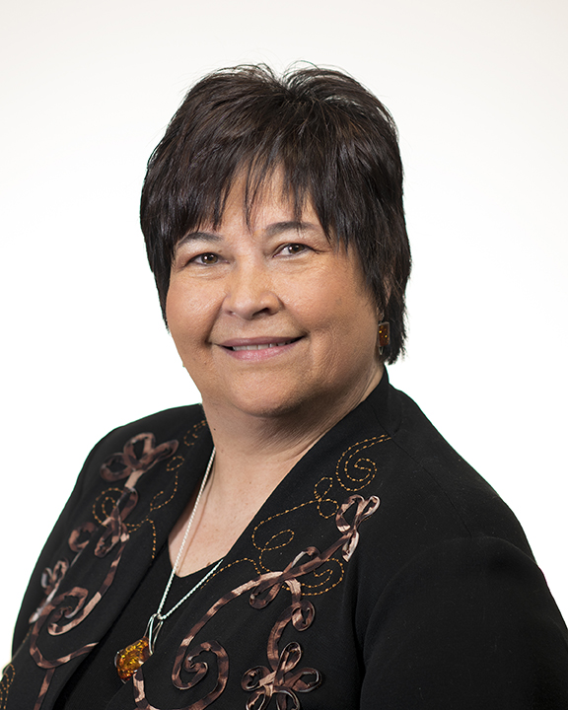
Celebrating Rhonda L. Sims
Kentucky Depart of Education (KDE) Associate Commissioner Rhonda Sims, Office of Assessment and Accountability, has announced her retirement effective July 1.
Serving at KDE since 1994, she has served with every commissioner of education since the Kentucky Education Reform Act of 1990.
For her significant contributions to the quality of public education in Kentucky, Sims has received the:
Kentucky Association of School Administrators’ William T. Nallia Education Leadership Award (2010) and the
Kevin M. Noland Award for Outstanding Public Service to Kentucky Schools (2014).

Slide 12
Questions and Answers
Please send questions or comments to dacinfo@education.ky.gov.
The next monthly DAC Webcast is scheduled for July 10 at 11 a.m. ET.
Thank you for your participation!

Slide 13
Division of Assessment and Accountability Support
Contact Information
KDE DAC Information
dacinfo@education.ky.gov
(502) 564-4394

