Slide 1
DAC Webcast April 10, 2025
Shara Savage, Branch Manager
Division of Assessment and Accountability Support
Office of Assessment and Accountability

Slide 2
Agenda
House Bill (HB) 298
ACT Score Reporting
K Screen Reminders
Kentucky Summative Assessment (KSA)/AKSA Site Visits
Alternate Kentucky Summative Assessment (AKSA) Update
Student Data Review and Rosters (SDRR) Updates
ACCESS/WIDA Alternate ACCESS Updates
Honoring John Wickizer

Slide 3
HB 298
Shara Savage, Branch Manager
Office of Assessment and Accountability

Slide 4
HB 298: Annual CSI Federal Classification Requirement
House Bill 298 amends KRS 160.346, requiring the Kentucky Department of Education (KDE) to identify schools for Comprehensive Support and Improvement (CSI) annually rather than every three years.
Impact:
Fall 2025 reporting will include CSI and ATSI identification as planned. Schools will be identified annually for CSI thereafter.
Additional Targeted Support and Improvement (ATSI) identification criteria did not change. 2025 is an identification year. The next new ATSI identification will occur in 2028.
Identification of Targeted Support and Improvement (TSI) will continue to occur annually.
4

Slide 5
ACT Score Reporting
Christen Roseberry, Program Consultant
Office of Assessment and Accountability

Slide 6
ACT Spring 2025 Junior Administration Score Reporting
Scores will be available 3-8 weeks after answer documents are received by ACT.
The final data and reports will be available no later than May 27.
Student-level data is considered confidential and should never be shared publicly. OAA recommends that schools and districts refrain from publicly or internally sharing data until after May 27, when the aggregate results are complete, to ensure accuracy and consistency in reporting.
Reporting Resources
2025 ACT Score Report Schedule
ACT Success Site
ACT Contact Webform

Slide 7
K Screen Reminders
Tiffany Christopher, Program Consultant
Office of Assessment and Accountability

Slide 8
Train the Trainers (TtT)
Virtual training presented by Curriculum Associates and the Kentucky Department of Education on April 30
Required for anyone who will train others in the district to implement the K Screen
Participants can register using this link
Registration will remain open until April 25
Training information will be sent out via email on April 28

Slide 9
KSA/AKSA Site Visits
Melissa Chandler, Program Consultant
Office of Assessment and Accountability

Slide 10
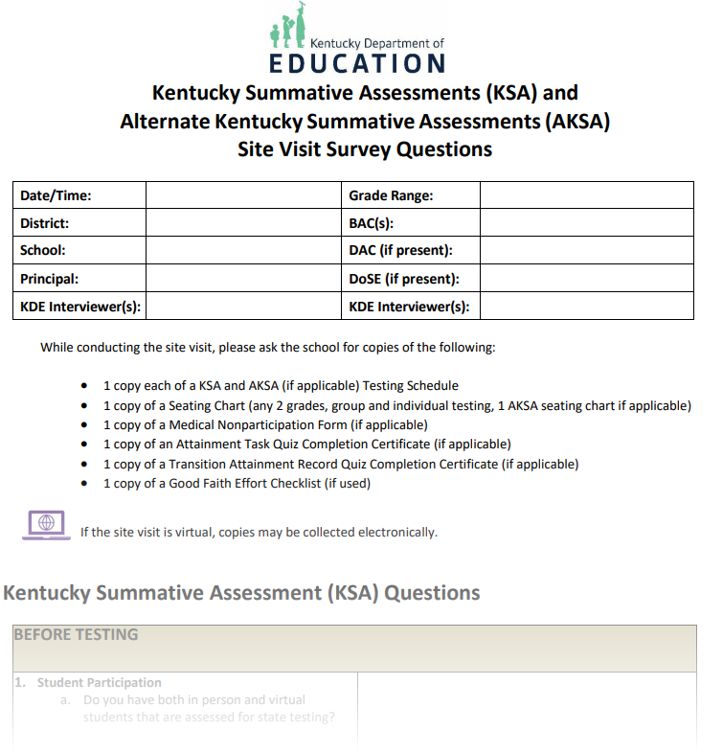
2025 KDE Site Visits
In-person and virtual monitoring is planned for spring 2025.
Sites will be selected both purposefully and at random.
Site visit questions are located on Assessment Support Forms webpage.

Slide 11
KDE Site Visits: What to Expect
In-person Site Visits
Approximately 30-minute advance notice phone call to DAC
Virtual Site Visits
OAA will contact DAC/BAC to schedule time in advance
Will be conducted via Microsoft Teams
For both in-person and virtual visits, school staff will be interviewed and asked to provide testing documentation (i.e., testing schedule, seating charts, good faith effort checklists, etc. )
Information collected from site visits will be compiled and added to a Google Form for reporting and auditing purposes

Slide 12
Caveon In-Person Monitoring Visits
In-person monitoring will occur by Caveon staff beginning in spring 2025.
A member of OAA staff will contact the DAC.
Caveon staff will arrive onsite before the start of the school day and will identify themselves with documentation.
All Caveon staff have passed background checks and have been trained regarding the Family Educational Rights and Privacy Act (FERPA) and Kentucky state laws protecting student privacy.
BACs will be interviewed and asked to provide testing documentation and procedures.
Caveon Monitors will not interfere with or disrupt testing in any manner or provide technical assistance or feedback during testing observations.
Information collected from site visits will be used for federal reporting and auditing purposes.

Slide 13
AKSA Update
Krista Mullins, Program Consultant
Office of Assessment and Accountability

Slide 14
AKSA Timeline Reminders
Window 2 runs from April 14 to May 23.
The Student Registration Database (SRD) opens for score entry on April 14.
The Transition Attainment Record (TAR) administration ends on May 23.
The last day to enter scores in SRD for Window 2 and TAR is May 30.
The last day to delete students from SRD is May 30.
Please note: Districts may choose to end the window earlier than May 23.

Slide 15
New Test Administrators
New test administrators in the district will need to complete all trainings (Admin Code, Inclusion of Special Populations, as well as both Attainment Task (AT) trainings) and the AT qualification quiz.
The new test administrator will need to register in the online training system (OTS), and the DAC will need to email Krista Mullins with the test administrator’s name to have the AT quiz opened.
Once the test administrator has successfully completed the AT quiz, the completion certificate should be given to the DAC.
Please note: Testing materials are not to be given to a test administrator until all required training is complete and the DAC has received the AT quiz completion certificate.

Slide 16
Changes with Students
If a student has moved into the district from out of state and meets Kentucky’s eligibility criteria for the alternate, or has recently qualified for the AKSA, the student must take Window 1 and Window 2 during the second Window (April 14 - May 23).
The DAC will need to add the student in SRD and complete the Spring 2025 Window 1 Makeup Requests During Window 2 form. Please allow 1 to 2 business days for KDE to review the request and send an email upon completion of processing the request.
For students who have transferred from another District in Kentucky, email Krista Mullins with the SSID number, district, and school the student now attends, so KDE can transfer the student in SRD. Please do not email student names.
If an Admissions and Release Committee (ARC) meeting takes place and determines a student is no longer eligible for AKSA, the student will take the KSA in the Spring. The student’s record in SRD will need to be deleted. DACs may submit a request for a student to be deleted from the SRD using the SRD/CRD Student Deletion Request 2025 form.

Slide 17
Entering Scores in SRD
Entering scores in Window 2 will be similar to Window 1 score entry in the SRD.
Prior to entering scores, a Form number will need to be chosen.
For Window 2, the Quality of School Climate and Safety (QSCS) Survey scores will also be entered. All students assessed on the AKSA must complete the QSCS survey.

Slide 18
Student Data Review and Roster (SDRR) Updates
Chris Williams, Program Consultant
Office of Assessment and Accountability

Slide 19
SDRR
Spring rosters open in SDRR on April 23 and will close on June 11.
Alternate Kentucky Summative Assessment (AKSA)
Kentucky Summative Assessment (KSA)
ACCESS (EL)
Alternate ACCESS
Postsecondary Readiness
Cohort (graduation rate)
Please note: To ensure accuracy in SDRR, student demographic updates must be completed in Infinite Campus (IC) by April 18, prior to the opening of spring rosters. Several helpful IC reports are available to support these updates and may be reviewed in advance.

Slide 20
IC Report Resources
District and school staff are strongly encouraged to utilize these tools to ensure accurate data in IC, which will then be reflected in SDRR.
IEP
IDEA Dec. 1 Count Extract
QA SPED report
Alternate Assessment
Alternate Assessment Tracking report
English Learners
English Learners Extract
Cohort Graduation Rate
Enrollment End Status Validation report
G-Code Validation High School-Aggregate report
IC Reports to Assist in Data Quality document

Slide 21
SDRR Resources
I Need Help
100-Day Tool
100-Day Quiz
Cohort Tool
Sandbox
Step-by-Step Instructions: Marking Accommodations, Change 100-Day Entity, Request Nonparticipation, etc.
Screencasts of the Step-by-Step Instructions.
Session for District and School Level Users on SDRR Functionality during Spring Rosters.

Slide 22
“Hot Topic” Office Hour Topics and Dates
Date | Topic (Links Included)
April 15 1-2p.m. ET | SDRR Resources: Where to Get Assistance
April 22- 1-2 p.m. ET | Spring Rosters Task List and Ticketing Basics
April 29 - 1-2 p.m. ET | Requesting Nonparticipations
May 6- 1-2 p.m. ET | Determining 100-Day Accountability: Rules and Tools

Slide 23
ACCESS for ELLs/WIDA Alternate ACCESS Updates
Chris Williams, Program Consultant
Office of Assessment and Accountability

Slide 24
ACCESS for ELLs and WIDA Alternate ACCESS Report Reminders
ACCESS and WIDA Alternate ACCESS Online Reports available in WIDA Assessment Management System (AMS) on April 28
ACCESS and WIDA Alternate ACCESS Printed Reports to be shipped to districts on May 7-8
Resources for Score Report
ACCESS for ELLs Score and Reports webpage
Interpretive Guide for Score Reports
WIDA Secure Portal- Under Resources-ACCESS For ELLs Parent Letters translated in 47 languages to accompany the score report, ACCESS for ELLs Parent Score Report Guides-explains the score reports, Under Webinars-webinar on March 11- Interpreting Score Reports

Slide 25
Questions and Answers
Please send questions or comments to dacinfo@education.ky.gov .
The next monthly DAC Webcast is scheduled for May 8 at 11 a.m. ET.
Thank you for your participation!

Slide 26
Division of Assessment and Accountability Support
Contact Information
KDE DAC Information
dacinfo@education.ky.gov
(502) 564-4394

Slide 27
Honoring John Wise Wickizer
Ben Riley, Program Consultant
Office of Assessment and Accountability

Slide 28
Remembering
John Wise Wickizer
View Obituary

