Slide 1
DAC Webcast April 9, 2026
Shara Savage, Director
Division of Assessment and Accountability Support
Office of Assessment and Accountability

Slide 2
Agenda
Kentucky Alternate Assessment Updates
K Screen Reminders
College Admissions Exam: SAT Updates and Reminders
KSA/AKSA Site Visits
Status of HB 257
Future DAC Webcast

Slide 3
Kentucky Alternate Assessment Updates
Krista Mullins, Program Consultant
Division of Assessment and Accountability Support
Office of Assessment and Accountability

Slide 4
Upcoming Important Dates
April 13: AKSA Office Hour #1 from 1 p.m.-2 p.m. ET
April 14: Window 2 and approved Window 1 makeups begin
April 14: Student Registration Database (SRD) opens for score entry
May 11: Student deletions in the SRD and Career Readiness Database (CRD) will begin for requests submitted in the deletion request form
May 22: AKSA Test Window 2, Transition Attainment Record (TAR) and Employability Skills Attainment Record (ESAR) Administration ends

Slide 5
Window 1 Makeups
Districts must wait for approval from KDE prior to administering Window 1 tasks.
Approved makeups may be administered beginning April 14.
Students must be added to SRD for the vendor to open SRD for Window 1 score entry.
All of the Window 1 tasks must be administered prior to Window 2 tasks.
One content per day and in the order of the binder
All students eligible for the AKSA must complete Window 1 and Window 2 tasks.

Slide 6
Window 2 Reminders
The Quality of School Climate and Safety (QSCS) Survey must be administered first.
It is acceptable to administer the QSCS Survey and the first content area in the same day.
New test administrators must complete all required training and successfully pass the qualification quiz prior to receiving materials or administering the test.
New alternate students will need to be added to the SRD.
If they have moved from another district in Kentucky, email the SSID number and the name of the school they attend to Krista Mullins to have them transferred.
The Admissions and Release Committee (ARC) must meet to review Kentucky’s eligibility criteria for any student who moves from another state.
If an ARC meets and determines the student is no longer eligible for the Alternate, the student will take the KSA.

Slide 7
K Screen Reminders
Krista Mullins, Program Consultant
Office of Assessment and Accountability
Division of Assessment & Accountability Support

Slide 8
K Screen Office Hour
The K Screen Refresh Office Hour will take place on Thursday, April 16, from 1 to 2 p.m. ET. ​
Topics for this Office Hour include the updated Implementation Guide and the Refresh Training Video.
DACs, BACs and K Screen Coordinators will have the opportunity to ask questions.
Questions can also be submitted prior to the Office Hour using the K Screen Office Hour Form.

Slide 9
College Admissions Exam: SAT Updates and Reminders
Christen Roseberry, Program Consultant
Division of Assessment and Accountability Support
Office of Assessment and Accountability

Slide 10
SAT Updates and Reminders
As a reminder, Friday, April 10 is the last day of the testing window.
OAA and College Board will host KY SAT Office Hour #6 on Tuesday, April 14 from 11 a.m.-12 p.m. ET focused on scores and the K-12 Reporting Portal.
Register to join OAA and College Board for a live webinar on Wednesday, May 20 from 11 a.m.-12 p.m. ET to do a deeper dive into the K-12 Reporting Portal, understand key reporting metrics, model how to analyze data for student groups, and learn how to use this data to adjust instructional plans for next year.

Slide 11
KSA/AKSA Site Visits
Shara Savage, Director
Division of Assessment and Accountability Support
Office of Assessment and Accountability

Slide 12
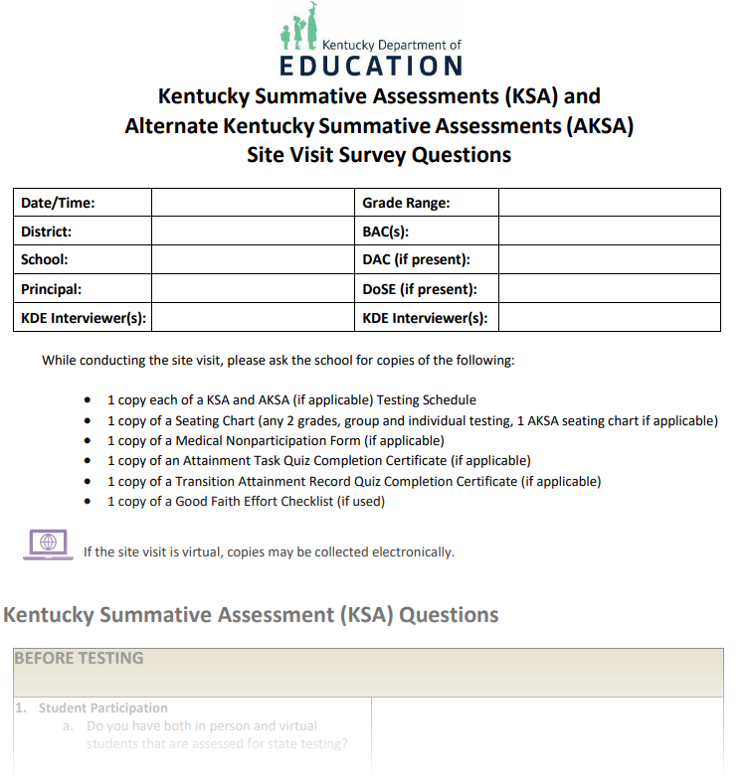
2026 KDE Site Visits
In-person and virtual monitoring is planned for spring 2026.
Sites will be selected both purposefully and at random.
Site visit questions are located on Assessment Support Forms webpage.

Slide 13
KDE Site Visits: What to Expect
In-person Site Visits
Approximately 30-minute advance notice phone call to DAC
Virtual Site Visits
OAA will contact DAC/BAC to schedule time in advance
Will be conducted via Microsoft Teams
For both in-person and virtual visits, school staff (BAC, DAC and test administrator upon availability) will be interviewed and asked to provide testing documentation (i.e., testing schedule, seating charts, good faith effort checklists, etc.)
Information collected from site visits will be compiled and added to a Google Form for reporting and auditing purposes

Slide 14
Caveon In-Person Monitoring Visits
In-person monitoring will also be conducted by Caveon, KDE’s test security vendor.
A member of OAA staff will contact the DAC, Caveon staff will arrive onsite at the start of the school day, and they will then identify themselves with documentation.
All Caveon staff have passed background checks and have been trained regarding the Family Educational Rights and Privacy Act (FERPA) and Kentucky state laws protecting student privacy.
BACs will be interviewed and asked to provide testing documentation and procedures.
Caveon will actively monitor test sessions.
Caveon Monitors will not interfere with or disrupt testing in any manner or provide technical assistance or feedback during testing observations.
Information collected from site visits will be used for federal reporting and auditing purposes.

Slide 15
Status of HB 257
Shara Savage, Director
Office of Assessment and Accountability
Division of Assessment & Accountability Support

Slide 16
HB 257 Update
House Bill (HB) 257, a bill to reimagine Kentucky’s state assessment and accountability systems, has passed and is awaiting the Governor’s signature.

Slide 17
Locally Developed Indicators of Quality
Locally Developed Indicators of Quality
Aligned to Kentucky academic standards
Allow all students to apply knowledge and skills in real-world contexts
May include local priorities (e.g., student well-being, fiscal responsibility, school safety)
Vibrant Learning
Emphasizes student agency and real-world application
Developed with families, communities, and workforce partners
Demonstrated through personalized projects and experiences tied to student interests
District Implementation
Districts may develop and implement a local system that includes:
Student participation in vibrant learning experiences
Locally developed performance indicators
If implemented, districts must:
Include student performance data (disaggregated by subgroup, where permissible)
Provide a public, online display of school and district performance
KDE Support
KDE will offer technical assistance
KDE may offer a one-time payment (up to $15,000 per district) to offset cost of development.

Slide 18
2025 – 2026 Assessment & Accountability
KSA Testing remains the same for Spring 26 Testing for grades 3 through 8, 10 and 11
Reading – Grades 3-8 and 10
Mathematics – Grades 3-8 and 10
Science – Grades 4, 7 and 11
Social Studies – Grades 5, 8 and 11
Editing and Mechanics – Grades 5, 8 and 11
On-Demand Writing – Grades 5, 8 and 11
Quality of School Climate and Safety Survey (QSCS)
AKSA Testing remains the same for Spring 26 Testing for grades 3 through 8, 10 and 11
Reading
Mathematics
Science
Social Studies
Writing
Quality of School Climate and Safety Survey (QSCS)
Fall Data Reporting remains the same for 2026
State Calculations with status and change cut scores will continue to determine school color ratings.
Federal Calculations with the three-year average will continue to determine classifications such as Comprehensive School and Improvement (CSI), Targeted School and Improvement (TSI), and Additional Targeted School and Improvement (ATSI).

Slide 19
2026 – 2027 Assessment & Accountability
KSA Testing Changes for Spring 27 Testing for grades 3 through 8, 10 and 11
The following has been removed from the state testing program:
Editing and Mechanics – Grades 5, 8 and 11
On-Demand Writing – Grades 5, 8 and 11
Quality of School Climate and Safety Survey (QSCS)
AKSA Testing Changes for Spring 27 Testing for grades 3 through 8, 10 and 11
The following has been removed from the state testing program:
Writing
Quality of School Climate and Safety Survey (QSCS)
New Accountability Changes for 2026-2027
Chronic Absenteeism will be a new indicator
Individual Student Growth will be a new indicator
Change is removed

Slide 20
Targeted Quality Measures to be reported on the Kentucky School Report Card until June 2030
Additional Readiness & Quality Measure
Educators
Percentage of certified teachers who have:
Achieved Rank II status or higher
Earned National Board Certification
Grade 8 Students
Percentage of students earning at least one high school credit by the end of grade 8
Grade 12 Students
Percentage of graduates who:
Complete the FAFSA by graduation or
Parents submit an approved opt-out

Slide 21
Future DAC Webcasts
Shara Savage, Director
Office of Assessment and Accountability
Division of Assessment & Accountability Support

Slide 22
Future DAC Webcast Question Collection
Moving to a More Streamlined Process
KDE is transitioning from email submissions (dacinfo) to a Google Form for submitting DAC questions
This will help:
Improve organization and tracking of requests
Ensure timely and consistent responses
Better identify trends and support needs across districts
Phased Implementation
May through July: Both email and Google Form options available
Gradual transition to encourage use of the Google Form
By August DAC Webcast:
Google Form will be the primary method for submitting questions
What This Means for DACs
Continue using dacinfo as needed during the transition
Begin using the Google Form as the preferred method
Additional guidance and reminders will be provided along the way

Slide 23
Questions and Answers
Please send questions or comments to dacinfo@education.ky.gov.
The next monthly DAC Webcast is scheduled for May 14 at 11 a.m. ET.
Thank you for your participation!

Slide 24
Division of Assessment and Accountability Support
Contact Information
KDE DAC Information
dacinfo@education.ky.gov
(502) 564-4394

