Slide 1
DAC Webcast
March 13, 2025
Jennifer Stafford, Ed.D, Director
Division of Assessment and Accountability Support
Office of Assessment and Accountability

Slide 2
Agenda
  ACT Reminders
  Kentucky Summative Assessment (KSA) Updates
  K Screen Reminders
  Alternate Kentucky Summative Assessment (AKSA) Updates
  Student Data Review and Rosters (SDRR) Updates
  ACCESS Updates
  Kentucky United We Learn (KUWL) Update

Slide 3
ACT Reminders
Christen Roseberry, Program Consultant
Office of Assessment and Accountability

Slide 4
ACT Deadline Reminders
Makeup Test Window – Qualified Exception to the Deadline (QED) window closes March 14
Makeup Test Window – Additional Order Window Deadline – March 14
Initial Test Window – Scheduled Pick Up (for accommodations/supports testing materials) – March 24
Deadline for ACT to receive Initial Test Window materials – March 28
Create online test sessions for the make up test window – March 19 – April 4

Slide 5
Kentucky Summative Assessment (KSA) Updates
Melissa Chandler, Program Consultant
Office of Assessment and Accountability

Slide 6
KSA Updates and Reminders
All scripts have been posted to the KY Portal.
Friday, March 14 is the deadline to verify Text-to-Speech (TTS) and online calculator accommodations in Infinite Campus (IC).
  Individual Education Programs (IEPs) must be locked to be included in the data pull that will occur on Monday, March 17.
PearsonAccess^{next} (PAN) will open on March 24.
Office Hours will be held for the 2025 KSA administration.

Slide 7
KSA Office Hour – First Session
Wednesday, March 26, 10-11 a.m. ET (Microsoft Teams link to be sent in upcoming Monday DAC Email)
Agenda:
  Pearson Tutorial in PAN
Create a report to view and add student accommodations
Create classes
Create test sessions and add students to sessions
    Q and A (open to all questions related to PAN, TestNav and KSA Administration)
  2025 KSA Office Hour Session 1 Form was shared in the March 3 Monday DAC Email to submit questions early
  Additional Office Hours – April 16 and May 14

Slide 8
K Screen Reminders
Tiffany Christopher, Program Consultant
Office of Assessment and Accountability

Slide 9
K Screen Ordering Window
The K Screen ordering window opened on Feb. 18 and the deadline for submissions is Friday, March 28.
Curriculum Associates estimates shipping to begin the week of May 9.
District Assessment Coordinators may order K Screen materials using The 2025-2026 K Screen Order Submission Form.
Please contact Tiffany Christopher with any questions concerning K Screen ordering.

Slide 10
Alternate Kentucky Summative Assessment (AKSA) Updates
Krista Mullins, Program Consultant
Office of Assessment and Accountability

Slide 11
AKSA Reminders
Window 2 is April 14-May 23.
The Student Registration Database (SRD) opens for score entry on April 14 and closes on May 30.
Window 2 Materials ship based on the date the district chose. If materials are not received in the district by the Friday of the week selected for shipping (March 28 or April 4), please email Krista Mullins.
Prior to administration of Window 2, all Test Administrators must complete the Administration Code Training, Inclusion of Special Populations Training and both Attainment Task (AT) Trainings.

Slide 12
AKSA Reminders Continued
Test Administrators must successfully complete the AT quiz and provide the quiz completion certificate to the District Assessment Coordinator (DAC) prior to receiving any testing materials from the DAC.
Ensure all students tested for AKSA have the completed eligibility paperwork in their Individual Education Plan (IEP) and are eligible for the AKSA.
Visual Impairment (VI) materials will have a list of students by their State Student Identification Number (SSID) instead of names.
Medical nonparticipations may be submitted in the Student Data Roster and Reviews (SDRR) application beginning April 23.
Window 1 makeups during Window 2 can be requested using a Google Form that will be sent in a Monday DAC email and Special Alternate email in early April.

Slide 13
AKSA Office Hours
The first of two Office Hours for AKSA will take place on Thursday, March 20 from 1:00 p.m. to 2:00 p.m. ET.
Topics for this first Office Hour will focus on preparing for the administration of Window 2:
  Students who transfer into the district
  Field test form numbers
  Window 1 makeups
  Ensuring students are in SRD
  New test administrators
  Test Materials
The second Office Hour will cover preparing for the end of the testing window and will take place on Thursday, May 15 from 1:00 p.m. to 2:00 p.m. ET.

Slide 14
Student Data Review and Roster (SDRR) Application Updates
Chris Williams, Program Consultant
Office of Assessment and Accountability

Slide 15
KSA District Test Collection
KSA test windows for elementary, middle and high schools are collected in SDRR.
District-level users can make changes to the KSA test windows.
School-level users will have read-only access and cannot make changes to the KSA test windows.
If legislation or emergency situations occur that alter the district calendar, additional information will be provided.
Collection window opened on March 12 and closes on March 28 at 5 p.m. ET.

Slide 16
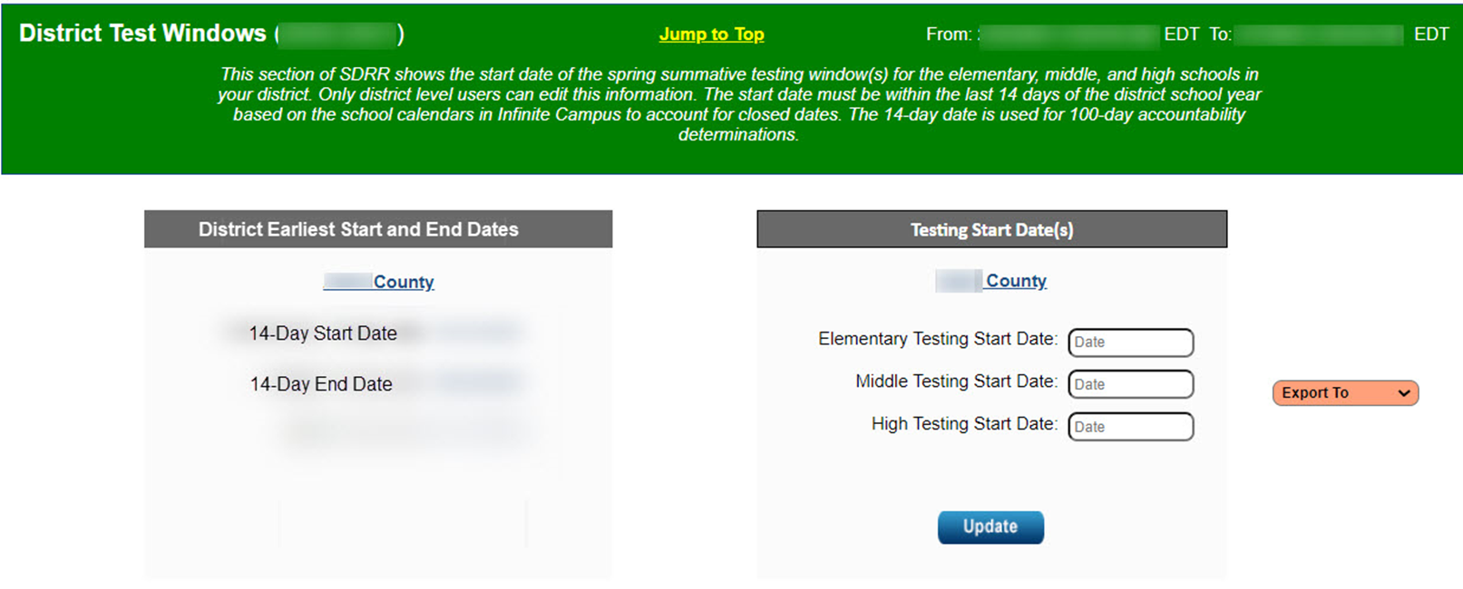
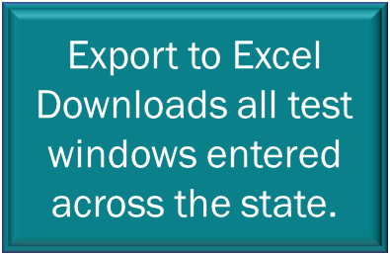
District Test Windows in SDRR

Slide 17
ACCESS Updates
Chris Williams, Program Consultant
Office of Assessment and Accountability

Slide 18
ACCESS for ELLs
Materials Returned
Data Validation in the WIDA Assessment Management System (AMS)
  March 19-April 2 is the window
  Last Opportunity with Data Recognition Corporation (DRC) to
    Correct any student demographics
    Fix Duplicate Records- students’ first and last name, birthdate, SSID, grade, school and district
    Students need invalidating
Score Reports in WIDA AMS
  ACCESS
    Online-April 28
    Paper-May 7-8
  WIDA Alternate ACCESS
    Online-April 28
    Paper- May 7-8

Slide 19
Kentucky United We Learn (KUWL) Update
Jennifer Stafford, Ed.D, Director
Division of Assessment and Accountability Support
Office of Assessment and Accountability

Slide 20
The Flight Path
Where have we been?
2021
  Listening Tour
  KCAE
  L3
2022 -2023
  Kentucky United We Learn Council
  Accountability Focus
2024
  4 Prototypes
  2 Model Frameworks with an Ongoing Study Phase for Input
Where are we going?​
2025​
  Town Halls​
  Model Framework 3.0​
2026 ​
  Recommendation to the General Assembly​

Slide 21
Town Halls Were Successful
Over 600 individuals attended the town halls.
75% Educators
14% Includes partners, students and unidentified
7% Community
2% Business
1% Legislative/Government
1% Family

Slide 22

Kentucky United We Learn

Slide 23
Questions and Answers
Please send questions or comments to dacinfo@education.ky.gov.
The next monthly DAC Webcast is scheduled for April 10 at 11 a.m. ET.
Thank you for your participation!

Slide 24
Division of Assessment and Accountability Support
Contact Information
KDE DAC Information
dacinfo@education.ky.gov
(502) 564-4394

