Slide 1
DAC Webcast
March 12, 2026
Shara Savage, Director
Division of Assessment and Accountability Support
Office of Assessment and Accountability

Slide 2
Agenda
K Screen Reminders
Alternate Kentucky Summative Assessment (AKSA) Updates
KSA Updates and Reminders
College Admissions Exam – SAT Updates and Reminders
ACT Scores and Transcripts
Student Data Review and Roster (SDRR) Application
WIDA ACCESS Assessments Updates
Accountability Update

Slide 3
K Screen Reminders
Tiffany Christopher, Program Consultant
Division of Assessment and Accountability Support
Office of Assessment and Accountability

Slide 4
K Screen Ordering Window
The K Screen ordering window opened on Feb. 23 and the deadline for submissions is Friday, April 3.​
Curriculum Associates estimates shipping to begin the week of May 11.​
District Assessment Coordinators (DACs) may order K Screen materials using K Screen Order Submission App.
Please contact Tiffany Christopher with any questions concerning K Screen ordering.

Slide 5
Alternate Kentucky Summative Assessment (AKSA) Updates
Krista Mullins, Program Consultant
Division of Assessment and Accountability Support
Office of Assessment and Accountability

Slide 6
Materials for Window 2
Window 2 Test Materials will ship based on the selection the district made in February:
  Week of March 30 (default if no selection made)
  Week of April 6
Please inventory test materials upon arrival to the district for any missing items and immediately ensure secure test materials are in a double-locked location.
If there are any issues with materials or if materials have not been received by Monday, April 13, please email krista.mullins@education.ky.gov.

Slide 7
AKSA Office Hour
The first Office Hour for AKSA will take place on Monday, April 13, from 1:00 p.m. to 2:00 p.m. ET. ​
  Topics for this first Office Hour will focus on preparing for the administration of Window 2:​
    Students who transfer into the district​
    Field test form numbers​
    Window 1 makeups​
    Ensuring students are in SRD​
    New test administrators​
  DACs, Building Assessment Coordinators (BACs), Directors of Special Education (DoSE) and test administrators will have the opportunity to ask questions.

Slide 8
Important Reminders
Test administrators may only receive materials after successful completion of the following:
  Administration Code training
  Inclusion of Special Populations training
  Both Overview and Attainment Task trainings (Part 1 and 2)
  Overview and Attainment Task Qualification Quiz
    This quiz may be opened for new test administrators by emailing Krista Mullins (prior to emailing, ensure all trainings have been completed).
    A certificate is generated as proof of successful completion. This certificate should be given to the DAC.
A form to request Window 1 makeups during Window 2 will be available in early April.
Medical nonparticipations may be submitted in the Student Data Roster and Reviews (SDRR) application when Spring rosters open.

Slide 9
Kentucky Summative Assessment (KSA) Updates and Reminders
Jessica Brumley, Program Consultant
Division of Assessment and Accountability Support
Office of Assessment and Accountability

Slide 10
KSA Updates and Reminders
All scripts have been posted to the KY Portal.
Friday, March 20 is the deadline to verify Text-to-Speech (TTS) and online calculator accommodations in Infinite Campus (IC).
  Individual Student Programs (IEPs) must be locked to be included in the data pull that will occur the week of March 23.
PearsonAccessnext (PAN) opens Monday, March 30.
Office Hours will be held for the 2026 KSA administration.

Slide 11
KSA Office Hour – Session One
KSA Office Hour Session 1 – Wednesday, March 25, 10-11 a.m. ET (Microsoft Teams link to be sent in upcoming Monday DAC email)
Agenda:
  Pearson Tutorial in PAN
    Create a report to view and add student accommodations
    Create classes
    Create test sessions and add students to sessions
  Q and A (open to all questions related to PAN, TestNav and the KSA administration)
2026 KSA Office Hour Session One Form was shared in the March 9 Monday DAC email for early question submission
Additional Office Hours: April 15 and May 13

Slide 12
College Admissions Exam:
SAT Updates and Reminders
Christen Roseberry, Program Consultant
Division of Assessment and Accountability Support
Office of Assessment and Accountability

Slide 13
SAT Updates and Reminders
The Kentucky SAT Junior State Administration window for spring 2026 opened on Monday, March 2. As of March 10, 20,967 students have completed testing.
As a reminder, all testing, including make-up tests, must occur by April 10.
Additionally, as a reminder, conducting a student readiness check ahead of test day can provide the student and test day staff with the opportunity to confirm student registrations are correct and provide the student time to practice with Bluebook.
OAA and College Board will host KY SAT Office Hour #5 on Wednesday, March 18 from 10:00-11:00 a.m. ET focused on irregularities, retests, and post-test activities. Registration is not required.

Slide 14
SAT Score Release Schedule
Test Submission Dates | Students Receive Scores Electronically
March 2 – 13, 2026 | April 2, 2026
March 16 – 27, 2026 | April 16, 2026
March 30 – April 10, 2026 | April 30, 2026

Slide 15
ACT Scores and Transcripts
Christen Roseberry
Division of Assessment and Accountability
Office of Assessment and Accountability

Slide 16
Reporting ACT Scores on Transcripts
ACT assessment scores are no longer available to KDE to publish to school districts. The ACT contract ended on June 30, 2025, when the state’s required college admissions exam changed to the SAT.
This change may affect student transcripts if the district has previously included state-published scores.
Districts that wish to continue including ACT scores on transcripts can do so by publishing those scores locally. Instructions for loading assessment scores can be found in the Infinite Campus Assessment Score Import Wizard instructions.

Slide 17
Student Data Review and Roster (SDRR) Application
Chris Williams
Division of Assessment and Accountability Support
Office of Assessment and Accountability

Slide 18
KSA Test Window Collection
KSA test windows for elementary, middle and high schools will be collected in SDRR.
District-level users will be able to make changes to the KSA test windows.
School-level users will have read-only access and cannot make changes to the KSA testing windows.
Collection window opened on Wednesday, March 11 and closes on Friday, March 27 at 5 p.m. ET.
Office of Assessment and Accountability (OAA) will pull from Infinite Campus (IC) to prepopulate the earliest start date based on changes made to the school calendars during the test window collection on Monday, March 16 and Monday, March 23.

Slide 19
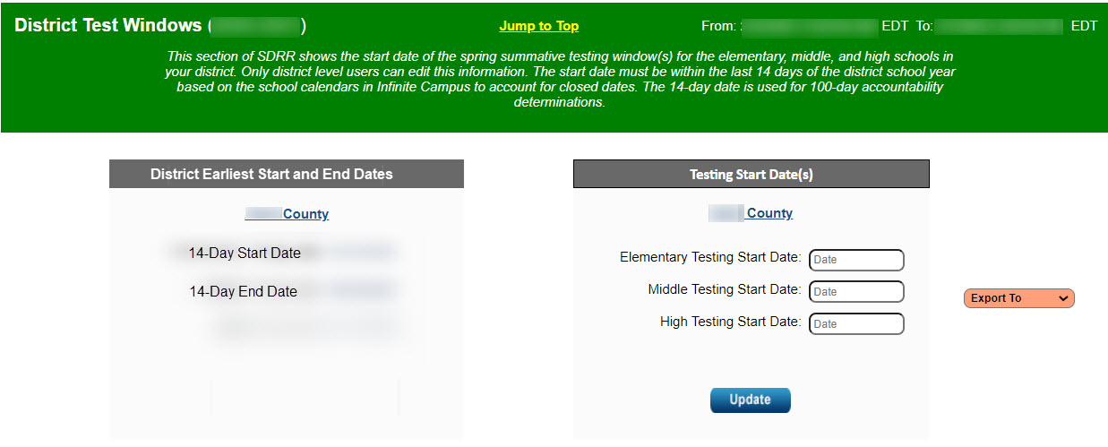
District Test Windows
Export to Excel
Downloads all test windows entered across the state.

Slide 20

SDRR Resources
February DAC PowerPoint and video-SDRR on the Meetings and Trainings and SDRR webpage
Monday DAC email on March 2 and Special DAC email on March 11 on the DAC Communications webpage
I Need Help button in SDRR

Slide 21
WIDA ACCESS Assessments Updates
Chris Williams, Program Consultant
Division of Assessment and Accountability Support
Office of Assessment and Accountability

Slide 22
WIDA ACCESS Assessments
Materials Returned
Data Validation in the WIDA Assessment Management System (AMS)
  March 18-April 1 is the window
  Last Opportunity with Data Recognition Corporation (DRC) to
    Correct any student demographics
    Fix Duplicate Records- students’ first and last name, birthdate, SSID, grade, school and district on both records and not removing any student records
    Marking accommodations
    Students need invalidating contact Chris Williams
Score Reports in WIDA AMS
    Online-April 27
    Paper-May 7-8

Slide 23
WIDA ACCESS Assessment Resources
WIDA AMS
  WIDA ACCESS and WIDA Alternate ACCESS Data Validation
WIDA Secure Portal
  ACCESS Data Validation Webinar Recording on March 3 under the heading webinars
  WIDA AMS User Guide Supplement for Data Validation

Slide 24
Status of HB 257
Shara Savage, Director
Office of Assessment and Accountability
Division of Assessment & Accountability Support

Slide 25
HB 257 Update
  House Bill (HB) 257, a bill to reimagine Kentucky’s state assessment and accountability systems.

Slide 26
Questions and Answers
Please send questions or comments to dacinfo@education.ky.gov.
The next monthly DAC Webcast is scheduled for April 9 at 11 a.m. ET.
Thank you for your participation!

Slide 27
Division of Assessment and Accountability Support
Contact Information
KDE DAC Information
dacinfo@education.ky.gov
(502) 564-4394

